Slide 1
Detection Algorithms for Biosurveillance: A tutorial
Andrew Moore | Professor | Computer Science, Carnegie Mellon | awm@cs.cmu.edu
Note to other teachers and users of these slides. Andrew would be delighted if you found this source material useful in giving your own lectures. Feel free to use these slides verbatim, or to modify them to fit your own needs. PowerPoint originals are available. If you make use of a significant portion of these slides in your own lecture, please include this message, or the following link to the source repository of Andrew’s tutorials: http://www.cs.cmu.edu/~awm/tutorials . Comments and corrections gratefully received.
Tutorial compiled with much help from…
Greg Cooper | Professor | Computer Science and RODS lab, U. Pitt | gfc@cbmi.upmc.edu
Bill Hogan | Assistant Professor | RODS lab, U. Pitt | wrh@cbmi.pitt.edu
Rich Tsui | Research Professor and associate Director of RODS lab | RODS lab, U. Pitt | tsui@cbmi.pitt.edu
Mike Wagner | Professor and Director of RODS lab | RODS lab, U. Pitt | mmw@cbmi.pitt.edu
RODS: http://www.health.pitt.edu/rods
Auton Lab: http://www.autonlab.org

Slide 2
Many Methods!
Method | Has Pitt/CMU tried it? | Tried but little used | Tried and used | Under development | Multivariate signal tracking? | Spatial?
Time-weighted averaging | Yes | Yes
Serfling | Yes |  | Yes
ARIMA | Yes | Yes
SARIMA + External Factors | Yes |  | Yes
Univariate HMM | Yes |  | Yes
Kalman Filter | Yes | Yes
Recursive Least Squares | Yes |  | Yes
Support Vector Machine | Yes | Yes
Neural Nets | Yes | Yes
Randomization | Yes |  | Yes | Yes
Spatial Scan Statistics | Yes |  |  | (w/ Howard Burkom) | Yes | Yes
Bayesian Networks | Yes |  |  | Yes | Yes
Contingency Tables | Yes |  | Yes
Scalar Outlier (SQC) | Yes | Yes
Multivariate Anomalies | Yes |  | Yes |  | Yes
Change-point statistics | Yes |  |  | Yes
FDR Tests | Yes |  | Yes |  | Yes
WSARE (Recent patterns) | Yes |  | Yes | Yes | Yes | Yes
PANDA (Causal Model) | Yes |  |  | Yes | Yes | Yes
FLUMOD (space/Time HMM) |  |  |  | Yes | Yes | Yes
Details of these methods and bibliography available from “Summary of Biosurveillance-relevant statistical and data mining technologies” by Moore, Cooper, Tsui and Wagner. Downloadable (PDF format) from www.cs.cmu.edu/~awm/biosurv-methods.pdf

Slide 3
What you’ll learn about
Noticing events in bio-event time series
Tracking many series at once
Detecting geographic hotspots
Finding emerging new patterns

Slide 4
What you’ll learn about
These are all powerful statistical methods, which means they all have to have one thing in common…
Noticing events in bio-event time series
Tracking many series at once
Detecting geographic hotspots
Finding emerging new patterns

Slide 5
What you’ll learn about
These are all powerful statistical methods, which means they all have to have one thing in common…
Boring Names.
Noticing events in bio-event time series
Tracking many series at once
Detecting geographic hotspots
Finding emerging new patterns

Slide 6
What you’ll learn about
These are all powerful statistical methods, which means they all have to have one thing in common…
Boring Names.
Noticing events in bio-event time series
Tracking many series at once
Detecting geographic hotspots
Finding emerging new patterns
Univariate Anomaly Detection
Multivariate Anomaly Detection
Spatial Scan Statistics
WSARE

Slide 7
What you’ll learn about
Noticing events in bio-event time series
Tracking many series at once
Detecting geographic hotspots
Finding emerging new patterns
Univariate Anomaly Detection
Multivariate Anomaly Detection
Spatial Scan Statistics
WSARE

Slide 8
Univariate Time Series
Signal
Time
Example Signals:
Number of ED visits today
Number of ED visits this hour
Number of Respiratory Cases Today
School absenteeism today
Nyquil Sales today

Slide 9
(When) is there an anomaly?

Slide 10
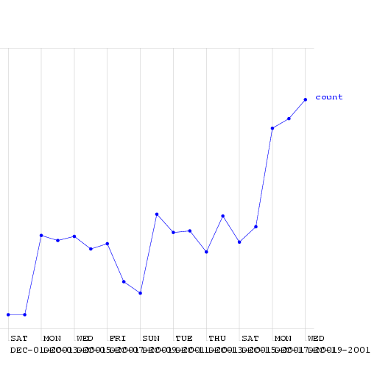
(When) is there an anomaly?
This is a time series of counts of primary-physician visits in data from Norfolk in December 2001. I added a fake outbreak, starting at a certain date. Can you guess when?

Slide 11
(When) is there an anomaly?
Here (much too high for a Friday)
This is a time series of counts of primary-physician visits in data from Norfolk in December 2001. I added a fake outbreak, starting at a certain date. Can you guess when?
(Ramp attack)

Slide 12
An easy case
Signal
Time
Dealt with by Statistical Quality Control
Record the mean and standard deviation up the the current time.
Signal an alarm if we go outside 3 sigmas

Slide 13
An easy case: Control Charts
Upper Safe Range
Signal
Mean
Time
Dealt with by Statistical Quality Control
Record the mean and standard deviation up the the current time.
Signal an alarm if we go outside 3 sigmas

Slide 14
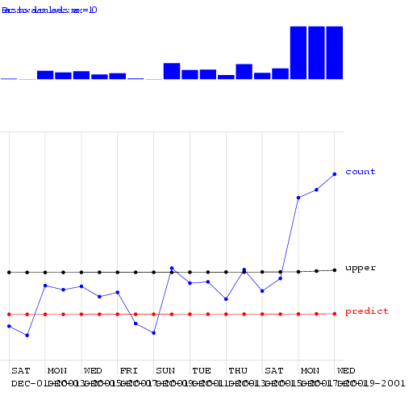
Control Charts on the Norfolk Data
Alarm Level

Slide 15
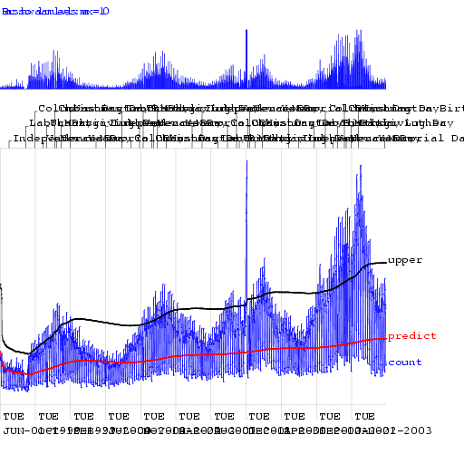
Control Charts on the Norfolk Data
Alarm Level

Slide 16
Looking at changes from yesterday

Slide 17
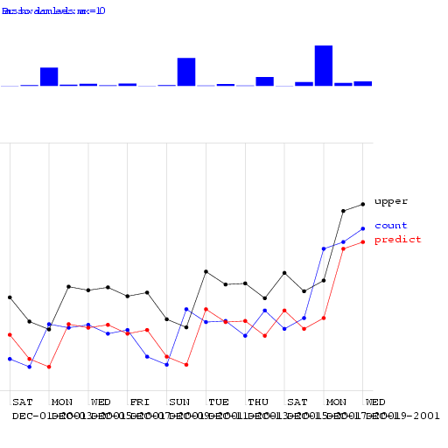
Looking at changes from yesterday
Alarm Level

Slide 18
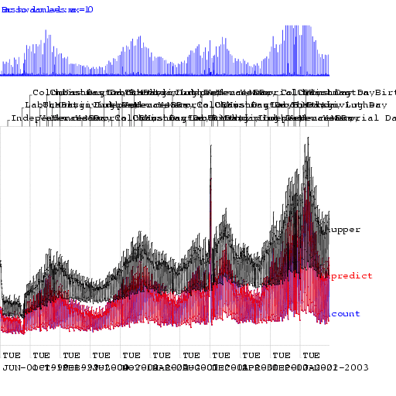
Looking at changes from yesterday
Alarm Level

Slide 19
We need a happy medium:
Control Chart: Too insensitive to recent changes
Change from yesterday: Too sensitive to recent changes

Slide 20
Moving Average

Slide 21
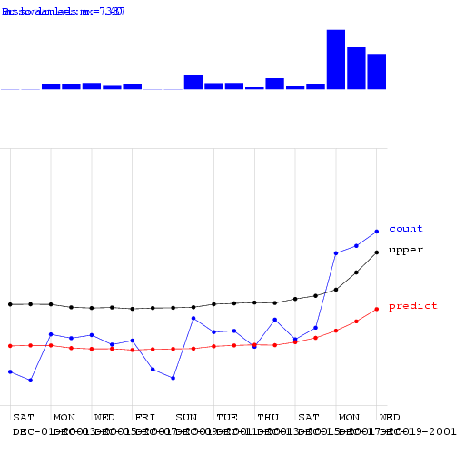
Moving Average

Slide 22
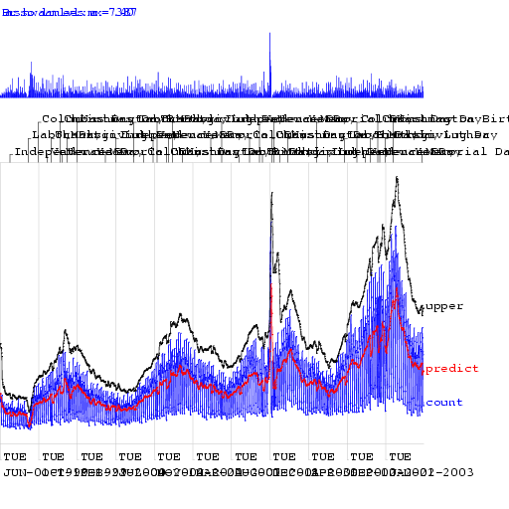
Moving Average

Slide 23
Moving Average
Looks better. But how can we be quantitative about this?

Slide 24
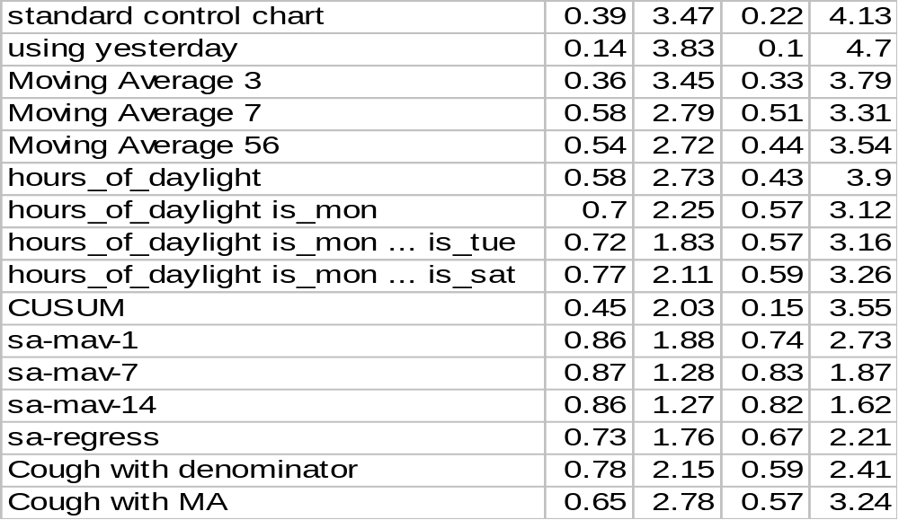
Algorithm Performance
Allowing one False Alarm per TWO weeks…
Allowing one False Alarm per SIX weeks…
Fraction of spikes detected
Days to detect a ramp attack
Fraction of spikes detected
Days to detect a ramp attack

Slide 25
Algorithm Performance
Allowing one False Alarm per TWO weeks…
Allowing one False Alarm per SIX weeks…
Fraction of spikes detected
Days to detect a ramp attack
Fraction of spikes detected
Days to detect a ramp attack

Slide 26
Algorithm Performance
Allowing one False Alarm per TWO weeks…
Allowing one False Alarm per SIX weeks…
Fraction of spikes detected
Days to detect a ramp attack
Fraction of spikes detected
Days to detect a ramp attack

Slide 27
Seasonal Effects
Signal
Time
Fit a periodic function (e.g. sine wave) to previous data. Predict today’s signal and 3-sigma confidence intervals. Signal an alarm if we’re off.
Reduces False alarms from Natural outbreaks.
Different times of year deserve different thresholds.

Slide 28
Algorithm Performance
Allowing one False Alarm per TWO weeks…
Allowing one False Alarm per SIX weeks…
Fraction of spikes detected
Days to detect a ramp attack
Fraction of spikes detected
Days to detect a ramp attack

Slide 29
Day-of-week effects
Fit a day-of-week component
E[Signal] = a + delta_{day}
E.G: delta_{mon}= +5.42, delta_{tue}= +2.20, delta_{wed}= +3.33, delta_{thu}= +3.10, delta_{fri}= +4.02, delta_{sat}= -12.2, delta_{sun}= -23.42
A simple form of ANOVA

Slide 30

Regression using Hours-in-day & IsMonday

Slide 31
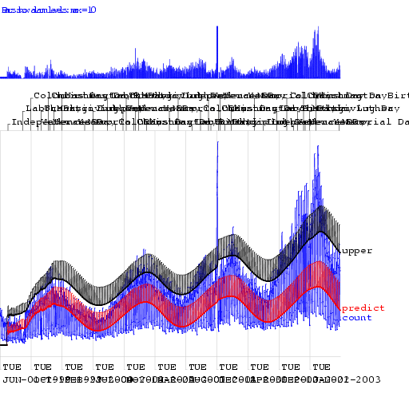
Regression using Hours-in-day & IsMonday

Slide 32
Algorithm Performance
Allowing one False Alarm per TWO weeks…
Allowing one False Alarm per SIX weeks…
Fraction of spikes detected
Days to detect a ramp attack
Fraction of spikes detected
Days to detect a ramp attack

Slide 33
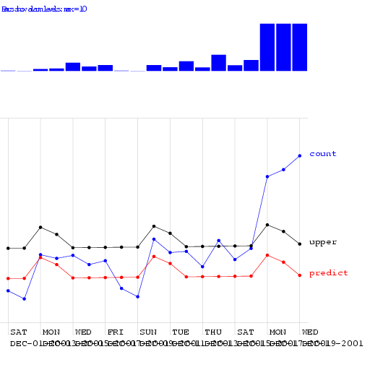
Regression using Mon-Tue

Slide 34
Algorithm Performance
Allowing one False Alarm per TWO weeks…
Allowing one False Alarm per SIX weeks…
Fraction of spikes detected
Days to detect a ramp attack
Fraction of spikes detected
Days to detect a ramp attack

Slide 35
CUSUM
CUmulative SUM Statistics
Keep a running sum of “surprises”: a sum of excesses each day over the prediction
When this sum exceeds threshold, signal alarm and reset sum

Slide 36
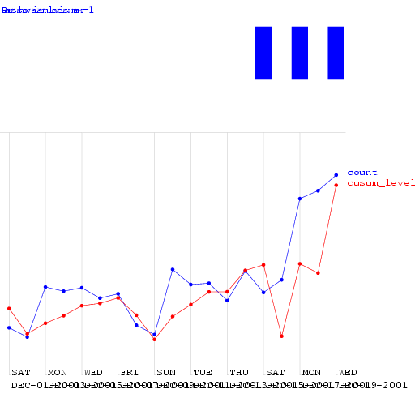
CUSUM

Slide 37
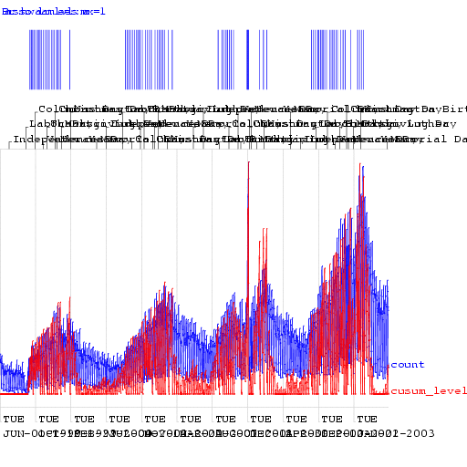
CUSUM

Slide 38
Algorithm Performance
Allowing one False Alarm per TWO weeks…
Allowing one False Alarm per SIX weeks…
Fraction of spikes detected
Days to detect a ramp attack
Fraction of spikes detected
Days to detect a ramp attack

Slide 39
The Sickness/Availability Model

Slide 40
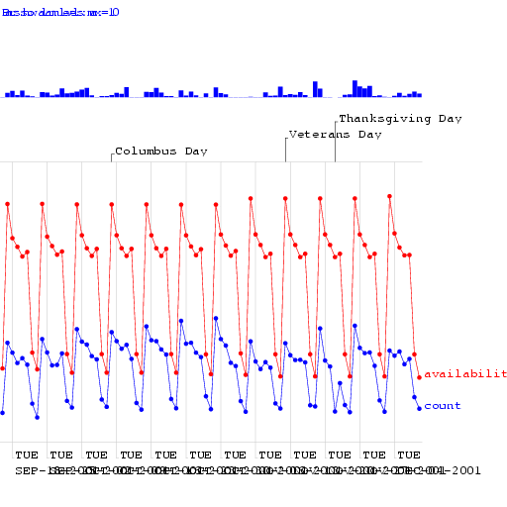
The Sickness/Availability Model

Slide 41
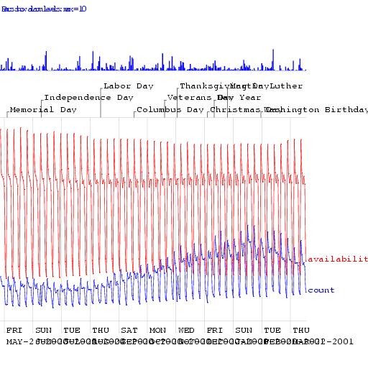
The Sickness/Availability Model

Slide 42
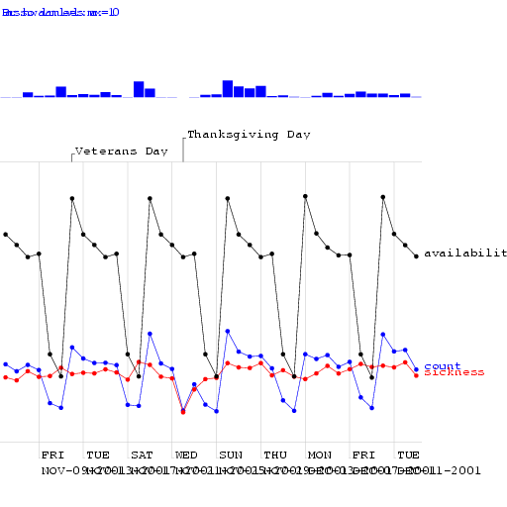
The Sickness/Availability Model

Slide 43
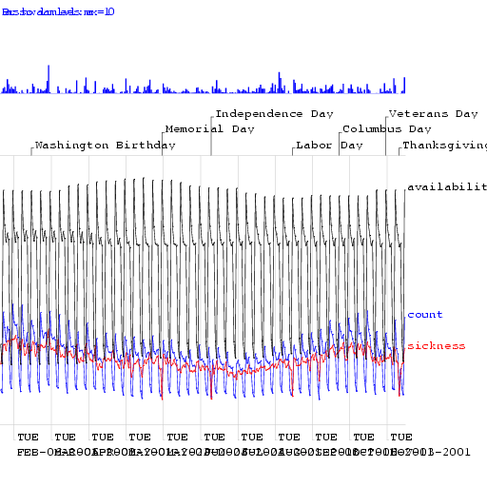
The Sickness/Availability Model

Slide 44
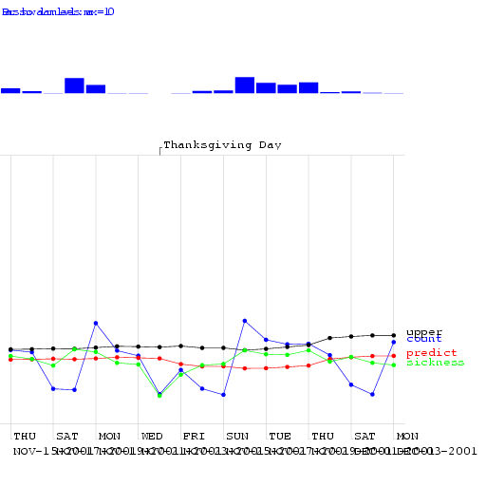
The Sickness/Availability Model

Slide 45
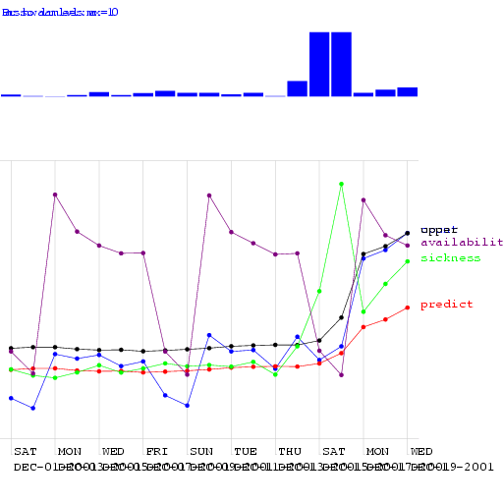
The Sickness/Availability Model

Slide 46
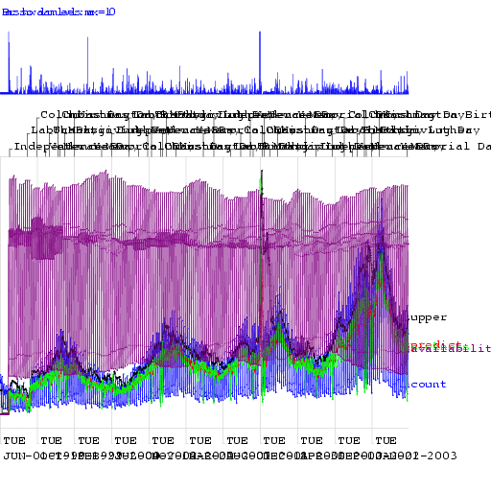
The Sickness/Availability Model

Slide 47
Algorithm Performance
Allowing one False Alarm per TWO weeks…
Allowing one False Alarm per SIX weeks…
Fraction of spikes detected
Days to detect a ramp attack
Fraction of spikes detected
Days to detect a ramp attack

Slide 48
Algorithm Performance
Allowing one False Alarm per TWO weeks…
Allowing one False Alarm per SIX weeks…
Fraction of spikes detected
Days to detect a ramp attack
Fraction of spikes detected
Days to detect a ramp attack

Slide 49
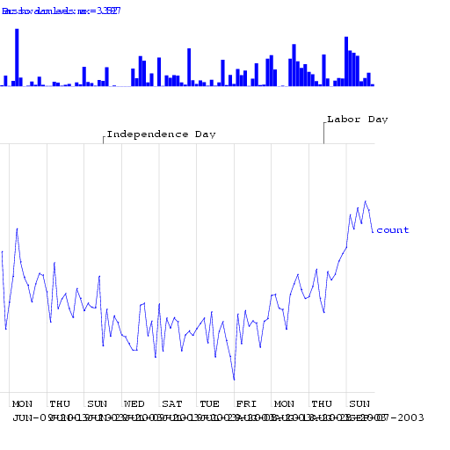
Exploiting Denominator Data

Slide 50
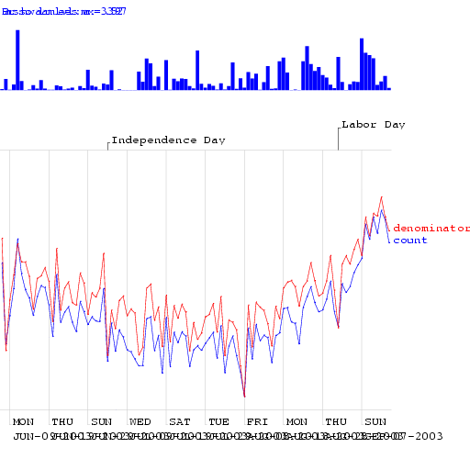
Exploiting Denominator Data

Slide 51
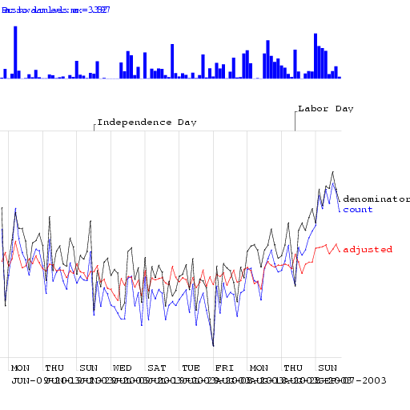
Exploiting Denominator Data

Slide 52
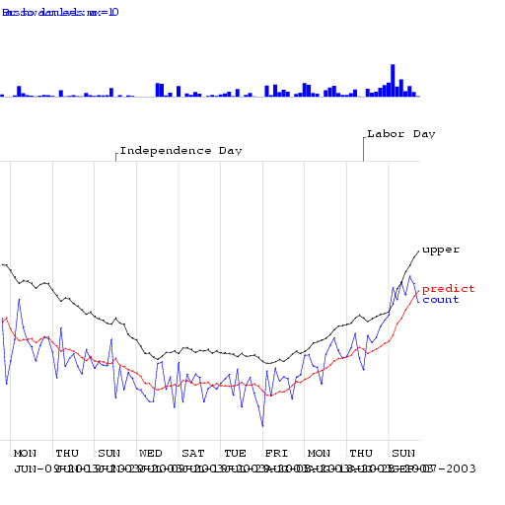
Exploiting Denominator Data

Slide 53
Algorithm Performance
Allowing one False Alarm per TWO weeks…
Allowing one False Alarm per SIX weeks…
Fraction of spikes detected
Days to detect a ramp attack
Fraction of spikes detected
Days to detect a ramp attack

Slide 54
Other state-of-the-art methods
Wavelets
Change-point detection
Kalman filters
Hidden Markov Models

Slide 55
What you’ll learn about
Noticing events in bio-event time series
Tracking many series at once
Detecting geographic hotspots
Finding emerging new patterns
Univariate Anomaly Detection
Multivariate Anomaly Detection
Spatial Scan Statistics
WSARE

Slide 56


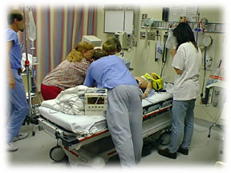
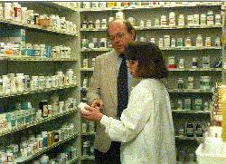
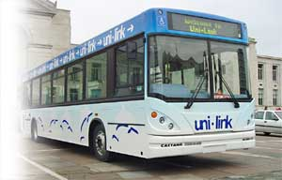
Multiple Signals

Slide 57
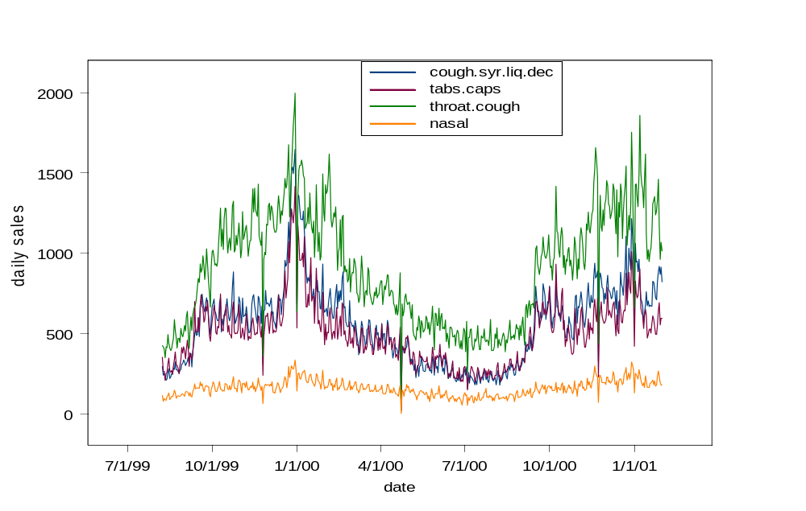
Multivariate Signals
(relevant to inhalational diseases)

Slide 58
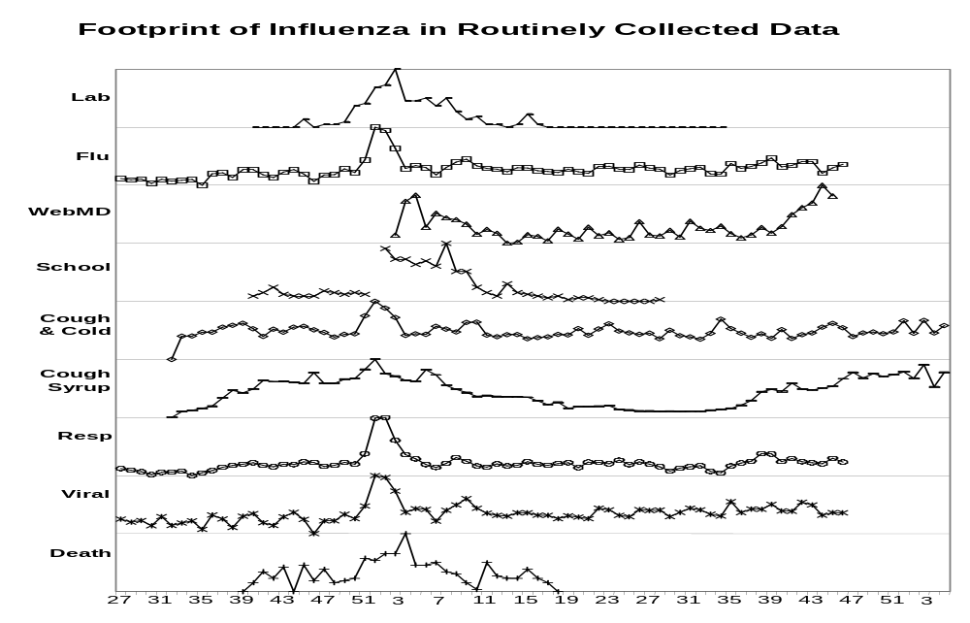
Multi Source Signals
Lab
Flu
WebMD
School
Cough&
Cold
Throat
Resp
Viral
Death
weeks

Slide 59
What if you’ve got multiple signals?
Red: Cough Sales
Blue: ED Respiratory Visits
Signal
Time
Idea One:
Simply treat it as two separate alarm-from-signal problems.
…Question: why might that not be the best we can do?

Slide 60
Another View
Red: Cough Sales
Blue: ED Respiratory Visits
Signal
Question: why might that not be the best we can do?
Cough Sales
ED Respiratory Visits

Slide 61
Another View
Red: Cough Sales
Blue: ED Respiratory Visits
Signal
This should be an anomaly
Question: why might that not be the best we can do?
Cough Sales
ED Respiratory Visits

Slide 62
N-dimensional Gaussian
Red: Cough Sales
Blue: ED Respiratory Visits
Signal
Good Practical Idea:
Model the joint with a Gaussian
This is a sensible N-dimensional SQC
…But you can also do N-dimensional modeling of dynamics (leads to the idea of Kalman Filter model)
One Sigma
Cough Sales
2 Sigma
ED Respiratory Visits

Slide 63
But what if joint N-dimensional distribution is highly non-Gaussian?
Red: Cough Sales
Blue: ED Respiratory Visits
Signal
Cough Sales
ED Respiratory Visits

Slide 64
What you’ll learn about
Noticing events in bio-event time series
Tracking many series at once
Detecting geographic hotspots
Finding emerging new patterns
Univariate Anomaly Detection
Multivariate Anomaly Detection
Spatial Scan Statistics
WSARE

Slide 65
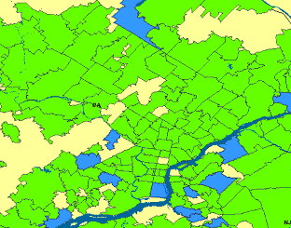
One Step of Spatial Scan
Entire area being scanned

Slide 66
One Step of Spatial Scan
Entire area being scanned
Current region being considered

Slide 67
One Step of Spatial Scan
Entire area being scanned
Current region being considered
I have a population of 5300 of whom 53 are sick (1%)
Everywhere else has a population of 2,200,000 of whom 20,000 are sick (0.9%)

Slide 68
One Step of Spatial Scan
Entire area being scanned
Current region being considered
I have a population of 5300 of whom 53 are sick (1%)
So... is that a big deal? Evaluated with Score function (e.g. Kulldorf’s score)
Everywhere else has a population of 2,200,000 of whom 20,000 are sick (0.9%)

Slide 69
One Step of Spatial Scan
Entire area being scanned
Current region being considered
I have a population of 5300 of whom 53 are sick (1%)
[Score = 1.4]
So... is that a big deal? Evaluated with Score function (e.g. Kulldorf’s score)
Everywhere else has a population of 2,200,000 of whom 20,000 are sick (0.9%)

Slide 70
Many Steps of Spatial Scan
Entire area being scanned
Highest scoring region in search so far
Current region being considered
I have a population of 5300 of whom 53 are sick (1%)
[Score = 1.4]
[Score = 9.3]
So... is that a big deal? Evaluated with Score function (e.g. Kulldorf’s score)
Everywhere else has a population of 2,200,000 of whom 20,000 are sick (0.9%)

Slide 71
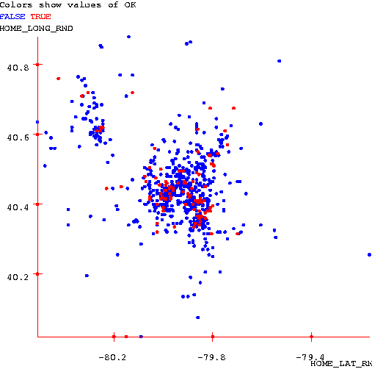
Scan Statistics
Standard approach:
Compute the likelihood of the data given the hypothesis that the rate of occurrence is uniform everywhere, L₀
For some geographical region, W, compute the likelihood that the rate of occurrence is uniform at one level inside the region and uniform at another level outside the region, L(W).
Compute the likelihood ratio, L(W)/L₀
Repeat for all regions, and find the largest likelihood ratio. This is the scan statistic, S*_{W}
Report the region, W, which yielded the max, S* _{W}
See [Glaz and Balakrishnan, 99] for details
Standard scan statistic question:
Given the geographical locations of occurrences of a phenomenon, is there a region with an unusually high (low) rate of these occurrences?

Slide 72
Significance testing
Standard approach:
Generate many randomized versions of the data set by shuffling the labels (positive instance of the phenomenon or not).
Compute S*_{W} for each randomized data set. This forms a baseline distribution for S*_{W} if the null hypothesis holds.
Compare the observed value of S*_{W} against the baseline distribution to determine a p-value.
Given that region W is the most likely to be abnormal, is it significantly abnormal?

Slide 73
Fast squares speedup
N
N
Theoretical complexity of fast squares: O(N²) (as opposed to naïve N³), if maximum density region sufficiently dense.
      If not, we can use several other speedup tricks.
In practice: 10-200x speedups on real and artificially generated datasets.
      Emergency Dept. dataset (600K records): 20 minutes, versus 66 hours with naïve approach.

Slide 74
Fast rectangles speedup
N
N
Work in progress
Theoretical complexity of fast rectangles: O(N²log N) (as opposed to naïve N⁴)

Slide 75
Fast oriented rectangles speedup
N
N
Work in progress
Theoretical complexity of fast rectangles: 18N²log N (as opposed to naïve 18N⁴)
        (Angles discretized to 5 degree buckets)

Slide 76
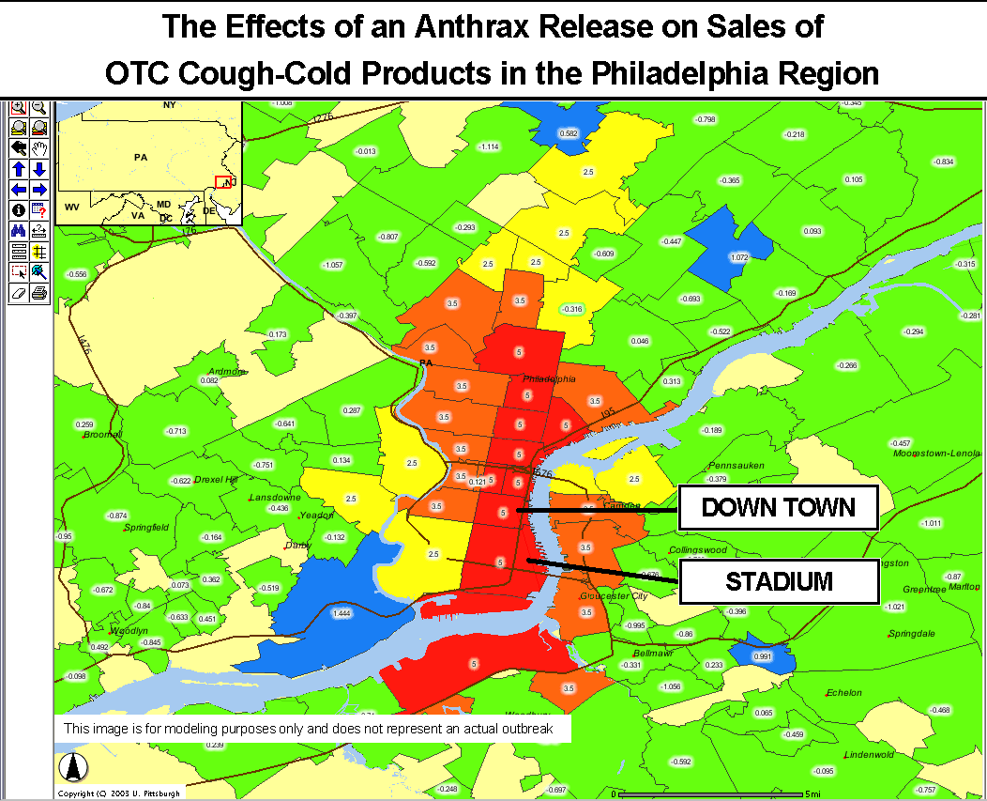
Why the Scan Statistic speed obsession?
Traditional Scan Statistics very expensive, especially with Randomization tests
New “Historical Model” Scan Statistics
Proposed new WSARE/Scan Statistic hybrid

Slide 77
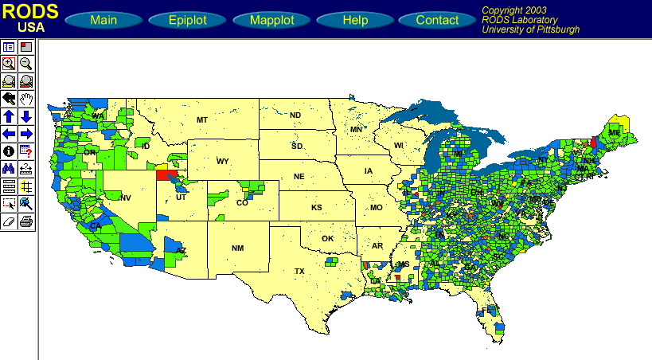
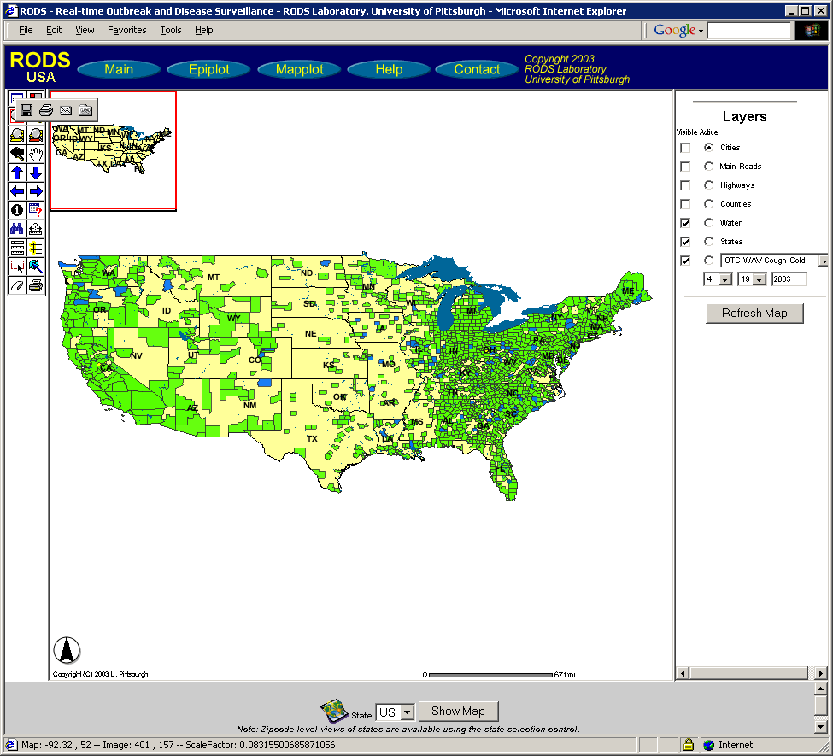
Why the Scan Statistic speed obsession?
Traditional Scan Statistics very expensive, especially with Randomization tests
New “Historical Model” Scan Statistics
Proposed new WSARE/Scan Statistic hybrid

Slide 78
Why the Scan Statistic speed obsession?
Traditional Scan Statistics very expensive, especially with Randomization tests
New “Historical Model” Scan Statistics
Proposed new WSARE/Scan Statistic hybrid
This is the strangest region because the age distribution of respiratory cases has changed dramatically for no reason that can be explained by known background changes

Slide 79
What you’ll learn about
Noticing events in bio-event time series
Tracking many series at once
Detecting geographic hotspots
Finding emerging new patterns
Univariate Anomaly Detection
Multivariate Anomaly Detection
Spatial Scan Statistics
WSARE

Slide 80
But there’s potentially more data than aggregates
Suppose we know that today in the ED we had…
    421 Cases
    78 Respiratory Cases
    190 Males
    32 Children
    21 from North Suburbs
    2 Postal workers
    (etc etc etc)
Have we made best use of all possible information?

Slide 81
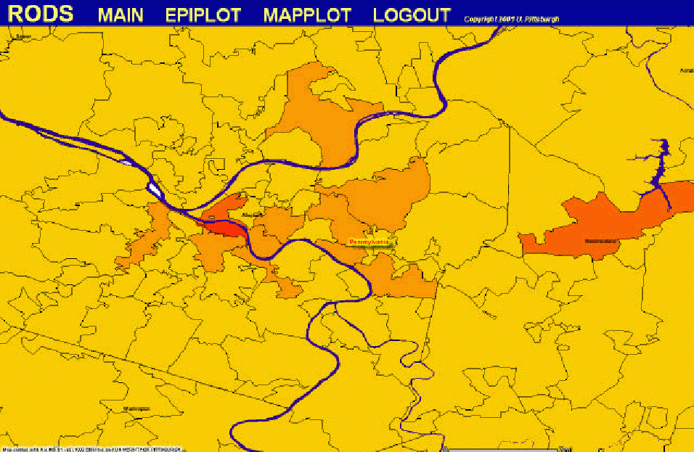
There are so many things to look at
Diarrhea
By Street
Among Children
Recent 3 hours
Diarrhea by
Neighborhood
Among Elderly
Recent 24 hrs
Human Analysts
Collapse
by county
Among Men
Recent week
Nyquil Sales by state
Recent 30 mins
Massive Computer Analysis
Absenteeism
by zipcode
Farm Workers
Recent month

Slide 82
WSARE v2.0
What’s Strange About Recent Events?
Designed to be easily applicable to any date/time-indexed biosurveillance-relevant data stream.

Slide 83
WSARE v2.0
Inputs:
1. Date/time-indexed biosurveillance-relevant data stream
2. Time Window Length
3. Which attributes to use?

Slide 84
WSARE v2.0
Inputs:
1. Date/time-indexed biosurveillance-relevant data stream
2. Time Window Length
3. Which attributes to use?
“ignore key and weather”
Example
“last 24 hours”
Primary Key | Date | Time | Hospital | ICD9 | Prodrome | Gender | Age | Home |  |  | Work |  |  | Recent Flu Levels | Recent Weather | (Many more…)
 |  |  |  |  |  |  |  | Large Scale | Medium Scale | Fine Scale | Large Scale | Medium Scale | Fine Scale
h6r32 | 6/2/2 | 14:12 | Down-town | 781 | Fever | M | 20s | NE | 15217 | A5 | NW | 15213 | B8 | 2% | 70R | …
t3q15 | 6/2/2 | 14:15 | River-side | 717 | Respiratory | M | 60s | NE | 15222 | J3 | NE | 15222 | J3 | 2% | 70R | …
t5hh5 | 6/2/2 | 14:15 | Smith-field | 622 | Respiratory | F | 80s | SE | 15210 | K9 | SE | 15210 | K9 | 2% | 70R | …
: | : | : | : | : | : | : | : | : | : | : | : | : | : | : | : | :

Slide 85
WSARE v2.0
Inputs:
1. Date/time-indexed biosurveillance-relevant data stream
2. Time Window Length
3. Which attributes to use?
3. And here’s how seriously you should take it
Outputs:
2. Here’s why
1. Here are the records that most surprise me
Primary Key | Date | Time | Hospital | ICD9 | Prodrome | Gender | Age | Home |  |  | Work |  |  | Recent Flu Levels | Recent Weather | (Many more…)
 |  |  |  |  |  |  |  | Large Scale | Medium Scale | Fine Scale | Large Scale | Medium Scale | Fine Scale
h6r32 | 6/2/2 | 14:12 | Down-town | 781 | Fever | M | 20s | NE | 15217 | A5 | NW | 15213 | B8 | 2% | 70R | …
t3q15 | 6/2/2 | 14:15 | River-side | 717 | Respiratory | M | 60s | NE | 15222 | J3 | NE | 15222 | J3 | 2% | 70R | …
t5hh5 | 6/2/2 | 14:15 | Smith-field | 622 | Respiratory | F | 80s | SE | 15210 | K9 | SE | 15210 | K9 | 2% | 70R | …
: | : | : | : | : | : | : | : | : | : | : | : | : | : | : | : | :

Slide 86
Simple WSARE
Date | Cases
Thu 5/22/2000 | C1, C2, C3, C4 …
Fri 5/23/2000 | C1, C2, C3, C4 …
: | :
: | :
Sat 12/9/2000 | C1, C2, C3, C4 …
Sun 12/10/2000 | C1, C2, C3, C4 …
: | :
Sat 12/16/2000 | C1, C2, C3, C4 …
: | :
Sat 12/23/2000 | C1, C2, C3, C4 …
: | :
: | :
Fri 9/14/2001 | C1, C2, C3, C4 …
Given 500 day’s worth of ER cases at 15 hospitals…

Slide 87
Simple WSARE
Date | Cases
Thu 5/22/2000 | C1, C2, C3, C4 …
Fri 5/23/2000 | C1, C2, C3, C4 …
: | :
: | :
Sat 12/9/2000 | C1, C2, C3, C4 …
Sun 12/10/2000 | C1, C2, C3, C4 …
: | :
Sat 12/16/2000 | C1, C2, C3, C4 …
: | :
Sat 12/23/2000 | C1, C2, C3, C4 …
: | :
: | :
Fri 9/14/2001 | C1, C2, C3, C4 …
Given 500 day’s worth of ER cases at 15 hospitals…
For each day…
  Take today’s cases

Slide 88
Simple WSARE
Date | Cases
Thu 5/22/2000 | C1, C2, C3, C4 …
Fri 5/23/2000 | C1, C2, C3, C4 …
: | :
: | :
Sat 12/9/2000 | C1, C2, C3, C4 …
Sun 12/10/2000 | C1, C2, C3, C4 …
: | :
Sat 12/16/2000 | C1, C2, C3, C4 …
: | :
Sat 12/23/2000 | C1, C2, C3, C4 …
: | :
: | :
Fri 9/14/2001 | C1, C2, C3, C4 …
Given 500 day’s worth of ER cases at 15 hospitals…
For each day…
  Take today’s cases
  The cases one week ago
  The cases two weeks ago

Slide 89
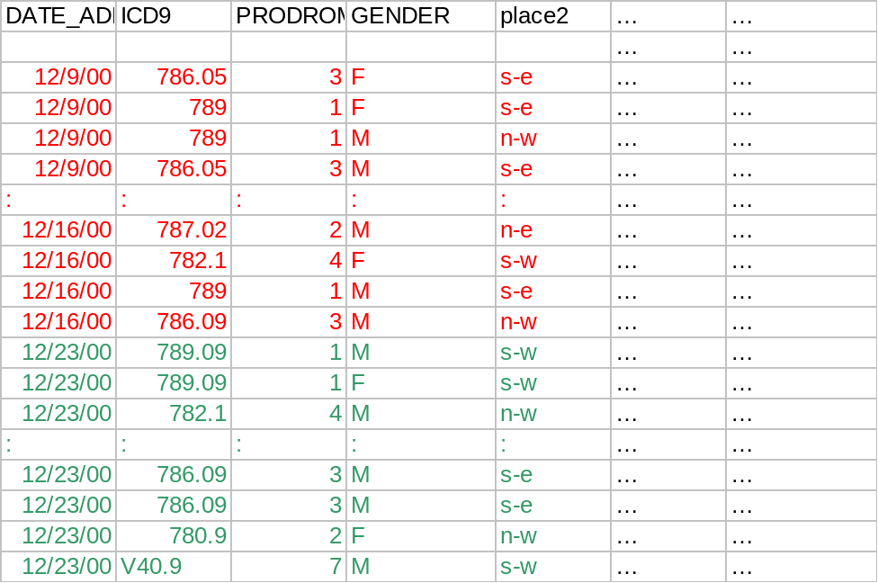
Simple WSARE
Given 500 day’s worth of ER cases at 15 hospitals…
For each day…
  Take today’s cases
  The cases one week ago
  The cases two weeks ago
Ask: “What’s different about today?”

Slide 90
Simple WSARE
Given 500 day’s worth of ER cases at 15 hospitals…
For each day…
  Take today’s cases
  The cases one week ago
  The cases two weeks ago
Ask: “What’s different about today?”
Fields we use:
Date, Time of Day, Prodrome, ICD9, Symptoms, Age, Gender, Coarse Location, Fine Location, ICD9 Derived Features, Census Block Derived Features, Work Details, Colocation Details

Slide 91
Example
Sat 12-23-2001 (daynum 36882, dayindex 239)
35.8% ( 48/134) of today's cases have 30 <= age < 40
17.0% ( 45/265) of other cases have 30 <= age < 40

Slide 92
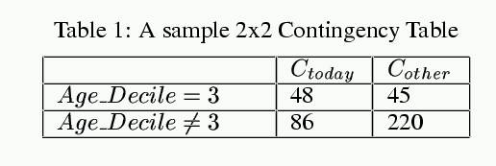
Example
Sat 12-23-2001 (daynum 36882, dayindex 239)
FISHER_PVALUE = 0.000051
35.8% ( 48/134) of today's cases have 30 <= age < 40
17.0% ( 45/265) of other cases have 30 <= age < 40

Slide 93
Searching for the best score…
Try ICD9 = x for each value of x
Try Gender=M, Gender=F
Try CoarseRegion=NE, =NW, SE, SW..
Try FineRegion=AA,AB,AC, … DD (4x4 Grid)
Try Hospital=x, TimeofDay=x, Prodrome=X, …
[In future… features of census blocks]
Overfitting Alert!

Slide 94
Example
Sat 12-23-2001 (daynum 36882, dayindex 239)
FISHER_PVALUE = 0.000051 RANDOMIZATION_PVALUE = 0.031
35.8% ( 48/134) of today's cases have 30 <= age < 40
17.0% ( 45/265) of other cases have 30 <= age < 40

Slide 95
Multiple component rules
We would like to be able to find rules like:
There are a surprisingly large number of children with respiratory problems today
  or
There are too many skin complaints among people from the affluent neighborhoods
These are things that would be missed by casual screening
BUT
  The danger of overfitting could be much worse
  It’s very computationally demanding
  How can we be sure the entire rule is meaningful?

Slide 96
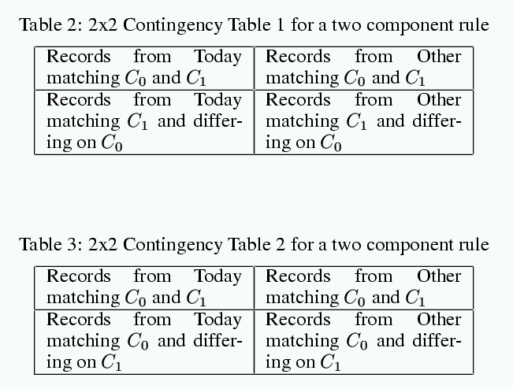
Checking two component rules
Must pass both tests to be allowed to live.

Slide 97
WSARE v2.0
Inputs:
1. Date/time-indexed biosurveillance-relevant data stream
2. Time Window Length
3. Which attributes to use?
3. And here’s how seriously you should take it
Outputs:
2. Here’s why
1. Here are the records that most surprise me
Primary Key | Date | Time | Hospital | ICD9 | Prodrome | Gender | Age | Home |  |  | Work |  |  | Recent Flu Levels | Recent Weather | (Many more…)
 |  |  |  |  |  |  |  | Large Scale | Medium Scale | Fine Scale | Large Scale | Medium Scale | Fine Scale
h6r32 | 6/2/2 | 14:12 | Down-town | 781 | Fever | M | 20s | NE | 15217 | A5 | NW | 15213 | B8 | 2% | 70R | …
t3q15 | 6/2/2 | 14:15 | River-side | 717 | Respiratory | M | 60s | NE | 15222 | J3 | NE | 15222 | J3 | 2% | 70R | …
t5hh5 | 6/2/2 | 14:15 | Smith-field | 622 | Respiratory | F | 80s | SE | 15210 | K9 | SE | 15210 | K9 | 2% | 70R | …
: | : | : | : | : | : | : | : | : | : | : | : | : | : | : | : | :

Slide 98
WSARE v2.0
Inputs:
1. Date/time-indexed biosurveillance-relevant data stream
2. Time Window Length
3. Which attributes to use?
3. And here’s how seriously you should take it
Outputs:
2. Here’s why
1. Here are the records that most surprise me
Primary Key | Date | Time | Hospital | ICD9 | Prodrome | Gender | Age | Home |  |  | Work |  |  | Recent Flu Levels | Recent Weather | (Many more…)
 |  |  |  |  |  |  |  | Large Scale | Medium Scale | Fine Scale | Large Scale | Medium Scale | Fine Scale
h6r32 | 6/2/2 | 14:12 | Down-town | 781 | Fever | M | 20s | NE | 15217 | A5 | NW | 15213 | B8 | 2% | 70R | …
t3q15 | 6/2/2 | 14:15 | River-side | 717 | Respiratory | M | 60s | NE | 15222 | J3 | NE | 15222 | J3 | 2% | 70R | …
t5hh5 | 6/2/2 | 14:15 | Smith-field | 622 | Respiratory | F | 80s | SE | 15210 | K9 | SE | 15210 | K9 | 2% | 70R | …
: | : | : | : | : | : | : | : | : | : | : | : | : | : | : | : | :
Normally, 8% of cases in the East are over-50s with respiratory problems.
But today it’s been 15%
Don’t be too impressed!
Taking into account all the patterns I’ve been searching over, there’s a 20% chance I’d have found a rule this dramatic just by chance

Slide 99
WSARE on recent Utah Data
Saturday June 1st in Utah:
The most surprising thing about recent records is:
Normally:
0.8% of records (50/6205) have time before 2pm and prodrome = Hemorrhagic
But recently:
2.1% of records (19/907) have time before 2pm and prodrome = Hemorrhagic
Pvalue = 0.0484042
Which means that in a world where nothing changes we'd
expect to have a result this significant about once
every 20 times we ran the program

Slide 100
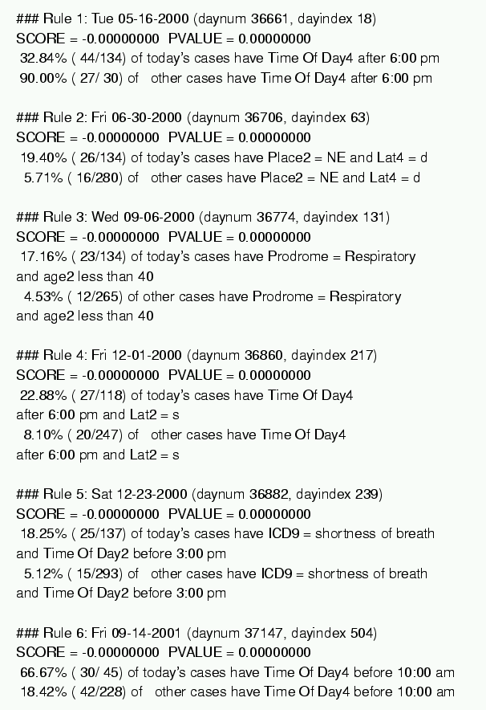
Results on Emergency Dept Data

Slide 101
WSARE 3.0
“Taking into account recent flu levels…”
“Taking into account that today is a public holday…”
“Taking into account that this is Spring…”
“Taking into account recent heatwave…”
“Taking into account that there’s a known natural Food-borne outbreak in progress…”
Bonus: More
efficient use of
historical data

Slide 102
Analysis of variance
Good news:
  If you’re tracking a daily aggregate (e.g. number of flu cases in your ED, or Nyquil Sales)…then ANOVA can take care of many of these effects.
But…
  What if you’re tracking a whole joint distribution of transactional events?

Slide 103
Idea: Bayesian Networks
“Patients from West Park Hospital are less likely to be young”
“On Cold Tuesday Mornings the folks coming in from the North part of the city are more likely to have respiratory problems”
“The Viral prodrome is more likely to co-occur with a Rash prodrome than Botulinic”
“On the day after a major holiday, expect a boost in the morning followed by a lull in the afternoon”

Slide 104
WSARE 3.0
All historical
data

Slide 105
WSARE 3.0
All historical
data

Slide 106
WSARE 3.0
All historical
data
Today’s
Environment
What should be happening today?

Slide 107
WSARE 3.0
All historical
data
Today’s
Environment
Today’s
Cases
What should be happening today?
What’s strange about today, considering its environment?

Slide 108
WSARE 3.0
All historical
data
Today’s
Environment
Today’s
Cases
What should be happening today?
What’s strange about today, considering its environment?
And how big a deal is this, considering how much search I’ve done?

Slide 109
WSARE 3.0
All historical
data
Today’s
Environment
Today’s
Cases
Cheap
What should be happening today?
What’s strange about today, considering its environment?
Expensive
And how big a deal is this, considering how much search I’ve done?

Slide 110
WSARE 3.0
All historical
data
Today’s
Environment
Today’s
Cases
Racing Randomization
Differential Randomization
All-dimensions Trees
Cheap
RADSEARCH
What should be happening today?
What’s strange about today, considering its environment?
Expensive
And how big a deal is this, considering how much search I’ve done?

Slide 111
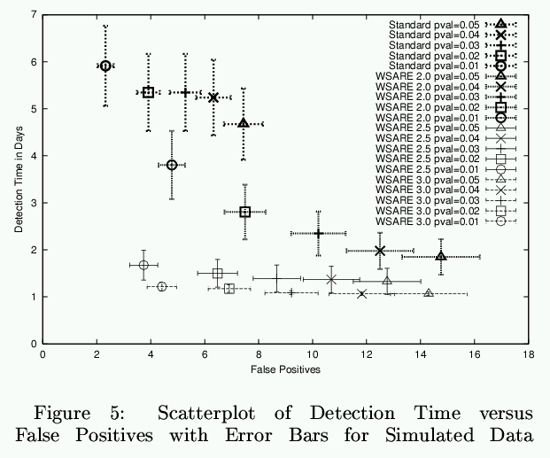
Results on Simulation

Slide 112
Results on Simulation
Standard
WSARE2.0
WSARE2.5
WSARE3.0

Slide 113
Conclusion
One approach to biosurveillance: one algorithm monitoring millions of signals derived from multivariate data
    instead of
  Hundreds of univariate detectors
Modeling historical data with Bayesian Networks to allow conditioning on unique features of today
Computationally intense unless we’re tricksy!
WSARE 2.0 Deployed during the past year
WSARE 3.0 about to go online
WSARE now being extended to additionally exploit over the counter medicine sales

Slide 114
Conclusion
Searching over thousands of contingency tables on a large database...
...only we have to do it 10,000 times on the replicas during randomization
...we also need to learn Bayes Nets from databases with millions of records...
...and keep relearning them as data arrives online...
...in the end we typically search about a billion alternative Bayes net structures for modeling 800,000 records in 10 minutes
One approach to biosurveillance: one algorithm monitoring millions of signals derived from multivariate data
    instead of
  Hundreds of univariate detectors
Modeling historical data with Bayesian Networks to allow conditioning on unique features of today
Computationally intense unless we’re tricksy!
WSARE 2.0 Deployed during the past year
WSARE 3.0 about to go online
WSARE now being extended to additionally exploit over the counter medicine sales

Slide 115
Conclusion
One approach to biosurveillance: one algorithm monitoring millions of signals derived from multivariate data
    instead of
  Hundreds of univariate detectors
Modeling historical data with Bayesian Networks to allow conditioning on unique features of today
Computationally intense unless we’re tricksy!
WSARE 2.0 Deployed during the past year
WSARE 3.0 about to go online
WSARE now being extended to additionally exploit over the counter medicine sales

Slide 116
Other New Algorithmic Developments
Specific Detectors
General Detectors
PANDA2: Patient-based Bayesian Network
[Cooper, Levander et. al]
WSARE meets Scan Statistics
Fast Scan Statistic
[Neill, Moore]
BARD: Airborne Attack Detection
[Hogan, Cooper]
Fast Scan for Oriented Regions
[Neill, Moore et al.]
Possible Future Connection
Historical Model Scan Statistic
[Hogan, Moore, Neill, Tsui, Wagner]
Question: How do we use all this information?
How can we “plug in” new streams?
How can we exploit multiattribute form?
Bayesian Network Spatial Scan
[Neill, Moore, Schneider, Cooper Wagner, Wong]

Slide 117
Other New Algorithmic Developments
Specific Detectors
General Detectors
PANDA2: Patient-based Bayesian Network
[Cooper, Levander et. al]
WSARE meets Scan Statistics
Please contact Greg Cooper gfc@cbmi.upmc.edu for information
Fast Scan Statistic
[Neill, Moore]
BARD: Airborne Attack Detection
[Hogan, Cooper]
Fast Scan for Oriented Regions
[Neill, Moore et al.]
Possible Future Connection
Historical Model Scan Statistic
[Hogan, Moore, Neill, Tsui, Wagner]
Question: How do we use all this information?
How can we “plug in” new streams?
How can we exploit multiattribute form?
Please contact Bill Hogan wrh@cbmi.pitt.edu for information
Bayesian Network Spatial Scan
[Neill, Moore, Schneider, Cooper Wagner, Wong]

Slide 118
For further info
Papers on these and other anti-terror applications: www.cs.cmu.edu/~awm/antiterror
Papers on scaling up many of these analysis methods: www.cs.cmu.edu/~awm/papers.html
Software implementing the above: www.autonlab.org
Copies of 18 lectures on 25 statistical data mining topics: www.cs.cmu.edu/~awm/781
CD-ROM, powerpoint-synchronized video/audio recordings of the above lectures: awm@cs.cmu.edu
Information Gain, Decision Trees
Probabilistic Reasoning, Bayes Classifiers, Density Estimation
Probability Densities in Data Mining
Gaussians in Data Mining
Maximum Likelihood Estimation
Gaussian Bayes Classifiers
Regression, Neural Nets
Overfitting: detection and avoidance
The many approaches to cross-validation
Locally Weighted Learning
Bayes Net, Bayes Net Structure Learning, Anomaly Detection
Andrew's Top 8 Favorite Regression Algorithms (Regression Trees, Cascade Correlation, Group Method Data Handling (GMDH), Multivariate Adaptive Regression Splines (MARS), Multilinear Interpolation, Radial Basis Functions, Robust Regression, Cascade Correlation + Projection Pursuit
Clustering, Mixture Models, Model Selection
K-means clustering and hierarchical clustering
Vapnik-Chervonenkis (VC) Dimensionality and Structural Risk Minimization
PAC Learning
Support Vector Machines
Time Series Analysis with Hidden Markov Models

Slide 119
References
WSARE 3.0 : Bayesian Network based Anomaly Pattern Detection
  Wong, Moore, Cooper and Wagner [ICML/KDD 2003]
Fast Grid Based Computation of Spatial Scan Statistics
  Neill and Moore [NIPS 2003]
  These and other Biosurveillance algorithms papers and free software available from
  http://www.autonlab.org/
  See also: http://www.health.pitt.edu/rods

