Slide 1
Learning Gaussian Bayes Classifiers
Note to other teachers and users of these slides. Andrew would be delighted if you found this source material useful in giving your own lectures. Feel free to use these slides verbatim, or to modify them to fit your own needs. PowerPoint originals are available. If you make use of a significant portion of these slides in your own lecture, please include this message, or the following link to the source repository of Andrew’s tutorials: http://www.cs.cmu.edu/~awm/tutorials . Comments and corrections gratefully received.
Andrew W. Moore
Associate Professor
School of Computer Science
Carnegie Mellon University
www.cs.cmu.edu/~awm
awm@cs.cmu.edu
412-268-7599

Slide 2
Maximum Likelihood learning of Gaussians for Classification
Why we should care
3 seconds to teach you a new learning algorithm
What if there are 10,000 dimensions?
What if there are categorical inputs?
Examples “out the wazoo”

Slide 3
Why we should care
One of the original “Data Mining” algorithms
Very simple and effective
Demonstrates the usefulness of our earlier groundwork

Slide 4
Where we were at the end of the MLE lecture…
Categorical inputs only
Real-valued inputs only
Mixed Real / Cat okay
Predict
category
Joint BC
Naïve BC
Dec Tree
Inputs
Classifier
Density
Estimator
Prob-
ability
Joint DE
Naïve DE
Gauss DE
Inputs
Predict
real no.
Inputs
Regressor

Slide 5
This lecture…
Categorical inputs only
Real-valued inputs only
Mixed Real / Cat okay
Predict
category
Joint BC
Naïve BC
Gauss BC
Dec Tree
Inputs
Classifier
Density
Estimator
Prob-
ability
Joint DE
Naïve DE
Gauss DE
Inputs
Predict
real no.
Inputs
Regressor

Slide 6
Road Map
Probability
Decision
Trees
Density
Estimation
PDFs
Bayes
Classifiers
MLE
Gaussians
MLE of
Gaussians

Slide 7
Road Map
Probability
Decision
Trees
Density
Estimation
PDFs
Bayes
Classifiers
MLE
Gaussians
MLE of
Gaussians
Gaussian
Bayes
Classifiers

Slide 8
Gaussian Bayes Classifier Assumption
The i’th record in the database is created using the following algorithm
Generate the output (the “class”) by drawing y_{i}~Multinomial(p₁,p₂,…p_{Ny})
Generate the inputs from a Gaussian PDF that depends on the value of y_{i} :
x_{i} ~ N(μ_{i} ,Σ_{i}).
Test your understanding. Given N_{y} classes and m input attributes, how many distinct scalar parameters need to be estimated?

Slide 9
MLE Gaussian Bayes Classifier
Let DB_{i} = Subset of
database DB in which
the output class is y = i
|DB_{i}|
p_{i}^{mle} = ------
|DB|
The i’th record in the database is created using the following algorithm
Generate the output (the “class”) by drawing y_{i}~Multinomial(p₁,p₂,…p_{Ny})
Generate the inputs from a Gaussian PDF that depends on the value of y_{i} :
x_{i} ~ N(μ_{i} ,Σ_{i}).
Test your understanding. Given N_{y} classes and m input attributes, how many distinct scalar parameters need to be estimated?

Slide 10
MLE Gaussian Bayes Classifier
Let DB_{i} = Subset of
database DB in which
the output class is y = i
The i’th record in the database is created using the following algorithm
Generate the output (the “class”) by drawing y_{i}~Multinomial(p₁,p₂,…p_{Ny})
Generate the inputs from a Gaussian PDF that depends on the value of y_{i} :
x_{i} ~ N(μ_{i} ,Σ_{i}).
Test your understanding. Given N_{y} classes and m input attributes, how many distinct scalar parameters need to be estimated?
(μ_{i}^{mle}, Σ_{i}^{mle} )= MLE Gaussian for DB_{i}

Slide 11
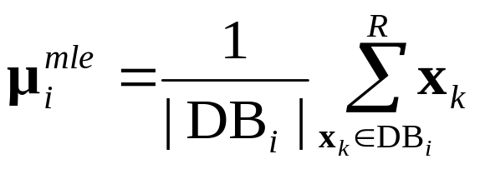
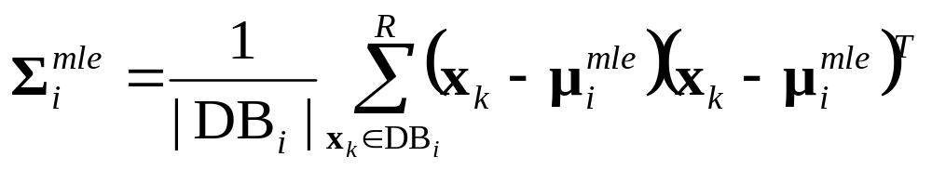
MLE Gaussian Bayes Classifier
Let DB_{i} = Subset of
database DB in which
the output class is y = i
The i’th record in the database is created using the following algorithm
Generate the output (the “class”) by drawing y_{i}~Multinomial(p₁,p₂,…p_{Ny})
Generate the inputs from a Gaussian PDF that depends on the value of y_{i} :
x_{i} ~ N(μ_{i} ,Σ_{i}).
Test your understanding. Given N_{y} classes and m input attributes, how many distinct scalar parameters need to be estimated?
(μ_{i}^{mle}, Σ_{i}^{mle} )= MLE Gaussian for DB_{i}

Slide 12
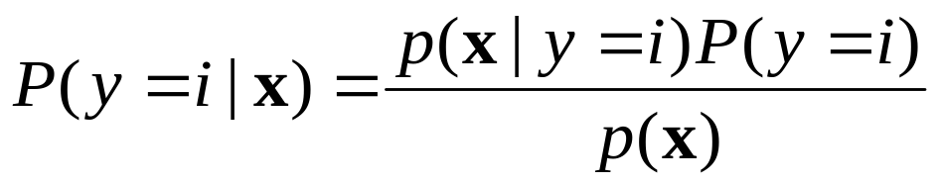
Gaussian Bayes Classification

Slide 13
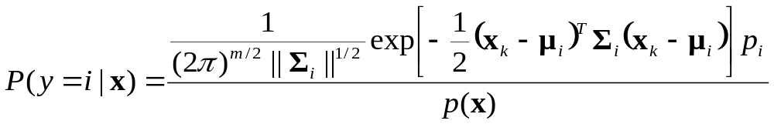
Gaussian Bayes Classification
How do we deal with that?

Slide 14
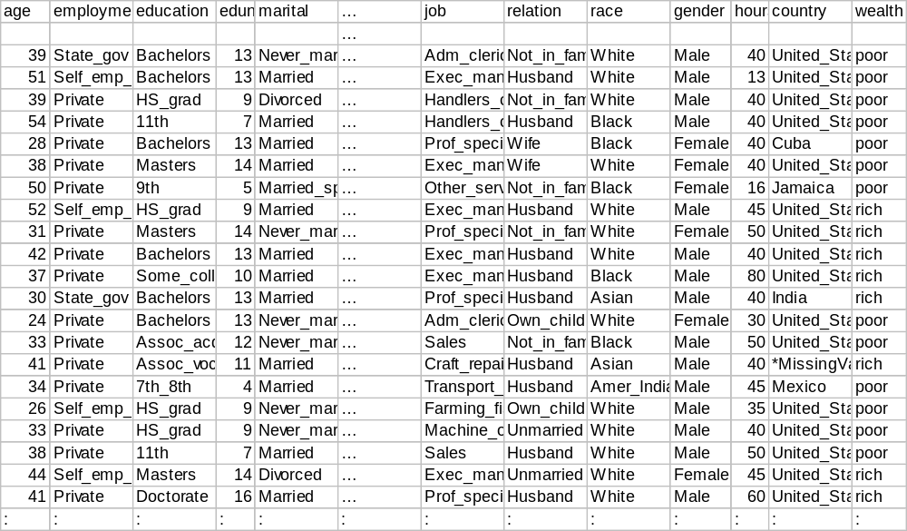
Here is a dataset
48,000 records, 16 attributes [Kohavi 1995]

Slide 15
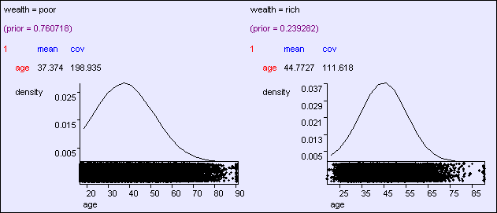
Predicting wealth from age

Slide 16
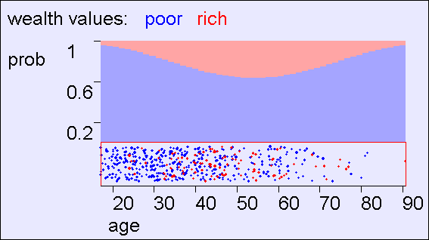
Predicting wealth from age

Slide 17
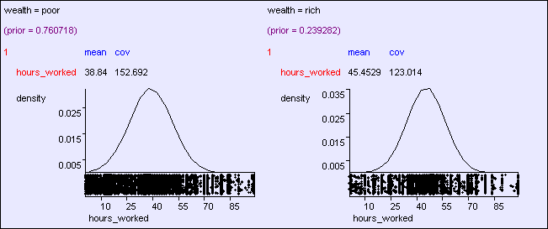
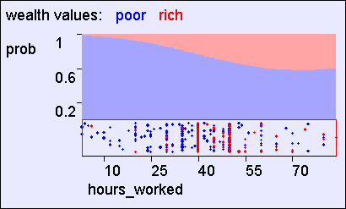
Wealth from hours worked

Slide 18
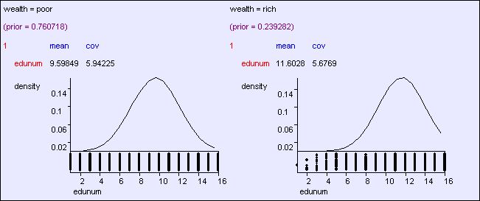
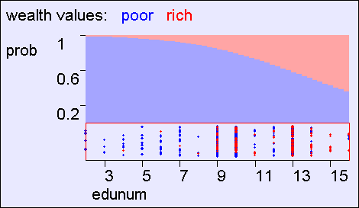
Wealth from years of education

Slide 19
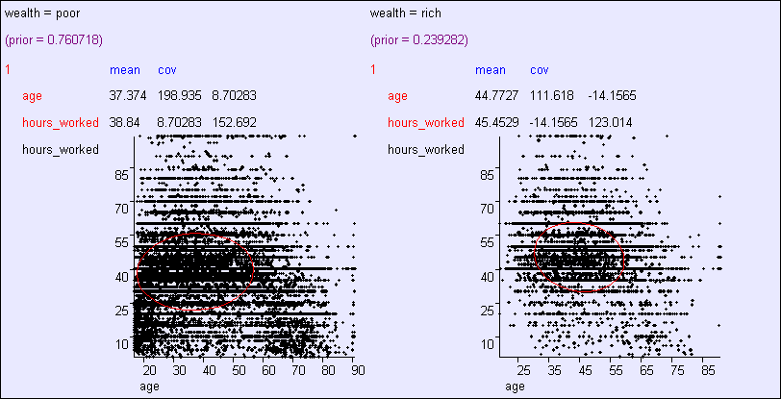
age, hours → wealth

Slide 20
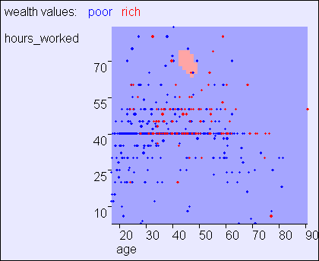
age, hours → wealth

Slide 21
age, hours → wealth
Having 2 inputs instead of one helps in two ways:
1. Combining evidence from two 1d Gaussians
2. Off-diagonal covariance distinguishes class “shape”

Slide 22
age, hours → wealth
Having 2 inputs instead of one helps in two ways:
1. Combining evidence from two 1d Gaussians
2. Off-diagonal covariance distinguishes class “shape”

Slide 23
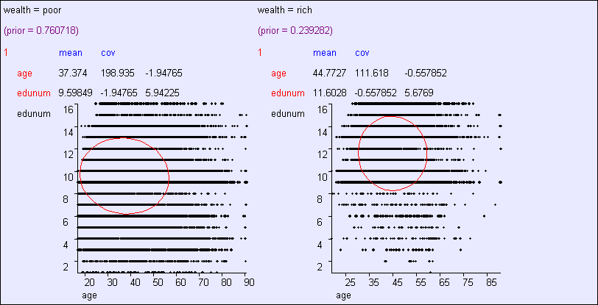
age, edunum → wealth

Slide 24
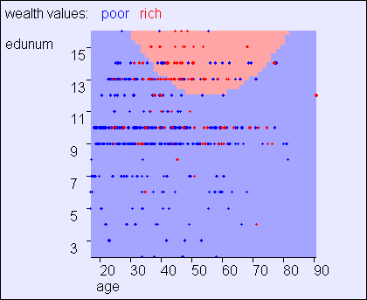
age, edunum → wealth

Slide 25
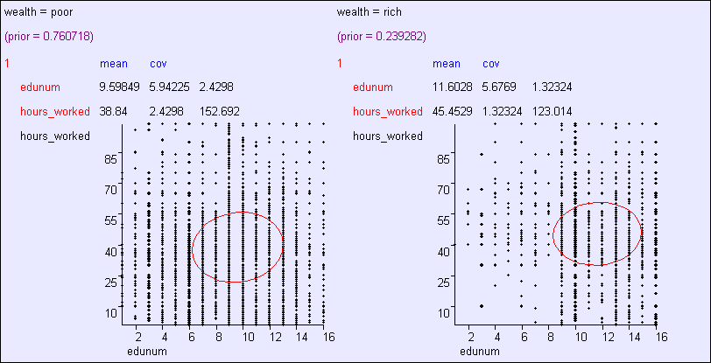
hours, edunum → wealth

Slide 26
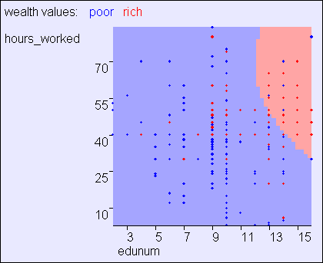
hours, edunum → wealth

Slide 27
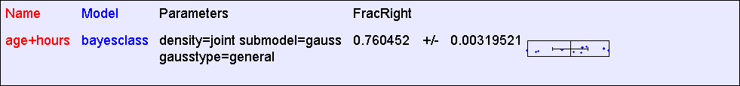

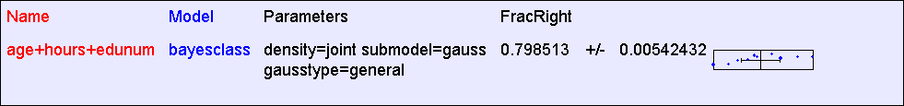
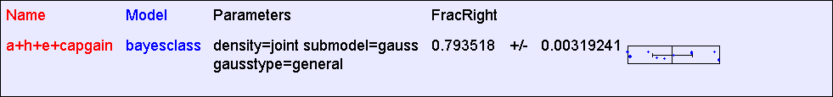

Accuracy

Slide 28
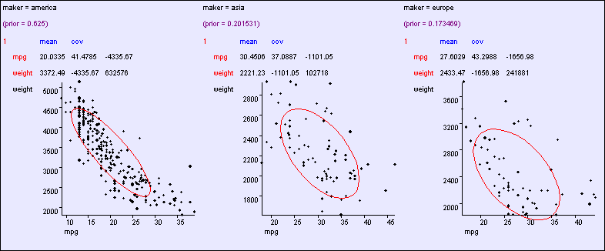
An “MPG” example

Slide 29
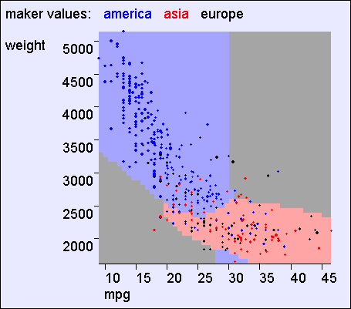
An “MPG” example

Slide 30
An “MPG” example
Things to note:
Class Boundaries can be weird shapes (hyperconic sections)
Class regions can be non-simply-connected
But it’s impossible to model arbitrarily weirdly shaped regions
Test your understanding: With one input, must classes be simply connected?

Slide 31
Overfitting dangers
Problem with “Joint” Bayes classifier:
    #parameters exponential with #dimensions.
        This means we just memorize the training data, and can overfit.

Slide 32
Overfitting dangers
Problem with “Joint” Bayes classifier:
    #parameters exponential with #dimensions.
        This means we just memorize the training data, and can overfit.
Problemette with Gaussian Bayes classifier:
    #parameters quadratic with #dimensions.
        With 10,000 dimensions and only 1,000 datapoints we could overfit.
        Question: Any suggested solutions?

Slide 33
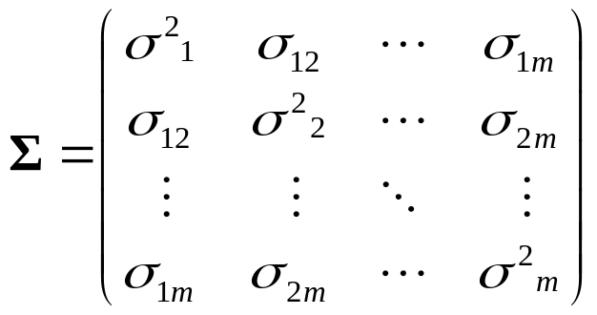
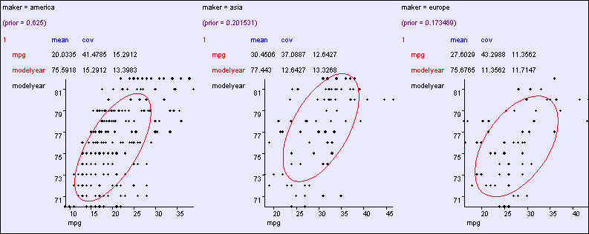
General: O(m²) parameters

Slide 34
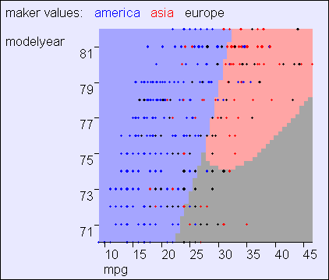
General: O(m²) parameters

Slide 35
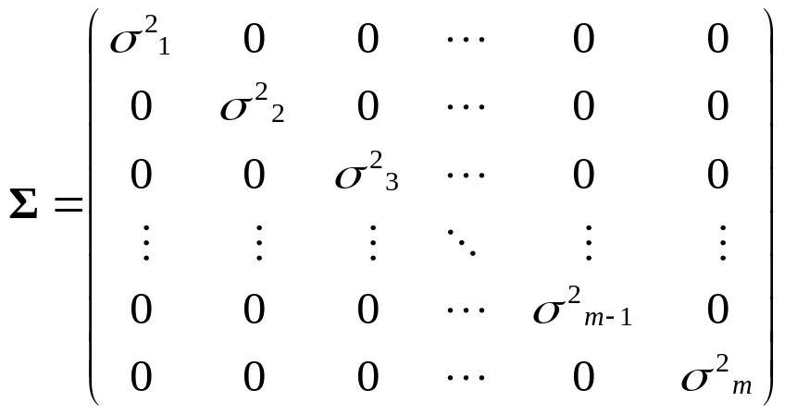
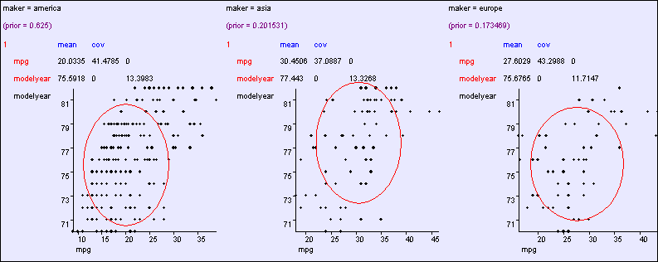
Aligned: O(m) parameters

Slide 36
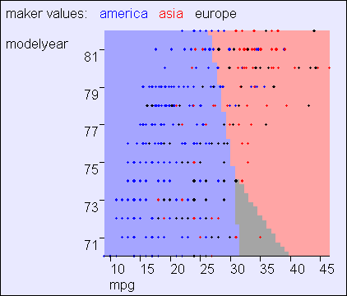
Aligned: O(m) parameters

Slide 37
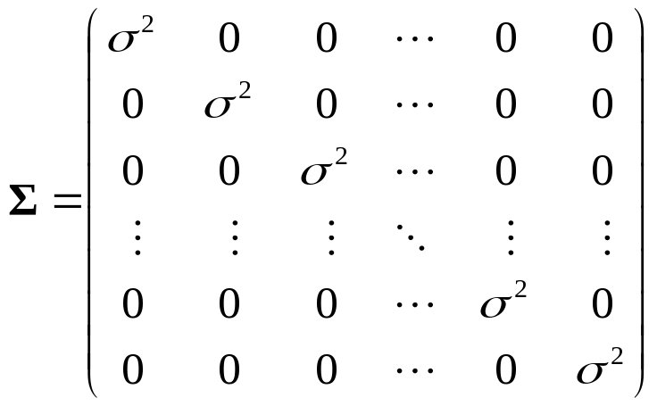
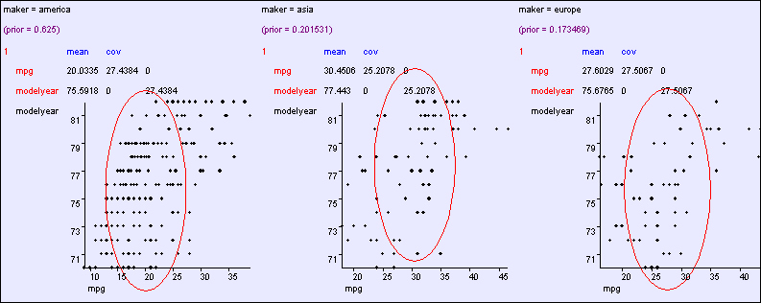
Spherical: O(1) cov parameters

Slide 38
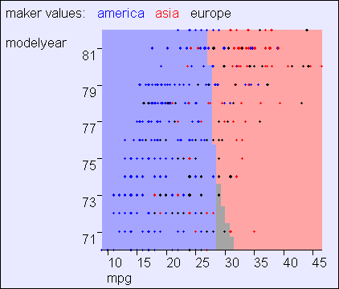
Spherical: O(1) cov parameters

Slide 39
BCs that have both real and categorical inputs?
Categorical inputs only
Real-valued inputs only
Mixed Real / Cat okay
Predict
category
Joint BC
Naïve BC
Gauss BC
Dec Tree
BC Here???
Inputs
Classifier
Density
Estimator
Prob-
ability
Joint DE
Naïve DE
Gauss DE
Inputs
Predict
real no.
Inputs
Regressor

Slide 40
BCs that have both real and categorical inputs?
Categorical inputs only
Real-valued inputs only
Mixed Real / Cat okay
Predict
category
Joint BC
Naïve BC
Gauss BC
Dec Tree
BC Here???
Inputs
Classifier
Density
Estimator
Prob-
ability
Joint DE
Naïve DE
Gauss DE
Inputs
Easy!
Guess how?
Predict
real no.
Inputs
Regressor

Slide 41
BCs that have both real and categorical inputs?
Categorical inputs only
Real-valued inputs only
Mixed Real / Cat okay
Predict
category
Joint BC
Naïve BC
Gauss BC
Dec Tree
Gauss/Joint BC
Gauss Naïve BC
Inputs
Classifier
Density
Estimator
Prob-
ability
Joint DE
Naïve DE
Gauss DE
Gauss DE
Gauss/Joint DE
Gauss Naïve DE
Inputs
Predict
real no.
Inputs
Regressor

Slide 42
BCs that have both real and categorical inputs?
Categorical inputs only
Real-valued inputs only
Mixed Real / Cat okay
Predict
category
Joint BC
Naïve BC
Gauss BC
Dec Tree
Gauss/Joint BC
Gauss Naïve BC
Inputs
Classifier
Density
Estimator
Prob-
ability
Joint DE
Naïve DE
Gauss DE
Gauss DE
Gauss/Joint DE
Gauss Naïve DE
Inputs
Predict
real no.
Inputs
Regressor

Slide 43
Mixed Categorical / Real Density Estimation
Write x = (u,v) = (u₁ ,u₂ ,…u_{q} ,v₁ ,v₂ … v_{m-q})
Real valued
Categorical valued
P(x |M)= P(u,v |M)
(where M is any Density Estimation Model)

Slide 44
Joint / Gauss DE Combo
Not sure which tasty
DE to enjoy? Try our…
P(u,v |M) = P(u |v ,M) P(v |M)
Gaussian with
parameters
depending on v
Big “m-q”-dimensional lookup table

Slide 45
MLE learning of the Joint / Gauss DE Combo
P(u,v |M) = P(u |v ,M) P(v |M)
μ_{v} | = | Mean of u among records matching v
Σ_{v} | = | Cov. of u among records matching v
q_{v} | = | Fraction of records that match v
u |v ,M ~ N(μ_{v} , Σ_{v}) , P(v |M) = q_{v}

Slide 46
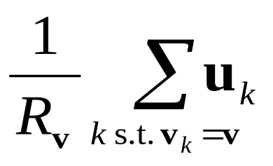
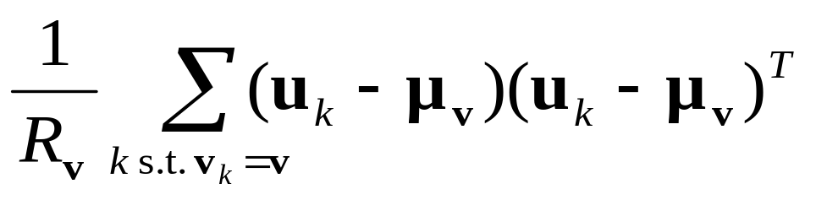
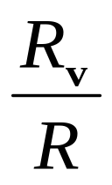
MLE learning of the Joint / Gauss DE Combo
P(u,v |M) = P(u |v ,M) P(v |M)
μ_{v} | = | Mean of u among records matching v | =
Σ_{v} | = | Cov. of u among records matching v | =
q_{v} | = | Fraction of records that match v | =
R_{v} = # records that match v
u |v ,M ~ N(μ_{v} , Σ_{v}) , P(v |M) = q_{v}

Slide 47
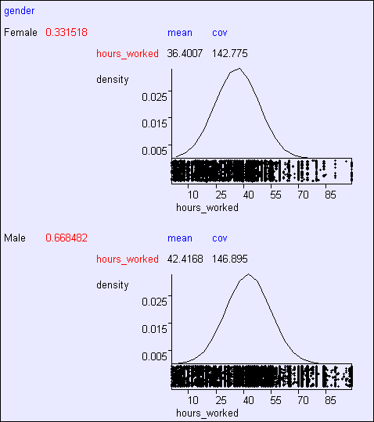
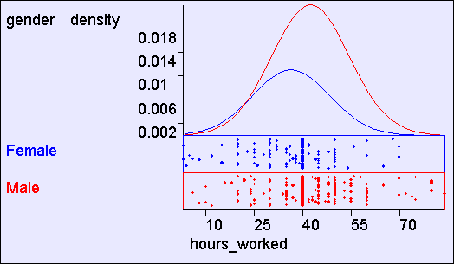
Gender and Hours Worked*
*As with all the results from the UCI “adult census” dataset, we can’t draw any real-world conclusions since it’s such a non-real-world sample

Slide 48
Joint / Gauss DE Combo
What we just did

Slide 49
Joint / Gauss BC Combo
What we do next

Slide 50
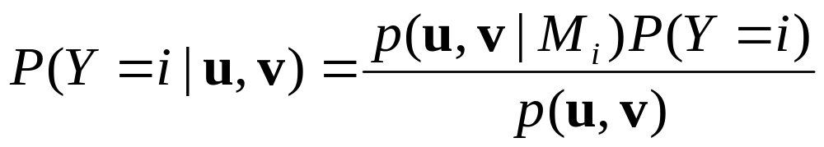
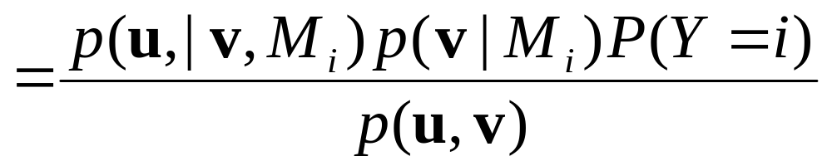
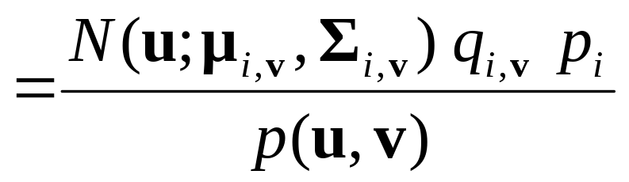
Joint / Gauss BC Combo

Slide 51
Joint / Gauss BC Combo
μ_{i,v} | = | Mean of u among records matching v and in which y=i
Σ_{i,v} | = | Cov. of u among records matching v and in which y=i
q_{i,v} | = | Fraction of “y=i” records that match v
p_{i} | = | Fraction of records that match “y=i”
Rather so-so-notation for “Gaussian with mean μ_{i,v} and covariance Σ_{i,v} evaluated at u”

Slide 52
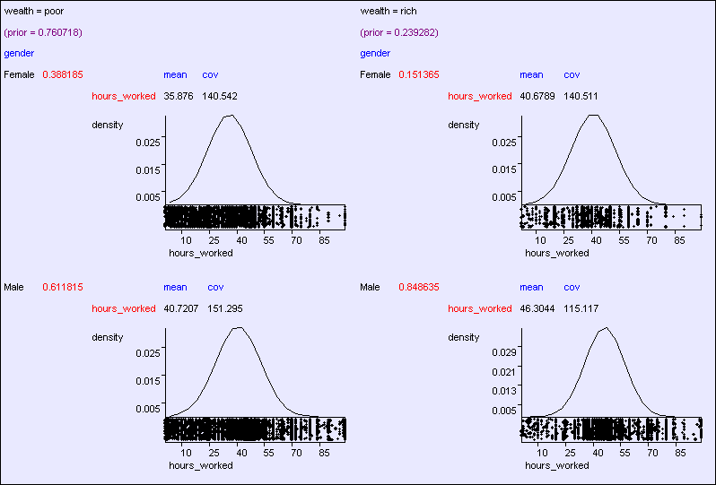
Gender, Hours→Wealth

Slide 53
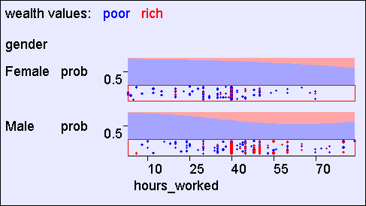
Gender, Hours→Wealth

Slide 54
Joint / Gauss DE Combo and Joint / Gauss BC Combo: The downside
(Yawn…we’ve done this before…)
  More than a few categorical attributes blah blah blah massive table blah blah lots of parameters blah blah just memorize training data blah blah blah do worse on future data blah blah need to be more conservative blah

Slide 55
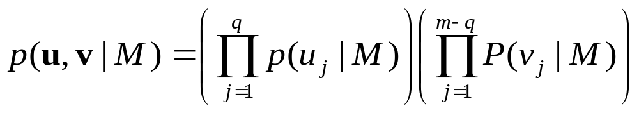
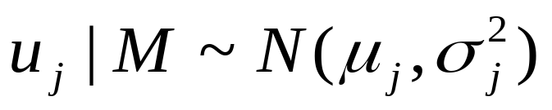
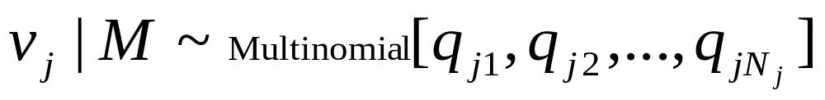
Naïve/Gauss combo for Density Estimation
Real
Categorical
How many parameters?

Slide 56
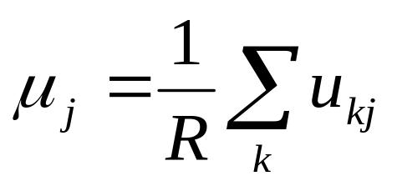
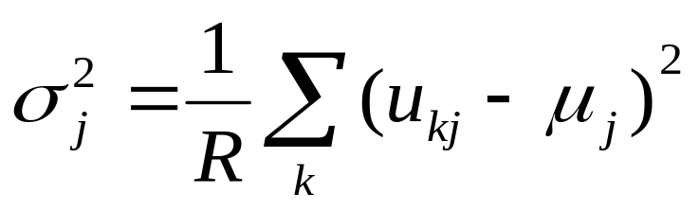
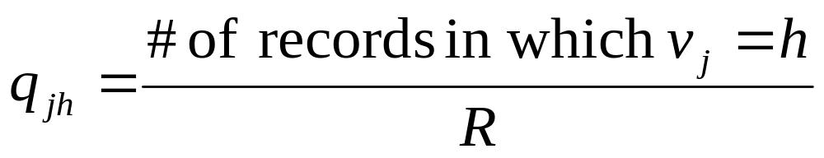
Naïve/Gauss combo for Density Estimation
Real
Categorical

Slide 57
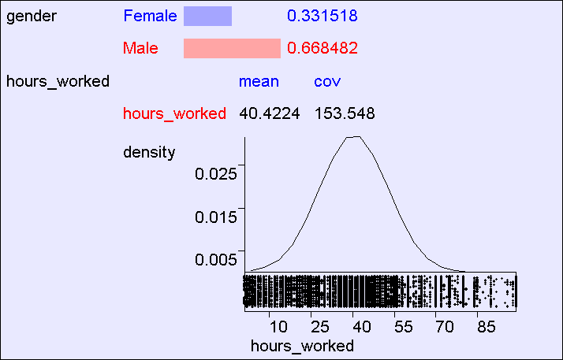
Naïve/Gauss DE Example

Slide 58
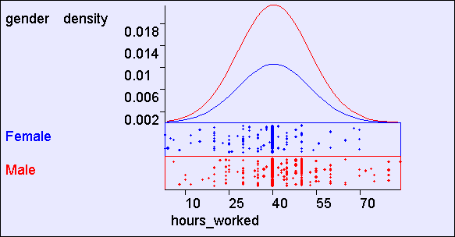
Naïve/Gauss DE Example

Slide 59
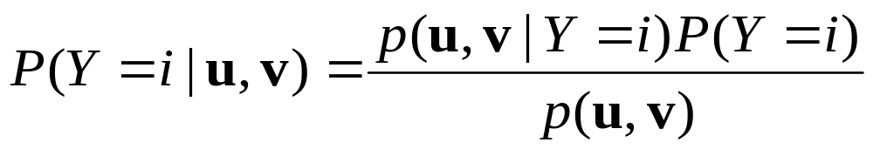


Naïve / Gauss BC
μ_{ij} | = | Mean of u_{j} among records in which y=i
σ²_{ij} | = | Var. of u_{j} among records in which y=i
q_{ij}[h] | = | Fraction of “y=i” records in which v_{j} = h
p_{i} | = | Fraction of records that match “y=i”

Slide 60

Gauss / Naïve BC Example

Slide 61

Gauss / Naïve BC Example

Slide 62

Learn Wealth from 15 attributes

Slide 63

Learn Wealth from 15 attributes
Same data, except all real values discretized to 3 levels

Slide 64

Learn Race from 15 attributes

Slide 65
What you should know
A lot of this should have just been a corollary of what you already knew
Turning Gaussian DEs into Gaussian BCs
Mixing Categorical and Real-Valued

Slide 66
Questions to Ponder
Suppose you wanted to create an example dataset where a BC involving Gaussians crushed decision trees like a bug. What would you do?
Could you combine Decision Trees and Bayes Classifiers? How? (maybe there is more than one possible way)

