Slide 1
Gaussians
Note to other teachers and users of these slides. Andrew would be delighted if you found this source material useful in giving your own lectures. Feel free to use these slides verbatim, or to modify them to fit your own needs. PowerPoint originals are available. If you make use of a significant portion of these slides in your own lecture, please include this message, or the following link to the source repository of Andrew’s tutorials: http://www.cs.cmu.edu/~awm/tutorials . Comments and corrections gratefully received.
Andrew W. Moore
Professor
School of Computer Science
Carnegie Mellon University
www.cs.cmu.edu/~awm
awm@cs.cmu.edu
412-268-7599

Slide 2
Gaussians in Data Mining
Why we should care
The entropy of a PDF
Univariate Gaussians
Multivariate Gaussians
Bayes Rule and Gaussians
Maximum Likelihood and MAP using Gaussians

Slide 3
Why we should care
Gaussians are as natural as Orange Juice and Sunshine
We need them to understand Bayes Optimal Classifiers
We need them to understand regression
We need them to understand neural nets
We need them to understand mixture models
…
(You get the idea)

Slide 4
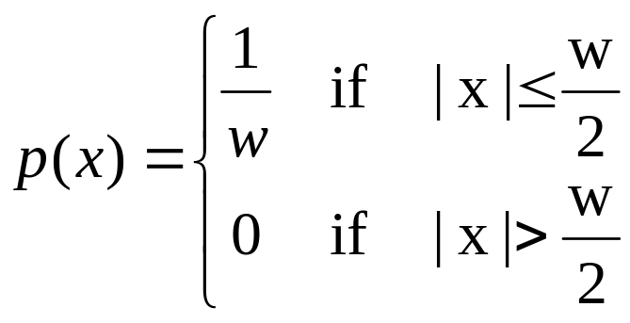
The “box” distribution
1/w
-w/2
0
w/2

Slide 5
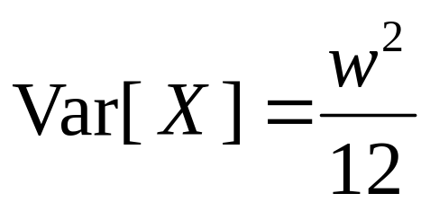
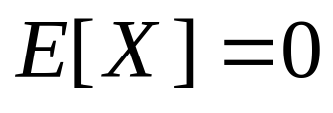
The “box” distribution
1/w
-w/2
0
w/2

Slide 6
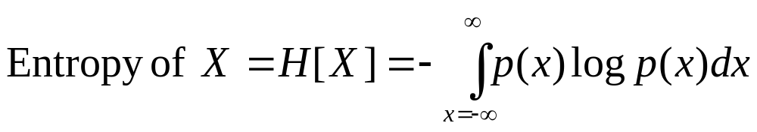
Entropy of a PDF
Natural log (ln or log_{e})
The larger the entropy of a distribution…
…the harder it is to predict
…the harder it is to compress it
…the less spiky the distribution

Slide 7
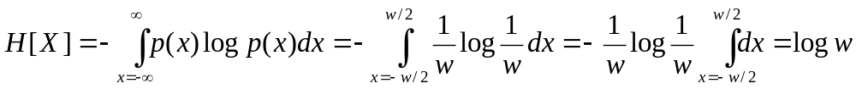
The “box” distribution
1/w
-w/2
0
w/2

Slide 8
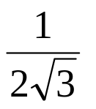
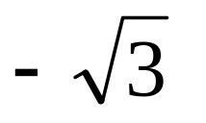
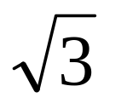
Unit variance box distribution
0

Slide 9
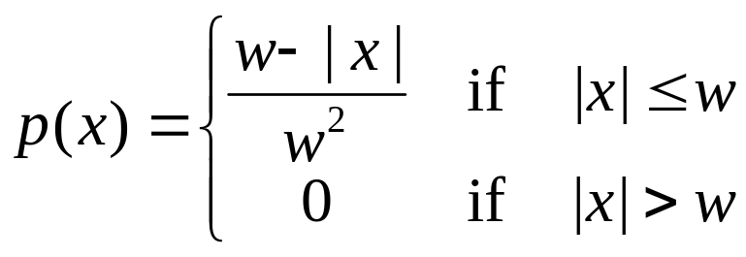

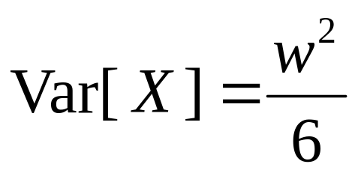


The Hat distribution
0

Slide 10
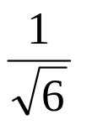
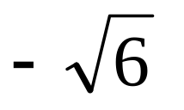
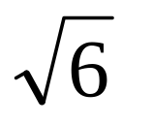
Unit variance hat distribution
0

Slide 11
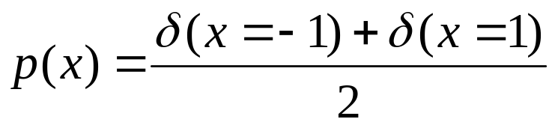
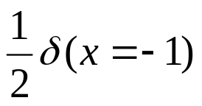
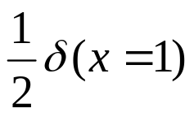

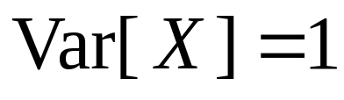
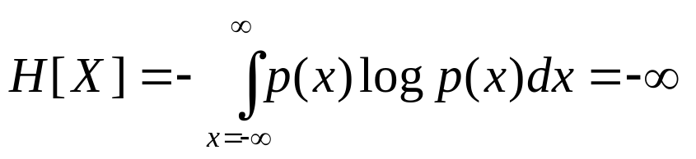
The “2 spikes” distribution
Dirac Delta
-1
0
1

Slide 12
Entropies of unit-variance distributions
Distribution | Entropy
Box | 1.242
Hat | 1.396
2 spikes | -infinity
??? | 1.4189
Largest possible entropy of any unit-variance distribution

Slide 13
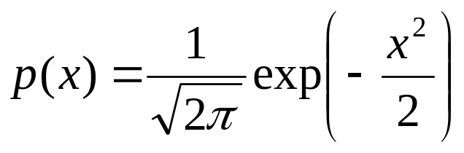
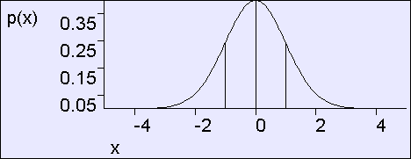
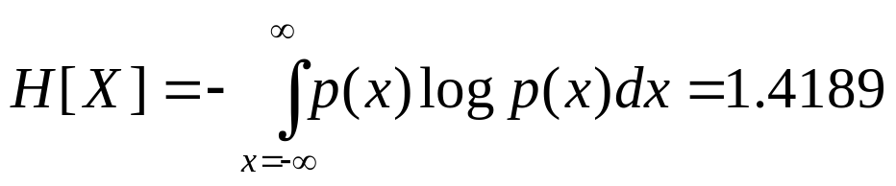
Unit variance Gaussian

Slide 14
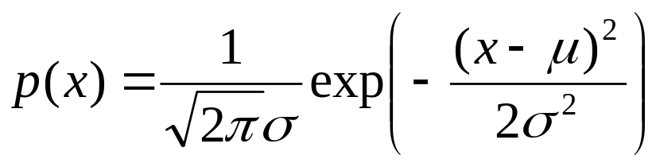
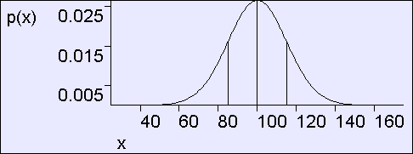
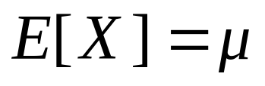
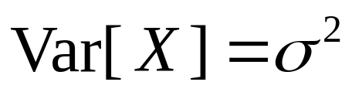
General Gaussian
σ=15
μ=100

Slide 15
General Gaussian
Also known as the normal distribution or Bell-shaped curve
σ=15
μ=100
Shorthand: We say X ~ N(μ,σ²) to mean “X is distributed as a Gaussian with parameters μ and σ²”.
In the above figure, X ~ N(100,15²)

Slide 16
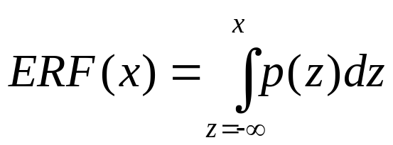
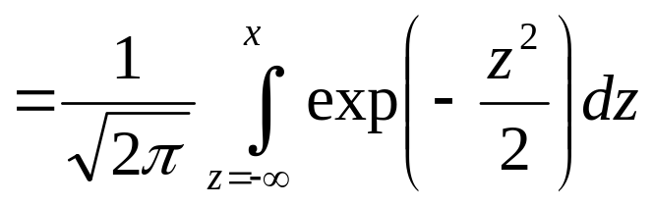
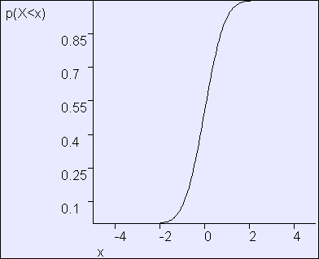
The Error Function
Assume X ~ N(0,1)
Define ERF(x) = P(X<x) = Cumulative Distribution of X

Slide 17
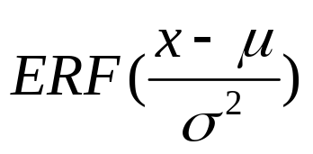
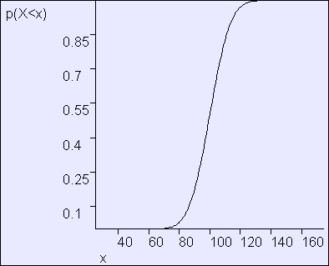
Using The Error Function
Assume X ~ N(μ,σ²)
P(X<x| μ,σ²) =

Slide 18
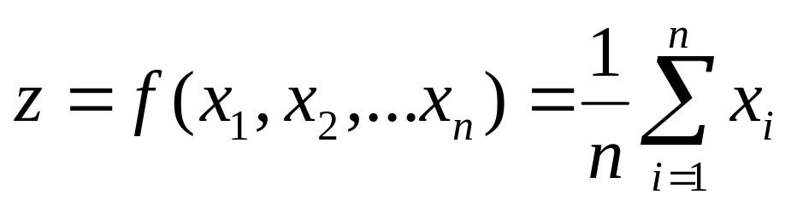
The Central Limit Theorem
If (X₁,X₂, … X_{n}) are i.i.d. continuous random variables
Then define
As n-->infinity, p(z)--->Gaussian with mean E[X_{i}] and variance Var[X_{i}]
Somewhat of a justification for assuming Gaussian noise is common

Slide 19
Other amazing facts about Gaussians
Wouldn’t you like to know?
We will not examine them until we need to.

Slide 20
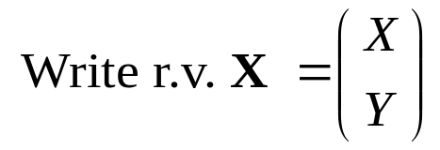

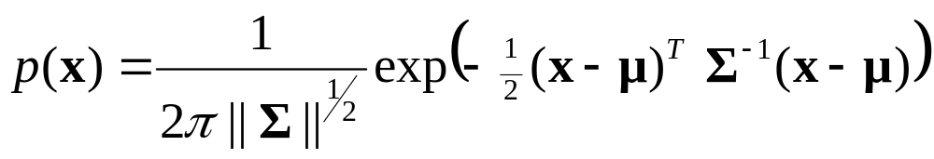
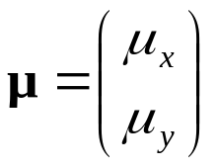
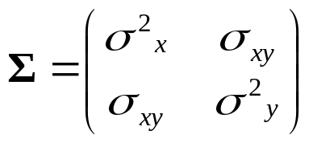
Bivariate Gaussians
Then define
to mean
Where the Gaussian’s parameters are…
Where we insist that Σ is symmetric non-negative definite

Slide 21
Bivariate Gaussians
Then define
to mean
Where the Gaussian’s parameters are…
Where we insist that Σ is symmetric non-negative definite
It turns out that E[X] = μ and Cov[X] = Σ. (Note that this is a resulting property of Gaussians, not a definition)*
*This note rates 7.4 on the pedanticness scale

Slide 22
Evaluating p(x): Step 1
Begin with vector x
x
μ

Slide 23
Evaluating p(x): Step 2
Begin with vector x
Define δ = x - μ
x
δ
μ

Slide 24
Evaluating p(x): Step 3
Contours defined by sqrt(δ^{T}Σ⁻¹δ) = constant
Begin with vector x
Define δ = x - μ
Count the number of contours crossed of the ellipsoids formed Σ⁻¹
D = this count = sqrt(δ^{T}Σ⁻¹δ) = Mahalonobis Distance between x and μ
x
δ
μ

Slide 25
Evaluating p(x): Step 4
Begin with vector x
Define δ = x - μ
Count the number of contours crossed of the ellipsoids formed Σ⁻¹
D = this count = sqrt(δ^{T}Σ⁻¹δ) = Mahalonobis Distance between x and μ
Define w = exp(-D ²/2)
exp(-D ²/2)
D ²
x close to μ in squared Mahalonobis space gets a large weight. Far away gets a tiny weight

Slide 26
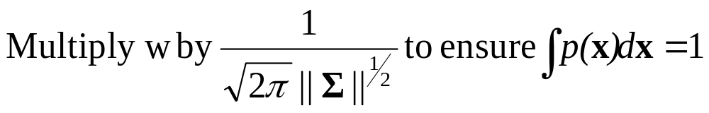
Evaluating p(x): Step 5
Begin with vector x
Define δ = x - μ
Count the number of contours crossed of the ellipsoids formed Σ⁻¹
D = this count = sqrt(δ^{T}Σ⁻¹δ) = Mahalonobis Distance between x and μ
Define w = exp(-D ²/2)
exp(-D ²/2)
D ²

Slide 27
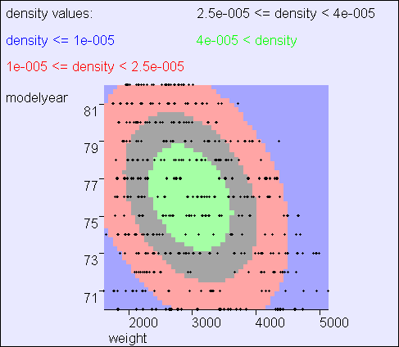
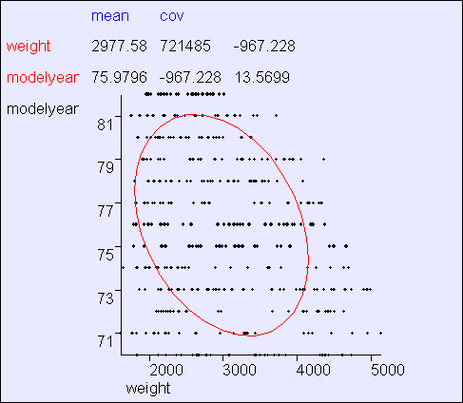
Example
Observe: Mean, Principal axes, implication of off-diagonal covariance term, max gradient zone of p(x)
Common convention: show contour corresponding to 2 standard deviations from mean

Slide 28
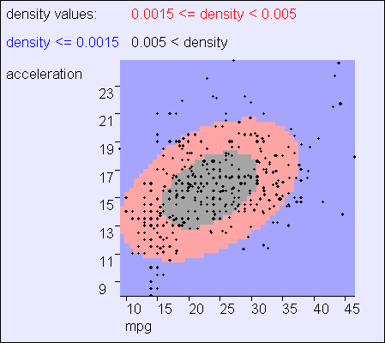
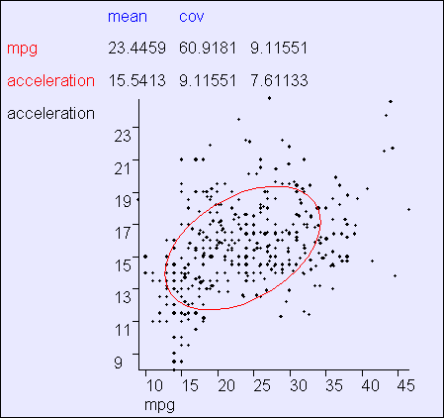
Example

Slide 29
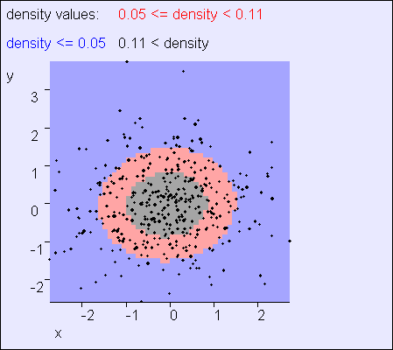
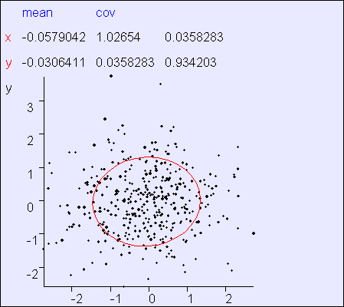
Example
In this example, x and y are almost independent

Slide 30
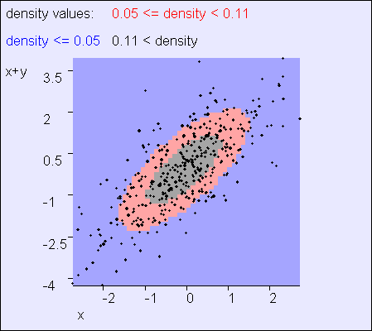
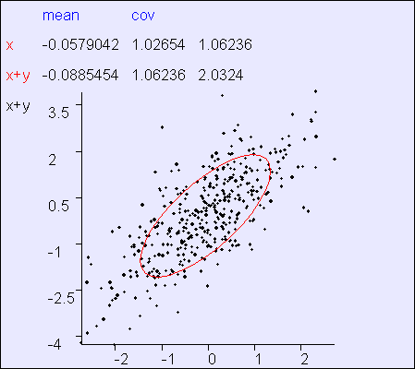
Example
In this example, x and “x+y” are clearly not independent

Slide 31
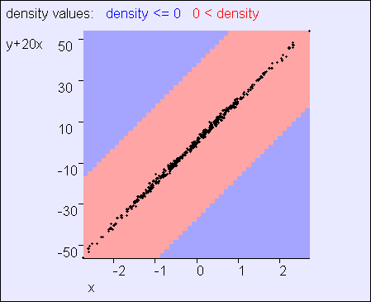
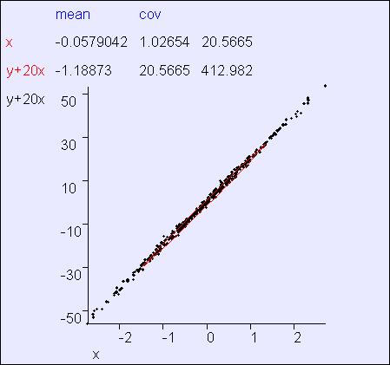
Example
In this example, x and “20x+y” are clearly not independent

Slide 32
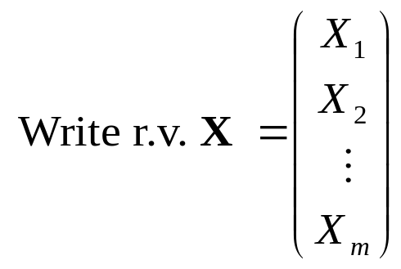
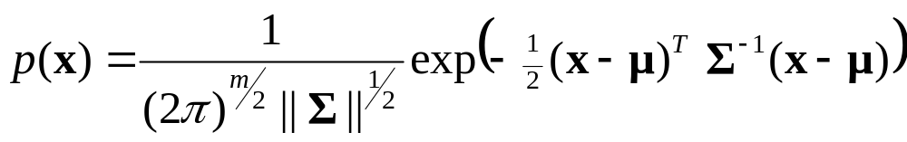
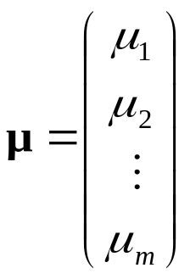
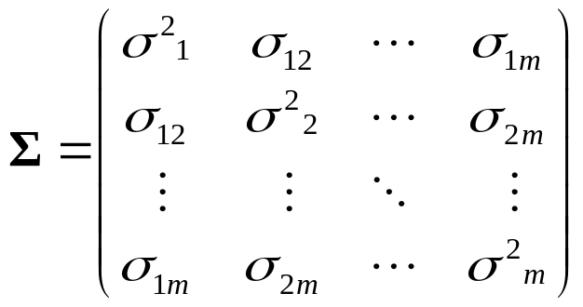
Multivariate Gaussians
Then define
to mean
Where the Gaussian’s parameters have…
Where we insist that Σ is symmetric non-negative definite
Again, E[X] = μ and Cov[X] = Σ. (Note that this is a resulting property of Gaussians, not a definition)

Slide 33
General Gaussians
x₂
x₁

Slide 34


Axis-Aligned Gaussians
x₂
x₁

Slide 35

Spherical Gaussians
x₂
x₁

Slide 36

Degenerate Gaussians
What’s so wrong with clipping one’s toenails in public?
x₂
x₁

Slide 37
Where are we now?
We’ve seen the formulae for Gaussians
We have an intuition of how they behave
We have some experience of “reading” a Gaussian’s covariance matrix
Coming next:
  Some useful tricks with Gaussians

Slide 38

Subsets of variables
This will be our standard notation for breaking an m-dimensional distribution into subsets of variables

Slide 39





Gaussian Marginals are Gaussian
Margin-
alize
THEN U is also distributed as a Gaussian

Slide 40
Gaussian Marginals are Gaussian
Margin-
alize
This fact is not immediately obvious
THEN U is also distributed as a Gaussian
Obvious, once we know it’s a Gaussian (why?)

Slide 41

Gaussian Marginals are Gaussian
Margin-
alize
How would you prove this?
THEN U is also distributed as a Gaussian

Slide 42






Linear Transforms remain Gaussian
Matrix A
Multiply
Assume X is an m-dimensional Gaussian r.v.
Define Y to be a p-dimensional r. v. thusly (note ):
…where A is a p x m matrix. Then…
Note: the “subset” result is a special case of this result

Slide 43



Adding samples of 2 independent Gaussians is Gaussian
+
Why doesn’t this hold if X and Y are dependent?
Which of the below statements is true?
    If X and Y are dependent, then X+Y is Gaussian but possibly with some other covariance
    If X and Y are dependent, then X+Y might be non-Gaussian

Slide 44




Conditional of Gaussian is Gaussian
Condition-
alize

Slide 45






Slide 46



P(w|m=82)
P(w|m=76)
P(w)

Slide 47
Note: when given value of v is μ_{v}, the conditional mean of u is μ_{u}
Note: marginal mean is a linear function of v
P(w|m=82)
Note: conditional variance can only be equal to or smaller than marginal variance
P(w|m=76)
Note: conditional variance is independent of the given value of v
P(w)

Slide 48




Gaussians and the chain rule
Chain
Rule
Let A be a constant matrix

Slide 49







Available Gaussian tools
Margin-
alize
Matrix A
Multiply
+
Condition-
alize
Chain
Rule

Slide 50
Assume…
You are an intellectual snob
You have a child

Slide 51
Intellectual snobs with children
…are obsessed with IQ
In the world as a whole, IQs are drawn from a Gaussian N(100,15²)

Slide 52
IQ tests
If you take an IQ test you’ll get a score that, on average (over many tests) will be your IQ
But because of noise on any one test the score will often be a few points lower or higher than your true IQ.
SCORE | IQ ~ N(IQ,10²)

Slide 53
Assume…
You drag your kid off to get tested
She gets a score of 130
“Yippee” you screech and start deciding how to casually refer to her membership of the top 2% of IQs in your Christmas newsletter.
P(X<130|μ=100,σ²=15²) =
P(X<2| μ=0,σ²=1) =
erf(2) = 0.977

Slide 54
Assume…
You are thinking:
Well sure the test isn’t accurate, so she might have an IQ of 120 or she might have an 1Q of 140, but the most likely IQ given the evidence “score=130” is, of course, 130.
You drag your kid off to get tested
She gets a score of 130
“Yippee” you screech and start deciding how to casually refer to her membership of the top 2% of IQs in your Christmas newsletter.
P(X<130|μ=100,σ²=15²) =
P(X<2| μ=0,σ²=1) =
erf(2) = 0.977
Can we trust this reasoning?

Slide 55


Maximum Likelihood IQ
IQ~N(100,15²)
S|IQ ~ N(IQ, 10²)
S=130
The MLE is the value of the hidden parameter that makes the observed data most likely
In this case

Slide 56
BUT….
IQ~N(100,15²)
S|IQ ~ N(IQ, 10²)
S=130
The MLE is the value of the hidden parameter that makes the observed data most likely
In this case
This is not the same as
“The most likely value of the parameter given the observed data”

Slide 57
What we really want:
IQ~N(100,15²)
S|IQ ~ N(IQ, 10²)
S=130
Question: What is IQ | (S=130)?
Called the Posterior Distribution of IQ

Slide 58
Which tool or tools?
IQ~N(100,15²)
S|IQ ~ N(IQ, 10²)
S=130
Question: What is IQ | (S=130)?
Margin-
alize
Matrix A
Multiply
+
Condition-
alize
Chain
Rule

Slide 59





Plan
IQ~N(100,15²)
S|IQ ~ N(IQ, 10²)
S=130
Question: What is IQ | (S=130)?
Chain
Rule
Condition-
alize
Swap

Slide 60
Working…
IQ~N(100,15²)
S|IQ ~ N(IQ, 10²)
S=130
Question: What is IQ | (S=130)?

Slide 61

Your pride and joy’s posterior IQ
If you did the working, you now have p(IQ|S=130)
If you have to give the most likely IQ given the score you should give
where MAP means “Maximum A-posteriori”

Slide 62
What you should know
The Gaussian PDF formula off by heart
Understand the workings of the formula for a Gaussian
Be able to understand the Gaussian tools described so far
Have a rough idea of how you could prove them
Be happy with how you could use them

