Slide 1
Iterative Improvement Search
Hill Climbing, Simulated Annealing, WALKSAT, and Genetic Algorithms
Andrew W. Moore
Professor
School of Computer Science
Carnegie Mellon University
www.cs.cmu.edu/~awm
awm@cs.cmu.edu
412-268-7599
Note to other teachers and users of these slides. Andrew would be delighted if you found this source material useful in giving your own lectures. Feel free to use these slides verbatim, or to modify them to fit your own needs. PowerPoint originals are available. If you make use of a significant portion of these slides in your own lecture, please include this message, or the following link to the source repository of Andrew’s tutorials: http://www.cs.cmu.edu/~awm/tutorials . Comments and corrections gratefully received.

Slide 2
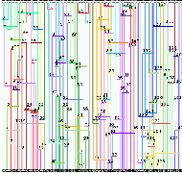
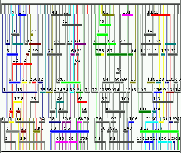
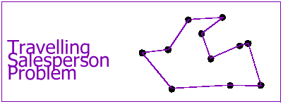
Example Problems
Channel Routing
Lots of Chip Real-estate
Same connectivity, much less space

Slide 3
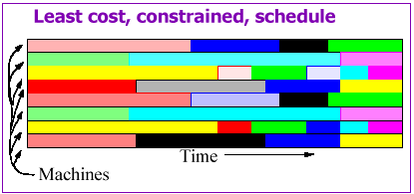
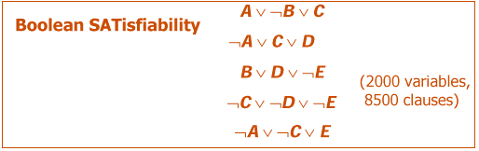
Example Problems
Also:
parking lot layout, product design, aero-dynamic design, “Million Queens” problem, radiotherapy treatment planning, …

Slide 4
Informal characterization
These are problems in which…
There is some combinatorial structure being optimized.
There is a cost function: Structure → Real, to be optimized, or at least a reasonable solution is to be found.
(So basic CSP methods only solve part of the problem … they satisfy constraints but don’t look for optimal constraint-satisfier.)
Searching all possible structures is intractable.
Depth first search approaches are too expensive.
There’s no known algorithm for finding the optimal solution efficiently.
Very informally, similar solutions have similar costs.

Slide 5
Iterative Improvement
Intuition: consider the configurations to be laid out on the surface of a landscape. We want to find the highest point.
(Unlike other AI search problems like 8-puzzle, we don’t care how we get there.)
“Iterative Improvement” methods:
Start at a random configuration; repeatedly consider various moves; accept some & reject some. When you’re stuck, restart.
We must invent a moveset that describes what moves we will consider from any configuration. Let’s invent movesets for out four sample problems.

Slide 6
Hill-climbing
Hill-climbing: Attempt to maximize Eval(X) by moving to the highest configuration in our moveset. If they’re all lower, we are stuck at a “local optimum.”
Let X := initial config
Let E := Eval(X)
Let N = moveset_size(X)
For ( i = 0 ; i<N ; i := i+1) Let E_{i} := Eval(move(X,i))
If all E_{i}’s are ≤ E, terminate, return X
Else let i* = argmax_{i} E_{i}
X := move(X,i*)
E := E_{i*}
Goto 3
(Not the most sophisticated algorithm in the world.)

Slide 7
Hill-climbing Issues
Trivial to program
Requires no memory (since no backtracking)
MoveSet design is critical. This is the real ingenuity – not the decision to use hill-climbing.
Evaluation function design often critical.
  Problems: dense local optima or plateaux
If the number of moves is enormous, the algorithm may be inefficient. What to do?
If the number of moves is tiny, the algorithm can get stuck easily. What to do?
It’s often cheaper to evaluate an incremental change of a previously evaluated object than to evaluate from scratch. Does hill-climbing permit that?
What if approximate evaluation is cheaper than accurate evaluation?
Inner-loop optimization often possible.

Slide 8
Randomized Hill-climbing
Let X := initial config
Let E := Eval(X)
Let i = random move from the moveset
Let E_{i} := Eval(move(X,i))
If E < E_{i} then X := move(X,i) E := E_{i}
Goto 3 unless bored.
What stopping criterion should we use?
Any obvious pros or cons compared with our previous hill climber?

Slide 9
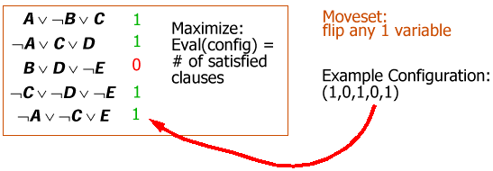
Hill-climbing example: GSAT
WALKSAT (randomized GSAT):
Pick a random unsatisfied clause;
Consider 3 moves: flipping each variable.
If any improve Eval, accept the best.
If none improve Eval, then 50% of the time, pick the move that is the least bad; 50% of the time, pick a random one.
This is the best known algorithm for satisfying Boolean formulae! [Selman]

Slide 10
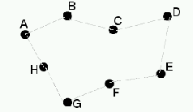
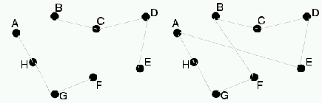
Hill-climbing Example: TSP
Minimize: Eval(Config) = length of tour
MoveSet: 2-change … k-change
Example: 2-change

Slide 11
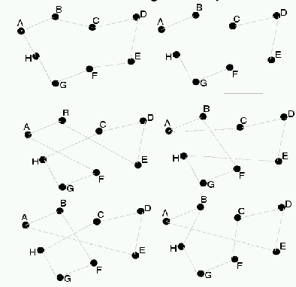
3-change Example

Slide 12
Hill-climbing Example: TSP
This class of algorithms for the TSP is usually referred to as k-opt
(MoveSet: 2-change, … k-change) for some constant k.
Lin showed empirically:
  3-opt solutions are much better than 2-opt
  4-opt solutions are not sufficiently better than 3-opt to justify the extra compute time
  A 3-opt tour for the 48-city problem of Held and Karp has about a probability of 0.05 of being optimal (100 random restarts will yield the optimal solution with probability 0.99)
  Further for his particular class of TSP, a 3-opt tour is optimal with probability 2^{-n/10} where n is a number of cities.
There is no theoretical justification for any of these results.

Slide 13
Simulated Annealing
Let X := initial config
Let E := Eval(X)
Let i = random move from the moveset
Let E_{i} := Eval(move(X,i))
If E < E_{i} then X := move(X,i) E := E_{i} Else with some probability, accept the move even though things get worse: X := move(X,i) E := E_{i}
Goto 3 unless bored.

Slide 14
Simulated Annealing
Let X := initial config
Let E := Eval(X)
Let i = random move from the moveset
Let E_{i} := Eval(move(X,i))
If E < E_{i} then X := move(X,i) E := E_{i} Else with some probability, accept the move even though things get worse: X := move(X,i) E := E_{i}
Goto 3 unless bored.
This may make the search fall out of mediocre local minima and into better local maxima.
How should we choose the probability of accepting a worsening move?
Idea One. Probability = 0.1
Idea Two. Probability decreases with time
Idea Three. Probability decreases with time, and also as E – E_{i} increases.

Slide 15
Simulated Annealing
If E_{i} >= E then definitely accept the change.
If E_{i} < E then accept the change with probability
exp (-(E - E_{i})/T_{i})
(called the Boltzman distribution)
…where T_{i} is a “temperature” parameter that gradually decreases. Typical cooling schedule: T_{i} = T₀ · r’
High temp: accept all moves (Random Walk)
Low temp: Stochastic Hill-Climbing
When enough iterations have passed without improvement, terminate.
This idea was introduced by Metropolis in 1953. It is “based” on “similarities” and “analogies” with the way that alloys manage to find a nearly global minimum energy level when they are cooled slowly.

Slide 16
Aside: Analogy-based algorithms
Your lecturer predicts that for any natural phenomenon you can think of, there will be at least one AI research group that will have a combinatorial optimization algorithm “based” on “analogies” and “similarities” with the phenomenon. Here’s the beginning of the list…
Metal cooling annealing
Evolution / Co-evolution / Sexual Reproduction
Thermodynamics
Societal Markets
Management Hierarchies
Ant/Insect Colonies
Immune System
Animal Behavior Conditioning
Neuron / Brain Models
Hill-climbing (okay, that’s a stretch…)
Particle Physics
Inability of Elephants to Play Chess

Slide 17
Simulated Annealing Issues
MoveSet design is critical. This is the real ingenuity – not the decision to use simulated annealing.
Evaluation function design often critical.
Annealing schedule often critical.
It’s often cheaper to evaluate an incremental change of a previously evaluated object than to evaluate from scratch. Does simulated annealing permit that?
What if approximate evaluation is cheaper than accurate evaluation?
Inner-loop optimization often possible.

Slide 18
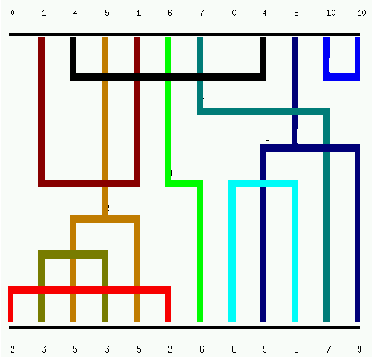
Manhattan Channel Routing

Slide 19
Channel Routing: Moveset
Simple moveset: pick up a wire and move it to another track at random. (Problem: almost all such moves are illegal!)
Fancy moveset: makes search more efficient
Packing wires onto the same track = = merging nodes. (The graph must remain acyclic, and you must check horizontal constraints too.)
Draw vertical constraints in a graph (arrow means “must lie above”)
4,10
1
4
10
7
9
5
9
7
5
1,6,8
3
8
6

Slide 20
Channel Routing: Cost Function
“Clearly, the objective function to be minimized is the channel width w. However, w is too crude a measure of the quality of intermediate solutions. Instead, … the following cost function is used:”
c = w² + λ_{p} · p² + λ_{u} · u
where
p is a lower bound on the size of the constraint graph after future merge operations,
u measures the variance of how tightly the horizontal tracks are packed,
and λ_{p} and λ_{u} are hand-tweaked constants.
--- Wong, Simulated Annealing for VLSI Design

Slide 21
“Modified Lam” schedule
(This is just to give you and idea of how wacky these things can be.)
Idea: dynamically lower and raise temp to meet a target accept rate over time.
Advantages: few parameters to tweak; you know in advance how long the algorithm will run; works well empirically.

Slide 22
SA Discussion
Simulated annealing is sometimes empirically much better at avoiding local minima than hill-climbing. It is a successful, frequently-used, algorithm. Worth putting in your algorithmic toolbox.
Sadly, not much opportunity to say anything formal about it (though there is a proof that with an infinitely slow cooling rate, you’ll find the global optimum).
There are mountains of practical, and problem-specific, papers on improvements.

Slide 23
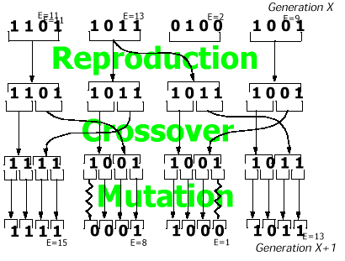
Genetic Algorithms
In the basic GA, objects are coded up (carefully) as binary strings. Goal is to optimize some function of the bit-strings.
(Diagram shamelessly copied from “Dean et al: AI: Theory and Practice”.)

Slide 24
Genetic Algorithm
A set of bitstrings. This set is called a Generation. the algorithm produces a new generation from an old generation thusly:
Let G be the current generation of N bitstrings.
For each bitstring (call them b₀, b₁, … b_{N-1}) define p_{i} = Eval(b_{i}) / Σ_{j} Eval(b_{j}).
Let G’ be the next generation. Begin with it empty.
For k = 0 ; k < N/2 ; k = k+1
  Choose two parents each with probability Prob(Parent = b_{i}) = p_{i}
  Randomly swap bits in the two parents to obtain two new bitstrings
  For each bit in turn in the new bitstring, randomly invert it with some low probability
  Add the two new bitstrings to G’
Let your first generation consist of random bitstrings.

Slide 25
GA Issues
Bitstring representation is critical. This is the real ingenuity – not the decision to use genetic algorithms. (How to encode TSP?)
Evaluation function design often critical. In-laws always critical.
It’s often cheaper to evaluate an incremental change of a previously evaluated object than to evaluate from scratch. Do Genetic Algorithms permit that?
What if approximate evaluation is cheaper than accurate evaluation?
Inner-loop optimization often possible.
Numerous twiddles:
Use rankings not evaluations in creating your p_{i} parent selection probabilities.
Cross over contiguous chunks of the string instead of random bits?
Needn’t be bit strings .. could use strings over other finite alphabets.
Optimize over sentences from a grammar representing functions or programs. Called Genetic Programming.

Slide 26
General Discussion
Often, the “second best way” to solve a problem.
But relatively easy to implement. Can save a great deal of programming effort.
But great care is needed in designing representations and movesets. If someone tells you that SA/Hillclimbing solved their problem, that person is probably not giving enough credit to their own problem-formulation-ability.
DON’T solve a problem with these methods that could be solved by Linear Programming, A-Star search or Constraint Propagation!
What if evaluating the objective function is really expensive?

Slide 27
What you should know about Iterative Improvement algs.
Hill-climbing
Simulated Annealing
SAT and Channel Routing domains
Given a simple problem (e.g. graph coloring from the CSP lectures) be able to give sensible suggestions as to how to code it up for the above algorithms.
References:
  Simulated Annealing: See Numerical Recipes in C, or for practical details of Modified Lam schedule etc.: Ochotta 1994 Ph.D. thesis, CMU ECE.
  Hillclimbing: Discussion in Russell and Norvig.
  GSAT, WALKSAT: papers by Bart Selman and Henry Kautz (www.research.att.com)
  Channel Routing: Wong et al., Simulated Annealing for VLSI Design, Kluwer 1988.

