Slide 1
Hidden Markov Models
Note to other teachers and users of these slides. Andrew would be delighted if you found this source material useful in giving your own lectures. Feel free to use these slides verbatim, or to modify them to fit your own needs. PowerPoint originals are available. If you make use of a significant portion of these slides in your own lecture, please include this message, or the following link to the source repository of Andrew’s tutorials: http://www.cs.cmu.edu/~awm/tutorials . Comments and corrections gratefully received.
Andrew W. Moore
Professor
School of Computer Science
Carnegie Mellon University
www.cs.cmu.edu/~awm
awm@cs.cmu.edu
412-268-7599

Slide 2
A Markov System
Has N states, called s₁, s₂ .. s_{N}
There are discrete timesteps, t=0, t=1, …
s₂
s₁
s₃
N = 3
t=0

Slide 3
A Markov System
Has N states, called s₁, s₂ .. s_{N}
There are discrete timesteps, t=0, t=1, …
On the t’th timestep the system is in exactly one of the available states. Call it q_{t}
Note: q_{t} ∈{s₁, s₂ .. s_{N} }
s₂
Current State
s₁
s₃
N = 3
t=0
q_{t}=q₀=s₃

Slide 4
A Markov System
Current State
Has N states, called s₁, s₂ .. s_{N}
There are discrete timesteps, t=0, t=1, …
On the t’th timestep the system is in exactly one of the available states. Call it q_{t}
Note: q_{t} ∈{s₁, s₂ .. s_{N} }
Between each timestep, the next state is chosen randomly.
s₂
s₁
s₃
N = 3
t=1
q_{t}=q₁=s₂

Slide 5
A Markov System
P(q_{t+1}=s₁|q_{t}=s₂) = 1/2
P(q_{t+1}=s₂|q_{t}=s₂) = 1/2
P(q_{t+1}=s₃|q_{t}=s₂) = 0
Has N states, called s₁, s₂ .. s_{N}
There are discrete timesteps, t=0, t=1, …
On the t’th timestep the system is in exactly one of the available states. Call it q_{t}
Note: q_{t} ∈{s₁, s₂ .. s_{N} }
Between each timestep, the next state is chosen randomly.
The current state determines the probability distribution for the next state.
P(q_{t+1}=s₁|q_{t}=s₁) = 0
P(q_{t+1}=s₂|q_{t}=s₁) = 0
P(q_{t+1}=s₃|q_{t}=s₁) = 1
s₂
s₁
s₃
N = 3
t=1
q_{t}=q₁=s₂
P(q_{t+1}=s₁|q_{t}=s₃) = 1/3
P(q_{t+1}=s₂|q_{t}=s₃) = 2/3
P(q_{t+1}=s₃|q_{t}=s₃) = 0

Slide 6
A Markov System
P(q_{t+1}=s₁|q_{t}=s₂) = 1/2
P(q_{t+1}=s₂|q_{t}=s₂) = 1/2
P(q_{t+1}=s₃|q_{t}=s₂) = 0
Has N states, called s₁, s₂ .. s_{N}
There are discrete timesteps, t=0, t=1, …
On the t’th timestep the system is in exactly one of the available states. Call it q_{t}
Note: q_{t} ∈{s₁, s₂ .. s_{N} }
Between each timestep, the next state is chosen randomly.
The current state determines the probability distribution for the next state.
P(q_{t+1}=s₁|q_{t}=s₁) = 0
P(q_{t+1}=s₂|q_{t}=s₁) = 0
P(q_{t+1}=s₃|q_{t}=s₁) = 1
s₂
1/2
1/2
2/3
s₁
s₃
1/3
N = 3
t=1
q_{t}=q₁=s₂
1
P(q_{t+1}=s₁|q_{t}=s₃) = 1/3
P(q_{t+1}=s₂|q_{t}=s₃) = 2/3
P(q_{t+1}=s₃|q_{t}=s₃) = 0
Often notated with arcs between states

Slide 7
Markov Property
P(q_{t+1}=s₁|q_{t}=s₂) = 1/2
P(q_{t+1}=s₂|q_{t}=s₂) = 1/2
P(q_{t+1}=s₃|q_{t}=s₂) = 0
q_{t+1} is conditionally independent of { q_{t-1}, q_{t-2}, … q₁, q₀ } given q_{t}.
In other words:
P(q_{t+1} = s_{j} |q_{t} = s_{i} ) =
P(q_{t+1} = s_{j} |q_{t} = s_{i} ,any earlier history)
Question: what would be the best Bayes Net structure to represent the Joint Distribution of ( q₀, q₁, … q₃,q₄ )?
P(q_{t+1}=s₁|q_{t}=s₁) = 0
P(q_{t+1}=s₂|q_{t}=s₁) = 0
P(q_{t+1}=s₃|q_{t}=s₁) = 1
s₂
1/2
1/2
2/3
s₁
s₃
1/3
N = 3
t=1
q_{t}=q₁=s₂
1
P(q_{t+1}=s₁|q_{t}=s₃) = 1/3
P(q_{t+1}=s₂|q_{t}=s₃) = 2/3
P(q_{t+1}=s₃|q_{t}=s₃) = 0

Slide 8
Markov Property
P(q_{t+1}=s₁|q_{t}=s₂) = 1/2
P(q_{t+1}=s₂|q_{t}=s₂) = 1/2
P(q_{t+1}=s₃|q_{t}=s₂) = 0
Answer:
q₀
q_{t+1} is conditionally independent of { q_{t-1}, q_{t-2}, … q₁, q₀ } given q_{t}.
In other words:
P(q_{t+1} = s_{j} |q_{t} = s_{i} ) =
P(q_{t+1} = s_{j} |q_{t} = s_{i} ,any earlier history)
Question: what would be the best Bayes Net structure to represent the Joint Distribution of ( q₀, q₁, q₂,q₃,q₄ )?
P(q_{t+1}=s₁|q_{t}=s₁) = 0
P(q_{t+1}=s₂|q_{t}=s₁) = 0
P(q_{t+1}=s₃|q_{t}=s₁) = 1
s₂
q₁
1/2
1/2
2/3
q₂
s₁
s₃
1/3
N = 3
t=1
q_{t}=q₁=s₂
1
q₃
P(q_{t+1}=s₁|q_{t}=s₃) = 1/3
P(q_{t+1}=s₂|q_{t}=s₃) = 2/3
P(q_{t+1}=s₃|q_{t}=s₃) = 0
q₄

Slide 9
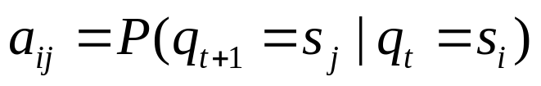
Markov Property
P(q_{t+1}=s₁|q_{t}=s₂) = 1/2
P(q_{t+1}=s₂|q_{t}=s₂) = 1/2
P(q_{t+1}=s₃|q_{t}=s₂) = 0
Answer:
q₀
q_{t+1} is conditionally independent of { q_{t-1}, q_{t-2}, … q₁, q₀ } given q_{t}.
In other words:
P(q_{t+1} = s_{j} |q_{t} = s_{i} ) =
P(q_{t+1} = s_{j} |q_{t} = s_{i} ,any earlier history)
Question: what would be the best Bayes Net structure to represent the Joint Distribution of ( q₀, q₁, q₂,q₃,q₄ )?
i | P(q_{t+1}=s₁|q_{t}=s_{i}) | P(q_{t+1}=s₂|q_{t}=s_{i}) | … | P(q_{t+1}=s_{j}|q_{t}=s_{i}) | … | P(q_{t+1}=s_{N}|q_{t}=s_{i})
1 | a₁₁ | a₁₂ | … | a_{1j} | … | a_{1N}
2 | a₂₁ | a₂₂ | … | a_{2j} | … | a_{2N}
3 | a₃₁ | a₃₂ | … | a_{3j} | … | a_{3N}
: | : | : | : | : | : | :
i | a_{i1} | a_{i2} | … | a_{ij} | … | a_{iN}
N | a_{N1} | a_{N2} | … | a_{Nj} | … | a_{NN}
P(q_{t+1}=s₁|q_{t}=s₁) = 0
P(q_{t+1}=s₂|q_{t}=s₁) = 0
P(q_{t+1}=s₃|q_{t}=s₁) = 1
s₂
q₁
1/2
1/2
2/3
q₂
s₁
s₃
1/3
Each of these probability tables is identical
N = 3
t=1
q_{t}=q₁=s₂
1
q₃
P(q_{t+1}=s₁|q_{t}=s₃) = 1/3
P(q_{t+1}=s₂|q_{t}=s₃) = 2/3
P(q_{t+1}=s₃|q_{t}=s₃) = 0
Notation:
q₄

Slide 10
A Blind Robot
A human and a robot wander around randomly on a grid…
 |  |  | R
 | H
Note: N (num. states) = 18 * 18 = 324
Location of Robot,
Location of Human
STATE q =

Slide 11
Dynamics of System
Each timestep the human moves randomly to an adjacent cell. And Robot also moves randomly to an adjacent cell.
q₀ =
 |  |  |  |  | R
H
Typical Questions:
  “What’s the expected time until the human is crushed like a bug?”
  “What’s the probability that the robot will hit the left wall before it hits the human?”
  “What’s the probability Robot crushes human on next time step?”

Slide 12
Example Question
“It’s currently time t, and human remains uncrushed. What’s the probability of crushing occurring at time t + 1 ?”
If robot is blind:
  We can compute this in advance.
If robot is omnipotent:
  (I.E. If robot knows state at time t), can compute directly.
If robot has some sensors, but incomplete state information …
  Hidden Markov Models are applicable!
We’ll do this first
Too Easy. We
won’t do this
Main Body
of Lecture

Slide 13
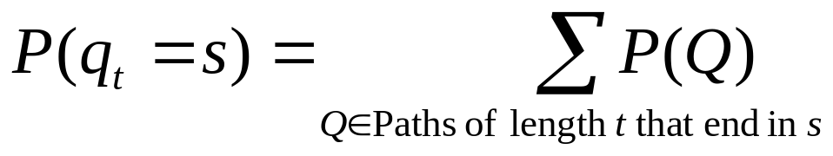
What is P(q_{t} =s)? slow, stupid answer
Step 1: Work out how to compute P(Q) for any path Q = q₁ q₂ q₃ .. q_{t}
  Given we know the start state q₁ (i.e. P(q₁)=1)
  P(q₁ q₂ .. q_{t}) = P(q₁ q₂ .. q_{t-1}) P(q_{t}|q₁ q₂ .. q_{t-1})
  = P(q₁ q₂ .. q_{t-1}) P(q_{t}|q_{t-1})
  = P(q₂|q₁)P(q₃|q₂)…P(q_{t}|q_{t-1})
Step 2: Use this knowledge to get P(q_{t} =s)
WHY?
Computation is exponential in t

Slide 14
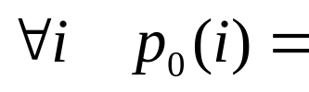
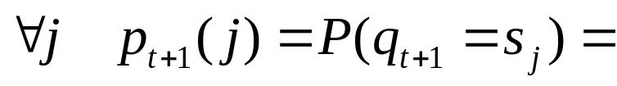
What is P(q_{t} =s) ? Clever answer
For each state s_{i}, define
  p_{t}(i) = Prob. state is s_{i} at time t
  = P(q_{t} = s_{i})
Easy to do inductive definition

Slide 15
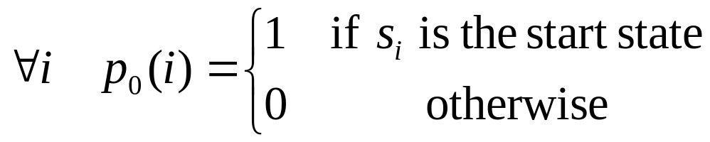
What is P(q_{t} =s) ? Clever answer
For each state s_{i}, define
  p_{t}(i) = Prob. state is s_{i} at time t
  = P(q_{t} = s_{i})
Easy to do inductive definition

Slide 16
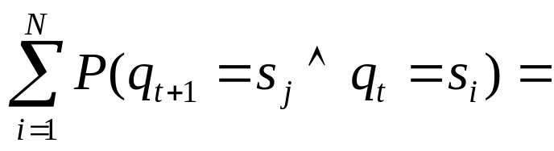
What is P(q_{t} =s) ? Clever answer
For each state s_{i}, define
  p_{t}(i) = Prob. state is s_{i} at time t
  = P(q_{t} = s_{i})
Easy to do inductive definition

Slide 17
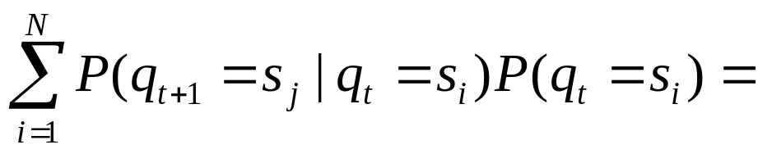
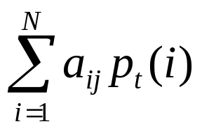
What is P(q_{t} =s) ? Clever answer
For each state s_{i}, define
  p_{t}(i) = Prob. state is s_{i} at time t
  = P(q_{t} = s_{i})
Easy to do inductive definition
Remember,

Slide 18
What is P(q_{t} =s) ? Clever answer
For each state s_{i}, define
  p_{t}(i) = Prob. state is s_{i} at time t
  = P(q_{t} = s_{i})
Easy to do inductive definition
Computation is simple.
Just fill in this table in this order:
t | p_{t}(1) | p_{t}(2) | … | p_{t}(N)
0 | 0 | 1 |  | 0
1
:
t_{final}

Slide 19
What is P(q_{t} =s) ? Clever answer
For each state s_{i}, define
  p_{t}(i) = Prob. state is s_{i} at time t
  = P(q_{t} = s_{i})
Easy to do inductive definition
Cost of computing P_{t}(i) for all states S_{i} is now O(t N²)
The stupid way was O(N^{t})
This was a simple example
It was meant to warm you up to this trick, called Dynamic Programming, because HMMs do many tricks like this.

Slide 20
Hidden State
“It’s currently time t, and human remains uncrushed. What’s the probability of crushing occurring at time t + 1 ?”
If robot is blind:
  We can compute this in advance.
If robot is omnipotent:
  (I.E. If robot knows state at time t), can compute directly.
If robot has some sensors, but incomplete state information …
  Hidden Markov Models are applicable!
We’ll do this first
Too Easy. We
won’t do this
Main Body
of Lecture

Slide 21
Hidden State
The previous example tried to estimate P(q_{t} = s_{i}) unconditionally (using no observed evidence).
Suppose we can observe something that’s affected by the true state.
Example: Proximity sensors. (tell us the contents of the 8 adjacent squares)
 |  |  | R₀
 |  | H
W | W | W
 | ®
H
W denotes “WALL”
True state q_{t}
What the robot sees: Observation O_{t}

Slide 22
Noisy Hidden State
Example: Noisy Proximity sensors. (unreliably tell us the contents of the 8 adjacent squares)
 |  |  | R₀
 |  | H
W | W | W
 | ®
H
W denotes “WALL”
True state q_{t}
Uncorrupted Observation
W |  | W
 | ® | W
H | H
What the robot sees: Observation O_{t}

Slide 23
Noisy Hidden State
Example: Noisy Proximity sensors. (unreliably tell us the contents of the 8 adjacent squares)
 |  |  | R₀ |  | 2
 |  | H
W | W | W
 | ®
H
W denotes “WALL”
True state q_{t}
Uncorrupted Observation
O_{t} is noisily determined depending on the current state.
Assume that O_{t} is conditionally independent of {q_{t-1}, q_{t-2}, … q₁, q_{0 ,}O_{t-1}, O_{t-2}, … O₁, O₀ } given q_{t}.
In other words:
P(O_{t} = X |q_{t} = s_{i} ) =
P(O_{t} = X |q_{t} = s_{i} ,any earlier history)
W |  | W
 | ® | W
H | H
What the robot sees: Observation O_{t}

Slide 24
Noisy Hidden State
Example: Noisy Proximity sensors. (unreliably tell us the contents of the 8 adjacent squares)
 |  |  | R₀ |  | 2
 |  | H
W | W | W
 | ®
H
W denotes “WALL”
True state q_{t}
Uncorrupted Observation
O_{t} is noisily determined depending on the current state.
Assume that O_{t} is conditionally independent of {q_{t-1}, q_{t-2}, … q₁, q_{0 ,}O_{t-1}, O_{t-2}, … O₁, O₀ } given q_{t}.
In other words:
P(O_{t} = X |q_{t} = s_{i} ) =
P(O_{t} = X |q_{t} = s_{i} ,any earlier history)
W |  | W
 | ® | W
H | H
What the robot sees: Observation O_{t}
Question: what’d be the best Bayes Net structure to represent the Joint Distribution of (q₀, q₁, q₂,q₃,q_{4 ,}O₀, O₁, O₂,O₃,O₄ )?

Slide 25
Noisy Hidden State
Answer:
q₀
Example: Noisy Proximity sensors. (unreliably tell us the contents of the 8 adjacent squares)
O₀
q₁
 |  |  | R₀ |  | 2
 |  | H
O₁
W | W | W
 | ®
H
W denotes “WALL”
q₂
True state q_{t}
Uncorrupted Observation
O₂
O_{t} is noisily determined depending on the current state.
Assume that O_{t} is conditionally independent of {q_{t-1}, q_{t-2}, … q₁, q_{0 ,}O_{t-1}, O_{t-2}, … O₁, O₀ } given q_{t}.
In other words:
P(O_{t} = X |q_{t} = s_{i} ) =
P(O_{t} = X |q_{t} = s_{i} ,any earlier history)
W |  | W
 | ® | W
H | H
q₃
O₃
What the robot sees: Observation O_{t}
q₄
Question: what’d be the best Bayes Net structure to represent the Joint Distribution of (q₀, q₁, q₂,q₃,q_{4 ,}O₀, O₁, O₂,O₃,O₄ )?
O₄

Slide 26
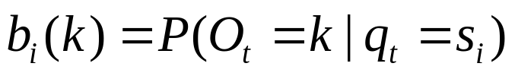
Noisy Hidden State
Answer:
q₀
Notation:
Example: Noisy Proximity sensors. (unreliably tell us the contents of the 8 adjacent squares)
O₀
i | P(O_{t}=1|q_{t}=s_{i}) | P(O_{t}=2|q_{t}=s_{i}) | … | P(O_{t}=k|q_{t}=s_{i}) | … | P(O_{t}=M|q_{t}=s_{i})
1 | b₁(1) | b₁ (2) | … | b₁ (k) | … | b₁(M)
2 | b₂ (1) | b₂ (2) | … | b₂(k) | … | b₂ (M)
3 | b₃ (1) | b₃ (2) | … | b₃(k) | … | b₃ (M)
: | : | : | : | : | : | :
i | b_{i}(1) | b_{i} (2) | … | b_{i}(k) | … | b_{i} (M)
: | : | : | : | : | : | :
N | b_{N} (1) | b_{N} (2) | … | b_{N}(k) | … | b_{N} (M)
q₁
 |  |  | R₀ |  | 2
 |  | H
O₁
W | W | W
 | ®
H
W denotes “WALL”
q₂
True state q_{t}
Uncorrupted Observation
O₂
O_{t} is noisily determined depending on the current state.
Assume that O_{t} is conditionally independent of {q_{t-1}, q_{t-2}, … q₁, q_{0 ,}O_{t-1}, O_{t-2}, … O₁, O₀ } given q_{t}.
In other words:
P(O_{t} = X |q_{t} = s_{i} ) =
P(O_{t} = X |q_{t} = s_{i} ,any earlier history)
W |  | W
 | ® | W
H | H
q₃
O₃
What the robot sees: Observation O_{t}
q₄
Question: what’d be the best Bayes Net structure to represent the Joint Distribution of (q₀, q₁, q₂,q₃,q_{4 ,}O₀, O₁, O₂,O₃,O₄ )?
O₄

Slide 27
Hidden Markov Models
Our robot with noisy sensors is a good example of an HMM
Question 1: State Estimation
  What is P(q_{T}=S_{i} | O₁O₂…O_{T})
  It will turn out that a new cute D.P. trick will get this for us.
Question 2: Most Probable Path
  Given O₁O₂…O_{T} , what is the most probable path that I took?
  And what is that probability?
  Yet another famous D.P. trick, the VITERBI algorithm, gets this.
Question 3: Learning HMMs:
  Given O₁O₂…O_{T} , what is the maximum likelihood HMM that could have produced this string of observations?
  Very very useful. Uses the E.M. Algorithm

Slide 28
Are H.M.M.s Useful?
You bet !!
Robot planning + sensing when there’s uncertainty (e.g. Reid Simmons / Sebastian Thrun / Sven Koenig)
Speech Recognition/Understanding Phones → Words, Signal → phones
Human Genome Project Complicated stuff your lecturer knows nothing about.
Consumer decision modeling
Economics & Finance.
Plus at least 5 other things I haven’t thought of.

Slide 29
Some Famous HMM Tasks
Question 1: State Estimation
  What is P(q_{T}=S_{i} | O₁O₂…O_{t})

Slide 30
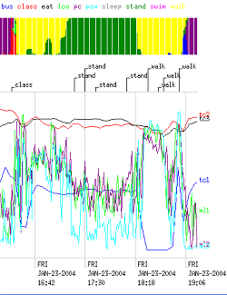
Some Famous HMM Tasks
Question 1: State Estimation
  What is P(q_{T}=S_{i} | O₁O₂…O_{t})

Slide 31
Some Famous HMM Tasks
Question 1: State Estimation
  What is P(q_{T}=S_{i} | O₁O₂…O_{t})

Slide 32
Some Famous HMM Tasks
Question 1: State Estimation
  What is P(q_{T}=S_{i} | O₁O₂…O_{t})
Question 2: Most Probable Path
  Given O₁O₂…O_{T} , what is the most probable path that I took?

Slide 33
Some Famous HMM Tasks
Question 1: State Estimation
  What is P(q_{T}=S_{i} | O₁O₂…O_{t})
Question 2: Most Probable Path
  Given O₁O₂…O_{T} , what is the most probable path that I took?

Slide 34
Some Famous HMM Tasks
Question 1: State Estimation
  What is P(q_{T}=S_{i} | O₁O₂…O_{t})
Question 2: Most Probable Path
  Given O₁O₂…O_{T} , what is the most probable path that I took?
Woke up at 8.35, Got on Bus at 9.46, Sat in lecture 10.05-11.22…

Slide 35
Some Famous HMM Tasks
Question 1: State Estimation
  What is P(q_{T}=S_{i} | O₁O₂…O_{t})
Question 2: Most Probable Path
  Given O₁O₂…O_{T} , what is the most probable path that I took?
Question 3: Learning HMMs:
  Given O₁O₂…O_{T} , what is the maximum likelihood HMM that could have produced this string of observations?

Slide 36
Some Famous HMM Tasks
Question 1: State Estimation
  What is P(q_{T}=S_{i} | O₁O₂…O_{T})
Question 2: Most Probable Path
  Given O₁O₂…O_{T} , what is the most probable path that I took?
Question 3: Learning HMMs:
  Given O₁O₂…O_{T} , what is the maximum likelihood HMM that could have produced this string of observations?

Slide 37
Some Famous HMM Tasks
O_{t}
a_{BB}
Question 1: State Estimation
  What is P(q_{T}=S_{i} | O₁O₂…O_{T})
Question 2: Most Probable Path
  Given O₁O₂…O_{T} , what is the most probable path that I took?
Question 3: Learning HMMs:
  Given O₁O₂…O_{T} , what is the maximum likelihood HMM that could have produced this string of observations?
b_{B}(O_{t})
Bus
O_{t-1}
a_{AB}
a_{CB}
O_{t+1}
a_{BA}
a_{BC}
b_{A}(O_{t-1})
b_{C}(O_{t+1})
Eat
walk
a_{AA}
a_{CC}

Slide 38
Basic Operations in HMMs
For an observation sequence O = O₁…O_{T}, the three basic HMM operations are:
Problem | Algorithm | Complexity⁺
Evaluation: Calculating P(q_{t}=S_{i} | O₁O₂…O_{t}) | Forward-Backward | O(TN²)
Inference: Computing Q* = argmax_{Q} P(Q|O) | Viterbi Decoding | O(TN²)
Learning: Computing λ* = argmax_{λ} P(O|λ) | Baum-Welch (EM) | O(TN²)
T = # timesteps, N = # states

Slide 39
HMM Notation
(from Rabiner’s Survey)
*L. R. Rabiner, "A Tutorial on Hidden Markov Models and Selected Applications in Speech Recognition," Proc. of the IEEE, Vol.77, No.2, pp.257--286, 1989.
Available from
http://ieeexplore.ieee.org/iel5/5/698/00018626.pdf?arnumber=18626
The states are labeled S₁ S₂ .. S_{N}
For a particular trial….
Let T be the number of observations
T is also the number of states passed through
O = O₁ O₂ .. O_{T} is the sequence of observations
Q = q₁ q₂ .. q_{T} is the notation for a path of states
λ = ⟨N,M,{π_{i,}},{a_{ij}},{b_{i}(j)}⟩ is the specification of an HMM

Slide 40
HMM Formal Definition
An HMM, λ, is a 5-tuple consisting of
N the number of states
M the number of possible observations
{π₁, π₂, .. π_{N}} The starting state probabilities
P(q₀ = S_{i}) = π_{i}
a₁₁ a₂₂ … a_{1N}
a₂₁ a₂₂ … a_{2N}
: : :
a_{N1} a_{N2} … a_{NN}
b₁(1) b₁(2) … b₁(M)
b₂(1) b₂(2) … b₂(M)
: : :
b_{N}(1) b_{N}(2) … b_{N}(M)
This is new. In our previous example, start state was deterministic
The state transition probabilities
P(q_{t+1}=S_{j} | q_{t}=S_{i})=a_{ij}
The observation probabilities
P(O_{t}=k | q_{t}=S_{i})=b_{i}(k)

Slide 41
Here’s an HMM
Start randomly in state 1 or 2
Choose one of the output symbols in each state at random.
S₁
1/3
S₂
XY
Z Y
1/3
2/3
ZX
2/3
1/3
1/3
S₃
N = 3
M = 3
π₁ = 1/2 π₂ = 1/2 π₃ = 0
a₁₁ = 0 a₁₂ = 1/3 a₁₃ = 2/3
a₁₂ = 1/3 a₂₂ = 0 a₁₃ = 2/3
a₁₃ = 1/3 a₃₂ = 1/3 a₁₃ = 1/3
b₁ (X) = 1/2 b₁ (Y) = 1/2 b₁ (Z) = 0
b₂ (X) = 0 b₂ (Y) = 1/2 b₂ (Z) = 1/2
b₃ (X) = 1/2 b₃ (Y) = 0 b₃ (Z) = 1/2
1/3

Slide 42
Here’s an HMM
Start randomly in state 1 or 2
Choose one of the output symbols in each state at random.
Let’s generate a sequence of observations:
S₁
1/3
S₂
XY
Z Y
1/3
2/3
ZX
2/3
1/3
1/3
S₃
50-50 choice between S₁ and S₂
N = 3
M = 3
π₁ = ½ π₂ = ½ π₃ = 0
a₁₁ = 0 a₁₂ = ⅓ a₁₃ = ⅔
a₁₂ = ⅓ a₂₂ = 0 a₁₃ = ⅔
a₁₃ = ⅓ a₃₂ = ⅓ a₁₃ = ⅓
b₁ (X) = ½ b₁ (Y) = ½ b₁ (Z) = 0
b₂ (X) = 0 b₂ (Y) = ½ b₂ (Z) = ½
b₃ (X) = ½ b₃ (Y) = 0 b₃ (Z) = ½
1/3
q₀= | __ | O₀= | __
q₁= | __ | O₁= | __
q₂= | __ | O₂= | __

Slide 43
Here’s an HMM
Start randomly in state 1 or 2
Choose one of the output symbols in each state at random.
Let’s generate a sequence of observations:
S₁
1/3
S₂
XY
Z Y
1/3
2/3
ZX
2/3
1/3
1/3
50-50 choice between X and Y
S₃
N = 3
M = 3
π₁ = ½ π₂ = ½ π₃ = 0
a₁₁ = 0 a₁₂ = ⅓ a₁₃ = ⅔
a₁₂ = ⅓ a₂₂ = 0 a₁₃ = ⅔
a₁₃ = ⅓ a₃₂ = ⅓ a₁₃ = ⅓
b₁ (X) = ½ b₁ (Y) = ½ b₁ (Z) = 0
b₂ (X) = 0 b₂ (Y) = ½ b₂ (Z) = ½
b₃ (X) = ½ b₃ (Y) = 0 b₃ (Z) = ½
1/3
q₀= | S₁ | O₀= | __
q₁= | __ | O₁= | __
q₂= | __ | O₂= | __

Slide 44
Here’s an HMM
Start randomly in state 1 or 2
Choose one of the output symbols in each state at random.
Let’s generate a sequence of observations:
S₁
1/3
S₂
XY
Z Y
1/3
2/3
ZX
2/3
1/3
1/3
Goto S₃ with probability 2/3 or S₂ with prob. 1/3
S₃
N = 3
M = 3
π₁ = ½ π₂ = ½ π₃ = 0
a₁₁ = 0 a₁₂ = ⅓ a₁₃ = ⅔
a₁₂ = ⅓ a₂₂ = 0 a₁₃ = ⅔
a₁₃ = ⅓ a₃₂ = ⅓ a₁₃ = ⅓
b₁ (X) = ½ b₁ (Y) = ½ b₁ (Z) = 0
b₂ (X) = 0 b₂ (Y) = ½ b₂ (Z) = ½
b₃ (X) = ½ b₃ (Y) = 0 b₃ (Z) = ½
1/3
q₀= | S₁ | O₀= | X
q₁= | __ | O₁= | __
q₂= | __ | O₂= | __

Slide 45
Here’s an HMM
Start randomly in state 1 or 2
Choose one of the output symbols in each state at random.
Let’s generate a sequence of observations:
S₁
1/3
S₂
XY
Z Y
1/3
2/3
ZX
2/3
1/3
1/3
50-50 choice between Z and X
S₃
N = 3
M = 3
π₁ = ½ π₂ = ½ π₃ = 0
a₁₁ = 0 a₁₂ = ⅓ a₁₃ = ⅔
a₁₂ = ⅓ a₂₂ = 0 a₁₃ = ⅔
a₁₃ = ⅓ a₃₂ = ⅓ a₁₃ = ⅓
b₁ (X) = ½ b₁ (Y) = ½ b₁ (Z) = 0
b₂ (X) = 0 b₂ (Y) = ½ b₂ (Z) = ½
b₃ (X) = ½ b₃ (Y) = 0 b₃ (Z) = ½
1/3
q₀= | S₁ | O₀= | X
q₁= | S₃ | O₁= | __
q₂= | __ | O₂= | __

Slide 46
Here’s an HMM
Start randomly in state 1 or 2
Choose one of the output symbols in each state at random.
Let’s generate a sequence of observations:
S₁
1/3
S₂
XY
Z Y
1/3
2/3
ZX
2/3
1/3
1/3
S₃
Each of the three next states is equally likely
N = 3
M = 3
π₁ = ½ π₂ = ½ π₃ = 0
a₁₁ = 0 a₁₂ = ⅓ a₁₃ = ⅔
a₁₂ = ⅓ a₂₂ = 0 a₁₃ = ⅔
a₁₃ = ⅓ a₃₂ = ⅓ a₁₃ = ⅓
b₁ (X) = ½ b₁ (Y) = ½ b₁ (Z) = 0
b₂ (X) = 0 b₂ (Y) = ½ b₂ (Z) = ½
b₃ (X) = ½ b₃ (Y) = 0 b₃ (Z) = ½
1/3
q₀= | S₁ | O₀= | X
q₁= | S₃ | O₁= | X
q₂= | __ | O₂= | __

Slide 47
Here’s an HMM
Start randomly in state 1 or 2
Choose one of the output symbols in each state at random.
Let’s generate a sequence of observations:
1/3
S₂
S₁
S₂
XY
Z Y
1/3
2/3
ZX
2/3
1/3
1/3
50-50 choice between Z and X
S₃
N = 3
M = 3
π₁ = ½ π₂ = ½ π₃ = 0
a₁₁ = 0 a₁₂ = ⅓ a₁₃ = ⅔
a₁₂ = ⅓ a₂₂ = 0 a₁₃ = ⅔
a₁₃ = ⅓ a₃₂ = ⅓ a₁₃ = ⅓
b₁ (X) = ½ b₁ (Y) = ½ b₁ (Z) = 0
b₂ (X) = 0 b₂ (Y) = ½ b₂ (Z) = ½
b₃ (X) = ½ b₃ (Y) = 0 b₃ (Z) = ½
1/3
q₀= | S₁ | O₀= | X
q₁= | S₃ | O₁= | X
q₂= | S₃ | O₂= | __

Slide 48
Here’s an HMM
Start randomly in state 1 or 2
Choose one of the output symbols in each state at random.
Let’s generate a sequence of observations:
S₁
1/3
S₂
XY
Z Y
1/3
2/3
ZX
2/3
1/3
1/3
S₃
N = 3
M = 3
π₁ = ½ π₂ = ½ π₃ = 0
a₁₁ = 0 a₁₂ = ⅓ a₁₃ = ⅔
a₁₂ = ⅓ a₂₂ = 0 a₁₃ = ⅔
a₁₃ = ⅓ a₃₂ = ⅓ a₁₃ = ⅓
b₁ (X) = ½ b₁ (Y) = ½ b₁ (Z) = 0
b₂ (X) = 0 b₂ (Y) = ½ b₂ (Z) = ½
b₃ (X) = ½ b₃ (Y) = 0 b₃ (Z) = ½
1/3
q₀= | S₁ | O₀= | X
q₁= | S₃ | O₁= | X
q₂= | S₃ | O₂= | Z

Slide 49
State Estimation
Start randomly in state 1 or 2
Choose one of the output symbols in each state at random.
Let’s generate a sequence of observations:
S₁
1/3
S₂
XY
Z Y
1/3
2/3
ZX
2/3
1/3
1/3
This is what the observer has to work with…
S₃
N = 3
M = 3
π₁ = ½ π₂ = ½ π₃ = 0
a₁₁ = 0 a₁₂ = ⅓ a₁₃ = ⅔
a₁₂ = ⅓ a₂₂ = 0 a₁₃ = ⅔
a₁₃ = ⅓ a₃₂ = ⅓ a₁₃ = ⅓
b₁ (X) = ½ b₁ (Y) = ½ b₁ (Z) = 0
b₂ (X) = 0 b₂ (Y) = ½ b₂ (Z) = ½
b₃ (X) = ½ b₃ (Y) = 0 b₃ (Z) = ½
1/3
q₀= | ? | O₀= | X
q₁= | ? | O₁= | X
q₂= | ? | O₂= | Z

Slide 50
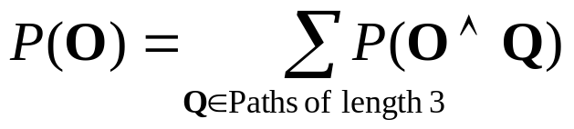
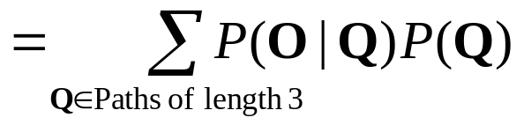
Prob. of a series of observations
What is P(O) = P(O₁ O₂ O₃) = P(O₁ = X ^ O₂ = X ^ O₃ = Z)?
Slow, stupid way:
How do we compute P(Q) for an arbitrary path Q?
How do we compute P(O|Q) for an arbitrary path Q?
S₁
1/3
S₂
XY
Z Y
1/3
2/3
ZX
2/3
1/3
1/3
S₃
1/3

Slide 51
Prob. of a series of observations
What is P(O) = P(O₁ O₂ O₃) = P(O₁ = X ^ O₂ = X ^ O₃ = Z)?
Slow, stupid way:
How do we compute P(Q) for an arbitrary path Q?
How do we compute P(O|Q) for an arbitrary path Q?
S₁
1/3
S₂
XY
Z Y
1/3
2/3
ZX
2/3
1/3
1/3
S₃
1/3
P(Q)= P(q₁,q₂,q₃)
=P(q₁) P(q₂,q₃|q₁) (chain rule)
=P(q₁) P(q₂|q₁) P(q₃| q₂,q₁) (chain)
=P(q₁) P(q₂|q₁) P(q₃| q₂) (why?)
Example in the case Q = S₁ S₃ S₃:
=1/2 * 2/3 * 1/3 = 1/9

Slide 52
Prob. of a series of observations
What is P(O) = P(O₁ O₂ O₃) = P(O₁ = X ^ O₂ = X ^ O₃ = Z)?
Slow, stupid way:
How do we compute P(Q) for an arbitrary path Q?
How do we compute P(O|Q) for an arbitrary path Q?
S₁
1/3
S₂
XY
Z Y
1/3
2/3
ZX
2/3
1/3
1/3
S₃
1/3
P(O|Q)
= P(O₁ O₂ O₃ |q₁ q₂ q₃ )
= P(O₁ | q₁ ) P(O₂ | q₂ ) P(O₃ | q₃ ) (why?)
Example in the case Q = S₁ S₃ S₃:
= P(X| S₁) P(X| S₃) P(Z| S₃) =
=1/2 * 1/2 * 1/2 = 1/8

Slide 53
Prob. of a series of observations
What is P(O) = P(O₁ O₂ O₃) = P(O₁ = X ^ O₂ = X ^ O₃ = Z)?
Slow, stupid way:
How do we compute P(Q) for an arbitrary path Q?
How do we compute P(O|Q) for an arbitrary path Q?
S₁
1/3
S₂
XY
Z Y
1/3
2/3
ZX
2/3
1/3
1/3
P(O) would need 27 P(Q)
computations and 27 P(O|Q)
computations
S₃
1/3
P(O|Q)
= P(O₁ O₂ O₃ |q₁ q₂ q₃ )
= P(O₁ | q₁ ) P(O₂ | q₂ ) P(O₃ | q₃ ) (why?)
Example in the case Q = S₁ S₃ S₃:
= P(X| S₁) P(X| S₃) P(Z| S₃) =
=1/2 * 1/2 * 1/2 = 1/8
A sequence of 20 observations would need 3²⁰ =
3.5 billion computations and 3.5 billion P(O|Q)
computations
So let’s be smarter…

Slide 54
The Prob. of a given series of observations, non-exponential-cost-style
Given observations O₁ O₂ … O_{T}
Define
α_{t}(i) = P(O₁ O₂ … O_{t} ∧ q_{t} = S_{i} | λ) where 1 ≤ t ≤ T
α_{t}(i) = Probability that, in a random trial,
      We’d have seen the first t observations
      We’d have ended up in S_{i} as the t’th state visited.
In our example, what is α₂(3) ?

Slide 55
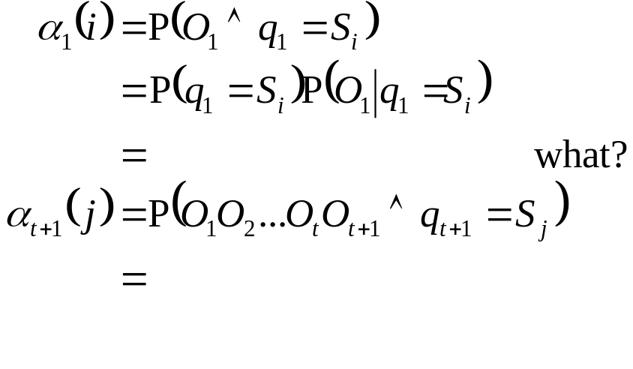
α_{t}(i): easy to define recursively
α_{t}(i) = P(O₁ O₂ … O_{T} ∧ q_{t} = S_{i} | λ) (α_{t}(i) can be defined stupidly by considering all paths length “t”. How?)

Slide 56
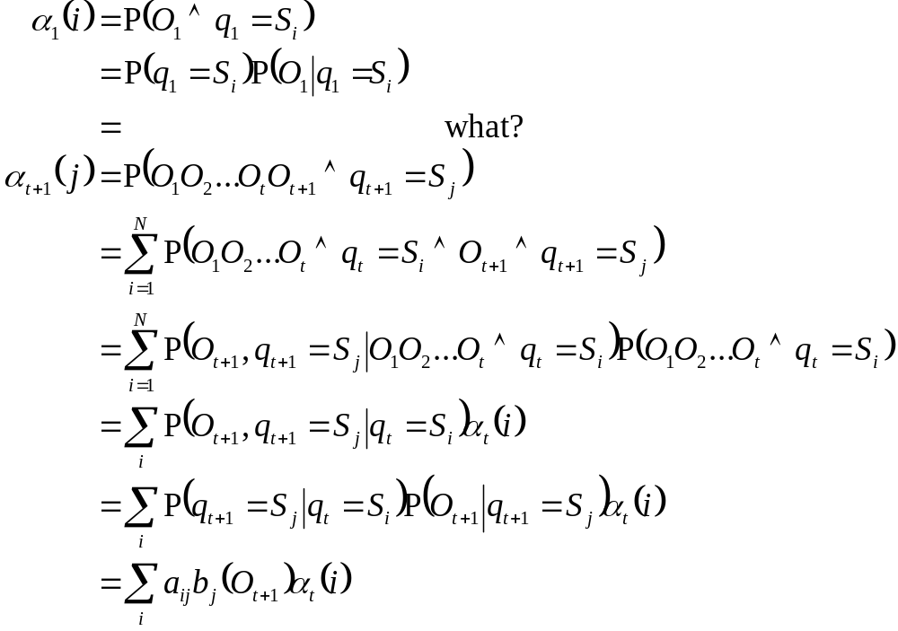
α_{t}(i): easy to define recursively
α_{t}(i) = P(O₁ O₂ … O_{T} ∧ q_{t} = S_{i} | λ) (α_{t}(i) can be defined stupidly by considering all paths length “t”. How?)

Slide 57
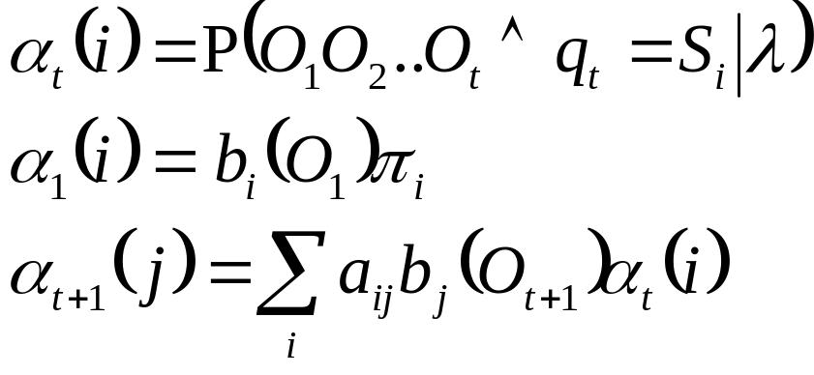
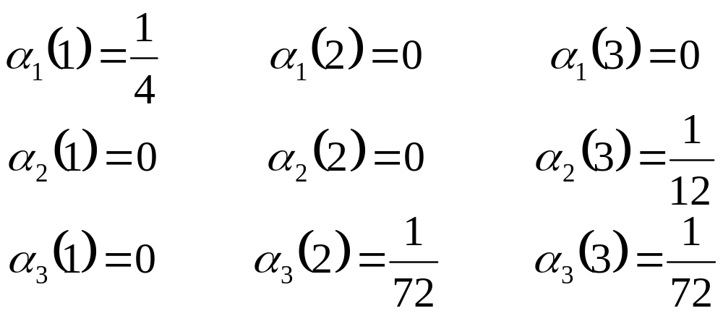
in our example
S₁
1/3
S₂
XY
Z Y
1/3
2/3
ZX
2/3
1/3
1/3
S₃
1/3
WE SAW O₁ O₂ O₃ = X X Z

Slide 58
Easy Question
We can cheaply compute
α_{t}(i)=P(O₁O₂…O_{t}∧q_{t}=S_{i})
(How) can we cheaply compute
P(O₁O₂…O_{t}) ?
(How) can we cheaply compute
P(q_{t}=S_{i}|O₁O₂…O_{t})

Slide 59
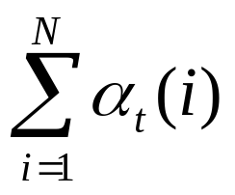
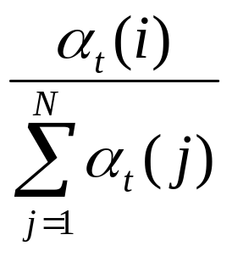
Easy Question
We can cheaply compute
α_{t}(i)=P(O₁O₂…O_{t}∧q_{t}=S_{i})
(How) can we cheaply compute
P(O₁O₂…O_{t}) ?
(How) can we cheaply compute
P(q_{t}=S_{i}|O₁O₂…O_{t})

Slide 60
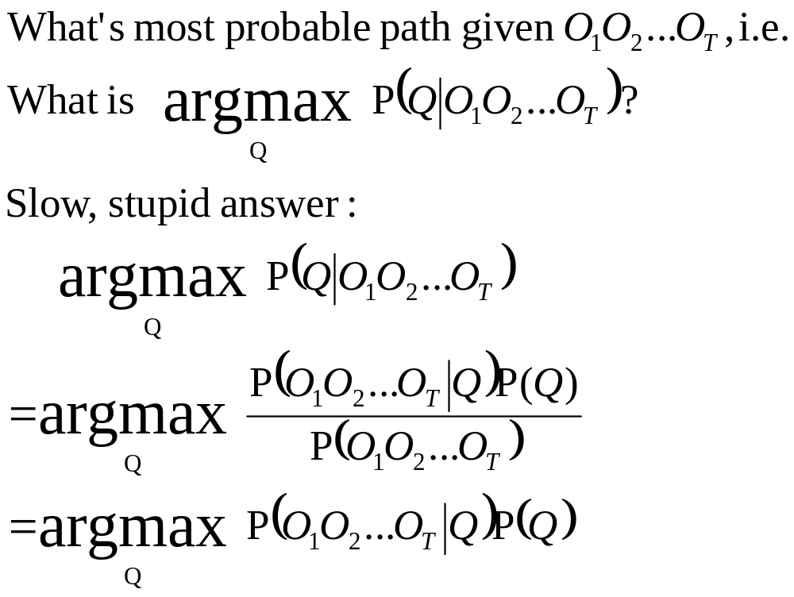
Most probable path given observations

Slide 61
Efficient MPP computation
We’re going to compute the following variables:
δ_{t}(i)= max P(q₁ q₂ .. q_{t-1} ∧ q_{t} = S_{i} ∧ O₁ .. O_{t})
q₁q₂..q_{t-1}
= The Probability of the path of Length t-1 with the maximum chance of doing all these things:
…OCCURING
and
…ENDING UP IN STATE S_{i}
and
…PRODUCING OUTPUT O₁…O_{t}
DEFINE: mpp_{t}(i) = that path
So: δ_{t}(i)= Prob(mpp_{t}(i))

Slide 62
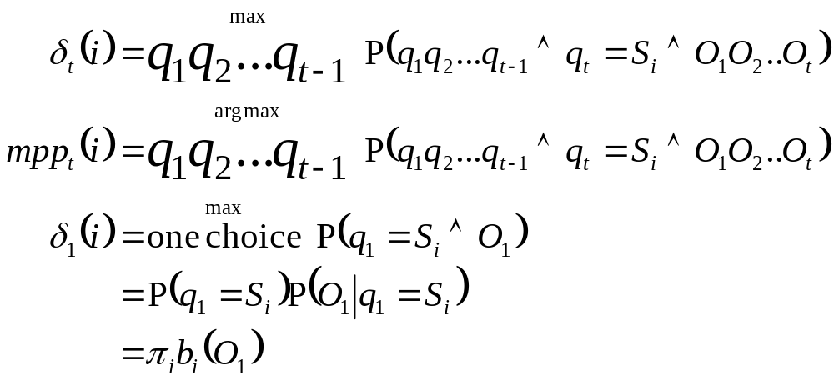
The Viterbi Algorithm
Now, suppose we have all the δ_{t}(i)’s and mpp_{t}(i)’s for all i.
HOW TO GET δ_{t+1}(j) and mpp_{t+1}(j)?
mpp_{t}(1) Prob=δ_{t}(1)
mpp_{t}(2)
:
mpp_{t}(N)
S₁
?
S₂
S_{j}
:
Prob=δ_{t}(2)
S_{N}
Prob=δ_{t}(N)
q_{t}
q_{t+1}

Slide 63
The Viterbi Algorithm
time t time t+1
S₁
: S_{j}
S_{i}
:
The most prob path with last two states S_{i} S_{j}
is
the most prob path to S_{i} , followed by transition S_{i} → S_{j}

Slide 64
The Viterbi Algorithm
time t time t+1
S₁
: S_{j}
S_{i}
:
The most prob path with last two states S_{i} S_{j}
is
the most prob path to S_{i} , followed by transition S_{i} → S_{j}
What is the prob of that path?
δ_{t}(i) x P(S_{i} → S_{j} ∧ O_{t+1} | λ)
= δ_{t}(i) a_{ij} b_{j} (O_{t+1})
SO The most probable path to S_{j} has S_{i*} as its penultimate state
where i*=argmax δ_{t}(i) a_{ij} b_{j} (O_{t+1})
i

Slide 65
The Viterbi Algorithm
time t time t+1
S₁
: S_{j}
S_{i}
:
The most prob path with last two states S_{i} S_{j}
is
the most prob path to S_{i} , followed by transition S_{i} → S_{j}
What is the prob of that path?
δ_{t}(i) x P(S_{i} → S_{j} ∧ O_{t+1} | λ)
= δ_{t}(i) a_{ij} b_{j} (O_{t+1})
SO The most probable path to S_{j} has S_{i*} as its penultimate state
where i*=argmax δ_{t}(i) a_{ij} b_{j} (O_{t+1})
i
Summary:
δ_{t+1}(j) = δ_{t}(i*) a_{ij} b_{j} (O_{t+1})
mpp_{t+1}(j) = mpp_{t+1}(i*)S_{i*}
}
with i* defined to the left

Slide 66
What’s Viterbi used for?
Classic Example
Speech recognition:
Signal → words
HMM → observable is signal
→ Hidden state is part of word formation
What is the most probable word given this signal?
UTTERLY GROSS SIMPLIFICATION
In practice: many levels of inference; not one big jump.

Slide 67
HMMs are used and useful
But how do you design an HMM?
Occasionally, (e.g. in our robot example) it is reasonable to deduce the HMM from first principles.
But usually, especially in Speech or Genetics, it is better to infer it from large amounts of data. O₁ O₂ .. O_{T} with a big “T”.
O₁ O₂ .. O_{T}
O₁ O₂ .. O_{T}
Observations previously
in lecture
Observations in the
next bit

Slide 68
Inferring an HMM
Remember, we’ve been doing things like
P(O₁ O₂ .. O_{T} | λ )
That “λ” is the notation for our HMM parameters.
Now We have some observations and we want to estimate λ from them.
AS USUAL: We could use
MAX LIKELIHOOD λ = argmax P(O₁ .. O_{T} | λ) λ
BAYES
Work out P( λ | O₁ .. O_{T} )
and then take E[λ] or max P( λ | O₁ .. O_{T} ) λ

Slide 69
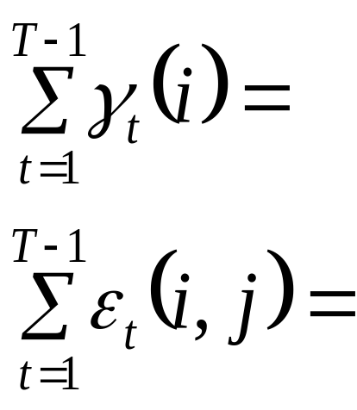
Max likelihood HMM estimation
Define
γ_{t}(i) = P(q_{t} = S_{i} | O₁O₂…O_{T} , λ )
ε_{t}(i,j) = P(q_{t} = S_{i} ∧ q_{t+1} = S_{j} | O₁O₂…O_{T} ,λ )
γ_{t}(i) and ε_{t}(i,j) can be computed efficiently ∀i,j,t
(Details in Rabiner paper)
Expected number of transitions out of state i during the path
Expected number of transitions from state i to state j during the path

Slide 70
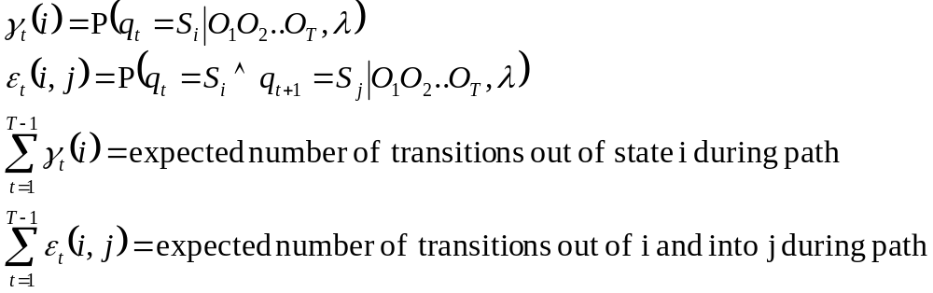
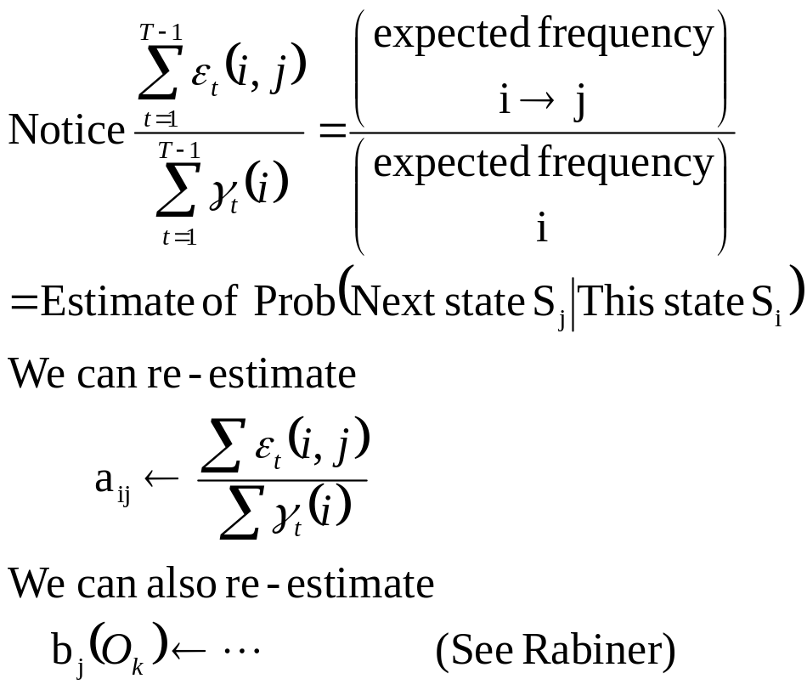
HMM estimation

Slide 71
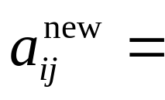
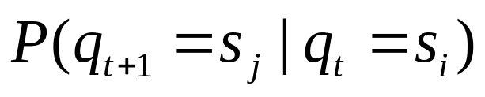
We want
new estimate of

Slide 72
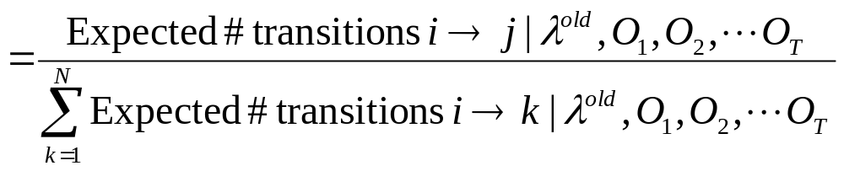
We want
new estimate of

Slide 73
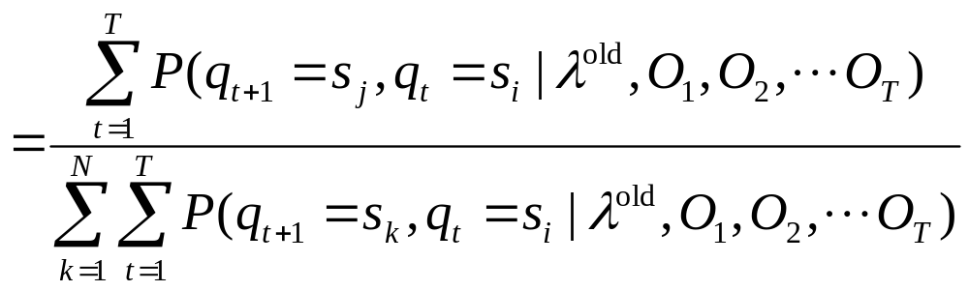
We want
new estimate of

Slide 74
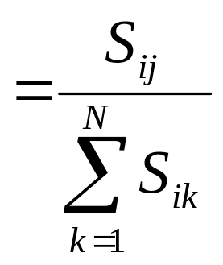
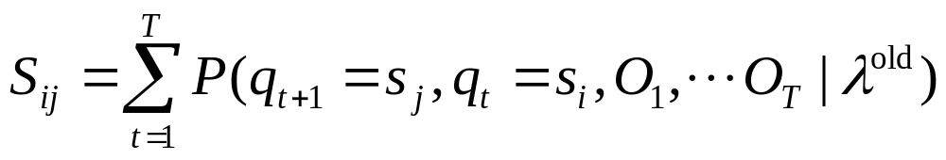

We want
new estimate of
where

Slide 75
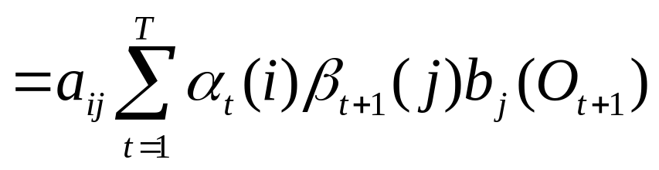
We want
new estimate of
where

Slide 76
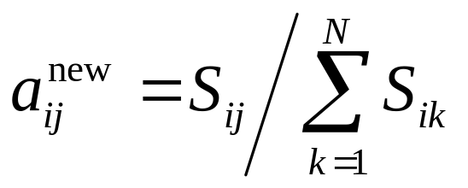
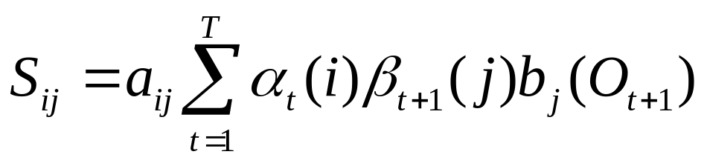
We want
where

Slide 77
We want
where
α
β
T
T
N
N

Slide 78
EM for HMMs
If we knew λ we could estimate EXPECTATIONS of quantities such as
Expected number of times in state i
Expected number of transitions i → j
If we knew the quantities such as
Expected number of times in state i
Expected number of transitions i → j
We could compute the MAX LIKELIHOOD estimate of
λ = ⟨{a_{ij}},{b_{i}(j)}, π_{i}⟩
Roll on the EM Algorithm…

Slide 79
EM 4 HMMs
Get your observations O₁ …O_{T}
Guess your first λ estimate λ(0), k=0
k = k+1
Given O₁ …O_{T}, λ(k) compute γ_{t}(i) , ε_{t}(i,j) ∀1 ≤ t ≤ T, ∀1 ≤ i ≤ N, ∀1 ≤ j ≤ N
Compute expected freq. of state i, and expected freq. i→j
Compute new estimates of a_{ij}, b_{j}(k), π_{i} accordingly. Call them λ(k+1)
Goto 3, unless converged.
Also known (for the HMM case) as the BAUM-WELCH algorithm.

Slide 80
Bad News
There are lots of local minima
Good News
The local minima are usually adequate models of the data.
Notice
EM does not estimate the number of states. That must be given.
Often, HMMs are forced to have some links with zero probability. This is done by setting a_{ij}=0 in initial estimate λ(0)
Easy extension of everything seen today: HMMs with real valued outputs

Slide 81
Bad News
Trade-off between too few states (inadequately modeling the structure in the data) and too many (fitting the noise).
Thus #states is a regularization parameter.
Blah blah blah… bias variance tradeoff…blah blah…cross-validation…blah blah….AIC, BIC….blah blah (same ol’ same ol’)
There are lots of local minima
Good News
The local minima are usually adequate models of the data.
Notice
EM does not estimate the number of states. That must be given.
Often, HMMs are forced to have some links with zero probability. This is done by setting a_{ij}=0 in initial estimate λ(0)
Easy extension of everything seen today: HMMs with real valued outputs

Slide 82
What You Should Know
What is an HMM ?
Computing (and defining) α_{t}(i)
The Viterbi algorithm
Outline of the EM algorithm
To be very happy with the kind of maths and analysis needed for HMMs
Fairly thorough reading of Rabiner* up to page 266* [Up to but not including “IV. Types of HMMs”].
*L. R. Rabiner, "A Tutorial on Hidden Markov Models and Selected Applications in Speech Recognition," Proc. of the IEEE, Vol.77, No.2, pp.257--286, 1989.
http://ieeexplore.ieee.org/iel5/5/698/00018626.pdf?arnumber=18626
DON’T PANIC: starts on p. 257.

