Slide 1
Predicting Real-valued outputs: an introduction to Regression
Andrew W. Moore
Professor
School of Computer Science
Carnegie Mellon University
www.cs.cmu.edu/~awm
awm@cs.cmu.edu
412-268-7599
Note to other teachers and users of these slides. Andrew would be delighted if you found this source material useful in giving your own lectures. Feel free to use these slides verbatim, or to modify them to fit your own needs. PowerPoint originals are available. If you make use of a significant portion of these slides in your own lecture, please include this message, or the following link to the source repository of Andrew’s tutorials: http://www.cs.cmu.edu/~awm/tutorials . Comments and corrections gratefully received.
This is reordered material from the Neural Nets lecture and the “Favorite Regression Algorithms” lecture

Slide 2
Single-Parameter Linear Regression

Slide 3
Linear Regression
DATASET
inputs | outputs
x₁ = 1 | y₁ = 1
x₂ = 3 | y₂ = 2.2
x₃ = 2 | y₃ = 2
x₄ = 1.5 | y₄ = 1.9
x₅ = 4 | y₅ = 3.1
↑
w
↓
← 1 →
Linear regression assumes that the expected value of the output given an input, E[y|x], is linear.
Simplest case: Out(x) = wx for some unknown w.
Given the data, we can estimate w.

Slide 4
1-parameter linear regression
Assume that the data is formed by
y_{i} = wx_{i} + noise_{i}
where…
the noise signals are independent
the noise has a normal distribution with mean 0 and unknown variance σ²
p(y|w,x) has a normal distribution with
mean wx
variance σ²

Slide 5
Bayesian Linear Regression
p(y|w,x) = Normal (mean wx, var σ²)
We have a set of datapoints (x₁,y₁) (x₂,y₂) … (x_{n},y_{n}) which are EVIDENCE about w.
We want to infer w from the data.
p(w|x₁, x₂, x₃,…x_{n}, y₁, y₂…y_{n})
You can use BAYES rule to work out a posterior distribution for w given the data.
Or you could do Maximum Likelihood Estimation

Slide 6
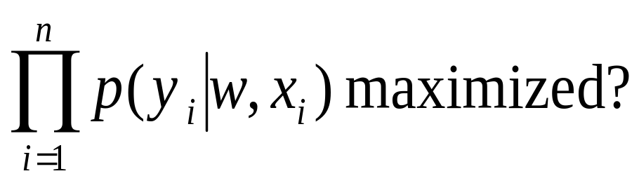
Maximum likelihood estimation of w
Asks the question:
“For which value of w is this data most likely to have happened?”
<=>
For what w is
p(y₁, y₂…y_{n} |x₁, x₂, x₃,…x_{n}, w) maximized?
<=>
For what w is

Slide 7
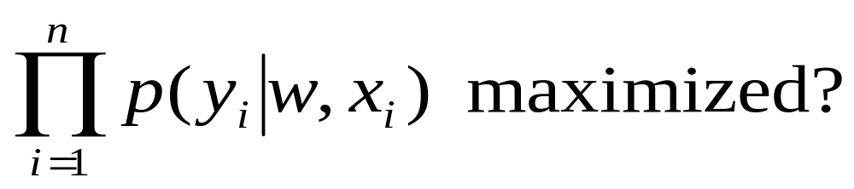
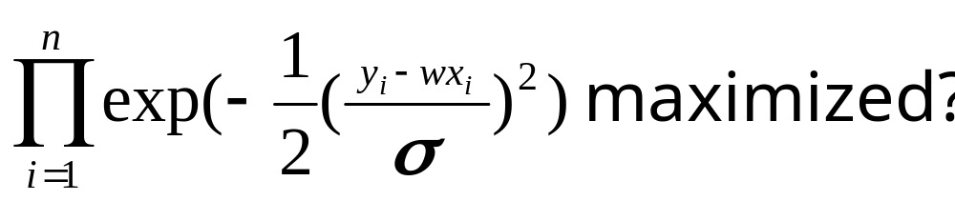
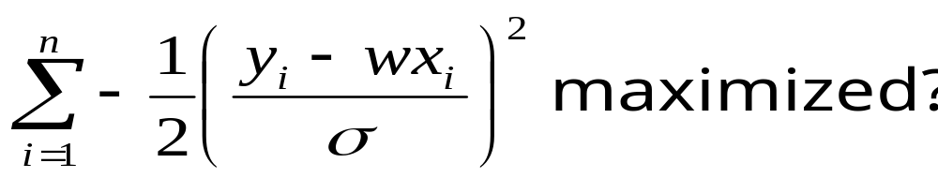
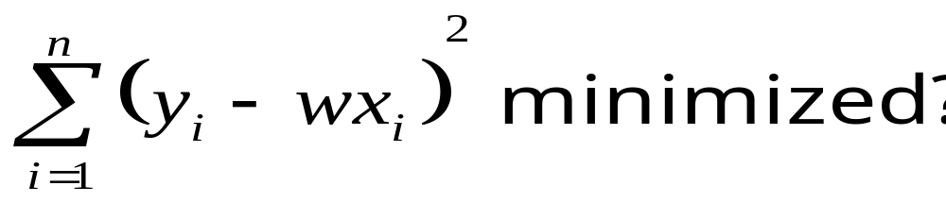
For what w is
For what w is
For what w is
For what w is

Slide 8
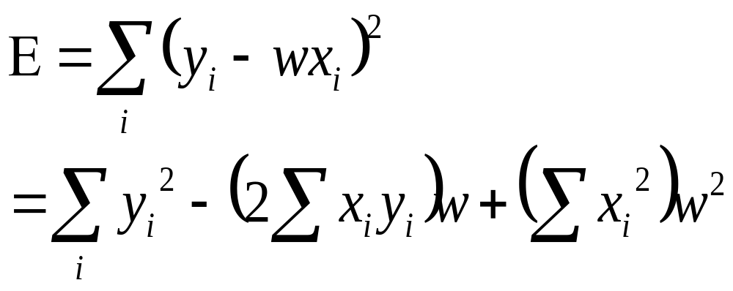
Linear Regression
The maximum likelihood w is the one that minimizes sum-of-squares of residuals
E(w)
w
We want to minimize a quadratic function of w.

Slide 9
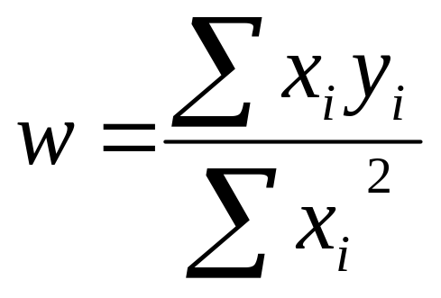
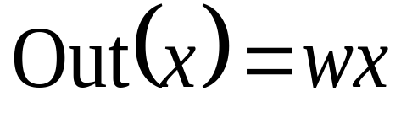
Linear Regression
Easy to show the sum of squares is minimized when
The maximum likelihood model is
We can use it for prediction

Slide 10
Linear Regression
Easy to show the sum of squares is minimized when
p(w)
w
Note: In Bayesian stats you’d have ended up with a prob dist of w
And predictions would have given a prob dist of expected output
Often useful to know your confidence. Max likelihood can give some kinds of confidence too.
The maximum likelihood model is
We can use it for prediction

Slide 11
Multivariate Linear Regression

Slide 12
Multivariate Regression
What if the inputs are vectors?
3 .
. 4 6 .
. 5
. 8
. 10
2-d input example
x₂
x₁
Dataset has form
x₁ y₁
x₂ y₂
x₃ y₃
.: :
.
x_{R} y_{R}

Slide 13
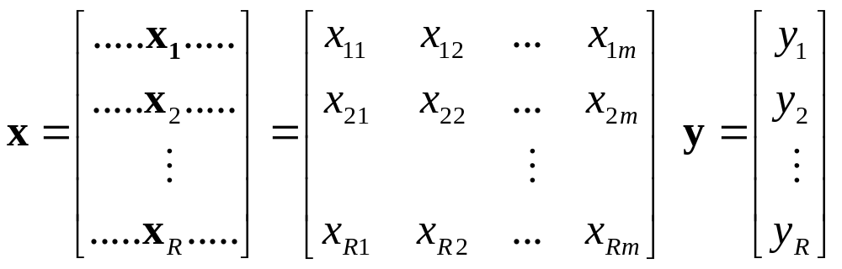
Multivariate Regression
Write matrix X and Y thus:
(there are R datapoints. Each input has m components)
The linear regression model assumes a vector w such that
Out(x) = w^{T}x = w₁x[1] + w₂x[2] + ….w_{m}x[D]
The max. likelihood w is w = (X^{T}X) ⁻¹(X^{T}Y)

Slide 14
Multivariate Regression
Write matrix X and Y thus:
IMPORTANT EXERCISE: PROVE IT !!!!!
(there are R datapoints. Each input has m components)
The linear regression model assumes a vector w such that
Out(x) = w^{T}x = w₁x[1] + w₂x[2] + ….w_{m}x[D]
The max. likelihood w is w = (X^{T}X) ⁻¹(X^{T}Y)

Slide 15
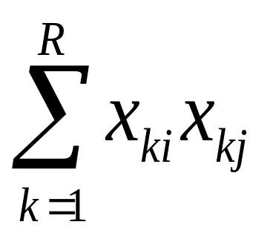
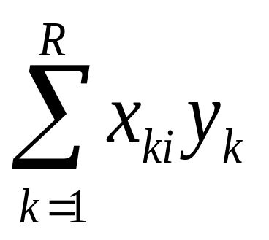
Multivariate Regression (con’t)
The max. likelihood w is w = (X^{T}X)⁻¹(X^{T}Y)
X^{T}X is an m x m matrix: i,j’th elt is
X^{T}Y is an m-element vector: i^{’th} elt

Slide 16
Constant Term in Linear Regression

Slide 17
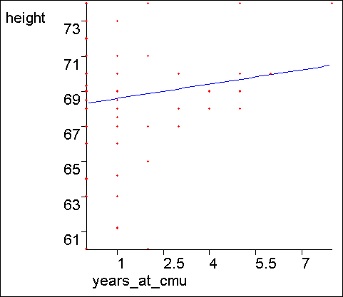
What about a constant term?
We may expect linear data that does not go through the origin.
Statisticians and Neural Net Folks all agree on a simple obvious hack.
Can you guess??

Slide 18
The constant term
The trick is to create a fake input “X₀” that always takes the value 1
X₁ | X₂ | Y
2 | 4 | 16
3 | 4 | 17
5 | 5 | 20
X₀ | X₁ | X₂ | Y
1 | 2 | 4 | 16
1 | 3 | 4 | 17
1 | 5 | 5 | 20
Before:
Y=w₁X₁+ w₂X₂
…has to be a poor model
After:
Y= w₀X₀+w₁X₁+ w₂X₂
= w₀+w₁X₁+ w₂X₂
…has a fine constant term
In this example, You should be able to see the MLE w₀ , w₁ and w₂ by inspection

Slide 19
Linear Regression with varying noise
Heteroscedasticity...

Slide 20
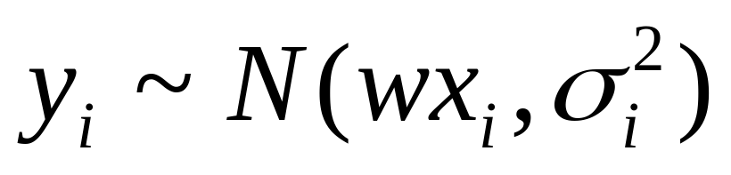
Regression with varying noise
Suppose you know the variance of the noise that was added to each datapoint.
y=3
x_{i} | y_{i} | σ_{i}²
½ | ½ | 4
1 | 1 | 1
2 | 1 | 1/4
2 | 3 | 4
3 | 2 | 1/4
σ=2
y=2
σ=1/2
y=1
σ=1
σ=1/2
σ=2
y=0
x=0
x=1
x=2
x=3
What’s the MLE estimate of w?
Assume

Slide 21
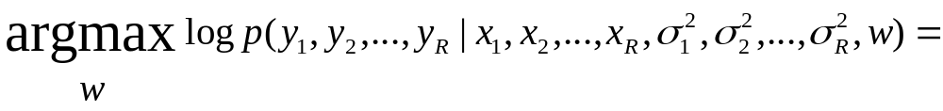
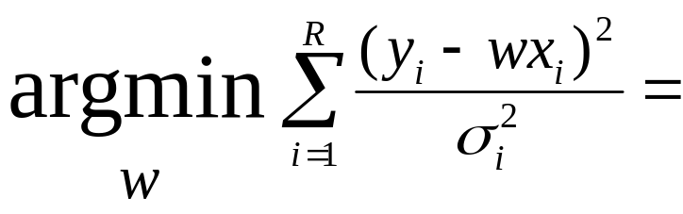
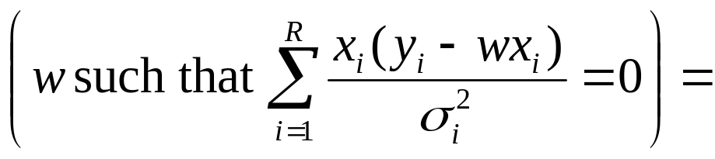
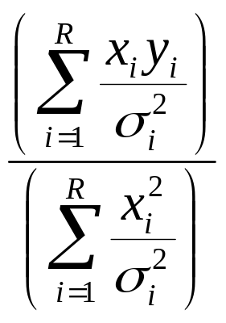
MLE estimation with varying noise
Assuming independence among noise and then plugging in equation for Gaussian and simplifying.
Setting dLL/dw equal to zero
Trivial algebra

Slide 22
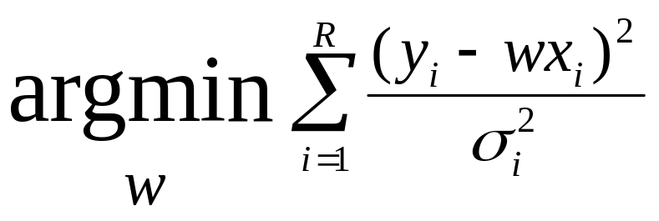
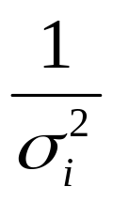
This is Weighted Regression
We are asking to minimize the weighted sum of squares
y=3
σ=2
y=2
σ=1/2
y=1
σ=1
σ=1/2
σ=2
y=0
x=0
x=1
x=2
x=3
where weight for i’th datapoint is

Slide 23
Non-linear Regression

Slide 24
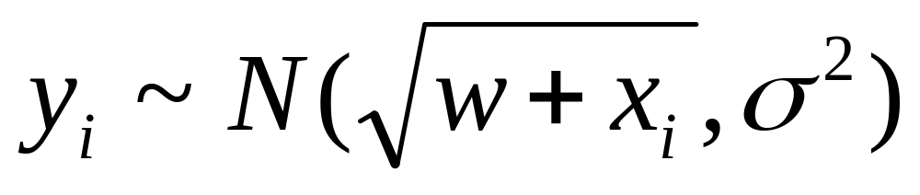
Non-linear Regression
Suppose you know that y is related to a function of x in such a way that the predicted values have a non-linear dependence on w, e.g:
y=3
x_{i} | y_{i}
½ | ½
1 | 2.5
2 | 3
3 | 2
3 | 3
y=2
y=1
y=0
x=0
x=1
x=2
x=3
What’s the MLE estimate of w?
Assume

Slide 25
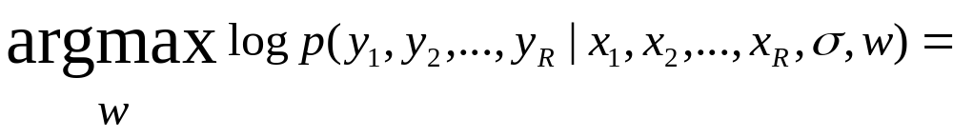
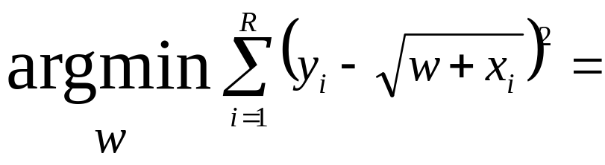
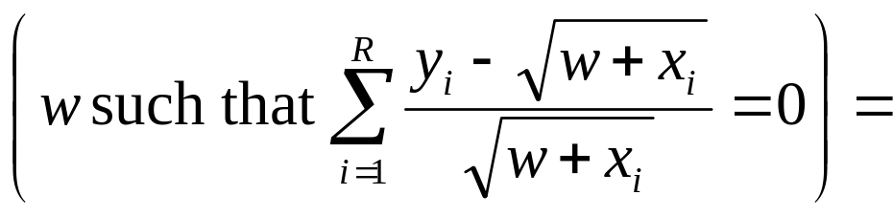
Non-linear MLE estimation
Assuming i.i.d. and then plugging in equation for Gaussian and simplifying.
Setting dLL/dw equal to zero

Slide 26
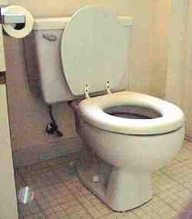
Non-linear MLE estimation
Assuming i.i.d. and then plugging in equation for Gaussian and simplifying.
Setting dLL/dw equal to zero
We’re down the algebraic toilet
So guess what we do?

Slide 27
Non-linear MLE estimation
Assuming i.i.d. and then plugging in equation for Gaussian and simplifying.
Common (but not only) approach:
Numerical Solutions:
Line Search
Simulated Annealing
Gradient Descent
Conjugate Gradient
Levenberg Marquart
Newton’s Method
Setting dLL/dw equal to zero
We’re down the algebraic toilet
Also, special purpose statistical-optimization-specific tricks such as E.M. (See Gaussian Mixtures lecture for introduction)
So guess what we do?

Slide 28
Polynomial Regression

Slide 29
Polynomial Regression
So far we’ve mainly been dealing with linear regression
X₁ | X₂ | Y
3 | 2 | 7
1 | 1 | 3
: | : | :
X=
y=
3 | 2
1 | 1
: | :
7
3
:
x₁=(3,2)..
y₁=7..
Z=
1 | 3 | 2
1 | 1 | 1
: |  | :
y=
7
3
:
β=(Z^{T}Z)⁻¹(Z^{T}y)
y^{est} = β₀+ β₁ x₁+ β₂ x₂
z₁=(1,3,2)..
z_{k}=(1,x_{k1},x_{k2})
y₁=7..

Slide 30
Quadratic Regression
It’s trivial to do linear fits of fixed nonlinear basis functions
X₁ | X₂ | Y
3 | 2 | 7
1 | 1 | 3
: | : | :
X=
y=
3 | 2
1 | 1
: | :
7
3
:
x₁=(3,2)..
y₁=7..
1 | 3 | 2 | 9 | 6 | 4
1 | 1 | 1 | 1 | 1 | 1
: |  |  |  |  | :
y=
Z=
7
3
:
β=(Z^{T}Z)⁻¹(Z^{T}y)
y^{est} = β₀+ β₁ x₁+ β₂ x₂+
β₃ x₁² + β₄ x₁x₂ + β₅ x₂²
z=(1 , x₁, x₂ , x₁², x₁x₂,x₂²,)

Slide 31
Quadratic Regression
It’s trivial to do linear fits of fixed nonlinear basis functions
Each component of a z vector is called a term.
Each column of the Z matrix is called a term column
How many terms in a quadratic regression with m inputs?
1 constant term
m linear terms
(m+1)-choose-2 = m(m+1)/2 quadratic terms
(m+2)-choose-2 terms in total = O(m²)
Note that solving β=(Z^{T}Z)⁻¹(Z^{T}y) is thus O(m⁶)
X₁ | X₂ | Y
3 | 2 | 7
1 | 1 | 3
: | : | :
X=
y=
3 | 2
1 | 1
: | :
7
3
:
x₁=(3,2)..
y₁=7..
1 | 3 | 2 | 9 | 6 | 4
1 | 1 | 1 | 1 | 1 | 1
: |  |  |  |  | :
y=
Z=
7
3
:
β=(Z^{T}Z)⁻¹(Z^{T}y)
y^{est} = β₀+ β₁ x₁+ β₂ x₂+
β₃ x₁² + β₄ x₁x₂ + β₅ x₂²
z=(1 , x₁, x₂ , x₁², x₁x₂,x₂²,)

Slide 32
Q^{th}-degree polynomial Regression
X₁ | X₂ | Y
3 | 2 | 7
1 | 1 | 3
: | : | :
X=
y=
3 | 2
1 | 1
: | :
7
3
:
x₁=(3,2)..
y₁=7..
1 | 3 | 2 | 9 | 6 | …
1 | 1 | 1 | 1 | 1 | …
: |  |  |  |  | …
7
3
:
y=
Z=
β=(Z^{T}Z)⁻¹(Z^{T}y)
y^{est} = β₀+
β₁ x₁+…
z=(all products of powers of inputs in which sum of powers is q or less,)

Slide 33
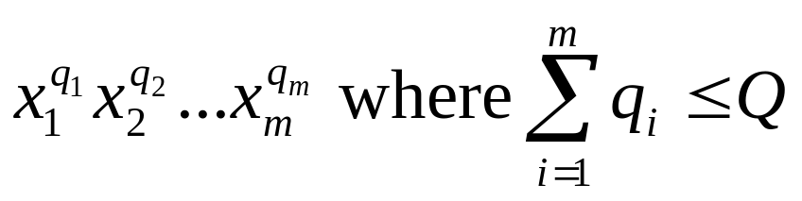
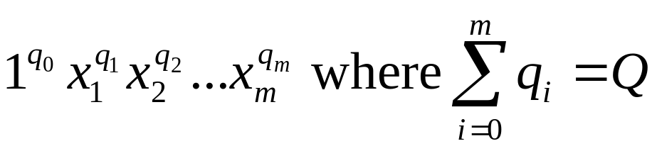
m inputs, degree Q: how many terms?
= the number of unique terms of the form
= the number of unique terms of the form
= the number of lists of non-negative integers [q₀,q₁,q₂,..q_{m}] in which Σq_{i} = Q
= the number of ways of placing Q red disks on a row of squares of length Q+m = (Q+m)-choose-Q
Q=11, m=4
q₀=2
q₁=2
q₂=0
q₃=4
q₄=3

Slide 34
Radial Basis Functions

Slide 35
Radial Basis Functions (RBFs)
X₁ | X₂ | Y
3 | 2 | 7
1 | 1 | 3
: | : | :
X=
y=
3 | 2
1 | 1
: | :
7
3
:
x₁=(3,2)..
y₁=7..
… | … | … | … | … | …
… | … | … | … | … | …
… | … | … | … | … | …
7
3
:
y=
Z=
β=(Z^{T}Z)⁻¹(Z^{T}y)
y^{est} = β₀+
β₁ x₁+…
z=(list of radial basis function evaluations)

Slide 36
1-d RBFs
y
c₁
c₁
c₁
x
y^{est} = β₁ φ₁(x) + β₂ φ₂(x) + β₃ φ₃(x)
where
φ_{i}(x) = KernelFunction( | x - c_{i} | / KW)

Slide 37
Example
y
c₁
c₁
c₁
x
y^{est} = 2φ₁(x) + 0.05φ₂(x) + 0.5φ₃(x)
where
φ_{i}(x) = KernelFunction( | x - c_{i} | / KW)

Slide 38
RBFs with Linear Regression
KW also held constant (initialized to be large enough that there’s decent overlap between basis functions*
*Usually much better than the crappy overlap on my diagram
All c_{i} ’s are held constant (initialized randomly or on a grid in m-dimensional input space)
y
c₁
c₁
c₁
x
y^{est} = 2φ₁(x) + 0.05φ₂(x) + 0.5φ₃(x)
where
φ_{i}(x) = KernelFunction( | x - c_{i} | / KW)

Slide 39
RBFs with Linear Regression
KW also held constant (initialized to be large enough that there’s decent overlap between basis functions*
*Usually much better than the crappy overlap on my diagram
All c_{i} ’s are held constant (initialized randomly or on a grid in m-dimensional input space)
y
c₁
c₁
c₁
x
y^{est} = 2φ₁(x) + 0.05φ₂(x) + 0.5φ₃(x)
where
φ_{i}(x) = KernelFunction( | x - c_{i} | / KW)
then given Q basis functions, define the matrix Z such that Z_{kj} = KernelFunction( | x_{k} - c_{i} | / KW) where x_{k} is the kth vector of inputs
And as before, β=(Z^{T}Z)⁻¹(Z^{T}y)

Slide 40
RBFs with NonLinear Regression
Allow the c_{i} ’s to adapt to the data (initialized randomly or on a grid in m-dimensional input space)
KW allowed to adapt to the data.
(Some folks even let each basis function have its own KW_{j},permitting fine detail in dense regions of input space)
y
c₁
c₁
c₁
x
y^{est} = 2φ₁(x) + 0.05φ₂(x) + 0.5φ₃(x)
where
φ_{i}(x) = KernelFunction( | x - c_{i} | / KW)
But how do we now find all the β_{j}’s, c_{i} ’s and KW ?

Slide 41
RBFs with NonLinear Regression
Allow the c_{i} ’s to adapt to the data (initialized randomly or on a grid in m-dimensional input space)
KW allowed to adapt to the data.
(Some folks even let each basis function have its own KW_{j},permitting fine detail in dense regions of input space)
y
c₁
c₁
c₁
x
y^{est} = 2φ₁(x) + 0.05φ₂(x) + 0.5φ₃(x)
where
φ_{i}(x) = KernelFunction( | x - c_{i} | / KW)
But how do we now find all the β_{j}’s, c_{i} ’s and KW ?
Answer: Gradient Descent

Slide 42
RBFs with NonLinear Regression
Allow the c_{i} ’s to adapt to the data (initialized randomly or on a grid in m-dimensional input space)
KW allowed to adapt to the data.
(Some folks even let each basis function have its own KW_{j},permitting fine detail in dense regions of input space)
y
c₁
c₁
c₁
x
y^{est} = 2φ₁(x) + 0.05φ₂(x) + 0.5φ₃(x)
where
φ_{i}(x) = KernelFunction( | x - c_{i} | / KW)
But how do we now find all the β_{j}’s, c_{i} ’s and KW ?
Answer: Gradient Descent
(But I’d like to see, or hope someone’s already done, a hybrid, where the c_{i} ’s and KW are updated with gradient descent while the β_{j}’s use matrix inversion)

Slide 43
Radial Basis Functions in 2-d
Two inputs.
Outputs (heights sticking out of page) not shown.
Center
Sphere of significant influence of center
x₂
x₁

Slide 44
Happy RBFs in 2-d
Blue dots denote coordinates of input vectors
Center
Sphere of significant influence of center
x₂
x₁

Slide 45
Crabby RBFs in 2-d
What’s the problem in this example?
Blue dots denote coordinates of input vectors
Center
Sphere of significant influence of center
x₂
x₁

Slide 46
More crabby RBFs
And what’s the problem in this example?
Blue dots denote coordinates of input vectors
Center
Sphere of significant influence of center
x₂
x₁

Slide 47
Hopeless!
Even before seeing the data, you should understand that this is a disaster!
Center
Sphere of significant influence of center
x₂
x₁

Slide 48
Unhappy
Even before seeing the data, you should understand that this isn’t good either..
Center
Sphere of significant influence of center
x₂
x₁

Slide 49
Robust Regression

Slide 50
Robust Regression
y
x

Slide 51
Robust Regression
This is the best fit that Quadratic Regression can manage
y
x

Slide 52
Robust Regression
…but this is what we’d probably prefer
y
x

Slide 53

LOESS-based Robust Regression
After the initial fit, score each datapoint according to how well it’s fitted…
y
You are a very good datapoint.
x

Slide 54
LOESS-based Robust Regression
After the initial fit, score each datapoint according to how well it’s fitted…
y
You are a very good datapoint.
You are not too shabby.
x

Slide 55
LOESS-based Robust Regression
After the initial fit, score each datapoint according to how well it’s fitted…
But you are pathetic.
y
You are a very good datapoint.
You are not too shabby.
x

Slide 56
Robust Regression
For k = 1 to R…
Let (x_{k},y_{k}) be the kth datapoint
Let y^{est}_{k} be predicted value of y_{k}
Let w_{k} be a weight for datapoint k that is large if the datapoint fits well and small if it fits badly:
    w_{k} = KernelFn([y_{k}- y^{est}_{k}]²)
y
x

Slide 57
Robust Regression
For k = 1 to R…
Let (x_{k},y_{k}) be the kth datapoint
Let y^{est}_{k} be predicted value of y_{k}
Let w_{k} be a weight for datapoint k that is large if the datapoint fits well and small if it fits badly:
    w_{k} = KernelFn([y_{k}- y^{est}_{k}]²)
y
x
Then redo the regression using weighted datapoints.
Weighted regression was described earlier in the “vary noise” section, and is also discussed in the “Memory-based Learning” Lecture.
Guess what happens next?

Slide 58
Robust Regression
For k = 1 to R…
Let (x_{k},y_{k}) be the kth datapoint
Let y^{est}_{k} be predicted value of y_{k}
Let w_{k} be a weight for datapoint k that is large if the datapoint fits well and small if it fits badly:
    w_{k} = KernelFn([y_{k}- y^{est}_{k}]²)
y
x
Then redo the regression using weighted datapoints.
I taught you how to do this in the “Instance-based” lecture (only then the weights depended on distance in input-space)
Repeat whole thing until converged!

Slide 59
Robust Regression---what we’re doing
What regular regression does:
Assume y_{k} was originally generated using the following recipe:
y_{k} = β₀+ β₁ x_{k}+ β₂ x_{k}² +N(0,σ²)
Computational task is to find the Maximum Likelihood β₀ , β₁ and β₂

Slide 60
Robust Regression---what we’re doing
What LOESS robust regression does:
Assume y_{k} was originally generated using the following recipe:
With probability p:
y_{k} = β₀+ β₁ x_{k}+ β₂ x_{k}² +N(0,σ²)
But otherwise
y_{k} ~ N(μ,σ_{huge}²)
Computational task is to find the Maximum Likelihood β₀ , β₁ , β₂ , p, μ and σ_{huge}

Slide 61
Robust Regression---what we’re doing
What LOESS robust regression does:
Assume y_{k} was originally generated using the following recipe:
With probability p:
y_{k} = β₀+ β₁ x_{k}+ β₂ x_{k}² +N(0,σ²)
But otherwise
y_{k} ~ N(μ,σ_{huge}²)
Computational task is to find the Maximum Likelihood β₀ , β₁ , β₂ , p, μ and σ_{huge}
Mysteriously, the reweighting procedure does this computation for us.
Your first glimpse of two spectacular letters:
E.M.

Slide 62
Regression Trees

Slide 63
Regression Trees
“Decision trees for regression”

Slide 64
A regression tree leaf
Predict age = 47
Mean age of records matching this leaf node

Slide 65
A one-split regression tree
Gender?
Female
Male
Predict age = 39
Predict age = 36

Slide 66
Choosing the attribute to split on
Gender | Rich? | Num. Children | Num. Beany Babies | Age
Female | No | 2 | 1 | 38
Male | No | 0 | 0 | 24
Male | Yes | 0 | 5+ | 72
: | : | : | : | :
We can’t use information gain.
What should we use?

Slide 67
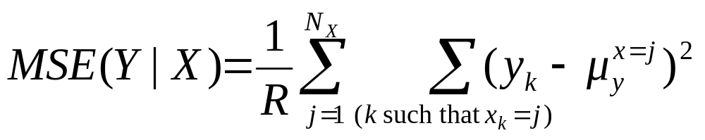
Choosing the attribute to split on
Gender | Rich? | Num. Children | Num. Beany Babies | Age
Female | No | 2 | 1 | 38
Male | No | 0 | 0 | 24
Male | Yes | 0 | 5+ | 72
: | : | : | : | :
MSE(Y|X) = The expected squared error if we must predict a record’s Y value given only knowledge of the record’s X value
If we’re told x=j, the smallest expected error comes from predicting the mean of the Y-values among those records in which x=j. Call this mean quantity μ_{y}^{x=j}
Then…

Slide 68
Choosing the attribute to split on
Gender | Rich? | Num. Children | Num. Beany Babies | Age
Female | No | 2 | 1 | 38
Male | No | 0 | 0 | 24
Male | Yes | 0 | 5+ | 72
: | : | : | : | :
Regression tree attribute selection: greedily choose the attribute that minimizes MSE(Y|X)
Guess what we do about real-valued inputs?
Guess how we prevent overfitting
MSE(Y|X) = The expected squared error if we must predict a record’s Y value given only knowledge of the record’s X value
If we’re told x=j, the smallest expected error comes from predicting the mean of the Y-values among those records in which x=j. Call this mean quantity μ_{y}^{x=j}
Then…

Slide 69
Pruning Decision
…property-owner = Yes
Do I deserve to live?
Gender?
Female
Male
Predict age = 39
Predict age = 36
# property-owning females = 56712
Mean age among POFs = 39
Age std dev among POFs = 12
# property-owning males = 55800
Mean age among POMs = 36
Age std dev among POMs = 11.5
Use a standard Chi-squared test of the null-hypothesis “these two populations have the same mean” and Bob’s your uncle.

Slide 70
Linear Regression Trees
…property-owner = Yes
Also known as “Model Trees”
Gender?
Female
Male
Predict age =
26 + 6 * NumChildren - 2 * YearsEducation
Predict age =
24 + 7 * NumChildren - 2.5 * YearsEducation
Leaves contain linear functions (trained using linear regression on all records matching that leaf)
Split attribute chosen to minimize MSE of regressed children.
Pruning with a different Chi-squared

Slide 71
Linear Regression Trees
…property-owner = Yes
Also known as “Model Trees”
Gender?
Female
Male
Detail: You typically ignore any categorical attribute that has been tested on higher up in the tree during the regression. But use all untested attributes, and use real-valued attributes even if they’ve been tested above
Predict age =
26 + 6 * NumChildren - 2 * YearsEducation
Predict age =
24 + 7 * NumChildren - 2.5 * YearsEducation
Leaves contain linear functions (trained using linear regression on all records matching that leaf)
Split attribute chosen to minimize MSE of regressed children.
Pruning with a different Chi-squared

Slide 72
Test your understanding
Assuming regular regression trees, can you sketch a graph of the fitted function y^{est(}x) over this diagram?
y
x

Slide 73
Test your understanding
Assuming linear regression trees, can you sketch a graph of the fitted function y^{est(}x) over this diagram?
y
x

Slide 74
Multilinear Interpolation

Slide 75
Multilinear Interpolation
Consider this dataset. Suppose we wanted to create a continuous and piecewise linear fit to the data
y
x

Slide 76
Multilinear Interpolation
Create a set of knot points: selected X-coordinates (usually equally spaced) that cover the data
y
q₁
q₂
q₃
q₄
q₅
x

Slide 77
Multilinear Interpolation
We are going to assume the data was generated by a noisy version of a function that can only bend at the knots. Here are 3 examples (none fits the data well)
y
q₁
q₂
q₃
q₄
q₅
x

Slide 78
How to find the best fit?
Idea 1: Simply perform a separate regression in each segment for each part of the curve
What’s the problem with this idea?
y
q₁
q₂
q₃
q₄
q₅
x

Slide 79
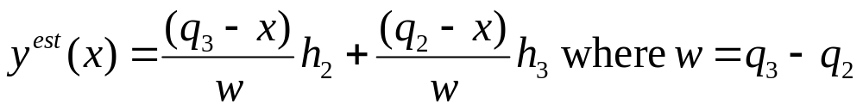
How to find the best fit?
Let’s look at what goes on in the red segment
h₂
y
h₃
q₁
q₂
q₃
q₄
q₅
x

Slide 80
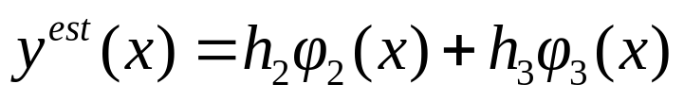
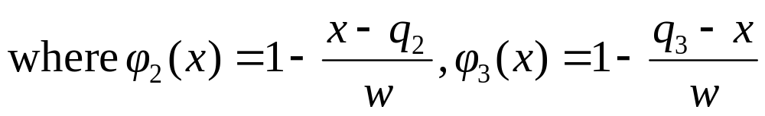
How to find the best fit?
In the red segment…
h₂
y
φ₂(x)
h₃
q₁
q₂
q₃
q₄
q₅
x

Slide 81
How to find the best fit?
In the red segment…
h₂
y
φ₂(x)
h₃
q₁
q₂
q₃
q₄
q₅
φ₃(x)
x

Slide 82
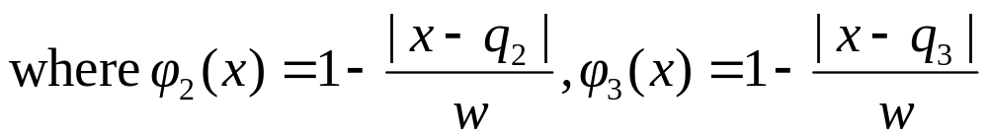
How to find the best fit?
In the red segment…
h₂
y
φ₂(x)
h₃
q₁
q₂
q₃
q₄
q₅
φ₃(x)
x

Slide 83
How to find the best fit?
In the red segment…
h₂
y
φ₂(x)
h₃
q₁
q₂
q₃
q₄
q₅
φ₃(x)
x

Slide 84
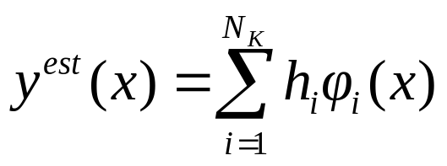
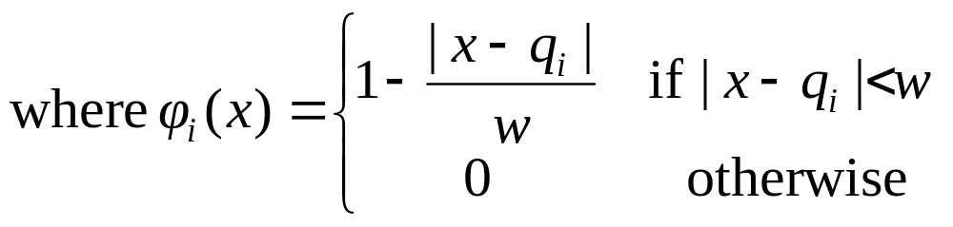
How to find the best fit?
In general
h₂
y
φ₂(x)
h₃
q₁
q₂
q₃
q₄
q₅
φ₃(x)
x

Slide 85
How to find the best fit?
In general
h₂
And this is simply a basis function regression problem!
We know how to find the least squares h_{ii}s!
y
φ₂(x)
h₃
q₁
q₂
q₃
q₄
q₅
φ₃(x)
x

Slide 86
In two dimensions…
Blue dots show locations of input vectors (outputs not depicted)
x₂
x₁

Slide 87
In two dimensions…
Each purple dot is a knot point. It will contain the height of the estimated surface
Blue dots show locations of input vectors (outputs not depicted)
x₂
x₁

Slide 88
In two dimensions…
Each purple dot is a knot point. It will contain the height of the estimated surface
But how do we do the interpolation to ensure that the surface is continuous?
Blue dots show locations of input vectors (outputs not depicted)
9
3
7
8
x₂
x₁

Slide 89
In two dimensions…
Each purple dot is a knot point. It will contain the height of the estimated surface
But how do we do the interpolation to ensure that the surface is continuous?
To predict the value here…
Blue dots show locations of input vectors (outputs not depicted)
9
3
7
8
x₂
x₁

Slide 90
In two dimensions…
Each purple dot is a knot point. It will contain the height of the estimated surface
But how do we do the interpolation to ensure that the surface is continuous?
To predict the value here…
First interpolate its value on two opposite edges…
Blue dots show locations of input vectors (outputs not depicted)
9
7
3
7
8
7.33
x₂
x₁

Slide 91
In two dimensions…
Each purple dot is a knot point. It will contain the height of the estimated surface
But how do we do the interpolation to ensure that the surface is continuous?
To predict the value here…
First interpolate its value on two opposite edges…
Then interpolate between those two values
Blue dots show locations of input vectors (outputs not depicted)
9
7
3
7.05
7
8
7.33
x₂
x₁

Slide 92
In two dimensions…
Each purple dot is a knot point. It will contain the height of the estimated surface
But how do we do the interpolation to ensure that the surface is continuous?
To predict the value here…
First interpolate its value on two opposite edges…
Then interpolate between those two values
Blue dots show locations of input vectors (outputs not depicted)
9
7
3
7.05
7
Notes:
This can easily be generalized to m dimensions.
It should be easy to see that it ensures continuity
The patches are not linear
8
7.33
x₂
x₁

Slide 93
Doing the regression
Given data, how do we find the optimal knot heights?
Happily, it’s simply a two-dimensional basis function problem.
(Working out the basis functions is tedious, unilluminating, and easy)
What’s the problem in higher dimensions?
9
3
7
8
x₂
x₁

Slide 94
MARS: Multivariate Adaptive Regression Splines

Slide 95
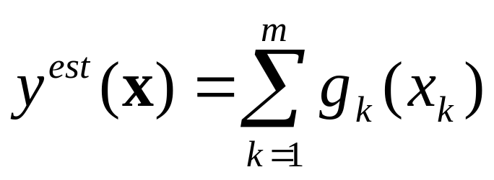
MARS
Multivariate Adaptive Regression Splines
Invented by Jerry Friedman (one of Andrew’s heroes)
Simplest version:
    Let’s assume the function we are learning is of the following form:
Instead of a linear combination of the inputs, it’s a linear combination of non-linear functions of individual inputs

Slide 96
MARS
Instead of a linear combination of the inputs, it’s a linear combination of non-linear functions of individual inputs
Idea: Each g_{k} is one of these
y
q₁
q₂
q₃
q₄
q₅
x

Slide 97
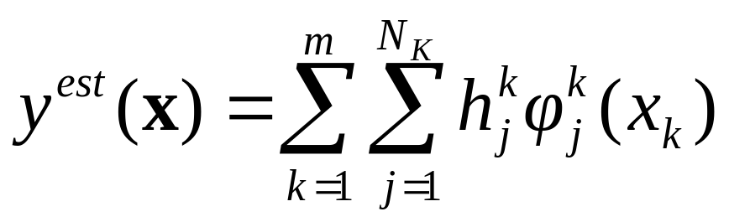
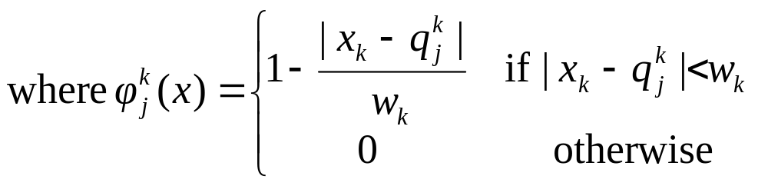
MARS
Instead of a linear combination of the inputs, it’s a linear combination of non-linear functions of individual inputs
q^{k}_{j} : The location of the j’th knot in the k’th dimension
h^{k}_{j} : The regressed height of the j’th knot in the k’th dimension
w^{k}: The spacing between knots in the kth dimension
y
q₁
q₂
q₃
q₄
q₅
x

Slide 98
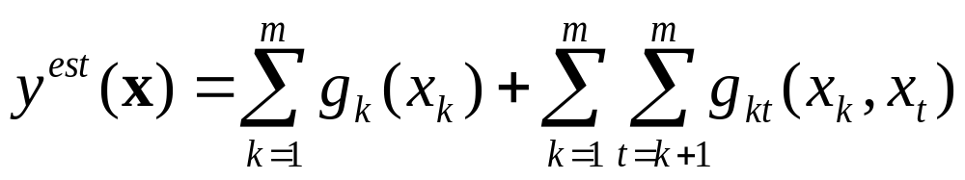
That’s not complicated enough!
Okay, now let’s get serious. We’ll allow arbitrary “two-way interactions”:
The function we’re learning is allowed to be a sum of non-linear functions over all one-d and 2-d subsets of attributes
Can still be expressed as a linear combination of basis functions
Thus learnable by linear regression
Full MARS: Uses cross-validation to choose a subset of subspaces, knot resolution and other parameters.

Slide 99
If you like MARS…
…See also CMAC (Cerebellar Model Articulated Controller) by James Albus (another of Andrew’s heroes)
  Many of the same gut-level intuitions
  But entirely in a neural-network, biologically plausible way
    (All the low dimensional functions are by means of lookup tables, trained with a delta-rule and using a clever blurred update and hash-tables)

Slide 100
Where are we now?
Inference
Engine Learn
Joint DE
Inputs
p(E₁|E₂)
Predict
category
Dec Tree, Gauss/Joint BC, Gauss Naïve BC,
Inputs
Classifier
Density
Estimator
Prob-
ability
Joint DE, Naïve DE, Gauss/Joint DE, Gauss Naïve DE
Inputs
Predict
real no.
Linear Regression, Polynomial Regression, RBFs, Robust Regression Regression Trees, Multilinear Interp, MARS
Inputs
Regressor

Slide 101
Citations
Radial Basis Functions
T. Poggio and F. Girosi, Regularization Algorithms for Learning That Are Equivalent to Multilayer Networks, Science, 247, 978--982, 1989
LOESS
W. S. Cleveland, Robust Locally Weighted Regression and Smoothing Scatterplots, Journal of the American Statistical Association, 74, 368, 829-836, December, 1979
Regression Trees etc
L. Breiman and J. H. Friedman and R. A. Olshen and C. J. Stone, Classification and Regression Trees, Wadsworth, 1984
J. R. Quinlan, Combining Instance-Based and Model-Based Learning, Machine Learning: Proceedings of the Tenth International Conference, 1993
MARS
J. H. Friedman, Multivariate Adaptive Regression Splines, Department for Statistics, Stanford University, 1988, Technical Report No. 102

