Slide 1
Instance-based learning
(a.k.a. memory-based) (a.k.a. non-parametric regression) (a.k.a. case-based) (a.k.a kernel-based)
Andrew W. Moore
Professor
School of Computer Science
Carnegie Mellon University
www.cs.cmu.edu/~awm
awm@cs.cmu.edu
412-268-7599
Note to other teachers and users of these slides. Andrew would be delighted if you found this source material useful in giving your own lectures. Feel free to use these slides verbatim, or to modify them to fit your own needs. PowerPoint originals are available. If you make use of a significant portion of these slides in your own lecture, please include this message, or the following link to the source repository of Andrew’s tutorials: http://www.cs.cmu.edu/~awm/tutorials . Comments and corrections gratefully received.
Software to play with the algorithms in this tutorial, and example data are available from: http://www.cs.cmu.edu/~awm/vizier . The example figures in this slide-set were created with the same software and data.

Slide 2
Overview
What do we want a regressor to do?
Why not stick with polynomial regression? Why not just “join the dots”?
What’s k-nearest-neighbor all about?
And how about kernel regression, locally weighted regression?
Hmm. But what about multivariate fitting?
And how do you compute all that stuff? And why should I care?

Slide 3
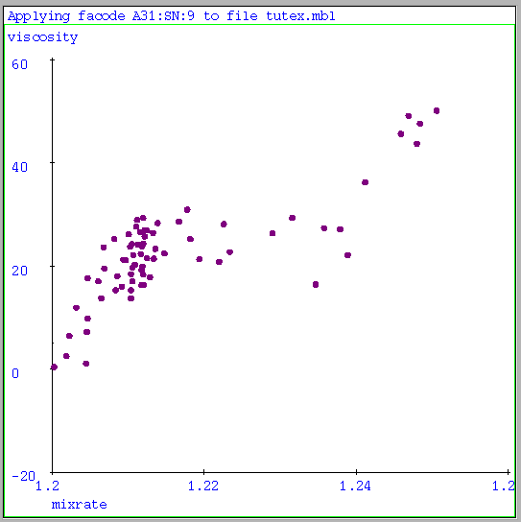
This Tutorial’s Starting Point
We’ve obtained some numeric data.
How do we exploit it?
Steel | Line | Slab | Temp | Cool | Cool
Temp | Speed | Width | Stage2 | Setpt | Gain
-0.4788 | 0.3849 | 0.0357 | 0.8384 | 0.6620 | -0.9512
0.3470 | -0.6488 | 0.6629 | -0.5087 | 0.6845 | -0.0647
0.8622 | -0.5367 | -0.2459 | -0.1438 | -0.7267 | -0.6119
-0.2099 | -0.5975 | 0.0614 | -0.7648 | 0.0222 | -0.7623
-0.4627 | 0.6218 | 0.9254 | 0.6081 | -0.8739 | -0.6439
0.7341 | 0.0745 | -0.2650 | -0.4510 | -0.4548 | 0.5753
0.4237 | -0.5143 | -0.0731 | 0.0385 | -0.8068 | 0.3098
-0.1267 | 0.8105 | -0.6619 | -0.0768 | -0.8738 | -0.3367
0.0332 | 0.7754 | 0.7718 | -0.5440 | 0.6237 | 0.5113
0.2668 | 0.8777 | -0.5690 | -0.5151 | 0.6493 | 0.7705
-0.5682 | 0.8457 | 0.5669 | -0.7359 | -0.3394 | 0.5880
. | . | . | . | . | .
. | . | . | . | . | .
. | . | . | . | . | .
Simple, uni-variate case
General, multi variate case

Slide 4
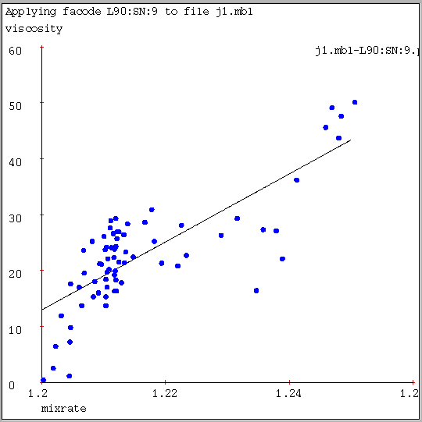
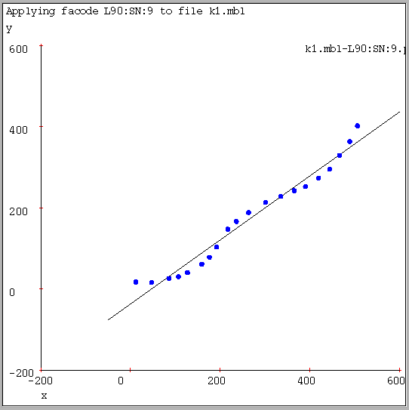
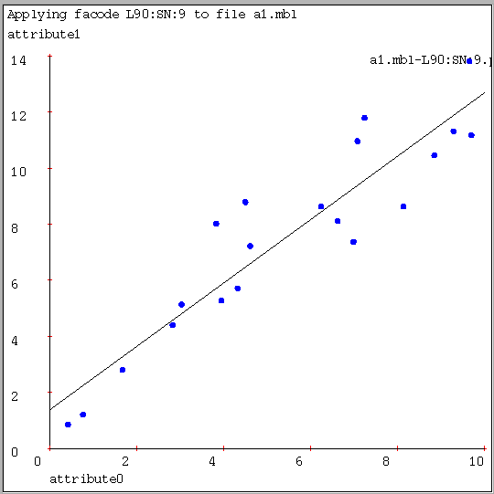
Why not just use Linear Regression?
Software and data for the algorithms in this tutorial: http://www.cs.cmu.edu/~awm/vizier . The example figures in this slide-set were created with the same software and data.
Here, linear regression manages to capture a significant trend in the data, but there is visual evidence of bias. | Here, linear regression appears to have a much better fit, but the bias is very clear. | Here, linear regression may indeed be the right thing.
Bias: the underlying choice of model (in this case, a line) cannot, with any choice of parameters (constant term and slope) and with any amount of data (the dots) capture the full relationship.

Slide 5
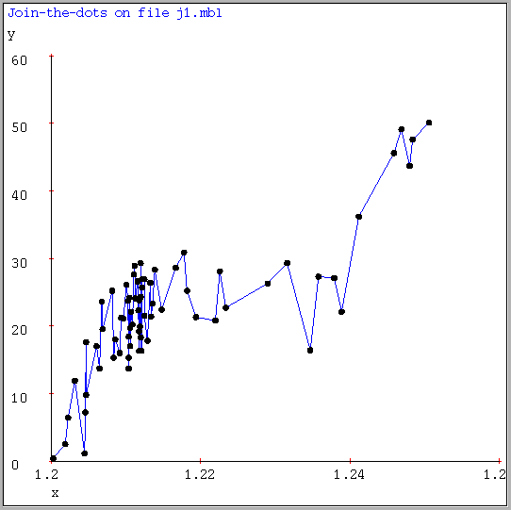
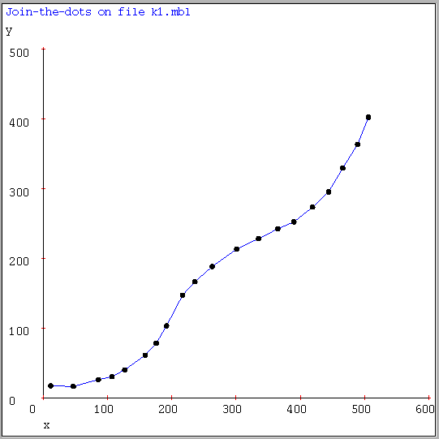
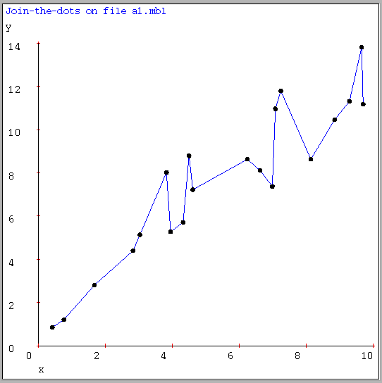
Why not just Join the Dots?
Here, joining the dots is clearly fitting noise. | Here, joining the dots looks very sensible. | Again, a clear case of noise fitting.
Why is fitting the noise so bad?

Slide 6
Why not just Join the Dots?
You will tend to make somewhat bigger prediction errors on new data than if you filtered the noise perfectly.
You don’t get good gradient estimates or noise estimates.
You can’t make sensible confidence intervals.
It’s morally wrong.
Also: Join the dots is much harder to implement for multivariate inputs.
Here, joining the dots is clearly fitting noise. | Here, joining the dots looks very sensible. | Again, a clear case of noise fitting.
Why is fitting the noise so bad?

Slide 7
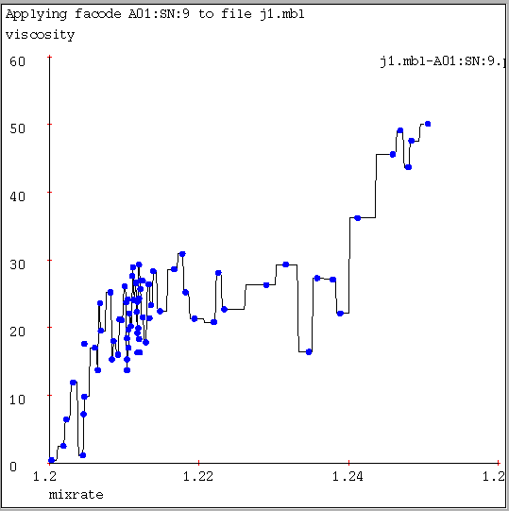
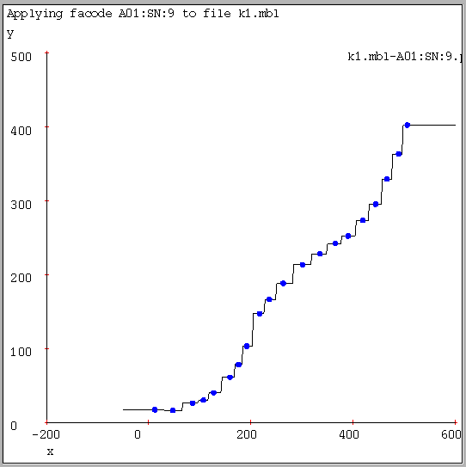
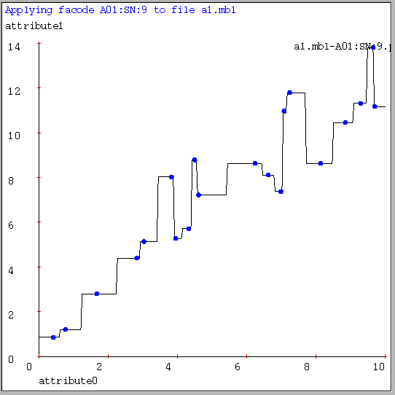
One-Nearest Neighbor
…One nearest neighbor for fitting is described shortly…
Similar to Join The Dots with two Pros and one Con.
PRO: It is easy to implement with multivariate inputs.
CON: It no longer interpolates locally.
PRO: An excellent introduction to instance-based learning…

Slide 8
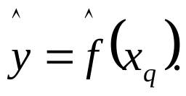
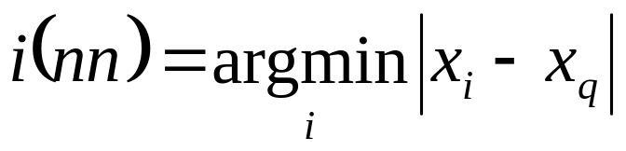
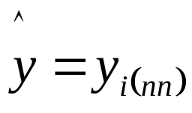
Univariate 1-Nearest Neighbor
Given datapoints (x₁,y₁) (x₂,y₂)..(x_{N},y_{N}),where we assume y_{i}=f(s_{i}) for some unknown function f.
Given query point x_{q}, your job is to predict
Nearest Neighbor:
1. Find the closest x_{i} in our set of datapoints
2. Predict
Here’s a dataset with one input, one output and four datapoints.
Here, this is the closest datapoint
Here, this is the closest datapoint
Here, this is the closest datapoint
Here, this is the closest datapoint
y
x

Slide 9
1-Nearest Neighbor is an example of….
Instance-based learning
A function approximator that has been around since about 1910.
To make a prediction, search database for similar datapoints, and fit with the local points.
x₁ y₁
x₂ y₂
x₃ y₃
.
.
x_{n} y_{n}
Four things make a memory based learner:
A distance metric
How many nearby neighbors to look at?
A weighting function (optional)
How to fit with the local points?

Slide 10
Nearest Neighbor
Four things make a memory based learner:
A distance metric Euclidian
How many nearby neighbors to look at? One
A weighting function (optional) Unused
How to fit with the local points? Just predict the same output as the nearest neighbor.

Slide 11
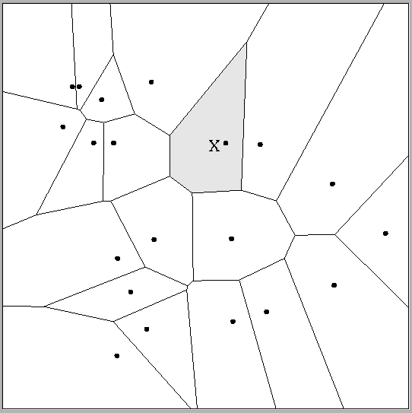
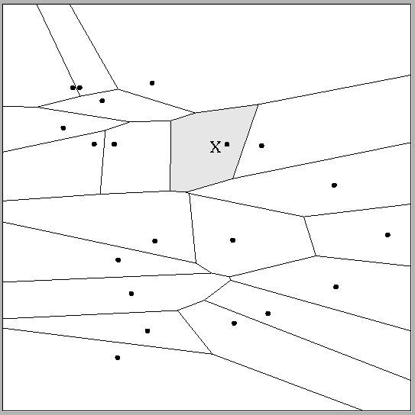
Multivariate Distance Metrics
Suppose the input vectors x1, x2, …xn are two dimensional:
x₁ = ( x₁₁ , x₁₂ ) , x₂ = ( x₂₁ , x₂₂ ) , …x_{N} = ( x_{N1} , x_{N2} ).
One can draw the nearest-neighbor regions in input space.
Dist(x_{i},x_{j}) = (x_{i1} – x_{j1})² + (x_{i2} – x_{j2})² | Dist(x_{i},x_{j}) =(x_{i1} – x_{j1})²+(3x_{i2} – 3x_{j2})²
The relative scalings in the distance metric affect region shapes.

Slide 12
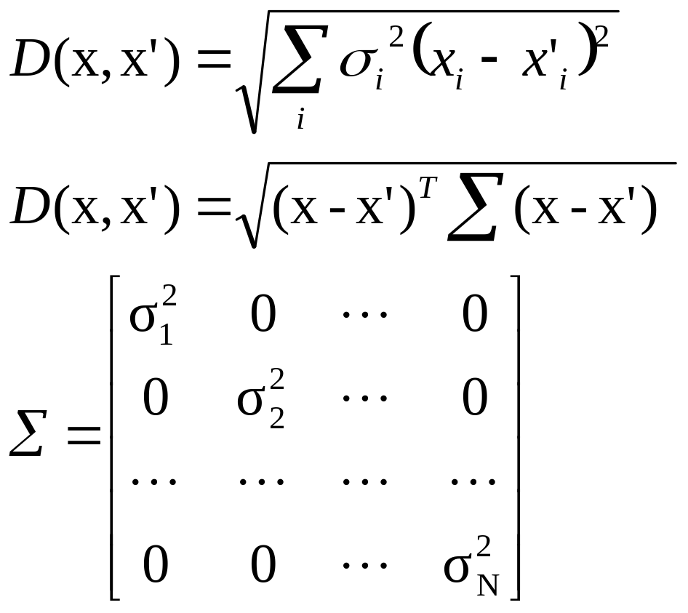
Euclidean Distance Metric
Or equivalently,
where
Other Metrics…
Mahalanobis, Rank-based, Correlation-based (Stanfill+Waltz, Maes’ Ringo system…)

Slide 13
The Zen of Voronoi Diagrams
CNN Article
Mystery of renowned zen garden revealed
Thursday, September 26, 2002 Posted: 10:11 AM EDT (1411 GMT)
LONDON (Reuters) -- For centuries visitors to the renowned Ryoanji Temple garden in Kyoto, Japan have been entranced and mystified by the simple arrangement of rocks.
The five sparse clusters on a rectangle of raked gravel are said to be pleasing to the eyes of the hundreds of thousands of tourists who visit the garden each year.
Scientists in Japan said on Wednesday they now believe they have discovered its mysterious appeal.
"We have uncovered the implicit structure of the Ryoanji garden's visual ground and have shown that it includes an abstract, minimalist depiction of natural scenery," said Gert Van Tonder of Kyoto University.
The researchers discovered that the empty space of the garden evokes a hidden image of a branching tree that is sensed by the unconscious mind.
"We believe that the unconscious perception of this pattern contributes to the enigmatic appeal of the garden," Van Tonder added.
He and his colleagues believe that whoever created the garden during the Muromachi era between 1333-1573 knew exactly what they were doing and placed the rocks around the tree image.
By using a concept called medial-axis transformation, the scientists showed that the hidden branched tree converges on the main area from which the garden is viewed.
The trunk leads to the prime viewing site in the ancient temple that once overlooked the garden.
It is thought that abstract art may have a similar impact.
"There is a growing realisation that scientific analysis can reveal unexpected structural features hidden in controversial abstract paintings," Van Tonder said

Slide 14
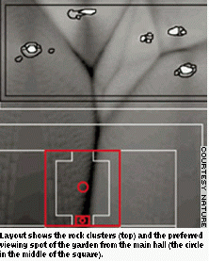
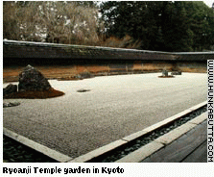
Zen Part Two
(Photos and article extracted from www.cnn.com)
Question: what set of five rocks placed at a distance would have not produced a tree-like voronoi diagram?

Slide 15
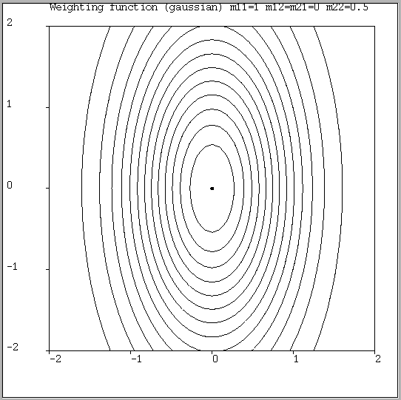
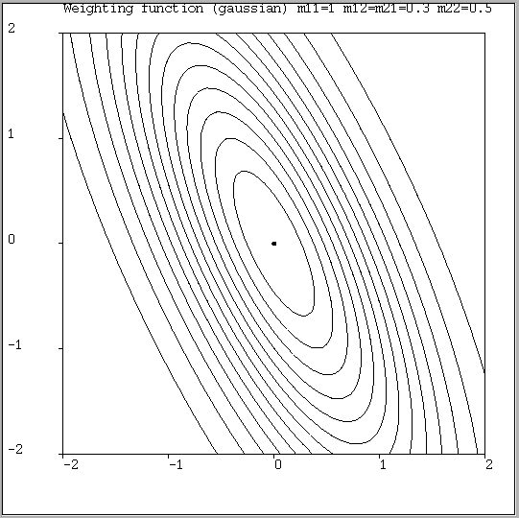
Notable Distance Metrics
Scaled Euclidian (L₂)
L₁ norm (absolute)
Mahalanobis (here, Σ on the previous slide is not necessarily diagonal, but is symmetric
L_{infinity} (max) norm

Slide 16
One-Nearest Neighbor
..let’s leave distance metrics for now, and go back to….
Objection:
That noise-fitting is really objectionable.
What’s the most obvious way of dealing with it?

Slide 17
k-Nearest Neighbor
Four things make a memory based learner:
A distance metric Euclidian
How many nearby neighbors to look at? k
A weighting function (optional) Unused
How to fit with the local points? Just predict the average output among the k nearest neighbors.

Slide 18
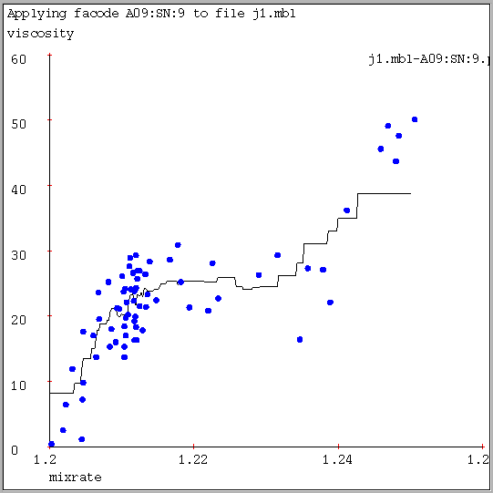
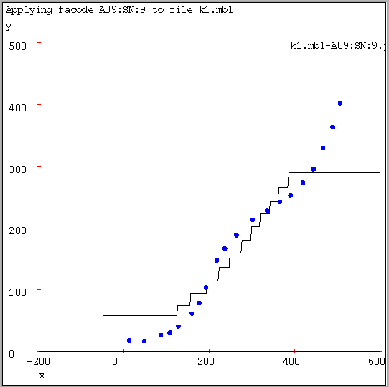
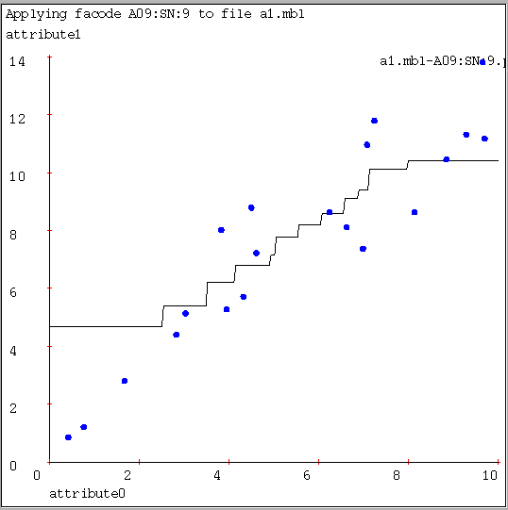
k-Nearest Neighbor (here k=9)
A magnificent job of noise-smoothing. Three cheers for 9-nearest-neighbor. But the lack of gradients and the jerkiness isn’t good. | Appalling behavior! Loses all the detail that join-the-dots and 1-nearest-neighbor gave us, yet smears the ends. | Fits much less of the noise, captures trends. But still, frankly, pathetic compared with linear regression.
K-nearest neighbor for function fitting smoothes away noise, but there are clear deficiencies.
What can we do about all the discontinuities that k-NN gives us?

Slide 19
Kernel Regression
Four things make a memory based learner:
A distance metric Scaled Euclidian
How many nearby neighbors to look at? All of them
A weighting function (optional) w_{i} = exp(-D(x_{i}, query)² / K_{w}²)
      Nearby points to the query are weighted strongly, far points weakly. The K_{W} parameter is the Kernel Width. Very important.
How to fit with the local points? Predict the weighted average of the outputs: predict = Σw_{i}y_{i} / Σw_{i}

Slide 20
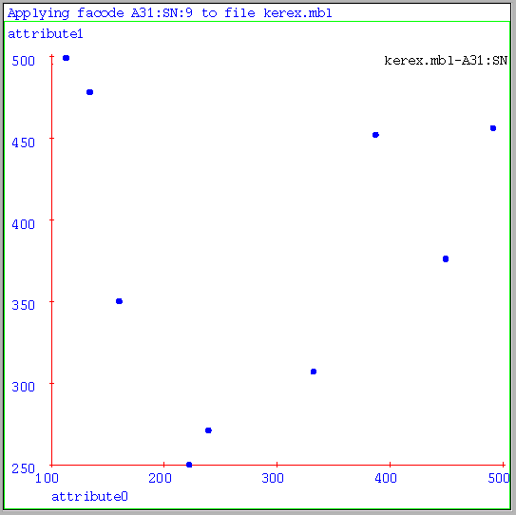
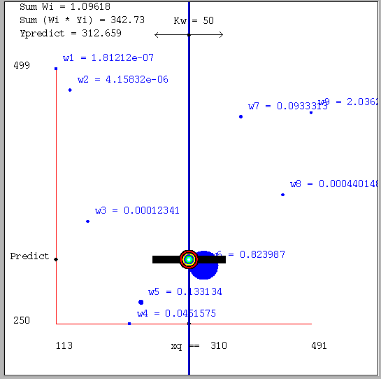
Kernel Regression in Pictures
Take this dataset…
..and do a kernel prediction with x_{q} (query) = 310, K_{w} = 50.

Slide 21
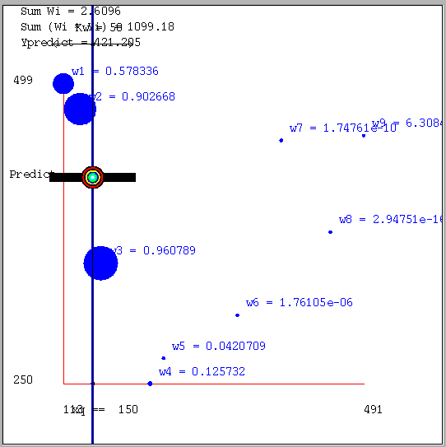
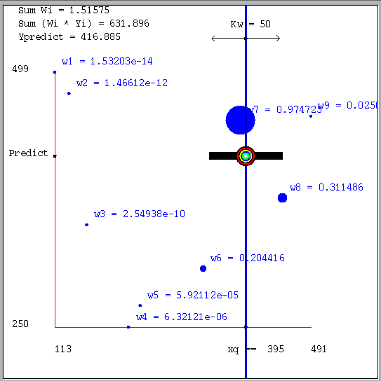
Varying the Query
x_{q} = 150
x_{q} = 395

Slide 22
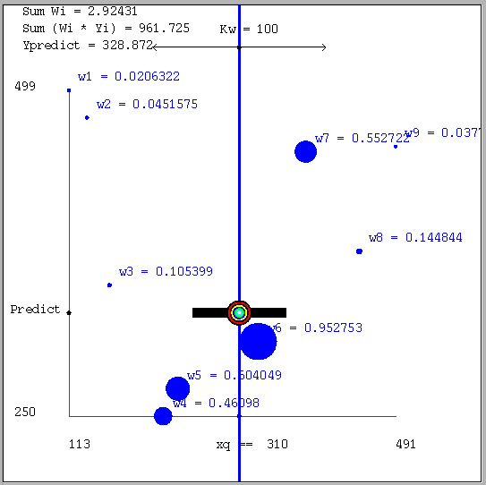
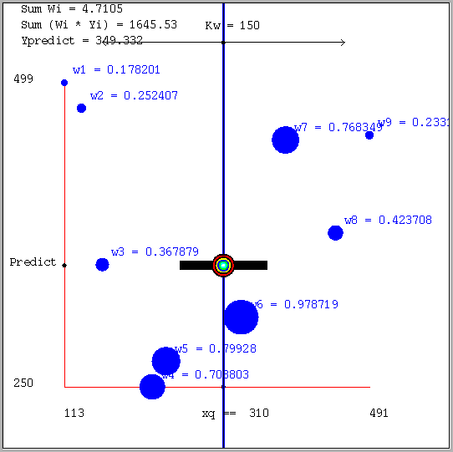
Varying the kernel width
x_{q} = 310 K_{W} = 50 (see the double arrow at top of diagram) | x_{q} = 310 (the same) K_{W} = 100 | x_{q} = 310 (the same) K_{W} = 150
Increasing the kernel width K_{w} means further away points get an opportunity to influence you.
As K_{w}→infinity, the prediction tends to the global average.

Slide 23
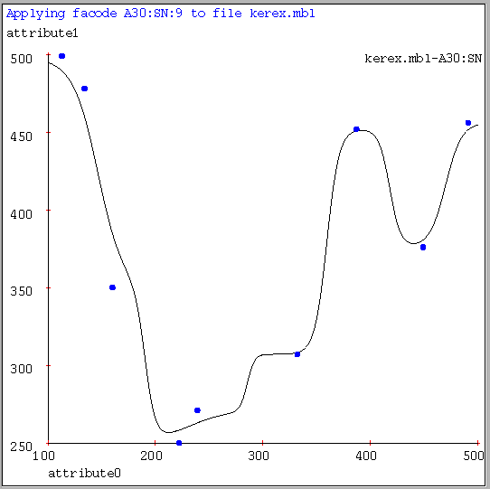
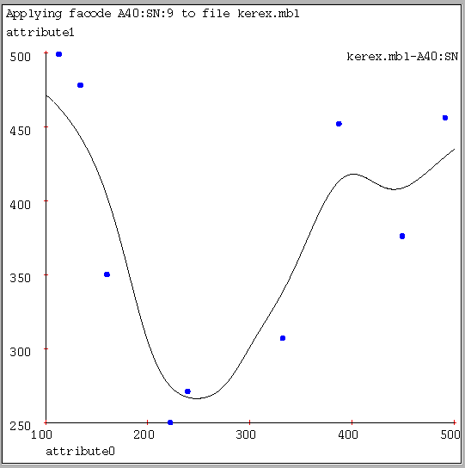
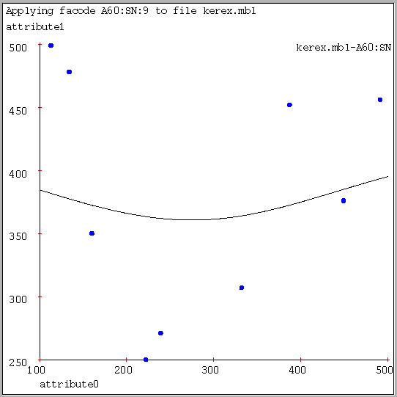
Kernel Regression Predictions
K_{W}=10 | K_{W}=20 | K_{W}=80
Increasing the kernel width K_{w} means further away points get an opportunity to influence you.
As K_{w}→infinity, the prediction tends to the global average.

Slide 24
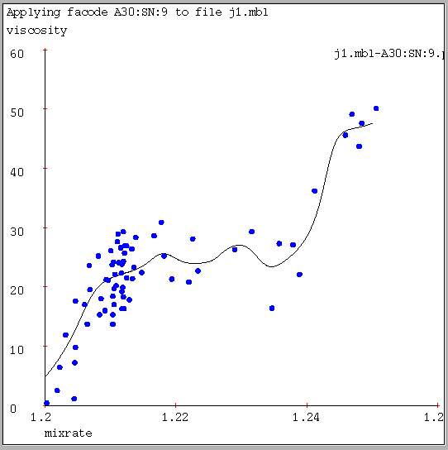
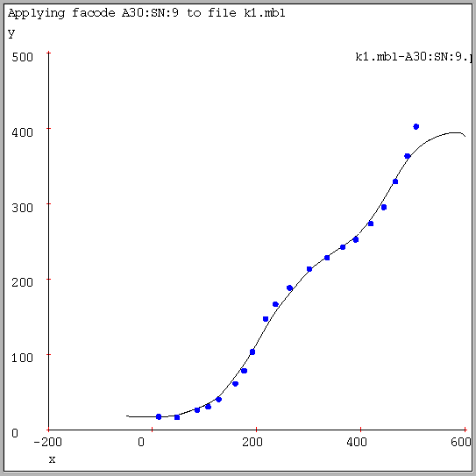
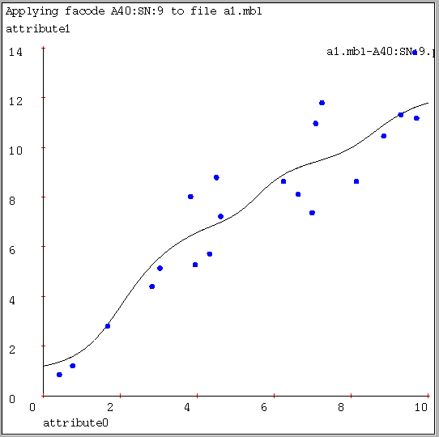
Kernel Regression on our test cases
Software and data for the algorithms in this tutorial: http://www.cs.cmu.edu/~awm/vizier . The example figures in this slide-set were created with the same software and data.
KW=1/32 of x-axis width. It’s nice to see a smooth curve at last. But rather bumpy. If Kw gets any higher, the fit is poor. | KW=1/32 of x-axis width. Quite splendid. Well done, kernel regression. The author needed to choose the right K_{W} to achieve this. | KW=1/16 axis width. Nice and smooth, but are the bumps justified, or is this overfitting?
Choosing a good K_{w} is important. Not just for Kernel Regression, but for all the locally weighted learners we’re about to see.

Slide 25
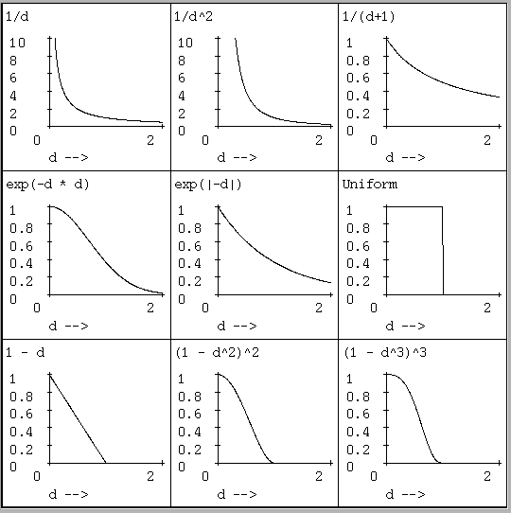
Weighting functions
Let
d=D(x_{i},x_{query})/K_{W}
Then here are some commonly used weighting functions…
(we use a Gaussian)

Slide 26
Weighting functions
Let
d=D(x_{i},x_{query})/K_{W}
Then here are some commonly used weighting functions…
(we use a Gaussian)
Newsflash:
The word on the street from recent non-parametric statistics papers is that the precise choice of kernel shape doesn’t matter much.

Slide 27
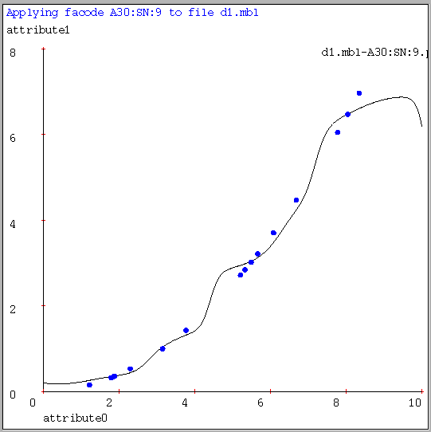
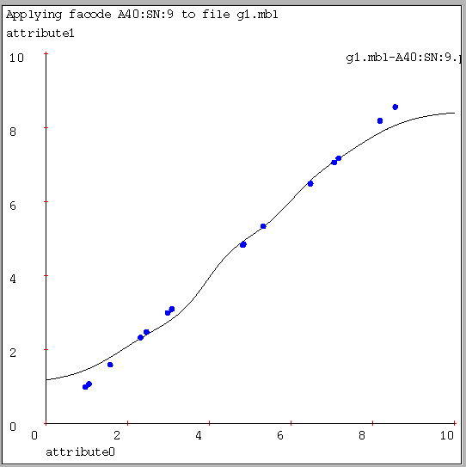
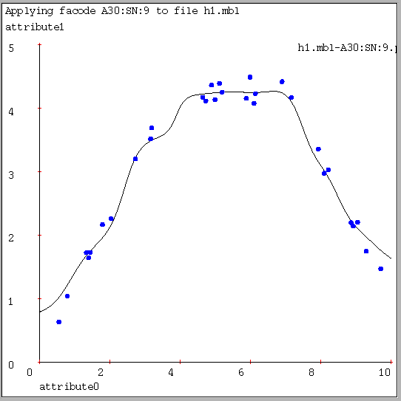
Kernel Regression can look bad
KW = Best. Clearly not capturing the simple structure of the data.. Note the complete failure to extrapolate at edges. | KW = Best. Also much too local. Why wouldn’t increasing Kw help? Because then it would all be “smeared”. | KW = Best. Three noisy linear segments. But best kernel regression gives poor gradients.
Time to try something more powerful…

Slide 28
Locally Weighted Regression
Kernel Regression:
Take a very very conservative function approximator called AVERAGING. Locally weight it.
Locally Weighted Regression:
Take a conservative function approximator called LINEAR REGRESSION. Locally weight it.
Let’s Review Linear Regression….

Slide 29
Unweighted Linear Regression
You’re lying asleep in bed. Then Nature wakes you.
YOU: “Oh. Hello, Nature!”
NATURE: “I have a coefficient β in mind. I took a bunch of real numbers called x₁, x₂ ..x_{N} thus: x₁=3.1,x₂=2, …x_{N}=4.5.
For each of them (k=1,2,..N), I generated y_{k}= βx_{k}+ε_{k}
where ε_{k} is a Gaussian (i.e. Normal) random variable with mean 0 and standard deviation σ. The ε_{k}’s were generated independently of each other.
Here are the resulting y_{i}’s: y₁=5.1 , y₂=4.2 , …y_{N}=10.2”
You: “Uh-huh.”
Nature: “So what do you reckon β is then, eh?”
WHAT IS YOUR RESPONSE?

Slide 30
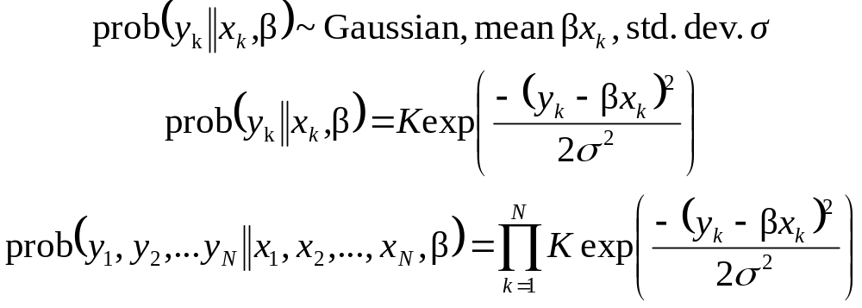
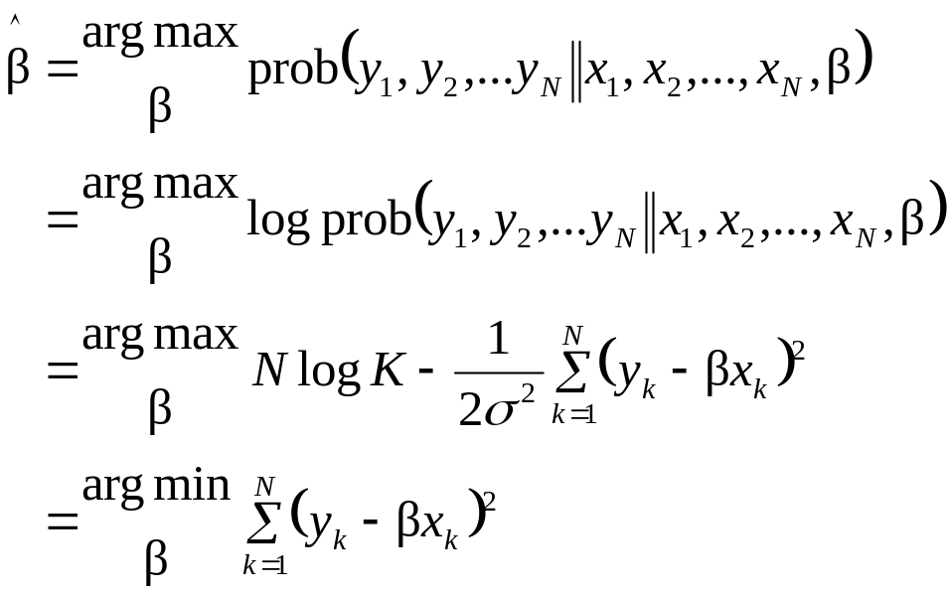
Global Linear Regression: y_{k}=βx_{k} +ε_{k}
Which value of β makes the y₁, y₂..y_{N} values most likely?

Slide 31
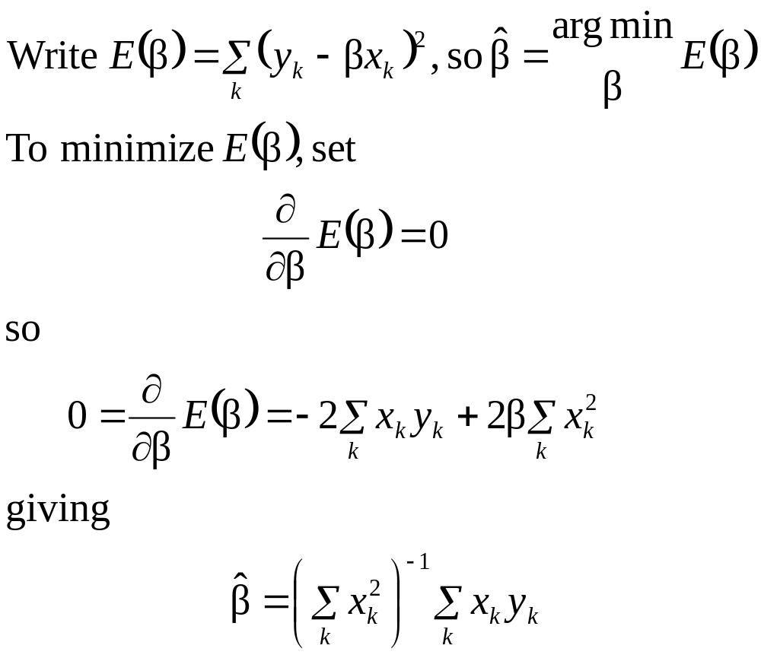
Least squares unweighted linear regression
E(β)=
sum of squares of green line lengths
↑
β
↓
← 1 →
E(β)
β

Slide 32
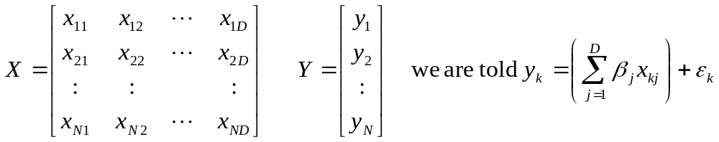
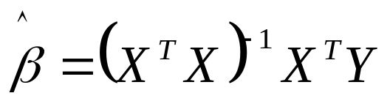
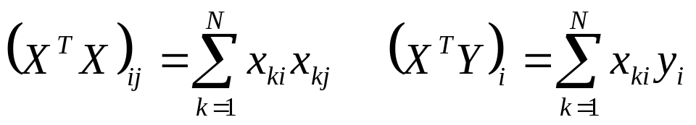
Multivariate unweighted linear regression
Nature supplies N input vectors. Each input vector x_{k}
is D-dimensional: x_{k} = ( x_{k1}, x_{k2} .. x_{kD} ) . Nature also supplies N corresponding output values y₁ .. y_{N}.
We must estimate β = (β₁, β₂ … β_{D}). It’s easily shown using matrices instead of scalars on the previous slide that
Note that X^{T}X is a D x D positive definite symmetric matrix, and X^{T}Y is a D x 1 vector:

Slide 33
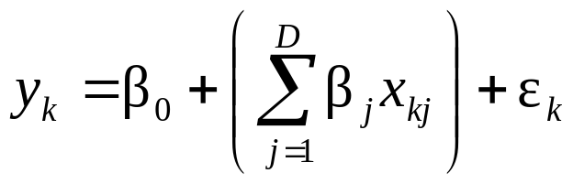
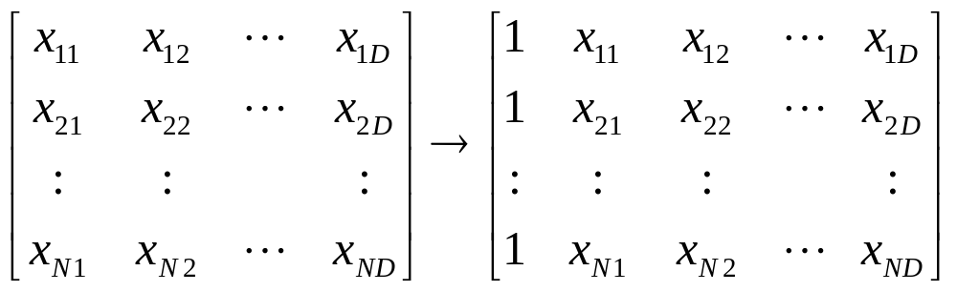
The Pesky Constant Term
Now: Nature doesn’t guarantee that the line/hyperplane passes through the origin.
In other words: Nature says
“No problem,” you reply. “Just add one extra input variable, x_{k0}, which is always 1”

Slide 34
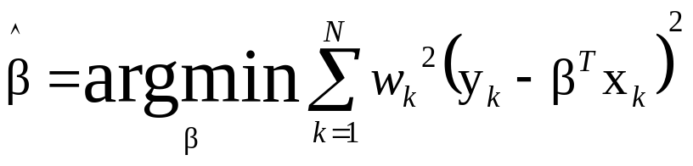
Locally Weighted Regression
Four things make a memory-based learner:
A distance metric Scaled Euclidian
How many nearby neighbors to look at? All of them
A weighting function (optional) w_{k} = exp(-D(x_{k}, x_{query})² / K_{w}²) Nearby points to the query are weighted strongly, far points weakly. The K_{w} parameter is the Kernel Width.
How to fit with the local points? First form a local linear model. Find the β that minimizes the locally weighted sum of squared residuals:
Then predict y_{predict}=β^{T} x_{query}

Slide 35
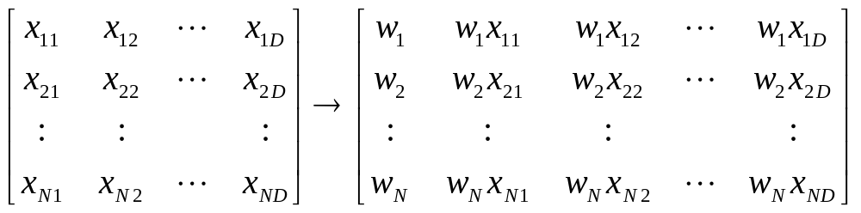
How LWR works
For each point (x_{k},y_{k}) compute w_{k}.
Let WX = Diag(w₁,..w_{N})X
Find w to minimize Σ(y_{i}-Σw_{j}T_{j}(x_{i}))² directly: w=(X^{T}X)⁻¹X^{T}Y
Linear regression not flexible but trains like lightning.
X - - > WX
Let WY=Diag(w₁,..w_{N})Y, so that y_{k} →w_{k}y_{k}
β = (WX^{T}WX)⁻¹(WX^{T}WY)
Query
Locally weighted regression is very flexible and fast to train.

Slide 36
Input X matrix of inputs: X[k] [i] = i’th component of k’th input point.
Input Y matrix of outputs: Y[k] = k’th output value.
Input xq = query input. Input kwidth.
WXTWX = empty (D+1) x (D+1) matrix
WXTWY = empty (D+1) x 1 matrix
for ( k = 1 ; k <= N ; k = k + 1 )
/* Compute weight of kth point */
wk = weight_function( distance( xq , X[k] ) / kwidth )
/* Add to (WX) ^T (WX) matrix */
for ( i = 0 ; i <= D ; i = i + 1 )
for ( j = 0 ; j <= D ; j = j + 1 )
if ( i == 0 ) xki = 1 else xki = X[k] [i]
if ( j == 0 ) xkj = 1 else xkj = X[k] [j]
WXTWX [i] [j] = WXTWX [i] [j] + wk * wk * xki * xkj
/* Add to (WX) ^T (WY) vector */
for ( i = 0 ; i <= D ; i = i + 1 )
if ( i == 0 ) xki = 1 else xki = X[k] [i]
WXTWY [i] = WXTWY [i] + wk * wk * xki * Y[k]
/* Compute the local beta. Call your favorite linear equation solver. Recommend Cholesky Decomposition for speed. Recommend Singular Val Decomp for Robustness. */
beta = (WXTWX)⁻¹ (WXTWY)
ypredict = beta[0] + beta[1]*xq[1] + beta[2]*xq[2] + … beta[D]*xq[D]

Slide 37
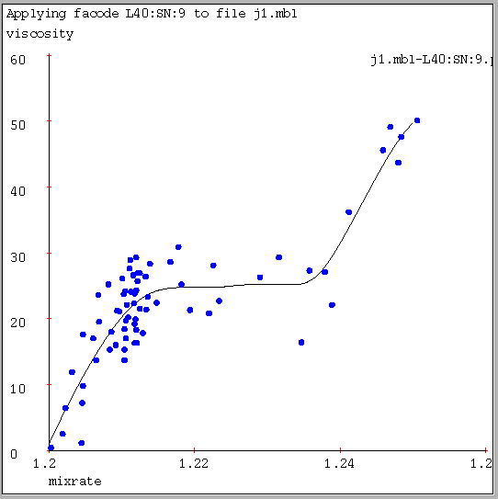


LWR on our test cases
Software and data for the algorithms in this tutorial: http://www.cs.cmu.edu/~awm/vizier . The example figures in this slide-set were created with the same software and data.
KW = 1/16 of x-axis width. | KW = 1/32 of x-axis width. | KW = 1/8 of x-axis width. Nicer and smoother, but even now, are the bumps justified, or is this overfitting?

Slide 38



Locally weighted Polynomial regression
Software and data for the algorithms in this tutorial: http://www.cs.cmu.edu/~awm/vizier . The example figures in this slide-set were created with the same software and data.
Kernel Regression Kernel width K_{W} at optimal level. KW = 1/100 x-axis | LW Linear Regression Kernel width K_{W} at optimal level. KW = 1/40 x-axis | LW Quadratic Regression Kernel width K_{W} at optimal level. KW = 1/15 x-axis
Local quadratic regression is easy: just add quadratic terms to the WXTWX matrix. As the regression degree increases, the kernel width can increase without introducing bias.

Slide 39

When’s Quadratic better than Linear?
It can let you use a wider kernel without introducing bias.
Sometimes you want more than a prediction, you want an estimate of the local Hessian. Then quadratic is your friend!
But in higher dimensions is appallingly expensive, and needs a lot of data. (Why?)
Two “Part-way-between-linear-and-quadratic” polynomials:
  “Ellipses”: Add x_{i}² terms to the model, but not cross-terms (no x_{i}x_{j} where i=j)
  “Circles”: Add only one extra term to the model:
Incremental insertion of polynomial terms is well established in conventional regression (GMDH,AIM): potentially useful here too

Slide 40
Multivariate Locally weighted learning
Locally
Weighted
Learner
Inputs
Outputs
All the methods described so far can generalize to multivariate input and output. But new questions arise:
What are good scalings for a Euclidean distance metric?
What is a better Euclidean distance metric?
Are all features relevant?
Do some features have a global rather than local influence?

Slide 41

A Bivariate Fit Example
Software and data for the algorithms in this tutorial: http://www.cs.cmu.edu/~awm/vizier . The example figures in this slide-set were created with the same software and data.
LWQ Regression
Let’s graph the prediction surface given 100 noisy datapoints: each with 2 inputs, one output
Kernel Width, Number of fully weighted Neighbors, Distance Metric Scales all optimized.
Kw = 1/16 axis width
4 nearest neighs full weight
Distance metric scales each axis equally.
f(x,y) = sin(x) + sin(y) + noise

Slide 42


Two more bivariate fits
Locally weighted linear regression.
KW, num neighs, metric scales all optimized.
KW=1/50 x-axis width. No neighbors fully weighted. y not included in distance metric, but is included in the regression.
f(x,y) = sin(x*x)+y+noise
Kernel Regression.
KW, num neighs, metric scales all optimized.
KW=1/100 x-axis width. 1-NN fully weighted. y not included in distance metric. f(x,y) = sin(x*x)

Slide 43
Fabricated Example
f(x1,x2,x3,x4,x5,x6,x7,x8,x9) = noise + x2 + x4 + 4sin(0.3x6 + 0.3x8).
(Here we see the result of searching for the best metric, feature set, kernel width, polynomial type for a set of 300 examples generated from the above function)
Recommendation.
Based on the search results so far, the recommended function approximator encoding is L20:SN:-0-0-9-9. Let me explain the meaning:
Locally weighted regression. The following features define the distance metric:
x6 (full strength).
x8 (full strength).
A gaussian weighting function is used with kernel width 0.0441942 in scaled input space. We do a weighted least squares with the following terms:
Term 0 = 1
Term 1 = x2/10
Term 2 = x4/10
Term 3 = x6/10
Term 4 = x8/10

Slide 44
Locally Weighted Learning: Variants
Range Searching: Average of all neighbors within a given range
Range-based linear regression: Linear regression on all points within a given range
Linear Regression on K-nearest-neighbors
Weighting functions that decay to zero at the kth nearest neighbor
Locally weighted Iteratively Reweighted Least Squares
Locally weighted Logistic Regression
Locally weighted classifiers
Multilinear Interpolation
Kuhn-Triangulation-based Interpolation
Spline Smoothers

Slide 45
Using Locally Weighted Learning for Modeling
“Hands-off” non-parametric relation finding
Low Dimensional Supervised Learning
Complex Function of a subset of inputs
Simple function of most inputs but complex function of a few
Complex function of a few features of many input variables

Slide 46
Use (1): “Hands-off” non-parametric relation finding.
You run an HMO (or a steel tempering process) (or a 7-dof dynamic robot arm)
You want an intelligent assistant to spot patterns and regularities among pairs or triplets of variables in your database…
HMO variables: | Steel Variables: | Robot Variables:
Physician Age | Line Speed | Roll
Patient Age | Line Spd -10mins | DRoll
Charge/Day | Line Spd -20mins | DDRoll
Charge/Discharge | Slab width | Pitch
Discharges/100 | Slab height | DPitch
ICD-9 Diagnosis | Slab Temp Stg1 | DDPitch
Market Share | Slab Temp Stg2 | SonarHeight
Mortality/100 | CoolTunn2 Setp | LaserHeight
Patient ZIP | CoolTunn5 Sep | FlightTime
Zip Median Age | CoolTunn2 Temp | ThrustRate
…. | …. | ….
You especially want to find more than just the linear correlations….

Slide 47
Use (2): Low Dimensional Supervised Learning
You have lots of data, not many input variables (less than 7, say) and you expect a very complex non-linear function of the data.
Function Approximator
Inputs
Outputs
Examples:
  Skin Thickness vs τ,φ for face scanner
  Topographical Map
  Tumor density vs (x,y,z)
  Mean wasted Aspirin vs (fill-target, mean-weight, weight-sdev, rate) for an aspirin-bottle filler
  Object-ball collision-point vs (x,y,θ) in Pool

Slide 48

Use (3): Complex Function of a subset of inputs

Slide 49
Use (4): Simple function of most inputs but complex function of a few.
Examples:
f(x) = x₁ + 3x₂ – x₄ + sin(log(x₅)*x₆) – x₇² + x₈ – x₉ + 8x₁₀
Car Engine Emissions
Food Cooling Tunnel

Slide 50
Use (5): Complex function of a few features of many input variables.
Examples:
Mapping from acoustic signals to “Probability of Machine Breakdown”.
Time series data analysis.
Mapping from Images to classifications.
Preprocessor
Function Approximator
Outputs
Image Pixels
(e.g. Product inspection, Medical imagery, Thin Film imaging..)

Slide 51
Local Weighted Learning: Pros & Cons vs Neural Nets
Local weighted learning has some advantages:
  Can fit low dimensional, very complex, functions very accurately. Neural nets require considerable tweaking to do this.
  You can get meaningful confidence intervals, local gradients back, not merely a prediction.
  Training, adding new data, is almost free.
  “One-shot” learning---not incremental
  Variable resolution.
  Doesn’t forget old training data unless statistics warrant.
  Cross-validation is cheap
Neural Nets have some advantages:
  With large datasets, MBL predictions are slow (although kdtree approximations, and newer cache approximations help a lot).
  Neural nets can be trained directly on problems with hundreds or thousands of inputs (e.g. from images). MBL would need someone to define a smaller set of image features instead.
  Nets learn incrementally.

Slide 52
What we have covered
Problems of bias for unweighted regression, and noise-fitting for “join the dots” methods
Nearest Neighbor and k-nearest neighbor
Distance Metrics
Kernel Regression
Weighting functions
Stable kernel regression
Review of unweighted linear regression
Locally weighted regression: concept and implementation
Multivariate Issues
Other Locally Weighted variants
Where to use locally weighted learning for modeling?
Locally weighted pros and cons

