Slide 1
Markov Systems, Markov Decision Processes, and Dynamic Programming
Prediction and Search in Probabilistic Worlds
Andrew W. Moore
Professor
School of Computer Science
Carnegie Mellon University
www.cs.cmu.edu/~awm
awm@cs.cmu.edu
412-268-7599
Note to other teachers and users of these slides. Andrew would be delighted if you found this source material useful in giving your own lectures. Feel free to use these slides verbatim, or to modify them to fit your own needs. PowerPoint originals are available. If you make use of a significant portion of these slides in your own lecture, please include this message, or the following link to the source repository of Andrew’s tutorials: http://www.cs.cmu.edu/~awm/tutorials . Comments and corrections gratefully received.

Slide 2
Discounted Rewards
An assistant professor gets paid, say, 20K per year.
How much, in total, will the A.P. earn in their life?
20 + 20 + 20 + 20 + 20 + … = Infinity
$
$
What’s wrong with this argument?

Slide 3
Discounted Rewards
“A reward (payment) in the future is not worth quite as much as a reward now.”
  Because of chance of obliteration
  Because of inflation
Example:
  Being promised $10,000 next year is worth only 90% as much as receiving $10,000 right now.
Assuming payment n years in future is worth only (0.9)^{n} of payment now, what is the AP’s Future Discounted Sum of Rewards ?

Slide 4
Discount Factors
People in economics and probabilistic decision-making do this all the time.
The “Discounted sum of future rewards” using discount factor γ” is
(reward now) +
γ (reward in 1 time step) +
γ ² (reward in 2 time steps) +
γ ³ (reward in 3 time steps) +
:
: (infinite sum)

Slide 5
The Academic Life
0.6
0.6
0.2
0.2
0.7
A.
Assistant
Prof
20
B.
Assoc.
Prof
60
T.
Tenured
Prof
400
0.2
S.
On the
Street
10
0.2
D.
Dead
0
0.3
Assume Discount Factor γ = 0.9
Define:
J_{A} = Expected discounted future rewards starting in state A
J_{B} = Expected discounted future rewards starting in state B
J_{T} = “ “ “ “ “ “ “ T
J_{S} = “ “ “ “ “ “ “ S
J_{D} = “ “ “ “ “ “ “ D
How do we compute J_{A}, J_{B}, J_{T}, J_{S}, J_{D} ?
0.7
0.3

Slide 6
Computing the Future Rewards of an Academic

Slide 7
A Markov System with Rewards…
Has a set of states {S₁ S₂ ·· S_{N}}
Has a transition probability matrix
P₁₁ P₁₂ ·· P_{1N}
P= P₂₁ P_{ij} = Prob(Next = S_{j} | This = S_{i} )
:
P_{N1} ·· P_{NN}
Each state has a reward. {r₁ r₂ ·· r_{N} }
There’s a discount factor γ . 0 < γ < 1
On Each Time Step …
0. Assume your state is S_{i}
1. You get given reward r_{i}
2. You randomly move to another state P(NextState = S_{j} | This = S_{i} ) = P_{ij}
3. All future rewards are discounted by γ

Slide 8
Solving a Markov System
Write J*(S_{i}) = expected discounted sum of future rewards starting in state S_{i}
J*(S_{i}) = r_{i} + γ x (Expected future rewards starting from your next state)
= r_{i} + γ(P_{i1}J*(S₁)+P_{i2}J*(S₂)+ ··· P_{iN}J*(S_{N}))
Using vector notation write
J*(S₁) r₁ P₁₁ P₁₂ ·· P_{1N}
J*(S₂) r₂ P_{21 ·.}
J= : R= : P= :
J*(S_{N}) r_{N} P_{N1} P_{N2} ·· P_{NN}
Question: can you invent a closed form expression for J in terms of R P and γ ?

Slide 9
Solving a Markov System with Matrix Inversion
Upside: You get an exact answer
Downside:

Slide 10
Solving a Markov System with Matrix Inversion
Upside: You get an exact answer
Downside: If you have 100,000 states you’re solving a 100,000 by 100,000 system of equations.

Slide 11
Value Iteration: another way to solve a Markov System
Define
J¹(S_{i}) = Expected discounted sum of rewards over the next 1 time step.
J²(S_{i}) = Expected discounted sum rewards during next 2 steps
J³(S_{i}) = Expected discounted sum rewards during next 3 steps
:
J^{k}(S_{i}) = Expected discounted sum rewards during next k steps
J¹(S_{i}) = (what?)
J²(S_{i}) = (what?)
:
J^{k+1}(S_{i}) = (what?)

Slide 12
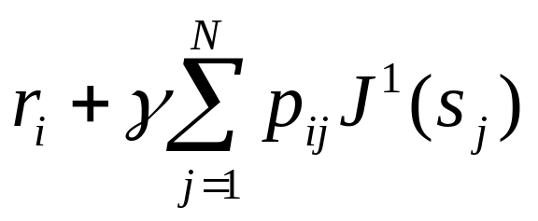
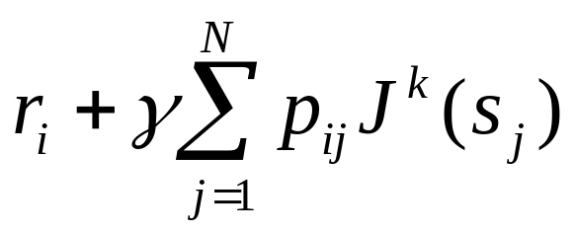
Value Iteration: another way to solve a Markov System
Define
J¹(S_{i}) = Expected discounted sum of rewards over the next 1 time step.
J²(S_{i}) = Expected discounted sum rewards during next 2 steps
J³(S_{i}) = Expected discounted sum rewards during next 3 steps
:
J^{k}(S_{i}) = Expected discounted sum rewards during next k steps
J¹(S_{i}) = r_{i} (what?)
J²(S_{i}) = (what?)
:
J^{k+1}(S_{i}) = (what?)
N = Number of states

Slide 13
Let’s do Value Iteration
1/2
WIND

0
1/2
γ = 0.5
SUN

+4
HAIL
.::.:.::
-8
1/2
1/2
1/2
1/2
k | J^{k}(SUN) | J^{k}(WIND) | J^{k}(HAIL)
1
2
3
4
5

Slide 14
Let’s do Value Iteration
1/2
WIND

0
1/2
γ = 0.5
SUN

+4
HAIL
.::.:.::
-8
1/2
1/2
1/2
1/2
k | J^{k}(SUN) | J^{k}(WIND) | J^{k}(HAIL)
1 | 4 | 0 | -8
2 | 5 | -1 | -10
3 | 5 | -1.25 | -10.75
4 | 4.94 | -1.44 | -11
5 | 4.88 | -1.52 | -11.11

Slide 15
Value Iteration for solving Markov Systems
Compute J¹(S_{i}) for each j
Compute J²(S_{i}) for each j
:
Compute J^{k}(S_{i}) for each j
As k→∞ J^{k}(S_{i})→J*(S_{i}) . Why?
When to stop? When
Max J^{k+1}(S_{i}) – J^{k}(S_{i}) < ξ
i
This is faster than matrix inversion (N³ style)
if the transition matrix is sparse

Slide 16
A Markov Decision Process
1
S
γ = 0.9
You run a startup company.
In every state you must choose between Saving money or Advertising.
Poor &
Unknown
+0
Poor &
Famous
+0
1
1/2
A
A
1/2
S
1/2
1/2
1/2
1/2
1
1/2
S
A
A
1/2
Rich &
Famous
+10
Rich &
Unknown
+10
S
1/2
1/2

Slide 17

Markov Decision Processes
An MDP has…
A set of states {s₁ ··· S_{N}}
A set of actions {a₁ ··· a_{M}}
A set of rewards {r₁ ··· r_{N}} (one for each state)
A transition probability function
On each step:
0. Call current state S_{i}
1. Receive reward r_{i}
2. Choose action ∈ {a₁ ··· a_{M}}
3. If you choose action a_{k} you’ll move to state S_{j} with probability
4. All future rewards are discounted by γ

Slide 18
A Policy
A policy is a mapping from states to actions.
Examples
1
S
1
PU
0
PF
0
STATE → ACTION
PU | S
PF | A
RU | S
RF | A
1/2
A
Policy Number 1:
1
S
A
1/2
RU
+10
RF
+10
STATE → ACTION
PU | A
PF | A
RU | A
RF | A
1/2
1
1/2
PU
0
A
PF
0
A
Policy Number 2:
1/2
1/2
1
RU
10
A
RF
10
A
How many possible policies in our example?
Which of the above two policies is best?
How do you compute the optimal policy?

Slide 19
Interesting Fact
For every M.D.P. there exists an optimal policy.
It’s a policy such that for every possible start state there is no better option than to follow the policy.
(Not proved in this lecture)

Slide 20
Computing the Optimal Policy
Idea One:
Run through all possible policies.
Select the best.
What’s the problem ??

Slide 21
Optimal Value Function
Define J*(S_{i}) = Expected Discounted Future Rewards, starting from state S_{i}, assuming we use the optimal policy
1
B
1
A
S₂
+3
0
Question
What (by inspection) is an optimal policy for that MDP?
(assume γ = 0.9)
1/2
1/2
S₁
+0
A
B
1/3
1/2
1/3
B
S₃
+2
1/2
1/3
A
1
What is J*(S₁) ?
What is J*(S₂) ?
What is J*(S₃) ?

Slide 22
Computing the Optimal Value Function with Value Iteration
Define
J^{k}(S_{i}) = Maximum possible expected sum of discounted rewards I can get if I start at state S_{i} and I live for k time steps.
Note that J¹(S_{i}) = r_{i}

Slide 23
Let’s compute J^{k}(S_{i}) for our example
k | J^{k}(PU) | J^{k}(PF) | J^{k}(RU) | J^{k}(RF)
1
2
3
4
5
6

Slide 24
Let’s compute J^{k}(S_{i}) for our example
k | J^{k}(PU) | J^{k}(PF) | J^{k}(RU) | J^{k}(RF)
1 | 0 | 0 | 10 | 10
2 | 0 | 4.5 | 14.5 | 19
3 | 2.03 | 6.53 | 25.08 | 18.55
4 | 3.852 | 12.20 | 29.63 | 19.26
5 | 7.22 | 15.07 | 32.00 | 20.40
6 | 10.03 | 17.65 | 33.58 | 22.43

Slide 25
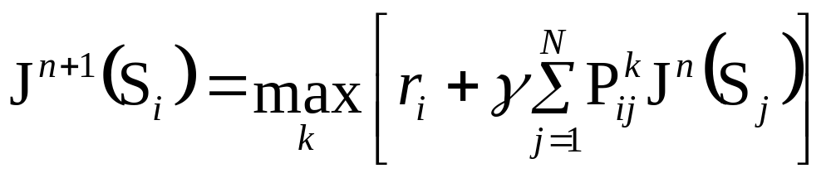
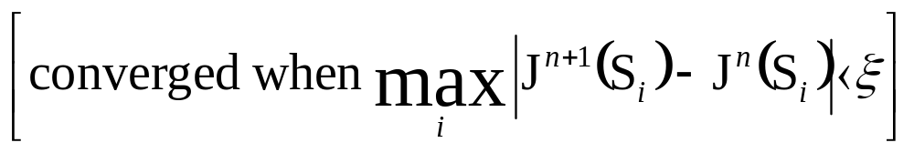
Bellman’s Equation
Value Iteration for solving MDPs
Compute J¹(S_{i}) for all i
Compute J²(S_{i}) for all i
:
Compute J^{n}(S_{i}) for all i
…..until converged
…Also known as
Dynamic Programming

Slide 26
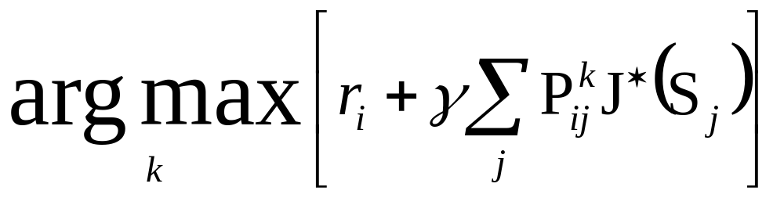
Finding the Optimal Policy
Compute J*(S_{i}) for all i using Value Iteration (a.k.a. Dynamic Programming)
Define the best action in state S_{i} as
(Why?)

Slide 27
Applications of MDPs
This extends the search algorithms of your first lectures to the case of probabilistic next states.
Many important problems are MDPs….
  Robot path planning
  Travel route planning
  Elevator scheduling
  Bank customer retention
  Autonomous aircraft navigation
  Manufacturing processes
  Network switching & routing

Slide 28
Asynchronous D.P.
Value Iteration:
“Backup S₁”, “Backup S₂”, ···· “Backup S_{N}”, then “Backup S₁”, “Backup S₂”, ···· repeat :
: There’s no reason that you need to do the backups in order!
Random Order …still works. Easy to parallelize (Dyna, Sutton 91)
On-Policy Order
Simulate the states that the system actually visits.
Efficient Order
e.g. Prioritized Sweeping [Moore 93]
Q-Dyna [Peng & Williams 93]

Slide 29
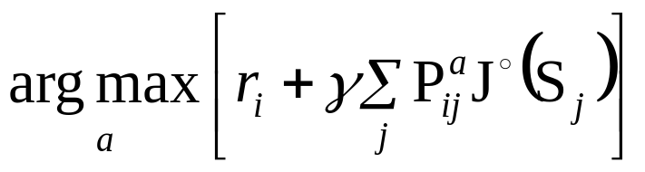
Policy Iteration
Another way to compute optimal policies
Write π(S_{i}) = action selected in the i’th state. Then π is a policy.
Write π^{t} = t’th policy on t’th iteration
Algorithm:
π˚ = Any randomly chosen policy
∀i compute J˚(S_{i}) = Long term reward starting at S_{i} using π˚
π₁(S_{i}) =
J₁ = ….
π₂(S_{i}) = ….
… Keep computing π¹ , π² , π³ …. until π^{k} = π^{k+1} . You now have an optimal policy.

Slide 30
Policy Iteration & Value Iteration: Which is best ???
It depends.
Lots of actions? Choose Policy Iteration
Already got a fair policy? Policy Iteration
Few actions, acyclic? Value Iteration
Best of Both Worlds:
Modified Policy Iteration [Puterman]
  …a simple mix of value iteration and policy iteration
3rd Approach
Linear Programming

Slide 31
Time to Moan
What’s the biggest problem(s) with what we’ve seen so far?

Slide 32
Dealing with large numbers of states
Don’t use a Table…
STATE | VALUE
s₁
S₂
:
S₁₅₁₂₂₁₈₉
use…
(Generalizers) (Hierarchies)
Splines
Variable Resolution
[Munos 1999]
A Function Approximator
Multi Resolution
Memory
Based
STATE
VALUE

Slide 33
Function approximation for value functions
Polynomials [Samuel, Boyan, Much O.R.
Literature]
Neural Nets [Barto & Sutton, Tesauro, Crites, Singh, Tsitsiklis]
Splines Economists, Controls
Downside: All convergence guarantees disappear.
Backgammon, Pole Balancing, Elevators, Tetris, Cell phones
Checkers, Channel Routing, Radio Therapy

Slide 34
Memory-based Value Functions
J(“state”) = J(most similar state in memory to “state”)
or
Average J(20 most similar states)
or
Weighted Average J(20 most similar states)
[Jeff Peng, Atkenson & Schaal,
Geoff Gordon, proved stuff
Scheider, Boyan & Moore 98]
“Planet Mars Scheduler”

Slide 35
Hierarchical Methods
Continuous State Space: “Split a state when statistically significant that a split would improve performance”
Discrete Space:
Chapman & Kaelbling 92, McCallum 95 (includes hidden state)
Continuous Space
e.g. Simmons et al 83, Chapman & Knelbling 92, Mark Ring 94 …, Munos 96
A kind of Decision Tree Value Function
with interpolation!
“Prove needs a higher resolution”
Moore 93, Moore & Atkeson 95
Multiresolution
A hierarchy with high level “managers” abstracting low level “servants”
Many O.R. Papers, Dayan & Sejnowski’s Feudal learning, Dietterich 1998 (MAX-Q hierarchy) Moore, Baird & Kaelbling 2000 (airports Hierarchy)

Slide 36
What You Should Know
Definition of a Markov System with Discounted rewards
How to solve it with Matrix Inversion
How (and why) to solve it with Value Iteration
Definition of an MDP, and value iteration to solve an MDP
Policy iteration
Great respect for the way this formalism generalizes the deterministic searching of the start of the class
But awareness of what has been sacrificed.

