Slide 1
Learning with Maximum Likelihood
Andrew W. Moore
Professor
School of Computer Science
Carnegie Mellon University
www.cs.cmu.edu/~awm
awm@cs.cmu.edu
412-268-7599
Note to other teachers and users of these slides. Andrew would be delighted if you found this source material useful in giving your own lectures. Feel free to use these slides verbatim, or to modify them to fit your own needs. PowerPoint originals are available. If you make use of a significant portion of these slides in your own lecture, please include this message, or the following link to the source repository of Andrew’s tutorials: http://www.cs.cmu.edu/~awm/tutorials . Comments and corrections gratefully received.

Slide 2
Maximum Likelihood learning of Gaussians for Data Mining
Why we should care
Learning Univariate Gaussians
Learning Multivariate Gaussians
What’s a biased estimator?
Bayesian Learning of Gaussians

Slide 3
Why we should care
Maximum Likelihood Estimation is a very very very very fundamental part of data analysis.
“MLE for Gaussians” is training wheels for our future techniques
Learning Gaussians is more useful than you might guess…

Slide 4
Learning Gaussians from Data
Suppose you have x₁, x₂, … x_{R} ~ (i.i.d) N(μ,σ²)
But you don’t know μ
(you do know σ²)
MLE: For which μ is x₁, x₂, … x_{R} most likely?
MAP: Which μ maximizes p(μ|x₁, x₂, … x_{R} , σ²)?

Slide 5
Learning Gaussians from Data
Suppose you have x₁, x₂, … x_{R} ~(i.i.d) N(μ,σ²)
But you don’t know μ
(you do know σ²)
Sneer
MLE: For which μ is x₁, x₂, … x_{R} most likely?
MAP: Which μ maximizes p(μ|x₁, x₂, … x_{R} , σ²)?

Slide 6
Learning Gaussians from Data
Suppose you have x₁, x₂, … x_{R} ~(i.i.d) N(μ,σ²)
But you don’t know μ
(you do know σ²)
Sneer
MLE: For which μ is x₁, x₂, … x_{R} most likely?
MAP: Which μ maximizes p(μ|x₁, x₂, … x_{R} , σ²)?
Despite this, we’ll spend 95% of our time on MLE. Why? Wait and see…

Slide 7
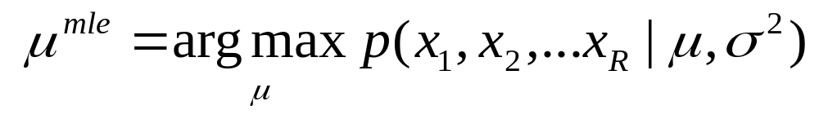
MLE for univariate Gaussian
Suppose you have x₁, x₂, … x_{R} ~(i.i.d) N(μ,σ²)
But you don’t know μ (you do know σ²)
MLE: For which μ is x₁, x₂, … x_{R} most likely?

Slide 8
Algebra Euphoria
= |  | (by i.i.d)
= |  | (monotonicity of log)
= |  | (plug in formula for Gaussian)
= |  | (after simplification)

Slide 9
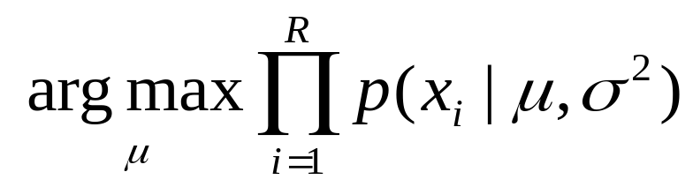
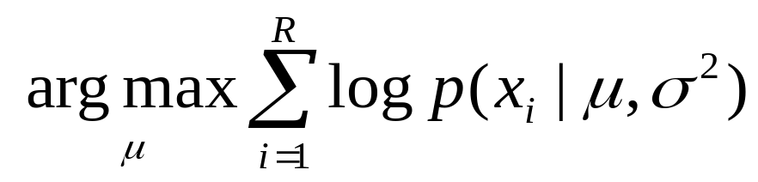
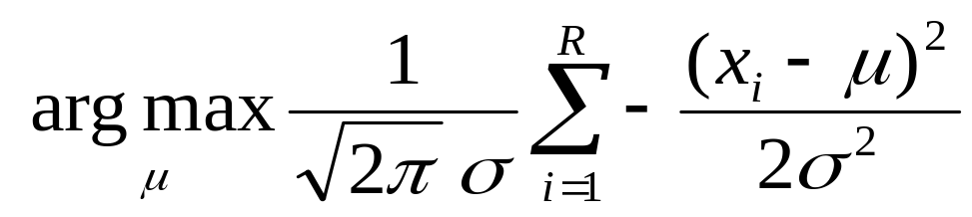
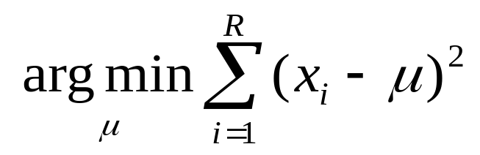
Algebra Euphoria
= |  | (by i.i.d)
= |  | (monotonicity of log)
= |  | (plug in formula for Gaussian)
= |  | (after simplification)

Slide 10
Intermission: A General Scalar MLE strategy
Task: Find MLE θ assuming known form for p(Data| θ,stuff)
Write LL = log P(Data| θ,stuff)
Work out ∂LL/∂θ using high-school calculus
Set ∂LL/∂θ=0 for a maximum, creating an equation in terms of θ
Solve it*
Check that you’ve found a maximum rather than a minimum or saddle-point, and be careful if θ is constrained
        *This is a perfect example of something that works perfectly in all textbook examples and usually involves surprising pain if you need it for something new.

Slide 11
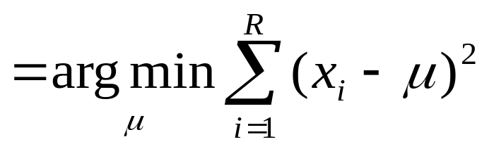
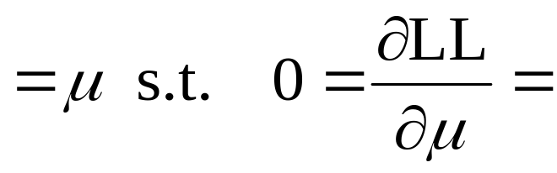
The MLE μ
= (what?)

Slide 12
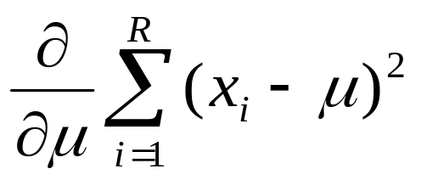
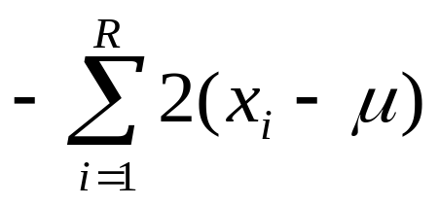
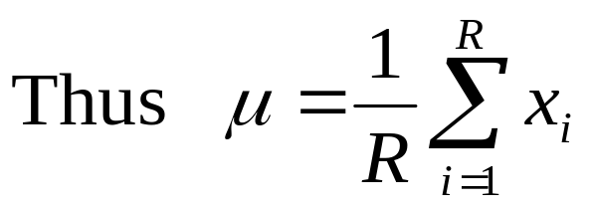
The MLE μ

Slide 13
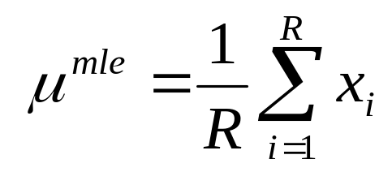
Lawks-a-lawdy!
The best estimate of the mean of a distribution is the mean of the sample!
At first sight:
This kind of pedantic, algebra-filled and ultimately unsurprising fact is exactly the reason people throw down their “Statistics” book and pick up their “Agent Based Evolutionary Data Mining Using The Neuro-Fuzz Transform” book.

Slide 14
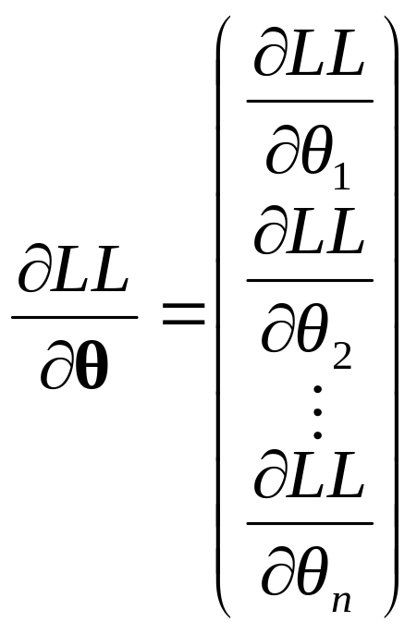
A General MLE strategy
Suppose θ = (θ₁, θ₂, …, θ_{n})^{T} is a vector of parameters.
Task: Find MLE θ assuming known form for p(Data| θ,stuff)
Write LL = log P(Data| θ,stuff)
Work out ∂LL/∂θ using high-school calculus

Slide 15
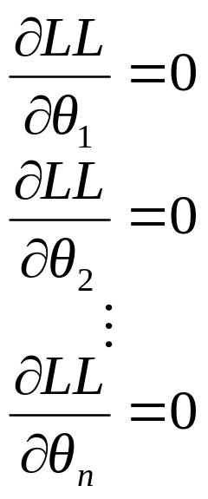
A General MLE strategy
Suppose θ = (θ₁, θ₂, …, θ_{n})^{T} is a vector of parameters.
Task: Find MLE θ assuming known form for p(Data| θ,stuff)
Write LL = log P(Data| θ,stuff)
Work out ∂LL/∂θ using high-school calculus
Solve the set of simultaneous equations

Slide 16
A General MLE strategy
Suppose θ = (θ₁, θ₂, …, θ_{n})^{T} is a vector of parameters.
Task: Find MLE θ assuming known form for p(Data| θ,stuff)
Write LL = log P(Data| θ,stuff)
Work out ∂LL/∂θ using high-school calculus
Solve the set of simultaneous equations
Check that you’re at a maximum

Slide 17
A General MLE strategy
Suppose θ = (θ₁, θ₂, …, θ_{n})^{T} is a vector of parameters.
Task: Find MLE θ assuming known form for p(Data| θ,stuff)
Write LL = log P(Data| θ,stuff)
Work out ∂LL/∂θ using high-school calculus
Solve the set of simultaneous equations
If you can’t solve them, what should you do?
Check that you’re at a maximum

Slide 18
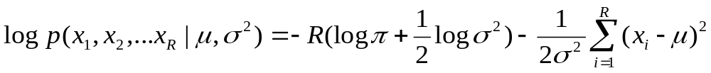
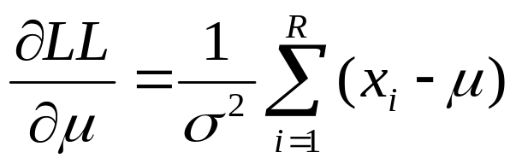
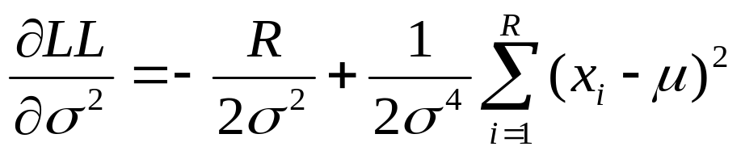
MLE for univariate Gaussian
Suppose you have x₁, x₂, … x_{R} ~(i.i.d) N(μ,σ²)
But you don’t know μ or σ²
MLE: For which θ =(μ,σ²) is x₁, x₂,…x_{R} most likely?

Slide 19
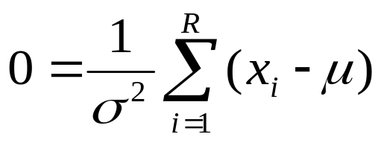
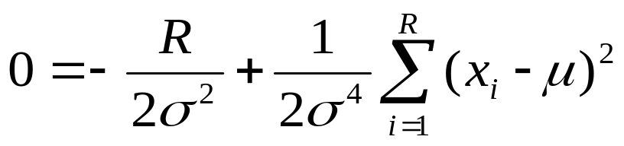
MLE for univariate Gaussian
Suppose you have x₁, x₂, … x_{R} ~(i.i.d) N(μ,σ²)
But you don’t know μ or σ²
MLE: For which θ =(μ,σ²) is x₁, x₂,…x_{R} most likely?

Slide 20
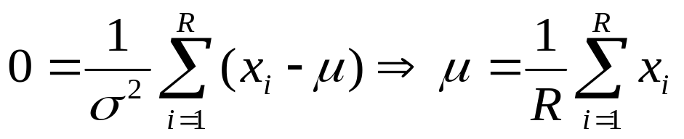
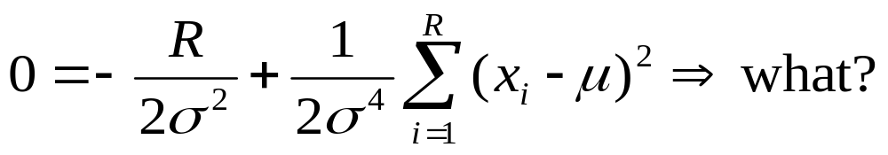
MLE for univariate Gaussian
Suppose you have x₁, x₂, … x_{R} ~(i.i.d) N(μ,σ²)
But you don’t know μ or σ²
MLE: For which θ =(μ,σ²) is x₁, x₂,…x_{R} most likely?

Slide 21
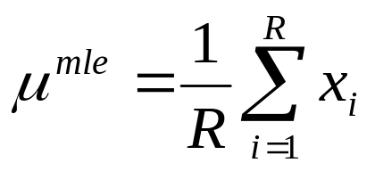
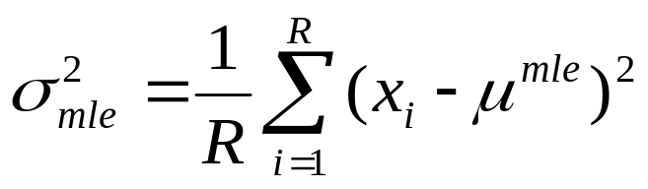
MLE for univariate Gaussian
Suppose you have x₁, x₂, … x_{R} ~(i.i.d) N(μ,σ²)
But you don’t know μ or σ²
MLE: For which θ =(μ,σ²) is x₁, x₂,…x_{R} most likely?

Slide 22
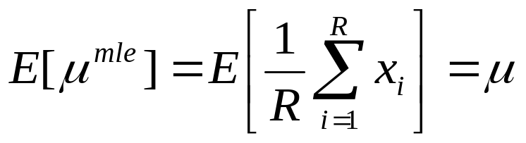
Unbiased Estimators
An estimator of a parameter is unbiased if the expected value of the estimate is the same as the true value of the parameters.
If x₁, x₂, … x_{R} ~(i.i.d) N(μ,σ²) then
μ^{mle} is unbiased

Slide 23
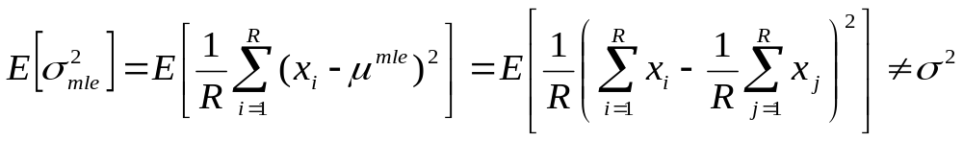
Biased Estimators
An estimator of a parameter is biased if the expected value of the estimate is different from the true value of the parameters.
If x₁, x₂, … x_{R} ~(i.i.d) N(μ,σ²) then
σ²_{mle} is biased

Slide 24
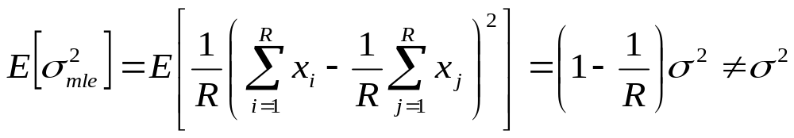
MLE Variance Bias
If x₁, x₂, … x_{R} ~(i.i.d) N(μ,σ²) then
Intuition check: consider the case of R=1
Why should our guts expect that σ²_{mle} would be an underestimate of true σ²?
How could you prove that?

Slide 25
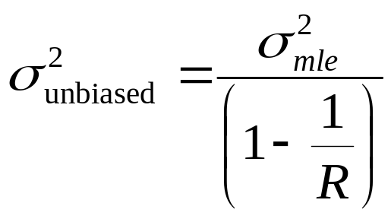
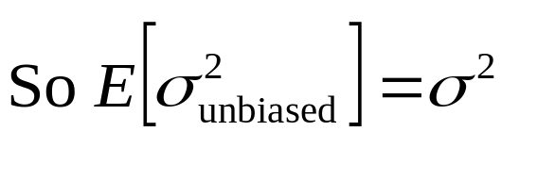
Unbiased estimate of Variance
If x₁, x₂, … x_{R} ~(i.i.d) N(μ,σ²) then
So define

Slide 26
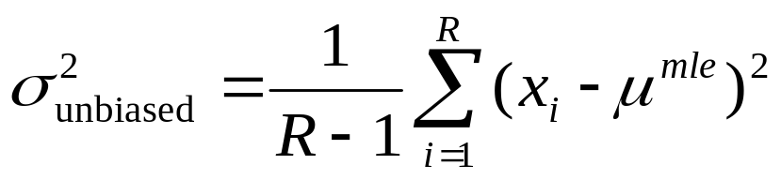
Unbiased estimate of Variance
If x₁, x₂, … x_{R} ~(i.i.d) N(μ,σ²) then
So define

Slide 27
Unbiaseditude discussion
Which is best?
Answer:
It depends on the task
And doesn’t make much difference once R--> large

Slide 28
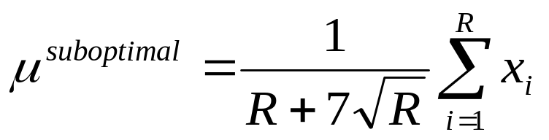
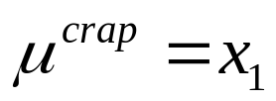
Don’t get too excited about being unbiased
Assume x₁, x₂, … x_{R} ~(i.i.d) N(μ,σ²)
Suppose we had these estimators for the mean
Are either of these unbiased?
Will either of them asymptote to the correct value as R gets large?
Which is more useful?

Slide 29
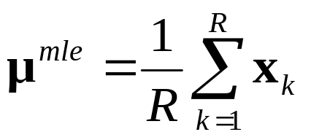
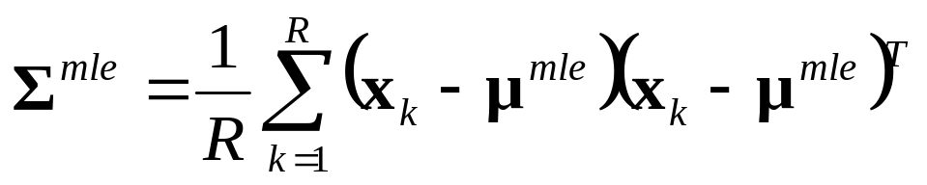
MLE for m-dimensional Gaussian
Suppose you have x₁, x₂, … x_{R} ~(i.i.d) N(μ,Σ)
But you don’t know μ or Σ
MLE: For which θ =(μ,Σ) is x₁, x₂, … x_{R} most likely?

Slide 30
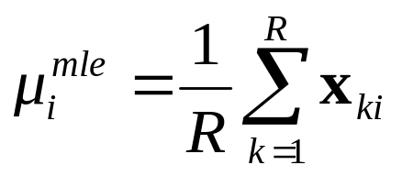
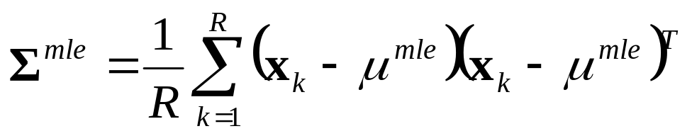
MLE for m-dimensional Gaussian
Suppose you have x₁, x₂, … x_{R} ~(i.i.d) N(μ,Σ)
But you don’t know μ or Σ
MLE: For which θ =(μ,Σ) is x₁, x₂, … x_{R} most likely?
Where 1 ≤ i ≤ m
And x_{ki} is value of the i^{th} component of x_{k} (the i^{th} attribute of the k^{th} record)
And μ_{i}^{mle} is the i^{th} component of μ^{mle}

Slide 31
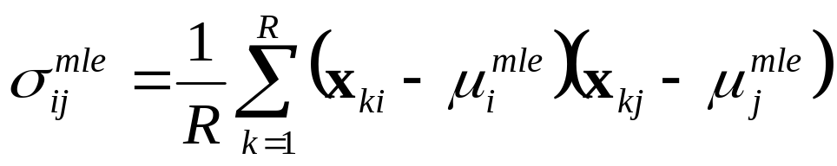
MLE for m-dimensional Gaussian
Suppose you have x₁, x₂, … x_{R} ~(i.i.d) N(μ,Σ)
But you don’t know μ or Σ
MLE: For which θ =(μ,Σ) is x₁, x₂, … x_{R} most likely?
Where 1 ≤ i ≤ m, 1 ≤ j ≤ m
And x_{ki} is value of the i^{th} component of x_{k} (the i^{th} attribute of the k^{th} record)
And σ_{ij}^{mle} is the (i,j)^{th} component of Σ^{mle}

Slide 32
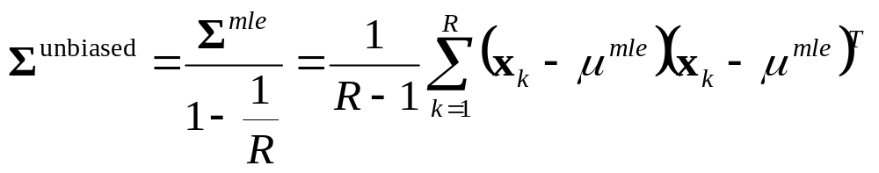
MLE for m-dimensional Gaussian
Q: How would you prove this?
  A: Just plug through the MLE recipe.
Note how Σ^{mle} is forced to be symmetric non-negative definite
Note the unbiased case
How many datapoints would you need before the Gaussian has a chance of being non-degenerate?
Suppose you have x₁, x₂, … x_{R} ~(i.i.d) N(μ,Σ)
But you don’t know μ or Σ
MLE: For which θ =(μ,Σ) is x₁, x₂, … x_{R} most likely?

Slide 33
Confidence intervals
We need to talk
We need to discuss how accurate we expect μ^{mle} and Σ^{mle} to be as a function of R
And we need to consider how to estimate these accuracies from data…
Analytically *
Non-parametrically (using randomization and bootstrapping) *
But we won’t. Not yet.
      *Will be discussed in future Andrew lectures…just before we need this technology.

Slide 34
Structural error
Actually, we need to talk about something else too..
What if we do all this analysis when the true distribution is in fact not Gaussian?
How can we tell? *
How can we survive? *
      *Will be discussed in future Andrew lectures…just before we need this technology.

Slide 35
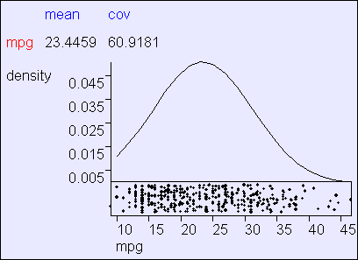
Gaussian MLE in action
Using R=392 cars from the “MPG” UCI dataset supplied by Ross Quinlan

Slide 36
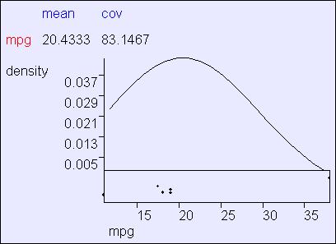
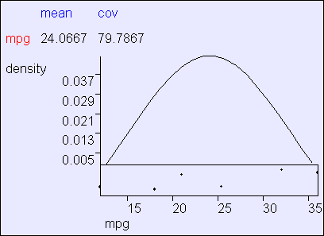
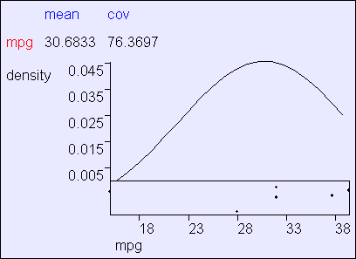
Data-starved Gaussian MLE
Using three subsets of MPG.
Each subset has 6 randomly-chosen cars.

Slide 37
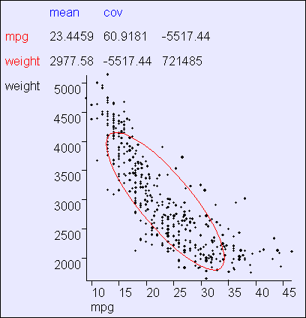
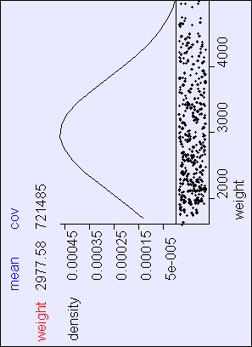
Bivariate MLE in action

Slide 38
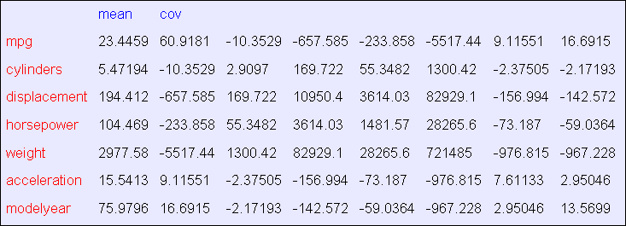
Multivariate MLE
Covariance matrices are not exciting to look at

Slide 39
Being Bayesian: MAP estimates for Gaussians
Suppose you have x₁, x₂, … x_{R} ~(i.i.d) N(μ,Σ)
But you don’t know μ or Σ
MAP: Which (μ,Σ) maximizes p(μ,Σ |x₁, x₂, … x_{R})?
Step 1: Put a prior on (μ,Σ)

Slide 40
Being Bayesian: MAP estimates for Gaussians
Suppose you have x₁, x₂, … x_{R} ~(i.i.d) N(μ,Σ)
But you don’t know μ or Σ
MAP: Which (μ,Σ) maximizes p(μ,Σ |x₁, x₂, … x_{R})?
Step 1: Put a prior on (μ,Σ)
Step 1a: Put a prior on Σ
    (ν₀-m-1) Σ ~ IW(ν₀, (ν₀-m-1) Σ ₀ )
    This thing is called the Inverse-Wishart distribution.
    A PDF over SPD matrices!

Slide 41
Being Bayesian: MAP estimates for Gaussians
ν₀ small: “I am not sure about my guess of Σ ₀ “
ν₀ large: “I’m pretty sure about my guess of Σ ₀ “
Σ ₀ : (Roughly) my best guess of Σ
Ε[Σ ] = Σ ₀
Suppose you have x₁, x₂, … x_{R} ~(i.i.d) N(μ,Σ)
But you don’t know μ or Σ
MAP: Which (μ,Σ) maximizes p(μ,Σ |x₁, x₂, … x_{R})?
Step 1: Put a prior on (μ,Σ)
Step 1a: Put a prior on Σ
    (ν₀-m-1) Σ ~ IW(ν₀, (ν₀-m-1) Σ ₀ )
    This thing is called the Inverse-Wishart distribution.
    A PDF over SPD matrices!

Slide 42
Being Bayesian: MAP estimates for Gaussians
Suppose you have x₁, x₂, … x_{R} ~(i.i.d) N(μ,Σ)
But you don’t know μ or Σ
MAP: Which (μ,Σ) maximizes p(μ,Σ |x₁, x₂, … x_{R})?
Step 1: Put a prior on (μ,Σ)
Step 1a: Put a prior on Σ
(ν₀-m-1)Σ ~ IW(ν₀, (ν₀-m-1)Σ ₀ )
Step 1b: Put a prior on μ | Σ
μ | Σ ~ N(μ₀ , Σ / κ₀)
Together, “Σ” and “μ | Σ” define a joint distribution on (μ,Σ)

Slide 43
Being Bayesian: MAP estimates for Gaussians
Suppose you have x₁, x₂, … x_{R} ~(i.i.d) N(μ,Σ)
But you don’t know μ or Σ
MAP: Which (μ,Σ) maximizes p(μ,Σ |x₁, x₂, … x_{R})?
κ₀ small: “I am not sure about my guess of μ ₀ “
κ₀ large: “I’m pretty sure about my guess of μ ₀ “
μ ₀ : My best guess of μ
E[μ ] = μ ₀
Step 1: Put a prior on (μ,Σ)
Step 1a: Put a prior on Σ
(ν₀-m-1)Σ ~ IW(ν₀, (ν₀-m-1)Σ ₀ )
Step 1b: Put a prior on μ | Σ
μ | Σ ~ N(μ₀ , Σ / κ₀)
Together, “Σ” and “μ | Σ” define a joint distribution on (μ,Σ)
Notice how we are forced to express our ignorance of μ proportionally to Σ

Slide 44
Being Bayesian: MAP estimates for Gaussians
Suppose you have x₁, x₂, … x_{R} ~(i.i.d) N(μ,Σ)
But you don’t know μ or Σ
MAP: Which (μ,Σ) maximizes p(μ,Σ |x₁, x₂, … x_{R})?
Why do we use this form of prior?
Step 1: Put a prior on (μ,Σ)
Step 1a: Put a prior on Σ
(ν₀-m-1)Σ ~ IW(ν₀, (ν₀-m-1)Σ ₀ )
Step 1b: Put a prior on μ | Σ
μ | Σ ~ N(μ₀ , Σ / κ₀)

Slide 45
Being Bayesian: MAP estimates for Gaussians
Suppose you have x₁, x₂, … x_{R} ~(i.i.d) N(μ,Σ)
But you don’t know μ or Σ
MAP: Which (μ,Σ) maximizes p(μ,Σ |x₁, x₂, … x_{R})?
Why do we use this form of prior?
Actually, we don’t have to
But it is computationally and algebraically convenient…
…it’s a conjugate prior.
Step 1: Put a prior on (μ,Σ)
Step 1a: Put a prior on Σ
(ν₀-m-1)Σ ~ IW(ν₀, (ν₀-m-1)Σ ₀ )
Step 1b: Put a prior on μ | Σ
μ | Σ ~ N(μ₀ , Σ / κ₀)

Slide 46
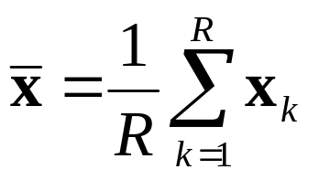
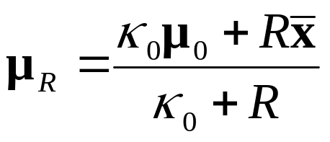
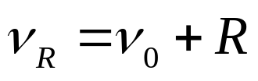
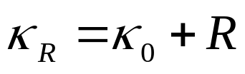
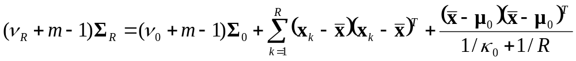
Being Bayesian: MAP estimates for Gaussians
Suppose you have x₁, x₂, … x_{R} ~(i.i.d) N(μ,Σ)
MAP: Which (μ,Σ) maximizes p(μ,Σ |x₁, x₂, … x_{R})?
Step 1: Prior: (ν₀-m-1) Σ ~ IW(ν₀, (ν₀-m-1) Σ ₀ ), μ | Σ ~ N(μ₀ , Σ / κ₀)
Step 2:
Step 3: Posterior: (ν_{R}+m-1)Σ ~ IW(ν_{R}, (ν_{R}+m-1) Σ _{R} ),
μ | Σ ~ N(μ_{R} , Σ / κ_{R})
Result: μ^{map} = μ_{R}, E[Σ |x₁, x₂, … x_{R} ]= Σ_{R}

Slide 47
Being Bayesian: MAP estimates for Gaussians
Look carefully at what these formulae are doing. It’s all very sensible.
Conjugate priors mean prior form and posterior form are same and characterized by “sufficient statistics” of the data.
The marginal distribution on μ is a student-t
One point of view: it’s pretty academic if R > 30
Suppose you have x₁, x₂, … x_{R} ~(i.i.d) N(μ,Σ)
MAP: Which (μ,Σ) maximizes p(μ,Σ |x₁, x₂, … x_{R})?
Step 1: Prior: (ν₀-m-1) Σ ~ IW(ν₀, (ν₀-m-1) Σ ₀ ), μ | Σ ~ N(μ₀ , Σ / κ₀)
Step 2:
Step 3: Posterior: (ν_{R}+m-1)Σ ~ IW(ν_{R}, (ν_{R}+m-1) Σ _{R} ),
μ | Σ ~ N(μ_{R} , Σ / κ_{R})
Result: μ^{map} = μ_{R}, E[Σ |x₁, x₂, … x_{R} ]= Σ_{R}

Slide 48
Where we’re at
Categorical inputs only
Real-valued inputs only
Mixed Real / Cat okay
Predict
category
Joint BC
Naïve BC
Dec Tree
Inputs
Classifier
Density
Estimator
Prob-
ability
Joint DE
Naïve DE
Gauss DE
Inputs
Predict
real no.
Inputs
Regressor

Slide 49
What you should know
The Recipe for MLE
What do we sometimes prefer MLE to MAP?
Understand MLE estimation of Gaussian parameters
Understand “biased estimator” versus “unbiased estimator”
Appreciate the outline behind Bayesian estimation of Gaussian parameters

Slide 50
Useful exercise
We’d already done some MLE in this class without even telling you!
Suppose categorical arity-n inputs x₁, x₂, … x_{R}~(i.i.d.) from a multinomial
M(p₁, p₂, … p_{n})
  where
P(x_{k}=j|p)=p_{j}
What is the MLE p=(p₁, p₂, … p_{n})?

