Slide 1
Very highly recommended book to buy if you’re even only half interested in geometry-meets-search-meets-AI-meets-robotics: Robot Motion Planning by Jean Claude Latombe (Kluwer, 1990)
Robot Motion Planning
Andrew W. Moore
Professor
School of Computer Science
Carnegie Mellon University
www.cs.cmu.edu/~awm
awm@cs.cmu.edu
412-268-7599
Note to other teachers and users of these slides. Andrew would be delighted if you found this source material useful in giving your own lectures. Feel free to use these slides verbatim, or to modify them to fit your own needs. PowerPoint originals are available. If you make use of a significant portion of these slides in your own lecture, please include this message, or the following link to the source repository of Andrew’s tutorials: http://www.cs.cmu.edu/~awm/tutorials . Comments and corrections gratefully received.

Slide 2
Let’s Think About Automating Reasoning
We’ve already seen
  Reasoning with Constraints
  State space search in discrete spaces
  Reasoning with multiple agents
Later (in this course) we’ll see
  Probabilistic Reasoning with Markov Decision Processes, Reinforcement Learning and HMMS
But NOW let’s think about
SPATIAL REASONING

Slide 3
Spatial Reasoning
Immovable Obstacles
Start Configuration
Goal Configuration
Can’t we use our previous methods?
Discrete Search? – Not a discrete problem
CSP? – Not a natural CSP formulation
Probabilistic? – Nope.

Slide 4
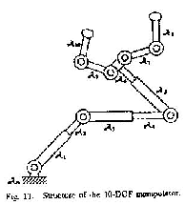
Robots
For our purposes, a robot is:
A set of moving rigid objects called LINKS which are connected by JOINTS.
Typically, joints are REVOLUTE or PRISMATIC.
Such joints each give one DEGREE OF FREEDOM.
Given p DOFs, the configuration of the robot can be represented by p values q = (q₁ q₂ ··· q_{p}) where q_{i} is the angle or length of the i’th joint

Slide 5
Free-Flying Polygons
If part of the robot is fixed in the world, the joints are all the DOFs you’re getting. But if the robot can be free-flying we get more DOFs.
May move in x direction or y direction
Fixed
0 DOFs
2 DOFs
Question: How many DOFs for a polyhedron free flying in 3D space?
May move in x & y dir and may rotate
3 DOFs

Slide 6
Examples
How many DOFs?
·
·
Fixed
Free flying
How many DOFs?
·
·
Midline ■■■ must always be horizontal.
How many DOFs?
·
·
The configuration q has one real valued entry per DOF.
~

Slide 7
Robot Motion Planning
An important, interesting, spatial reasoning problem.
Let A be a robot with p degrees of freedom, living in a 2-D or 3-D world.
Let B be a set of obstacles in this 2-D or 3-D world.
Call a configuration LEGAL if it neither intersects any obstacles nor self-intersects.
Given an initial configuration q_{start} and a goal config q_{goal}, generate a continuous path of legal configurations between them, or report failure if no such path exists.
~
~

Slide 8
Configuration Space
Is the set of legal configurations of the robot. It also defines the topology of continuous motions
For rigid-object robots (no joints) there exists a transformation to the robot and obstacles that turns the robot into a single point. The C-Space Transform

Slide 9
Configuration Space Transform Examples
2-D World
2 DOFs
Where can I move this robot in the vicinity of this obstacle?
Where can I move this point in the vicinity of this expanded obstacle?
…is equivalent to…

Slide 10
Configuration Space Transform Examples
2-D World
2 DOFs
Where can I move this robot in the vicinity of this obstacle?
Where can I move this point in the vicinity of this expanded obstacle?
…is equivalent to…
Assuming you’re not allowed to rotate

Slide 11
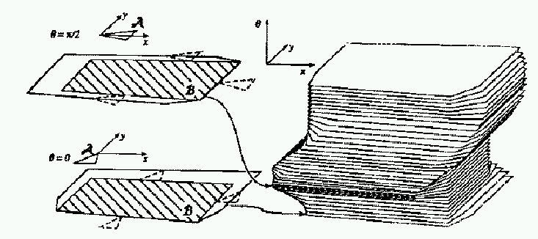
Configuration Space Transform Examples
2-D World
3 DOFs
We’ve turned the problem from “Twist and turn this 2-D polygon past this other 2-D polygon” into “Find a path for this point in 3-D space past this weird 3-D obstacle”.
Why’s this transform useful?
Because we can plan paths for points instead of polyhedra/polygons

Slide 12
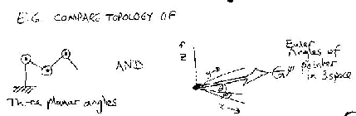
Warning: Topology
If you ever tried implementing these things you’ll quickly start having to deal with spaces which aren’t ℜ^{N}.
E.G. The space of directions in 2-D space: SO(2).
AND The space of directions and orientations in 3-D space: SO(3).
AND Cartesian products thereof.
NOT JUST A CASE OF: “So what? Some of my real numbers happen to be angles”.

Slide 13
Robot Motion Planning Research
…Has produced four kinds of algorithms. The first is the Visibility Graph.

Slide 14
Visibility Graph
Suppose someone gives you a CSPACE with polygonal obstacles
q_{goal}
If there were no blocks, shortest path would be a straight line.
Else it must be a sequence of straight lines “shaving” corners of obstacles.
q_{start}
Obvious, but very awkward to prove

Slide 15
Visibility Graph Algorithm
Find all non-blocked lines between polygon vertices, start and goal.
Search the graph of these lines for the shortest path. (Guess best search algorithm?)
q_{goal}
q_{start}
If there are n vertices, the easy algorithm is O(n³). Slightly tougher O(n²logn). O(n²) in theory.

Slide 16
Visibility Graph Method
COMPLAINT
Visibility graph method finds the shortest path.
Bit it does so by skirting along and close to obstacles.
Any error in control, or model of obstacle locations, and Bang! Screech!!
  Who cares about optimality?
  Perhaps we want to get a non-stupid path that steers as far from the obstacles as it can.

Slide 17
Voronoi Diagrams
Y
R
G
B
Someone gives you some dots. Each dot is a different color.
You color in the whole of 2-D space according to this rule:
“The color of any given point equals the color of the nearest dot.”
The borders between your different regions are a VORNOI DIAGRAM.
For n point in 2-D space the exact Voronoi diagram can be computed in time O(n log n).

Slide 18
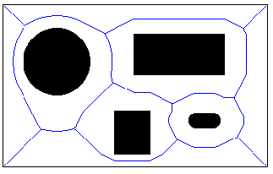
Voronoi Diagram from Polygons instead of Points

Slide 19
Voronoi Diagram Methods for C-Space Motion Planning
Compute the Voronoi Diagram of C-space.
Compute shortest straightline path from start to any point on Voronoi Diagram.
Compute shortest straightline path from goal to any point on Voronoi Diagram.
Compute shortest path from start to goal along Voronoi Diagram.

Slide 20
Voronoi Diagrams
COMPLAINT
Assumes polygons, and very complex above 2-D.
Answer: very nifty approximate algorithms (see Howie Choset’s work http://voronoi.sbp.ri.cmu.edu/~choset)
This “use Voronoi to keep clear of obstacles” is just a heuristic. And can be made to look stupid:
Can you see how?

Slide 21
Voronoi Diagrams
COMPLAINT
Assumes polygons, and very complex above 2-D.
Answer: very nifty approximate algorithms (see Howie Choset’s work http://voronoi.sbp.ri.cmu.edu/~choset)
This “use Voronoi to keep clear of obstacles” is just a heuristic. And can be made to look stupid:
Start ·
· Goal

Slide 22
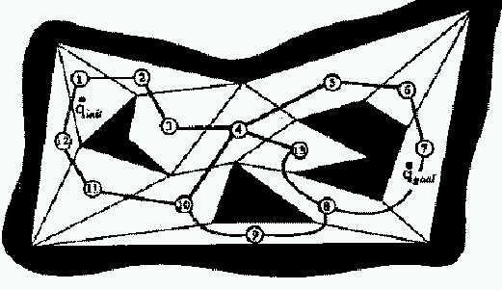
Cell Decomposition Methods
Cell Decomp Method One: Exact Decomp
Break free space into convex exact polygons.
…But this is also impractical above 2-D or with non-polygons.

Slide 23
Approximate Cell Decomposition
 |  |  |  |  |  | . | . |  |  |  | G
 |  |  |  |  |  | . | .
 |  | . |  |  |  | .
 |  | · | . |  |  | .
 | . |  | . |  |  | . | . | .
 | . |  | . |  |  |  | . | .
 | · |  | · |  |  |  | . |  | .
 | . |  | · |  |  |  |  | . |  | .
 | . | . | . |  |  |  |  | . | .
 |  |  | . |  |  |  |  | . | .
S
Lay down a grid
Avoid any cell which intersects an obstacle
Plan shortest path through other cells (e.g. with A*)
If no path exists, double the resolution and try again. Keep trying!!

Slide 24
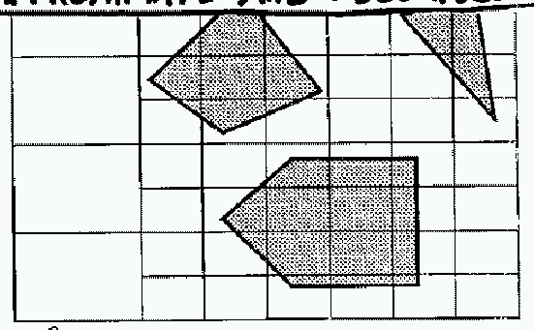
Variable Resolution “Approximate and Decompose”

Slide 25
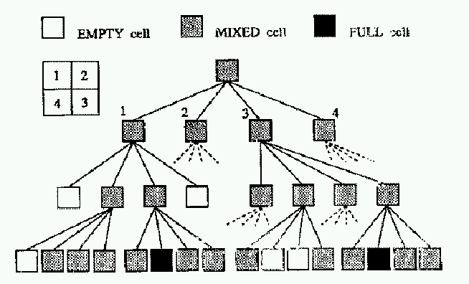
Variable Resolution “Approximate and Decompose”

Slide 26
Approximate Cell Decomposition
COMPLAINTS
Not so many complaints. This is actually used in practical systems.
But
Not exact (no notion of “best” path)
Not complete: doesn’t know if problem actually unsolvable
Still hopeless above a small number of dimensions?

Slide 27
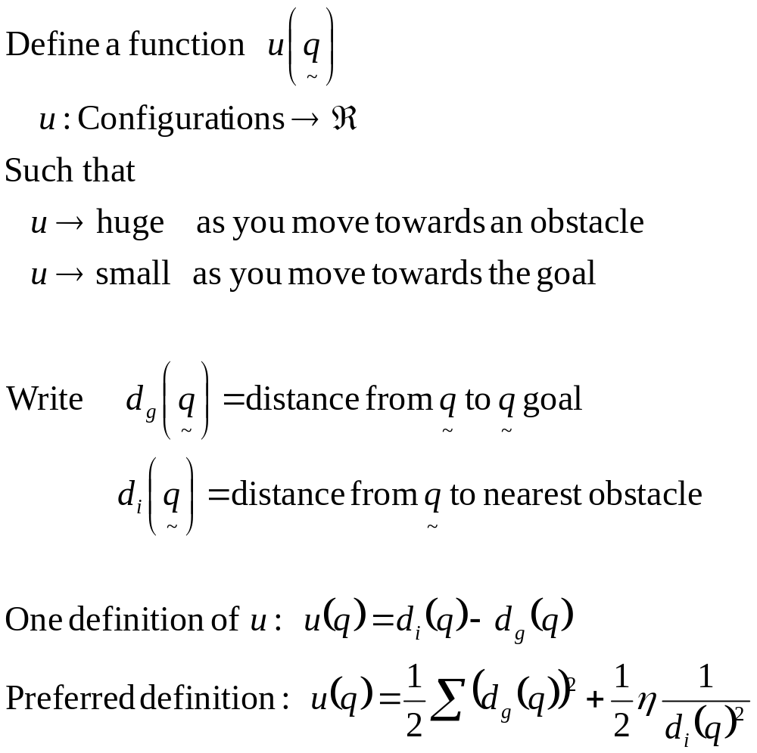
Potential Methods
SIMPLE MOTION PLANNER: Steepest Descent on u

Slide 28
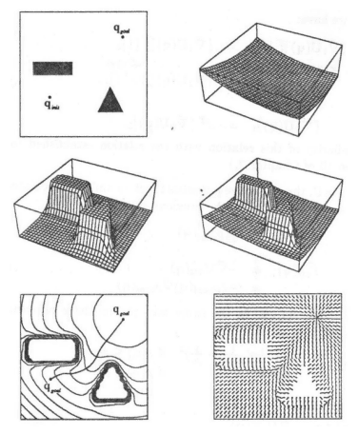
Potential Field Example

Slide 29
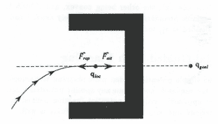
Spot the Obvious Problem!
Solution I:
Use special local-minimum-free potential fields (Laplace equations can do this) – But very expensive to compute
Solution II:
When at a local minimum start doing some searching - example soon

Slide 30
Comparison
 | Potential Fields | Approx Cell Decomp | Voronoi | Visibility
Practical above 2 or 3 D?
Practical above 8 D?
Fast to Compute?
Usable Online?
Gives Optimal?
Spots Impossibilities?
Easy to Implement?

Slide 31
Latombe’s Numerical Potential Field Method
And now…..
Let’s look at one of the state-of-the-art motion planners.
Combines Cell Decomposition and Potential Fields
Key insight: Compute an “optimal” potential field in world coordinate space (not config space)
Define a C-space potential field in terms of world-space potential field.

Slide 32
N.P.F. Step I
Get given a problem.
You have a world ω which is a 2-D or 3-D space.
There are obstacles and a robot. Robot may be fixed or free-flying, may be jointed or totally rigid.
You have a start configuration.
Goal spec. is more flexible than mere goal configuration: You can specify between 1 and P points (P = number of DOFs) in world space, and state that various points on the robot should meet those world points. E.G.
“I want my tip to end up here”
“I want my tip here, my wrist there, and my shoulder way over there.”
or

Slide 33

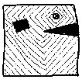
N.P.F. Step II
For each given world-goal-point we compute an optimal potential field in worldspace.
Example:
world-goal-point for x joint on arm
Optimal potential field can simply be “shortest distance”.
Computed by discretizing world-space on a fine grid.
Q: Why is fine grid not too expensive now?

Slide 34

Skeletons in the World Space
Zombie DNA
Easy to skeletonize with a grid
Then what?
  Extend the skeleton to join to the goal
  Compute least-cost-to-goal for all points on skeleton
  Define potential field by traveling downhill to local part of skeleton.
The exact definition of this is unclear. It is NOT “shortest path to skeleton” and not “shortest path to goal” but a kind of combination. Defined inductively by first de**** all points 1 away from skeleton as 1 + least adjacent skeleton-cell cost. Then points next to them, etc., etc.

Slide 35
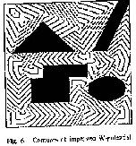
Potential from the Skeleton Method
Remember, we do one of these for each world-goal-point.

Slide 36
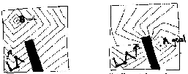
N.P.F. IV
Compute a potential field for configurations.
Remember, for each goal point we have computed a world-space potential.
. B goal
B
. A goal
A
“B” point contours
“A” point contours

Slide 37
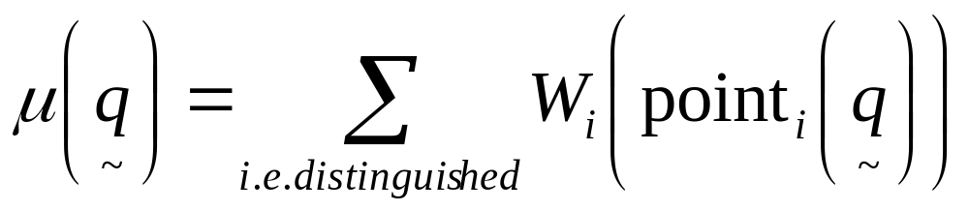
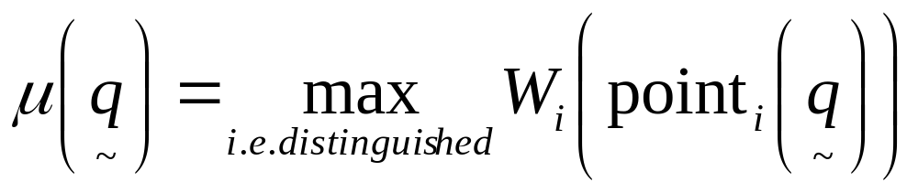
N.P.F. IV
Combining world space potentials into a C-space potential.
If W_{i}(point_{i}(q) is the potential field for the i’th distinguished point on the robot…
We could define
~
or many other combination methods, e.g.
Empirically, this is preferred

Slide 38
NPF V
We’re pretty much done!
Perform gradient descent from the start configuration with your C-space potential field…
Until…
  You get to the goal config
  You find you’re in a local minimum.
  Sadly, although the worldspace potentials were minimum-free, the combination is not.
  What to do in a local minimum??
  Best first search
  Random search

Slide 39
Best First Search with NPF
Remember all the C-space places you’ve visited in the search (search on a fine C-space grid).
When you expand a grid point consider all its neighbors on the grid.
Always expand gridpoint with lowest C-space potential value.
  During most of search runs quickly down gradient.
  When in a local minimum, must wait for minimum to “fill up”.

Slide 40
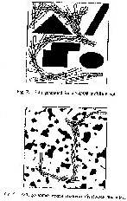
Empirical Results
1/10 second to solve on a SPARC. (In 1992 claimed to be fastest algorithm by 2 orders of magnitude, and three orders of nuns.)
5 seconds to solve.
3 degrees of freedom.

Slide 41
Randomized Search with NPF
On each step choose from a random set of, say, 100 neighbors on C-space grid.
If none reduce the potential, current state is recorded as being a local minimum.
    If was local minimum, perform a random walk for t timesteps to escape (one hopes)
Keep doing this, building up a graph of “adjacent” local minima.
Continue until one local minimum turns out to be the goal.
HOW? Many details, and a slightly depressingly large number of magic parameters are involved.

Slide 42
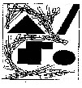
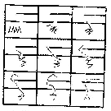
Randomized Search Results
10 secs. (Slower than best first)
2 mins. 8 DOF
Spectacular result.

Slide 43
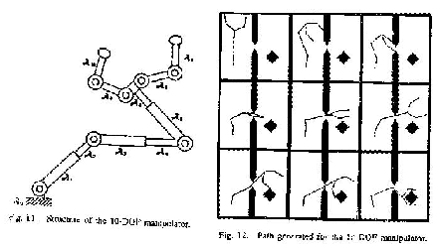
Randomized Search Results
10 DOF 3 mins.
31 DOF manipulator in 3-D workspace 15 mins.

Slide 44
What Should You Know
How to define configuration space obstacles
The basic idea behind, and Pros and Cons of
  VISIBILITY GRAPH METHODS
  VORONOI METHODS
  CELL DECOMPOSITION METHODS
  POTENTIAL FIELD METHODS
Latombe’s trick of using optimal world-space potentials for good C-space potentials.
See also the book Robot Motion Planning by Latombe (Klumer 1990). Russell & Norvig has a rather brief chapter on the subject.

Slide 45
Comparison
 | Potential Fields | Approx Cell Decomp | Voronoi | Visibility
Practical above 2 or 3 D?
Practical above 8 D?
Fast to Compute? |  |  |  | In 2-d
Usable Online?
Gives Optimal? |  |  |  | In 2-d
Spots Impossibilities?
Easy to Implement?
?
?
?

