Slide 1
Non-zero-sum Game Theory, Auctions and Negotiation
So you want to know about…
…Well what’s it worth to you, eh?
Andrew W. Moore
Associate Professor
School of Computer Science
Carnegie Mellon University
www.cs.cmu.edu/~awm
awm@cs.cmu.edu
412-268-7599
Note to other teachers and users of these slides. Andrew would be delighted if you found this source material useful in giving your own lectures. Feel free to use these slides verbatim, or to modify them to fit your own needs. PowerPoint originals are available. If you make use of a significant portion of these slides in your own lecture, please include this message, or the following link to the source repository of Andrew’s tutorials: http://www.cs.cmu.edu/~awm/tutorials . Comments and corrections gratefully received.

Slide 2
A Non-Zero Sum Game
Prisoner’s Dilemma
 | B Cooperates | B Defects
A Cooperates | -1 , -1 A’s B’s payoff payoff | -9 , 0 A’s B’s payoff payoff
A Defects | 0 , -9 A’s B’s payoff payoff | -6 , -6 A’s B’s payoff payoff
Non-Zero-Sum means there’s at least one outcome in which (A’s PAYOFF + B’s PAYOFF) ≠ 0

Slide 3
Normal Form Representation of a Non-Zero-Sum Game with n players
Is a set of n strategy spaces S₁ , S₂ …S_{n}
where S_{i} = The set of strategies available to player i
And n payoff functions
u₁ , u₂ … u_{n}
where
u_{i} : S₁ x S₂ x … S_{n} →ℜ
is a function that takes a combination of strategies (one for each player) and returns the payoff for player i

Slide 4
PLAYER B (2)
 | C | D
C | -1 , -1 | -9 , 0
D | 0 , -9 | -6 , -6
PLAYER A (1)
n = 2
S₁ = {C,D}
S₂ = {C,D}
u₁ (C,C) = -1 u₂ (C,C) = -1
u₁ (C,D) = -9 u₂ (C,D) = 0
u₁ (D,C) = 0 u₂ (D,C) = -9
u₁ (D,D) = -6 u₂ (D,D) = -6
what would you do if you were Player A ??

Slide 5
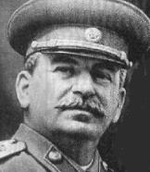
Strict Domination
IT’S A COLD, CRUEL WORLD. GET OVER IT.
Assuming B plays “C”, what should I do ?
Player
A
Assuming B plays “D”, what oh what should I do ?
PLAYER B
 | C | D
C | -1 , -1 | -9 , 0
D | 0 , -9 | -6 , -6
If one of a player’s strategies is never the right thing to do, no matter what the opponents do, then it is Strictly Dominated
PLAYER A

Slide 6
“Understanding” a Game
Fundamental assumption of game theory:
Get Rid of the Strictly Dominated strategies. They Won’t Happen.
 | C | D
C | -1 , -1 | -9 , 0
D | 0 , -9 | -6 , -6
In some cases (e.g. prisoner’s dilemma) this means, if players are “rational” we can predict the outcome of the game.

Slide 7
“Understanding” a Game
Fundamental assumption of game theory:
Get Rid of the Strictly Dominated strategies. They Won’t Happen.
 | C | D
C | -1 , -1 | -9 , 0
D | 0 , -9 | -6 , -6
In some cases (e.g. prisoner’s dilemma) this means, if players are “rational” we can predict the outcome of the game.

Slide 8
“Understanding” a Game
Fundamental assumption of game theory:
Get Rid of the Strictly Dominated strategies. They Won’t Happen.
 | C | D
C | -1 , -1 | -9 , 0
D | 0 , -9 | -6 , -6
 | C | D
D | 0 , -9 | -6 , -6
In some cases (e.g. prisoner’s dilemma) this means, if players are “rational” we can predict the outcome of the game.

Slide 9
“Understanding” a Game
Fundamental assumption of game theory:
Get Rid of the Strictly Dominated strategies. They Won’t Happen.
 | C | D
C | -1 , -1 | -9 , 0
D | 0 , -9 | -6 , -6
 | C | D
D | 0 , -9 | -6 , -6
In some cases (e.g. prisoner’s dilemma) this means, if players are “rational” we can predict the outcome of the game.

Slide 10
“Understanding” a Game
Fundamental assumption of game theory:
Get Rid of the Strictly Dominated strategies. They Won’t Happen.
 | C | D
C | -1 , -1 | -9 , 0
D | 0 , -9 | -6 , -6
 | C | D
D | 0 , -9 | -6 , -6
In some cases (e.g. prisoner’s dilemma) this means, if players are “rational” we can predict the outcome of the game.
 | D
D | -6 , -6

Slide 11
Strict Domination Removal Example
Player B
 | I | II | III | IV
I | 3 , 1 | 4 , 1 | 5 , 9 | 2 , 6
II | 5 , 3 | 5 , 8 | 9 , 7 | 9 , 3
III | 2 , 3 | 8 , 4 | 6 , 2 | 6 , 3
IV | 3 , 8 | 3 , 1 | 2 , 3 | 4 , 5
Player A
So is strict domination the best tool for predicting what will transpire in a game ?

Slide 12
Strict Domination doesn’t capture the whole picture
 | I | II | III
I | 0 , 4 | 4 , 0 | 5 , 3
II | 4 , 0 | 0 , 4 | 5 , 3
III | 3 , 5 | 3 , 5 | 6 , 6
What strict domination eliminations can we do?
What would you predict the players of this game would do?

Slide 13
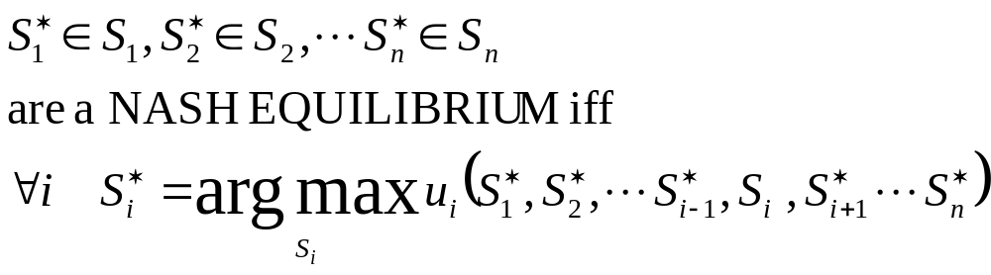
Nash Equilibria

Slide 14
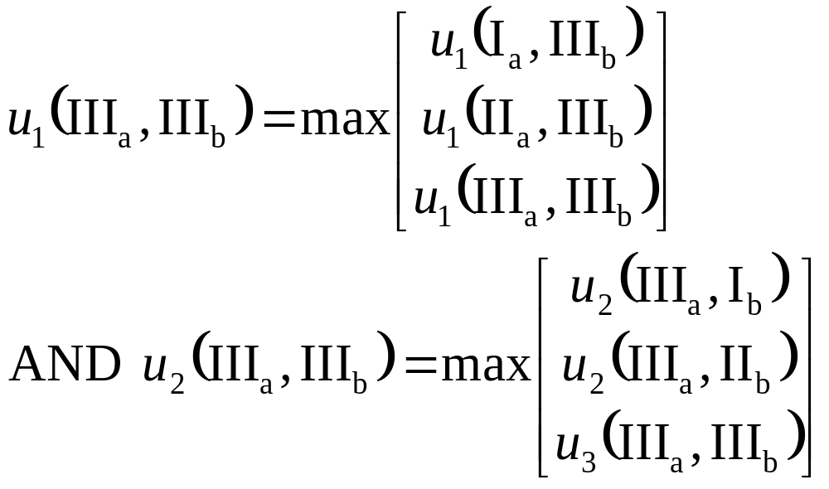
Nash Equilibria
 | I_{b} | II_{b} | III_{b}
I_{a} | 0 4 | 4 0 | 5 3
II_{a} | 4 0 | 0 4 | 5 3
III_{a} | 3 5 | 3 5 | 6 6
(III_{a},III_{b}) is a N.E. because

Slide 15
If (S₁* , S₂*) is an N.E. then player 1 won’t want to change their play given player 2 is doing S₂*
If (S₁* , S₂*) is an N.E. then player 2 won’t want to change their play given player 1 is doing S₁*
Find the NEs:
-1 -1 | -9 0 |  |  | 0 4 | 4 0 | 3
0 -9 | -6 -6 |  |  | 0 | 0 4 | 3
 |  |  |  | 3 5 | 5 | 6 6
Is there always at least one NE ?
Can there be more than one NE ?

Slide 16
Example with no NEs among the pure strategies:
 | S₁ | S₂
S₁
S₂

Slide 17
Example with no NEs among the pure strategies:
 | S₁ | S₂
S₁ | 0 1 | 1 0
S₂ | 1 0 | 0 1

Slide 18
2-player mixed strategy Nash Equilibrium
The pair of mixed strategies (M_{A} , M_{B}) are a Nash Equilibrium iff
  M_{A} is player A’s best mixed strategy response to M_{B}
  AND
  M_{B} is player B’s best mixed strategy response to M_{A}

Slide 19
Fundamental Theorems
In the n-player pure strategy game G={S₁ S₂ ·· S_{n}; u₁ u₂ ·· u_{n}}, if iterated elimination of strictly dominated strategies eliminates all but the strategies (S₁* , S₂* ·· S_{n}*) then these strategies are the unique NE of the game
Any NE will survive iterated elimination of strictly dominated strategies
[Nash, 1950] If n is finite and S_{i} is finite ∀i, then there exists at least one NE (possibly involving mixed strategies)

Slide 20
The “What to do in Pittsburgh on a Saturday afternoon” game
Pat enjoys football
Chris enjoys hockey
Pat and Chris are friends: they enjoy spending time together
Chris
 | H | F
H | 1 2 | 0 0
F | 0 0 | 2 1
Pat
Two Nash Equilibria.
How useful is Game Theory in this case??
Why this example is troubling…

Slide 21
INTERMISSION
(Why) are Nash Equilibria useful for A.I. researchers?
Will our algorithms ever need to play…
Prisoner’s Dilemma?
Saturday Afternoon?

Slide 22


Nash Equilibria Being Useful
THE
OF
THE
Commons
TRAGEDY
            
YE OLDE
COMMONS
You graze goats on the commons to eventually fatten up and sell
The more goats you graze the less well fed they are
And so the less money you get when you sell them

Slide 23

Commons Facts
Selling
Price
per
Goat
6¢
5
4
3
2
1
0
0 10 20 30 36
G= number of goats
How many goats would one rational farmer choose to graze?
What would the farmer earn?
What about a group of n individual farmers?
Answering this…
…is good practice for
answering this

Slide 24
n farmers
i’th farmer has an infinite space of strategies
g_{i} ∈ [ 0 , 36 ]
An outcome of
( g₁ , g₂ , g₃ ·· , g_{n} )
will pay how much to the i’th farmer?

Slide 25
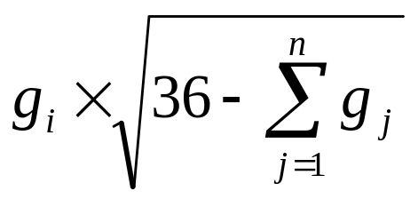
n farmers
i’th farmer has an infinite space of strategies
g_{i} ∈ [ 0 , 36 ]
An outcome of
( g₁ , g₂ , g₃ ·· , g_{n} )
will pay how much to the i’th farmer?

Slide 26
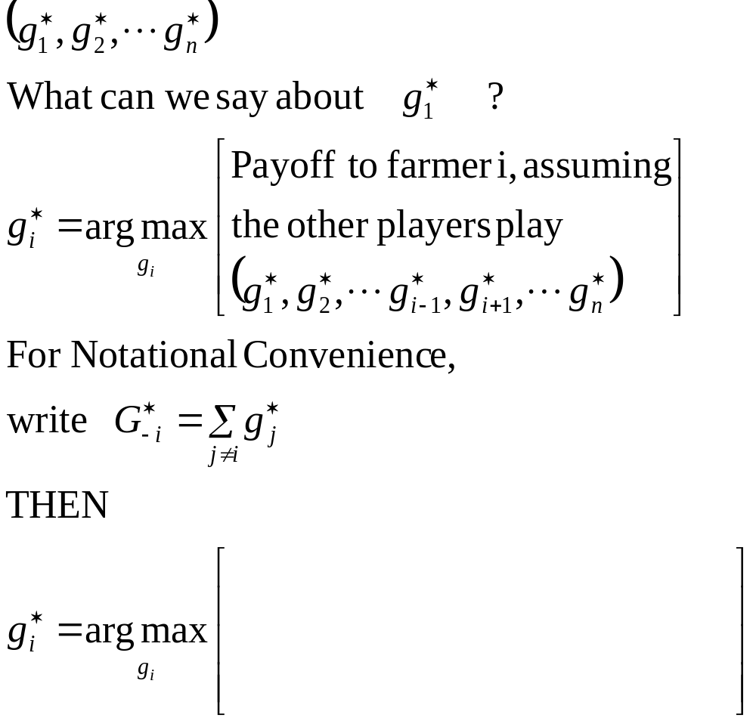
Let’s Assume a pure Nash Equilibrium exists.
Call it
What?

Slide 27
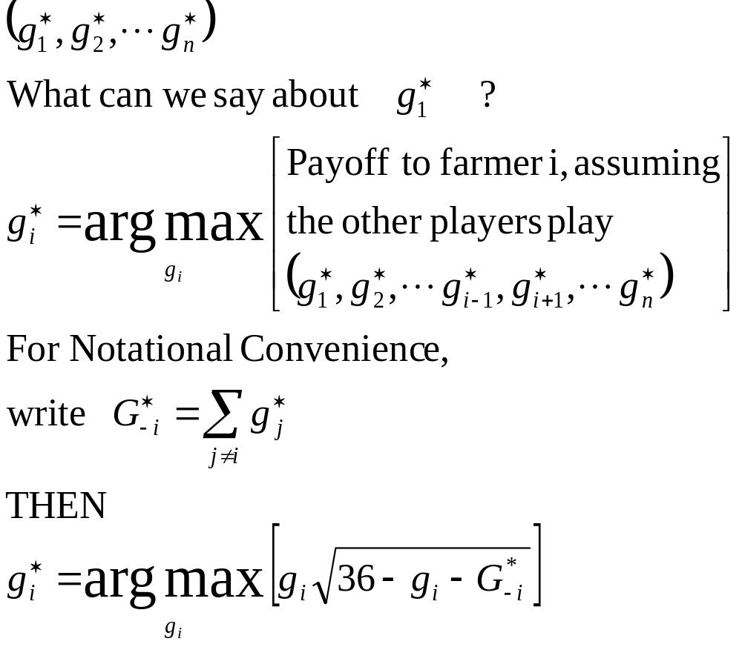
Let’s Assume a pure Nash Equilibrium exists.
Call it

Slide 28
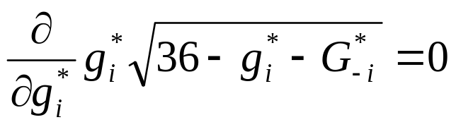
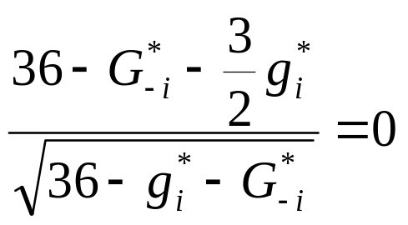
Let’s Assume a pure Nash Equilibrium exists.
Call it
g*_{i} must satisfy
therefore

Slide 29
We have n linear equations in n unknowns
g₁* = 24 - 2/3( g₂*+g₃*+ ···g_{n}*)
g₂* = 24 - 2/3(g₁*+ g₃*+ ···g_{n}*)
g₃* = 24 - 2/3(g₁*+g₂*+ g₄*···g_{n}*)
: : :
g_{n}* = 24 - 2/3(g₁*+ ···g_{n-1}*)
Clearly all the g_{i}*’s are the same (Proof by “it’s bloody obvious”)
Write g*=g₁*=···g_{n}*
Solution to g*=24 – 2/3(n-1)g* is: g*= 72__
2n+1

Slide 30
Consequences
At the Nash Equilibrium a rational farmer grazes
goats.
How many goats in general will be grazed? Trivial algebra gives: goats total being grazed
[as n --> infinity , #goats --> 36]
How much profit per farmer?
How much if the farmers could all cooperate?
72
2n+1
36 - 36
2n+1
1.26¢ if
24 farmers
432
(2n+1)^{3/2}
24*sqrt(12) = 83.1
n n
3.46¢ if
24 farmers

Slide 31
The Tragedy
The farmers act “rationally” and earn 1.26 cents each.
But if they’d all just got together and decided “one goat each” they’d have got 3.46 cents each.
Is there a bug in Game Theory?
in the Farmers?
in Nash?
Would you recommend the farmers hire a police force?

Slide 32
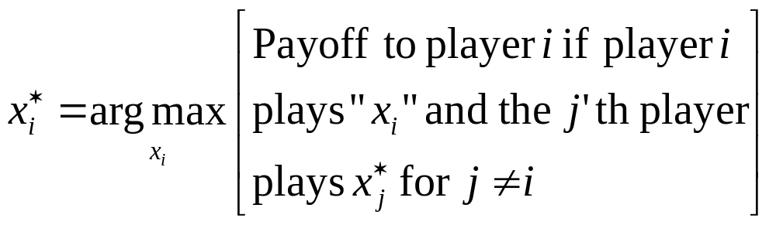
Recipe for Nash-Equilibrium-Based Analysis of Such Games
Assume you’ve been given a problem where the i’th player chooses a real number x_{i}
Guess the existence of a Nash equilibrium (x₁* , x₂* ··· x_{n}*)
Note that , ∀i,
Hack the algebra, often using “at x_{i}* we have ∂ Payoff + 0 “ ∂x_{i}

Slide 33
INTERMISSION
Does the Tragedy of the Commons matter to us when we’re building intelligent machines?
Maybe repeated play means we can learn to cooperate??

Slide 34
Repeated Games with Implausible Threats
Takeo and Randy are stuck in an elevator
Takeo has a $1000 bill
Randy has a stick of dynamite
Randy says “Give me $1000 or I’ll blow us both up.”
gives Randy the money
Takeo
keeps money
Randy
Randy
Explode
Explode
Do Nothing
Do Nothing
Takeo: | -1000 | Takeo: | -10⁷ | Takeo: | 0 | Takeo: | -10⁷
Randy: | 1000 | Randy: | -10⁷ | Randy: | 0 | Randy: | -10⁷
What should Takeo do?????

Slide 35
Using the formalism of Repeated Games With Implausible Threats, Takeo should Not give the money to Randy
Takeo Assumes Randy is Rational
At this node, Randy will choose the left branch
Randy
T: 0 T: -10⁷
R: 0 R: -10⁷
Repeated Games
Suppose you have a game which you are going to play a finite number of times.
What should you do?

Slide 36
2-Step Prisoner’s Dilemma
GAME 1
Player B
GAME 2
(Played with knowledge of outcome of GAME 1)
Player B
 | C | D
C | -1 , -1 | -9 , 0
D | 0 , -9 | -6 , -6
 | C | D
C | -1 , -1 | -9 , 0
D | 0 , -9 | -6 , -6
Player A
Player A
Idea 1
Player A has four pure strategies
    C then C
    C then D
    D then C
    D then D
Ditto for B
Is Idea 1 correct?

Slide 37
Important Theoretical Result:
Assuming Implausible Threats, if the game G has a unique N.E. (s₁* ,·· s_{n}*) then the new game of repeating G T times, and adding payouts, has a unique N.E. of repeatedly choosing the original N.E. (s₁* ,·· s_{n}*) in every game.
If you’re about to play prisoner’s dilemma 20 times, you should defect 20 times.
DRAT ☹

Slide 38
Intermission
Game theory has been cute so far.
But depressing.
Now let’s make it really work for us.
We’re going to get more real.
The notation’s growing teeth.

Slide 39
Bayesian Games
You are Player A in the following game. What should you do?
Player B
 | S₁ | S₂
S₁ | 3 ? | -2 ?
S₂ | 0 ? | 6 ?
Player A
Question: When does this situation arise?

Slide 40
Hockey lovers get 2 units for watching hockey, and 1 unit for watching football.
Football lovers get 2 units for watching football, and 1 unit for watching hockey.
Pat’s a hockey lover.
Pat thinks Chris is probably a hockey lover also, but Pat is not sure.
Chris
Chris
 | H | F
H | 2 2 | 0 0
F | 0 0 | 1 1
 | H | F
H | 2 1 | 0 0
F | 0 0 | 1 2
Pat
Pat
With 2/3 chance
1/3 chance

Slide 41
In a Bayesian Game each player is given a type. All players know their own types but only a prob. dist. for their opponent’s types
An n-player Bayesian Game has
a set of action spaces A₁ ·· A_{n} a set of type spaces T₁ ·· T_{n} a set of beliefs P₁ ·· P_{n} a set of payoff functions u₁ ·· u_{n}
P_{-i}(t_{-i}|t_{i}) is the prob dist of the types for the other players, given player i has type i .
u_{i}(a₁ , a₂ ··· a_{n} , t_{i} ) is the payout to player i if player j chooses action a_{j} (with a_{j} ∈ A_{j} ) (forall j=1,2,···n) and if player i has type t_{i} ∈ T_{i}

Slide 42
Bayesian Games: Who Knows What?
We assume that all players enter knowing the full information about the A_{i}’s , T_{i}’s, P_{i}’s and u_{i}’s
The i’th player knows t_{i}, but not t₁ t₂ t₃ ·· t_{i-1} t_{i+1} ·· t_{n}
All players know that all other players know the above
And they know that they know that they know, ad infinitum
Definition: A strategy S_{i}(t_{i}) in a Bayesian Game is a mapping from T_{i}→A_{i} : a specification of what action would be taken for each type

Slide 43
Example
A₁ = {H,F} A₂ = {H,F}
T₁ = {H-love,Flove} T₂ = {Hlove, Flove}
P₁ (t₂ = Hlove | t₁ = Hlove) = 2/3
P₁ (t₂ = Flove | t₁ = Hlove) = 1/3
P₁ (t₂ = Hlove | t₁ = Flove) = 2/3
P₁ (t₂ = Flove | t₁ = Hlove) = 1/3
P₂ (t₁ = Hlove | t₂ = Hlove) = 1
P₂ (t₁ = Flove | t₂ = Hlove) = 0
P₂ (t₁ = Hlove | t₂ = Flove) = 1
P₂ (t₁ = Flove | t₂ = Hlove) = 0
u₁ (H,H,Hlove) = 2 u₂ (H,H,Hlove) = 2
u₁ (H,H,Flove) = 1 u₂ (H,H,Flove) = 1
u₁ (H,F,Hlove) = 0 u₂ (H,F,Hlove) = 0
u₁ (H,F,Flove) = 0 u₂ (H,F,Flove) = 0
u₁ (F,H,Hlove) = 0 u₂ (F,H,Hlove) = 0
u₁ (F,H,Flove) = 0 u₂ (F,H,Flove) = 0
u₁ (F,F,Hlove) = 1 u₂ (F,F,Hlove) = 1
u₁ (F,F,Flove) = 2 u₂ (F,F,Flove) = 2

Slide 44
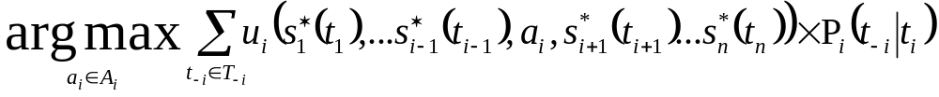
Bayesian Nash Equilibrium
(GASP, SPLUTTER)
The set of strategies (s₁* ,s₂* ··· s_{n}*) are a
Pure Strategy Bayesian Nash Equilibrium
iff for each player i, and for each possible type of i : t_{i}∈T_{i}
s_{i}*(t_{i}) =
i.e. no player, in any of their types, wants to change their strategy

Slide 45
NEGOTIATION: A Bayesian Game
Two players: S, (seller) and
B, (buyer)
T_{s} = [0,1] the seller’s type is a real number between 0 and 1 specifying the value (in dollars) to them of the object they are selling
T_{b} = [0,1] the buyer’s type is also a real number. The value to the buyer.
Assume that at the start
V_{s} ∈T_{s} is chosen uniformly at random
V_{b} ∈T_{b} is chosen uniformly at random

Slide 46
The “Double Auction” Negotiation
S writes down a price for the item (g_{s})
B simultaneously writes down a price (g_{b})
Prices are revealed
If g_{s} ≥ g_{b} no trade occurs, both players have payoff 0
If g_{s} ≤ g_{b} then buyer pays the midpoint price (g_{s}+g_{b}) 2 and receives the item
Payoff to S : 1/2(g_{s}+g_{b})-V_{s}
Payoff to B : V_{b}-1/2(g_{s}+g_{b})

Slide 47
Negotiation in Bayesian Game Notation
T_{s} = [0,1] write V_{s}∈T_{s}
T_{b} = [0,1] write V_{b}∈T_{b}
P_{s}(V_{b}|V_{s}) = P_{s}(V_{b}) = uniform distribution on [0,1]
P_{b}(V_{s}|V_{b}) = P_{b}(V_{s}) = uniform distribution on [0,1]
A_{s} = [0,1] write g_{s}∈A_{s}
A_{b} = [0,1] write g_{b}∈A_{b}
u_{s}(P_{s},P_{b},V_{s}) = What?
u_{b}(P_{s},P_{b},V_{b}) = What?

Slide 48
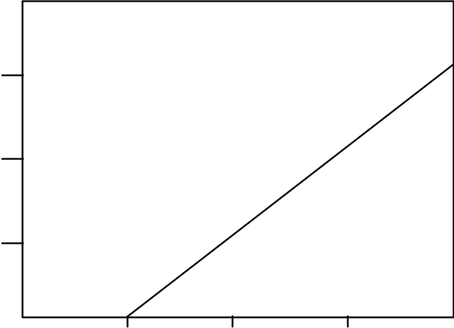
Double Negotiation: When does trade occur?
…when
g_{b}*(V_{b}) = 1/12 + 2/3 V_{b} > 1/4 + 2/3 V_{s} = g_{s}*(V_{s})
i.e. when V_{b} > V_{s} + 1/4
1
¾
½
¼
↑
V_{s}
Trade Happens Here
0 ¼ ½ ¾ 1
V_{b} →
Prob(Trade Happens) = 1/2 x (3/4)² = 9/32

Slide 49
Value of Trade
1
↑
V_{s}
3/4
0
1
1/4
V_{b} →
Ε[V_{s}|Trade Occurs] = 1/3 x 3/4 = 1/4
Ε[V_{b}|Trade Occurs] = 1/4 + 2/3 x 3/4 = 3/4
If trade occurs, expected trade price is
1/2[g_{s}*(V_{s}) + g_{b}*(V_{b})] =
1/2(1/12 + 2/3V_{b} + 1/4 + 2/3V_{s}) =
1/6 + 1/3V_{b} + 1/3V_{s}

Slide 50
Value of Trade continued…
Ε[ profit to S | trade occurred ] =
Ε[ 1/6 + 1/3V_{b} + 1/3V_{s} – V_{s} | trade occurred ] =
1/6 + 1/3Ε[ V_{b} | trade ] – 2/3Ε[ V_{s} | trade ] =
1/6 + 1/3 x 3/4 - 2/3 x 1/4 = 1/4
Similar Algebra Shows: Ε[ profit to B | trade occurred ] = 1/4 also
Using This Game Ε[ B’s profit ]= 1/4x9/32=0.07 Ε[ S’s profit ]= 0.07 | If Both Were “Honest” Ε[ B profit ]=1/12=0.083 Ε[ S profit ]=1/12=0.083
This Game seems Inefficient. What can be done???

Slide 51
Double Auction: Final Comments
There are other Nash Equilibrium strategies.
But the one we saw is provably most efficient.
In general, even for arbitrary prob. dists. of V_{s} and V_{b}, no efficient NE’s can exist.
And no other games for this kind of trading can exist and be efficient.

Slide 52
Double Auction Discussion
What if seller used “giant eagle” tactics?
Seller states “I’ll sell it to you for price p : take it or leave it”
Exercise:
How should* seller choose price (taking into account V_{s} of course) ?
And how should* buyer choose whether to buy ? *(at a B.N.E.)
When could/should double auction technology be used?
(How) can “V_{s},V_{b} drawn randomly from [0,1]” be relaxed ?

Slide 53
MULTI-
PLAYER
AUCTIONS

Slide 54
First Price Sealed Bid
Seller wants to sell an object that has no value to seller… anything seller is paid is pure profit.
There are n available buyers
Assumptions:
Assume buyer i has a value for the object distributed uniformly randomly in [0…1]∋V_{i}
Assume V_{i}’s all independent
Buyer i does not know V_{j} for i≠j
Buyer i does know all V_{j}’s randomly generated from [0,1]

Slide 55
First Price Sealed Bid Rules
Each buyer writes down their bid.
Call buyer i’s bid g_{i}
Buyer who wrote highest bid must buy object from seller at price=bid
Question: Why is “bid = V_{i}” a stupid strategy ??

Slide 56
Auction Analysis: Back to Bayesian Nash Equils
We’ll assume that all players other than i do a linear strategy:
g_{j}*(V_{j}) = m_{j}V_{j} for j ≠ i
Then what should i do ?
This assumption is completely unjustified right now. Later we’ll see why it was an okay assumption to make.

Slide 57
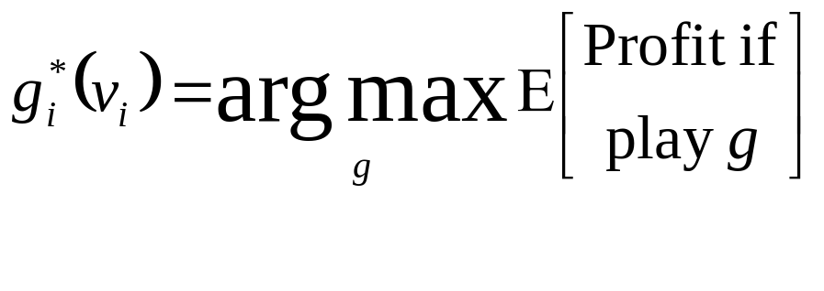

Slide 58
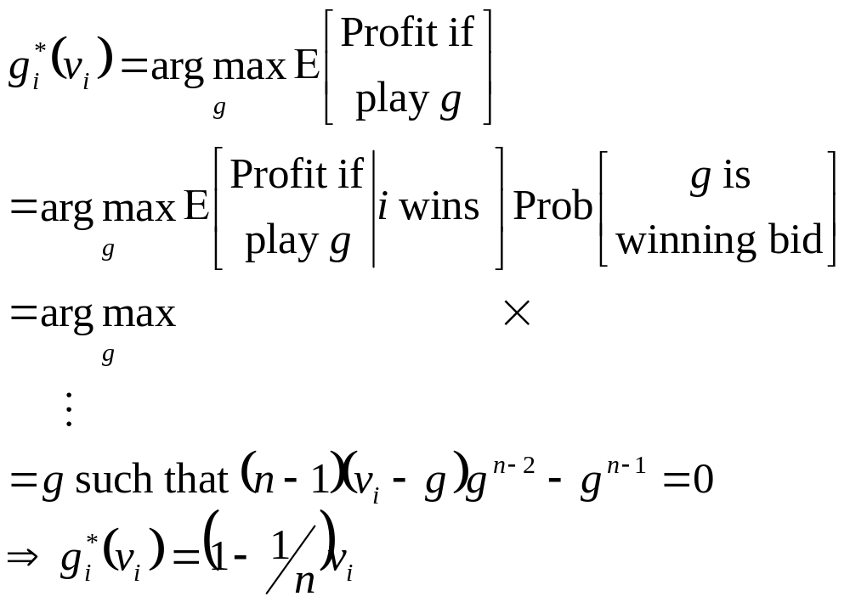
what?
what?

Slide 59
what?
what?
Thus we’ve an N.E. because if all other players use a linear strategy then it’s in i’s interest to do so too. Above holds ∀i
See, I told you the linear assumption would be okay.

Slide 60
First-Price Sealed Auction
At BNE all players use
g_{i}*(V_{i}) = (1-1/n)V_{i}
Note: [Fact of probability]
Expected value of the largest of n numbers drawn independently from [0,1] is n
n+1
Expected profit to seller = what?

Slide 61
First-Price Sealed Auction
At BNE all players use
g_{i}*(V_{i}) = (1-1/n)V_{i}
Note: [Fact of probability]
Expected value of the largest of n numbers drawn independently from [0,1] is n
n+1
Expected profit to seller =
Expected highest bid = what?

Slide 62
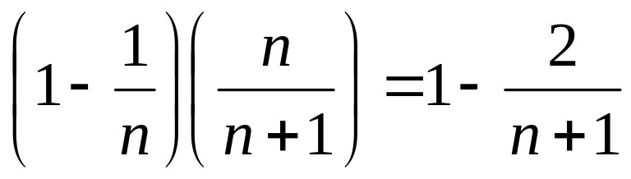
First-Price Sealed Auction
At BNE all players use
g_{i}*(V_{i}) = (1-1/n)V_{i}
Note: [Fact of probability]
Expected value of the largest of n numbers drawn independently from [0,1] is n
n+1
Expected profit to seller =
Expected highest bid =
Seller likes
large n
Exercise: compute expected profit to player i. Show it is 0(1/n).

Slide 63
Second-Price Sealed Bid
A different game:
Each buyer writes their bid
Buyer with highest bid must buy the object
But the price they pay is the second highest bid
What is player i’s best strategy
Why?
What is seller’s expected profit?

Slide 64
Auction Comments
Second-price auction is preferred by cognoscenti
  No more efficient
  But general purpose
  And computationally better
  And less variance (better risk management)
Auction design is interesting
  So far mostly for economics
  But soon for e-commerce etc.?
Important but not covered here
  Expertise
  Collusion
  Combinatoric Auctions
  What if all cooperative ????

Slide 65
What You Should Know
Strict dominance
Nash Equilibria
Continuous games like Tragedy of the Commons
Rough, vague, appreciation of threats
Bayesian Game formulation
Double Auction
1st/2nd Price auctions

Slide 66
What You Shouldn’t Know
How many goats your lecturer has on his property
What strategy Mephistopheles uses in his negotiations
What strategy this University employs when setting tuition
How to square a circle using only compass and straight edge
How many of your friends and colleagues are active Santa informants, and how critical they’ve been of your obvious failings

