Slide 1
PAC-learning
Note to other teachers and users of these slides. Andrew would be delighted if you found this source material useful in giving your own lectures. Feel free to use these slides verbatim, or to modify them to fit your own needs. PowerPoint originals are available. If you make use of a significant portion of these slides in your own lecture, please include this message, or the following link to the source repository of Andrew’s tutorials: http://www.cs.cmu.edu/~awm/tutorials . Comments and corrections gratefully received.
Andrew W. Moore
Associate Professor
School of Computer Science
Carnegie Mellon University
www.cs.cmu.edu/~awm
awm@cs.cmu.edu
412-268-7599

Slide 2
Probably Approximately Correct (PAC) Learning
Imagine we’re doing classification with categorical inputs.
All inputs and outputs are binary.
Data is noiseless.
There’s a machine f(x,h) which has H possible settings (a.k.a. hypotheses), called h₁, h₂ .. h_{H}.

Slide 3
Example of a machine
f(x,h) consists of all logical sentences about X1, X2 .. Xm that contain only logical ands.
Example hypotheses:
X1 ^ X3 ^ X19
X3 ^ X18
X7
X1 ^ X2 ^ X2 ^ x4 … ^ Xm
Question: if there are 3 attributes, what is the complete set of hypotheses in f?

Slide 4
Example of a machine
f(x,h) consists of all logical sentences about X1, X2 .. Xm that contain only logical ands.
Example hypotheses:
X1 ^ X3 ^ X19
X3 ^ X18
X7
X1 ^ X2 ^ X2 ^ x4 … ^ Xm
Question: if there are 3 attributes, what is the complete set of hypotheses in f? (H = 8)
True | X2 | X3 | X2 ^ X3
X1 | X1 ^ X2 | X1 ^ X3 | X1 ^ X2 ^ X3

Slide 5
And-Positive-Literals Machine
f(x,h) consists of all logical sentences about X1, X2 .. Xm that contain only logical ands.
Example hypotheses:
X1 ^ X3 ^ X19
X3 ^ X18
X7
X1 ^ X2 ^ X2 ^ x4 … ^ Xm
Question: if there are m attributes, how many hypotheses in f?

Slide 6
And-Positive-Literals Machine
f(x,h) consists of all logical sentences about X1, X2 .. Xm that contain only logical ands.
Example hypotheses:
X1 ^ X3 ^ X19
X3 ^ X18
X7
X1 ^ X2 ^ X2 ^ x4 … ^ Xm
Question: if there are m attributes, how many hypotheses in f? (H = 2^{m})

Slide 7
And-Literals Machine
f(x,h) consists of all logical sentences about X1, X2 .. Xm or their negations that contain only logical ands.
Example hypotheses:
X1 ^ ~X3 ^ X19
X3 ^ ~X18
~X7
X1 ^ X2 ^ ~X3 ^ … ^ Xm
Question: if there are 2 attributes, what is the complete set of hypotheses in f?

Slide 8
And-Literals Machine
f(x,h) consists of all logical sentences about X1, X2 .. Xm or their negations that contain only logical ands.
Example hypotheses:
X1 ^ ~X3 ^ X19
X3 ^ ~X18
~X7
X1 ^ X2 ^ ~X3 ^ … ^ Xm
Question: if there are 2 attributes, what is the complete set of hypotheses in f? (H = 9)
True |  | True
True |  | X2
True |  | ~X2
X1 |  | True
X1 | ^ | X2
X1 | ^ | ~X2
~X1 |  | True
~X1 | ^ | X2
~X1 | ^ | ~X2

Slide 9
And-Literals Machine
f(x,h) consists of all logical sentences about X1, X2 .. Xm or their negations that contain only logical ands.
Example hypotheses:
X1 ^ ~X3 ^ X19
X3 ^ ~X18
~X7
X1 ^ X2 ^ ~X3 ^ … ^ Xm
Question: if there are m attributes, what is the size of the complete set of hypotheses in f?
True |  | True
True |  | X2
True |  | ~X2
X1 |  | True
X1 | ^ | X2
X1 | ^ | ~X2
~X1 |  | True
~X1 | ^ | X2
~X1 | ^ | ~X2

Slide 10
And-Literals Machine
f(x,h) consists of all logical sentences about X1, X2 .. Xm or their negations that contain only logical ands.
Example hypotheses:
X1 ^ ~X3 ^ X19
X3 ^ ~X18
~X7
X1 ^ X2 ^ ~X3 ^ … ^ Xm
Question: if there are m attributes, what is the size of the complete set of hypotheses in f? (H = 3^{m})
True |  | True
True |  | X2
True |  | ~X2
X1 |  | True
X1 | ^ | X2
X1 | ^ | ~X2
~X1 |  | True
~X1 | ^ | X2
~X1 | ^ | ~X2

Slide 11
Lookup Table Machine
f(x,h) consists of all truth tables mapping combinations of input attributes to true and false
Example hypothesis:
Question: if there are m attributes, what is the size of the complete set of hypotheses in f?
X1 | X2 | X3 | X4 | Y
0 | 0 | 0 | 0 | 0
0 | 0 | 0 | 1 | 1
0 | 0 | 1 | 0 | 1
0 | 0 | 1 | 1 | 0
0 | 1 | 0 | 0 | 1
0 | 1 | 0 | 1 | 0
0 | 1 | 1 | 0 | 0
0 | 1 | 1 | 1 | 1
1 | 0 | 0 | 0 | 0
1 | 0 | 0 | 1 | 0
1 | 0 | 1 | 0 | 0
1 | 0 | 1 | 1 | 1
1 | 1 | 0 | 0 | 0
1 | 1 | 0 | 1 | 0
1 | 1 | 1 | 0 | 0
1 | 1 | 1 | 1 | 0

Slide 12
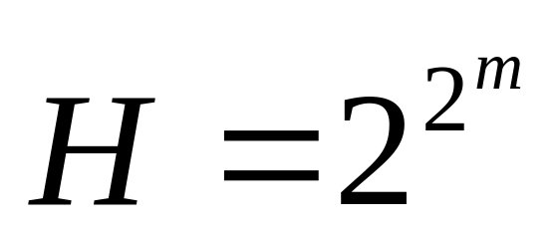
Lookup Table Machine
f(x,h) consists of all truth tables mapping combinations of input attributes to true and false
Example hypothesis:
Question: if there are m attributes, what is the size of the complete set of hypotheses in f?
X1 | X2 | X3 | X4 | Y
0 | 0 | 0 | 0 | 0
0 | 0 | 0 | 1 | 1
0 | 0 | 1 | 0 | 1
0 | 0 | 1 | 1 | 0
0 | 1 | 0 | 0 | 1
0 | 1 | 0 | 1 | 0
0 | 1 | 1 | 0 | 0
0 | 1 | 1 | 1 | 1
1 | 0 | 0 | 0 | 0
1 | 0 | 0 | 1 | 0
1 | 0 | 1 | 0 | 0
1 | 0 | 1 | 1 | 1
1 | 1 | 0 | 0 | 0
1 | 1 | 0 | 1 | 0
1 | 1 | 1 | 0 | 0
1 | 1 | 1 | 1 | 0

Slide 13
A Game
We specify f, the machine
Nature choose hidden random hypothesis h*
Nature randomly generates R datapoints
  How is a datapoint generated?
    Vector of inputs x_{k} = (x_{k1},x_{k2}, x_{km}) is drawn from a fixed unknown distrib: D
    The corresponding output y_{k}=f(x_{k} , h*)
We learn an approximation of h* by choosing some h^{est} for which the training set error is 0

Slide 14
Test Error Rate
We specify f, the machine
Nature choose hidden random hypothesis h*
Nature randomly generates R datapoints
  How is a datapoint generated?
    Vector of inputs x_{k} = (x_{k1},x_{k2}, x_{km}) is drawn from a fixed unknown distrib: D
    The corresponding output y_{k}=f(x_{k} , h*)
We learn an approximation of h* by choosing some h^{est} for which the training set error is 0
For each hypothesis h ,
Say h is Correctly Classified (CCd) if h has zero training set error
Define TESTERR(h )
    = Fraction of test points that h will classify correctly
    = P(h classifies a random test point correctly)
Say h is BAD if TESTERR(h) > ε

Slide 15
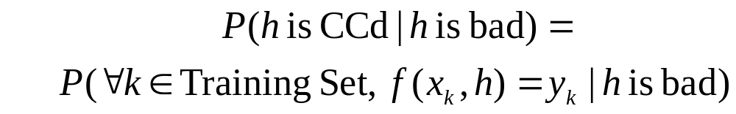
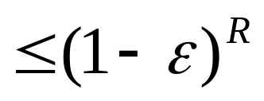
Test Error Rate
We specify f, the machine
Nature choose hidden random hypothesis h*
Nature randomly generates R datapoints
  How is a datapoint generated?
    Vector of inputs x_{k} = (x_{k1},x_{k2}, x_{km}) is drawn from a fixed unknown distrib: D
    The corresponding output y_{k}=f(x_{k} , h*)
We learn an approximation of h* by choosing some h^{est} for which the training set error is 0
For each hypothesis h ,
Say h is Correctly Classified (CCd) if h has zero training set error
Define TESTERR(h )
    = Fraction of test points that i will classify correctly
    = P(h classifies a random test point correctly)
Say h is BAD if TESTERR(h) > ε

Slide 16

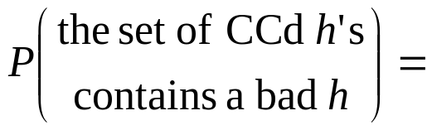

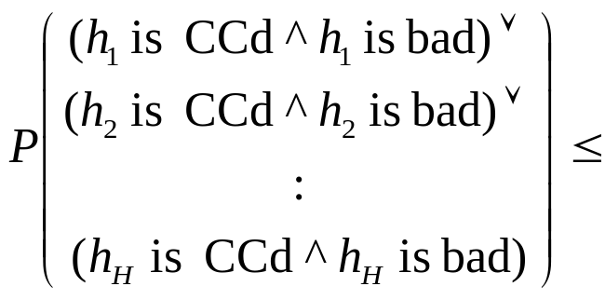
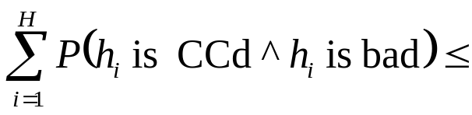
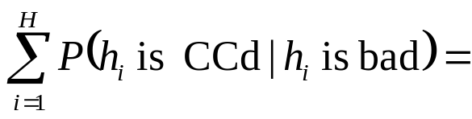

Test Error Rate
We specify f, the machine
Nature choose hidden random hypothesis h*
Nature randomly generates R datapoints
  How is a datapoint generated?
    Vector of inputs x_{k} = (x_{k1},x_{k2}, x_{km}) is drawn from a fixed unknown distrib: D
    The corresponding output y_{k}=f(x_{k} , h*)
We learn an approximation of h* by choosing some h^{est} for which the training set error is 0
For each hypothesis h ,
Say h is Correctly Classified (CCd) if h has zero training set error
Define TESTERR(h )
    = Fraction of test points that i will classify correctly
    = P(h classifies a random test point correctly)
Say h is BAD if TESTERR(h) > ε

Slide 17
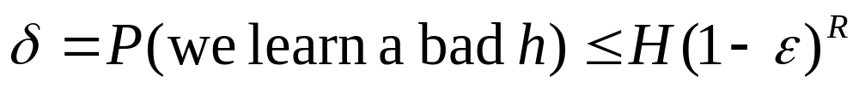
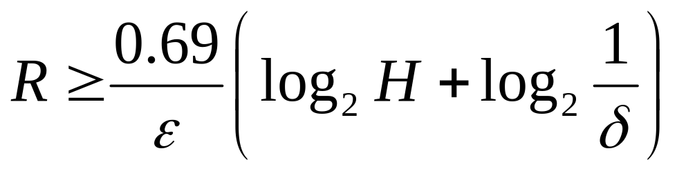
PAC Learning
Chose R such that with probability less than δ we’ll select a bad h^{est} (i.e. an h^{est} which makes mistakes more than fraction ε of the time)
Probably Approximately Correct
As we just saw, this can be achieved by choosing R such that
i.e. R such that

Slide 18
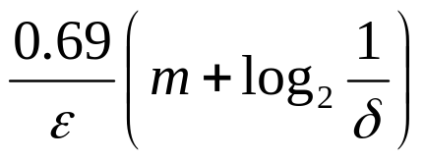
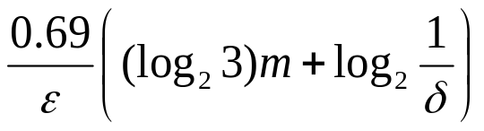
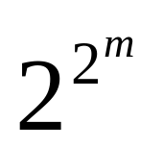
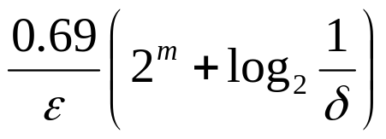
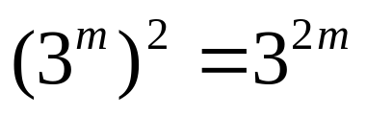
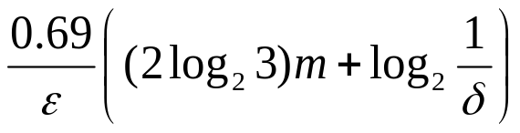
PAC in action
Machine | Example Hypothesis | H | R required to PAC-learn
And-positive-literals | X3 ^ X7 ^ X8 | 2^{m}
And-literals | X3 ^ ~X7 | 3^{m}
Lookup Table
And-lits or And-lits | (X1 ^ X5) v (X2 ^ ~X7 ^ X8)
X1 | X2 | X3 | X4 | Y
0 | 0 | 0 | 0 | 0
0 | 0 | 0 | 1 | 1
0 | 0 | 1 | 0 | 1
0 | 0 | 1 | 1 | 0
0 | 1 | 0 | 0 | 1
0 | 1 | 0 | 1 | 0
0 | 1 | 1 | 0 | 0
0 | 1 | 1 | 1 | 1
1 | 0 | 0 | 0 | 0
1 | 0 | 0 | 1 | 0
1 | 0 | 1 | 0 | 0
1 | 0 | 1 | 1 | 1
1 | 1 | 0 | 0 | 0
1 | 1 | 0 | 1 | 0
1 | 1 | 1 | 0 | 0
1 | 1 | 1 | 1 | 0

Slide 19
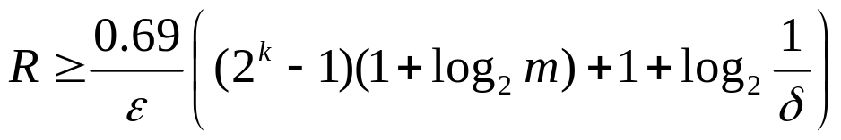
PAC for decision trees of depth k
Assume m attributes
H_{k} = Number of decision trees of depth k
H₀ =2
H_{k+1} = (#choices of root attribute) *
(# possible left subtrees) *
(# possible right subtrees)
= m * H_{k} * H_{k}
Write L_{k} = log₂ H_{k}
L₀ = 1
L_{k+1} = log₂ m + 2L_{k}
So L_{k} = (2 ^{k}-1)(1+log₂ m) +1
So to PAC-learn, need

Slide 20
What you should know
Be able to understand every step in the math that gets you to
Understand that you thus need this many records to PAC-learn a machine with H hypotheses
Understand examples of deducing H for various machines

