Slide 1
Probability Densities in Data Mining
Andrew W. Moore
Professor
School of Computer Science
Carnegie Mellon University
www.cs.cmu.edu/~awm
awm@cs.cmu.edu
412-268-7599
Note to other teachers and users of these slides. Andrew would be delighted if you found this source material useful in giving your own lectures. Feel free to use these slides verbatim, or to modify them to fit your own needs. PowerPoint originals are available. If you make use of a significant portion of these slides in your own lecture, please include this message, or the following link to the source repository of Andrew’s tutorials: http://www.cs.cmu.edu/~awm/tutorials . Comments and corrections gratefully received.

Slide 2
Probability Densities in Data Mining
Why we should care
Notation and Fundamentals of continuous PDFs
Multivariate continuous PDFs
Combining continuous and discrete random variables

Slide 3
Why we should care
Real Numbers occur in at least 50% of database records
Can’t always quantize them
So need to understand how to describe where they come from
A great way of saying what’s a reasonable range of values
A great way of saying how multiple attributes should reasonably co-occur

Slide 4
Why we should care
Can immediately get us Bayes Classifiers that are sensible with real-valued data
You’ll need to intimately understand PDFs in order to do kernel methods, clustering with Mixture Models, analysis of variance, time series and many other things
Will introduce us to linear and non-linear regression

Slide 5
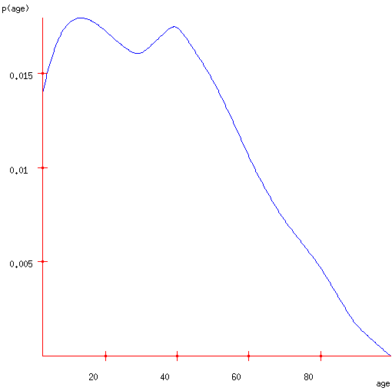
A PDF of American Ages in 2000

Slide 6
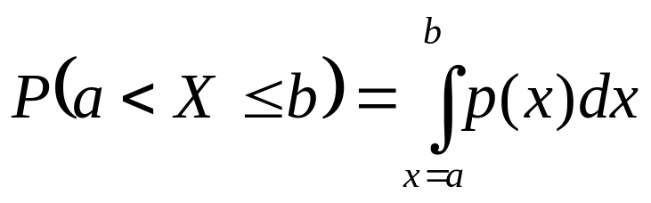
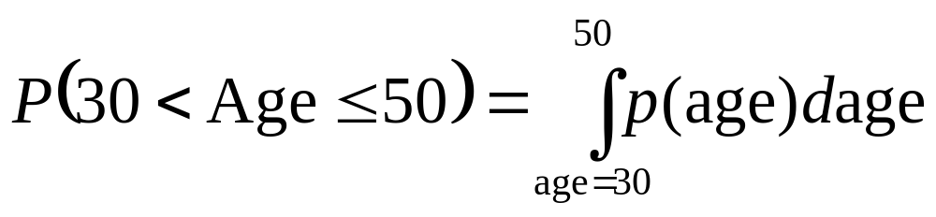
A PDF of American Ages in 2000
Let X be a continuous random variable.
If p(x) is a Probability Density Function for X then…
= 0.36

Slide 7
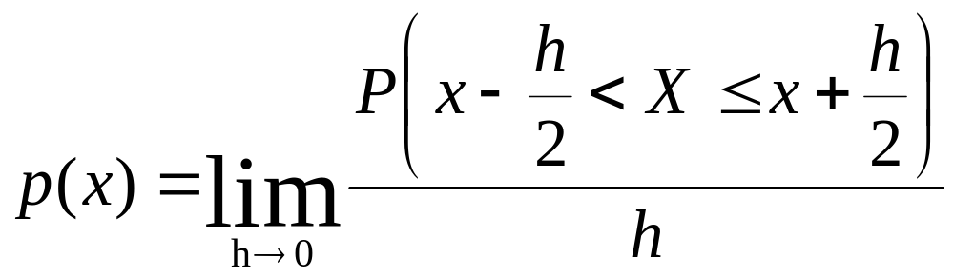
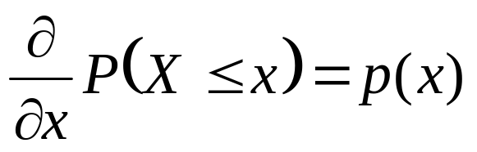
Properties of PDFs
That means…

Slide 8
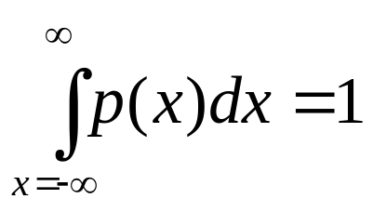

Properties of PDFs
Therefore…
Therefore…

Slide 9
Talking to your stomach
What’s the gut-feel meaning of p(x)?
If
    p(5.31) = 0.06 and p(5.92) = 0.03
then
    when a value X is sampled from the distribution, you are 2 times as likely to find that X is “very close to” 5.31 than that X is “very close to” 5.92.

Slide 10
Talking to your stomach
What’s the gut-feel meaning of p(x)?
If
    p(5.31) = 0.06 and p(5.92) = 0.03
then
    when a value X is sampled from the distribution, you are 2 times as likely to find that X is “very close to” 5.31 than that X is “very close to” 5.92.
a
b
a
b

Slide 11
Talking to your stomach
What’s the gut-feel meaning of p(x)?
If
    p(5.31) = 0.03 and p(5.92) = 0.06
then
    when a value X is sampled from the distribution, you are 2 times as likely to find that X is “very close to” 5.31 than that X is “very close to” 5.92.
a
2z
b
z
a
b

Slide 12
Talking to your stomach
What’s the gut-feel meaning of p(x)?
If
    p(5.31) = 0.03 and p(5.92) = 0.06
then
    when a value X is sampled from the distribution, you are α times as likely to find that X is “very close to” 5.31 than that X is “very close to” 5.92.
a
αz
b
z
a
b

Slide 13
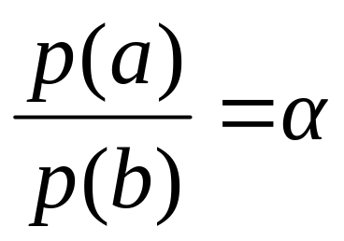
Talking to your stomach
What’s the gut-feel meaning of p(x)?
If
then
    when a value X is sampled from the distribution, you are α times as likely to find that X is “very close to” 5.31 than that X is “very close to” 5.92.
a
b

Slide 14
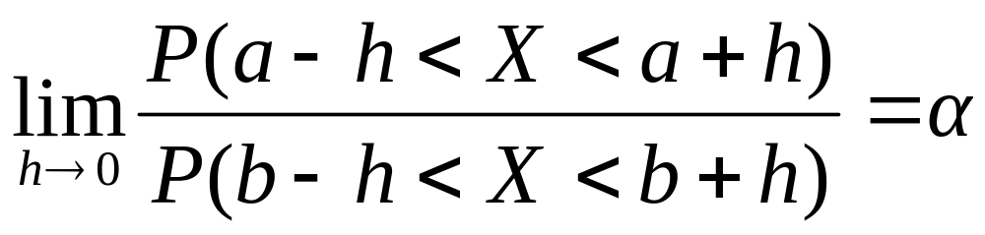
Talking to your stomach
What’s the gut-feel meaning of p(x)?
If
then

Slide 15
Yet another way to view a PDF
A recipe for sampling a random age.
Generate a random dot from the rectangle surrounding the PDF curve. Call the dot (age,d)
If d < p(age) stop and return age
Else try again: go to Step 1.

Slide 16


Test your understanding
True or False:

Slide 17
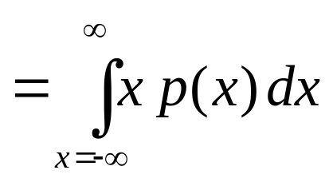
Expectations
E[X] = the expected value of random variable X
= the average value we’d see if we took a very large number of random samples of X

Slide 18
Expectations
E[X] = the expected value of random variable X
= the average value we’d see if we took a very large number of random samples of X
E[age]=35.897
= the first moment of the shape formed by the axes and the blue curve
= the best value to choose if you must guess an unknown person’s age and you’ll be fined the square of your error

Slide 19
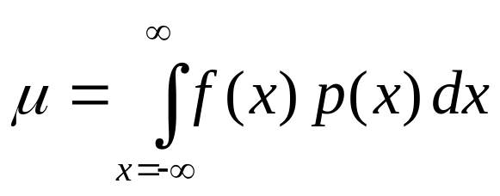
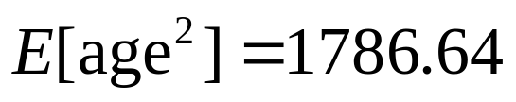
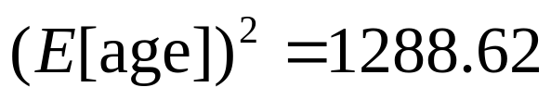

Expectation of a function
μ=E[f(X)] = the expected value of f(x) where x is drawn from X’s distribution.
= the average value we’d see if we took a very large number of random samples of f(X)
Note that in general:

Slide 20
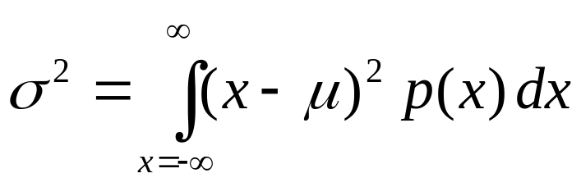

Variance
σ² = Var[X] = the expected squared difference between x and E[X]
= amount you’d expect to lose if you must guess an unknown person’s age and you’ll be fined the square of your error, and assuming you play optimally

Slide 21

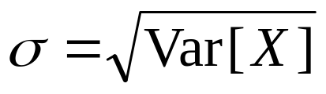
Standard Deviation
σ² = Var[X] = the expected squared difference between x and E[X]
= amount you’d expect to lose if you must guess an unknown person’s age and you’ll be fined the square of your error, and assuming you play optimally
σ = Standard Deviation = “typical” deviation of X from its mean

Slide 22
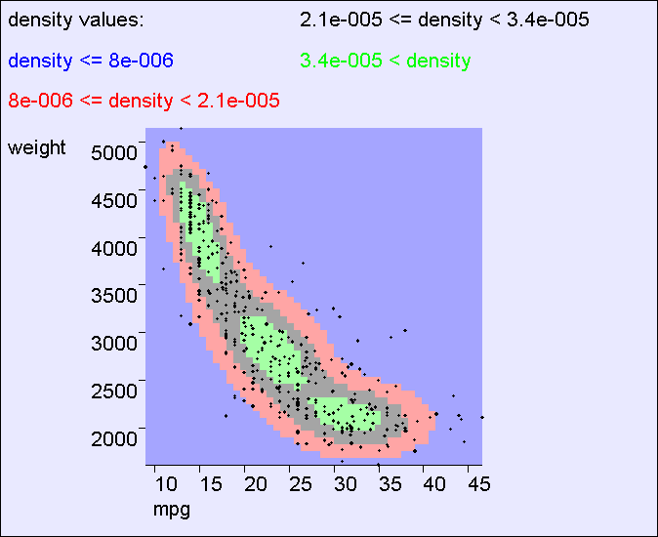
In 2 dimensions
p(x,y) = probability density of random variables (X,Y) at location (x,y)

Slide 23
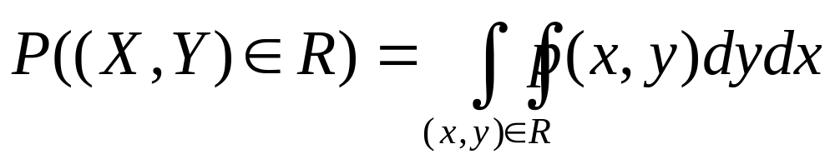
In 2 dimensions
Let X,Y be a pair of continuous random variables, and let R be some region of (X,Y) space…

Slide 24
In 2 dimensions
Let X,Y be a pair of continuous random variables, and let R be some region of (X,Y) space…
P( 20<mpg<30 and
2500<weight<3000) =
area under the 2-d surface within the red rectangle

Slide 25
In 2 dimensions
Let X,Y be a pair of continuous random variables, and let R be some region of (X,Y) space…
P( [(mpg-25)/10]² +
[(weight-3300)/1500]²
< 1 ) =
area under the 2-d surface within the red oval

Slide 26
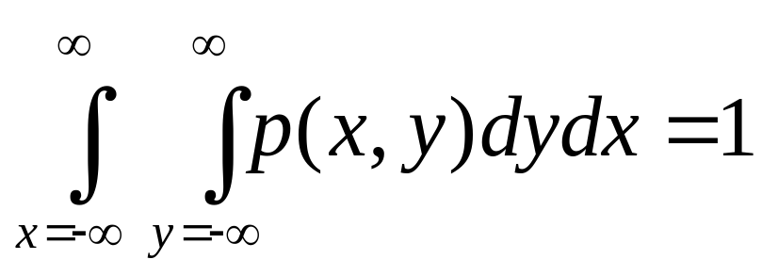
In 2 dimensions
Let X,Y be a pair of continuous random variables, and let R be some region of (X,Y) space…
Take the special case of region R = “everywhere”.
Remember that with probability 1, (X,Y) will be drawn from “somewhere”.
So..

Slide 27
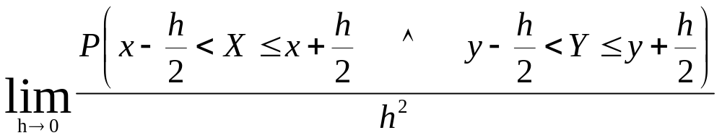
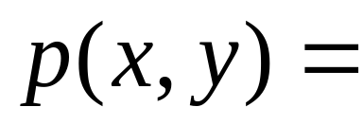
In 2 dimensions
Let X,Y be a pair of continuous random variables, and let R be some region of (X,Y) space…

Slide 28
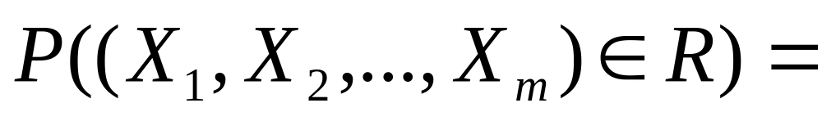
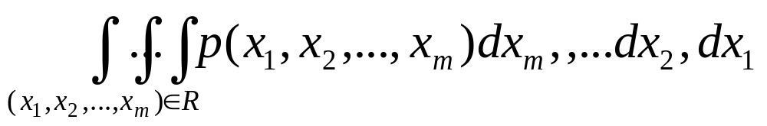
In m dimensions
Let (X₁,X₂,…X_{m}) be an n-tuple of continuous random variables, and let R be some region of R^{m} …

Slide 29
Independence
If X and Y are independent then knowing the value of X does not help predict the value of Y
mpg,weight NOT independent

Slide 30
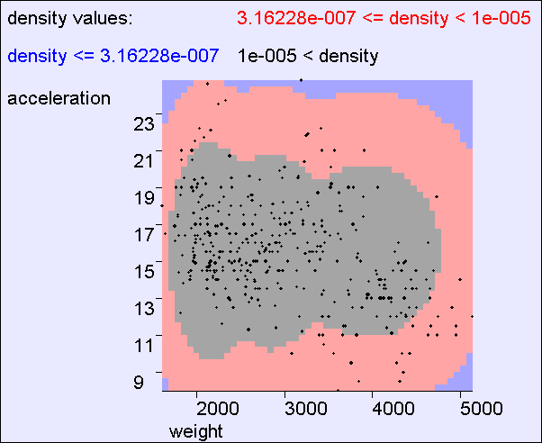
Independence
If X and Y are independent then knowing the value of X does not help predict the value of Y
the contours say that acceleration and weight are independent

Slide 31
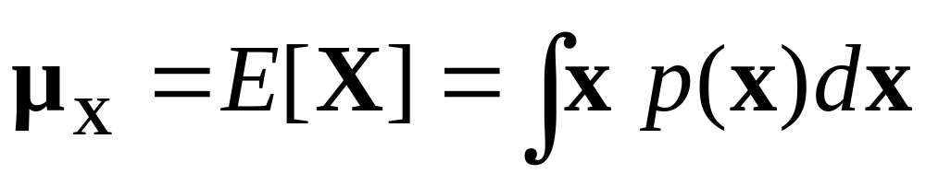
Multivariate Expectation
E[mpg,weight] =
(24.5,2600)
The centroid of the cloud

Slide 32
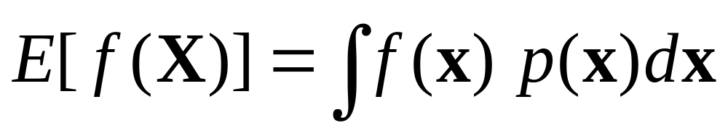
Multivariate Expectation

Slide 33
Test your understanding
All the time?
Only when X and Y are independent?
It can fail even if X and Y are independent?

Slide 34
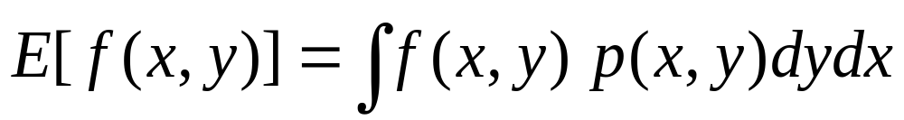

Bivariate Expectation

Slide 35
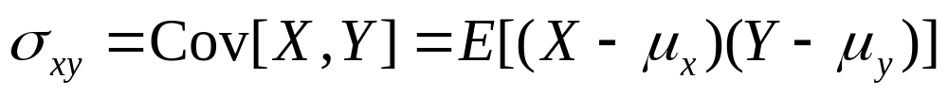
Bivariate Covariance

Slide 36
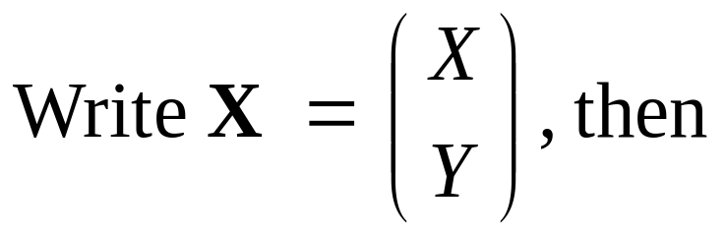
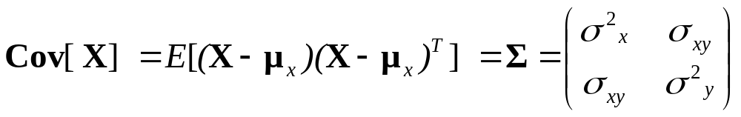
Bivariate Covariance

Slide 37


Covariance Intuition
E[mpg,weight] =
(24.5,2600)

Slide 38
Covariance Intuition
Principal
Eigenvector
of Σ
E[mpg,weight] =
(24.5,2600)

Slide 39
Covariance Fun Facts
True or False: If σ_{xy} = 0 then X and Y are independent
True or False: If X and Y are independent then σ_{xy} = 0
True or False: If σ_{xy} = σ_{x} σ_{y} then X and Y are deterministically related
True or False: If X and Y are deterministically related then σ_{xy} = σ_{x} σ_{y}
How could you prove or disprove these?

Slide 40
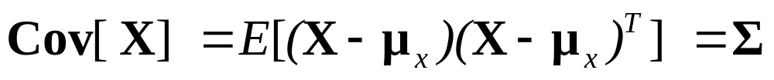
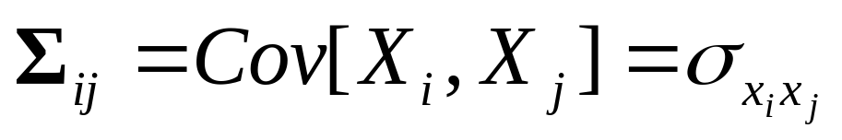
General Covariance
Let X = (X₁,X₂, … X_{k}) be a vector of k continuous random variables
S is a k x k symmetric non-negative definite matrix
If all distributions are linearly independent it is positive definite
If the distributions are linearly dependent it has determinant zero

Slide 41
Test your understanding
All the time?
Only when X and Y are independent?
It can fail even if X and Y are independent?

Slide 42
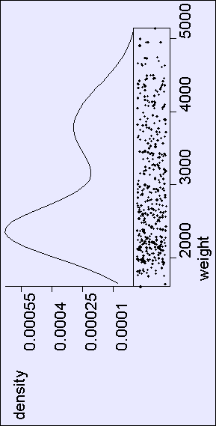
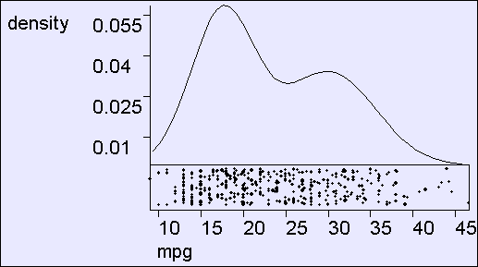
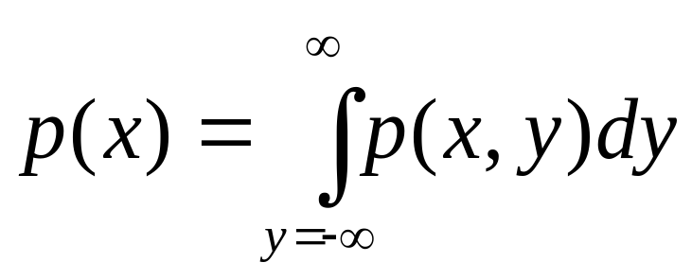
Marginal Distributions

Slide 43

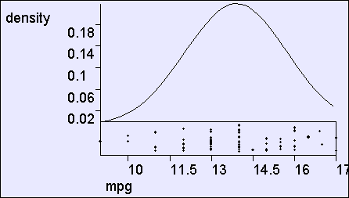

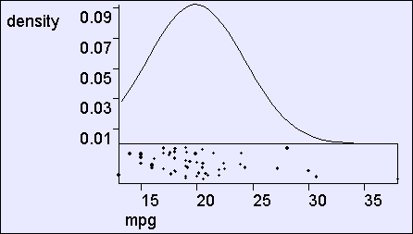

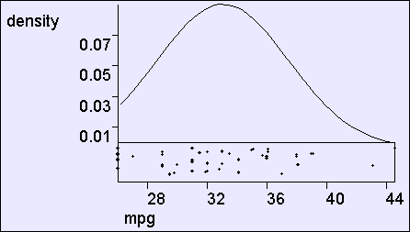
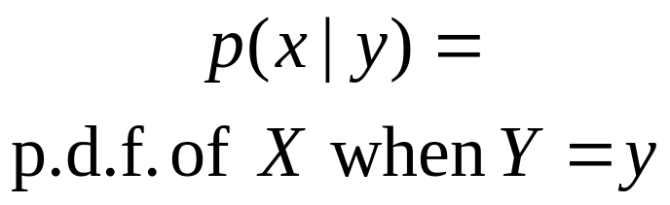
Conditional Distributions

Slide 44
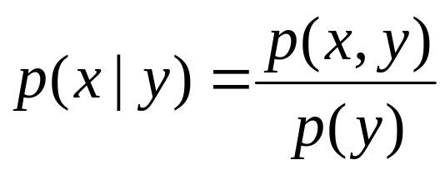
Conditional Distributions
Why?

Slide 45
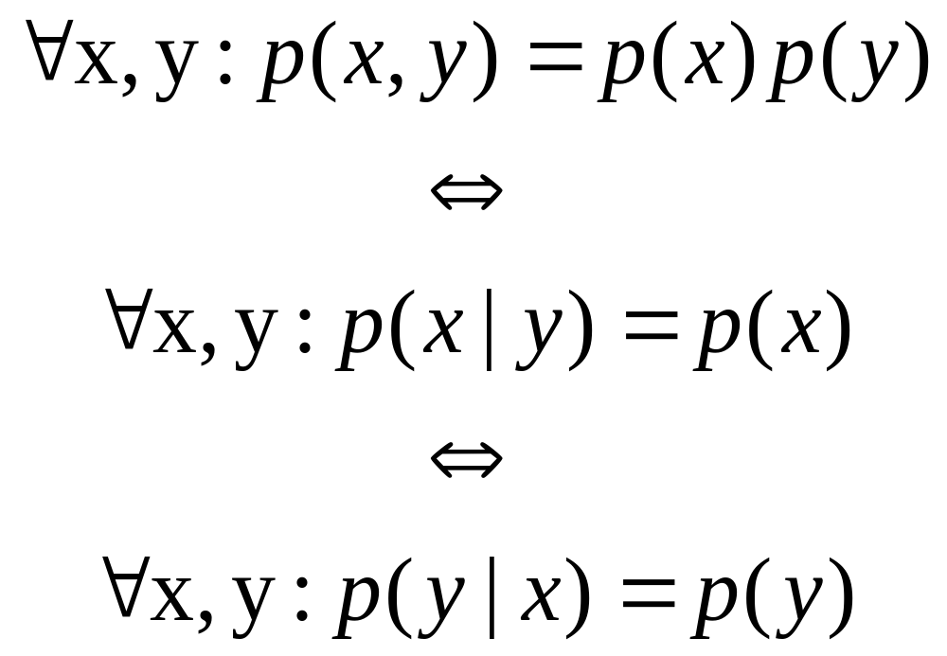
Independence Revisited
It’s easy to prove that these statements are equivalent…

Slide 46
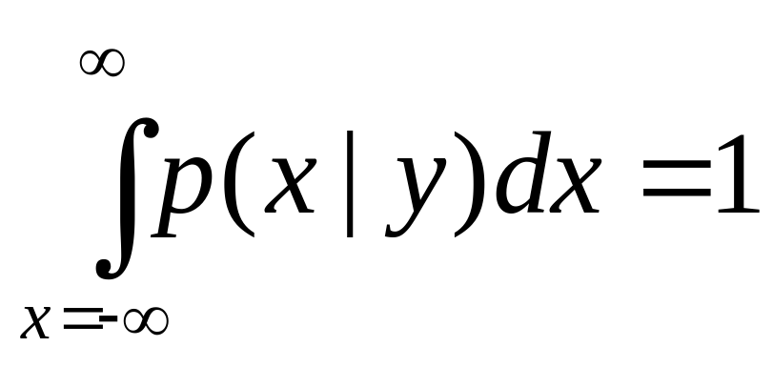
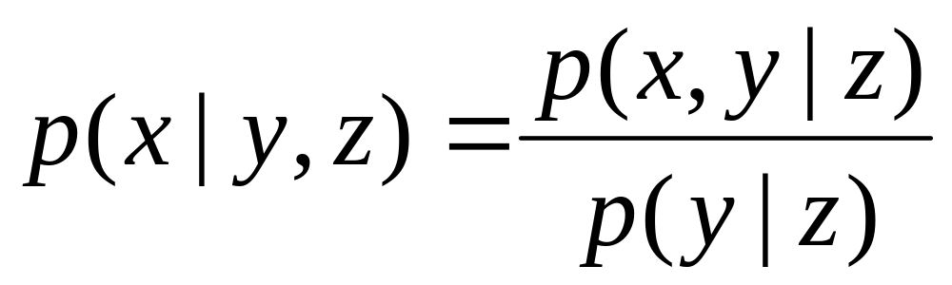
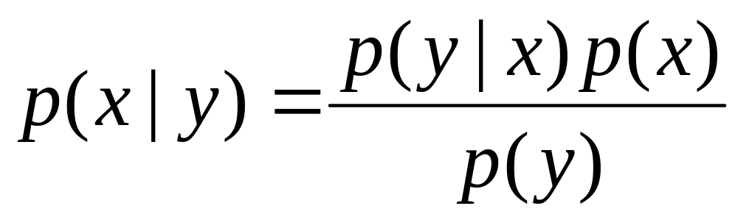
More useful stuff
(These can all be proved from definitions on previous slides)
Bayes
Rule

Slide 47
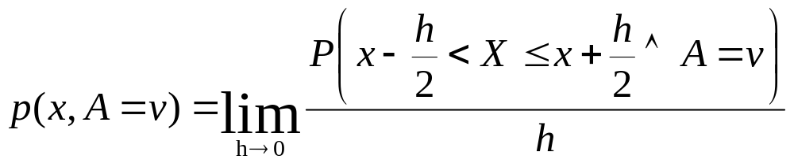
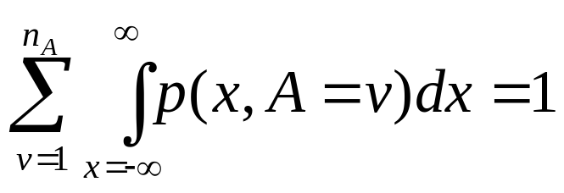
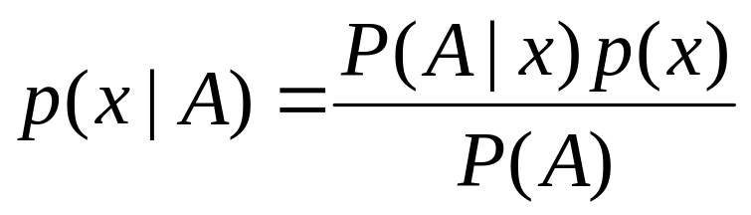
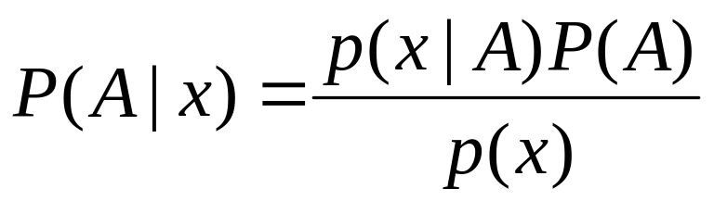
Mixing discrete and continuous variables
Bayes
Rule
Bayes
Rule

Slide 48
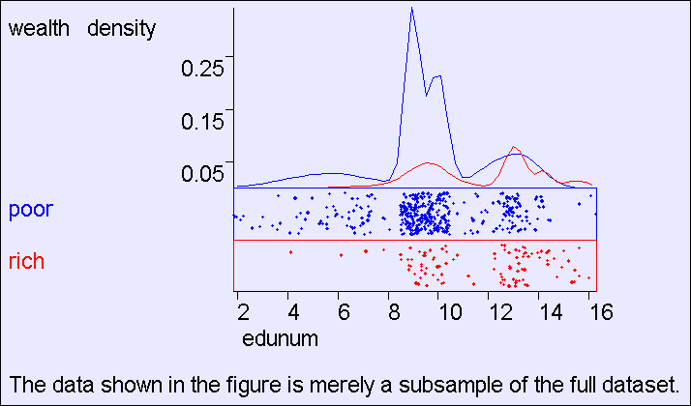
Mixing discrete and continuous variables
P(EduYears,Wealthy)

Slide 49
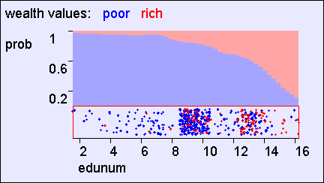
Mixing discrete and continuous variables
P(EduYears,Wealthy)
P(Wealthy| EduYears)

Slide 50
Mixing discrete and continuous variables
P(EduYears,Wealthy)
P(Wealthy| EduYears)
P(EduYears|Wealthy)
Renormalized
Axes

Slide 51
What you should know
You should be able to play with discrete, continuous and mixed joint distributions
You should be happy with the difference between p(x) and P(A)
You should be intimate with expectations of continuous and discrete random variables
You should smile when you meet a covariance matrix
Independence and its consequences should be second nature

Slide 52
Discussion
Are PDFs the only sensible way to handle analysis of real-valued variables?
Why is covariance an important concept?
Suppose X and Y are independent real-valued random variables distributed between 0 and 1:
  What is p[min(X,Y)]?
  What is E[min(X,Y)]?
Prove that E[X] is the value u that minimizes E[(X-u)²]
What is the value u that minimizes E[|X-u|]?

