Slide 1
Probabilistic and Bayesian Analytics
Andrew W. Moore
Professor
School of Computer Science
Carnegie Mellon University
www.cs.cmu.edu/~awm
awm@cs.cmu.edu
412-268-7599
Note to other teachers and users of these slides. Andrew would be delighted if you found this source material useful in giving your own lectures. Feel free to use these slides verbatim, or to modify them to fit your own needs. PowerPoint originals are available. If you make use of a significant portion of these slides in your own lecture, please include this message, or the following link to the source repository of Andrew’s tutorials: http://www.cs.cmu.edu/~awm/tutorials . Comments and corrections gratefully received.

Slide 2
Probability
The world is a very uncertain place
30 years of Artificial Intelligence and Database research danced around this fact
And then a few AI researchers decided to use some ideas from the eighteenth century

Slide 3
What we’re going to do
We will review the fundamentals of probability.
It’s really going to be worth it
In this lecture, you’ll see an example of probabilistic analytics in action: Bayes Classifiers

Slide 4
Discrete Random Variables
A is a Boolean-valued random variable if A denotes an event, and there is some degree of uncertainty as to whether A occurs.
Examples
A = The US president in 2023 will be male
A = You wake up tomorrow with a headache
A = You have Ebola

Slide 5
Probabilities
We write P(A) as “the fraction of possible worlds in which A is true”
We could at this point spend 2 hours on the philosophy of this.
But we won’t.

Slide 6
Visualizing A
Event space of all possible worlds
Worlds in which A is true
P(A) = Area of
reddish oval
Its area is 1
Worlds in which A is False

Slide 7
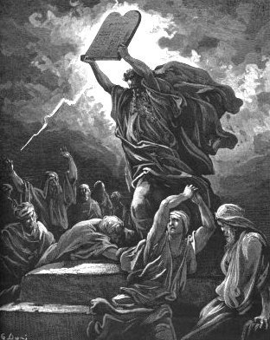
The Axioms Of Probability

Slide 8
The Axioms of Probability
0 <= P(A) <= 1
P(True) = 1
P(False) = 0
P(A or B) = P(A) + P(B) - P(A and B)
      Where do these axioms come from? Were they “discovered”?
      Answers coming up later.

Slide 9
Interpreting the axioms
0 <= P(A) <= 1
P(True) = 1
P(False) = 0
P(A or B) = P(A) + P(B) - P(A and B)
The area of A can’t get any smaller than 0
And a zero area would mean no world could ever have A true

Slide 10
Interpreting the axioms
0 <= P(A) <= 1
P(True) = 1
P(False) = 0
P(A or B) = P(A) + P(B) - P(A and B)
The area of A can’t get any bigger than 1
And an area of 1 would mean all worlds will have A true

Slide 11
Interpreting the axioms
0 <= P(A) <= 1
P(True) = 1
P(False) = 0
P(A or B) = P(A) + P(B) - P(A and B)
A
B

Slide 12
Interpreting the axioms
0 <= P(A) <= 1
P(True) = 1
P(False) = 0
P(A or B) = P(A) + P(B) - P(A and B)
A
P(A or B)
B
P(A and B)
B
Simple addition and subtraction

Slide 13
These Axioms are Not to be Trifled With
There have been attempts to do different methodologies for uncertainty
    Fuzzy Logic
    Three-valued logic
    Dempster-Shafer
    Non-monotonic reasoning
But the axioms of probability are the only system with this property:
If you gamble using them you can’t be unfairly exploited by an opponent using some other system [di Finetti 1931]

Slide 14
Theorems from the Axioms
0 <= P(A) <= 1, P(True) = 1, P(False) = 0
P(A or B) = P(A) + P(B) - P(A and B)
    From these we can prove:
    P(not A) = P(~A) = 1-P(A)
How?

Slide 15
Side Note
I am inflicting these proofs on you for two reasons:
  These kind of manipulations will need to be second nature to you if you use probabilistic analytics in depth
  Suffering is good for you

Slide 16
Another important theorem
0 <= P(A) <= 1, P(True) = 1, P(False) = 0
P(A or B) = P(A) + P(B) - P(A and B)
    From these we can prove:
    P(A) = P(A ^ B) + P(A ^ ~B)
How?

Slide 17
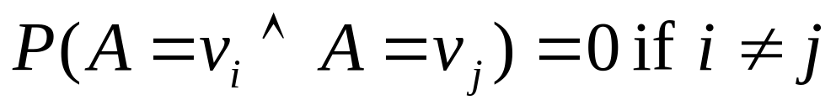
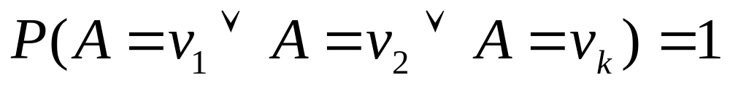
Multivalued Random Variables
Suppose A can take on more than 2 values
A is a random variable with arity k if it can take on exactly one value out of {v₁,v₂, .. v_{k}}
Thus…

Slide 18
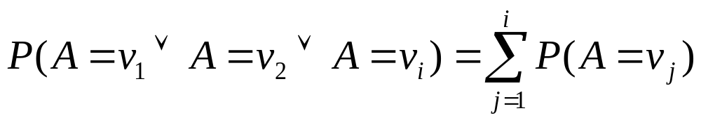
An easy fact about Multivalued Random Variables:
Using the axioms of probability…
      0 <= P(A) <= 1, P(True) = 1, P(False) = 0
      P(A or B) = P(A) + P(B) - P(A and B)
And assuming that A obeys…
It’s easy to prove that

Slide 19
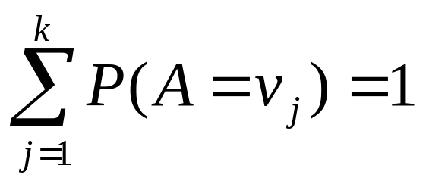
An easy fact about Multivalued Random Variables:
Using the axioms of probability…
      0 <= P(A) <= 1, P(True) = 1, P(False) = 0
      P(A or B) = P(A) + P(B) - P(A and B)
And assuming that A obeys…
It’s easy to prove that
And thus we can prove

Slide 20
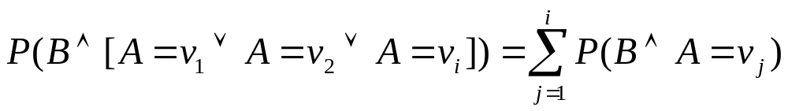
Another fact about Multivalued Random Variables:
Using the axioms of probability…
      0 <= P(A) <= 1, P(True) = 1, P(False) = 0
      P(A or B) = P(A) + P(B) - P(A and B)
And assuming that A obeys…
It’s easy to prove that

Slide 21
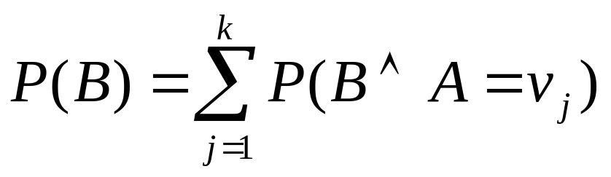
Another fact about Multivalued Random Variables:
Using the axioms of probability…
      0 <= P(A) <= 1, P(True) = 1, P(False) = 0
      P(A or B) = P(A) + P(B) - P(A and B)
And assuming that A obeys…
It’s easy to prove that
And thus we can prove

Slide 22
Elementary Probability in Pictures
P(~A) + P(A) = 1

Slide 23
Elementary Probability in Pictures
P(B) = P(B ^ A) + P(B ^ ~A)

Slide 24
Elementary Probability in Pictures

Slide 25
Elementary Probability in Pictures

Slide 26
Conditional Probability
P(A|B) = Fraction of worlds in which B is true that also have A true
H = “Have a headache”
F = “Coming down with Flu”
P(H) = 1/10
P(F) = 1/40
P(H|F) = 1/2
“Headaches are rare and flu is rarer, but if you’re coming down with ‘flu there’s a 50-50 chance you’ll have a headache.”
F
H

Slide 27
Conditional Probability
P(H|F) = Fraction of flu-inflicted worlds in which you have a headache
= #worlds with flu and headache
------------------------------------
#worlds with flu
= Area of “H and F” region
------------------------------
Area of “F” region
= P(H ^ F)
-----------
P(F)
F
H
H = “Have a headache”
F = “Coming down with Flu”
P(H) = 1/10
P(F) = 1/40
P(H|F) = 1/2

Slide 28
Definition of Conditional Probability
P(A ^ B)
P(A|B) = -----------
P(B)
Corollary: The Chain Rule
P(A ^ B) = P(A|B) P(B)

Slide 29
Probabilistic Inference
H = “Have a headache”
F = “Coming down with Flu”
P(H) = 1/10
P(F) = 1/40
P(H|F) = 1/2
F
H
One day you wake up with a headache. You think: “Drat! 50% of flus are associated with headaches so I must have a 50-50 chance of coming down with flu”
Is this reasoning good?

Slide 30
Probabilistic Inference
H = “Have a headache”
F = “Coming down with Flu”
P(H) = 1/10
P(F) = 1/40
P(H|F) = 1/2
F
H
P(F ^ H) = …
P(F|H) = …

Slide 31
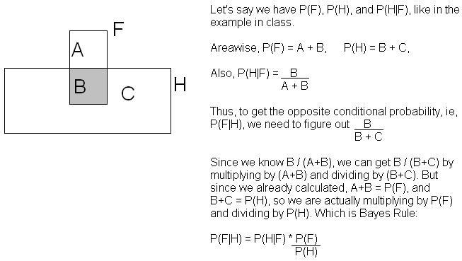
Another way to understand the intuition
Thanks to Jahanzeb Sherwani for contributing this explanation:

Slide 32
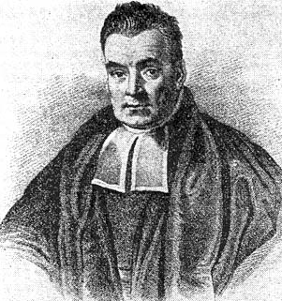
What we just did…
P(A ^ B) P(A|B) P(B)
P(B|A) = ----------- = ---------------
P(A) P(A)
This is Bayes Rule
Bayes, Thomas (1763) An essay towards solving a problem in the doctrine of chances. Philosophical Transactions of the Royal Society of London, 53:370-418

Slide 33
Using Bayes Rule to Gamble
$1.00
The “Win” envelope has a dollar and four beads in it
The “Lose” envelope has three beads and no money
Trivial question: someone draws an envelope at random and offers to sell it to you. How much should you pay?

Slide 34
Using Bayes Rule to Gamble
$1.00
The “Win” envelope has a dollar and four beads in it
The “Lose” envelope has three beads and no money
Interesting question: before deciding, you are allowed to see one bead drawn from the envelope.
  Suppose it’s black: How much should you pay?
  Suppose it’s red: How much should you pay?

Slide 35
Calculation…
$1.00

Slide 36
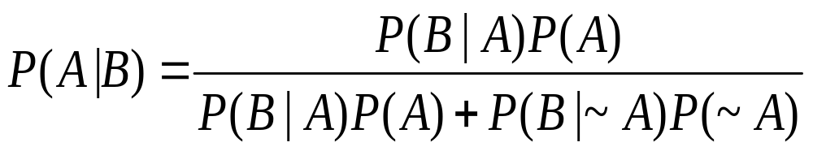
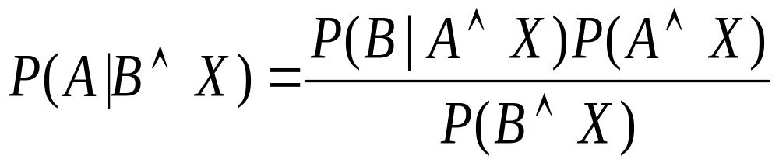
More General Forms of Bayes Rule

Slide 37
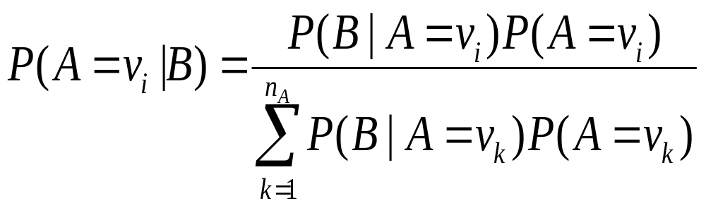
More General Forms of Bayes Rule

Slide 38
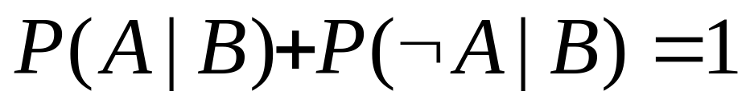
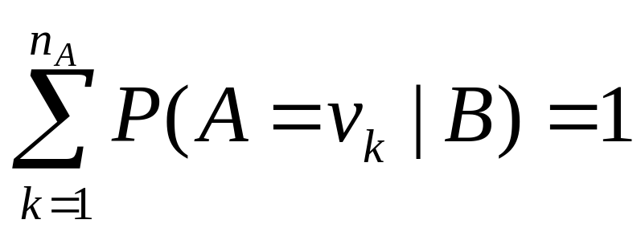
Useful Easy-to-prove facts

Slide 39
The Joint Distribution
Example: Boolean variables A, B, C
Recipe for making a joint distribution of M variables:

Slide 40
The Joint Distribution
Example: Boolean variables A, B, C
Recipe for making a joint distribution of M variables:
Make a truth table listing all combinations of values of your variables (if there are M Boolean variables then the table will have 2^{M} rows).
A | B | C
0 | 0 | 0
0 | 0 | 1
0 | 1 | 0
0 | 1 | 1
1 | 0 | 0
1 | 0 | 1
1 | 1 | 0
1 | 1 | 1

Slide 41
The Joint Distribution
Example: Boolean variables A, B, C
Recipe for making a joint distribution of M variables:
Make a truth table listing all combinations of values of your variables (if there are M Boolean variables then the table will have 2^{M} rows).
For each combination of values, say how probable it is.
A | B | C | Prob
0 | 0 | 0 | 0.30
0 | 0 | 1 | 0.05
0 | 1 | 0 | 0.10
0 | 1 | 1 | 0.05
1 | 0 | 0 | 0.05
1 | 0 | 1 | 0.10
1 | 1 | 0 | 0.25
1 | 1 | 1 | 0.10

Slide 42
The Joint Distribution
Example: Boolean variables A, B, C
Recipe for making a joint distribution of M variables:
Make a truth table listing all combinations of values of your variables (if there are M Boolean variables then the table will have 2^{M} rows).
For each combination of values, say how probable it is.
If you subscribe to the axioms of probability, those numbers must sum to 1.
A | B | C | Prob
0 | 0 | 0 | 0.30
0 | 0 | 1 | 0.05
0 | 1 | 0 | 0.10
0 | 1 | 1 | 0.05
1 | 0 | 0 | 0.05
1 | 0 | 1 | 0.10
1 | 1 | 0 | 0.25
1 | 1 | 1 | 0.10
A
0.05
0.10
0.05
0.10
0.25
0.05
C
B
0.10
0.30

Slide 43
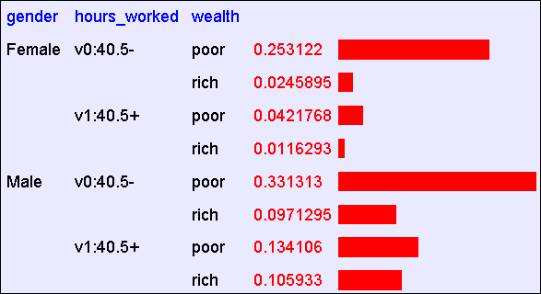
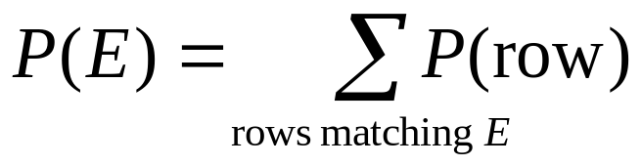
Using the Joint
One you have the JD you can ask for the probability of any logical expression involving your attribute

Slide 44
Using the Joint
P(Poor Male) = 0.4654

Slide 45
Using the Joint
P(Poor) = 0.7604

Slide 46
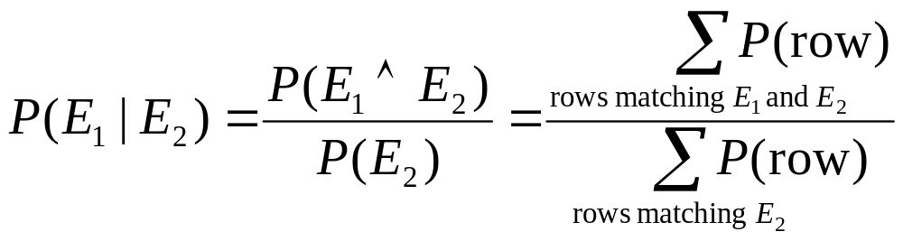
Inference with the Joint

Slide 47
Inference with the Joint
P(Male | Poor) = 0.4654 / 0.7604 = 0.612

Slide 48
Inference is a big deal
I’ve got this evidence. What’s the chance that this conclusion is true?
  I’ve got a sore neck: how likely am I to have meningitis?
  I see my lights are out and it’s 9pm. What’s the chance my spouse is already asleep?

Slide 49
Inference is a big deal
I’ve got this evidence. What’s the chance that this conclusion is true?
  I’ve got a sore neck: how likely am I to have meningitis?
  I see my lights are out and it’s 9pm. What’s the chance my spouse is already asleep?

Slide 50
Inference is a big deal
I’ve got this evidence. What’s the chance that this conclusion is true?
  I’ve got a sore neck: how likely am I to have meningitis?
  I see my lights are out and it’s 9pm. What’s the chance my spouse is already asleep?
There’s a thriving set of industries growing based around Bayesian Inference. Highlights are: Medicine, Pharma, Help Desk Support, Engine Fault Diagnosis

Slide 51
Where do Joint Distributions come from?
Idea One: Expert Humans
Idea Two: Simpler probabilistic facts and some algebra
Example: Suppose you knew
P(A) = 0.7
P(B|A) = 0.2
P(B|~A) = 0.1
P(C|A^B) = 0.1
P(C|A^~B) = 0.8
P(C|~A^B) = 0.3
P(C|~A^~B) = 0.1
Then you can automatically compute the JD using the chain rule
In another lecture: Bayes Nets, a systematic way to do this.
P(A=x ^ B=y ^ C=z) =
P(C=z|A=x^ B=y) P(B=y|A=x) P(A=x)

Slide 52
Where do Joint Distributions come from?
Idea Three: Learn them from data!
    Prepare to see one of the most impressive learning algorithms you’ll come across in the entire course….

Slide 53
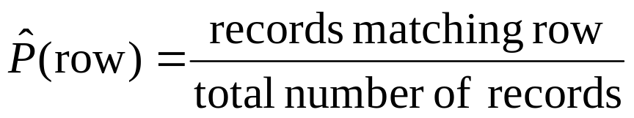
Learning a joint distribution
Build a JD table for your attributes in which the probabilities are unspecified
The fill in each row with
A | B | C | Prob
0 | 0 | 0 | ?
0 | 0 | 1 | ?
0 | 1 | 0 | ?
0 | 1 | 1 | ?
1 | 0 | 0 | ?
1 | 0 | 1 | ?
1 | 1 | 0 | ?
1 | 1 | 1 | ?
A | B | C | Prob
0 | 0 | 0 | 0.30
0 | 0 | 1 | 0.05
0 | 1 | 0 | 0.10
0 | 1 | 1 | 0.05
1 | 0 | 0 | 0.05
1 | 0 | 1 | 0.10
1 | 1 | 0 | 0.25
1 | 1 | 1 | 0.10
Fraction of all records in which
A and B are True but C is False

Slide 54
Example of Learning a Joint
This Joint was obtained by learning from three attributes in the UCI “Adult” Census Database [Kohavi 1995]

Slide 55
Where are we?
We have recalled the fundamentals of probability
We have become content with what JDs are and how to use them
And we even know how to learn JDs from data.

Slide 56
Density Estimation
Our Joint Distribution learner is our first example of something called Density Estimation
A Density Estimator learns a mapping from a set of attributes to a Probability
Input
Attributes
Density
Estimator
Probability

Slide 57
Density Estimation
Compare it against the two other major kinds of models:
Input
Attributes
Classifier
Prediction of
categorical output
Input
Attributes
Density
Estimator
Probability
Input
Attributes
Regressor
Prediction of
real-valued output

Slide 58
Evaluating Density Estimation
Test-set criterion for estimating performance on future data*
* See the Decision Tree or Cross Validation lecture for more detail
Input
Attributes
Test set Accuracy
Classifier
Prediction of
categorical output
Input
Attributes
Density
Estimator
?
Probability
Input
Attributes
Regressor
Prediction of
real-valued output
Test set Accuracy

Slide 59
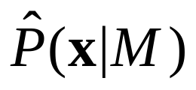
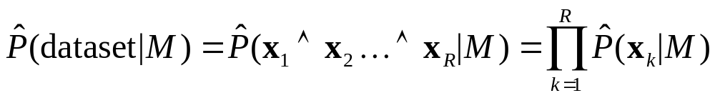
Evaluating a density estimator
Given a record x, a density estimator M can tell you how likely the record is:
Given a dataset with R records, a density estimator can tell you how likely the dataset is:
  (Under the assumption that all records were independently generated from the Density Estimator’s JD)

Slide 60
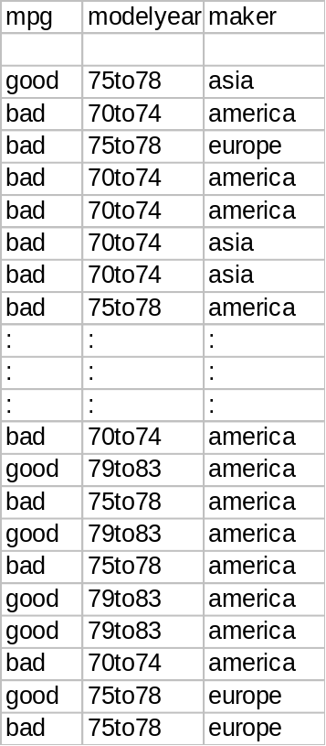
A small dataset: Miles Per Gallon
192 Training Set Records
From the UCI repository (thanks to Ross Quinlan)

Slide 61
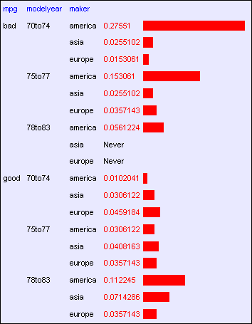
A small dataset: Miles Per Gallon
192 Training Set Records

Slide 62
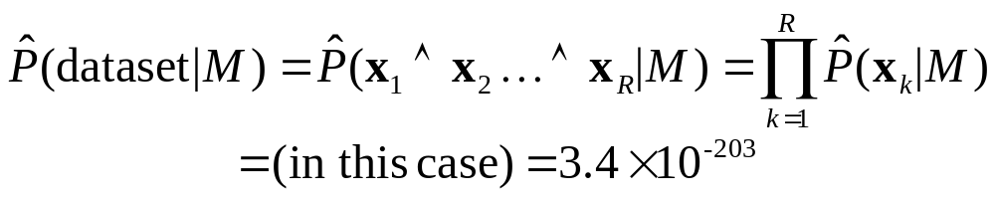
A small dataset: Miles Per Gallon
192 Training Set Records

Slide 63
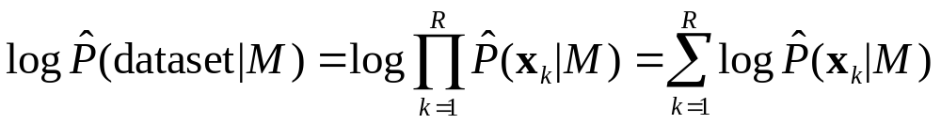
Log Probabilities
Since probabilities of datasets get so small we usually use log probabilities

Slide 64
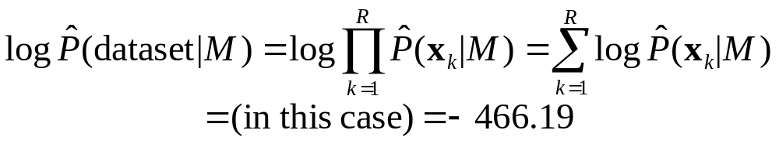
A small dataset: Miles Per Gallon
192 Training Set Records

Slide 65
Summary: The Good News
We have a way to learn a Density Estimator from data.
Density estimators can do many good things…
  Can sort the records by probability, and thus spot weird records (anomaly detection)
  Can do inference: P(E1|E2)
        Automatic Doctor / Help Desk etc
  Ingredient for Bayes Classifiers (see later)

Slide 66
Summary: The Bad News
Density estimation by directly learning the joint is trivial, mindless and dangerous

Slide 67
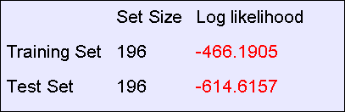
Using a test set
An independent test set with 196 cars has a worse log likelihood
(actually it’s a billion quintillion quintillion quintillion quintillion times less likely)
….Density estimators can overfit. And the full joint density estimator is the overfittiest of them all!

Slide 68
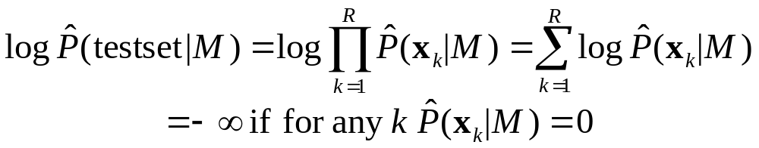
Overfitting Density Estimators
If this ever happens, it means there are certain combinations that we learn are impossible

Slide 69
Using a test set
The only reason that our test set didn’t score -infinity is that my code is hard-wired to always predict a probability of at least one in 10²⁰
We need Density Estimators that are less prone to overfitting

Slide 70
Naïve Density Estimation
The problem with the Joint Estimator is that it just mirrors the training data.
We need something which generalizes more usefully.
The naïve model generalizes strongly:
Assume that each attribute is distributed independently of any of the other attributes.

Slide 71
Independently Distributed Data
Let x[i] denote the i’th field of record x.
The independently distributed assumption says that for any i,v, u₁ u₂… u_{i-1} u_{i+1}… u_{M}
Or in other words, x[i] is independent of {x[1],x[2],..x[i-1], x[i+1],…x[M]}
This is often written as

Slide 72
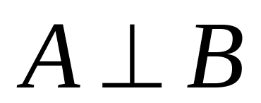
A note about independence
Assume A and B are Boolean Random Variables. Then
“A and B are independent”
if and only if
P(A|B) = P(A)
“A and B are independent” is often notated as

Slide 73
Independence Theorems
Assume P(A|B) = P(A)
Then P(A^B) =
    = P(A) P(B)
Assume P(A|B) = P(A)
Then P(B|A) =
    = P(B)

Slide 74
Independence Theorems
Assume P(A|B) = P(A)
Then P(~A|B) =
    = P(~A)
Assume P(A|B) = P(A)
Then P(A|~B) =
    = P(A)

Slide 75
Multivalued Independence
For multivalued Random Variables A and B,
if and only if
from which you can then prove things like…

Slide 76
Back to Naïve Density Estimation
Let x[i] denote the i’th field of record x:
Naïve DE assumes x[i] is independent of {x[1],x[2],..x[i-1], x[i+1],…x[M]}
Example:
  Suppose that each record is generated by randomly shaking a green dice and a red dice
    Dataset 1: A = red value, B = green value
    Dataset 2: A = red value, B = sum of values
    Dataset 3: A = sum of values, B = difference of values
  Which of these datasets violates the naïve assumption?

Slide 77
Using the Naïve Distribution
Once you have a Naïve Distribution you can easily compute any row of the joint distribution.
Suppose A, B, C and D are independently distributed. What is P(A^~B^C^~D)?

Slide 78
Using the Naïve Distribution
Once you have a Naïve Distribution you can easily compute any row of the joint distribution.
Suppose A, B, C and D are independently distributed. What is P(A^~B^C^~D)?
= P(A|~B^C^~D) P(~B^C^~D)
= P(A) P(~B^C^~D)
= P(A) P(~B|C^~D) P(C^~D)
= P(A) P(~B) P(C^~D)
= P(A) P(~B) P(C|~D) P(~D)
= P(A) P(~B) P(C) P(~D)

Slide 79
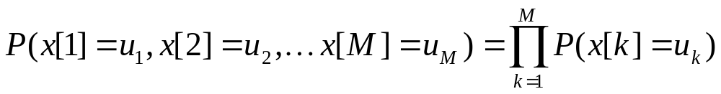
Naïve Distribution General Case
Suppose x[1], x[2], … x[M] are independently distributed.
So if we have a Naïve Distribution we can construct any row of the implied Joint Distribution on demand.
So we can do any inference
But how do we learn a Naïve Density Estimator?

Slide 80
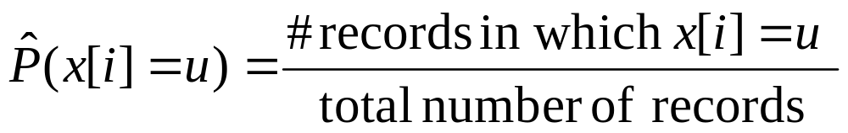
Learning a Naïve Density Estimator
Another trivial learning algorithm!

Slide 81
Contrast
Joint DE | Naïve DE
Can model anything | Can model only very boring distributions
No problem to model “C is a noisy copy of A” | Outside Naïve’s scope
Given 100 records and more than 6 Boolean attributes will screw up badly | Given 100 records and 10,000 multivalued attributes will be fine

Slide 82
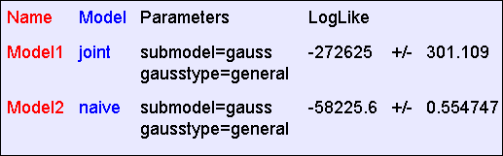
Empirical Results: “Hopeless”
The “hopeless” dataset consists of 40,000 records and 21 Boolean attributes called a,b,c, … u. Each attribute in each record is generated 50-50 randomly as 0 or 1.
Average test set log probability during 10 folds of k-fold cross-validation*
Described in a future Andrew lecture
Despite the vast amount of data, “Joint” overfits hopelessly and does much worse

Slide 83
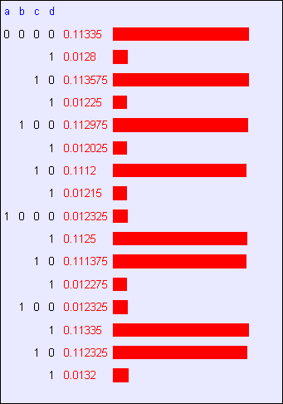
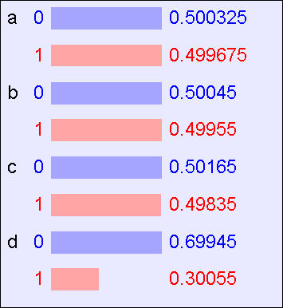
Empirical Results: “Logical”
The “logical” dataset consists of 40,000 records and 4 Boolean attributes called a,b,c,d where a,b,c are generated 50-50 randomly as 0 or 1. D = A^~C, except that in 10% of records it is flipped
The DE learned by “Joint”
The DE learned by “Naive”

Slide 84
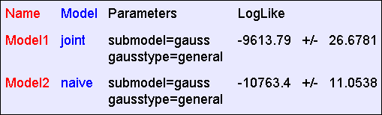
Empirical Results: “Logical”
The “logical” dataset consists of 40,000 records and 4 Boolean attributes called a,b,c,d where a,b,c are generated 50-50 randomly as 0 or 1. D = A^~C, except that in 10% of records it is flipped
The DE learned by “Joint”
The DE learned by “Naive”

Slide 85
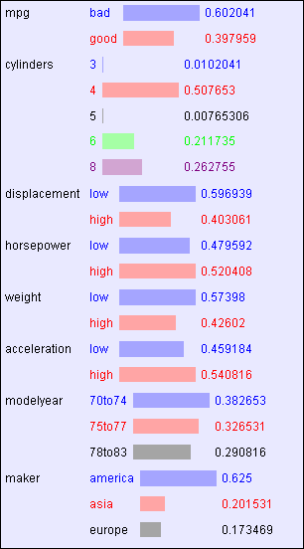
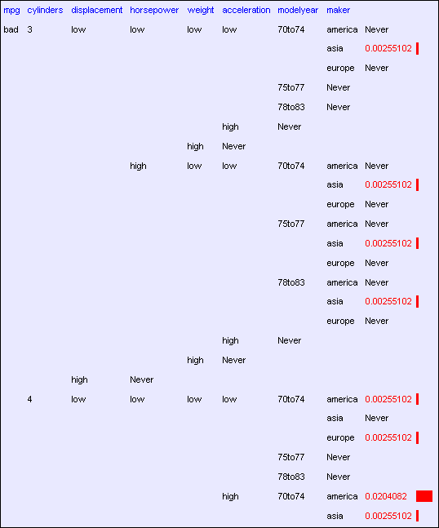
Empirical Results: “MPG”
The “MPG” dataset consists of 392 records and 8 attributes
A tiny part of the DE learned by “Joint”
The DE learned by “Naive”

Slide 86
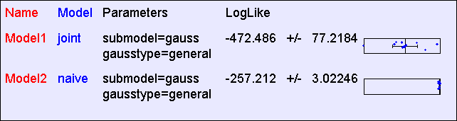
Empirical Results: “MPG”
The “MPG” dataset consists of 392 records and 8 attributes
A tiny part of the DE learned by “Joint”
The DE learned by “Naive”

Slide 87
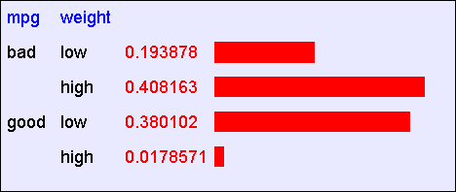
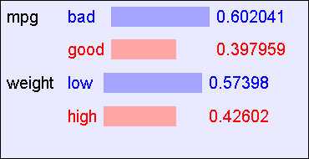
Empirical Results: “Weight vs. MPG”
Suppose we train only from the “Weight” and “MPG” attributes
The DE learned by “Joint”
The DE learned by “Naive”

Slide 88
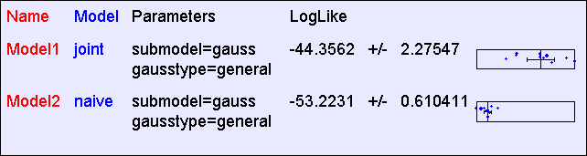
Empirical Results: “Weight vs. MPG”
Suppose we train only from the “Weight” and “MPG” attributes
The DE learned by “Joint”
The DE learned by “Naive”

Slide 89
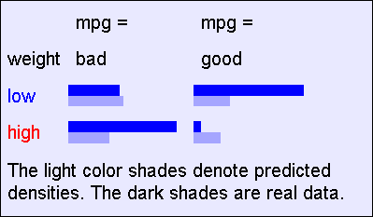
“Weight vs. MPG”: The best that Naïve can do
The DE learned by “Joint”
The DE learned by “Naive”

Slide 90
Reminder: The Good News
We have two ways to learn a Density Estimator from data.
*In other lectures we’ll see vastly more impressive Density Estimators (Mixture Models, Bayesian Networks, Density Trees, Kernel Densities and many more)
Density estimators can do many good things…
  Anomaly detection
  Can do inference: P(E1|E2) Automatic Doctor / Help Desk etc
  Ingredient for Bayes Classifiers

Slide 91
Bayes Classifiers
A formidable and sworn enemy of decision trees
Input
Attributes
Classifier
Prediction of
categorical output
DT
BC

Slide 92
How to build a Bayes Classifier
Assume you want to predict output Y which has arity n_{Y} and values v₁, v₂, … v_{ny}.
Assume there are m input attributes called X₁, X₂, … X_{m}
Break dataset into n_{Y} smaller datasets called DS₁, DS₂, … DS_{ny}.
Define DS_{i} = Records in which Y=v_{i}
For each DS_{i} , learn Density Estimator M_{i} to model the input distribution among the Y=v_{i} records.

Slide 93
How to build a Bayes Classifier
Assume you want to predict output Y which has arity n_{Y} and values v₁, v₂, … v_{ny}.
Assume there are m input attributes called X₁, X₂, … X_{m}
Break dataset into n_{Y} smaller datasets called DS₁, DS₂, … DS_{ny}.
Define DS_{i} = Records in which Y=v_{i}
For each DS_{i} , learn Density Estimator M_{i} to model the input distribution among the Y=v_{i} records.
M_{i} estimates P(X₁, X₂, … X_{m} | Y=v_{i} )

Slide 94
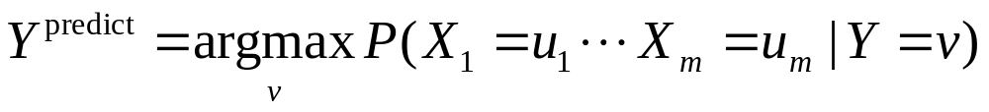
How to build a Bayes Classifier
Assume you want to predict output Y which has arity n_{Y} and values v₁, v₂, … v_{ny}.
Assume there are m input attributes called X₁, X₂, … X_{m}
Break dataset into n_{Y} smaller datasets called DS₁, DS₂, … DS_{ny}.
Define DS_{i} = Records in which Y=v_{i}
For each DS_{i} , learn Density Estimator M_{i} to model the input distribution among the Y=v_{i} records.
M_{i} estimates P(X₁, X₂, … X_{m} | Y=v_{i} )
Idea: When a new set of input values (X₁ = u₁, X₂ = u₂, …. X_{m} = u_{m}) come along to be evaluated predict the value of Y that makes P(X₁, X₂, … X_{m} | Y=v_{i} ) most likely
Is this a good idea?

Slide 95
How to build a Bayes Classifier
Assume you want to predict output Y which has arity n_{Y} and values v₁, v₂, … v_{ny}.
Assume there are m input attributes called X₁, X₂, … X_{m}
Break dataset into n_{Y} smaller datasets called DS₁, DS₂, … DS_{ny}.
Define DS_{i} = Records in which Y=v_{i}
For each DS_{i} , learn Density Estimator M_{i} to model the input distribution among the Y=v_{i} records.
M_{i} estimates P(X₁, X₂, … X_{m} | Y=v_{i} )
Idea: When a new set of input values (X₁ = u₁, X₂ = u₂, …. X_{m} = u_{m}) come along to be evaluated predict the value of Y that makes P(X₁, X₂, … X_{m} | Y=v_{i} ) most likely
This is a Maximum Likelihood classifier.
It can get silly if some Ys are very unlikely
Is this a good idea?

Slide 96
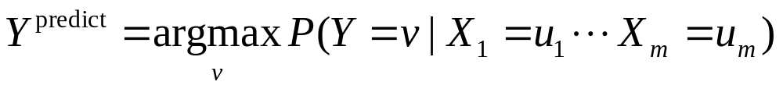
How to build a Bayes Classifier
Assume you want to predict output Y which has arity n_{Y} and values v₁, v₂, … v_{ny}.
Assume there are m input attributes called X₁, X₂, … X_{m}
Break dataset into n_{Y} smaller datasets called DS₁, DS₂, … DS_{ny}.
Define DS_{i} = Records in which Y=v_{i}
For each DS_{i} , learn Density Estimator M_{i} to model the input distribution among the Y=v_{i} records.
M_{i} estimates P(X₁, X₂, … X_{m} | Y=v_{i} )
Idea: When a new set of input values (X₁ = u₁, X₂ = u₂, …. X_{m} = u_{m}) come along to be evaluated predict the value of Y that makes P(Y=v_{i} | X₁, X₂, … X_{m}) most likely
Much Better Idea
Is this a good idea?

Slide 97
Terminology
MLE (Maximum Likelihood Estimator):
MAP (Maximum A-Posteriori Estimator):

Slide 98
Getting what we need

Slide 99
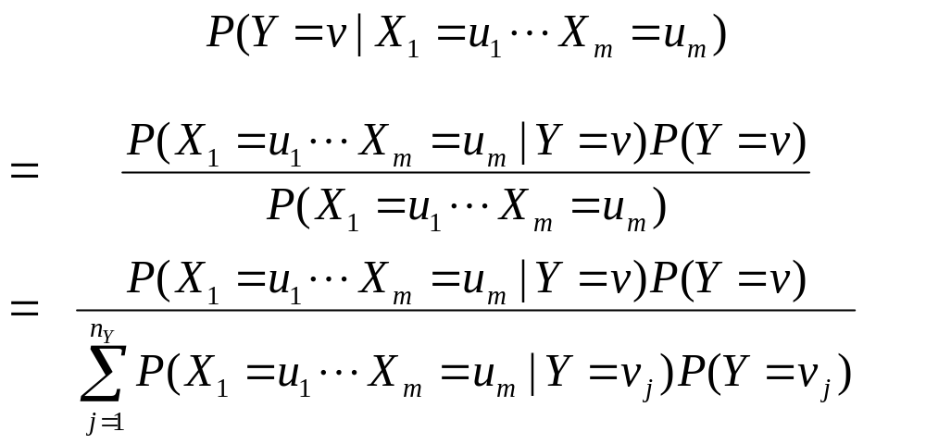
Getting a posterior probability

Slide 100
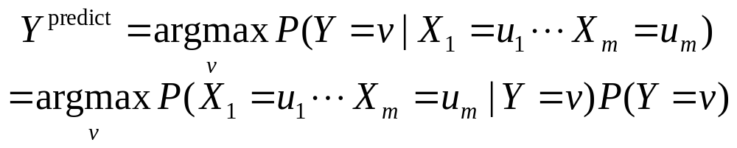
Bayes Classifiers in a nutshell
1. Learn the distribution over inputs for each value Y.
2. This gives P(X₁, X₂, … X_{m} | Y=v_{i} ).
3. Estimate P(Y=v_{i} ). as fraction of records with Y=v_{i} .
4. For a new prediction:

Slide 101
Bayes Classifiers in a nutshell
1. Learn the distribution over inputs for each value Y.
2. This gives P(X₁, X₂, … X_{m} | Y=v_{i} ).
3. Estimate P(Y=v_{i} ). as fraction of records with Y=v_{i} .
4. For a new prediction:
We can use our favorite Density Estimator here.
Right now we have two options:
Joint Density Estimator
Naïve Density Estimator

Slide 102
Joint Density Bayes Classifier
In the case of the joint Bayes Classifier this degenerates to a very simple rule:
Y^{predict} = the most common value of Y among records in which X₁ = u₁, X₂ = u₂, …. X_{m} = u_{m}.
Note that if no records have the exact set of inputs X₁ = u₁, X₂ = u₂, …. X_{m} = u_{m}, then P(X₁, X₂, … X_{m} | Y=v_{i} ) = 0 for all values of Y.
In that case we just have to guess Y’s value

Slide 103
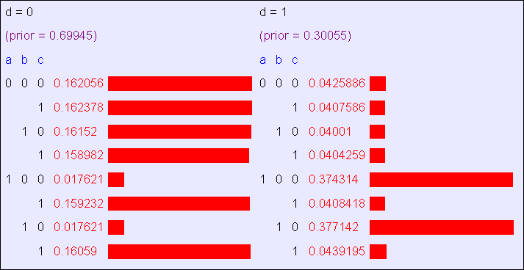
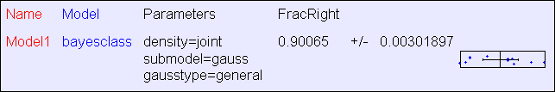
Joint BC Results: “Logical”
The “logical” dataset consists of 40,000 records and 4 Boolean attributes called a,b,c,d where a,b,c are generated 50-50 randomly as 0 or 1. D = A^~C, except that in 10% of records it is flipped
The Classifier learned by “Joint BC”

Slide 104
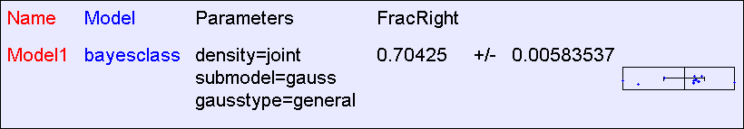
Joint BC Results: “All Irrelevant”
The “all irrelevant” dataset consists of 40,000 records and 15 Boolean attributes called a,b,c,d..o where a,b,c are generated 50-50 randomly as 0 or 1. v (output) = 1 with probability 0.75, 0 with prob 0.25

Slide 105
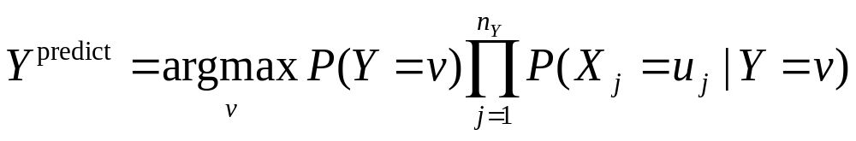
Naïve Bayes Classifier
In the case of the naive Bayes Classifier this can be simplified:

Slide 106
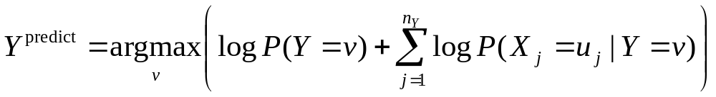
Naïve Bayes Classifier
In the case of the naive Bayes Classifier this can be simplified:
Technical Hint:
If you have 10,000 input attributes that product will underflow in floating point math. You should use logs:

Slide 107



BC Results: “XOR”
The “XOR” dataset consists of 40,000 records and 2 Boolean inputs called a and b, generated 50-50 randomly as 0 or 1. c (output) = a XOR b
The Classifier learned by “Joint BC”
The Classifier learned by “Naive BC”

Slide 108


Naive BC Results: “Logical”
The “logical” dataset consists of 40,000 records and 4 Boolean attributes called a,b,c,d where a,b,c are generated 50-50 randomly as 0 or 1. D = A^~C, except that in 10% of records it is flipped
The Classifier learned by “Naive BC”

Slide 109

Naive BC Results: “Logical”
The “logical” dataset consists of 40,000 records and 4 Boolean attributes called a,b,c,d where a,b,c are generated 50-50 randomly as 0 or 1. D = A^~C, except that in 10% of records it is flipped
The Classifier learned by “Joint BC”
This result surprised Andrew until he had thought about it a little

Slide 110


Naïve BC Results: “All Irrelevant”
The “all irrelevant” dataset consists of 40,000 records and 15 Boolean attributes called a,b,c,d..o where a,b,c are generated 50-50 randomly as 0 or 1. v (output) = 1 with probability 0.75, 0 with prob 0.25
The Classifier learned by “Naive BC”

Slide 111


BC Results: “MPG”: 392 records
The Classifier learned by “Naive BC”

Slide 112

BC Results: “MPG”: 40 records

Slide 113
More Facts About Bayes Classifiers
Many other density estimators can be slotted in*.
Density estimation can be performed with real-valued inputs*
Bayes Classifiers can be built with real-valued inputs*
Rather Technical Complaint: Bayes Classifiers don’t try to be maximally discriminative---they merely try to honestly model what’s going on*
Zero probabilities are painful for Joint and Naïve. A hack (justifiable with the magic words “Dirichlet Prior”) can help*.
Naïve Bayes is wonderfully cheap. And survives 10,000 attributes cheerfully!
*See future Andrew Lectures

Slide 114
What you should know
Probability
  Fundamentals of Probability and Bayes Rule
  What’s a Joint Distribution
  How to do inference (i.e. P(E1|E2)) once you have a JD
Density Estimation
  What is DE and what is it good for
  How to learn a Joint DE
  How to learn a naïve DE

Slide 115
What you should know
Bayes Classifiers
  How to build one
  How to predict with a BC
  Contrast between naïve and joint BCs

Slide 116
Interesting Questions
Suppose you were evaluating NaiveBC, JointBC, and Decision Trees
    Invent a problem where only NaiveBC would do well
    Invent a problem where only Dtree would do well
    Invent a problem where only JointBC would do well
    Invent a problem where only NaiveBC would do poorly
    Invent a problem where only Dtree would do poorly
    Invent a problem where only JointBC would do poorly

