Slide 1

A gentle introduction to the mathematics of biosurveillance: Bayes Rule and Bayes Classifiers
Andrew W. Moore
Professor
The Auton Lab
School of Computer Science
Carnegie Mellon University
http://www.autonlab.org
Associate Member
The RODS Lab
University of Pittburgh
Carnegie Mellon University
http://rods.health.pitt.edu
Note to other teachers and users of these slides. Andrew would be delighted if you found this source material useful in giving your own lectures. Feel free to use these slides verbatim, or to modify them to fit your own needs. PowerPoint originals are available. If you make use of a significant portion of these slides in your own lecture, please include this message, or the following link to the source repository of Andrew’s tutorials: http://www.cs.cmu.edu/~awm/tutorials . Comments and corrections gratefully received.
awm@cs.cmu.edu
412-268-7599

Slide 2
What we’re going to do
We will review the concept of reasoning with uncertainty
Also known as probability
This is a fundamental building block
It’s really going to be worth it

Slide 3
What we’re going to do
We will review the concept of reasoning with uncertainty
Also known as probability
This is a fundamental building block
It’s really going to be worth it
      (No I mean it… it really is going to be worth it!)

Slide 4
Discrete Random Variables
A is a Boolean-valued random variable if A denotes an event, and there is some degree of uncertainty as to whether A occurs.
Examples
  A = The next patient you examine is suffering from inhalational anthrax
  A = The next patient you examine has a cough
  A = There is an active terrorist cell in your city

Slide 5
Probabilities
We write P(A) as “the fraction of possible worlds in which A is true”
We could at this point spend 2 hours on the philosophy of this.
But we won’t.

Slide 6
Visualizing A
Event space of all possible worlds
Worlds in which A is true
P(A) = Area of
reddish oval
Its area is 1
Worlds in which A is False

Slide 7
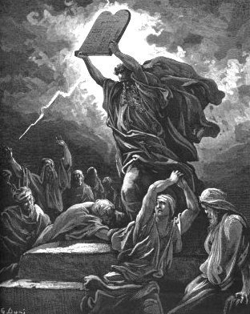
The Axioms Of Probability

Slide 8
The Axioms Of Probability
0 <= P(A) <= 1
P(True) = 1
P(False) = 0
P(A or B) = P(A) + P(B) - P(A and B)
The area of A can’t get any smaller than 0
And a zero area would mean no world could ever have A true

Slide 9
Interpreting the axioms
0 <= P(A) <= 1
P(True) = 1
P(False) = 0
P(A or B) = P(A) + P(B) - P(A and B)
The area of A can’t get any bigger than 1
And an area of 1 would mean all worlds will have A true

Slide 10
Interpreting the axioms
0 <= P(A) <= 1
P(True) = 1
P(False) = 0
P(A or B) = P(A) + P(B) - P(A and B)
A
B

Slide 11
Interpreting the axioms
0 <= P(A) <= 1
P(True) = 1
P(False) = 0
P(A or B) = P(A) + P(B) - P(A and B)
A
P(A or B)
B
P(A and B)
B
Simple addition and subtraction

Slide 12
These Axioms are Not to be Trifled With
There have been attempts to do different methodologies for uncertainty
    Fuzzy Logic
    Three-valued logic
    Dempster-Shafer
    Non-monotonic reasoning
But the axioms of probability are the only system with this property:
If you gamble using them you can’t be unfairly exploited by an opponent using some other system [di Finetti 1931]

Slide 13
Another important theorem
0 <= P(A) <= 1, P(True) = 1, P(False) = 0
P(A or B) = P(A) + P(B) - P(A and B)
    From these we can prove:
    P(A) = P(A and B) + P(A and not B)
A
B

Slide 14
Conditional Probability
P(A|B) = Fraction of worlds in which B is true that also have A true
H = “Have a headache”
F = “Coming down with Flu”
P(H) = 1/10
P(F) = 1/40
P(H|F) = 1/2
“Headaches are rare and flu is rarer, but if you’re coming down with ‘flu there’s a 50-50 chance you’ll have a headache.”
F
H

Slide 15
Conditional Probability
P(H|F) = Fraction of flu-inflicted worlds in which you have a headache
= #worlds with flu and headache
------------------------------------
#worlds with flu
= Area of “H and F” region
------------------------------
Area of “F” region
= P(H and F)
---------------
P(F)
F
H
H = “Have a headache”
F = “Coming down with Flu”
P(H) = 1/10
P(F) = 1/40
P(H|F) = 1/2

Slide 16
Definition of Conditional Probability
P(A and B)
P(A|B) = -----------
P(B)
Corollary: The Chain Rule
P(A and B) = P(A|B) P(B)

Slide 17
Probabilistic Inference
H = “Have a headache”
F = “Coming down with Flu”
P(H) = 1/10
P(F) = 1/40
P(H|F) = 1/2
F
H
One day you wake up with a headache. You think: “Drat! 50% of flus are associated with headaches so I must have a 50-50 chance of coming down with flu”
Is this reasoning good?

Slide 18
Probabilistic Inference
H = “Have a headache”
F = “Coming down with Flu”
P(H) = 1/10
P(F) = 1/40
P(H|F) = 1/2
F
H
P(F and H) = …
P(F|H) = …

Slide 19
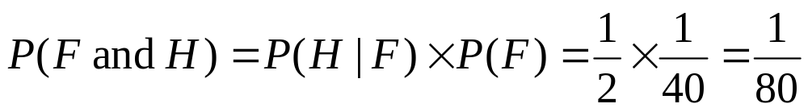
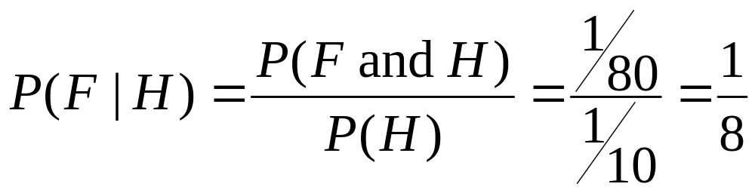
Probabilistic Inference
H = “Have a headache”
F = “Coming down with Flu”
P(H) = 1/10
P(F) = 1/40
P(H|F) = 1/2
F
H

Slide 20
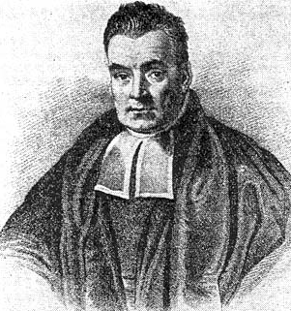
What we just did…
P(A ^ B) P(A|B) P(B)
P(B|A) = ----------- = ---------------
P(A) P(A)
This is Bayes Rule
Bayes, Thomas (1763) An essay towards solving a problem in the doctrine of chances. Philosophical Transactions of the Royal Society of London, 53:370-418

Slide 21
Bad Hygiene
Good Hygiene
Menu
Menu
Menu
Menu
Menu
Menu
Menu
You are a health official, deciding whether to investigate a restaurant
You lose a dollar if you get it wrong.
You win a dollar if you get it right
  Half of all restaurants have bad hygiene
  In a bad restaurant, ¾ of the menus are smudged
  In a good restaurant, 1/3 of the menus are smudged
  You are allowed to see a randomly chosen menu

Slide 22
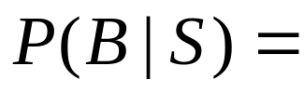
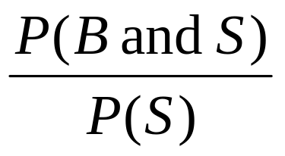
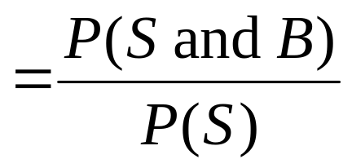
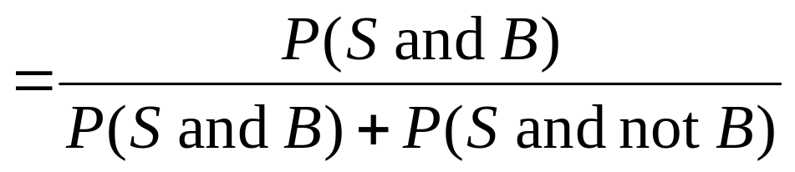
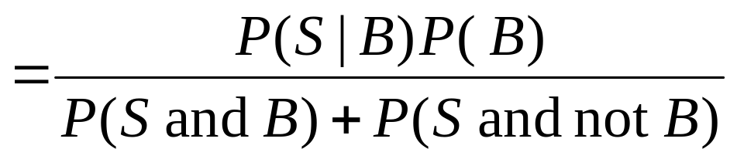
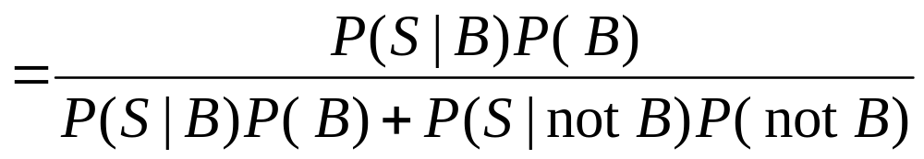
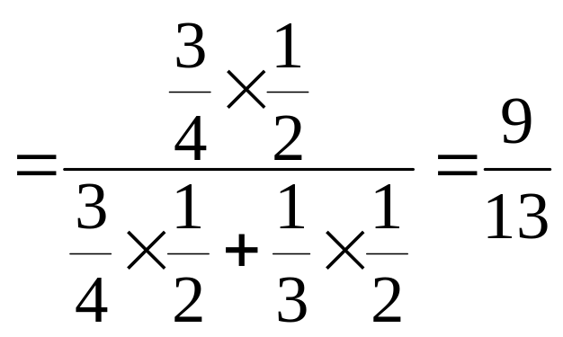

Slide 23
Menu
Menu
Menu
Menu
Menu
Menu
Menu
Menu
Menu
Menu
Menu
Menu
Menu
Menu
Menu
Menu

Slide 24
Bayesian Diagnosis
Buzzword | Meaning | In our example | Our example’s value
True State | The true state of the world, which you would like to know | Is the restaurant bad?

Slide 25
Bayesian Diagnosis
Buzzword | Meaning | In our example | Our example’s value
True State | The true state of the world, which you would like to know | Is the restaurant bad?
Prior | Prob(true state = x) | P(Bad) | 1/2

Slide 26
Bayesian Diagnosis
Buzzword | Meaning | In our example | Our example’s value
True State | The true state of the world, which you would like to know | Is the restaurant bad?
Prior | Prob(true state = x) | P(Bad) | 1/2
Evidence | Some symptom, or other thing you can observe | Smudge

Slide 27
Bayesian Diagnosis
Buzzword | Meaning | In our example | Our example’s value
True State | The true state of the world, which you would like to know | Is the restaurant bad?
Prior | Prob(true state = x) | P(Bad) | 1/2
Evidence | Some symptom, or other thing you can observe
Conditional | Probability of seeing evidence if you did know the true state | P(Smudge|Bad) | 3/4
 |  | P(Smudge|not Bad) | 1/3

Slide 28
Bayesian Diagnosis
Buzzword | Meaning | In our example | Our example’s value
True State | The true state of the world, which you would like to know | Is the restaurant bad?
Prior | Prob(true state = x) | P(Bad) | 1/2
Evidence | Some symptom, or other thing you can observe
Conditional | Probability of seeing evidence if you did know the true state | P(Smudge|Bad) | 3/4
 |  | P(Smudge|not Bad) | 1/3
Posterior | The Prob(true state = x | some evidence) | P(Bad|Smudge) | 9/13

Slide 29
Bayesian Diagnosis
Buzzword | Meaning | In our example | Our example’s value
True State | The true state of the world, which you would like to know | Is the restaurant bad?
Prior | Prob(true state = x) | P(Bad) | 1/2
Evidence | Some symptom, or other thing you can observe
Conditional | Probability of seeing evidence if you did know the true state | P(Smudge|Bad) | 3/4
 |  | P(Smudge|not Bad) | 1/3
Posterior | The Prob(true state = x | some evidence) | P(Bad|Smudge) | 9/13
Inference, Diagnosis, Bayesian Reasoning | Getting the posterior from the prior and the evidence

Slide 30
Bayesian Diagnosis
Buzzword | Meaning | In our example | Our example’s value
True State | The true state of the world, which you would like to know | Is the restaurant bad?
Prior | Prob(true state = x) | P(Bad) | 1/2
Evidence | Some symptom, or other thing you can observe
Conditional | Probability of seeing evidence if you did know the true state | P(Smudge|Bad) | 3/4
 |  | P(Smudge|not Bad) | 1/3
Posterior | The Prob(true state = x | some evidence) | P(Bad|Smudge) | 9/13
Inference, Diagnosis, Bayesian Reasoning | Getting the posterior from the prior and the evidence
Decision theory | Combining the posterior with known costs in order to decide what to do

Slide 31
Many Pieces of Evidence

Slide 32
Many Pieces of Evidence
Pat walks in to the surgery.
Pat is sore and has a headache but no cough

Slide 33
Many Pieces of Evidence
Priors
P(Flu) | = | 1/40 | P(Not Flu) | = | 39/40
P( Headache | Flu ) | = | 1/2 | P( Headache | not Flu ) | = | 7 / 78
P( Cough | Flu ) | = | 2/3 | P( Cough | not Flu ) | = | 1/6
P( Sore | Flu ) | = | 3/4 | P( Sore | not Flu ) | = | 1/3
Pat walks in to the surgery.
Pat is sore and has a headache but no cough
Conditionals

Slide 34
Many Pieces of Evidence
Priors
P(Flu) | = | 1/40 | P(Not Flu) | = | 39/40
P( Headache | Flu ) | = | 1/2 | P( Headache | not Flu ) | = | 7 / 78
P( Cough | Flu ) | = | 2/3 | P( Cough | not Flu ) | = | 1/6
P( Sore | Flu ) | = | 3/4 | P( Sore | not Flu ) | = | 1/3
Pat walks in to the surgery.
Pat is sore and has a headache but no cough
What is P( F | H and not C and S ) ?
Conditionals

Slide 35
P(Flu) | = | 1/40 | P(Not Flu) | = | 39/40
P( Headache | Flu ) | = | 1/2 | P( Headache | not Flu ) | = | 7 / 78
P( Cough | Flu ) | = | 2/3 | P( Cough | not Flu ) | = | 1/6
P( Sore | Flu ) | = | 3/4 | P( Sore | not Flu ) | = | 1/3
The Naïve Assumption

Slide 36
P(Flu) | = | 1/40 | P(Not Flu) | = | 39/40
P( Headache | Flu ) | = | 1/2 | P( Headache | not Flu ) | = | 7 / 78
P( Cough | Flu ) | = | 2/3 | P( Cough | not Flu ) | = | 1/6
P( Sore | Flu ) | = | 3/4 | P( Sore | not Flu ) | = | 1/3
The Naïve Assumption
If I know Pat has Flu…
…and I want to know if Pat has a cough…
…it won’t help me to find out whether Pat is sore

Slide 37
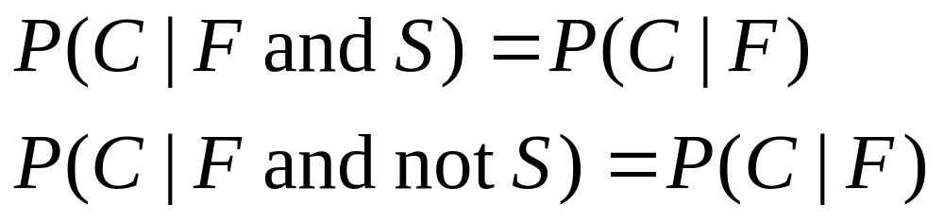
P(Flu) | = | 1/40 | P(Not Flu) | = | 39/40
P( Headache | Flu ) | = | 1/2 | P( Headache | not Flu ) | = | 7 / 78
P( Cough | Flu ) | = | 2/3 | P( Cough | not Flu ) | = | 1/6
P( Sore | Flu ) | = | 3/4 | P( Sore | not Flu ) | = | 1/3
The Naïve Assumption
If I know Pat has Flu…
…and I want to know if Pat has a cough…
…it won’t help me to find out whether Pat is sore
Coughing is explained away by Flu

Slide 38
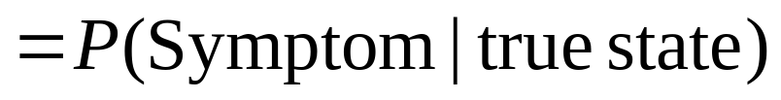
The Naïve Assumption: General Case
P(Flu) | = | 1/40 | P(Not Flu) | = | 39/40
P( Headache | Flu ) | = | 1/2 | P( Headache | not Flu ) | = | 7 / 78
P( Cough | Flu ) | = | 2/3 | P( Cough | not Flu ) | = | 1/6
P( Sore | Flu ) | = | 3/4 | P( Sore | not Flu ) | = | 1/3
If I know the true state…
  …and I want to know about one of the symptoms…
    …then it won’t help me to find out anything about the other symptoms
Other symptoms are explained away by the true state

Slide 39
The Naïve Assumption: General Case
P(Flu) | = | 1/40 | P(Not Flu) | = | 39/40
P( Headache | Flu ) | = | 1/2 | P( Headache | not Flu ) | = | 7 / 78
P( Cough | Flu ) | = | 2/3 | P( Cough | not Flu ) | = | 1/6
P( Sore | Flu ) | = | 3/4 | P( Sore | not Flu ) | = | 1/3
If I know the true state…
  …and I want to know about one of the symptoms…
    …then it won’t help me to find out anything about the other symptoms
What are the good things about the Naïve assumption?
What are the bad things?
Other symptoms are explained away by the true state

Slide 40
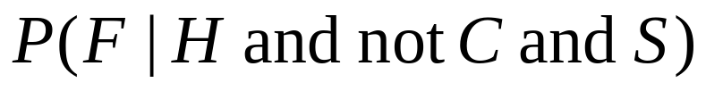
P(Flu) | = | 1/40 | P(Not Flu) | = | 39/40
P( Headache | Flu ) | = | 1/2 | P( Headache | not Flu ) | = | 7 / 78
P( Cough | Flu ) | = | 2/3 | P( Cough | not Flu ) | = | 1/6
P( Sore | Flu ) | = | 3/4 | P( Sore | not Flu ) | = | 1/3

Slide 41
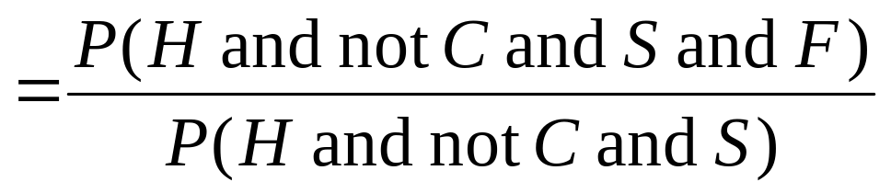
P(Flu) | = | 1/40 | P(Not Flu) | = | 39/40
P( Headache | Flu ) | = | 1/2 | P( Headache | not Flu ) | = | 7 / 78
P( Cough | Flu ) | = | 2/3 | P( Cough | not Flu ) | = | 1/6
P( Sore | Flu ) | = | 3/4 | P( Sore | not Flu ) | = | 1/3

Slide 42
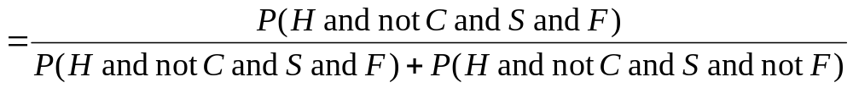
P(Flu) | = | 1/40 | P(Not Flu) | = | 39/40
P( Headache | Flu ) | = | 1/2 | P( Headache | not Flu ) | = | 7 / 78
P( Cough | Flu ) | = | 2/3 | P( Cough | not Flu ) | = | 1/6
P( Sore | Flu ) | = | 3/4 | P( Sore | not Flu ) | = | 1/3

Slide 43
P(Flu) | = | 1/40 | P(Not Flu) | = | 39/40
P( Headache | Flu ) | = | 1/2 | P( Headache | not Flu ) | = | 7 / 78
P( Cough | Flu ) | = | 2/3 | P( Cough | not Flu ) | = | 1/6
P( Sore | Flu ) | = | 3/4 | P( Sore | not Flu ) | = | 1/3
How do I get P(H and not C and S and F)?

Slide 44

P(Flu) | = | 1/40 | P(Not Flu) | = | 39/40
P( Headache | Flu ) | = | 1/2 | P( Headache | not Flu ) | = | 7 / 78
P( Cough | Flu ) | = | 2/3 | P( Cough | not Flu ) | = | 1/6
P( Sore | Flu ) | = | 3/4 | P( Sore | not Flu ) | = | 1/3

Slide 45
P(Flu) | = | 1/40 | P(Not Flu) | = | 39/40
P( Headache | Flu ) | = | 1/2 | P( Headache | not Flu ) | = | 7 / 78
P( Cough | Flu ) | = | 2/3 | P( Cough | not Flu ) | = | 1/6
P( Sore | Flu ) | = | 3/4 | P( Sore | not Flu ) | = | 1/3
Chain rule: P( █ and █ ) = P( █ | █ ) × P( █ )

Slide 46

P(Flu) | = | 1/40 | P(Not Flu) | = | 39/40
P( Headache | Flu ) | = | 1/2 | P( Headache | not Flu ) | = | 7 / 78
P( Cough | Flu ) | = | 2/3 | P( Cough | not Flu ) | = | 1/6
P( Sore | Flu ) | = | 3/4 | P( Sore | not Flu ) | = | 1/3
Naïve assumption: lack of cough and soreness have no effect on headache if I am already assuming Flu

Slide 47
P(Flu) | = | 1/40 | P(Not Flu) | = | 39/40
P( Headache | Flu ) | = | 1/2 | P( Headache | not Flu ) | = | 7 / 78
P( Cough | Flu ) | = | 2/3 | P( Cough | not Flu ) | = | 1/6
P( Sore | Flu ) | = | 3/4 | P( Sore | not Flu ) | = | 1/3
Chain rule: P( █ and █ ) = P( █ | █ ) × P( █ )

Slide 48
P(Flu) | = | 1/40 | P(Not Flu) | = | 39/40
P( Headache | Flu ) | = | 1/2 | P( Headache | not Flu ) | = | 7 / 78
P( Cough | Flu ) | = | 2/3 | P( Cough | not Flu ) | = | 1/6
P( Sore | Flu ) | = | 3/4 | P( Sore | not Flu ) | = | 1/3
Naïve assumption: Sore has no effect on Cough if I am already assuming Flu

Slide 49
P(Flu) | = | 1/40 | P(Not Flu) | = | 39/40
P( Headache | Flu ) | = | 1/2 | P( Headache | not Flu ) | = | 7 / 78
P( Cough | Flu ) | = | 2/3 | P( Cough | not Flu ) | = | 1/6
P( Sore | Flu ) | = | 3/4 | P( Sore | not Flu ) | = | 1/3
Chain rule: P( █ and █ ) = P( █ | █ ) × P( █ )

Slide 50
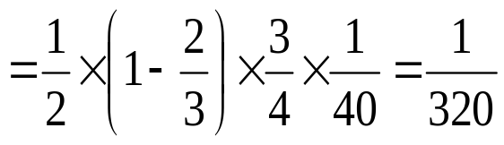
P(Flu) | = | 1/40 | P(Not Flu) | = | 39/40
P( Headache | Flu ) | = | 1/2 | P( Headache | not Flu ) | = | 7 / 78
P( Cough | Flu ) | = | 2/3 | P( Cough | not Flu ) | = | 1/6
P( Sore | Flu ) | = | 3/4 | P( Sore | not Flu ) | = | 1/3

Slide 51
P(Flu) | = | 1/40 | P(Not Flu) | = | 39/40
P( Headache | Flu ) | = | 1/2 | P( Headache | not Flu ) | = | 7 / 78
P( Cough | Flu ) | = | 2/3 | P( Cough | not Flu ) | = | 1/6
P( Sore | Flu ) | = | 3/4 | P( Sore | not Flu ) | = | 1/3

Slide 52
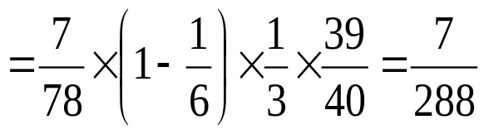
P(Flu) | = | 1/40 | P(Not Flu) | = | 39/40
P( Headache | Flu ) | = | 1/2 | P( Headache | not Flu ) | = | 7 / 78
P( Cough | Flu ) | = | 2/3 | P( Cough | not Flu ) | = | 1/6
P( Sore | Flu ) | = | 3/4 | P( Sore | not Flu ) | = | 1/3

Slide 53


P(Flu) | = | 1/40 | P(Not Flu) | = | 39/40
P( Headache | Flu ) | = | 1/2 | P( Headache | not Flu ) | = | 7 / 78
P( Cough | Flu ) | = | 2/3 | P( Cough | not Flu ) | = | 1/6
P( Sore | Flu ) | = | 3/4 | P( Sore | not Flu ) | = | 1/3
= 0.1139 (11% chance of Flu, given symptoms)

Slide 54
Building A Bayes Classifier
Priors
P(Flu) | = | 1/40 | P(Not Flu) | = | 39/40
P( Headache | Flu ) | = | 1/2 | P( Headache | not Flu ) | = | 7 / 78
P( Cough | Flu ) | = | 2/3 | P( Cough | not Flu ) | = | 1/6
P( Sore | Flu ) | = | 3/4 | P( Sore | not Flu ) | = | 1/3
Conditionals

Slide 55
The General Case

Slide 56
Building a naïve Bayesian Classifier
Assume:
True state has N possible values: 1, 2, 3 .. N
There are K symptoms called Symptom₁, Symptom₂, … Symptom_{K}
Symptom_{i} has M_{i} possible values: 1, 2, .. M_{i}
P(State=1) | = | ___ |  | P(State=2) | = | ___ | … | P(State=N) | = | ___
P( Sym₁=1 | State=1 ) | = | ___ |  | P( Sym₁=1 | State=2 ) | = | ___ | … | P( Sym₁=1 | State=N ) | = | ___
P( Sym₁=2 | State=1 ) | = | ___ |  | P( Sym₁=2 | State=2 ) | = | ___ | … | P( Sym₁=2 | State=N ) | = | ___
: |  | : | : | : |  | : |  | : |  | :
P( Sym₁=M₁ | State=1 ) | = | ___ |  | P( Sym₁=M₁ | State=2 ) | = | ___ | … | P( Sym₁=M₁ | State=N ) | = | ___
P( Sym₂=1 | State=1 ) | = | ___ |  | P( Sym₂=1 | State=2 ) | = | ___ | … | P( Sym₂=1 | State=N ) | = | ___
P( Sym₂=2 | State=1 ) | = | ___ |  | P( Sym₂=2 | State=2 ) | = | ___ | … | P( Sym₂=2 | State=N ) | = | ___
: |  | : | : | : |  | : |  | : |  | :
P( Sym₂=M₂ | State=1 ) | = | ___ |  | P( Sym₂=M₂ | State=2 ) | = | ___ | … | P( Sym₂=M₂ | State=N ) | = | ___
 |  | : |  | : |  |  |  | :
P( Sym_{K}=1 | State=1 ) | = | ___ |  | P( Sym_{K}=1 | State=2 ) | = | ___ | … | P( Sym_{K}=1 | State=N ) | = | ___
P( Sym_{K}=2 | State=1 ) | = | ___ |  | P( Sym_{K}=2 | State=2 ) | = | ___ | … | P( Sym_{K}=2 | State=N ) | = | ___
: |  | : | : | : |  | : |  | : |  | :
P( Sym_{K}=M_{K} | State=1 ) | = | ___ |  | P( Sym_{K}=M₁ | State=2 ) | = | ___ | … | P( Sym_{K}=M₁ | State=N ) | = | ___

Slide 57
Building a naïve Bayesian Classifier
Assume:
True state has N values: 1, 2, 3 .. N
There are K symptoms called Symptom₁, Symptom₂, … Symptom_{K}
Symptom_{i} has M_{i} values: 1, 2, .. M_{i}
P(State=1) | = | ___ |  | P(State=2) | = | ___ | … | P(State=N) | = | ___
P( Sym₁=1 | State=1 ) | = | ___ |  | P( Sym₁=1 | State=2 ) | = | ___ | … | P( Sym₁=1 | State=N ) | = | ___
P( Sym₁=2 | State=1 ) | = | ___ |  | P( Sym₁=2 | State=2 ) | = | ___ | … | P( Sym₁=2 | State=N ) | = | ___
: |  | : | : | : |  | : |  | : |  | :
P( Sym₁=M₁ | State=1 ) | = | ___ |  | P( Sym₁=M₁ | State=2 ) | = | ___ | … | P( Sym₁=M₁ | State=N ) | = | ___
P( Sym₂=1 | State=1 ) | = | ___ |  | P( Sym₂=1 | State=2 ) | = | ___ | … | P( Sym₂=1 | State=N ) | = | ___
P( Sym₂=2 | State=1 ) | = | ___ |  | P( Sym₂=2 | State=2 ) | = | ___ | … | P( Sym₂=2 | State=N ) | = | ___
: |  | : | : | : |  | : |  | : |  | :
P( Sym₂=M₂ | State=1 ) | = | ___ |  | P( Sym₂=M₂ | State=2 ) | = | ___ | … | P( Sym₂=M₂ | State=N ) | = | ___
 |  | : |  | : |  |  |  | :
P( Sym_{K}=1 | State=1 ) | = | ___ |  | P( Sym_{K}=1 | State=2 ) | = | ___ | … | P( Sym_{K}=1 | State=N ) | = | ___
P( Sym_{K}=2 | State=1 ) | = | ___ |  | P( Sym_{K}=2 | State=2 ) | = | ___ | … | P( Sym_{K}=2 | State=N ) | = | ___
: |  | : | : | : |  | : |  | : |  | :
P( Sym_{K}=M_{K} | State=1 ) | = | ___ |  | P( Sym_{K}=M₁ | State=2 ) | = | ___ | … | P( Sym_{K}=M₁ | State=N ) | = | ___
Example:
P( Anemic | Liver Cancer) = 0.21

Slide 58
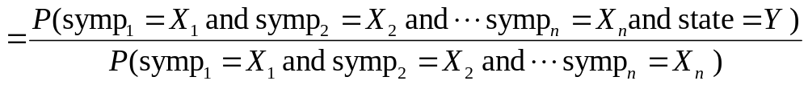
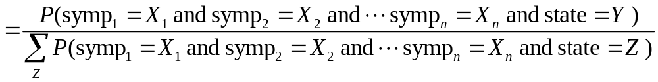
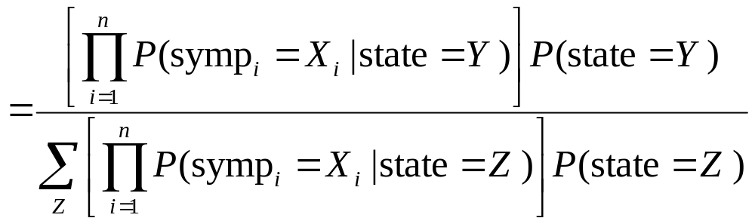
P(State=1) | = | ___ |  | P(State=2) | = | ___ | … | P(State=N) | = | ___
P( Sym₁=1 | State=1 ) | = | ___ |  | P( Sym₁=1 | State=2 ) | = | ___ | … | P( Sym₁=1 | State=N ) | = | ___
P( Sym₁=2 | State=1 ) | = | ___ |  | P( Sym₁=2 | State=2 ) | = | ___ | … | P( Sym₁=2 | State=N ) | = | ___
: |  | : | : | : |  | : |  | : |  | :
P( Sym₁=M₁ | State=1 ) | = | ___ |  | P( Sym₁=M₁ | State=2 ) | = | ___ | … | P( Sym₁=M₁ | State=N ) | = | ___
P( Sym₂=1 | State=1 ) | = | ___ |  | P( Sym₂=1 | State=2 ) | = | ___ | … | P( Sym₂=1 | State=N ) | = | ___
P( Sym₂=2 | State=1 ) | = | ___ |  | P( Sym₂=2 | State=2 ) | = | ___ | … | P( Sym₂=2 | State=N ) | = | ___
: |  | : | : | : |  | : |  | : |  | :
P( Sym₂=M₂ | State=1 ) | = | ___ |  | P( Sym₂=M₂ | State=2 ) | = | ___ | … | P( Sym₂=M₂ | State=N ) | = | ___
 |  | : |  | : |  |  |  | :
P( Sym_{K}=1 | State=1 ) | = | ___ |  | P( Sym_{K}=1 | State=2 ) | = | ___ | … | P( Sym_{K}=1 | State=N ) | = | ___
P( Sym_{K}=2 | State=1 ) | = | ___ |  | P( Sym_{K}=2 | State=2 ) | = | ___ | … | P( Sym_{K}=2 | State=N ) | = | ___
: |  | : | : | : |  | : |  | : |  | :
P( Sym_{K}=M_{K} | State=1 ) | = | ___ |  | P( Sym_{K}=M₁ | State=2 ) | = | ___ | … | P( Sym_{K}=M₁ | State=N ) | = | ___

Slide 59
P(State=1) | = | ___ |  | P(State=2) | = | ___ | … | P(State=N) | = | ___
P( Sym₁=1 | State=1 ) | = | ___ |  | P( Sym₁=1 | State=2 ) | = | ___ | … | P( Sym₁=1 | State=N ) | = | ___
P( Sym₁=2 | State=1 ) | = | ___ |  | P( Sym₁=2 | State=2 ) | = | ___ | … | P( Sym₁=2 | State=N ) | = | ___
: |  | : | : | : |  | : |  | : |  | :
P( Sym₁=M₁ | State=1 ) | = | ___ |  | P( Sym₁=M₁ | State=2 ) | = | ___ | … | P( Sym₁=M₁ | State=N ) | = | ___
P( Sym₂=1 | State=1 ) | = | ___ |  | P( Sym₂=1 | State=2 ) | = | ___ | … | P( Sym₂=1 | State=N ) | = | ___
P( Sym₂=2 | State=1 ) | = | ___ |  | P( Sym₂=2 | State=2 ) | = | ___ | … | P( Sym₂=2 | State=N ) | = | ___
: |  | : | : | : |  | : |  | : |  | :
P( Sym₂=M₂ | State=1 ) | = | ___ |  | P( Sym₂=M₂ | State=2 ) | = | ___ | … | P( Sym₂=M₂ | State=N ) | = | ___
 |  | : |  | : |  |  |  | :
P( Sym_{K}=1 | State=1 ) | = | ___ |  | P( Sym_{K}=1 | State=2 ) | = | ___ | … | P( Sym_{K}=1 | State=N ) | = | ___
P( Sym_{K}=2 | State=1 ) | = | ___ |  | P( Sym_{K}=2 | State=2 ) | = | ___ | … | P( Sym_{K}=2 | State=N ) | = | ___
: |  | : | : | : |  | : |  | : |  | :
P( Sym_{K}=M_{K} | State=1 ) | = | ___ |  | P( Sym_{K}=M₁ | State=2 ) | = | ___ | … | P( Sym_{K}=M₁ | State=N ) | = | ___
Coming Soon: How this is used in Practical Biosurveillance
Also coming soon: Bringing time and space into this kind of reasoning. And how to not be naïve.

Slide 60
Conclusion
You will hear lots of “Bayesian” this and “conditional probability” that this week.
It’s simple: don’t let wooly academic types trick you into thinking it is fancy.
You should know:
  What are: Bayesian Reasoning, Conditional Probabilities, Priors, Posteriors.
  Appreciate how conditional probabilities are manipulated.
  Why the Naïve Bayes Assumption is Good.
  Why the Naïve Bayes Assumption is Evil.

Slide 61
Text mining
Motivation: an enormous (and growing!) supply of rich data
Most of the available text data is unstructured…
Some of it is semi-structured:
  Header entries (title, authors’ names, section titles, keyword lists, etc.)
  Running text bodies (main body, abstract, summary, etc.)
Natural Language Processing (NLP)
Text Information Retrieval

Slide 62
Text processing
Natural Language Processing:
  Automated understanding of text is a very very very challenging Artificial Intelligence problem
  Aims on extracting semantic contents of the processed documents
  Involves extensive research into semantics, grammar, automated reasoning, …
  Several factors making it tough for a computer include:
    Polysemy (the same word having several different meanings)
    Synonymy (several different ways to describe the same thing)

Slide 63
Text processing
Text Information Retrieval:
  Search through collections of documents in order to find objects:
    relevant to a specific query
    similar to a specific document
  For practical reasons, the text documents are parameterized
  Terminology:
    Documents (text data units: books, articles, paragraphs, other chunks such as email messages, ...)
    Terms (specific words, word pairs, phrases)

Slide 64
Text Information Retrieval
Typically, the text databases are parametrized with a document-term matrix
Each row of the matrix corresponds to one of the documents
Each column corresponds to a different term
Shortness of breath
Difficulty breathing
Rash on neck
Sore neck and difficulty breathing
Just plain ugly

Slide 65
Text Information Retrieval
Typically, the text databases are parametrized with a document-term matrix
Each row of the matrix corresponds to one of the documents
Each column corresponds to a different term
 |  | breath | difficulty | just | neck | plain | rash | short | sore | ugly
Shortness of breath |  | 1 | 0 | 0 | 0 | 0 | 0 | 1 | 0 | 0
Difficulty breathing |  | 1 | 1 | 0 | 0 | 0 | 0 | 0 | 0 | 0
Rash on neck |  | 0 | 0 | 0 | 1 | 0 | 1 | 0 | 0 | 0
Sore neck and difficulty breathing |  | 1 | 1 | 0 | 1 | 0 | 0 | 0 | 1 | 0
Just plain ugly |  | 0 | 0 | 1 | 0 | 1 | 0 | 0 | 0 | 1

Slide 66
Parametrization for Text Information Retrieval
Depending on the particular method of parametrization the matrix entries may be:
  binary
  (telling whether a term Tj is present in the document Di or not)
  counts (frequencies)
  (total number of repetitions of a term Tj in Di)
  weighted frequencies
  (see the slide following the next)

Slide 67
Typical applications of Text IR
Document indexing and classification
(e.g. library systems)
Search engines
(e.g. the Web)
Extraction of information from textual sources
(e.g. profiling of personal records, consumer complaint processing)

Slide 68
Typical applications of Text IR
Document indexing and classification
(e.g. library systems)
Search engines
(e.g. the Web)
Extraction of information from textual sources
(e.g. profiling of personal records, consumer complaint processing)

Slide 69
Building a naïve Bayesian Classifier
Assume:
True state has N values: 1, 2, 3 .. N
There are K symptoms called Symptom₁, Symptom₂, … Symptom_{K}
Symptom_{i} has M_{i} values: 1, 2, .. M_{i}
P(State=1) | = | ___ |  | P(State=2) | = | ___ | … | P(State=N) | = | ___
P( Sym₁=1 | State=1 ) | = | ___ |  | P( Sym₁=1 | State=2 ) | = | ___ | … | P( Sym₁=1 | State=N ) | = | ___
P( Sym₁=2 | State=1 ) | = | ___ |  | P( Sym₁=2 | State=2 ) | = | ___ | … | P( Sym₁=2 | State=N ) | = | ___
: |  | : | : | : |  | : |  | : |  | :
P( Sym₁=M₁ | State=1 ) | = | ___ |  | P( Sym₁=M₁ | State=2 ) | = | ___ | … | P( Sym₁=M₁ | State=N ) | = | ___
P( Sym₂=1 | State=1 ) | = | ___ |  | P( Sym₂=1 | State=2 ) | = | ___ | … | P( Sym₂=1 | State=N ) | = | ___
P( Sym₂=2 | State=1 ) | = | ___ |  | P( Sym₂=2 | State=2 ) | = | ___ | … | P( Sym₂=2 | State=N ) | = | ___
: |  | : | : | : |  | : |  | : |  | :
P( Sym₂=M₂ | State=1 ) | = | ___ |  | P( Sym₂=M₂ | State=2 ) | = | ___ | … | P( Sym₂=M₂ | State=N ) | = | ___
 |  | : |  | : |  |  |  | :
P( Sym_{K}=1 | State=1 ) | = | ___ |  | P( Sym_{K}=1 | State=2 ) | = | ___ | … | P( Sym_{K}=1 | State=N ) | = | ___
P( Sym_{K}=2 | State=1 ) | = | ___ |  | P( Sym_{K}=2 | State=2 ) | = | ___ | … | P( Sym_{K}=2 | State=N ) | = | ___
: |  | : | : | : |  | : |  | : |  | :
P( Sym_{K}=M_{K} | State=1 ) | = | ___ |  | P( Sym_{K}=M₁ | State=2 ) | = | ___ | … | P( Sym_{K}=M₁ | State=N ) | = | ___

Slide 70
Building a naïve Bayesian Classifier
Assume:
True state has N values: 1, 2, 3 .. N
There are K symptoms called Symptom₁, Symptom₂, … Symptom_{K}
Symptom_{i} has M_{i} values: 1, 2, .. M_{i}
GI, Respiratory, Constitutional …
prodrome
P(State=1) | = | ___ |  | P(State=2) | = | ___ | … | P(State=N) | = | ___
P( Sym₁=1 | State=1 ) | = | ___ |  | P( Sym₁=1 | State=2 ) | = | ___ | … | P( Sym₁=1 | State=N ) | = | ___
P( Sym₁=2 | State=1 ) | = | ___ |  | P( Sym₁=2 | State=2 ) | = | ___ | … | P( Sym₁=2 | State=N ) | = | ___
: |  | : | : | : |  | : |  | : |  | :
P( Sym₁=M₁ | State=1 ) | = | ___ |  | P( Sym₁=M₁ | State=2 ) | = | ___ | … | P( Sym₁=M₁ | State=N ) | = | ___
P( Sym₂=1 | State=1 ) | = | ___ |  | P( Sym₂=1 | State=2 ) | = | ___ | … | P( Sym₂=1 | State=N ) | = | ___
P( Sym₂=2 | State=1 ) | = | ___ |  | P( Sym₂=2 | State=2 ) | = | ___ | … | P( Sym₂=2 | State=N ) | = | ___
: |  | : | : | : |  | : |  | : |  | :
P( Sym₂=M₂ | State=1 ) | = | ___ |  | P( Sym₂=M₂ | State=2 ) | = | ___ | … | P( Sym₂=M₂ | State=N ) | = | ___
 |  | : |  | : |  |  |  | :
P( Sym_{K}=1 | State=1 ) | = | ___ |  | P( Sym_{K}=1 | State=2 ) | = | ___ | … | P( Sym_{K}=1 | State=N ) | = | ___
P( Sym_{K}=2 | State=1 ) | = | ___ |  | P( Sym_{K}=2 | State=2 ) | = | ___ | … | P( Sym_{K}=2 | State=N ) | = | ___
: |  | : | : | : |  | : |  | : |  | :
P( Sym_{K}=M_{K} | State=1 ) | = | ___ |  | P( Sym_{K}=M₁ | State=2 ) | = | ___ | … | P( Sym_{K}=M₁ | State=N ) | = | ___

Slide 71
Building a naïve Bayesian Classifier
Assume:
True state has N values: 1, 2, 3 .. N
There are K symptoms called Symptom₁, Symptom₂, … Symptom_{K}
Symptom_{i} has M_{i} values: 1, 2, .. M_{i}
GI, Respiratory, Constitutional …
prodrome
words
word₁
word₂
word_{K}
P(State=1) | = | ___ |  | P(State=2) | = | ___ | … | P(State=N) | = | ___
P( Sym₁=1 | State=1 ) | = | ___ |  | P( Sym₁=1 | State=2 ) | = | ___ | … | P( Sym₁=1 | State=N ) | = | ___
P( Sym₁=2 | State=1 ) | = | ___ |  | P( Sym₁=2 | State=2 ) | = | ___ | … | P( Sym₁=2 | State=N ) | = | ___
: |  | : | : | : |  | : |  | : |  | :
P( Sym₁=M₁ | State=1 ) | = | ___ |  | P( Sym₁=M₁ | State=2 ) | = | ___ | … | P( Sym₁=M₁ | State=N ) | = | ___
P( Sym₂=1 | State=1 ) | = | ___ |  | P( Sym₂=1 | State=2 ) | = | ___ | … | P( Sym₂=1 | State=N ) | = | ___
P( Sym₂=2 | State=1 ) | = | ___ |  | P( Sym₂=2 | State=2 ) | = | ___ | … | P( Sym₂=2 | State=N ) | = | ___
: |  | : | : | : |  | : |  | : |  | :
P( Sym₂=M₂ | State=1 ) | = | ___ |  | P( Sym₂=M₂ | State=2 ) | = | ___ | … | P( Sym₂=M₂ | State=N ) | = | ___
 |  | : |  | : |  |  |  | :
P( Sym_{K}=1 | State=1 ) | = | ___ |  | P( Sym_{K}=1 | State=2 ) | = | ___ | … | P( Sym_{K}=1 | State=N ) | = | ___
P( Sym_{K}=2 | State=1 ) | = | ___ |  | P( Sym_{K}=2 | State=2 ) | = | ___ | … | P( Sym_{K}=2 | State=N ) | = | ___
: |  | : | : | : |  | : |  | : |  | :
P( Sym_{K}=M_{K} | State=1 ) | = | ___ |  | P( Sym_{K}=M₁ | State=2 ) | = | ___ | … | P( Sym_{K}=M₁ | State=N ) | = | ___

Slide 72
Building a naïve Bayesian Classifier
Assume:
True state has N values: 1, 2, 3 .. N
There are K symptoms called Symptom₁, Symptom₂, … Symptom_{K}
Symptom_{i} has M_{i} values: 1, 2, .. M_{i}
GI, Respiratory, Constitutional …
prodrome
words
word₁
word₂
word_{K}
word_{i}
is either present or absent_{i}
P(State=1) | = | ___ |  | P(State=2) | = | ___ | … | P(State=N) | = | ___
P( Sym₁=1 | State=1 ) | = | ___ |  | P( Sym₁=1 | State=2 ) | = | ___ | … | P( Sym₁=1 | State=N ) | = | ___
P( Sym₁=2 | State=1 ) | = | ___ |  | P( Sym₁=2 | State=2 ) | = | ___ | … | P( Sym₁=2 | State=N ) | = | ___
: |  | : | : | : |  | : |  | : |  | :
P( Sym₁=M₁ | State=1 ) | = | ___ |  | P( Sym₁=M₁ | State=2 ) | = | ___ | … | P( Sym₁=M₁ | State=N ) | = | ___
P( Sym₂=1 | State=1 ) | = | ___ |  | P( Sym₂=1 | State=2 ) | = | ___ | … | P( Sym₂=1 | State=N ) | = | ___
P( Sym₂=2 | State=1 ) | = | ___ |  | P( Sym₂=2 | State=2 ) | = | ___ | … | P( Sym₂=2 | State=N ) | = | ___
: |  | : | : | : |  | : |  | : |  | :
P( Sym₂=M₂ | State=1 ) | = | ___ |  | P( Sym₂=M₂ | State=2 ) | = | ___ | … | P( Sym₂=M₂ | State=N ) | = | ___
 |  | : |  | : |  |  |  | :
P( Sym_{K}=1 | State=1 ) | = | ___ |  | P( Sym_{K}=1 | State=2 ) | = | ___ | … | P( Sym_{K}=1 | State=N ) | = | ___
P( Sym_{K}=2 | State=1 ) | = | ___ |  | P( Sym_{K}=2 | State=2 ) | = | ___ | … | P( Sym_{K}=2 | State=N ) | = | ___
: |  | : | : | : |  | : |  | : |  | :
P( Sym_{K}=M_{K} | State=1 ) | = | ___ |  | P( Sym_{K}=M₁ | State=2 ) | = | ___ | … | P( Sym_{K}=M₁ | State=N ) | = | ___

Slide 73
Building a naïve Bayesian Classifier
Assume:
True state has N values: 1, 2, 3 .. N
There are K symptoms called Symptom₁, Symptom₂, … Symptom_{K}
Symptom_{i} has M_{i} values: 1, 2, .. M_{i}
GI, Respiratory, Constitutional …
prodrome
words
word₁
word₂
word_{K}
word_{i}
is either present or absent_{i}
P(Prod'm=GI) | = | ___ |  | P(Prod'm=respir) | = | ___ | … | P(Prod'm=const) | = | ___
P( angry | Prod'm=GI ) | = | ___ |  | P( angry | Prod'm=respir ) | = | ___ | … | P( angry | Prod'm=const ) | = | ___
P( ~angry | Prod'm=GI ) | = | ___ |  | P(~angry | Prod'm=respir ) | = | ___ | … | P(~angry | Prod'm=const ) | = | ___
P( blood | Prod'm=GI ) | = | ___ |  | P( blood | Prod'm=respir ) | = | ___ | … | P( blood | Prod'm=const ) | = | ___
P( ~blood | Prod'm=GI ) | = | ___ |  | P( ~blood | Prod'm=respir) | = | ___ | … | P( ~blood | Prod'm=const ) | = | ___
 |  | : |  | : |  |  |  | :
P( vomit | Prod'm=GI ) | = | ___ |  | P( vomit | Prod'm=respir ) | = | ___ | … | P( vomit | Prod'm=const ) | = | ___
P( ~vomit | Prod'm=GI ) | = | ___ |  | P( ~vomit |Prod'm=respir ) | = | ___ | … | P( ~vomit | Prod'm=const ) | = | ___

Slide 74
Building a naïve Bayesian Classifier
Assume:
True state has N values: 1, 2, 3 .. N
There are K symptoms called Symptom₁, Symptom₂, … Symptom_{K}
Symptom_{i} has M_{i} values: 1, 2, .. M_{i}
GI, Respiratory, Constitutional …
prodrome
words
word₁
word₂
word_{K}
word_{i}
is either present or absent_{i}
P(Prod'm=GI) | = | ___ |  | P(Prod'm=respir) | = | ___ | … | P(Prod'm=const) | = | ___
P( angry | Prod'm=GI ) | = | ___ |  | P( angry | Prod'm=respir ) | = | ___ | … | P( angry | Prod'm=const ) | = | ___
P( ~angry | Prod'm=GI ) | = | ___ |  | P(~angry | Prod'm=respir ) | = | ___ | … | P(~angry | Prod'm=const ) | = | ___
P( blood | Prod'm=GI ) | = | ___ |  | P( blood | Prod'm=respir ) | = | ___ | … | P( blood | Prod'm=const ) | = | ___
P( ~blood | Prod'm=GI ) | = | ___ |  | P( ~blood | Prod'm=respir) | = | ___ | … | P( ~blood | Prod'm=const ) | = | ___
 |  | : |  | : |  |  |  | :
P( vomit | Prod'm=GI ) | = | ___ |  | P( vomit | Prod'm=respir ) | = | ___ | … | P( vomit | Prod'm=const ) | = | ___
P( ~vomit | Prod'm=GI ) | = | ___ |  | P( ~vomit |Prod'm=respir ) | = | ___ | … | P( ~vomit | Prod'm=const ) | = | ___
Example:
Prob( Chief Complaint contains “Blood” | Prodrome = Respiratory ) = 0.003

Slide 75
Building a naïve Bayesian Classifier
Assume:
True state has N values: 1, 2, 3 .. N
There are K symptoms called Symptom₁, Symptom₂, … Symptom_{K}
Symptom_{i} has M_{i} values: 1, 2, .. M_{i}
GI, Respiratory, Constitutional …
prodrome
words
word₁
word₂
word_{K}
word_{i}
is either present or absent_{i}
Q: Where do these numbers come from?
P(Prod'm=GI) | = | ___ |  | P(Prod'm=respir) | = | ___ | … | P(Prod'm=const) | = | ___
P( angry | Prod'm=GI ) | = | ___ |  | P( angry | Prod'm=respir ) | = | ___ | … | P( angry | Prod'm=const ) | = | ___
P( ~angry | Prod'm=GI ) | = | ___ |  | P(~angry | Prod'm=respir ) | = | ___ | … | P(~angry | Prod'm=const ) | = | ___
P( blood | Prod'm=GI ) | = | ___ |  | P( blood | Prod'm=respir ) | = | ___ | … | P( blood | Prod'm=const ) | = | ___
P( ~blood | Prod'm=GI ) | = | ___ |  | P( ~blood | Prod'm=respir) | = | ___ | … | P( ~blood | Prod'm=const ) | = | ___
 |  | : |  | : |  |  |  | :
P( vomit | Prod'm=GI ) | = | ___ |  | P( vomit | Prod'm=respir ) | = | ___ | … | P( vomit | Prod'm=const ) | = | ___
P( ~vomit | Prod'm=GI ) | = | ___ |  | P( ~vomit |Prod'm=respir ) | = | ___ | … | P( ~vomit | Prod'm=const ) | = | ___
Example:
Prob( Chief Complaint contains “Blood” | Prodrome = Respiratory ) = 0.003

Slide 76
Building a naïve Bayesian Classifier
Assume:
True state has N values: 1, 2, 3 .. N
There are K symptoms called Symptom₁, Symptom₂, … Symptom_{K}
Symptom_{i} has M_{i} values: 1, 2, .. M_{i}
GI, Respiratory, Constitutional …
prodrome
words
word₁
word₂
word_{K}
word_{i}
is either present or absent_{i}
Q: Where do these numbers come from?
P(Prod'm=GI) | = | ___ |  | P(Prod'm=respir) | = | ___ | … | P(Prod'm=const) | = | ___
P( angry | Prod'm=GI ) | = | ___ |  | P( angry | Prod'm=respir ) | = | ___ | … | P( angry | Prod'm=const ) | = | ___
P( ~angry | Prod'm=GI ) | = | ___ |  | P(~angry | Prod'm=respir ) | = | ___ | … | P(~angry | Prod'm=const ) | = | ___
P( blood | Prod'm=GI ) | = | ___ |  | P( blood | Prod'm=respir ) | = | ___ | … | P( blood | Prod'm=const ) | = | ___
P( ~blood | Prod'm=GI ) | = | ___ |  | P( ~blood | Prod'm=respir) | = | ___ | … | P( ~blood | Prod'm=const ) | = | ___
 |  | : |  | : |  |  |  | :
P( vomit | Prod'm=GI ) | = | ___ |  | P( vomit | Prod'm=respir ) | = | ___ | … | P( vomit | Prod'm=const ) | = | ___
P( ~vomit | Prod'm=GI ) | = | ___ |  | P( ~vomit |Prod'm=respir ) | = | ___ | … | P( ~vomit | Prod'm=const ) | = | ___
A: Learn them from expert-labeled data
Example:
Prob( Chief Complaint contains “Blood” | Prodrome = Respiratory ) = 0.003

Slide 77
Learning a Bayesian Classifier
Before deployment of classifier,
 |  | breath | difficulty | just | neck | plain | rash | short | sore | ugly
Shortness of breath |  | 1 | 0 | 0 | 0 | 0 | 0 | 1 | 0 | 0
Difficulty breathing |  | 1 | 1 | 0 | 0 | 0 | 0 | 0 | 0 | 0
Rash on neck |  | 0 | 0 | 0 | 1 | 0 | 1 | 0 | 0 | 0
Sore neck and difficulty breathing |  | 1 | 1 | 0 | 1 | 0 | 0 | 0 | 1 | 0
Just plain ugly |  | 0 | 0 | 1 | 0 | 1 | 0 | 0 | 0 | 1

Slide 78
Learning a Bayesian Classifier
Before deployment of classifier, get labeled training data
 | EXPERT SAYS | breath | difficulty | just | neck | plain | rash | short | sore | ugly
Shortness of breath | Resp | 1 | 0 | 0 | 0 | 0 | 0 | 1 | 0 | 0
Difficulty breathing | Resp | 1 | 1 | 0 | 0 | 0 | 0 | 0 | 0 | 0
Rash on neck | Rash | 0 | 0 | 0 | 1 | 0 | 1 | 0 | 0 | 0
Sore neck and difficulty breathing | Resp | 1 | 1 | 0 | 1 | 0 | 0 | 0 | 1 | 0
Just plain ugly | Other | 0 | 0 | 1 | 0 | 1 | 0 | 0 | 0 | 1

Slide 79
Learning a Bayesian Classifier
Before deployment of classifier, get labeled training data
Learn parameters (conditionals, and priors)
 | EXPERT SAYS | breath | difficulty | just | neck | plain | rash | short | sore | ugly
Shortness of breath | Resp | 1 | 0 | 0 | 0 | 0 | 0 | 1 | 0 | 0
Difficulty breathing | Resp | 1 | 1 | 0 | 0 | 0 | 0 | 0 | 0 | 0
Rash on neck | Rash | 0 | 0 | 0 | 1 | 0 | 1 | 0 | 0 | 0
Sore neck and difficulty breathing | Resp | 1 | 1 | 0 | 1 | 0 | 0 | 0 | 1 | 0
Just plain ugly | Other | 0 | 0 | 1 | 0 | 1 | 0 | 0 | 0 | 1
P(Prod'm=GI) | = | ___ |  | P(Prod'm=respir) | = | ___ | … | P(Prod'm=const) | = | ___
P( angry | Prod'm=GI ) | = | ___ |  | P( angry | Prod'm=respir ) | = | ___ | … | P( angry | Prod'm=const ) | = | ___
P( ~angry | Prod'm=GI ) | = | ___ |  | P(~angry | Prod'm=respir ) | = | ___ | … | P(~angry | Prod'm=const ) | = | ___
P( blood | Prod'm=GI ) | = | ___ |  | P( blood | Prod'm=respir ) | = | ___ | … | P( blood | Prod'm=const ) | = | ___
P( ~blood | Prod'm=GI ) | = | ___ |  | P( ~blood | Prod'm=respir) | = | ___ | … | P( ~blood | Prod'm=const ) | = | ___
 |  | : |  | : |  |  |  | :
P( vomit | Prod'm=GI ) | = | ___ |  | P( vomit | Prod'm=respir ) | = | ___ | … | P( vomit | Prod'm=const ) | = | ___
P( ~vomit | Prod'm=GI ) | = | ___ |  | P( ~vomit |Prod'm=respir ) | = | ___ | … | P( ~vomit | Prod'm=const ) | = | ___

Slide 80
Learning a Bayesian Classifier
Before deployment of classifier, get labeled training data
Learn parameters (conditionals, and priors)
 | EXPERT SAYS | breath | difficulty | just | neck | plain | rash | short | sore | ugly
Shortness of breath | Resp | 1 | 0 | 0 | 0 | 0 | 0 | 1 | 0 | 0
Difficulty breathing | Resp | 1 | 1 | 0 | 0 | 0 | 0 | 0 | 0 | 0
Rash on neck | Rash | 0 | 0 | 0 | 1 | 0 | 1 | 0 | 0 | 0
Sore neck and difficulty breathing | Resp | 1 | 1 | 0 | 1 | 0 | 0 | 0 | 1 | 0
Just plain ugly | Other | 0 | 0 | 1 | 0 | 1 | 0 | 0 | 0 | 1
P(Prod'm=GI) | = | ___ |  | P(Prod'm=respir) | = | ___ | … | P(Prod'm=const) | = | ___
P( angry | Prod'm=GI ) | = | ___ |  | P( angry | Prod'm=respir ) | = | ___ | … | P( angry | Prod'm=const ) | = | ___
P( ~angry | Prod'm=GI ) | = | ___ |  | P(~angry | Prod'm=respir ) | = | ___ | … | P(~angry | Prod'm=const ) | = | ___
P( blood | Prod'm=GI ) | = | ___ |  | P( blood | Prod'm=respir ) | = | ___ | … | P( blood | Prod'm=const ) | = | ___
P( ~blood | Prod'm=GI ) | = | ___ |  | P( ~blood | Prod'm=respir) | = | ___ | … | P( ~blood | Prod'm=const ) | = | ___
 |  | : |  | : |  |  |  | :
P( vomit | Prod'm=GI ) | = | ___ |  | P( vomit | Prod'm=respir ) | = | ___ | … | P( vomit | Prod'm=const ) | = | ___
P( ~vomit | Prod'm=GI ) | = | ___ |  | P( ~vomit |Prod'm=respir ) | = | ___ | … | P( ~vomit | Prod'm=const ) | = | ___

Slide 81
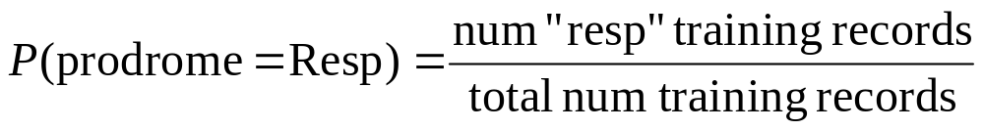
Learning a Bayesian Classifier
Before deployment of classifier, get labeled training data
Learn parameters (conditionals, and priors)
 | EXPERT SAYS | breath | difficulty | just | neck | plain | rash | short | sore | ugly
Shortness of breath | Resp | 1 | 0 | 0 | 0 | 0 | 0 | 1 | 0 | 0
Difficulty breathing | Resp | 1 | 1 | 0 | 0 | 0 | 0 | 0 | 0 | 0
Rash on neck | Rash | 0 | 0 | 0 | 1 | 0 | 1 | 0 | 0 | 0
Sore neck and difficulty breathing | Resp | 1 | 1 | 0 | 1 | 0 | 0 | 0 | 1 | 0
Just plain ugly | Other | 0 | 0 | 1 | 0 | 1 | 0 | 0 | 0 | 1
P(Prod'm=GI) | = | ___ |  | P(Prod'm=respir) | = | ___ | … | P(Prod'm=const) | = | ___
P( angry | Prod'm=GI ) | = | ___ |  | P( angry | Prod'm=respir ) | = | ___ | … | P( angry | Prod'm=const ) | = | ___
P( ~angry | Prod'm=GI ) | = | ___ |  | P(~angry | Prod'm=respir ) | = | ___ | … | P(~angry | Prod'm=const ) | = | ___
P( blood | Prod'm=GI ) | = | ___ |  | P( blood | Prod'm=respir ) | = | ___ | … | P( blood | Prod'm=const ) | = | ___
P( ~blood | Prod'm=GI ) | = | ___ |  | P( ~blood | Prod'm=respir) | = | ___ | … | P( ~blood | Prod'm=const ) | = | ___
 |  | : |  | : |  |  |  | :
P( vomit | Prod'm=GI ) | = | ___ |  | P( vomit | Prod'm=respir ) | = | ___ | … | P( vomit | Prod'm=const ) | = | ___
P( ~vomit | Prod'm=GI ) | = | ___ |  | P( ~vomit |Prod'm=respir ) | = | ___ | … | P( ~vomit | Prod'm=const ) | = | ___

Slide 82
Learning a Bayesian Classifier
Before deployment of classifier, get labeled training data
Learn parameters (conditionals, and priors)
 | EXPERT SAYS | breath | difficulty | just | neck | plain | rash | short | sore | ugly
Shortness of breath | Resp | 1 | 0 | 0 | 0 | 0 | 0 | 1 | 0 | 0
Difficulty breathing | Resp | 1 | 1 | 0 | 0 | 0 | 0 | 0 | 0 | 0
Rash on neck | Rash | 0 | 0 | 0 | 1 | 0 | 1 | 0 | 0 | 0
Sore neck and difficulty breathing | Resp | 1 | 1 | 0 | 1 | 0 | 0 | 0 | 1 | 0
Just plain ugly | Other | 0 | 0 | 1 | 0 | 1 | 0 | 0 | 0 | 1
P(Prod'm=GI) | = | ___ |  | P(Prod'm=respir) | = | ___ | … | P(Prod'm=const) | = | ___
P( angry | Prod'm=GI ) | = | ___ |  | P( angry | Prod'm=respir ) | = | ___ | … | P( angry | Prod'm=const ) | = | ___
P( ~angry | Prod'm=GI ) | = | ___ |  | P(~angry | Prod'm=respir ) | = | ___ | … | P(~angry | Prod'm=const ) | = | ___
P( blood | Prod'm=GI ) | = | ___ |  | P( blood | Prod'm=respir ) | = | ___ | … | P( blood | Prod'm=const ) | = | ___
P( ~blood | Prod'm=GI ) | = | ___ |  | P( ~blood | Prod'm=respir) | = | ___ | … | P( ~blood | Prod'm=const ) | = | ___
 |  | : |  | : |  |  |  | :
P( vomit | Prod'm=GI ) | = | ___ |  | P( vomit | Prod'm=respir ) | = | ___ | … | P( vomit | Prod'm=const ) | = | ___
P( ~vomit | Prod'm=GI ) | = | ___ |  | P( ~vomit |Prod'm=respir ) | = | ___ | … | P( ~vomit | Prod'm=const ) | = | ___

Slide 83
Learning a Bayesian Classifier
Before deployment of classifier, get labeled training data
Learn parameters (conditionals, and priors)
During deployment, apply classifier
 | EXPERT SAYS | breath | difficulty | just | neck | plain | rash | short | sore | ugly
Shortness of breath | Resp | 1 | 0 | 0 | 0 | 0 | 0 | 1 | 0 | 0
Difficulty breathing | Resp | 1 | 1 | 0 | 0 | 0 | 0 | 0 | 0 | 0
Rash on neck | Rash | 0 | 0 | 0 | 1 | 0 | 1 | 0 | 0 | 0
Sore neck and difficulty breathing | Resp | 1 | 1 | 0 | 1 | 0 | 0 | 0 | 1 | 0
Just plain ugly | Other | 0 | 0 | 1 | 0 | 1 | 0 | 0 | 0 | 1
P(Prod'm=GI) | = | ___ |  | P(Prod'm=respir) | = | ___ | … | P(Prod'm=const) | = | ___
P( angry | Prod'm=GI ) | = | ___ |  | P( angry | Prod'm=respir ) | = | ___ | … | P( angry | Prod'm=const ) | = | ___
P( ~angry | Prod'm=GI ) | = | ___ |  | P(~angry | Prod'm=respir ) | = | ___ | … | P(~angry | Prod'm=const ) | = | ___
P( blood | Prod'm=GI ) | = | ___ |  | P( blood | Prod'm=respir ) | = | ___ | … | P( blood | Prod'm=const ) | = | ___
P( ~blood | Prod'm=GI ) | = | ___ |  | P( ~blood | Prod'm=respir) | = | ___ | … | P( ~blood | Prod'm=const ) | = | ___
 |  | : |  | : |  |  |  | :
P( vomit | Prod'm=GI ) | = | ___ |  | P( vomit | Prod'm=respir ) | = | ___ | … | P( vomit | Prod'm=const ) | = | ___
P( ~vomit | Prod'm=GI ) | = | ___ |  | P( ~vomit |Prod'm=respir ) | = | ___ | … | P( ~vomit | Prod'm=const ) | = | ___

Slide 84
Learning a Bayesian Classifier
Before deployment of classifier, get labeled training data
Learn parameters (conditionals, and priors)
During deployment, apply classifier
 | EXPERT SAYS | breath | difficulty | just | neck | plain | rash | short | sore | ugly
Shortness of breath | Resp | 1 | 0 | 0 | 0 | 0 | 0 | 1 | 0 | 0
Difficulty breathing | Resp | 1 | 1 | 0 | 0 | 0 | 0 | 0 | 0 | 0
Rash on neck | Rash | 0 | 0 | 0 | 1 | 0 | 1 | 0 | 0 | 0
Sore neck and difficulty breathing | Resp | 1 | 1 | 0 | 1 | 0 | 0 | 0 | 1 | 0
Just plain ugly | Other | 0 | 0 | 1 | 0 | 1 | 0 | 0 | 0 | 1
P(Prod'm=GI) | = | ___ |  | P(Prod'm=respir) | = | ___ | … | P(Prod'm=const) | = | ___
P( angry | Prod'm=GI ) | = | ___ |  | P( angry | Prod'm=respir ) | = | ___ | … | P( angry | Prod'm=const ) | = | ___
P( ~angry | Prod'm=GI ) | = | ___ |  | P(~angry | Prod'm=respir ) | = | ___ | … | P(~angry | Prod'm=const ) | = | ___
P( blood | Prod'm=GI ) | = | ___ |  | P( blood | Prod'm=respir ) | = | ___ | … | P( blood | Prod'm=const ) | = | ___
P( ~blood | Prod'm=GI ) | = | ___ |  | P( ~blood | Prod'm=respir) | = | ___ | … | P( ~blood | Prod'm=const ) | = | ___
 |  | : |  | : |  |  |  | :
P( vomit | Prod'm=GI ) | = | ___ |  | P( vomit | Prod'm=respir ) | = | ___ | … | P( vomit | Prod'm=const ) | = | ___
P( ~vomit | Prod'm=GI ) | = | ___ |  | P( ~vomit |Prod'm=respir ) | = | ___ | … | P( ~vomit | Prod'm=const ) | = | ___
New Chief Complaint: “Just sore breath”

Slide 85
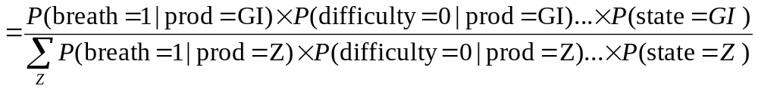
Learning a Bayesian Classifier
Before deployment of classifier, get labeled training data
Learn parameters (conditionals, and priors)
During deployment, apply classifier
 | EXPERT SAYS | breath | difficulty | just | neck | plain | rash | short | sore | ugly
Shortness of breath | Resp | 1 | 0 | 0 | 0 | 0 | 0 | 1 | 0 | 0
Difficulty breathing | Resp | 1 | 1 | 0 | 0 | 0 | 0 | 0 | 0 | 0
Rash on neck | Rash | 0 | 0 | 0 | 1 | 0 | 1 | 0 | 0 | 0
Sore neck and difficulty breathing | Resp | 1 | 1 | 0 | 1 | 0 | 0 | 0 | 1 | 0
Just plain ugly | Other | 0 | 0 | 1 | 0 | 1 | 0 | 0 | 0 | 1
P(Prod'm=GI) | = | ___ |  | P(Prod'm=respir) | = | ___ | … | P(Prod'm=const) | = | ___
P( angry | Prod'm=GI ) | = | ___ |  | P( angry | Prod'm=respir ) | = | ___ | … | P( angry | Prod'm=const ) | = | ___
P( ~angry | Prod'm=GI ) | = | ___ |  | P(~angry | Prod'm=respir ) | = | ___ | … | P(~angry | Prod'm=const ) | = | ___
P( blood | Prod'm=GI ) | = | ___ |  | P( blood | Prod'm=respir ) | = | ___ | … | P( blood | Prod'm=const ) | = | ___
P( ~blood | Prod'm=GI ) | = | ___ |  | P( ~blood | Prod'm=respir) | = | ___ | … | P( ~blood | Prod'm=const ) | = | ___
 |  | : |  | : |  |  |  | :
P( vomit | Prod'm=GI ) | = | ___ |  | P( vomit | Prod'm=respir ) | = | ___ | … | P( vomit | Prod'm=const ) | = | ___
P( ~vomit | Prod'm=GI ) | = | ___ |  | P( ~vomit |Prod'm=respir ) | = | ___ | … | P( ~vomit | Prod'm=const ) | = | ___
New Chief Complaint: “Just sore breath”

Slide 86
CoCo Performance (AUC scores)
Botulism 0.78
rash, 0.91
neurological 0.92
hemorrhagic, 0.93;
constitutional 0.93
gastrointestinal 0.95
other, 0.96
respiratory 0.96

Slide 87
Conclusion
Automated text extraction is increasingly important
There is a very wide world of text extraction outside Biosurveillance
The field has changed very fast, even in the past three years.
Warning, although Bayes Classifiers are simplest to implement, Logistic Regression or other discriminative methods often learn more accurately. Consider using off the shelf methods, such as William Cohen’s successful “minor third” open-source libraries: http://minorthird.sourceforge.net/
Real systems (including CoCo) have many ingenious special-case improvements.

Slide 88
Discussion
What new data sources should we apply algorithms to?
  EG Self-reporting?
What are related surveillance problems to which these kinds of algorithms can be applied?
Where are the gaps in the current algorithms world?
Are there other spatial problems out there?
Could new or pre-existing algorithms help in the period after an outbreak is detected?
Other comments about favorite tools of the trade.

