Slide 1
Reinforcement Learning
Andrew W. Moore
Associate Professor
School of Computer Science
Carnegie Mellon University
www.cs.cmu.edu/~awm
awm@cs.cmu.edu
412-268-7599
Note to other teachers and users of these slides. Andrew would be delighted if you found this source material useful in giving your own lectures. Feel free to use these slides verbatim, or to modify them to fit your own needs. PowerPoint originals are available. If you make use of a significant portion of these slides in your own lecture, please include this message, or the following link to the source repository of Andrew’s tutorials: http://www.cs.cmu.edu/~awm/tutorials . Comments and corrections gratefully received.

Slide 2
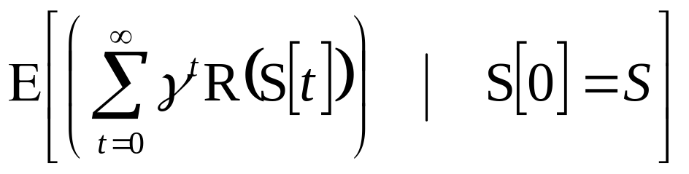
Predicting Delayed Rewards IN A DISCOUNTED MARKOV SYSTEM
0.4
0.6
0.5
R=0
R=3
R=0
S₁
0.5
S₃
S₂
0.2
R=0
0.5
0.4
R=-5
R=1
0.4
S₄
S₅
0.2
S₆
0.8
0.5
1
Prob(next state = S₅|this state = S₄) = 0.8 etc…
What is expected sum of future rewards (discounted) ?
Just Solve It! We use standard Markov System Theory

Slide 3
Learning Delayed Rewards…
S₁
?
?
?
S₂
?
?
?
S₃
?
?
?
R=?
R=?
R=?
?
S₄
?
?
?
S₅
?
?
?
S₆
?
?
?
R=?
R=?
R=?
All you can see is a series of states and rewards:
S₁(R=0) S₂(R=0) S₃(R=4) S₂(R=0) S₄(R=0) S₅(R=0)
Task: Based on this sequence, estimate J*(S₁),J*(S₂)···J*(S₆)

Slide 4
Idea 1: Supervised Learning
Assume
γ=1/2
S₁(R=0) S₂(R=0) S₃(R=4) S₂(R=0) S₄(R=0) S₅(R=0)
At t=1 we were in state S₁ and eventually got a long term discounted reward of 0+γ0+γ²4+γ³0+γ⁴0…= 1
At t=2 in state S₂ ltdr = 2 At t=5 in state S₄ ltdr = 0
At t=3 in state S₃ ltdr = 4 At t=6 in state S₅ ltdr = 0
At t=4 in state S₂ ltdr = 0
State | Observations of LTDR | Mean LTDR
S₁ | 1 | 1 | =J^{est}(S₁)
S₂ | 2 , 0 | 1 | =J^{est}(S₂)
S₃ | 4 | 4 | =J^{est}(S₃)
S₄ | 0 | 0 | =J^{est}(S₄)
S₅ | 0 | 0 | =J^{est}(S₅)

Slide 5
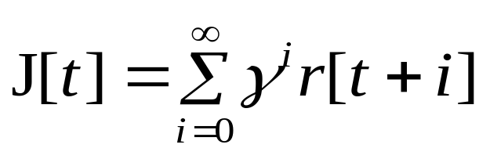
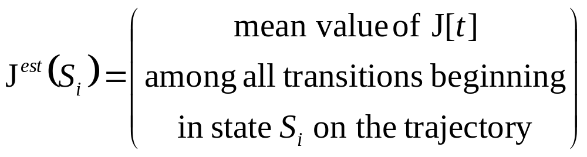
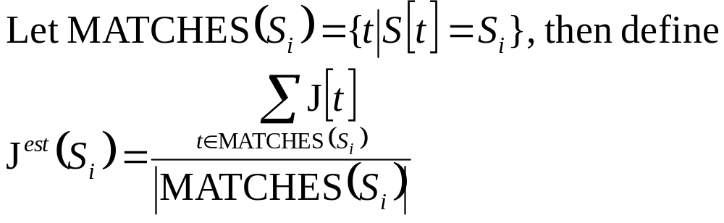
Supervised Learning ALG
Watch a trajectory S[0] r[0] S[1] r[1] ···· S[T]r[T]
For t=0,1, ··· T , compute
Compute
You’re done!

Slide 6
Supervised Learning ALG for the timid
If you have an anxious personality you may be worried about edge effects for some of the final transitions. With large trajectories these are negligible.
•
•

Slide 7
Online Supervised Learning
Initialize: Count[S_{i}] = 0 ∀S_{i} SumJ[S_{i}] = 0 ∀S_{i} Eligibility[S_{i}] = 0 ∀S_{i}
Observe:
When we experience S_{i} with reward r do this:
∀j Elig[S_{j}] γElig[S_{j}]
Elig[S_{j}] Elig[S_{j}] + 1
∀j SumJ[S_{j}] SumJ[S_{j}]+rxElig[S_{j}]
Count[S_{i}] Count[S_{i}] + 1
Then at any time,
J^{est}(S_{j})= SumJ[S_{j}]/Count[S_{j}]

Slide 8
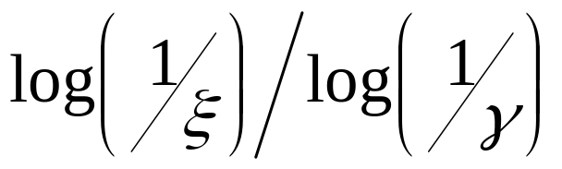
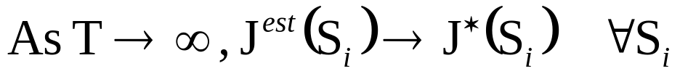
Online Supervised Learning Economics
Given N states S₁ ··· S_{N} , OSL needs O(N) memory.
Each update needs O(N) work since we must update all Elig[ ] array elements
Idea: Be sparse and only update/process Elig[ ]
elements with values >ξ for tiny ξ
There are only
such elements
Easy to prove:

Slide 9
Online Supervised Learning
COMPLAINT
Let’s grab OSL off the street, bundle it into a black van, take it to a bunker and interrogate it under 600 Watt lights.
S₁(r=0) S₂(r=0) S₃(r=4) S₂(r=0) S₄(r=0) S₅(r=0)
State | Observations of LTDR | ^ J(S_{i})
S₁ | 1 | 1
S₂ | 2 , 0 | 1
S₃ | 4 | 4
S₄ | 0 | 0
S₅ | 0 | 0
There’s something a little suspicious about this (efficiency-wise)

Slide 10
Certainty-Equivalent (CE) Learning
Idea: Use your data to estimate the underlying Markov system, instead of trying to estimate J directly.
S₁(r=0) S₂(r=0) S₃(r=4) S₂(r=0) S₄(r=0) S₅(r=0)
You draw in the transitions + probs
Estimated Markov System:
S₁
r^{est} = 0
S₂
r^{est} = 0
S₃
r^{est} = 4
S₄
r^{est} = 0
S₅
r^{est} = 0
What’re the estimated J values?

Slide 11
C.E. Method for Markov Systems
Initialize:
Count[S_{i}] = 0 #Times visited S_{i}
SumR[S_{i}] = 0 Sum of rewards from S_{i}
Trans[S_{i},S_{j}] = 0 #Times transitioned from S_{i} S_{j}
When we are in state S_{i} , and we receive reward r , and we move to S_{j} …
Count[S_{i}] Count[S_{i}] + 1
SumR[S_{i}] SumR[S_{i}] + r
Trans[S_{i},S_{j}] Trans[S_{i},S_{j}] + 1
Then at any time
r^{est}(S_{j}) = SumR[S_{i}] / Count[S_{i}]
P^{est}_{ij} = Estimated Prob(next = S_{j} | this = S_{i} )
= Trans[S_{i},S_{j}] / Count[S_{i}]
∀S_{i}
∀S_{j}

Slide 12
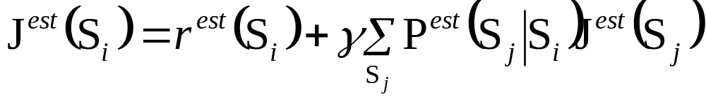
C.E. for Markov Systems
(continued) …
So at any time we have
r^{est}(S_{j}) and P^{est} (next=S_{j} | this=S_{i} )
∀S_{i}S_{j} = P^{est}_{ij}
So at any time we can solve the set of linear equations
[In vector notation,
J^{est} = r^{est} + γP^{est}J
=> J^{est} = (I-γP^{est})⁻¹r^{est}
where J^{est} r^{est} are vectors of length N
P^{est} is an NxN matrix
N = # states ]

Slide 13
C.E. Online Economics
Memory: O(N²)
Time to update counters: O(1)
Time to re-evaluate J^{est}
  O(N³) if use matrix inversion
  O(N²k_{CRIT}) if use value iteration and we need k_{CRIT} iterations to converge
  O(Nk_{CRIT}) if use value iteration, and k_{CRIT} to converge, and M.S. is Sparse (i.e. mean # successors is constant)

Slide 14
Certainty Equivalent Learning
COMPLAINT
Memory use could be O(N²) !
And time per update could be O(Nk_{CRIT}) up to O(N³) !
Too expensive for some people.
Prioritized sweeping will help, (see later), but first let’s review a very inexpensive approach

Slide 15
Why this obsession with onlineiness?
I really care about supplying up-to-date J^{est} estimates all the time.
Can you guess why?
If not, all will be revealed in good time…

Slide 16
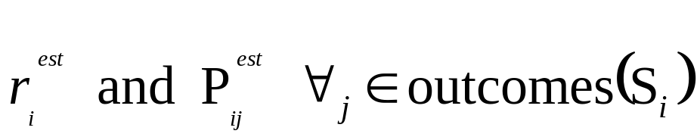
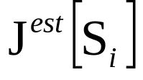
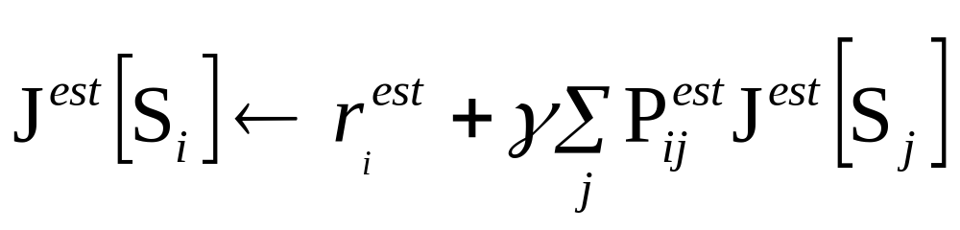
Less Time: More Data
Limited Backups
Do previous C.E. algorithm.
At each time timestep we observe S_{i}(r) S_{j} and update Count[S_{i}], SumR[S_{i}], Trans[S_{i},S_{j}]
And thus also update estimates
But instead of re-solving for J^{est}, do much less work. Just do one “backup” of

Slide 17
“One Backup C.E.” Economics
NO IMPROVEMENT THERE!
Space : O(N²)
Time to update statistics : O(1)
Time to update J^{est} : O(1)
Good News: Much cheaper per transition
Good News: Contraction Mapping proof (modified) promises convergence to optimal
Bad News: Wastes data

Slide 18
Prioritized Sweeping
[Moore + Atkeson, ’93]
Tries to be almost as data-efficient as full CE but not much more expensive than “One Backup” CE.
On every transition, some number (β) of states may have a backup applied. Which ones?
  The most “deserving”
  We keep a priority queue of which states have the biggest potential for changing their J^{est}(Sj) value

Slide 19
Where Are We?
Trying to do online J^{est} prediction from streams of transitions
 | Space | J^{est} Update Cost
Supervised Learning | 0(N_{s}) | 0( )
Full C.E. Learning | 0(N_{so}) | 0(N_{so}N_{s}) 0(N_{so}k_{CRIT})
One Backup C.E. Learning | 0(N_{so}) | 0(1)
Prioritized Sweeping | 0(N_{so}) | 0(1)
__1__
log(1/γ)
Data Efficiency:
• •
• •
• •
• •
N_{so}= # state-outcomes (number of arrows on the M.S. diagram)
N_{s}= # states
What Next ?
Sample Backups !!!

Slide 20
Temporal Difference Learning
[Sutton 1988]
Only maintain a J^{est} array…
nothing else
So you’ve got
J^{est} (S₁) J^{est} (S₂) , ··· J^{est} (S_{N})
and you observe
S_{i} ^{r} S_{j}
what should you do?
Can You Guess ?
A transition from i that receives an immediate reward of r and jumps to j

Slide 21
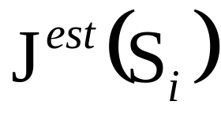
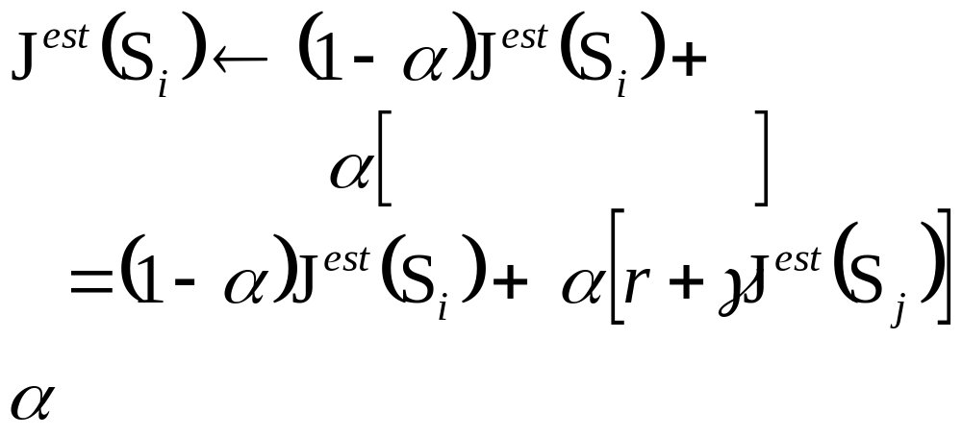
TD Learning
S_{i} ^{r} S_{j}
We update =
We nudge it to be closer to expected future rewards
WEIGHTED
SUM
Expected future
rewards
is called a “learning rate” parameter. (See “η” in the neural lecture)

Slide 22
Simplified TD Analysis
r₁= ?
TERMINATE
P₁=?
S₀
r₂= ?
P₂=?
TERMINATE
r=0
P_{M}=?
:
r_{M}= ?
TERMINATE
Suppose you always begin in S₀
You then transition at random to one of M places. You don’t know the transition probs. You then get a place-dependent reward (unknown in advance).
Then the trial terminates.
Define J*(S₀)= Expected reward
Let’s estimate it with TD

Slide 23
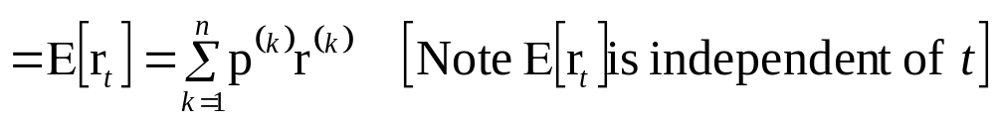
r⁽¹⁾
p⁽¹⁾
r^{(k)} = reward of k’th terminal state
p^{(k)} = prob of k’th terminal state
S₀
p⁽²⁾
r⁽²⁾
·
·
·
p^{(N)}
r^{(N)}
r=0
We’ll do a series of trials. Reward on t’th trail is r_{t}
Define J*(S₀) = J* = E[r_{t}]

Slide 24
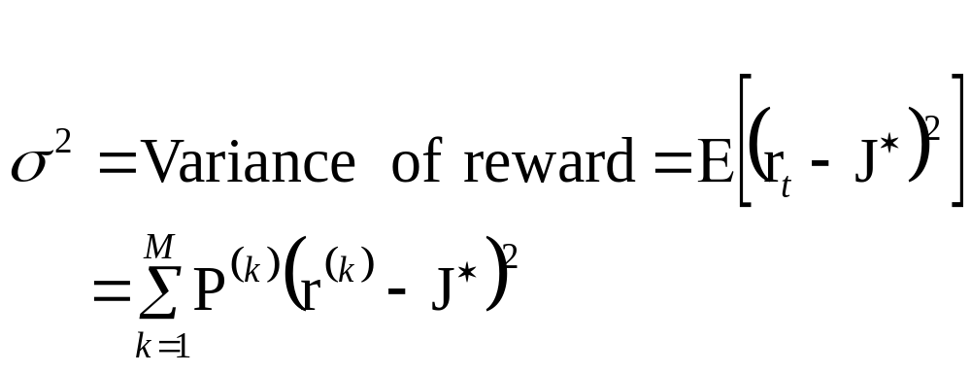
Let’s run TD-Learning, where
J_{t} = Estimate J^{est}(S₀) before the t’th trial.
From definition of TD-Learning:
J_{t+1} = (1-α)J_{t} + αr_{t}
Useful quantity: Define

Slide 25
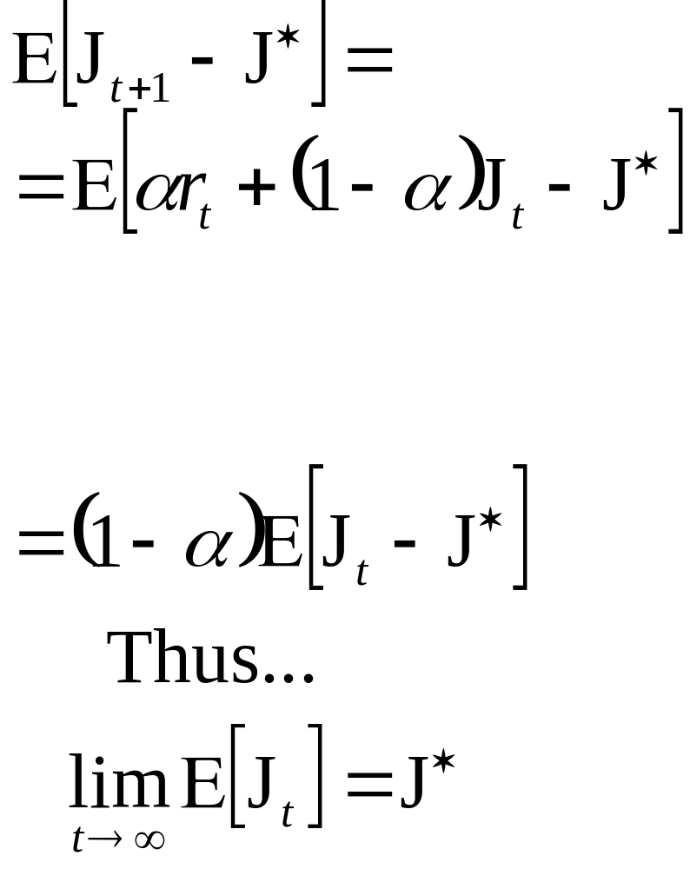
Remember J* = E[r_{t}], σ² = E[(r_{t}-J*)²] J_{t+1} = αr_{t} + (1-α)J_{t}
W H Y ?
Is this impressive??

Slide 26
Remember J* = E[r_{t}], σ² = E[(r_{t}-J*)²] J_{t+1} = αr_{t} + (1-α)J_{t}
Write S_{t} = Expected squared error between J_{t} and J* before the t’th iteration
S_{t+1} = E[(J_{t+1}-J*)²]
= E[(αr_{t}+(1-α)J_{t} - J*)²]
= E[(α[r_{t}-J*]+(1-α)[J_{t} - J*])²]
= E[α²(r_{t}-J*)²+α(1-α)(r_{t}-J*)(J_{t} - J*)+(1-α)²(J_{t} - J*)²]
= α²E[(r_{t}-J*)²]+α(1-α)E[(r_{t}-J*)(J_{t} - J*)]+(1-α)²E[(J_{t} - J*)²]
=
= α²σ²+(1-α)²S_{t}
WHY?

Slide 27
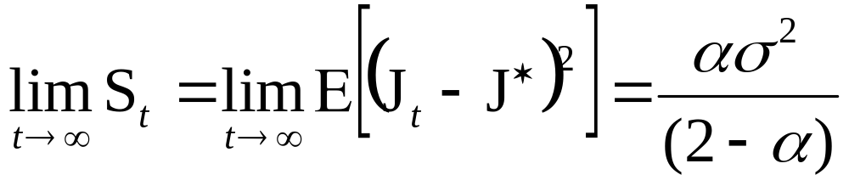
And it is thus easy to show that ….
What do you think of TD learning?
How would you improve it?

Slide 28
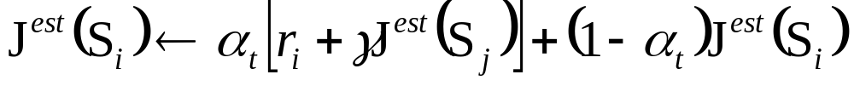
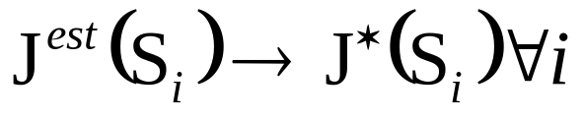
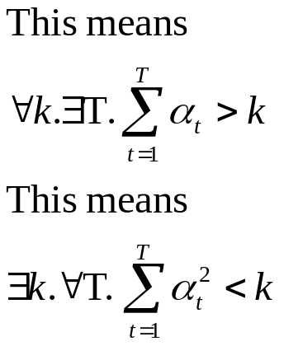
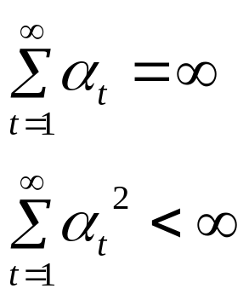
Decaying Learning Rate
[Dayan 1991ish] showed that for General TD learning of a Markow System (not just our simple model) that if you use update rule
then, as number of observations goes to infinity
PROVIDED
All states visited ∞ly often

Slide 29
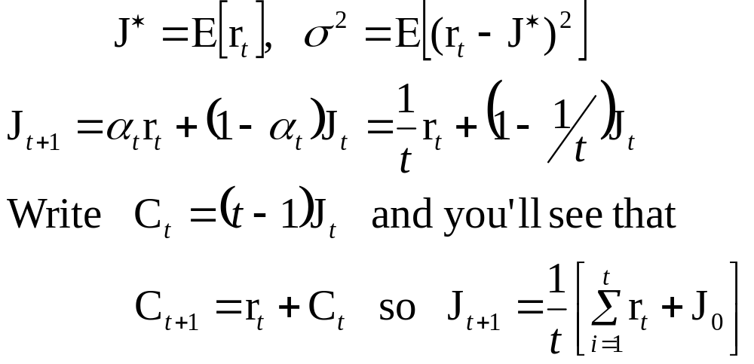
Decaying Learning Rate
This Works: α_{t} = 1/t
This Doesn’t: α_{t} = α₀
This Works: α_{t} = β/(β+t) [e.g. β=1000]
This Doesn’t: α_{t} = βα_{t-1} (β<1)
IN OUR EXAMPLE….USE α_{t} = 1/t
Remember
And…

Slide 30
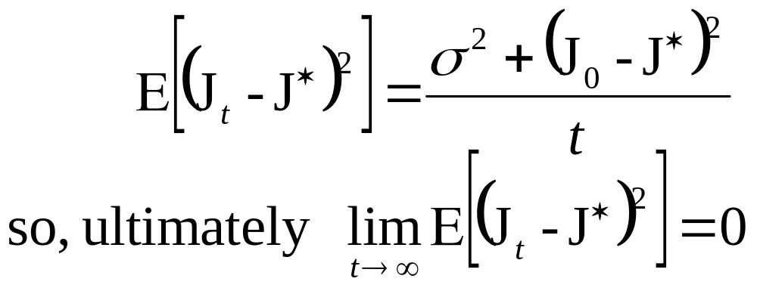
Decaying Learning Rate con’t…
…

Slide 31
A Fancier TD…
Write S[t] = state at time t
Suppose α = 1/4 γ = 1/2
Assume J^{est}(S₂₃)=0 J^{est} (S₁₇)=0 J^{est} (S₄₄)=16
Assume t = 405 and S[t] = S₂₃
Observe S₂₃ S₁₇ with reward 0
Now t = 406, S[t] = S₁₇, S[t-1] = S₂₃
J^{est} (S₂₃)= , J^{est} (S₁₇)= , J^{est} (S₄₄)=
Observe S₁₇ S₄₄
Now t = 407, S[t] = S44
J^{est} (S₂₃)= , J^{est} (S₁₇)= , J^{est} (S₄₄)=
INSIGHT: J^{est} (S₂₃) might think
(r=0)
(r=0)
I gotta get me some of that !!!

Slide 32
TD(λ) Comments
TD(λ=0) is the original TD
TD(λ=1) is almost the same as supervised learning (except it uses a learning rate instead of explicit counts)
TD(λ=0.7) is often empirically the best performer
Dayan’s proof holds for all 0≤λ≤1
Updates can be made more computationally efficient with “eligibility” traces (similar to O.S.L.)
Question:
  Can you invent a problem that would make TD(0) look bad and TD(1) look good?
  How about TD(0) look good & TD(1) bad??

Slide 33
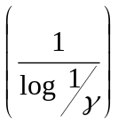
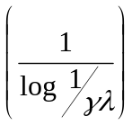
Learning M.S. Summary
 |  | Space | J Update Cost | Data Efficiency
 | Supervised Learning | 0(N_{s}) | 0 | • •
 | Full C.E. Learning | 0(N_{so}) | 0(N_{so}N_{s}) 0(N_{so}k_{CRIT}) | • •
 | One Backup C.E. Learning | 0(N_{so}) | 0(1) | • •
 | Prioritized Sweeping | 0(N_{so}) | 0(1) | • •
 | TD(0) | 0(N_{s}) | 0(1) | • •
 | TD(λ) , 0<λ≤1 | 0(N_{s}) | 0 | • •
MODEL-BASED
MODEL FREE

Slide 34
Learning Policies for MDPs
The Heart
of
REINFORCEMENT
Learning
See previous lecture slides for definition of and computation with MDPs.
state

Slide 35
The task:
World: You are in state 34.
Your immediate reward is 3. You have 3 actions.
Robot: I’ll take action 2.
World: You are in state 77.
Your immediate reward is -7. You have 2 actions.
Robot: I’ll take action 1.
World: You’re in state 34 (again).
Your immediate reward is 3. You have 3 actions. The Markov property means once you’ve selected an action the P.D.F. of your next state is the same as the last time you tried the action in this state.

Slide 36
The “Credit Assignment” Problem
I’m in state 43, | reward = 0, | action = 2
“ “ “ 39, | “ = 0, | “ = 4
“ “ “ 22, | “ = 0, | “ = 1
“ “ “ 21, | “ = 0, | “ = 1
“ “ “ 21, | “ = 0, | “ = 1
“ “ “ 13, | “ = 0, | “ = 2
“ “ “ 54, | “ = 0, | “ = 2
“ “ “ 26, | “ = 100,
Yippee! I got to a state with a big reward! But which of my actions along the way actually helped me get there??
This is the Credit Assignment problem.
It makes Supervised Learning approaches (e.g. Boxes [Michie & Chambers]) very, very slow.
Using the MDP assumption helps avoid this problem.

Slide 37
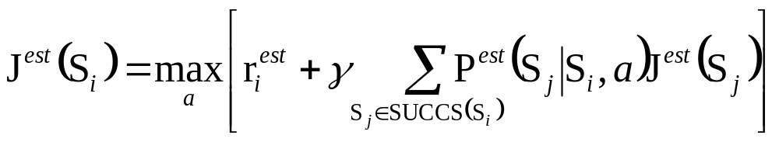
MDP Policy Learning
 | Space | Update Cost | Data Efficiency
Full C.E. Learning | 0(N_{sAo}) | 0(N_{sAo}k_{CRIT}) | • •
One Backup C.E. Learning | 0(N_{sAo}) | 0(N_{Α0}) | • •
Prioritized Sweeping | 0(N_{sAo}) | 0(βN_{Α0}) | • •
We’ll think about Model-Free in a moment…
The C.E. methods are very similar to the MS case, except now do value-iteration-for-MDP backups

Slide 38
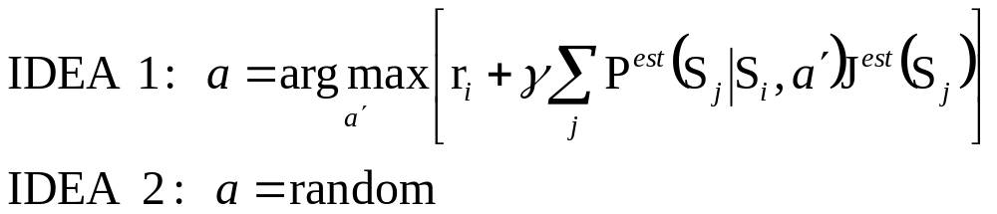
Choosing Actions
We’re in state S_{i}
We can estimate r_{i}^{est}
“ “ “ P^{est}(next = S_{j} | this = S_{i} , action a)
“ “ “ J^{est} (next = S_{j} )
So what action should we choose ?
Any problems with these ideas?
Any other suggestions?
Could we be optimal?

Slide 39
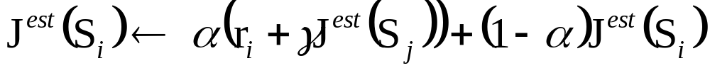
Model-Free R.L.
Why not use T.D. ?
Observe
update
r
S_{i}
a
S_{j}
What’s wrong with this?

Slide 40
Q-Learning: Model-Free R.L.
[Watkins, 1988]
Define
Q*(S_{i},a)= Expected sum of discounted future rewards if I start in state S_{i}, if I then take action a, and if I’m subsequently optimal
Questions:
Define Q*(S_{i},a) in terms of J*
Define J*(S_{i}) in terms of Q*

Slide 41
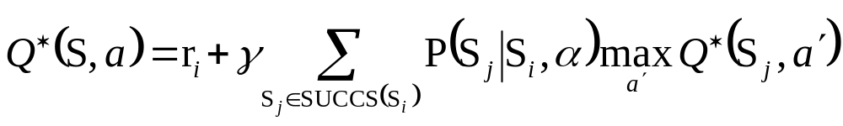
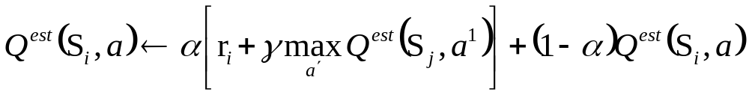
Q-Learning Update
Note that
In Q-learning we maintain a table of Q^{est} values instead of J^{est} values…
When you see S_{i} S_{j} do…
reward
action a
This is even cleverer than it looks: the Q^{est} values are not biased by any particular exploration policy. It avoids the Credit Assignment problem.

Slide 42
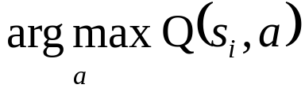
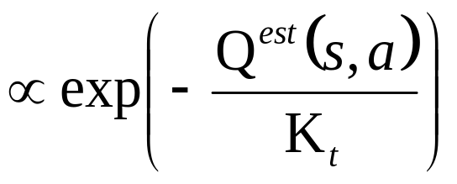
Q-Learning: Choosing Actions
Same issues as for CE choosing actions
Don’t always be greedy, so don’t always choose:
Don’t always be random (otherwise it will take a long time to reach somewhere exciting)
Boltzmann exploration [Watkins]
Prob(choose action a)
Optimism in the face of uncertainty [Sutton ’90, Kaelbling ’90]
  Initialize Q-values optimistically high to encourage exploration
  Or take into account how often each s,a pair has been tried

Slide 43
Q-Learning Comments
[Watkins] proved that Q-learning will eventually converge to an optimal policy.
Empirically it is cute
Empirically it is very slow
Why not do Q(λ) ?
  Would not make much sense [reintroduce the credit assignment problem]
  Some people (e.g. Peng & Williams) have tried to work their way around this.

Slide 44
If we had time…
Value function approximation
  Use a Neural Net to represent J^{est} [e.g. Tesauro]
  Use a Neural Net to represent Q^{est} [e.g. Crites]
  Use a decision tree
    with Q-learning [Chapman + Kaelbling ’91]
    with C.E. learning [Moore ’91]
    How to split up space?
      Significance test on Q values [Chapman + Kaelbling]
      Execution accuracy monitoring [Moore ’91]
      Game Theory [Moore + Atkeson ’95]
      New influence/variance criteria [Munos ’99]

Slide 45
If we had time…
R.L. Theory
  Counterexamples [Boyan + Moore], [Baird]
  Value Function Approximators with Averaging will converge to something [Gordon]
  Neural Nets can fail [Baird]
  Neural Nets with Residual Gradient updates will converge to something
  Linear approximators for TD learning will converge to something useful [Tsitsiklis + Van Roy]

Slide 46
What You Should Know
Supervised learning for predicting delayed rewards
Certainty equivalent learning for predicting delayed rewards
Model free learning (TD) for predicting delayed rewards
Reinforcement Learning with MDPs: What’s the task?
Why is it hard to choose actions?
Q-learning (including being able to work through small simulated examples of RL)

