Slide 1
Spatial biosurveillance
Authors of Slides
Andrew Moore
Carnegie Mellon
awm@cs.cmu.edu
Daniel Neill
Carnegie Mellon
d.neill@cs.cmu.edu
Slides and Software and Papers at:
http://www.autonlab.org
awm@cs.cmu.edu
412-268-7599
Thanks to:
Howard Burkom, Greg Cooper, Kenny Daniel, Bill Hogan, Martin Kulldorf, Robin Sabhnani, Jeff Schneider, Rich Tsui, Mike Wagner
Note to other teachers and users of these slides. Andrew would be delighted if you found this source material useful in giving your own lectures. Feel free to use these slides verbatim, or to modify them to fit your own needs. PowerPoint originals are available. If you make use of a significant portion of these slides in your own lecture, please include this message, or the following link to the source repository of Andrew’s tutorials: http://www.cs.cmu.edu/~awm/tutorials . Comments and corrections gratefully received.

Slide 2
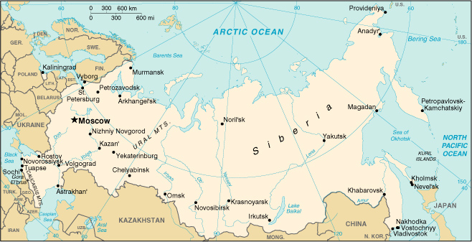
..Early Thursday Morning. Russia. April 1979...
Sverdlovsk

Slide 3
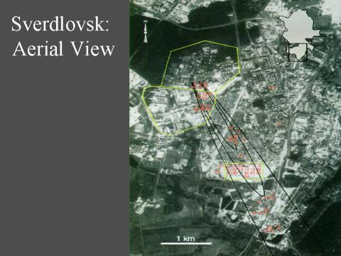
Sverdlovsk

Slide 4
Sverdlovsk
During April and May 1979, there were 77 Confirmed cases of inhalational anthrax

Slide 5
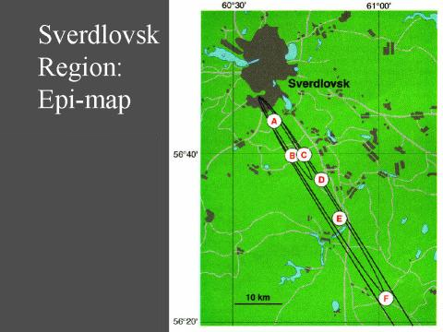

Slide 6
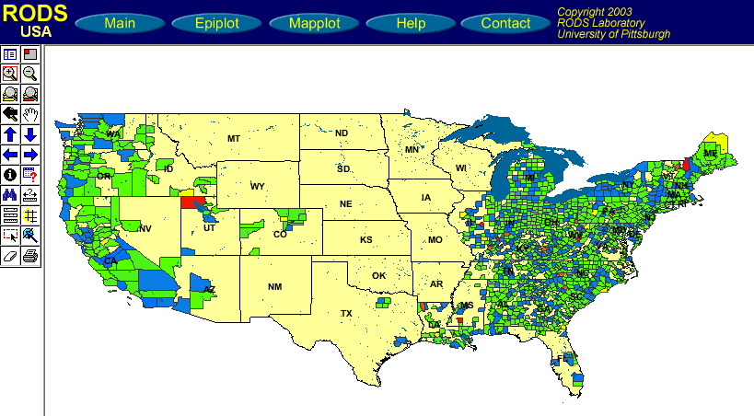
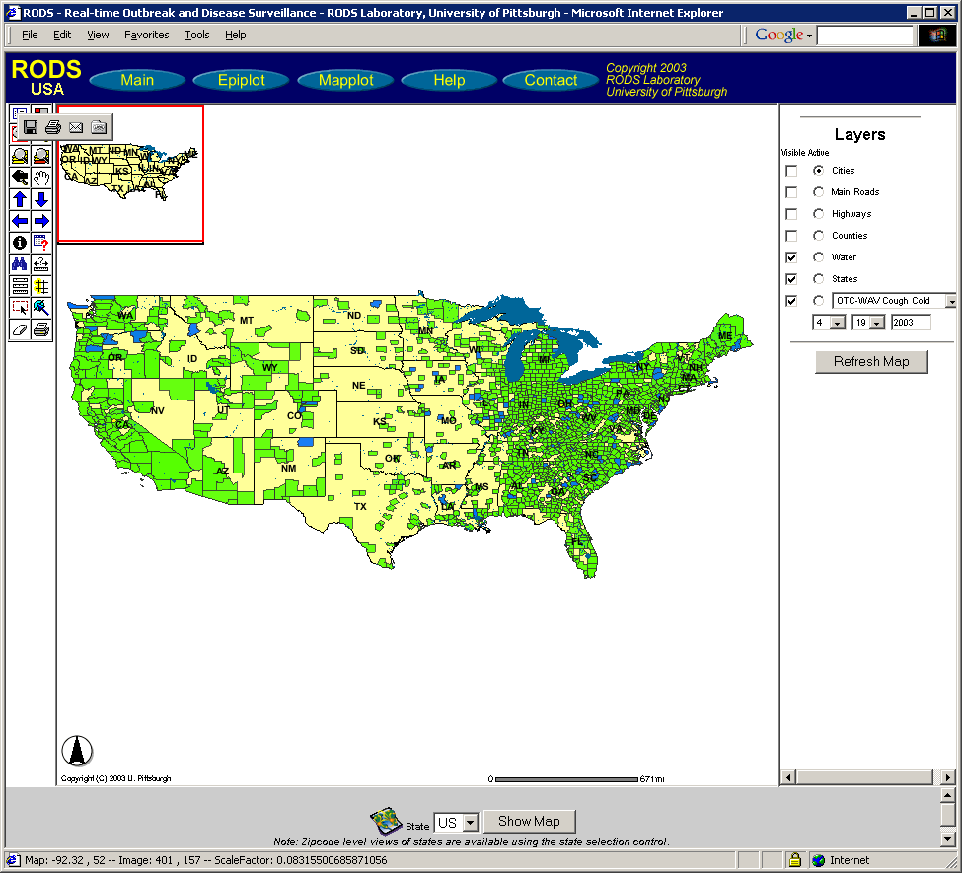
Goals of spatial cluster detection
To identify the locations, shapes, and sizes of potentially anomalous spatial regions.
To determine whether each of these potential clusters is more likely to be a “true” cluster or a chance occurrence.
In other words, is anything unexpected going on, and if so, where?
Notes:
The task of spatial cluster detection has two main goals: first, to identify the locations, shapes and sizes of potentially anomalous spatial regions, and second, to determine whether each potential cluster is more likely to be a “true” cluster or simply due to chance. In other words, we wish to answer the questions, is anything unexpected going on in our data, and if so, where?

Slide 7
Disease surveillance
Given: count for each zip code
(e.g. number of Emergency Dept. visits, or over-the-counter drug sales, of a specific type)
Do any regions have sufficiently high counts to be indicative of an emerging disease epidemic in that area?
How many cases do we expect to see in each area?
Are there any regions with significantly more cases than expected?
Notes:
For example, in the task of disease surveillance, we are given a count for each zip code, which may correspond to the number of Emergency Department visits, or over-the-counter drug sales, of a specific type (for instance, respiratory ED visits, or sales of cough-and-cold medication). Given all of this data, we wish to know whether any spatial regions have sufficiently high counts to be indicative of an emerging disease epidemic in that area. Thus we must first determine how many cases we expect to see in each area, and then we can determine whether there are any spatial regions with significantly more cases than expected.

Slide 8
A simple approach
For each zip code:
  Infer how many cases we expect to see, either from given denominator data (e.g. census population) or from historical data (e.g. time series of previous counts).
  Perform a separate statistical significance test on that zip code, obtaining its p-value.
Report all zip codes that are significant at some level α.
What are the potential problems?
Notes:
One very simplistic approach would be to consider each zip code separately, first inferring how many cases we expect to see (either from historical data or from a given census population), and then performing a statistical significance test to decide whether the actual count of that zip code is higher than expected. We would then report all zip codes that are significant, i.e. having p-values below some given level alpha. So why is this simplistic approach not a particularly good one?

Slide 9
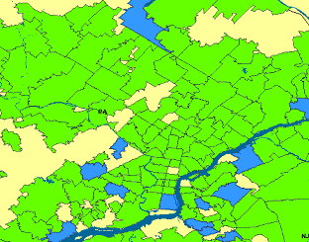
A simple approach
For each zip code:
  Infer how many cases we expect to see, either from given denominator data (e.g. census population) or from historical data (e.g. time series of previous counts).
  Perform a separate statistical significance test on that zip code, obtaining its p-value.
Report all zip codes that are significant at some level α.
One abnormal zip code might not be interesting…
But a cluster of abnormal zip codes would be!
What are the potential problems?
Notes:
One reason is that it fails to take into account the spatial proximity of locations. If we see abnormal counts in one zip code, this might not be strange enough on its own to indicate an emerging disease epidemic. But if we see that the surrounding zip codes also have higher than expected counts, this may give us sufficient evidence that something interesting is going on.

Slide 10
A simple approach
Multiple hypothesis testing
For each zip code:
  Infer how many cases we expect to see, either from given denominator data (e.g. census population) or from historical data (e.g. time series of previous counts).
  Perform a separate statistical significance test on that zip code, obtaining its p-value.
Report all zip codes that are significant at some level α.
Thousands of locations to test…
5% chance of false positive for each…
Almost certain to get large numbers of false alarms!
How do we bound the overall probability of getting any false alarms?
What are the potential problems?
Notes:
Another serious issue with the simplistic approach is the multiple hypothesis testing problem. We are simultaneously testing thousands of spatial locations, where each hypothesis test we perform has a 5% chance of generating a false positive. Then the result of performing all of these tests is that we are almost certain to end up with large numbers of false alarms! So the question, then, is how to bound the overall probability of getting any false alarms, without drastically reducing the power of our test.

Slide 11
One Step of Spatial Scan
Entire area being scanned

Slide 12
One Step of Spatial Scan
Entire area being scanned
Current region being considered

Slide 13
One Step of Spatial Scan
Entire area being scanned
Current region being considered
I have a population of 5300 of whom 53 are sick (1%)
Everywhere else has a population of 2,200,000 of whom 20,000 are sick (0.9%)

Slide 14
One Step of Spatial Scan
Entire area being scanned
Current region being considered
I have a population of 5300 of whom 53 are sick (1%)
So... is that a big deal? Evaluated with Score function.
Everywhere else has a population of 2,200,000 of whom 20,000 are sick (0.9%)

Slide 15
Scoring functions
Define models:
  of the null hypothesis H₀: no attacks.
  of the alternative hypotheses H₁(S): attack in region S.

Slide 16
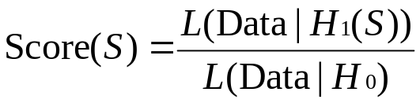
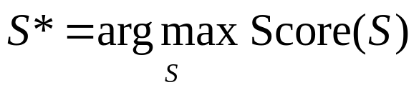
Scoring functions
Define models:
  of the null hypothesis H₀: no attacks.
  of the alternative hypotheses H₁(S): attack in region S.
Derive a score function Score(S) = Score(C, B).
  Likelihood ratio:
  To find the most significant region:

Slide 17
Scoring functions
C = Count in region
B = Baseline (e.g. Population at risk)
Define models:
  of the null hypothesis H₀: no attacks.
  of the alternative hypotheses H₁(S): attack in region S.
Derive a score function Score(S) = Score(C, B).
  Likelihood ratio:
  To find the most significant region:

Slide 18
Scoring functions
Example: Kulldorf’s score
Assumption: c_{i} ~ Poisson(qb_{i})
H₀: q = q_{all} everywhere
H₁: q = q_{in} inside region,
q = q_{out} outside region
Define models:
  of the null hypothesis H₀: no attacks.
  of the alternative hypotheses H₁(S): attack in region S.
Derive a score function Score(S) = Score(C, B).
  Likelihood ratio:
  To find the most significant region:

Slide 19
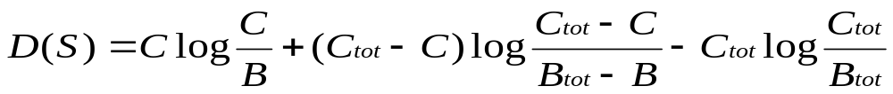
Scoring functions
Example: Kulldorf’s score
Assumption: c_{i} ~ Poisson(qb_{i})
H₀: q = q_{all} everywhere
H₁: q = q_{in} inside region,
q = q_{out} outside region
Define models:
  of the null hypothesis H₀: no attacks.
  of the alternative hypotheses H₁(S): attack in region S.
Derive a score function Score(S) = Score(C, B).
  Likelihood ratio:
  To find the most significant region:
(Individually Most Powerful statistic for detecting significant increases) (but still…just an example)

Slide 20
The generalized spatial scan
Obtain data for a set of spatial locations s_{i}.
Choose a set of spatial regions S to search.
Choose models of the data under null hypothesis H₀ (no clusters) and alternative hypotheses H₁(S) (cluster in region S).
Derive a score function F(S) based on H₁(S) and H₀.
Find the most anomalous regions (i.e. those regions S with highest F(S)).
Determine whether each of these potential clusters is actually an anomalous cluster.

Slide 21
1. Obtain data for a set of spatial locations s_{i}.
For each spatial location s_{i}, we are given a count c_{i} and a baseline b_{i}.
For example: c_{i} = # of respiratory disease cases, b_{i} = at-risk population.
Goal: to find regions where the counts are higher than expected, given the baselines.
c_{i} = 20, b_{i} = 5000
Population-based method:
Expectation-based method:
Baselines represent population, whether given (e.g. census) or inferred (e.g. from sales); can be adjusted for age, risk factors, seasonality, etc.
Baselines represent expected counts, inferred from the time series of previous counts, accounting for day-of-week and seasonality effects.
Under null hypothesis, we expect counts to be proportional to baselines.
Under null hypothesis, we expect counts to be equal to baselines.
Compare disease rate (count / pop) inside and outside region.
Compare region’s actual count to its expected count.

Slide 22
1. Obtain data for a set of spatial locations s_{i}.
For each spatial location s_{i}, we are given a count c_{i} and a baseline b_{i}.
For example: c_{i} = # of respiratory disease cases, b_{i} = at-risk population.
Goal: to find regions where the counts are higher than expected, given the baselines.
c_{i} = 20, b_{i} = 5000
Discussion question: When is it preferable to use each method?
Population-based method:
Expectation-based method:
Baselines represent population, whether given (e.g. census) or inferred (e.g. from sales); can be adjusted for age, risk factors, seasonality, etc.
Baselines represent expected counts, inferred from the time series of previous counts, accounting for day-of-week and seasonality effects.
Under null hypothesis, we expect counts to be proportional to baselines.
Under null hypothesis, we expect counts to be equal to baselines.
Compare disease rate (count / pop) inside and outside region.
Compare region’s actual count to its expected count.
Notes:
Discussion: depends on both the data given and what sort of clusters we want to be able to detect…

Slide 23
2. Choose a set of spatial regions S to search.
Some practical considerations:
  Set of regions should cover entire search space.
  Adjacent regions should partially overlap.
Choose a set of regions that corresponds well with the size/shape of the clusters we want to detect.
  Typically, we consider some fixed shape (e.g. circle, rectangle) and allow its location and dimensions to vary.
Don’t search too few regions:
Don’t search too many regions:
Reduced power to detect clusters outside the search space.
Overall power to detect any given subset of regions reduced because of multiple hypothesis testing.
Computational infeasibility!

Slide 24
2. Choose a set of spatial regions S to search.
Our typical approach for disease surveillance:
  map spatial locations to grid
  search over the set of all gridded rectangular regions.
Allows us to detect both compact and elongated clusters (important because of wind- or water-borne pathogens).
Computationally efficient
  can evaluate any rectangular region in constant time
  can use fast spatial scan algorithm

Slide 25
2. Choose a set of spatial regions S to search.
Our typical approach for disease surveillance:
  map spatial locations to grid
  search over the set of all gridded rectangular regions.
Allows us to detect both compact and elongated clusters (important because of wind- or water-borne pathogens).
Computationally efficient
  can evaluate any rectangular region in constant time
  can use fast spatial scan algorithm
Can also search over non-axis-aligned rectangles by examining multiple rotations of the data

Slide 26
3-4. Choose models of the data under H₀ and H₁(S), and derive a score function F(S).
Most difficult steps: must choose models which are efficiently computable and relevant.

Slide 27
3-4. Choose models of the data under H₀ and H₁(S), and derive a score function F(S).
Most difficult steps: must choose models which are efficiently computable and relevant.
F(S) must be computable as function of some additive sufficient statistics of region S, e.g. total count C(S) and total baseline B(S).

Slide 28
3-4. Choose models of the data under H₀ and H₁(S), and derive a score function F(S).
Most difficult steps: must choose models which are efficiently computable and relevant.
tradeoff!
F(S) must be computable as function of some additive sufficient statistics of region S, e.g. total count C(S) and total baseline B(S).
Any simplifying assumptions should not greatly affect our ability to distinguish between clusters and non-clusters.

Slide 29
3-4. Choose models of the data under H₀ and H₁(S), and derive a score function F(S).
Most difficult steps: must choose models which are efficiently computable and relevant.
tradeoff!
F(S) must be computable as function of some additive sufficient statistics of region S, e.g. total count C(S) and total baseline B(S).
Any simplifying assumptions should not greatly affect our ability to distinguish between clusters and non-clusters.
Iterative design process
Test detection power
Remove effect (preprocessing)?
Y
Calibrate
Basic model
High power?
Done
Filter out regions (postprocessing)?
N
Add complexity to model?
Find unmodeled effect harming performance

Slide 30
3-4. Choose models of the data under H₀ and H₁(S), and derive a score function F(S).
Most difficult steps: must choose models which are efficiently computable and relevant.
tradeoff!
Discussion question: What effects should be treated with each technique?
F(S) must be computable as function of some additive sufficient statistics of region S, e.g. total count C(S) and total baseline B(S).
Any simplifying assumptions should not greatly affect our ability to distinguish between clusters and non-clusters.
Iterative design process
Test detection power
Remove effect (preprocessing)?
Y
Calibrate
Basic model
High power?
Done
Filter out regions (postprocessing)?
N
Add complexity to model?
Find unmodeled effect harming performance
Notes:
Preprocessing: correct data to remove the effect (e.g. missing data-- infer values).
Postprocessing: filter out regions caused by known effects (e.g. in OTC, single-store spikes caused by bulk purchases or promotional sales)
Add model complexity: e.g. Poisson distribution cannot account for such effects as overdispersion, correlation.

Slide 31
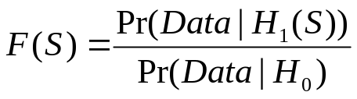
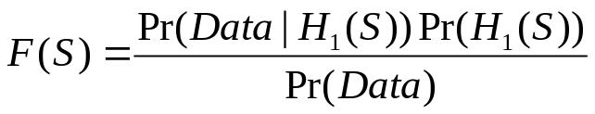
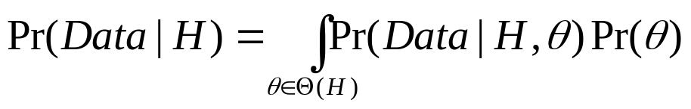
Computing the score function
Method 1 (Frequentist, hypothesis testing approach):
Use likelihood ratio
Prior probability of region S
Method 2 (Bayesian approach):
Use posterior probability
What to do when each hypothesis has a parameter space Θ?
Method A (Maximum likelihood approach)
Method B (Marginal likelihood approach)

Slide 32
Computing the score function
Method 1 (Frequentist, hypothesis testing approach):
Use likelihood ratio
Most common (frequentist) approach: use likelihood ratio statistic, with maximum likelihood estimates of any free parameters, and compute statistical significance by randomization.
Method A (Maximum likelihood approach)

Slide 33
5. Find the most anomalous regions, i.e. those regions S with highest F(S).
Naïve approach: compute F(S) for each spatial region S.
Better approach: apply fancy algorithms (e.g. Kulldorf’s SatScan or the fast spatial scan algorithm (Neill and Moore, KDD 2004).
Problem: millions of regions to search!

Slide 34
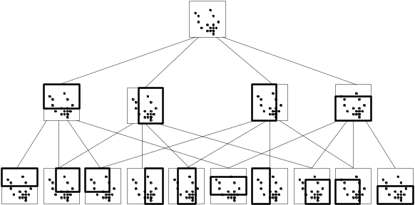
5. Find the most anomalous regions, i.e. those regions S with highest F(S).
Naïve approach: compute F(S) for each spatial region S.
Better approach: apply fancy algorithms (e.g. Kulldorf’s SatScan or the fast spatial scan algorithm (Neill and Moore, KDD 2004).
Problem: millions of regions to search!
Start by examining large rectangular regions S. If we can show that none of the smaller rectangles contained in S can have high scores, we do not need to individually search each of these subregions.
  Using a multiresolution data structure (overlap-kd tree) enables us to efficiently move between searching at coarse and fine resolutions.

Slide 35
5. Find the most anomalous regions, i.e. those regions S with highest F(S).
Result: 20-2000x speedups vs. naïve approach, without any loss of accuracy
Naïve approach: compute F(S) for each spatial region S.
Better approach: apply fancy algorithms (e.g. Kulldorf’s SatScan or the fast spatial scan algorithm (Neill and Moore, KDD 2004).
Problem: millions of regions to search!
Start by examining large rectangular regions S. If we can show that none of the smaller rectangles contained in S can have high scores, we do not need to individually search each of these subregions.
  Using a multiresolution data structure (overlap-kd tree) enables us to efficiently move between searching at coarse and fine resolutions.

Slide 36
6. Determine whether each of these potential clusters is actually an anomalous cluster.
Frequentist approach: calculate statistical significance of each region by randomization testing.
D(S) = 21.2
D(S) = 15.1
D(S) = 18.5
Original grid G
Notes:
For example, if G_1 was the only replica grid with a p-value greater than 15, the upper right region would have a p-value of 2/1000 and the other two regions shown would have a p-value of 1/1000.
In other words, a region would be significant at alpha = .05 if its score is so high that under the null hypothesis, we would not expect to see any regions with scores that high 95% of the time.

Slide 37
6. Determine whether each of these potential clusters is actually an anomalous cluster.
Frequentist approach: calculate statistical significance of each region by randomization testing.
…
D(S) = 21.2
D(S) = 15.1
D*(G₁) = 16.7
D*(G₉₉₉) = 4.2
1. Create R = 999 replica grids by sampling under H₀, using max-likelihood estimates of any free params.
D(S) = 18.5
Original grid G
Notes:
For example, if G_1 was the only replica grid with a p-value greater than 15, the upper right region would have a p-value of 2/1000 and the other two regions shown would have a p-value of 1/1000.
In other words, a region would be significant at alpha = .05 if its score is so high that under the null hypothesis, we would not expect to see any regions with scores that high 95% of the time.

Slide 38
6. Determine whether each of these potential clusters is actually an anomalous cluster.
Frequentist approach: calculate statistical significance of each region by randomization testing.
…
D(S) = 21.2
D(S) = 15.1
D*(G₁) = 16.7
D*(G₉₉₉) = 4.2
1. Create R = 999 replica grids by sampling under H₀, using max-likelihood estimates of any free params.
D(S) = 18.5
Original grid G
2. Find maximum region score D* for each replica.
Notes:
For example, if G_1 was the only replica grid with a p-value greater than 15, the upper right region would have a p-value of 2/1000 and the other two regions shown would have a p-value of 1/1000.
In other words, a region would be significant at alpha = .05 if its score is so high that under the null hypothesis, we would not expect to see any regions with scores that high 95% of the time.

Slide 39
6. Determine whether each of these potential clusters is actually an anomalous cluster.
Frequentist approach: calculate statistical significance of each region by randomization testing.
…
D(S) = 21.2
D(S) = 15.1
D*(G₁) = 16.7
D*(G₉₉₉) = 4.2
1. Create R = 999 replica grids by sampling under H₀, using max-likelihood estimates of any free params.
D(S) = 18.5
Original grid G
2. Find maximum region score D* for each replica.
3. For each potential cluster S, count R_{beat} = number of replica grids G’ with D*(G’) higher than D(S).
4. p-value of region S = (R_{beat}+1)/(R+1).
5. All regions with p-value < α are significant at level α.
Notes:
For example, if G_1 was the only replica grid with a p-value greater than 15, the upper right region would have a p-value of 2/1000 and the other two regions shown would have a p-value of 1/1000.
In other words, a region would be significant at alpha = .05 if its score is so high that under the null hypothesis, we would not expect to see any regions with scores that high 95% of the time.

Slide 40
6. Determine whether each of these potential clusters is actually an anomalous cluster.
Bayesian approach: calculate posterior probability of each potential cluster.
1. Score of region S = Pr(Data | H₁(S)) Pr(H₁(S))
2. Total probability of the data: Pr(Data) =
Pr(Data | H₀) Pr(H₀) + ∑_{S} Pr(Data | H₁(S)) Pr(H₁(S))
3. Posterior probability of region S: Pr(H₁(S) | Data) =
Pr(Data | H₁(S)) Pr(H₁(S)) / Pr(Data).
4. Report all clusters with posterior probability > some threshold, or “sound the alarm” if total posterior probability of all clusters sufficiently high.
Original grid G
No randomization testing necessary… about 1000x faster than naïve frequentist approach!
Notes:
For example, if G_1 was the only replica grid with a p-value greater than 15, the upper right region would have a p-value of 2/1000 and the other two regions shown would have a p-value of 1/1000.
In other words, a region would be significant at alpha = .05 if its score is so high that under the null hypothesis, we would not expect to see any regions with scores that high 95% of the time.

Slide 41
Making the spatial scan fast
256 x 256 grid = 1 billion regions!
Naïve frequentist scan
1000 replicas
x 12 hrs / replica
= 500 days!
Fast frequentist scan
Naïve Bayesian scan
1000 replicas
x 36 sec / replica
= 10 hrs
12 hrs (to search original grid)
Fast Bayesian scan

Slide 42
Why the Scan Statistic speed obsession?
Traditional Scan Statistics very expensive, especially with Randomization tests
Going national
A few hours could actually matter!

Slide 43
Results
Notes:
If you’re interested in more details of the algorithm, please see our paper; for now, I’ll skip to some results.

Slide 44
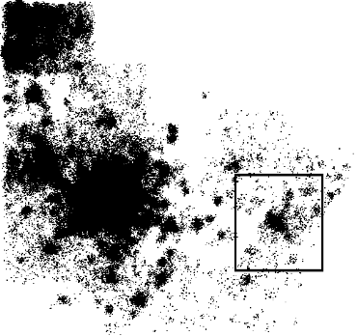
Summary of results
The fast spatial scan results in huge speedups (as compared to exhaustive search), making fast real-time detection of clusters feasible.
No loss of accuracy: fast spatial scan finds the exact same regions and p-values as exhaustive search.
OTC data from National Retail Data Monitor
ED data
Notes:
Our main algorithmic result is that the fast spatial scan allows us to achieve significant speedups as compared to exhaustive search, making the fast real-time detection of clusters computationally feasible. Most importantly, we achieve these speedups without any loss of accuracy: the fast spatial scan finds exactly the same regions and p-values as exhaustive search.

Slide 45
Performance comparison
Algorithm name | Search space | Number of regions | Search time (total) | Time / region | Likelihood ratio
SaTScan | Circles centered at datapts | 150 billion | 16 hours | 400 ns | 413.56
exhaustive | Axis-aligned rectangles | 1.1 trillion | 45 days | 3600 ns | 429.85
fast spatial scan | Axis-aligned rectangles | 1.1 trillion | 81 minutes | 4.4 ns | 429.85
On ED dataset (600,000 records), 1000 replicas
For SaTScan: M=17,000 distinct spatial locations
For Exhaustive/fast: 256 x 256 grid
Notes:
Here we present some results of a preliminary comparison to Martin Kulldorff’s SaTScan software on the Emergency Department datset, which contains 600 thousand records. Note that an accurate comparison is difficult since SaTScan searches over a very different set of regions, circles centered at a data point rather than rectangles aligned with a grid. There are advantages to each approach, as we discuss in our paper. But the big question is, since there are many more elongated regions than compact regions, can we still search this set of regions in a reasonable amount of time? If we use an exhaustive search, of course, the answer is no. But our fast spatial scan allows us to find the same region as exhaustive search, but in less total time than either the exhaustive search or SaTScan. The key is that we can achieve the same results as if we had searched all of these regions, but actually search only a small fraction of regions. In this case, the most significant rectangular region had a low aspect ratio, so all three methods found approximately the same region and likelihood ratio score; if the most significant rectangular region was highly elongated, we would expect a search over rectangles to find a region with a much higher likelihood ratio.

Slide 46
Performance comparison
Algorithm name | Search space | Number of regions | Search time (total) | Time / region | Likelihood ratio
SaTScan | Circles centered at datapts | 150 billion | 16 hours | 400 ns | 413.56
exhaustive | Axis-aligned rectangles | 1.1 trillion | 45 days | 3600 ns | 429.85
fast spatial scan | Axis-aligned rectangles | 1.1 trillion | 81 minutes | 4.4 ns | 429.85
On ED dataset (600,000 records), 1000 replicas
For SaTScan: M=17,000 distinct spatial locations
For Exhaustive/fast: 256 x 256 grid
Algorithms: Neill and Moore, NIPS 2003, KDD 2004
Deployment: Neill, Moore, Tsui and Wagner, Morbidity and Mortality Weekly Report, Nov. ‘04
Notes:
Here we present some results of a preliminary comparison to Martin Kulldorff’s SaTScan software on the Emergency Department datset, which contains 600 thousand records. Note that an accurate comparison is difficult since SaTScan searches over a very different set of regions, circles centered at a data point rather than rectangles aligned with a grid. There are advantages to each approach, as we discuss in our paper. But the big question is, since there are many more elongated regions than compact regions, can we still search this set of regions in a reasonable amount of time? If we use an exhaustive search, of course, the answer is no. But our fast spatial scan allows us to find the same region as exhaustive search, but in less total time than either the exhaustive search or SaTScan. The key is that we can achieve the same results as if we had searched all of these regions, but actually search only a small fraction of regions. In this case, the most significant rectangular region had a low aspect ratio, so all three methods found approximately the same region and likelihood ratio score; if the most significant rectangular region was highly elongated, we would expect a search over rectangles to find a region with a much higher likelihood ratio.

Slide 47
d-dimensional partitioning
Parent region S is divided into 2d overlapping children: an “upper child” and a “lower child” in each dimension.
Then for any rectangular subregion S’ of S, exactly one of the following is true:
  S’ is contained entirely in (at least) one of the children S₁… S_{2d}.
  S’ contains the center region S_{C}, which is common to all the children.
Starting with the entire grid G and repeating this partitioning recursively, we obtain the overlap-kd tree structure.
S₅
S₁
S₂
S₃
S
S₄
S_{C}
S₆
Algorithm: Neill, Moore and Mitchell NIPS 2004

Slide 48
Limitations of the algorithm
Data must be aggregated to a grid.
Not appropriate for very high-dimensional data.
Assumes that we are interested in finding (rotated) rectangular regions.
Less useful for special cases (e.g. square regions, small regions only).
Slower for finding multiple regions.

Slide 49
Related work
  non-specific clustering: evaluates general tendency of data to cluster
  focused clustering: evaluates risk w.r.t. a given spatial location (e.g. potential hazard)
  disease mapping: models spatial variation in risk by applying spatial smoothing.
  spatial scan statistics (and related techniques).

