Slide 1

An introduction to time series approaches in biosurveillance
Andrew W. Moore
Professor
The Auton Lab
School of Computer Science
Carnegie Mellon University
http://www.autonlab.org
Associate Member
The RODS Lab
University of Pittburgh
Carnegie Mellon University
http://rods.health.pitt.edu
Note to other teachers and users of these slides. Andrew would be delighted if you found this source material useful in giving your own lectures. Feel free to use these slides verbatim, or to modify them to fit your own needs. PowerPoint originals are available. If you make use of a significant portion of these slides in your own lecture, please include this message, or the following link to the source repository of Andrew’s tutorials: http://www.cs.cmu.edu/~awm/tutorials . Comments and corrections gratefully received.
awm@cs.cmu.edu
412-268-7599

Slide 2
Univariate Time Series
Signal
Time
Example Signals:
Number of ED visits today
Number of ED visits this hour
Number of Respiratory Cases Today
School absenteeism today
Nyquil Sales today

Slide 3
(When) is there an anomaly?

Slide 4
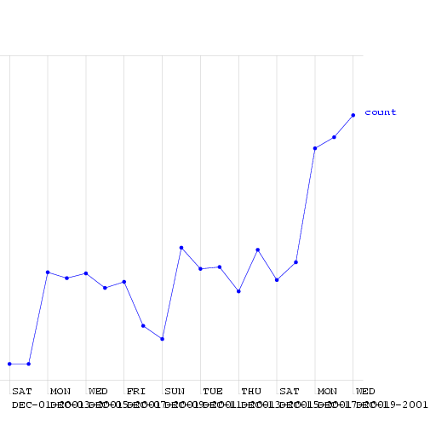
(When) is there an anomaly?
This is a time series of counts of primary-physician visits in data from Norfolk in December 2001. I added a fake outbreak, starting at a certain date. Can you guess when?

Slide 5
(When) is there an anomaly?
Here (much too high for a Friday)
This is a time series of counts of primary-physician visits in data from Norfolk in December 2001. I added a fake outbreak, starting at a certain date. Can you guess when?
(Ramp outbreak)

Slide 6
An easy case
Signal
Time
Dealt with by Statistical Quality Control
Record the mean and standard deviation up the the current time.
Signal an alarm if we go outside 3 sigmas

Slide 7
An easy case: Control Charts
Upper Safe Range
Signal
Mean
Time
Dealt with by Statistical Quality Control
Record the mean and standard deviation up the the current time.
Signal an alarm if we go outside 3 sigmas

Slide 8
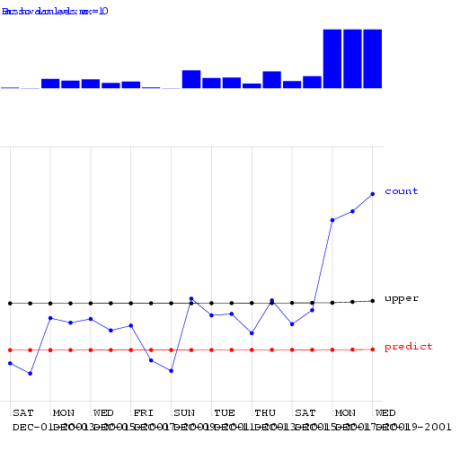
Control Charts on the Norfolk Data
Alarm Level

Slide 9
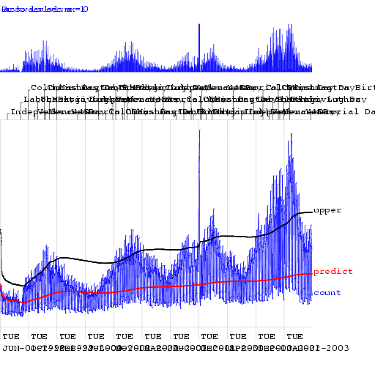
Control Charts on the Norfolk Data
Alarm Level

Slide 10
Looking at changes from yesterday

Slide 11
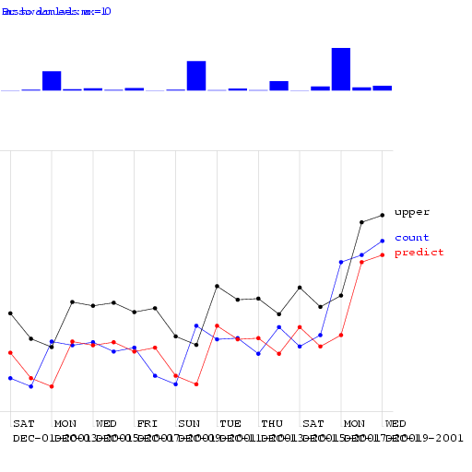
Looking at changes from yesterday
Alarm Level

Slide 12
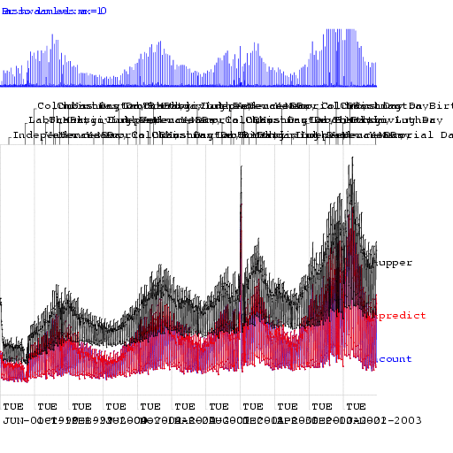
Looking at changes from yesterday
Alarm Level

Slide 13
We need a happy medium:
Control Chart: Too insensitive to recent changes
Change from yesterday: Too sensitive to recent changes

Slide 14
Moving Average

Slide 15
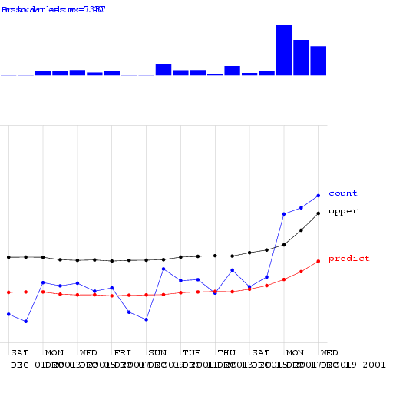
Moving Average

Slide 16
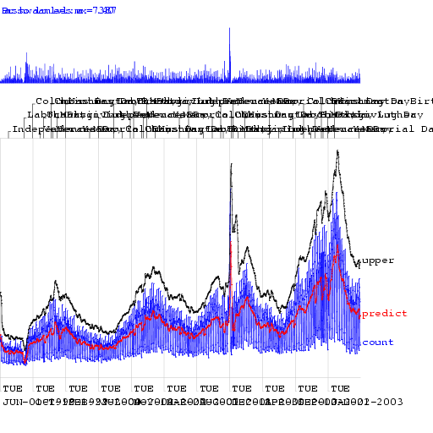
Moving Average

Slide 17
Moving Average
Looks better. But how can we be quantitative about this?

Slide 18
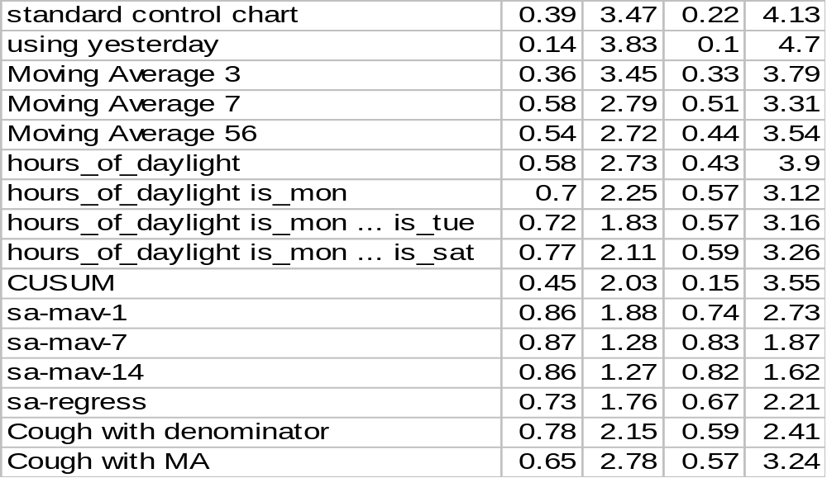
Algorithm Performance
Allowing one False Alarm per TWO weeks…
Allowing one False Alarm per SIX weeks…
Days to detect a ramp outbreak
Fraction of spikes detected
Days to detect a ramp outbreak
Fraction of spikes detected

Slide 19
Semi-synthetic data: spike outbreaks
1. Take a real time series
2. Add a spike of random height on a random date
3. See what alarm levels your algorithm gives on every day of the data
4. On what fraction of non-spike days is there an equal or higher alarm
Only one
5. That’s an example of the false positive rate this algorithm would need if it was going to detect the actual spike.

Slide 20
Semi-synthetic data: spike outbreaks
1. Take a real time series
2. Add a spike of random height on a random date
2. Add a spike of random height on a random date
2. Add a spike of random height on a random date
2. Add a spike of random height on a random date
2. Add a spike of random height on a random date
2. Add a spike of random height on a random date
2. Add a spike of random height on a random date
3. See what alarm levels your algorithm gives on every day of the data
4. On what fraction of non-spike days is there an equal or higher alarm
3. See what alarm levels your algorithm gives on every day of the data
4. On what fraction of non-spike days is there an equal or higher alarm
3. See what alarm levels your algorithm gives on every day of the data
4. On what fraction of non-spike days is there an equal or higher alarm
3. See what alarm levels your algorithm gives on every day of the data
4. On what fraction of non-spike days is there an equal or higher alarm
3. See what alarm levels your algorithm gives on every day of the data
4. On what fraction of non-spike days is there an equal or higher alarm
3. See what alarm levels your algorithm gives on every day of the data
4. On what fraction of non-spike days is there an equal or higher alarm
3. See what alarm levels your algorithm gives on every day of the data
4. On what fraction of non-spike days is there an equal or higher alarm
Only one
Do this 1000 times to get an average performance
Only one
Only one
Only one
Only one
Only one
5. That’s an example of the false positive rate this algorithm would need if it was going to detect the actual spike.
5. That’s an example of the false positive rate this algorithm would need if it was going to detect the actual spike.
5. That’s an example of the false positive rate this algorithm would need if it was going to detect the actual spike.
5. That’s an example of the false positive rate this algorithm would need if it was going to detect the actual spike.
5. That’s an example of the false positive rate this algorithm would need if it was going to detect the actual spike.
5. That’s an example of the false positive rate this algorithm would need if it was going to detect the actual spike.
5. That’s an example of the false positive rate this algorithm would need if it was going to detect the actual spike.

Slide 21
Semi-synthetic data: ramp outbreaks
1. Take a real time series
2. Add a ramp of random height on a random date
3. See what alarm levels your algorithm gives on every day of the data
4. If you allowed a specific false positive rate, how far into the ramp would you be before you signaled an alarm?

Slide 22
Semi-synthetic data: ramp outbreaks
1. Take a real time series
2. Add a ramp of random height on a random date
2. Add a ramp of random height on a random date
2. Add a ramp of random height on a random date
2. Add a ramp of random height on a random date
2. Add a ramp of random height on a random date
2. Add a ramp of random height on a random date
3. See what alarm levels your algorithm gives on every day of the data
4. If you allowed a specific false positive rate, how far into the ramp would you be before you signaled an alarm?
3. See what alarm levels your algorithm gives on every day of the data
4. If you allowed a specific false positive rate, how far into the ramp would you be before you signaled an alarm?
3. See what alarm levels your algorithm gives on every day of the data
4. If you allowed a specific false positive rate, how far into the ramp would you be before you signaled an alarm?
3. See what alarm levels your algorithm gives on every day of the data
4. If you allowed a specific false positive rate, how far into the ramp would you be before you signaled an alarm?
3. See what alarm levels your algorithm gives on every day of the data
4. If you allowed a specific false positive rate, how far into the ramp would you be before you signaled an alarm?
3. See what alarm levels your algorithm gives on every day of the data
4. If you allowed a specific false positive rate, how far into the ramp would you be before you signaled an alarm?
Do this 1000 times to get an average performance

Slide 23
Evaluation methods
All synthetic

Slide 24
Evaluation methods
All synthetic
  You can account for variation in the way the baseline will look.
  You can publish evaluation data and share results without data agreement problems
  You can easily generate large numbers of tests
  You know where the outbreaks are

Slide 25
Evaluation methods
All synthetic
  You can account for variation in the way the baseline will look.
  You can publish evaluation data and share results without data agreement problems
  You can easily generate large numbers of tests
  You know where the outbreaks are
  Your baseline data might be unrealistic

Slide 26
Evaluation methods
All synthetic
  You can account for variation in the way the baseline will look.
  You can publish evaluation data and share results without data agreement problems
  You can easily generate large numbers of tests
  You know where the outbreaks are
  Your baseline data might be unrealistic
Semi-Synthetic
  Can’t account for variation in the baseline.
  You can’t share data
  You can easily generate large numbers of tests
  You know where the outbreaks are

Slide 27
Evaluation methods
All synthetic
  You can account for variation in the way the baseline will look.
  You can publish evaluation data and share results without data agreement problems
  You can easily generate large numbers of tests
  You know where the outbreaks are
  Your baseline data might be unrealistic
Semi-Synthetic
  Can’t account for variation in the baseline.
  You can’t share data
  You can easily generate large numbers of tests
  You know where the outbreaks are
  Don’t know where the outbreaks aren’t

Slide 28
Evaluation methods
All synthetic
  You can account for variation in the way the baseline will look.
  You can publish evaluation data and share results without data agreement problems
  You can easily generate large numbers of tests
  You know where the outbreaks are
  Your baseline data might be unrealistic
Semi-Synthetic
  Can’t account for variation in the baseline.
  You can’t share data
  You can easily generate large numbers of tests
  You know where the outbreaks are
  Don’t know where the outbreaks aren’t
  Your baseline data is realistic

Slide 29
Evaluation methods
All synthetic
  You can account for variation in the way the baseline will look.
  You can publish evaluation data and share results without data agreement problems
  You can easily generate large numbers of tests
  You know where the outbreaks are
  Your baseline data might be unrealistic
Semi-Synthetic
  Can’t account for variation in the baseline.
  You can’t share data
  You can easily generate large numbers of tests
  You know where the outbreaks are
  Don’t know where the outbreaks aren’t
  Your baseline data is realistic
  Your outbreak data might be unrealistic

Slide 30
Evaluation methods
All synthetic
  You can account for variation in the way the baseline will look.
  You can publish evaluation data and share results without data agreement problems
  You can easily generate large numbers of tests
  You know where the outbreaks are
  Your baseline data might be unrealistic
Semi-Synthetic
  Can’t account for variation in the baseline.
  You can’t share data
  You can easily generate large numbers of tests
  You know where the outbreaks are
  Don’t know where the outbreaks aren’t
  Your baseline data is realistic
  Your outbreak data might be unrealistic
All real
  You can’t get many outbreaks to test
  You need experts to decide what is an outbreak
  Some kinds of outbreak have no available data
  You can’t share data

Slide 31
Evaluation methods
All synthetic
  You can account for variation in the way the baseline will look.
  You can publish evaluation data and share results without data agreement problems
  You can easily generate large numbers of tests
  You know where the outbreaks are
  Your baseline data might be unrealistic
Semi-Synthetic
  Can’t account for variation in the baseline.
  You can’t share data
  You can easily generate large numbers of tests
  You know where the outbreaks are
  Don’t know where the outbreaks aren’t
  Your baseline data is realistic
  Your outbreak data might be unrealistic
All real
  You can’t get many outbreaks to test
  You need experts to decide what is an outbreak
  Some kinds of outbreak have no available data
  You can’t share data
  Your baseline data is realistic
  Your outbreak data is realistic

Slide 32
Evaluation methods
All synthetic
  You can account for variation in the way the baseline will look.
  You can publish evaluation data and share results without data agreement problems
  You can easily generate large numbers of tests
  You know where the outbreaks are
  Your baseline data might be unrealistic
Semi-Synthetic
  Can’t account for variation in the baseline.
  You can’t share data
  You can easily generate large numbers of tests
  You know where the outbreaks are
  Don’t know where the outbreaks aren’t
  Your baseline data is realistic
  Your outbreak data might be unrealistic
All real
  You can’t get many outbreaks to test
  You need experts to decide what is an outbreak
  Some kinds of outbreak have no available data
  You can’t share data
  Your baseline data is realistic
  Your outbreak data is realistic
  Is the test typical?

Slide 33
Evaluation methods
All synthetic
  You can account for variation in the way the baseline will look.
  You can publish evaluation data and share results without data agreement problems
  You can easily generate large numbers of tests
  You know where the outbreaks are
  Your baseline data might be unrealistic
Semi-Synthetic
  Can’t account for variation in the baseline.
  You can’t share data
  You can easily generate large numbers of tests
  You know where the outbreaks are
  Don’t know where the outbreaks aren’t
  Your baseline data is realistic
  Your outbreak data might be unrealistic
All real
  You can’t get many outbreaks to test
  You need experts to decide what is an outbreak
  Some kinds of outbreak have no available data
  You can’t share data
  Your baseline data is realistic
  Your outbreak data is realistic
  Is the test typical?
None of these options is satisfactory.
Evaluation of Biosurveillance algorithms is really hard. It has got to be. This is a real problem, and we must learn to live with it.

Slide 34
Algorithm Performance
Allowing one False Alarm per TWO weeks…
Allowing one False Alarm per SIX weeks…
Days to detect a ramp outbreak
Fraction of spikes detected
Days to detect a ramp outbreak
Fraction of spikes detected

Slide 35
Algorithm Performance
Allowing one False Alarm per TWO weeks…
Allowing one False Alarm per SIX weeks…
Days to detect a ramp outbreak
Fraction of spikes detected
Days to detect a ramp outbreak
Fraction of spikes detected

Slide 36
Seasonal Effects
Signal
Time
Fit a periodic function (e.g. sine wave) to previous data. Predict today’s signal and 3-sigma confidence intervals. Signal an alarm if we’re off.
Reduces False alarms from Natural outbreaks.
Different times of year deserve different thresholds.

Slide 37
Algorithm Performance
Allowing one False Alarm per TWO weeks…
Allowing one False Alarm per SIX weeks…
Days to detect a ramp outbreak
Fraction of spikes detected
Days to detect a ramp outbreak
Fraction of spikes detected

Slide 38
Day-of-week effects
Fit a day-of-week component
E[Signal] = a + delta_{day}
E.G: delta_{mon}= +5.42, delta_{tue}= +2.20, delta_{wed}= +3.33, delta_{thu}= +3.10, delta_{fri}= +4.02, delta_{sat}= -12.2, delta_{sun}= -23.42
A simple form of ANOVA

Slide 39

Regression using Hours-in-day & IsMonday

Slide 40
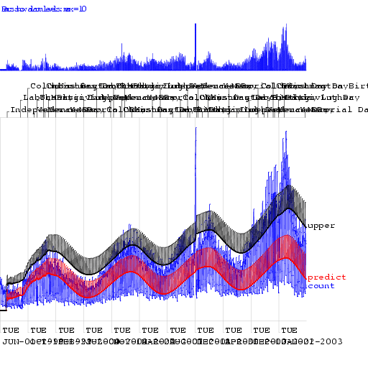
Regression using Hours-in-day & IsMonday

Slide 41
Algorithm Performance
Allowing one False Alarm per TWO weeks…
Allowing one False Alarm per SIX weeks…
Days to detect a ramp outbreak
Fraction of spikes detected
Days to detect a ramp outbreak
Fraction of spikes detected

Slide 42
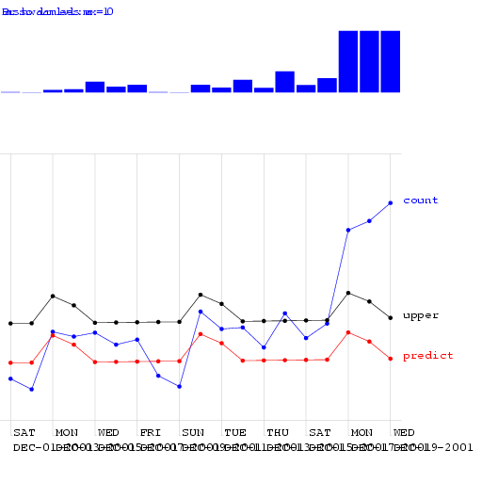
Regression using Mon-Tue

Slide 43
Algorithm Performance
Allowing one False Alarm per TWO weeks…
Allowing one False Alarm per SIX weeks…
Days to detect a ramp outbreak
Fraction of spikes detected
Days to detect a ramp outbreak
Fraction of spikes detected

Slide 44
CUSUM
CUmulative SUM Statistics
Keep a running sum of “surprises”: a sum of excesses each day over the prediction
When this sum exceeds threshold, signal alarm and reset sum

Slide 45
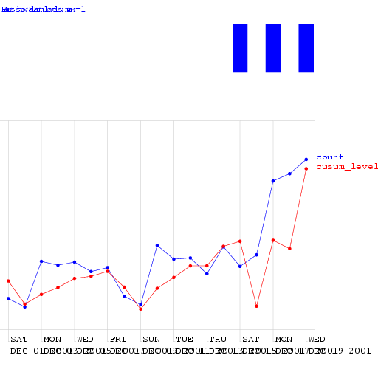
CUSUM

Slide 46
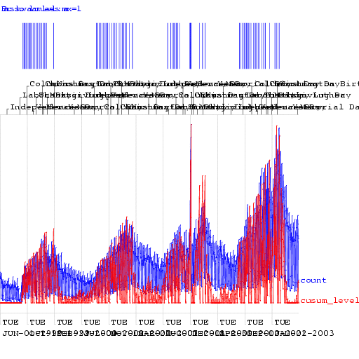
CUSUM

Slide 47
Algorithm Performance
Allowing one False Alarm per TWO weeks…
Allowing one False Alarm per SIX weeks…
Days to detect a ramp outbreak
Fraction of spikes detected
Days to detect a ramp outbreak
Fraction of spikes detected

Slide 48
The Sickness/Availability Model

Slide 49
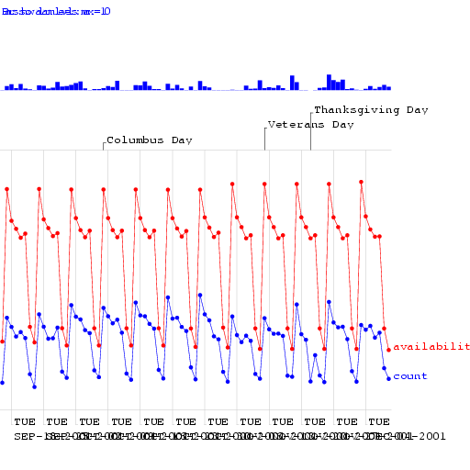
The Sickness/Availability Model

Slide 50
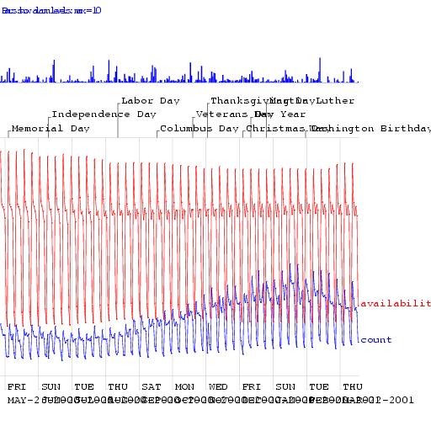
The Sickness/Availability Model

Slide 51
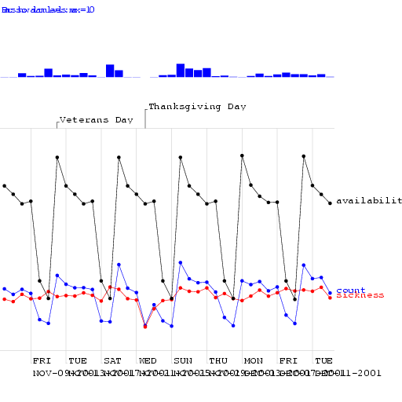
The Sickness/Availability Model

Slide 52
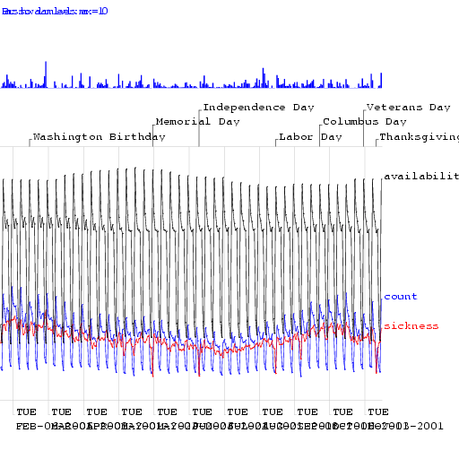
The Sickness/Availability Model

Slide 53
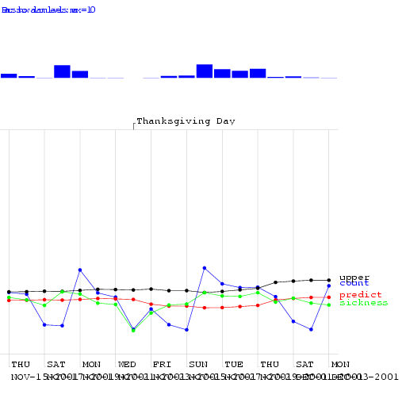
The Sickness/Availability Model

Slide 54
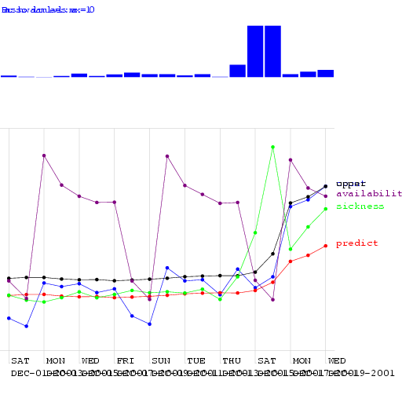
The Sickness/Availability Model

Slide 55
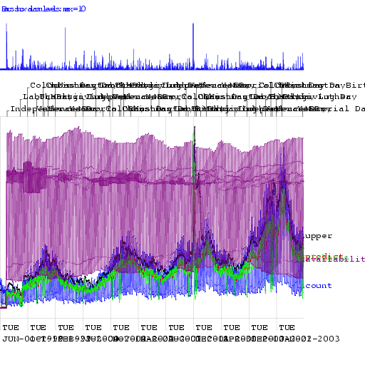
The Sickness/Availability Model

Slide 56
Algorithm Performance
Allowing one False Alarm per TWO weeks…
Allowing one False Alarm per SIX weeks…
Days to detect a ramp outbreak
Fraction of spikes detected
Days to detect a ramp outbreak
Fraction of spikes detected

Slide 57
Algorithm Performance
Allowing one False Alarm per TWO weeks…
Allowing one False Alarm per SIX weeks…
Days to detect a ramp outbreak
Fraction of spikes detected
Days to detect a ramp outbreak
Fraction of spikes detected

Slide 58
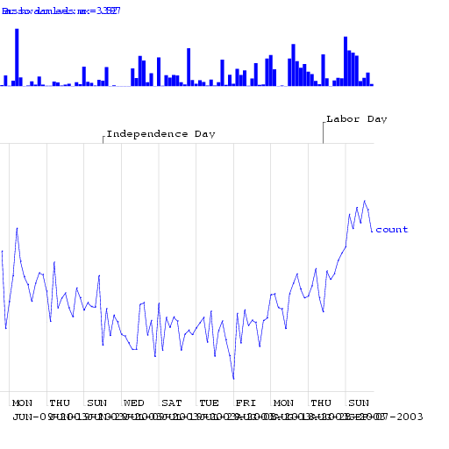
Exploiting Denominator Data

Slide 59
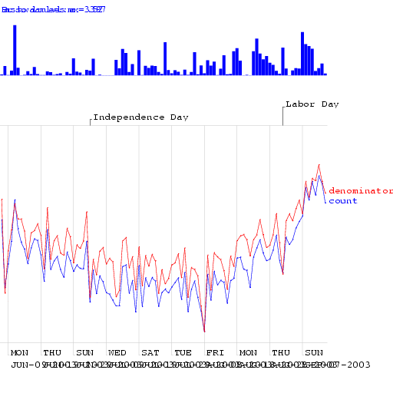
Exploiting Denominator Data

Slide 60
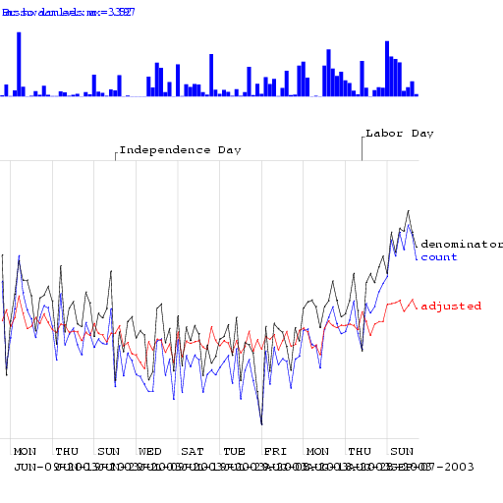
Exploiting Denominator Data

Slide 61
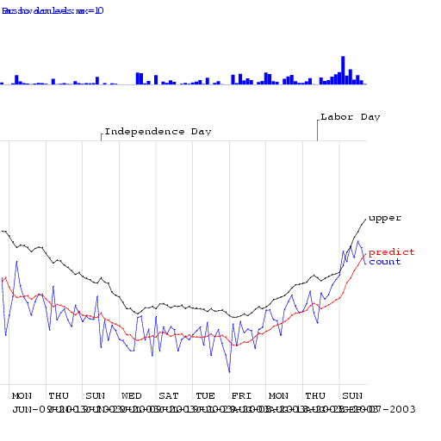
Exploiting Denominator Data

Slide 62
Algorithm Performance
Allowing one False Alarm per TWO weeks…
Allowing one False Alarm per SIX weeks…
Days to detect a ramp outbreak
Fraction of spikes detected
Days to detect a ramp outbreak
Fraction of spikes detected

Slide 63
Show Walkerton Results

Slide 64
Other state-of-the-art methods
Wavelets
Change-point detection
Kalman filters
Hidden Markov Models

