Slide 1
VC-dimension for characterizing classifiers
Andrew W. Moore
Associate Professor
School of Computer Science
Carnegie Mellon University
www.cs.cmu.edu/~awm
awm@cs.cmu.edu
412-268-7599
Note to other teachers and users of these slides. Andrew would be delighted if you found this source material useful in giving your own lectures. Feel free to use these slides verbatim, or to modify them to fit your own needs. PowerPoint originals are available. If you make use of a significant portion of these slides in your own lecture, please include this message, or the following link to the source repository of Andrew’s tutorials: http://www.cs.cmu.edu/~awm/tutorials . Comments and corrections gratefully received.

Slide 2
A learning machine
A learning machine f takes an input x and transforms it, somehow using weights α, into a predicted output y^{est} = +/- 1
α
α is some vector of adjustable parameters
x
f
y^{est}

Slide 3
Examples
α
x
f
y^{est}
f(x,b) = sign(x.x – b)
denotes +1
denotes -1

Slide 4
Examples
α
x
f
y^{est}
f(x,w) = sign(x.w)
denotes +1
denotes -1

Slide 5
Examples
α
x
f
y^{est}
f(x,w,b) = sign(x.w+b)
denotes +1
denotes -1

Slide 6
How do we characterize “power”?
Different machines have different amounts of “power”.
Tradeoff between:
  More power: Can model more complex classifiers but might overfit.
  Less power: Not going to overfit, but restricted in what it can model.
How do we characterize the amount of power?

Slide 7
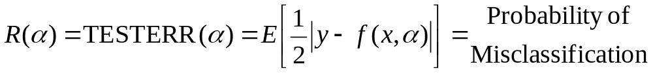
Some definitions
Given some machine f
And under the assumption that all training points (x_{k},y_{k}) were drawn i.i.d from some distribution.
And under the assumption that future test points will be drawn from the same distribution
Define
Official terminology
Terminology we’ll use

Slide 8
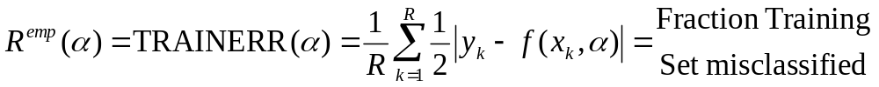
Some definitions
Given some machine f
And under the assumption that all training points (x_{k},y_{k}) were drawn i.i.d from some distribution.
And under the assumption that future test points will be drawn from the same distribution
Define
Official terminology
Terminology we’ll use
R = #training set data points

Slide 9
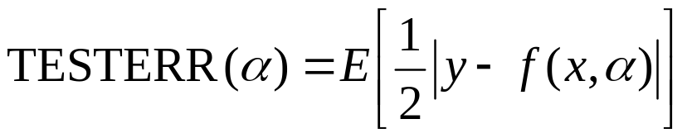
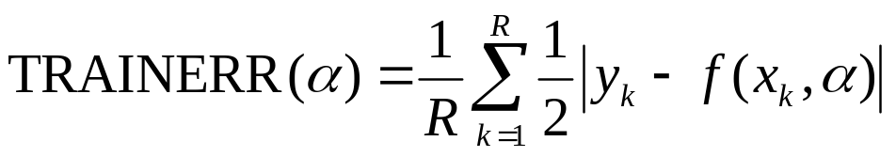
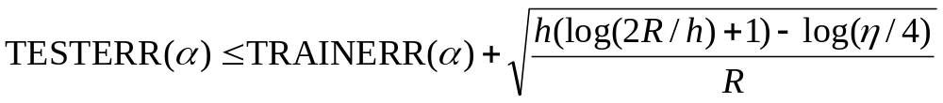
Vapnik-Chervonenkis dimension
Given some machine f, let h be its VC dimension.
h is a measure of f’s power (h does not depend on the choice of training set)
Vapnik showed that with probability 1-η
This gives us a way to estimate the error on future data based only on the training error and the VC-dimension of f

Slide 10
What VC-dimension is used for
Given some machine f, let h be its VC dimension.
h is a measure of f’s power.
Vapnik showed that with probability 1-η
But given machine f, how do we define and compute h?
This gives us a way to estimate the error on future data based only on the training error and the VC-dimension of f

Slide 11
Shattering
Machine f can shatter a set of points x₁, x₂ .. x_{r} if and only if…
  For every possible training set of the form (x₁,y₁) , (x₂,y₂) ,… (x_{r} ,y_{r})
  …There exists some value of α that gets zero training error.
There are 2^{r} such training sets to consider, each with a different combination of +1’s and –1’s for the y’s

Slide 12
Shattering
Machine f can shatter a set of points x₁, x₂ .. X_{r} if and only if…
  For every possible training set of the form (x₁,y₁) , (x₂,y₂) ,… (x_{r} ,y_{r})
  …There exists some value of α that gets zero training error.
Question: Can the following f shatter the following points?
f(x,w) = sign(x.w)

Slide 13
Shattering
Machine f can shatter a set of points x₁, x₂ .. X_{r} if and only if…
  For every possible training set of the form (x₁,y₁) , (x₂,y₂) ,… (x_{r} ,y_{r})
  …There exists some value of α that gets zero training error.
Question: Can the following f shatter the following points?
f(x,w) = sign(x.w)
Answer: No problem. There are four training sets to consider
w=(0,1)
w=(-2,3)
w=(2,-3)
w=(0,-1)

Slide 14
Shattering
Machine f can shatter a set of points x₁, x₂ .. X_{r} if and only if…
  For every possible training set of the form (x₁,y₁) , (x₂,y₂) ,… (x_{r} ,y_{r})
  …There exists some value of α that gets zero training error.
Question: Can the following f shatter the following points?
f(x,b) = sign(x.x-b)

Slide 15
Shattering
Machine f can shatter a set of points x₁, x₂ .. X_{r} if and only if…
  For every possible training set of the form (x₁,y₁) , (x₂,y₂) ,… (x_{r} ,y_{r})
  …There exists some value of α that gets zero training error.
Question: Can the following f shatter the following points?
f(x,b) = sign(x.x-b)
Answer: No way my friend.

Slide 16
Definition of VC dimension
Given machine f, the VC-dimension h is
  The maximum number of points that can be arranged so that f shatter them.
Example: What’s VC dimension of f(x,b) = sign(x.x-b)

Slide 17
VC dim of trivial circle
Given machine f, the VC-dimension h is
  The maximum number of points that can be arranged so that f shatter them.
Example: What’s VC dimension of f(x,b) = sign(x.x-b)
  Answer = 1: we can’t even shatter two points! (but it’s clear we can shatter 1)

Slide 18
Reformulated circle
Given machine f, the VC-dimension h is
  The maximum number of points that can be arranged so that f shatter them.
Example: For 2-d inputs, what’s VC dimension of f(x,q,b) = sign(qx.x-b)

Slide 19
Reformulated circle
Given machine f, the VC-dimension h is
  The maximum number of points that can be arranged so that f shatter them.
Example: What’s VC dimension of f(x,q,b) = sign(qx.x-b)
Answer = 2
q,b are -ve

Slide 20
Reformulated circle
Given machine f, the VC-dimension h is
  The maximum number of points that can be arranged so that f shatter them.
Example: What’s VC dimension of f(x,q,b) = sign(qx.x-b)
Answer = 2 (clearly can’t do 3)
q,b are -ve

Slide 21
VC dim of separating line
Given machine f, the VC-dimension h is
  The maximum number of points that can be arranged so that f shatter them.
Example: For 2-d inputs, what’s VC-dim of f(x,w,b) = sign(w.x+b)?
Well, can f shatter these three points?

Slide 22
VC dim of line machine
Given machine f, the VC-dimension h is
  The maximum number of points that can be arranged so that f shatter them.
Example: For 2-d inputs, what’s VC-dim of f(x,w,b) = sign(w.x+b)?
Well, can f shatter these three points?
Yes, of course.
All -ve or all +ve is trivial
One +ve can be picked off by a line
One -ve can be picked off too.

Slide 23
VC dim of line machine
Given machine f, the VC-dimension h is
  The maximum number of points that can be arranged so that f shatter them.
Example: For 2-d inputs, what’s VC-dim of f(x,w,b) = sign(w.x+b)?
Well, can we find four points that f can shatter?

Slide 24
VC dim of line machine
Given machine f, the VC-dimension h is
  The maximum number of points that can be arranged so that f shatter them.
Example: For 2-d inputs, what’s VC-dim of f(x,w,b) = sign(w.x+b)?
Well, can we find four points that f can shatter?
Can always draw six lines between pairs of four points.

Slide 25
VC dim of line machine
Given machine f, the VC-dimension h is
  The maximum number of points that can be arranged so that f shatter them.
Example: For 2-d inputs, what’s VC-dim of f(x,w,b) = sign(w.x+b)?
Well, can we find four points that f can shatter?
Can always draw six lines between pairs of four points.
Two of those lines will cross.

Slide 26
VC dim of line machine
Given machine f, the VC-dimension h is
  The maximum number of points that can be arranged so that f shatter them.
Example: For 2-d inputs, what’s VC-dim of f(x,w,b) = sign(w.x+b)?
Well, can we find four points that f can shatter?
Can always draw six lines between pairs of four points.
Two of those lines will cross.
If we put points linked by the crossing lines in the same class they can’t be linearly separated
So a line can shatter 3 points but not 4
So VC-dim of Line Machine is 3

Slide 27
VC dim of linear classifiers in m-dimensions
If input space is m-dimensional and if f is sign(w.x-b), what is the VC-dimension?
Proof that h >= m: Show that m points can be shattered
Can you guess how?

Slide 28
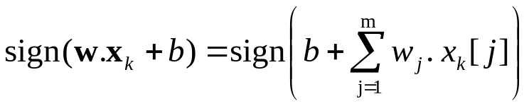
VC dim of linear classifiers in m-dimensions
If input space is m-dimensional and if f is sign(w.x-b), what is the VC-dimension?
Proof that h >= m: Show that m points can be shattered
Define m input points thus:
  x₁ = (1,0,0,…,0)
  x₂ = (0,1,0,…,0)
  :
  x_{m} = (0,0,0,…,1) So x_{k}[j] = 1 if k=j and 0 otherwise
Let y₁, y₂,… y_{m} , be any one of the 2^{m} combinations of class labels.
Guess how we can define w₁, w₂,… w_{m} and b to ensure sign(w. x_{k} + b) = y_{k} for all k ? Note:

Slide 29
VC dim of linear classifiers in m-dimensions
If input space is m-dimensional and if f is sign(w.x-b), what is the VC-dimension?
Proof that h >= m: Show that m points can be shattered
Define m input points thus:
  x₁ = (1,0,0,…,0)
  x₂ = (0,1,0,…,0)
  :
  x_{m} = (0,0,0,…,1) So x_{k}[j] = 1 if k=j and 0 otherwise
Let y₁, y₂,… y_{m} , be any one of the 2^{m} combinations of class labels.
Guess how we can define w₁, w₂,… w_{m} and b to ensure sign(w. x_{k} + b) = y_{k} for all k ? Note:
Answer: b=0 and w_{k} = y_{k} for all k.

Slide 30
VC dim of linear classifiers in m-dimensions
If input space is m-dimensional and if f is sign(w.x-b), what is the VC-dimension?
Now we know that h >= m
In fact, h=m+1
Proof that h >= m+1 is easy
Proof that h < m+2 is moderate

Slide 31
What does VC-dim measure?
Is it the number of parameters?
        Related but not really the same.
I can create a machine with one numeric parameter that really encodes 7 parameters (How?)
And I can create a machine with 7 parameters which has a VC-dim of 1 (How?)
Andrew’s private opinion: it often is the number of parameters that counts.

Slide 32
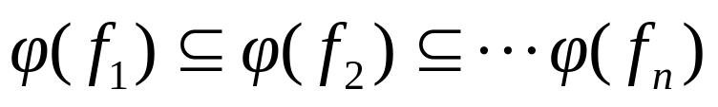
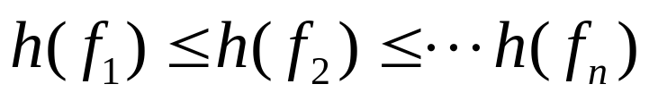
Structural Risk Minimization
Let φ(f) = the set of functions representable by f.
Suppose
Then (Hey, can you formally prove this?)
We’re trying to decide which machine to use.
We train each machine and make a table…
i | f_{i} | TRAINERR | VC-Conf | Probable upper bound on TESTERR | Choice
1 | f₁
2 | f₂
3 | f₃ |  |  |  | 
4 | f₄
5 | f₅
6 | f₆

Slide 33
Using VC-dimensionality
That’s what VC-dimensionality is about
People have worked hard to find VC-dimension for..
  Decision Trees
  Perceptrons
  Neural Nets
  Decision Lists
  Support Vector Machines
  And many many more
All with the goals of
  Understanding which learning machines are more or less powerful under which circumstances
  Using Structural Risk Minimization for to choose the best learning machine

Slide 34
Alternatives to VC-dim-based model selection
What could we do instead of the scheme below?
i | f_{i} | TRAINERR | VC-Conf | Probable upper bound on TESTERR | Choice
1 | f₁
2 | f₂
3 | f₃ |  |  |  | 
4 | f₄
5 | f₅
6 | f₆

Slide 35
Alternatives to VC-dim-based model selection
What could we do instead of the scheme below?
  Cross-validation
i | f_{i} | TRAINERR | 10-FOLD-CV-ERR | Choice
1 | f₁
2 | f₂
3 | f₃ |  |  | 
4 | f₄
5 | f₅
6 | f₆

Slide 36
Alternatives to VC-dim-based model selection
What could we do instead of the scheme below?
  Cross-validation
  AIC (Akaike Information Criterion)
As the amount of data goes to infinity, AIC promises* to select the model that’ll have the best likelihood for future data
*Subject to about a million caveats
i | f_{i} | LOGLIKE(TRAINERR) | #parameters | AIC | Choice
1 | f₁
2 | f₂
3 | f₃
4 | f₄ |  |  |  | 
5 | f₅
6 | f₆

Slide 37
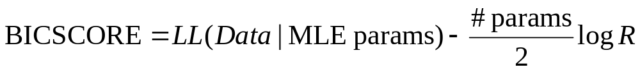
Alternatives to VC-dim-based model selection
What could we do instead of the scheme below?
  Cross-validation
  AIC (Akaike Information Criterion)
  BIC (Bayesian Information Criterion)
As the amount of data goes to infinity, BIC promises* to select the model that the data was generated from. More conservative than AIC.
*Another million caveats
i | f_{i} | LOGLIKE(TRAINERR) | #parameters | BIC | Choice
1 | f₁
2 | f₂
3 | f₃ |  |  |  | 
4 | f₄
5 | f₅
6 | f₆

Slide 38
Which model selection method is best?
  (CV) Cross-validation
  AIC (Akaike Information Criterion)
  BIC (Bayesian Information Criterion)
  (SRMVC) Structural Risk Minimize with VC-dimension
AIC, BIC and SRMVC have the advantage that you only need the training error.
CV error might have more variance
SRMVC is wildly conservative
Asymptotically AIC and Leave-one-out CV should be the same
Asymptotically BIC and a carefully chosen k-fold should be the same
BIC is what you want if you want the best structure instead of the best predictor (e.g. for clustering or Bayes Net structure finding)
Many alternatives to the above including proper Bayesian approaches.
It’s an emotional issue.

Slide 39
Extra Comments
Beware: that second “VC-confidence” term is usually very very conservative (at least hundreds of times larger than the empirical overfitting effect).
An excellent tutorial on VC-dimension and Support Vector Machines (which we’ll be studying soon):
    C.J.C. Burges. A tutorial on support vector machines for pattern recognition. Data Mining and Knowledge Discovery, 2(2):955-974, 1998. http://citeseer.nj.nec.com/burges98tutorial.html

Slide 40
What you should know
The definition of a learning machine: f(x,α)
The definition of Shattering
Be able to work through simple examples of shattering
The definition of VC-dimension
Be able to work through simple examples of VC-dimension
Structural Risk Minimization for model selection
Awareness of other model selection methods

