Slide 1
Homophily
Social Network Analysis, Lecture 7
E&K 4
AAIT ITSC Spring 2018
Instructor: Stephen Wu

Slide 2
Today… Homophily!
Before: Networks as graphs, Graph theory, Random graphs
Today: Homophily
Mechanisms
Affiliation

Slide 3
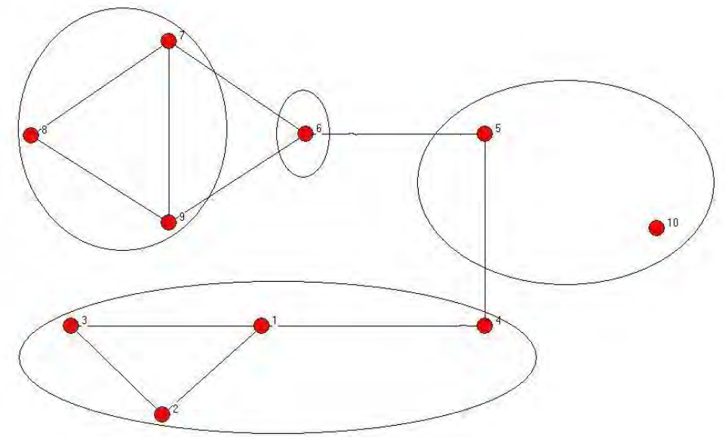
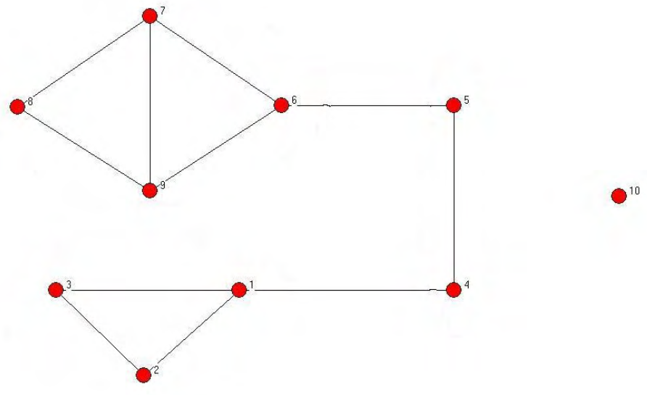
Review: Community structure
defined on nodes/vertices
Dfn: A community structure, ∏, is a collection of disjoint subsets of V (i.e., a partition) whose union is V.

Slide 4
Grouping by similarity…
Homophily: we tend to be similar to our friends
Plato: “similarity begets friendship”
Aristotle: people “love those who are like themselves”
Intrinsic causes, e.g., triadic closure
Extrinsic causes, e.g., affiliation

Slide 5
Measuring homophily
Pick a characteristic, e.g., ethnicity
Does that kind of similarity matter?
… links more likely than random?
Possible results:
Not significant
Homophily (signif. more likely links)
Inverse homophily (signif. less likely)

Slide 6
Example: Childhood friendships
Edges:
P(M:M edge) = p²
P(F:F edge) = q²
P(M:F edge) = 2pq
Test: if heterogeneous edges are significantly less than 2pq, we have homophily!
= male, proportion p
= female, proportion q

Slide 7
Individual Exercise:
Does this graph show homophily by gender?
= male, proportion p
= female, proportion q
Notes:
p = 6/9 = 2/3
q = 3/9 = 1/3
2pq = 2/9 = .222
5/16 = .3125 edges are heterogeneous => YES

Slide 8
Model of Spatial Segregation
Schelling Model

Slide 9
Schelling Model (1972, 1978)
Simpl. 1: people=agents in 2 groups
Simpl. 2: space=grid (8 neighbors)
Simpl. 3: time in rounds
Homophily constraint
Agents need threshold in-group neighbors
Else “discontent” – will move in next round
1 | 2 | 3
4 |  | 5
6 | 7 | 8
* “models are always wrong, but sometimes they can be useful”

Slide 10
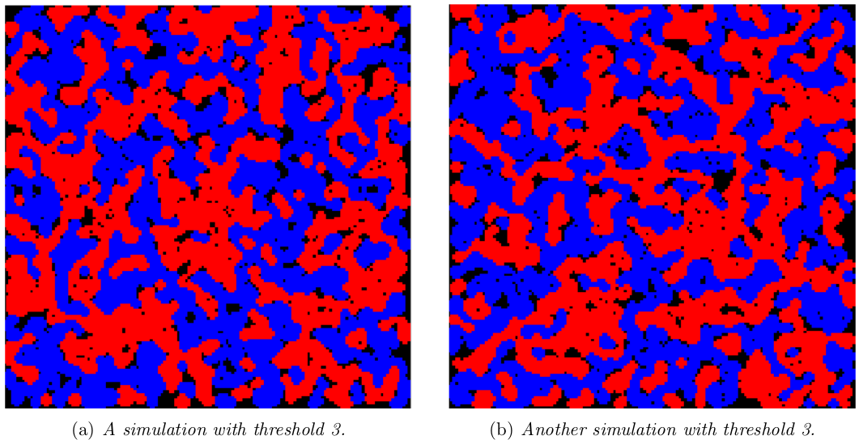
Local homophily → Global effect
150x150 grid, 100k blue, 100k red,
Threshold = 3

Slide 11
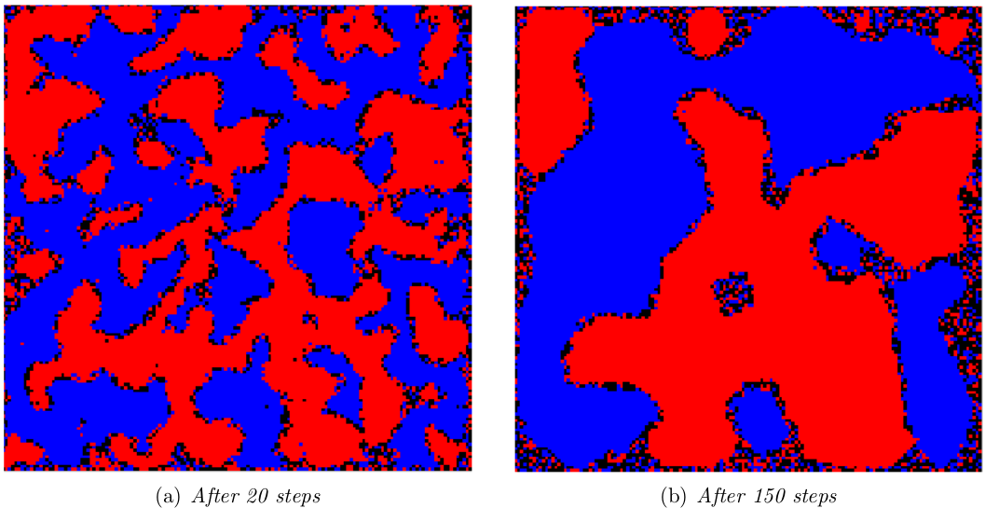
Local homophily → Global effect
150x150 grid, 100k blue, 100k red,
Threshold = 4
Individual desires for homophily have global effect!

Slide 12
Mechanisms of homophily

Slide 13
Group Discussion:
Is there homophily because
people form friendships with those like them?
people change & become like those around them?
selection
socialization/social influence

Slide 14
Selection v. Social Influence
Selecting similar friends
Characteristics shape network
Intentional: e.g., at a social gathering
Systemic: e.g., physical neighborhood
Socialization/social influence
Network shapes characteristics
Nodes are mutable (changeable)

Slide 15
What’s at play in Homophily?
Nuanced… unfolding over time, which characteristic, etc.
How to study this?
Longitudinal studies! How did behavior change…
before/after joining a “group”
as neighbors’ behavior changed

Slide 16
Example: Homophily & Health?
Obesity study (Christakis & Fowler 2007)
12,000 people, 32 year
Obese vs. non-Obese clusters (homophily!)
Hypotheses for cause
Selection: friendships form between similar obesity status
Socialization: changes in obesity status influence friends’ obesity status
Confounding: Homophily explained by other characteristics

Slide 17
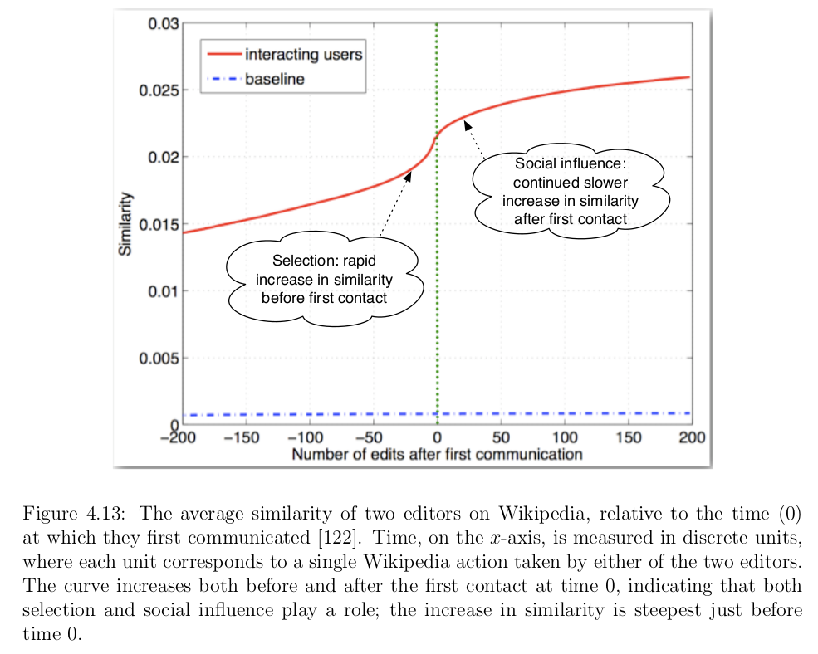
Example: Wikipedia editors
Similarity: overlap in editing topics (y-axis)
Time 0: editors message each other

Slide 18
Group Discussion:
Situation: You’re a public health officer who notes that the use of illegal drugs has increased among some clusters of people (that exhibit homophily) in your area.
So you design a health intervention to stop the use of illegal drugs. Because of your limited resources, you’re directly interacting with relatively few people, then hoping for those people to change their behavior and then be “change” agents.
Question: Is the health intervention more likely to be successful if the homophily of drug users is based on
(a) Selection
(b) Socialization
Why?

Slide 19
Affiliation

Slide 20
Extrinsic node properties – Foci
Intrinsic (to graph) only – incomplete picture!
Foci (focal points of activity) are
“social, psychological, legal, or physical entit[ies] around which joint activities are organized”
Not on typical Social Network graph
Subsets of V
Many/overlapping possible!

Slide 21
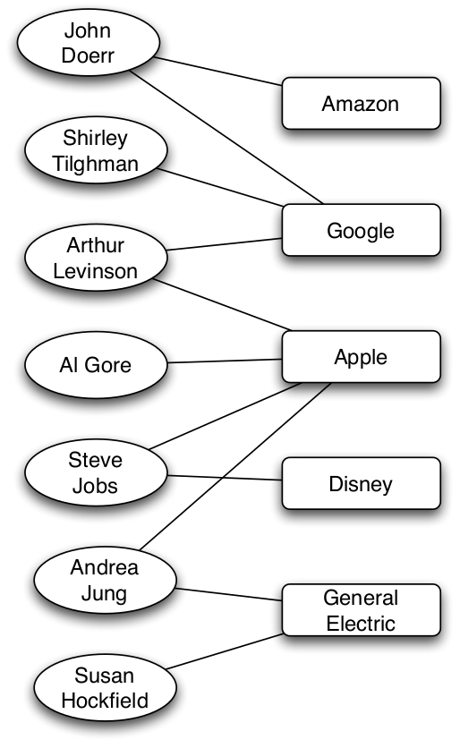
Affiliation networks
G=(V₁, V₂, E), where E=(v₁, v₂)
Bipartite graphs: only connections across 2 types of nodes
nodes
(here: people)
foci
(here: company board of directors)
What about node-node links?
member-of

Slide 22
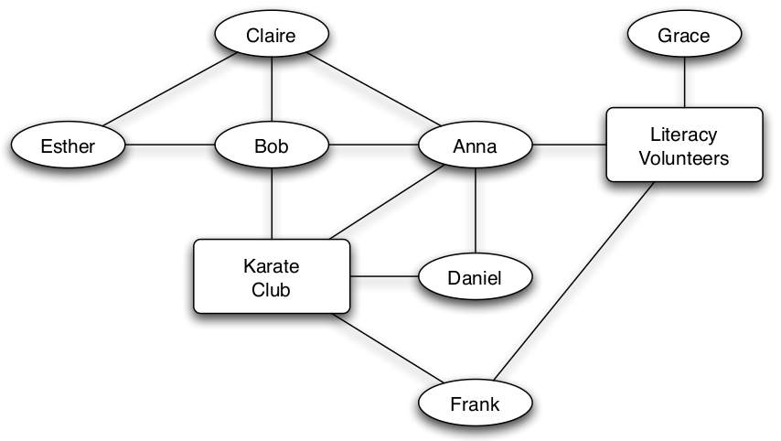
Social-Affiliation Networks
Affiliation networks: had 2 types of nodes
Social-Affiliation networks: also 2 types of edges

Slide 23
3 types of Closure
Triadic closure:
person => person:person
Focal closure:
focus => person:person
Membership closure:
person => focus:person

Slide 25
Announcements
Academic Dishonesty: plagiarism or cheating will receive a score of “0” on an assignment/exam for the first penalty, and a 1-year suspension for the second.
Midterm 1: Raw: mean= 45.3. Curve was y=(x-35)* 45/29 + 45, matching the span to AAU letter grades.
“Drop”-rejected students: Absences will be excused and assignment extensions granted.
Late Assignments: All assignments must be submitted to pass the class.
Lecture Schedule: Mon @ 1:30pm = 7:30 ሰአት.
No-lab 17th or 24th May: Lab will not meet, as I will be traveling.
Guest lecture 21st May: Dr. Sunkari will give a guest lecture at the regular 1:30pm time on 21st May covering “Contagion.” Attendance will be taken.

