Slide 1
Growing Networks
Social Network Analysis, Lecture 8
MOJ 5
AAIT ITSC Spring 2018
Instructor: Stephen Wu

Slide 2
Outline
Before: Networks as graphs, Graph theory, Random graphs, Homophily
Temporal analysis necessary
Today: Growing random networks, exhibit life-like characteristics?
Preferential attachment
Assortativity and degree correlation
Clustering

Slide 3
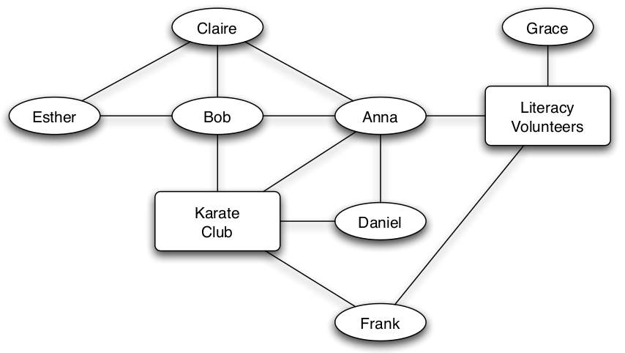
Background: New links over time
Triadic closure:
person => person:person
Focal closure:
focus => person:person
Membership closure:
person => focus:person
Social-Affiliation Graph

Slide 4
What about new nodes?
Pre-existing network: m connected nodes
At “birth”:
Index node’s “birth order” = i
Node i gets d_{i}(i) links at random
Later, at time t:
# New links = d_{i}(t) - d_{i}(i)

Slide 5
Properties of real networks…
In a growing random network model… Express realistic properties?
Nodes aren’t equally likely to link
Low diameters
High Clustering

Slide 6
Group Discussion:
For a new node i, how would you pick nodes that i should link to at birth?

Slide 7
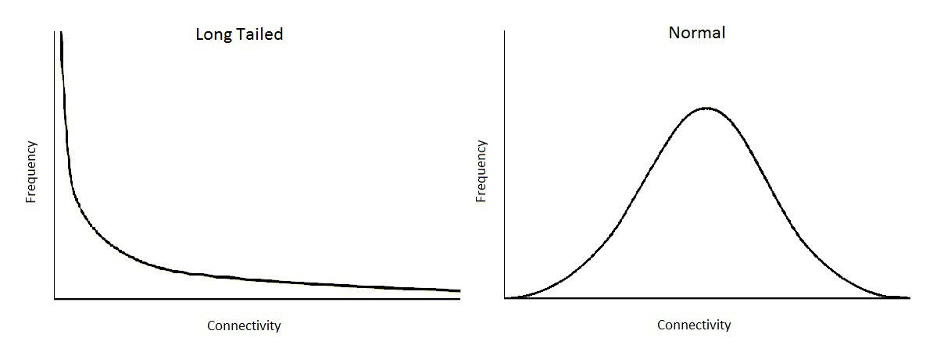
Preferential Attachment (Barabasi & Albert 1999)
Idea: Nodes of high degree are more likely to form new links
Ex: Well-cited scientific papers more likely to be read & cited (Price 1976)
{long,fat,heavy}-tail/scale-free distr.
A few rich get richer
Long tail of “poor”
Image credit: Pender, Casey. The Long-tailed Network Structure of Trade. In Blog: PPE.life. 2017. Blog: http://ppe.life/long-tailed-trade/.

Slide 8
Pref. attachment on a Graph
New node is “born”; link to node i?
Expected degree of i:
(Using the mean-field approximation)
Freq. distr. of degree:
probability is proportionate to node degree
new node will make m connections
total # links * 2
(At time t: = 2 tm)

Slide 9
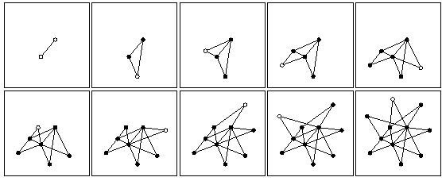
What pref. attachment gets you
Long-tail degree distribution
Older nodes have highest degrees
Not always precise in practice (e.g., article citations)
→ Hybrid models: random uniform + pref. attach.

Slide 10
Diameter in pref. attachment
Proposition: (Bollobas & Riordan 2002)
In a preferential attachment model where each newborn node forms m≥2 links,
as n grows the resulting network will consist of a single component with diameter proportional to
log(n)/(log log(n)),
almost surely.
Poisson: proportional to log(n).
→ Pref. attach: lower diameter

Slide 11
Degree Assortativity

Slide 12
Group Discussion
Do you expect a node to connect to other nodes that have a similar node degree, or different?
(e.g., high degree nodes connect with other high degree nodes)
Real networks: SIMILAR!
→ Assortativity

Slide 13
Assortativity
Prob that i has degree d is at least as high (and at least once higher) than j
Nodes’ and their neighbors’ degrees are positively correlated
Proposition: On average…
Node i’s degree is larger than node j’s degree at time t after both are born …
if and only if i is older than j.
In that case, the estimated distribution of i’s neighbors’ degrees
strictly first order stochastically dominates
that of j’s at each time t > j, and in particular for all d < d_{i}(t).

Slide 14
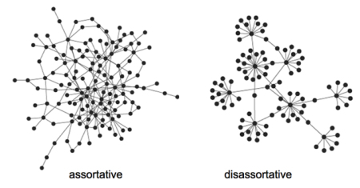
Ex: Assortativity

Slide 15
Clustering in Growing networks

Slide 16
Simple process → clustering
New node chooses to link to node j (prob p)
Next:
Follow from node j to another node with prob q
Or jump to new node with prob 1-q

Slide 17
Group Discussion:
New node chooses to link to node j (prob p)
Next:
Follow from node j to another node with prob q
Or jump to new node with prob 1-q
What happens if q=0?
If q=1?
Notes:
q=0 => uniformly random attachment
q=1 => 1st node random, rest found via network

Slide 18
Announcements
No lab 17th or 24th May: Lab will not meet, as I will be traveling. Use this time to complete Assignment 4.
Guest lecture 21st May: Dr. Sunkari will give a guest lecture at the regular 1:30pm time on 21st May covering “Contagion.” Attendance will be taken.
Academic Dishonesty: plagiarism or cheating will receive a score of “0” on an assignment/exam for the first penalty, and a 1-year suspension for the second.
Midterm 1: Raw: mean= 45.3. Curve was y=(x-35)* 45/29 + 45, matching the span to AAU letter grades.
Late Assignments: All assignments must be submitted to pass the class.

