Slide 1
Information Cascades
Social Network Analysis, Lecture 9
E&K 19
AAIT ITSC Spring 2018
Instructor: Stephen Wu

Slide 2
Outline
Before: Growing graphs over time
Today: How information spreads
Introduction
Simple model & Cascades
How cascades stop
Weak ties in cascades

Slide 3
Background: Growing networks
Pre-existing network: m connected nodes
New nodes! At “birth”:
Index node’s “birth order” = i
Node i gets d_{i}(i) links at random
Later, at time t:
# New links = d_{i}(t) - d_{i}(i)

Slide 4
How do things spread within a network?
Ex: How do videos go viral?
Ex: How do people develop religious or political philosophy?
Ex: How are healthy behaviors adopted in rural communities?
Ex: Which technology products succeed, and which die out?
Focus on the local: me & friends

Slide 5
Early studies
Ryan & Gross 1943
Coleman, Katz, Menzel 1966
Farmers: Why adopt a new type of corn seeds?
Heard about from salesmen
Adopted because of peers’ experience
Doctors: Why adopt a new treatment medication?
Early adopters: “bridges” of high SES
Adopted because of community

Slide 6
“Diffusion of Innovations”
What innovations? E.g., A vs. B
New behaviors, practices, opinions, conventions, technologies, etc.
Principles (Everett 1995)
Relative advantage: A better than B?
Complexity: Easy to understand?
Observability: See it?
Trialability: Try it out?
Compatibility: Fit with social context?

Slide 7
A Simple model of Information Diffusion

Slide 8
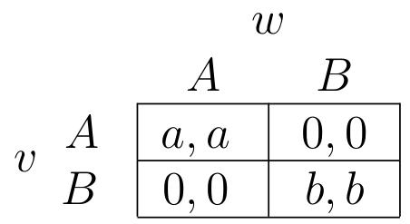
A-B coordination game
Focus on 2 nodes, v and w
Each choose behavior A or B
Direct-benefit effects:
Benefits to you increase as more neighbors adopt
Payoff matrix:
v
w
Extend to multiple nodes

Slide 9
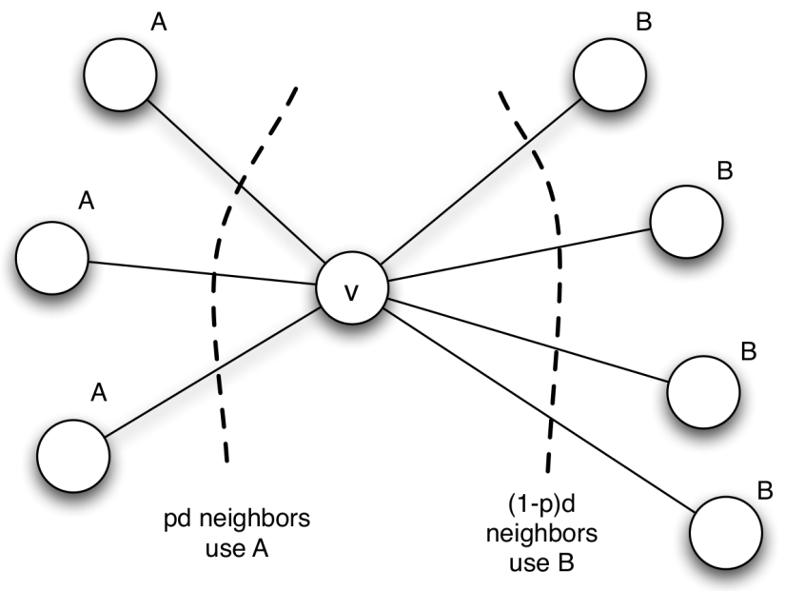
Optimal strategy depends on… neighbors!
prob. of neighbor choosing A
prob. of neighbor choosing B
Of d neighbors:
pd choose A
(1-p)d choose B
v choose A or B given neighbors?
Which expected payoff is higher?
To prefer A:
Threshold q:
Proportion of neighbors choosing A
must outweigh the payoff of choosing B
= q
Notes:
The threshold can be interpreted as this:
“The proportion of neighbors choosing A
has to outweigh the payoff of choosing B”

Slide 10
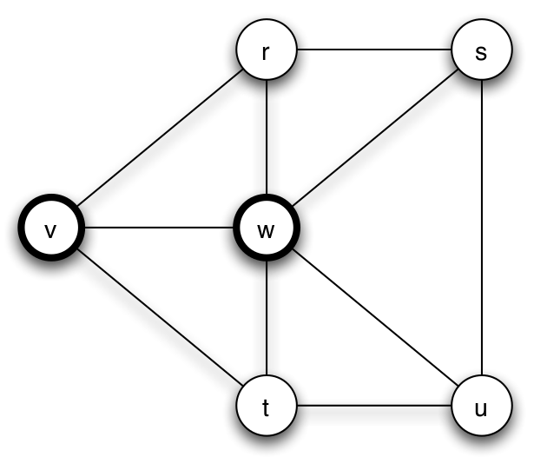
Individual Exercise:
Which behavior should node r prefer?
(bold) a=3
(normal) b=2
Threshold
to prefer A:

Slide 11
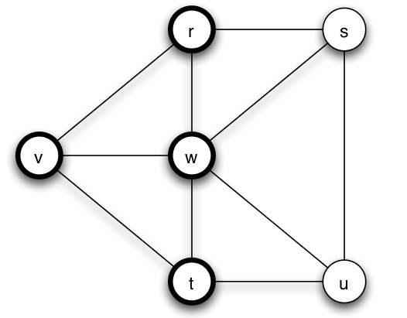
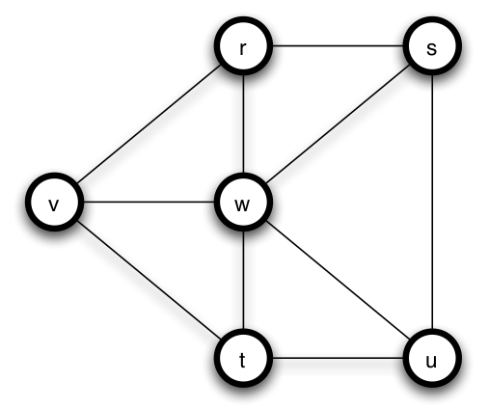
What happens over time?
Early adopters of A
Cascade of adopting A
Complete cascade
Nodes v and w couldn’t influence s and u alone, but they did eventually via r and t

Slide 12
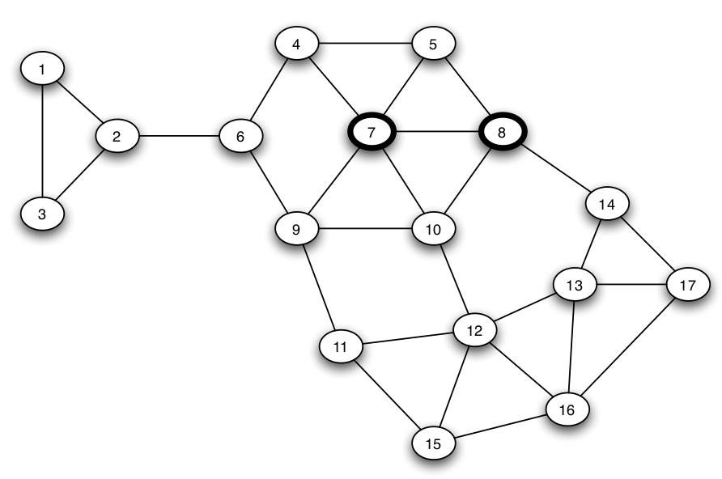
Cascades: A bigger example
1/3 < 2/5
2/3 > 2/5
a=3
b=2
q_{a}=2/5
1/3 < 2/5
1/4 < 2/5
2/4 > 2/5

Slide 13
Cascades: A bigger example
2/3 > 2/5
a=3
b=2
q_{a}=2/5
1/3 < 2/5
2/4 > 2/5
1/5 < 2/5

Slide 14
Cascades: A bigger example
a=3
b=2
q_{a}=2/5
2/3 > 2/5
1/3 < 2/5
1/3 < 2/5
1/5 < 2/5
1/3 < 2/5
Not a complete cascade! Why?

Slide 15
Why do Cascades Stop?

Slide 16

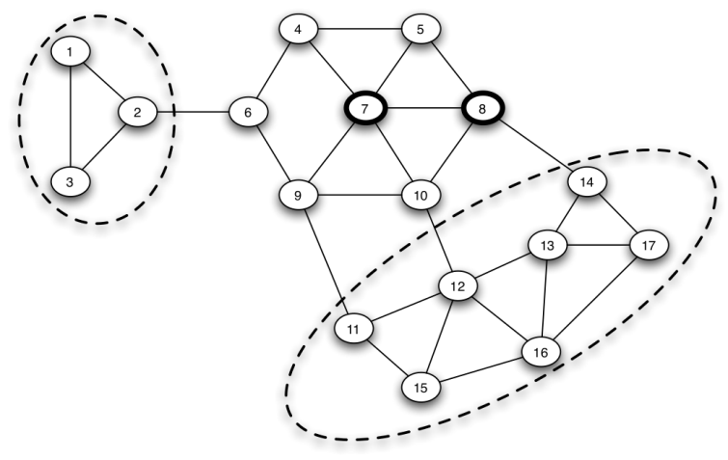
Clusters kill cascades!
Hard for innovations to break in…
Cluster of density p (1 definition):
Set of nodes, each node has at least p fraction of neighbors in the set
Clusters of density 2/3

Slide 17
Clusters kill cascades! Formally…
With initial adopters, threshold q for adopting behavior A…
If there is a cluster of density >(1-q), ⇒ no complete cascade!
If no complete cascade, ⇒ remaining network has cluster of density >(1-q)

Slide 18
Group Discussion
You are working for a tech startup.
Your product has reached some of the population but there are clusters that have not been penetrated.
How do you overcome the clustering effect?
Strategies:
Change payoff (increase product quality!)
Convince key network nodes to adopt

Slide 19
Can initial adopters cause a complete cascade?
Dfn: The cascade capacity is the maximum threshold at which a complete cascade is possible
Complete cascade is “easy” if payoffs strongly favor A (=low threshold)
Cascade capacity = worst payoffs (for A) that could cause complete cascade

Slide 20
Cascade capacity, by example
Infinite path
Early adopters of A
If q = b/(a+b) = ½
u & v will adopt,
then x & w,
then…
Cascade capacity: network-specific
But NEVER > ½ (inferior A beats B)

Slide 21
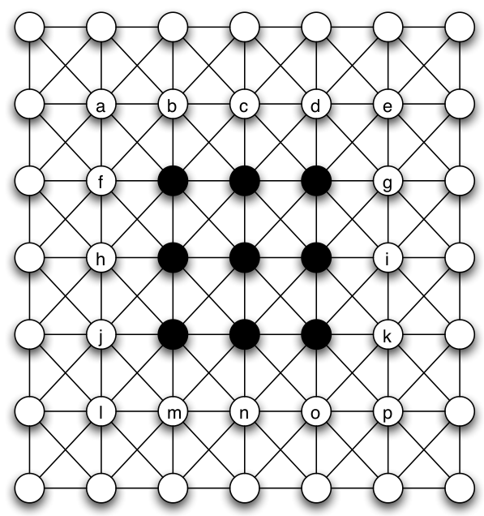
Individual Exercise:
Infinite grid
What is the cascade capacity of the infinite grid?
(Try thresholds of 1/8, 2/8, 3/8, 4/8.)

Slide 22
Weak Ties in Diffusion

Slide 23
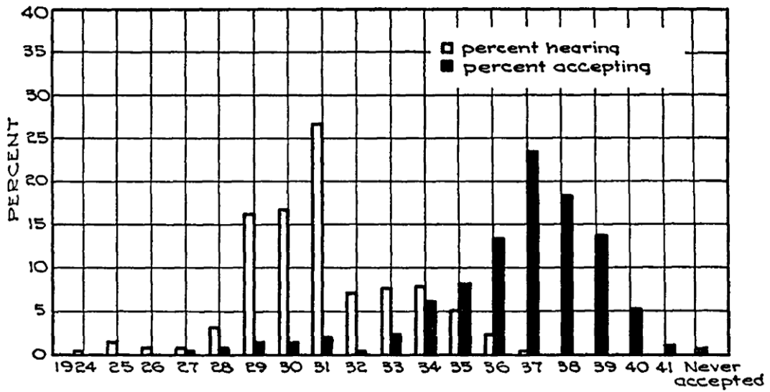
Information vs. Adoption
Ryan & Gross 1941: new seed corn

Slide 24
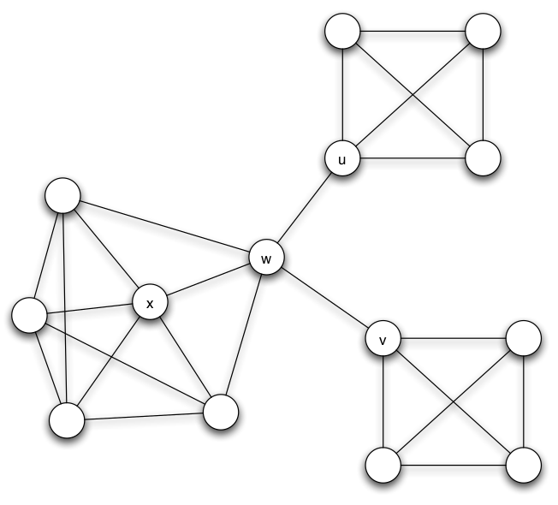
Weak ties: Pros & Cons
Weak ties spread innovative info
Like no threshold
Bad at spreading new/costly behaviors
E.g., u and v won’t adopt A if q > 1/4

Slide 25
Common Knowledge & Collective Action

Slide 26
Payoffs of Collective Action
Ex: Revolt against a repressive regime (or a bad boss). Will others join?
If no: negative payoff to participants!
If yes: positive payoff (possibly)!
So should you join or not?...

Slide 27
Problem of common knowledge
Don’t know what others would do?
Only have local knowledge
Pluralistic ignorance: wildly inaccurate guesses of others’ stance
Model: each person has threshold on others’ involvement
Guess involvement based on local network

Slide 28
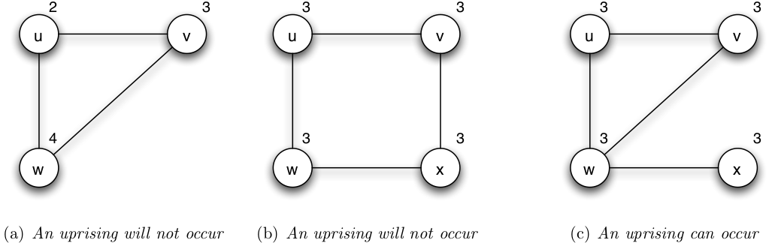
Structure affects knowledge
Promote change: Low thresholds AND common knowledge!
Prevent change: Less communication means less risk!

Slide 29
Summary
Information/behavior cascades in network
Model cascades with A-B coordination game
Thresholds
Clusters kill cascades
Weak ties don’t penetrate tight-knit
Network structure affects knowledge, which affects collective action
Other models:
Different thresholds per node
Bilingual option: choose both A and B

Slide 30
Announcements
Thursday lecture. We will have lecture during the regular lab time on Thursday, 31st May @ 8:30am.
Final exam review. I hope to do a Final Exam Review on Thursday, but if I don't have enough time, it will be Friday morning instead.
Final exam. The Final Exam is scheduled for Monday, 4th June @ 8:30am.
Late assignments due. Please turn in all assignments by 11th June @ 1:30pm for 75% credit. Submissions by 14th June @ 8:30am will get 25% credit. After 8:30am, students with any number of missing assignments will receive an Fx for the course.

