Slide 1
Community Detection (Communities, part 2)
Social Network Analysis, Lecture 5
MOJ 13.2
AAIT ITSC Spring 2018
Instructor: Stephen Wu

Slide 2
Today…
Hierarchical clustering
Stochastic Block Models
Brief review of probability theory

Slide 3
Review: Network=Graph
vertices
Dfn: A graph G is a tuple (V, E)
Edges in E connect vertices in V
Dfn: A neighbor set N(v) is the set of vertices adjacent to v.
edges
Set of vertices u
Neighbors of v
not v itself
There’s an edge

Slide 4
Review: Community structure
Dfn: A community structure, , is a collection of disjoint subsets of V (i.e., a partition) whose union is V.
defined on nodes/vertices
7
8
6
5
9
10
3
1
4
2

Slide 5
Review: CONCOR
In a partition, nodes are similar (w.r.t. edges)
Find similar nodes via correlation
Pattern of edges: adjacency matrix
2D adjacency matrix -> 2D correlation matrix
Iterate!... Will become stable…

Slide 6
Background: Pearson Correlation
How related are variables X and Y?
+1: positively related
0: not related
-1: inversely related
How to calculate it (for a sample)?
covariance of X and Y
mean value of Y sample
standard deviation of Y sample

Slide 7
Review: Correlation Matrices
A
 | A | B | C | D | E | F | G | H | I | J | K | L | M
A | 0 | 1 | 0 | 0 | 0 | 0 | 0 | 0 | 0 | 0 | 0 | 0 | 0
B | 1 | 0 | 0 | 0 | 0 | 0 | 0 | 0 | 0 | 0 | 0 | 0 | 0
C | 0 | 0 | 0 | 0 | 1 | 0 | 0 | 0 | 0 | 0 | 0 | 0 | 0
D | 0 | 0 | 0 | 0 | 1 | 0 | 0 | 0 | 0 | 0 | 0 | 0 | 0
E | 0 | 0 | 1 | 1 | 0 | 0 | 0 | 0 | 0 | 0 | 0 | 0 | 0
F | 0 | 0 | 0 | 0 | 0 | 0 | 1 | 1 | 0 | 0 | 0 | 0 | 0
G | 0 | 0 | 0 | 0 | 0 | 1 | 0 | 0 | 1 | 1 | 0 | 0 | 0
H | 0 | 0 | 0 | 0 | 0 | 1 | 0 | 0 | 0 | 1 | 0 | 0 | 1
I | 0 | 0 | 0 | 0 | 0 | 0 | 1 | 0 | 0 | 0 | 1 | 0 | 0
J | 0 | 0 | 0 | 0 | 0 | 0 | 1 | 1 | 0 | 0 | 1 | 0 | 0
K | 0 | 0 | 0 | 0 | 0 | 0 | 0 | 0 | 1 | 1 | 0 | 1 | 0
L | 0 | 0 | 0 | 0 | 0 | 0 | 0 | 0 | 0 | 0 | 1 | 0 | 1
M | 0 | 0 | 0 | 0 | 0 | 0 | 0 | 1 | 0 | 0 | 0 | 1 | 0
C⁽¹⁾
 | A | B | C | D | E | F | G | H | I | J | K | L | M
A | 1.00 | -0.08 | -0.08 | -0.08 | -0.12 | -0.12 | -0.16 | -0.16 | -0.12 | -0.16 | -0.16 | -0.12 | -0.12
B | -0.08 | 1.00 | -0.08 | -0.08 | -0.12 | -0.12 | -0.16 | -0.16 | -0.12 | -0.16 | -0.16 | -0.12 | -0.12
C | -0.08 | -0.08 | 1.00 | 1.00 | -0.12 | -0.12 | -0.16 | -0.16 | -0.12 | -0.16 | -0.16 | -0.12 | -0.12
D | -0.08 | -0.08 | 1.00 | 1.00 | -0.12 | -0.12 | -0.16 | -0.16 | -0.12 | -0.16 | -0.16 | -0.12 | -0.12
E | -0.12 | -0.12 | -0.12 | -0.12 | 1.00 | -0.18 | -0.23 | -0.23 | -0.18 | -0.23 | -0.23 | -0.18 | -0.18
F | -0.12 | -0.12 | -0.12 | -0.12 | -0.18 | 1.00 | -0.23 | -0.23 | 0.41 | 0.78 | -0.23 | -0.18 | 0.41
G | -0.16 | -0.16 | -0.16 | -0.16 | -0.23 | -0.23 | 1.00 | 0.57 | -0.23 | -0.30 | 0.57 | -0.23 | -0.23
H | -0.16 | -0.16 | -0.16 | -0.16 | -0.23 | -0.23 | 0.57 | 1.00 | -0.23 | -0.30 | 0.13 | 0.27 | -0.23
I | -0.12 | -0.12 | -0.12 | -0.12 | -0.18 | 0.41 | -0.23 | -0.23 | 1.00 | 0.78 | -0.23 | 0.41 | -0.18
J | -0.16 | -0.16 | -0.16 | -0.16 | -0.23 | 0.78 | -0.30 | -0.30 | 0.78 | 1.00 | -0.30 | 0.27 | 0.27
K | -0.16 | -0.16 | -0.16 | -0.16 | -0.23 | -0.23 | 0.57 | 0.13 | -0.23 | -0.30 | 1.00 | -0.23 | 0.27
L | -0.12 | -0.12 | -0.12 | -0.12 | -0.18 | -0.18 | -0.23 | 0.27 | 0.41 | 0.27 | -0.23 | 1.00 | -0.18
M | -0.12 | -0.12 | -0.12 | -0.12 | -0.18 | 0.41 | -0.23 | -0.23 | -0.18 | 0.27 | 0.27 | -0.18 | 1.00
Find similar nodes!

Slide 8
Hierarchical Clustering
MOJ 13.2.2

Slide 9
Intuition: Hierarchical Clustering
Node similarity (distance) metric
Find communities on blank nodes
Apply threshold t₀ and add edges
Draw graph of communities G^{(t0)}
Community = Component of G^{(t0)}
Decrease (increase) threshold & repeat, yielding G^{(tn+1)}

Slide 10
Group Discussion:
How would you calculate/represent the similarity between two friends to get:
a) Clusters in which friends who know each other are close
b) Clusters like a), but take ethnic group into account

Slide 11
Hier. Clustering Example (1)
exclude
2 nodes
Node distance: Manhattan distance
 | 1 | 2 | 3 | 4 | 5 | 6 | 7 | 8 | 9 | 10
1 | 1 | 1 | 1 | 1 | 0 | 0 | 0 | 0 | 0 | 0
2 | 1 | 1 | 1 | 0 | 0 | 0 | 0 | 0 | 0 | 0
3 | 1 | 1 | 1 | 0 | 0 | 0 | 0 | 0 | 0 | 0
4 | 1 | 0 | 0 | 1 | 1 | 0 | 0 | 0 | 0 | 0
5 | 0 | 0 | 0 | 1 | 1 | 1 | 0 | 0 | 0 | 0
6 | 0 | 0 | 0 | 0 | 1 | 1 | 1 | 0 | 1 | 0
7 | 0 | 0 | 0 | 0 | 0 | 1 | 1 | 1 | 1 | 0
8 | 0 | 0 | 0 | 0 | 0 | 0 | 1 | 1 | 1 | 0
9 | 0 | 0 | 0 | 0 | 0 | 1 | 1 | 1 | 1 | 0
10 | 0 | 0 | 0 | 0 | 0 | 0 | 0 | 0 | 0 | 1
7
8
6
5
9
10
3
1
4
2
G
G⁽⁰⁾
Π⁽⁰⁾
A
Distance = 0

Slide 12
Hier. Clustering Example (2)
exclude
2 nodes
Node distance: Manhattan distance
 | 1 | 2 | 3 | 4 | 5 | 6 | 7 | 8 | 9 | 10
1 | 1 | 1 | 1 | 1 | 0 | 0 | 0 | 0 | 0 | 0
2 | 1 | 1 | 1 | 0 | 0 | 0 | 0 | 0 | 0 | 0
3 | 1 | 1 | 1 | 0 | 0 | 0 | 0 | 0 | 0 | 0
4 | 1 | 0 | 0 | 1 | 1 | 0 | 0 | 0 | 0 | 0
5 | 0 | 0 | 0 | 1 | 1 | 1 | 0 | 0 | 0 | 0
6 | 0 | 0 | 0 | 0 | 1 | 1 | 1 | 0 | 1 | 0
7 | 0 | 0 | 0 | 0 | 0 | 1 | 1 | 1 | 1 | 0
8 | 0 | 0 | 0 | 0 | 0 | 0 | 1 | 1 | 1 | 0
9 | 0 | 0 | 0 | 0 | 0 | 1 | 1 | 1 | 1 | 0
10 | 0 | 0 | 0 | 0 | 0 | 0 | 0 | 0 | 0 | 1
7
8
6
5
9
10
3
1
4
2
G⁽⁰⁾
G⁽¹⁾
Π⁽¹⁾
A
Distance = 1

Slide 13
Individual exercise:
What is Π⁽²⁾?
 | 1 | 2 | 3 | 4 | 5 | 6 | 7 | 8 | 9 | 10
1 | 1 | 1 | 1 | 1 | 0 | 0 | 0 | 0 | 0 | 0
2 | 1 | 1 | 1 | 0 | 0 | 0 | 0 | 0 | 0 | 0
3 | 1 | 1 | 1 | 0 | 0 | 0 | 0 | 0 | 0 | 0
4 | 1 | 0 | 0 | 1 | 1 | 0 | 0 | 0 | 0 | 0
5 | 0 | 0 | 0 | 1 | 1 | 1 | 0 | 0 | 0 | 0
6 | 0 | 0 | 0 | 0 | 1 | 1 | 1 | 0 | 1 | 0
7 | 0 | 0 | 0 | 0 | 0 | 1 | 1 | 1 | 1 | 0
8 | 0 | 0 | 0 | 0 | 0 | 0 | 1 | 1 | 1 | 0
9 | 0 | 0 | 0 | 0 | 0 | 1 | 1 | 1 | 1 | 0
10 | 0 | 0 | 0 | 0 | 0 | 0 | 0 | 0 | 0 | 1
7
8
6
5
9
10
3
1
4
2

Slide 14
Hier. Clustering Example (3)
exclude
2 nodes
Node distance: Manhattan distance
 | 1 | 2 | 3 | 4 | 5 | 6 | 7 | 8 | 9 | 10
1 | 1 | 1 | 1 | 1 | 0 | 0 | 0 | 0 | 0 | 0
2 | 1 | 1 | 1 | 0 | 0 | 0 | 0 | 0 | 0 | 0
3 | 1 | 1 | 1 | 0 | 0 | 0 | 0 | 0 | 0 | 0
4 | 1 | 0 | 0 | 1 | 1 | 0 | 0 | 0 | 0 | 0
5 | 0 | 0 | 0 | 1 | 1 | 1 | 0 | 0 | 0 | 0
6 | 0 | 0 | 0 | 0 | 1 | 1 | 1 | 0 | 1 | 0
7 | 0 | 0 | 0 | 0 | 0 | 1 | 1 | 1 | 1 | 0
8 | 0 | 0 | 0 | 0 | 0 | 0 | 1 | 1 | 1 | 0
9 | 0 | 0 | 0 | 0 | 0 | 1 | 1 | 1 | 1 | 0
10 | 0 | 0 | 0 | 0 | 0 | 0 | 0 | 0 | 0 | 1
7
8
6
5
9
10
3
1
4
2
G⁽²⁾
G⁽¹⁾
Π⁽²⁾
A
Distance = 2

Slide 15
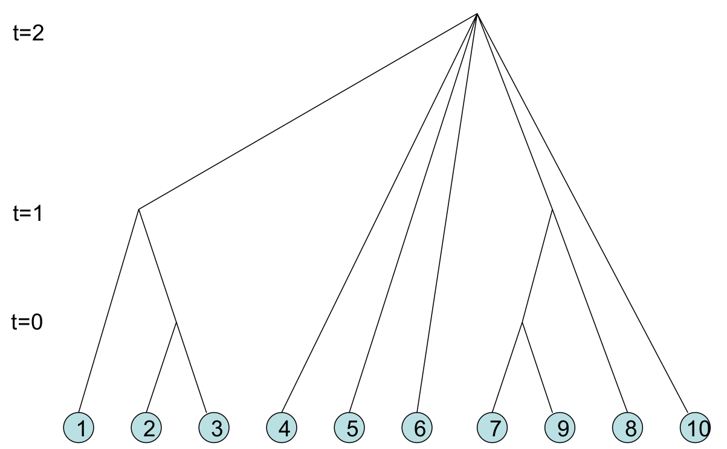
Cluster Dendrogram
Clusters merge over time
Issues:
When do you stop?
(Just report the tree? Stopping criteria?)
Ignoring structure of G^{(t)}

Slide 16
Stochastic Block Models
MOJ 13.2.3-13.2.4
Clusters
Probabilities!

Slide 17
Generative vs. Discriminative
Given network G, find best partition Π*
Π* = max P(Π | G)
Π
Generative Models
Discriminative Models
Use Bayes’ Rule
P(Π | G) = P(G | Π) ·P(Π) / P(G)
Model the generation of G
Estimate parameters for the model from data
Directly calculate
P(Π | G)
Discriminate between possible Π values
Define features, find patterns implying Π

Slide 18
General formulation
prob. of edges observed in G
possible partition
likelihood function;
i.e., prob. assuming params η
parameters: probabilities of edges
prob. of not producing edges (that weren’t observed in G)
1 prob. per i,j pair!
TOO ABSTRACT!

Slide 19
Think-Pair-Share:
Why do we care about defining the likelihood?
Choose the best model parameters!

Slide 20
Simplify: In- or Out-block
General: η → 1 prob per i,j pair
Copic/Jackson/Kirman: η → p_{in}, p_{out}
P_{in}: prob. of link within community
P_{out}: prob. of link outside community
pairs in same community
# links in communities under Π

Slide 21
Maximum Likelihood Algorithm
i and j within community
i and j not in community
Take log of both sides… rearrange…
Simple calculation: # pairs in communities
# links in communities

Slide 22
Implementing ML: Issues
Estimate p_{in} and p_{out} alongside Π
Solution: Pick p_{in} and p_{out}, build Π, then estimate p_{in} and p_{out}… iterate!
Exponential blowup of possible Π… can’t test all
Solution: Approximate which Π to explore

Slide 23
Latent Space Estimation
Copic/Jackson/Kirman: η → p_{in}, p_{out}
Other bases for probabilities?
Define space S
Any info about nodes, links, groups!
L(G | S)

Slide 24
Announcements
Assignments 0 & 1: Grades are out via Slack. Please see me after class today, if I told you to.
Slack: Habteab, Nahom: sign up for AAIT ITSC Slack. Email me (wu.stephen.t@gmail.com) or supply your email address some other way.
Github: Buruk, Habteab: to push to git, you need access. Email Dr. Stephen with your github username. You’ll need to accept the invitation.
No class 5th Apr or 9th Apr. Next class is 12th Apr, and Assignment 2 is due.
New Lecture Schedule: Mon @ 8:00am, from 16th April.

