Slide 1
Social Network Analysis: Introduction
Lecture 01: E&K Ch 1-2.1
AAIT ITSC
Spring 2018
Instructor: Stephen Wu
Credits: h/t Venkateswarlu Sunkari

Slide 2
Outline
What is a Network?
Social Networks
Syllabus & Main Themes
Intro to Graph Theory
Lab 0: github, Slack, setup

Slide 3
What is a network?

Slide 4
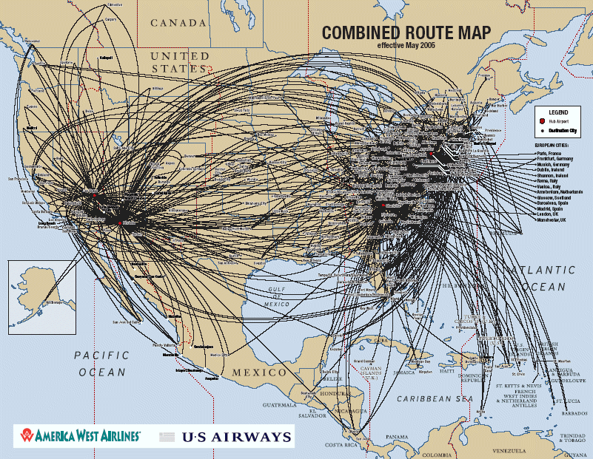
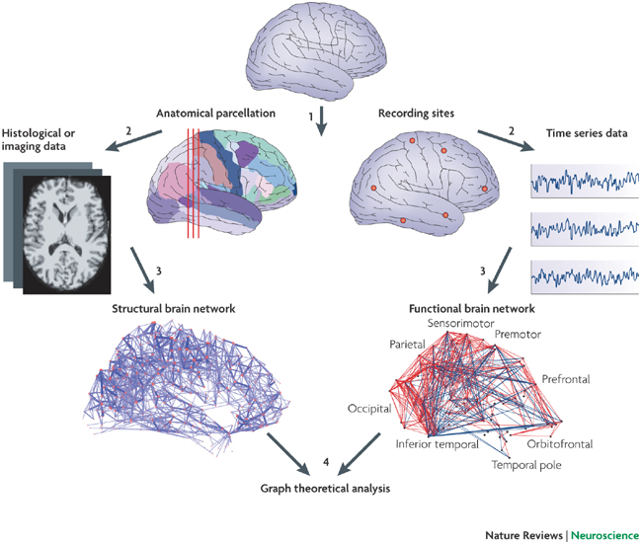
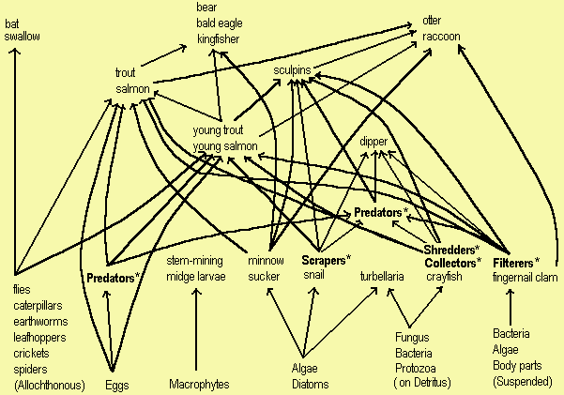
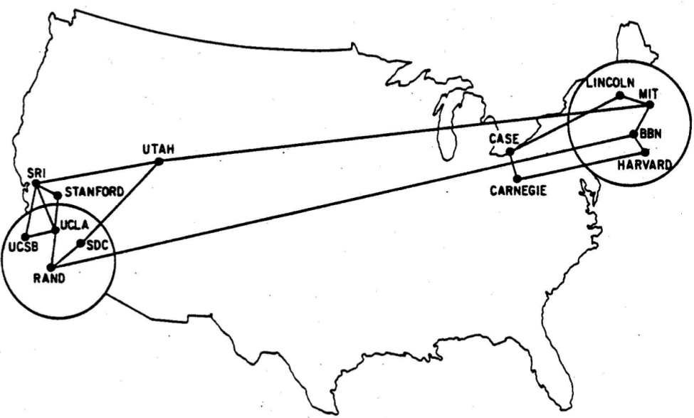
Networks are everywhere…
Transportation
Biological
Ecological
Computing

Slide 5
1-minute Discussion in Groups:
Brainstorm anything else that is a network. In 1 minute!

Slide 6
What is a network?
Intuitively: Objects and Links
Objects: people, airports, concepts, computers, webpages, etc…
Links: friends, inheritance, co-occurrence, predation, etc…

Slide 7
1-minute Discussion in Groups:
How do these networks
differ from each other?
Directed vs. Undirected
Different structural shapes
Behavior vs. Structure
Static vs. Dynamic
...

Slide 8
Social Networks

Slide 9
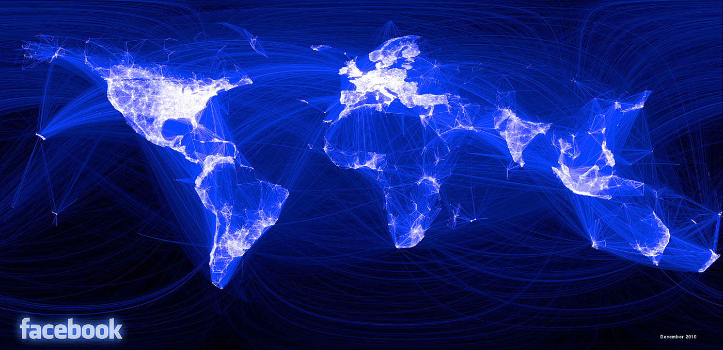
“The Social Network” in 2010

Slide 10
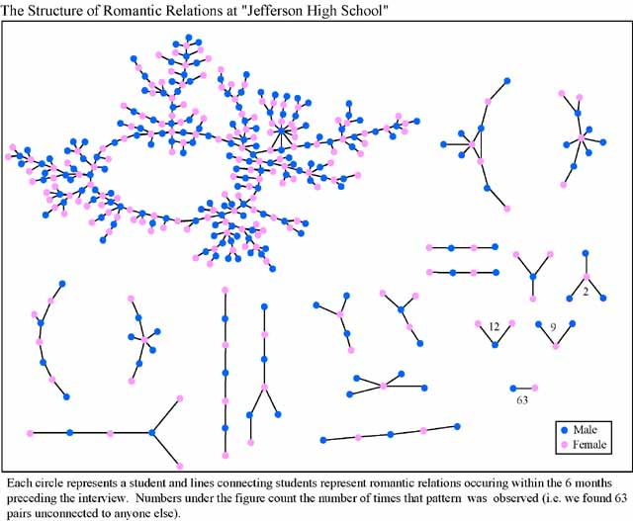
Dfn: A social network is...
a description of the social structure between actors, mostly individuals or organizations.
It indicates the ways in which they are connected through various social familiarities ranging from casual acquaintance to close familiar bonds.

Slide 11
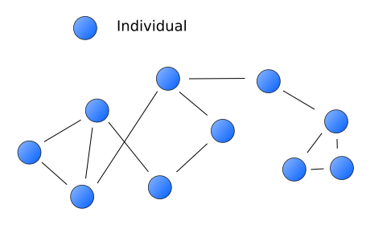
Social Network Analysis is...
… mapping & measuring
relationships & flows between
people, groups, orgs, computers,
or other information/knowledge
processing entities

Slide 12
Social Network Analysis
We measure Social Network in terms of:
1. Degree Centrality:
The number of direct connections a node has. What really matters is where those connections lead to and how they connect the otherwise unconnected.
2. Betweenness Centrality:
A node with high betweenness has great influence over what flows in the network indicating important links and single point of failure.
3. Closeness Centrality:
The measure of closeness of a node which are close to everyone else.
The pattern of the direct and indirect ties allows the nodes any other node in the network more quickly than anyone else. They have the shortest paths to all others.

Slide 13
On github: https://github.com/dragonstw/socialnets18
Syllabus

Slide 14
SNA Main Themes (E&K 1.2)
Graph Theory: Describe structure
Game Theory: Describe behavior
Strategic Interaction: Choosing behavior
Information Networks: Nodes convey information
Population Effects of Network Dynamics: influence and conformity, etc
Structural Effects of Network Dynaimcs: cascading and contagion
Institutions/Aggregate Behavior

Slide 15
Graph Theory Basics

Slide 16
A Network is a Graph
A set of objects/ individuals
Dfn: A graph G is a tuple (V, E)
Edges in E connect vertices in V
Dfn: A neighbor set N(v) is the set of vertices adjacent to v.
Set of links between objects
Set of vertices u
Neighbors of v
not v itself
There’s an edge

Slide 17
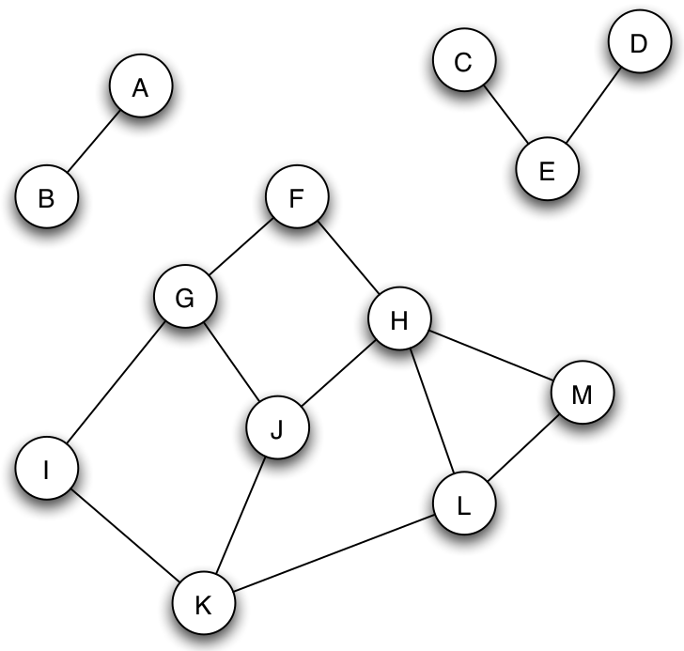
Individual Exercise:
For the pictured network, write:
V =
E =
N(A) =
N(J) =
N(M) =

Slide 18
Graphs: Adjacency Matrix
N(v) pre-calc
 | A | B | C | D | E | F | G | H | I | J | K | L | M
A | 0 | 1 | 0 | …
B | 1 | 0 | 0 | …
C | 0 | 0 | ... |  | 1
D | … | … |  |  | 1
E |  |  | 1 | 1
F |  |  |  |  |  |  | 1 | 1
G |  |  |  |  |  | 1 |  |  | 1 | 1
H |  |  |  |  |  | 1 |  |  |  | 1 |  |  | 1
I |  |  |  |  |  |  | 1 |  |  |  | 1
J |  |  |  |  |  |  | 1 | 1 |  |  | 1
K |  |  |  |  |  |  |  |  | 1 | 1 |  | 1
L |  |  |  |  |  |  |  |  |  |  | 1 |  | 1
M |  |  |  |  |  |  |  | 1 |  |  |  | 1

Slide 19
Graphs: Undirected/Directed
A
A
E
B
E
B
D
C
D
C
Edges: defined by 2 vertices v and u
Undirected: unordered (v, u)
Directed: ordered (v, u)

Slide 20
Individual Exercise:
A
A
E
B
E
B
D
C
D
C
For the pictured undirected and directed graphs, write the adjacency matrices.

Slide 21
Graphs: Node Degree
Dfn: The node degree is the number of neighbors a node has.
|N(v)|
Note: Network’s degree distribution allows classification of network
A
deg=3
E
B
D
C

Slide 22
Graphs: Paths & Cycles
Dfn: A path is a sequence of nodes where pairs of consecutive nodes are connected by an edge.
Directed graph: direction matters!
Dfn: A cycle is a path where the start node is also the end node
A
E
B
Paths? Cycles?
D
C

Slide 23
Graphs: Path Length/Distance
Dfn: The distance between 2 nodes in a graph = length of the shortest path linking the 2 nodes
Note: Need to find shortest path!
Dfn: The diameter of the graph is the max distance between a node pair
A
E
B
Distance? Diameter?
D
C

Slide 24
Graphs: Connectedness
Not edge!
Dfn: A graph (or subgraph) is connected if there is a path between each pair of nodes.
If no path, this is disconnected.

Slide 25
On github: https://github.com/dragonstw/socialnets18/assignments/assignment00.md
Assignment 0: Setup

