Slide 1
Communities
Social Network Analysis, Lecture 4
E&K Ch 3.6 & MOJ 13.2
AAIT ITSC Spring 2018
Instructor: Stephen Wu

Slide 2
Announcements
Next class: Lab Thursday, 27th March 2018 @ 8:30am. Assignment1 is due!!
Absence Update: Absences will be counted from 8th March. Most students already have 2-4 absences! However, if the instructor cancels/is late, subtract that # absences/tardies.
Late work: No leniency on Assignment 0 late policy (earning 75%), make sure to submit, or else you’ll get an Fx!
New Lecture Schedule: Mondays @ 8:00am
Slack & Github: Sign up for AAIT ITSC Slack. Also, to push to git, you need access. Email Dr. Stephen (wu.stephen.t@gmail.com) with your github username.

Slide 3
Today…
Last: graph structure & metrics
What is community?
Finding communities
CONCOR
Edge removal (Girvan-Newman)

Slide 4
Review: Network=Graph
vertices
Dfn: A graph G is a tuple (V, E)
Edges in E connect vertices in V
Dfn: A neighbor set N(v) is the set of vertices adjacent to v.
edges
Set of vertices u
Neighbors of v
not v itself
There’s an edge

Slide 5
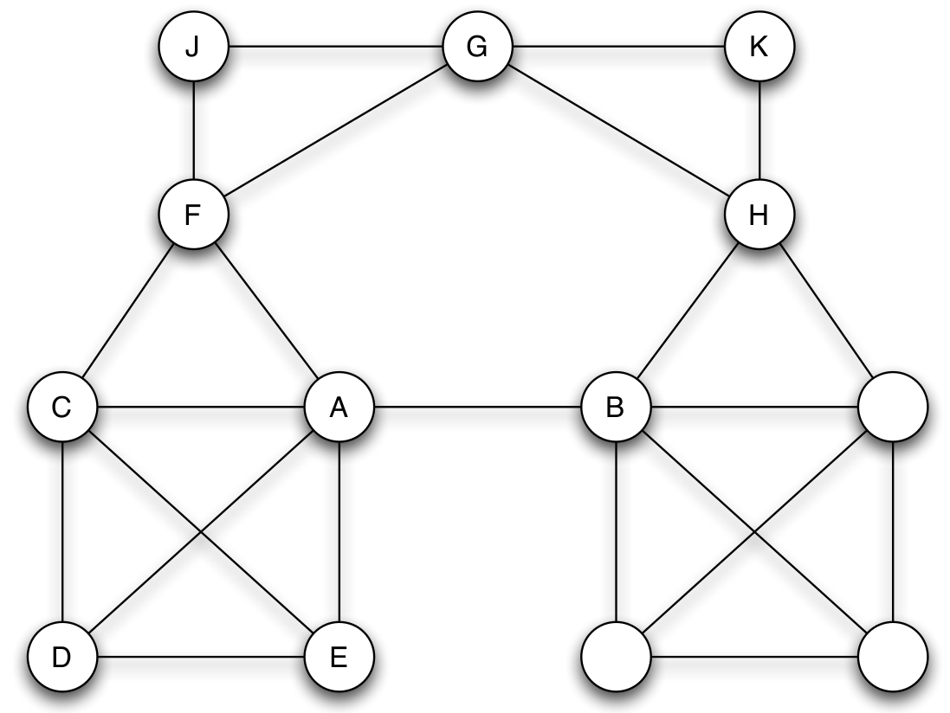
Review: Local Bridges
Dfn: Edge e = (i,j)
is a local bridge
in the graph G
if:
path_{G-e}(i, j) ― path_{G}(i, j) > 2
i.e., no friends in common
Bridging “communities”
span of local bridge

Slide 6
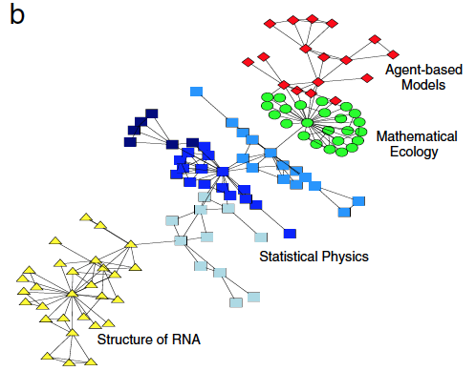
Group Discussion:
How would you define a community/cluster/partition in a network?

Slide 7
Structural equivalence
Dfn: Two nodes i and j are structurally equivalent for graph G if:
I.e., relationships to all other nodes are identical!
In practice: too rigid
Group into equivalence classes
edges are the same
all other nodes

Slide 8
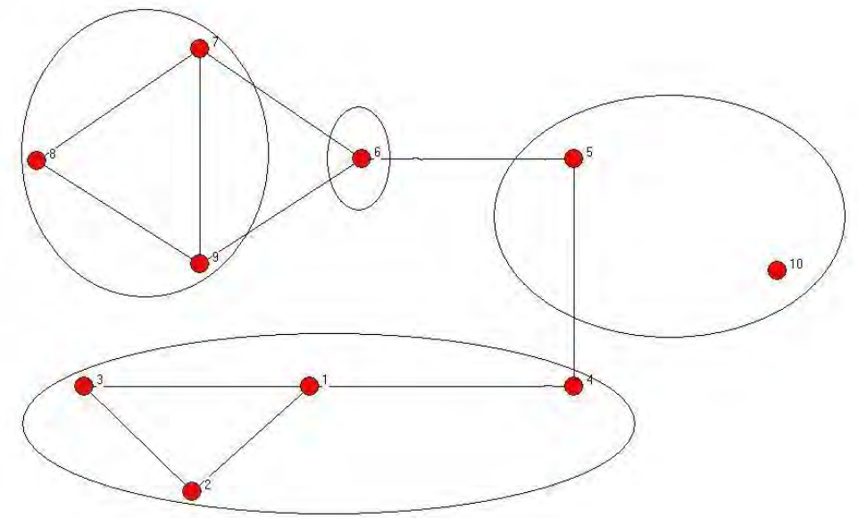
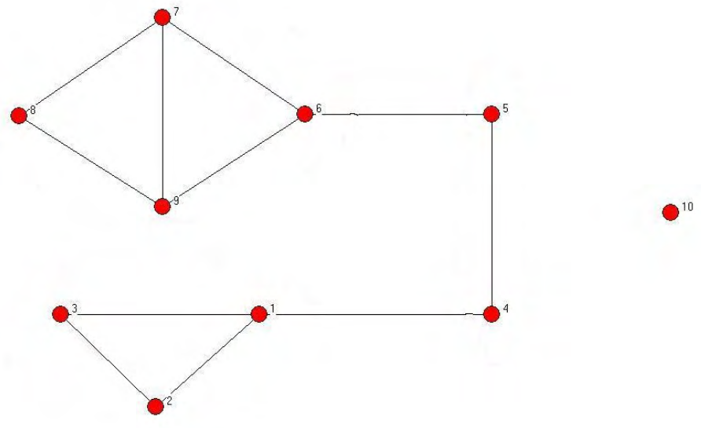
Community structure
defined on nodes/vertices
Dfn: A community structure, ∏, is a collection of disjoint subsets of V (i.e., a partition) whose union is V.

Slide 9
Why find communities?
Improve web client performance
Recommender systems
Efficient graph storage/access
Study node relationships

Slide 10
Community Detection/ Graph Partitioning
CONCOR, edge removal

Slide 11
Group Discussion:
How would you find communities/clusters/partitions in a network?
Why are you looking?
Literature: no consensus!
(Un-)observed node traits?
Influence on node behavior
Observable network structure?
Link formation properties?

Slide 12
CONCOR
CONvergance of iterated CORrelations

Slide 13
CONCOR Intuition
In a partition, nodes are similar (w.r.t. edges)
Find similar nodes via correlation
Pattern of edges: adjacency matrix

Slide 14
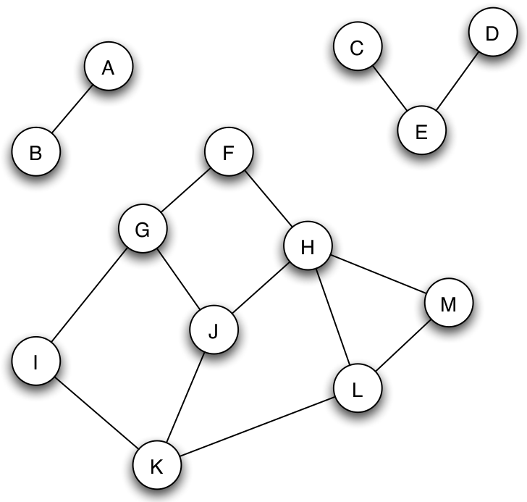
Review: Adjacency Matrix
N(v) pre-calc
 | A | B | C | D | E | F | G | H | I | J | K | L | M
A | 0 | 1 | 0 | …
B | 1 | 0 | 0 | …
C | 0 | 0 | ... |  | 1
D | … | … |  |  | 1
E |  |  | 1 | 1
F |  |  |  |  |  |  | 1 | 1
G |  |  |  |  |  | 1 |  |  | 1 | 1
H |  |  |  |  |  | 1 |  |  |  | 1 |  |  | 1
I |  |  |  |  |  |  | 1 |  |  |  | 1
J |  |  |  |  |  |  | 1 | 1 |  |  | 1
K |  |  |  |  |  |  |  |  | 1 | 1 |  | 1
L |  |  |  |  |  |  |  |  |  |  | 1 |  | 1
M |  |  |  |  |  |  |  | 1 |  |  |  | 1

Slide 15
Background: Pearson Correlation
How related are variables X and Y?
+1: positively related
0: not related
-1: inversely related
How to calculate it (for a sample)?
covariance of X and Y
mean value of Y sample
standard deviation of Y sample

Slide 16
CONCOR Intuition
In a partition, nodes are similar (w.r.t. edges)
Find similar nodes via correlation
Pattern of edges: adjacency matrix
2D adjacency matrix -> 2D correlation matrix
Iterate!... Will become stable…

Slide 17
Iterated Correlation Matrices
A
 | A | B | C | D | E | F | G | H | I | J | K | L | M
A | 0 | 1 | 0 | 0 | 0 | 0 | 0 | 0 | 0 | 0 | 0 | 0 | 0
B | 1 | 0 | 0 | 0 | 0 | 0 | 0 | 0 | 0 | 0 | 0 | 0 | 0
C | 0 | 0 | 0 | 0 | 1 | 0 | 0 | 0 | 0 | 0 | 0 | 0 | 0
D | 0 | 0 | 0 | 0 | 1 | 0 | 0 | 0 | 0 | 0 | 0 | 0 | 0
E | 0 | 0 | 1 | 1 | 0 | 0 | 0 | 0 | 0 | 0 | 0 | 0 | 0
F | 0 | 0 | 0 | 0 | 0 | 0 | 1 | 1 | 0 | 0 | 0 | 0 | 0
G | 0 | 0 | 0 | 0 | 0 | 1 | 0 | 0 | 1 | 1 | 0 | 0 | 0
H | 0 | 0 | 0 | 0 | 0 | 1 | 0 | 0 | 0 | 1 | 0 | 0 | 1
I | 0 | 0 | 0 | 0 | 0 | 0 | 1 | 0 | 0 | 0 | 1 | 0 | 0
J | 0 | 0 | 0 | 0 | 0 | 0 | 1 | 1 | 0 | 0 | 1 | 0 | 0
K | 0 | 0 | 0 | 0 | 0 | 0 | 0 | 0 | 1 | 1 | 0 | 1 | 0
L | 0 | 0 | 0 | 0 | 0 | 0 | 0 | 0 | 0 | 0 | 1 | 0 | 1
M | 0 | 0 | 0 | 0 | 0 | 0 | 0 | 1 | 0 | 0 | 0 | 1 | 0
C⁽⁰⁾
 | A | B | C | D | E | F | G | H | I | J | K | L | M
A | 1.00 | -0.08 | -0.08 | -0.08 | -0.12 | -0.12 | -0.16 | -0.16 | -0.12 | -0.16 | -0.16 | -0.12 | -0.12
B | -0.08 | 1.00 | -0.08 | -0.08 | -0.12 | -0.12 | -0.16 | -0.16 | -0.12 | -0.16 | -0.16 | -0.12 | -0.12
C | -0.08 | -0.08 | 1.00 | 1.00 | -0.12 | -0.12 | -0.16 | -0.16 | -0.12 | -0.16 | -0.16 | -0.12 | -0.12
D | -0.08 | -0.08 | 1.00 | 1.00 | -0.12 | -0.12 | -0.16 | -0.16 | -0.12 | -0.16 | -0.16 | -0.12 | -0.12
E | -0.12 | -0.12 | -0.12 | -0.12 | 1.00 | -0.18 | -0.23 | -0.23 | -0.18 | -0.23 | -0.23 | -0.18 | -0.18
F | -0.12 | -0.12 | -0.12 | -0.12 | -0.18 | 1.00 | -0.23 | -0.23 | 0.41 | 0.78 | -0.23 | -0.18 | 0.41
G | -0.16 | -0.16 | -0.16 | -0.16 | -0.23 | -0.23 | 1.00 | 0.57 | -0.23 | -0.30 | 0.57 | -0.23 | -0.23
H | -0.16 | -0.16 | -0.16 | -0.16 | -0.23 | -0.23 | 0.57 | 1.00 | -0.23 | -0.30 | 0.13 | 0.27 | -0.23
I | -0.12 | -0.12 | -0.12 | -0.12 | -0.18 | 0.41 | -0.23 | -0.23 | 1.00 | 0.78 | -0.23 | 0.41 | -0.18
J | -0.16 | -0.16 | -0.16 | -0.16 | -0.23 | 0.78 | -0.30 | -0.30 | 0.78 | 1.00 | -0.30 | 0.27 | 0.27
K | -0.16 | -0.16 | -0.16 | -0.16 | -0.23 | -0.23 | 0.57 | 0.13 | -0.23 | -0.30 | 1.00 | -0.23 | 0.27
L | -0.12 | -0.12 | -0.12 | -0.12 | -0.18 | -0.18 | -0.23 | 0.27 | 0.41 | 0.27 | -0.23 | 1.00 | -0.18
M | -0.12 | -0.12 | -0.12 | -0.12 | -0.18 | 0.41 | -0.23 | -0.23 | -0.18 | 0.27 | 0.27 | -0.18 | 1.00
C^{(t)}
 | A | B | C | D | E | F | G | H | I | J | K | L | M
A | 1 | 1 | 1 | 1 | 1 | -1 | 1 | 1 | -1 | -1 | 1 | -1 | -1
B | 1 | 1 | 1 | 1 | 1 | -1 | 1 | 1 | -1 | -1 | 1 | -1 | -1
C | 1 | 1 | 1 | 1 | 1 | -1 | 1 | 1 | -1 | -1 | 1 | -1 | -1
D | 1 | 1 | 1 | 1 | 1 | -1 | 1 | 1 | -1 | -1 | 1 | -1 | -1
E | 1 | 1 | 1 | 1 | 1 | -1 | 1 | 1 | -1 | -1 | 1 | -1 | -1
F | -1 | -1 | -1 | -1 | -1 | 1 | -1 | -1 | 1 | 1 | -1 | 1 | 1
G | 1 | 1 | 1 | 1 | 1 | -1 | 1 | 1 | -1 | -1 | 1 | -1 | -1
H | 1 | 1 | 1 | 1 | 1 | -1 | 1 | 1 | -1 | -1 | 1 | -1 | -1
I | -1 | -1 | -1 | -1 | -1 | 1 | -1 | -1 | 1 | 1 | -1 | 1 | 1
J | -1 | -1 | -1 | -1 | -1 | 1 | -1 | -1 | 1 | 1 | -1 | 1 | 1
K | 1 | 1 | 1 | 1 | 1 | -1 | 1 | 1 | -1 | -1 | 1 | -1 | -1
L | -1 | -1 | -1 | -1 | -1 | 1 | -1 | -1 | 1 | 1 | -1 | 1 | 1
M | -1 | -1 | -1 | -1 | -1 | 1 | -1 | -1 | 1 | 1 | -1 | 1 | 1
C⁽¹⁾
 | A | B | C | D | E | F | G | H | I | J | K | L | M
A | 1.00 | -0.08 | -0.08 | -0.08 | -0.12 | -0.12 | -0.16 | -0.16 | -0.12 | -0.16 | -0.16 | -0.12 | -0.12
B | -0.08 | 1.00 | -0.08 | -0.08 | -0.12 | -0.12 | -0.16 | -0.16 | -0.12 | -0.16 | -0.16 | -0.12 | -0.12
C | -0.08 | -0.08 | 1.00 | 1.00 | -0.12 | -0.12 | -0.16 | -0.16 | -0.12 | -0.16 | -0.16 | -0.12 | -0.12
D | -0.08 | -0.08 | 1.00 | 1.00 | -0.12 | -0.12 | -0.16 | -0.16 | -0.12 | -0.16 | -0.16 | -0.12 | -0.12
E | -0.12 | -0.12 | -0.12 | -0.12 | 1.00 | -0.18 | -0.23 | -0.23 | -0.18 | -0.23 | -0.23 | -0.18 | -0.18
F | -0.12 | -0.12 | -0.12 | -0.12 | -0.18 | 1.00 | -0.23 | -0.23 | 0.41 | 0.78 | -0.23 | -0.18 | 0.41
G | -0.16 | -0.16 | -0.16 | -0.16 | -0.23 | -0.23 | 1.00 | 0.57 | -0.23 | -0.30 | 0.57 | -0.23 | -0.23
H | -0.16 | -0.16 | -0.16 | -0.16 | -0.23 | -0.23 | 0.57 | 1.00 | -0.23 | -0.30 | 0.13 | 0.27 | -0.23
I | -0.12 | -0.12 | -0.12 | -0.12 | -0.18 | 0.41 | -0.23 | -0.23 | 1.00 | 0.78 | -0.23 | 0.41 | -0.18
J | -0.16 | -0.16 | -0.16 | -0.16 | -0.23 | 0.78 | -0.30 | -0.30 | 0.78 | 1.00 | -0.30 | 0.27 | 0.27
K | -0.16 | -0.16 | -0.16 | -0.16 | -0.23 | -0.23 | 0.57 | 0.13 | -0.23 | -0.30 | 1.00 | -0.23 | 0.27
L | -0.12 | -0.12 | -0.12 | -0.12 | -0.18 | -0.18 | -0.23 | 0.27 | 0.41 | 0.27 | -0.23 | 1.00 | -0.18
M | -0.12 | -0.12 | -0.12 | -0.12 | -0.18 | 0.41 | -0.23 | -0.23 | -0.18 | 0.27 | 0.27 | -0.18 | 1.00
+1, -1: Two communities!

Slide 18
CONCOR Summary
Node similarity by correlation
Iterate to stability, bisect graph
Repeat!
Issues:
Meaningful bisection?
How many bisections?

Slide 19
Edge Removal: Girvan-Newman Method

Slide 20
Edge Removal (Girvan-Newman 2002)
Local bridges connect weakly interacting parts of network
Remove local bridges (weak ties)!
Questions:
Many bridges?
No bridges?
Betweenness
(Or centrality, etc.)

Slide 21
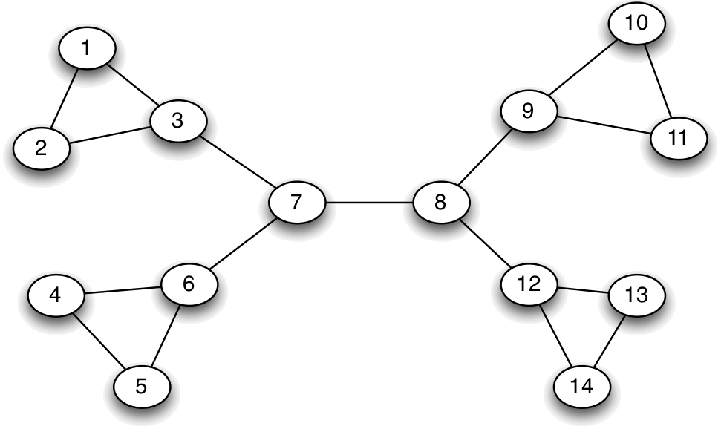
Edge Removal: Betweenness
The flow between v and u is 1
Divide flow between shortest paths
Dfn: The betweenness of edge e is the total flow for all pairs.

Slide 22
Individual Exercise:
What is the betweenness for
Edge 7-8?
Edge 8-9?

Slide 23
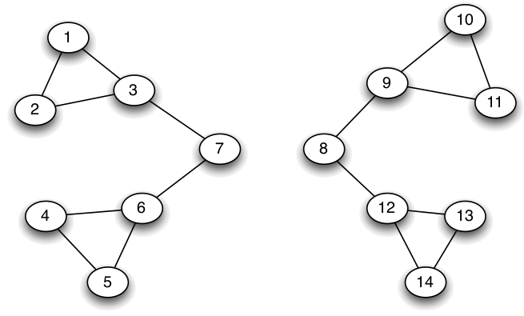
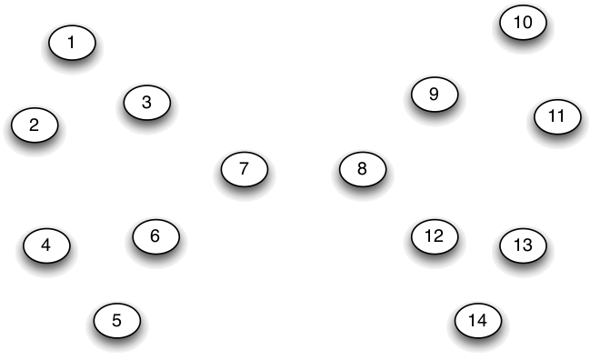
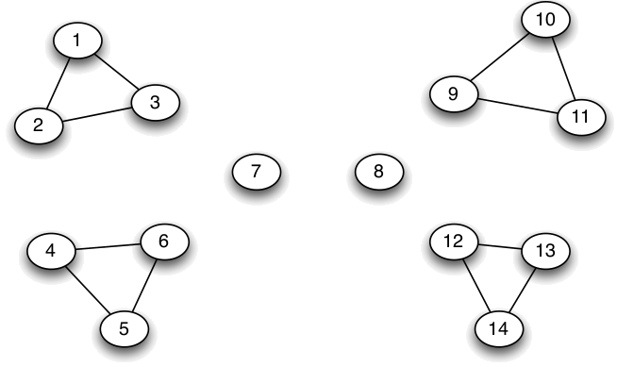

Girvan-Newman Method
Calculate betweenness of all edges
Cut (remove max betweenness)
Repeat!

Slide 24
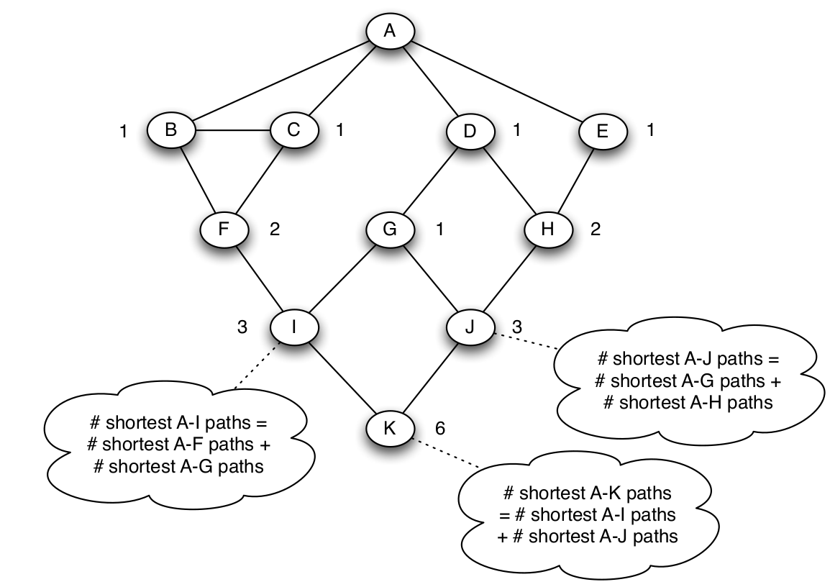
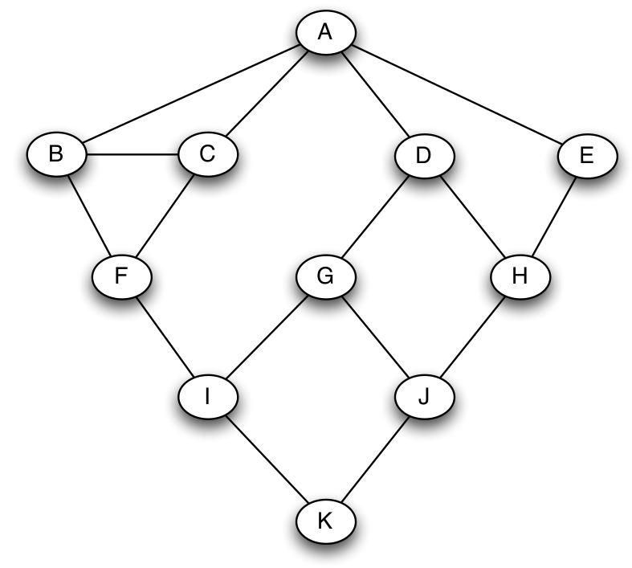
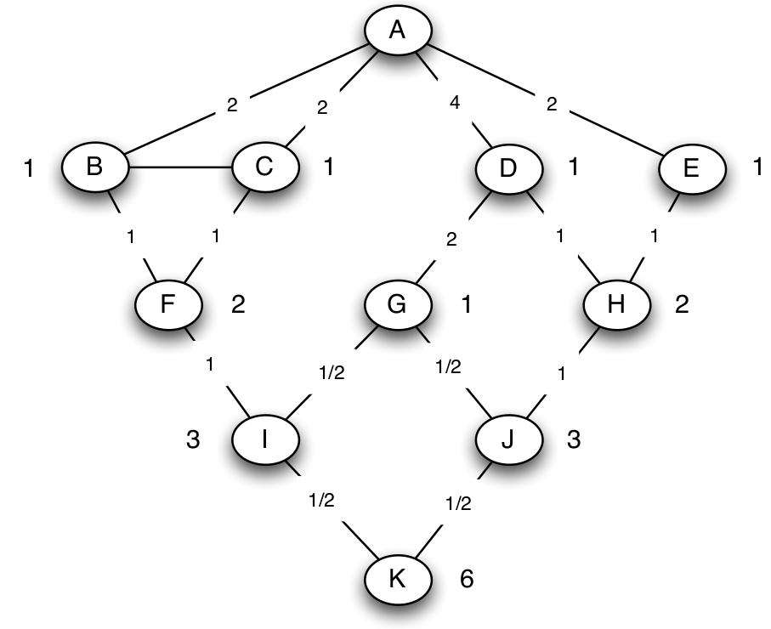
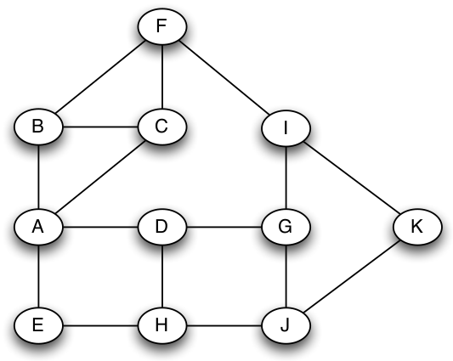
Computing Betweenness
BFS from v
# shortest paths from v to each node
Propagate flow

Slide 25
Girvan-Newman Method
Calculate betweenness of all edges
Cut (remove max betweenness)
Repeat!
When do
we stop???

Slide 26
Modularity (Stopping Criterion)
Intuition: More edges inside a community than random chance
the community v and u are assigned to; 1 if equal
1_{v,u} = 1 if there is an edge v, u
divide over all edges m
Expected edges in a random version (preview)

Slide 27
Edge removal summary
Remove edges
E.g., pick by betweenness
This bisects the graph
Modularity as stopping criterion
In practice:
Ok for several thousand nodes
Bigger – need to approximate betweenness

