Slide 1
Random Graphs
Social Network Analysis, Lecture 6
MOJ 1.2.3, 4; E&K 20.1-20.2
AAIT ITSC Spring 2018
Instructor: Stephen Wu

Slide 2
Today… Random graphs!
Last: Community Detection
Background: Probability Theory
Static random models
Poisson random networks
“Small World” model
The configuration model
Calculating metrics

Slide 3
Background: Probability Theory

Slide 4
Background: Random Variables
RVs: Represent probabilistic events
E.g., coin flip X
X: {H, T}→{p, (1-p)}
Options should add to 1
Instances of coin flips = samples
How flips play out = distribution
heads w/ prob p
tails w/ prob (1-p)

Slide 5
Background: Prob. Mass Function
Coin toss: Uniform
Coin toss: Weighted
Single dice: Uniform
Single dice: Weighted
How to know if it’s fair? Sample many times!

Slide 6
Background: Binomial Distr.
Out of n coin flips, how many H?
Prob n heads:
sampled 100 times
Written:
X is distr. according to a binomial distr.

Slide 7
Background: Binomial Coeff.
How many ways are there to get n out of 3 heads?
Calculate:
8 possible results
HHH
HHT
HTH
HTT
THH
THT
TTH
TTT
3 Heads:
= 1 way
Pascal’s triangle
1
1 1
1 2 1
1 3 3 1
1 4 6 4 1
1 5 10 10 5 1
1 6 15 20 15 6 1
…
2 Heads:
= 3 ways
1 Heads:
= 3 ways
0 Heads:
= 1 way

Slide 8
Group Discussion:
A 6-sided dice is a multinomial distribution.
How will this differ from binomial?
Notes:
There are more possible outcomes. You also need to estimate more parameters – a probability for each outcome (or one less that number).

Slide 9
Poisson Random Networks
Erdös and Rényi, 1959-1961; MOJ 1.2.3, 4.1.1

Slide 10
Binomial Link Formation Erdös and Rényi, 1959-1961
Nodes n = {1,…, n}
i, j links form with probability p
No link: (1-p)
Independent probabilities
6
1
5
2
4
3

Slide 11
Individual Exercise (with calculator):
Given p, what is the probability that each graph is produced?
a) p = 0.1 b) p = 0.4
c) p = 0.1 d) p = 0.4
6
1
6
1
5
2
5
2
4
3
4
3
Notes:
(0.1)^2 * (0.9)^13 = 2.54 x 10^-3
(0.4)^2 * (0.6)^13 = 2.09 x 10^-4
(0.1)^7 * (0.9)^8 = 4.30 x 10^-8
(0.4)^7 * (0.6)^8 = 2.75 x 10^-5

Slide 12
Group Discussion:
Derive a general equation for the probability of a network with n nodes, m edges, and link formation probability p.
Notes:
(0.1)^2 * (0.9)^13 = 2.54 x 10^-3
(0.4)^2 * (0.6)^13 = 2.09 x 10^-4
(0.1)^7 * (0.9)^8 = 4.30 x 10^-8
(0.4)^7 * (0.6)^8 = 2.75 x 10^-5

Slide 13
Probability of Node degree d
Links form independently
For 1 node i (out of n nodes):
→ binomial!
Note: Not exactly independent, since 1 link affects 2 nodes. But as n increases, this effect is minimal

Slide 14
Poisson Approximation see MOJ 1.2.3
Usually: large n, small p
Poisson: normally, # events in fixed interval, with events independent

Slide 15
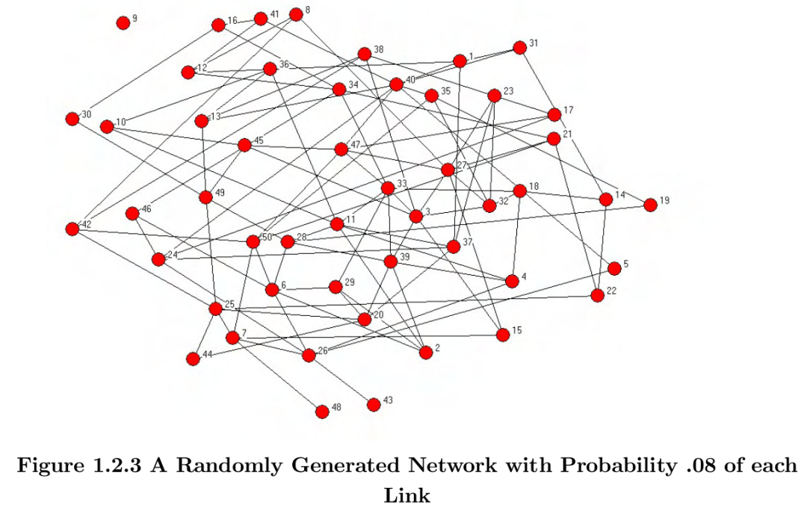
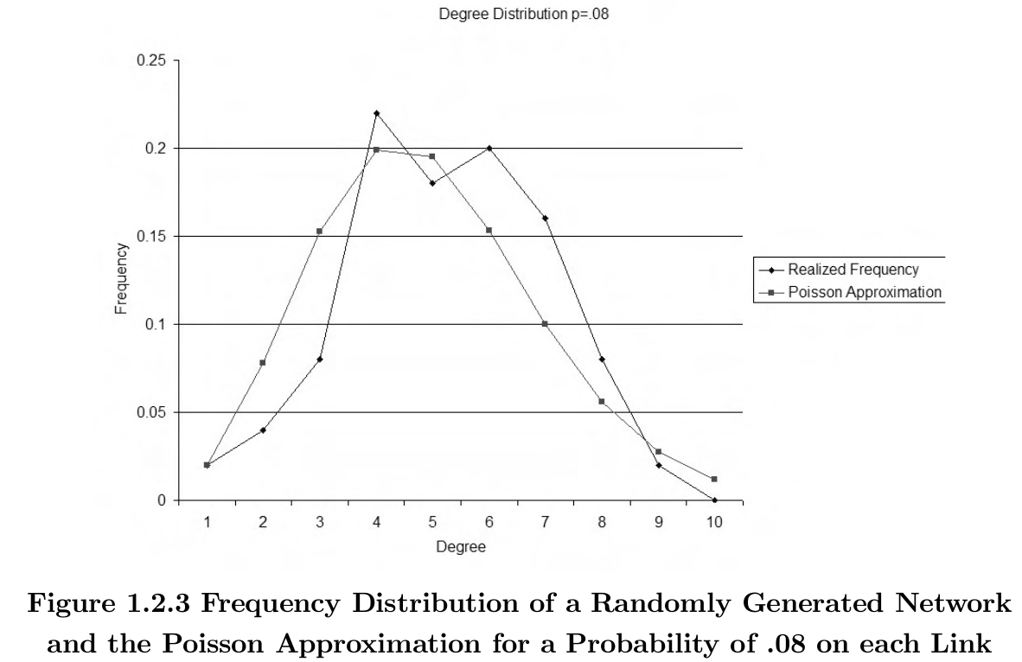
Examples: Poisson model
Images MOJ 1.2

Slide 16
Small World Model
Watts & Strogatz, 1998ff; MOJ 4.1.2, E&K 20.1-20.2

Slide 17
Why an alternate model?
Real life: high clustering, low avg. path length/diameter
E.g., me: CC=0.556, APL=2.93, d=10
Poisson: lacks high clustering
Any link formation prob: p
Triadic closure? Etc?
Low avg. path length/diameter

Slide 18
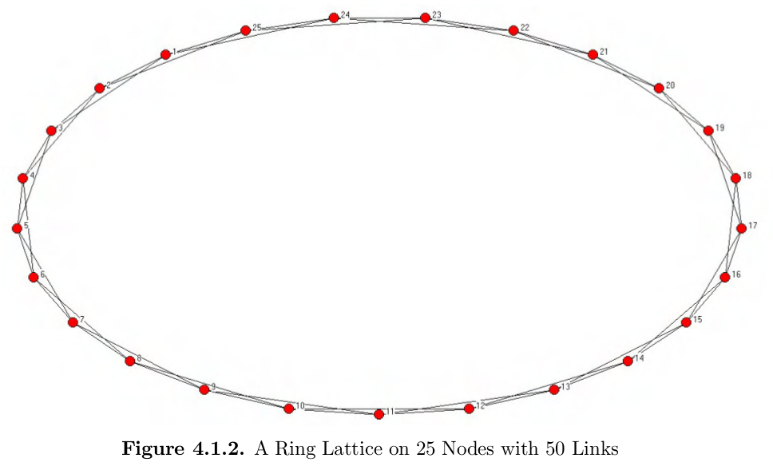
Watts-Strogatz: Starting out
each connected to 2 neighbors each side
High clustering, high diameter/APL
High clustering, high diameter/APL

Slide 19
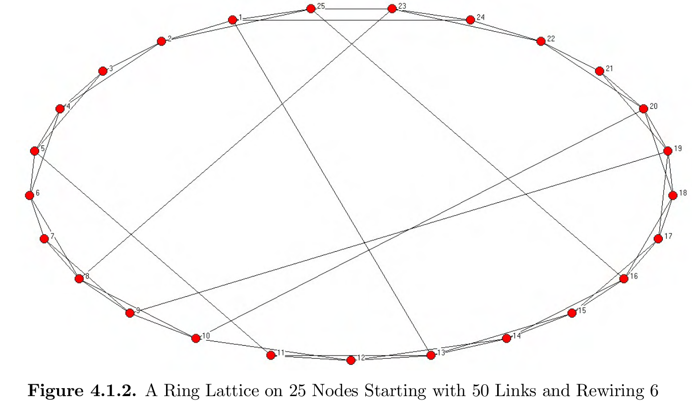
Watts-Strogatz: Rewiring
High clustering, lower diameter/APL
High clustering, high diameter/APL

Slide 20
Think-Pair-Share:
Why is the Watts-Strogatz model often called the “small world” model?

Slide 21
Watts-Strogatz: Summary
Model “small world phenomenon”
high clustering
low distance
Start w/ highly clustered network
Rewire some links
Explore in Assignment 3!

Slide 22
The Configuration Model
Bender & Canfield 1978; MOJ 4.1.4

Slide 23
Degr. Distributions → Sequences
Node i with degree d_{i}, list d_{i} times
Ex: 1112233445566677788999
7
8
6
5
9
10
3
1
4
2

Slide 24
Add links
Randomly select pairs; link & remove
1112233445566677788999
Links:
3,7
6,6
8,9
3,7
duplicate link: multi-graph!
1,4 1,5 2,4 6,8
5,7 1,9 2,9
7
self-link
8
6
5
Despite self-links and duplicate links, new graph with similar degree distribution!
9
10
3
1
4
2

Slide 25
Modularity, revisited
Stopping criterion for partitioning
Expected random edges (Configuration model) within a community
the communities that v and u are assigned to
1_{v,u} = 1 if there is an edge v, u
1 if equal
count edges within a community
divide over all edges m

Slide 26
Modularity interpretation
Values: [-0.5, 1.0]
- (neg): communities cut across links more than random
0: communities capture nothing
+(pos): communities have more links than you’d expect at random
Criterion: stop partitioning when modularity drops below threshold

Slide 27
Think-Pair-Share:
Could you use a Poisson random network to calculate modularity?
If so, how? If not, why not?

Slide 28
Calculating Metrics on Random Networks

Slide 29
Metrics will vary!
Which graph for calculations?
E.g., Poisson, 6 nodes, p=0.4
6
1
6
1
6
1
5
2
5
2
5
2
4
3
4
3
4
3
Avg node degree: 2.33
Avg node degree: 2
Avg node degree: 3
Simulate!
Consider the Limit
Notes:
Avg node degree
3+2+1+4+1+3 -> 2.33
-> 2
-> 3

Slide 30
Announcements
Assignment 2 being graded: Grades for Assignment 2 are not ready. Please see me if you haven’t gotten Assignment 0 or 1 grades.
Midterm: Remember there will be a midterm Mon 23rd April @ 8:00am.
Assignment 3: Remember Assignment 3 is due Thu 26th April @ 8:30am.
New Lecture Schedule: Mon @ 8:00am, starting today.

