Slide 1
Midterm Exam Review
Social Network Analysis
AAIT ITSC Spring 2018
Instructor: Stephen Wu

Slide 2
Outline
1. SNA Introduction
2. Graphs
A. Basics
B. Beyond nodes
C. Beyond edges
3. Network Structure
A. Components, clusters,
B. Ties & Bridges
C. Centrality
4. Community Detection
A. Graph bisection
B. Edge removal
C. Hierarchical clust.
D. Stoch. block models
5. Random Graphs
A. Poisson model
B. Small worlds
C. Configuration
SNA Introduction
Graphs
Basics
Beyond nodes
Beyond edges
Network Structure
Components, clusters, communities
Ties & Bridges
Centrality
Community Detection
Graph bisection
Edge removal
Hierarchical clustering
Stochastic block models
Random Graphs
Poisson (Erdos-Renyi) model
Small worlds (Watts-Strogatz) model
Configuration model

Slide 3
Re-Introduction to SNA
1. SNA Introduction
2. Graphs
A. Basics
B. Beyond nodes
C. Beyond edges
3. Network Structure
A. Components, clusters,
B. Ties & Bridges
C. Centrality
4. Community Detection
A. Graph bisection
B. Edge removal
C. Hierarchical clust.
D. Stoch. block models
5. Random Graphs
A. Poisson model
B. Small worlds
C. Configuration

Slide 4
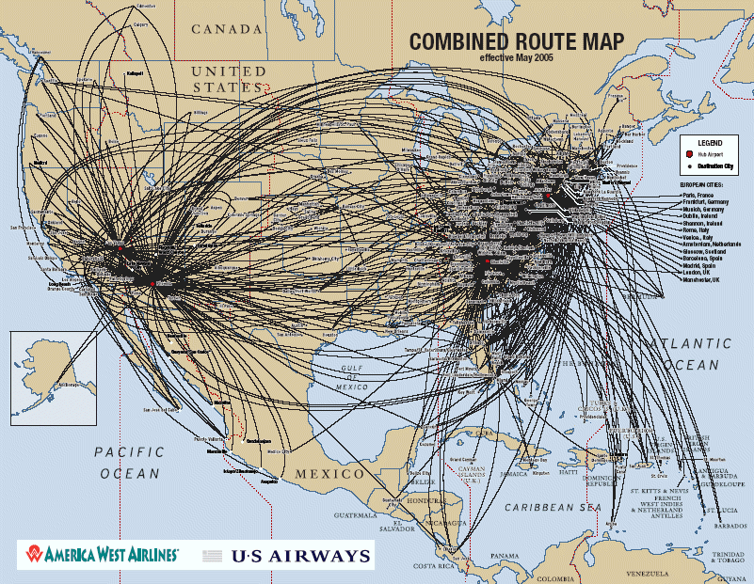
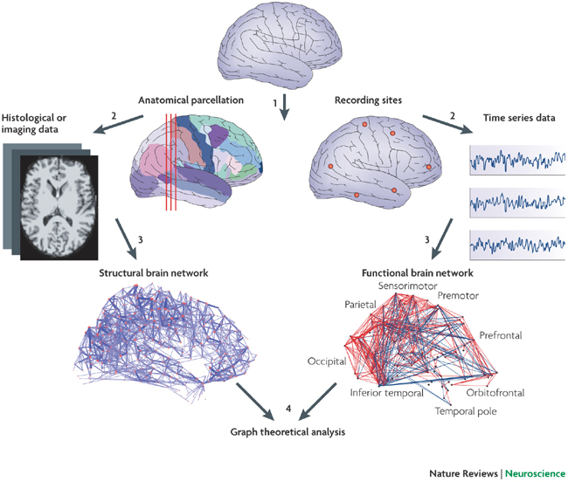
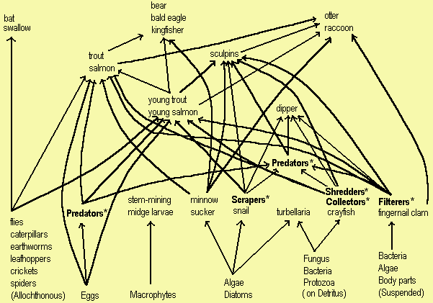
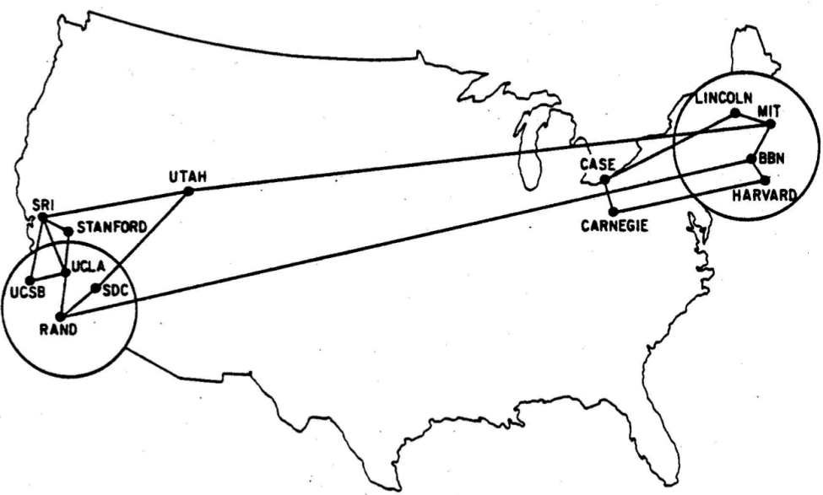
1. SNA Introduction
2. Graphs
A. Basics
B. Beyond nodes
C. Beyond edges
3. Network Structure
A. Components, clusters,
B. Ties & Bridges
C. Centrality
4. Community Detection
A. Graph bisection
B. Edge removal
C. Hierarchical clust.
D. Stoch. block models
5. Random Graphs
A. Poisson model
B. Small worlds
C. Configuration
Networks are everywhere…
Transportation
Biological
Ecological
Computing

Slide 5
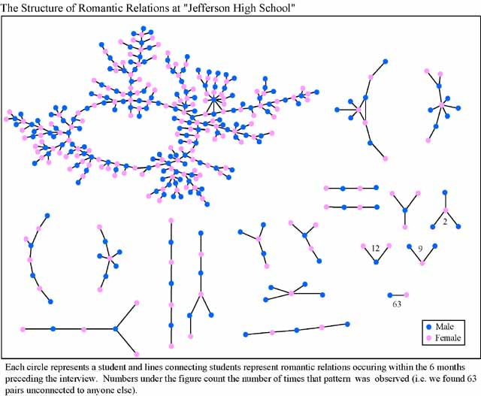
1. SNA Introduction
2. Graphs
A. Basics
B. Beyond nodes
C. Beyond edges
3. Network Structure
A. Components, clusters,
B. Ties & Bridges
C. Centrality
4. Community Detection
A. Graph bisection
B. Edge removal
C. Hierarchical clust.
D. Stoch. block models
5. Random Graphs
A. Poisson model
B. Small worlds
C. Configuration
Dfn: A social network is...
a description of the social structure between actors, mostly individuals or organizations.
It indicates the ways in which they are connected through various social familiarities ranging from casual acquaintance to close familiar bonds.

Slide 6
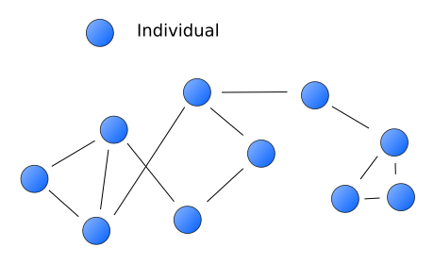
1. SNA Introduction
2. Graphs
A. Basics
B. Beyond nodes
C. Beyond edges
3. Network Structure
A. Components, clusters,
B. Ties & Bridges
C. Centrality
4. Community Detection
A. Graph bisection
B. Edge removal
C. Hierarchical clust.
D. Stoch. block models
5. Random Graphs
A. Poisson model
B. Small worlds
C. Configuration
Social Network Analysis is...
… mapping & measuring relationships & flows between
people, groups, orgs, computers, or other information/knowledge
processing entities

Slide 7
Graph Theory
1. SNA Introduction
2. Graphs
A. Basics
B. Beyond nodes
C. Beyond edges
3. Network Structure
A. Components, clusters,
B. Ties & Bridges
C. Centrality
4. Community Detection
A. Graph bisection
B. Edge removal
C. Hierarchical clust.
D. Stoch. block models
5. Random Graphs
A. Poisson model
B. Small worlds
C. Configuration

Slide 8
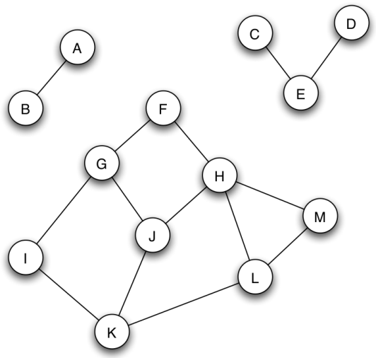
1. SNA Introduction
2. Graphs
A. Basics
B. Beyond nodes
C. Beyond edges
3. Network Structure
A. Components, clusters,
B. Ties & Bridges
C. Centrality
4. Community Detection
A. Graph bisection
B. Edge removal
C. Hierarchical clust.
D. Stoch. block models
5. Random Graphs
A. Poisson model
B. Small worlds
C. Configuration
A Network is a Graph
Dfn: A graph G is a tuple (V, E)
Edges in E connect vertices in V
An adjacency matrix shows which vertices are connected.
 | A | B | C | D | E | F | G | H | I | J | K | L | M
A | 0 | 1 | 0 | …
B | 1 | 0 | 0 | …
C | 0 | 0 | ... |  | 1
D | … | … |  |  | 1
E |  |  | 1 | 1
F |  |  |  |  |  |  | 1 | 1
G |  |  |  |  |  | 1 |  |  | 1 | 1
H |  |  |  |  |  | 1 |  |  |  | 1 |  |  | 1
I |  |  |  |  |  |  | 1 |  |  |  | 1
J |  |  |  |  |  |  | 1 | 1 |  |  | 1
K |  |  |  |  |  |  |  |  | 1 | 1 |  | 1
L |  |  |  |  |  |  |  |  |  |  | 1 |  | 1
M |  |  |  |  |  |  |  | 1 |  |  |  | 1

Slide 9
1. SNA Introduction
2. Graphs
A. Basics
B. Beyond nodes
C. Beyond edges
3. Network Structure
A. Components, clusters,
B. Ties & Bridges
C. Centrality
4. Community Detection
A. Graph bisection
B. Edge removal
C. Hierarchical clust.
D. Stoch. block models
5. Random Graphs
A. Poisson model
B. Small worlds
C. Configuration
Graphs: Undirected/Directed
A
A
E
B
E
B
D
C
D
C
Edges: defined by 2 vertices v and u
Undirected: unordered (v, u)
Directed: ordered (v, u)

Slide 10
Practice:
1. SNA Introduction
2. Graphs
A. Basics
B. Beyond nodes
C. Beyond edges
3. Network Structure
A. Components, clusters,
B. Ties & Bridges
C. Centrality
4. Community Detection
A. Graph bisection
B. Edge removal
C. Hierarchical clust.
D. Stoch. block models
5. Random Graphs
A. Poisson model
B. Small worlds
C. Configuration
A
A
E
B
E
B
D
C
D
C
For each pictured graph, write the node set, edge set, and adjacency matrix.

Slide 11
1. SNA Introduction
2. Graphs
A. Basics
B. Beyond nodes
C. Beyond edges
3. Network Structure
A. Components, clusters,
B. Ties & Bridges
C. Centrality
4. Community Detection
A. Graph bisection
B. Edge removal
C. Hierarchical clust.
D. Stoch. block models
5. Random Graphs
A. Poisson model
B. Small worlds
C. Configuration
Review: Node Degree
Dfn: The node degree is the number of neighbors a node has.
|N(v)|
w.r.t. adjacency matrix:
A
deg=3
E
B
adjacency matrix value
D
C
 | A | B | C | D | E
A | 0 | 1 | 0 | 0 | 1
B | 1 | 0 | 1 | 0 | 0
C | 0 | 1 | 0 | 0 | 1
D | 0 | 0 | 0 | 0 | 1
E | 1 | 0 | 1 | 1 | 0
pick row v

Slide 12
Directed: In- & Out-Degree
1. SNA Introduction
2. Graphs
A. Basics
B. Beyond nodes
C. Beyond edges
3. Network Structure
A. Components, clusters,
B. Ties & Bridges
C. Centrality
4. Community Detection
A. Graph bisection
B. Edge removal
C. Hierarchical clust.
D. Stoch. block models
5. Random Graphs
A. Poisson model
B. Small worlds
C. Configuration
A
Out-degree:
In-degree:
E
B
D
C
column v, not row
 | A | B | C | D | E
A | 0 | 1 | 0 | 0 | 1
B | 0 | 0 | 0 | 0 | 0
C | 0 | 1 | 0 | 0 | 1
D | 0 | 0 | 0 | 0 | 0
E | 0 | 0 | 0 | 1 | 0

Slide 13
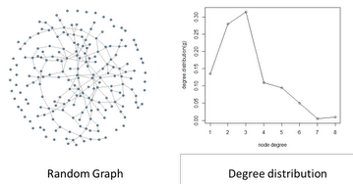
Degree Distribution
1. SNA Introduction
2. Graphs
A. Basics
B. Beyond nodes
C. Beyond edges
3. Network Structure
A. Components, clusters,
B. Ties & Bridges
C. Centrality
4. Community Detection
A. Graph bisection
B. Edge removal
C. Hierarchical clust.
D. Stoch. block models
5. Random Graphs
A. Poisson model
B. Small worlds
C. Configuration
Plot node degrees of every node
Statistics: max, min, mean, variance, skewness, kurtosis
Useful: classifying graphs

Slide 14
Avg. node degree, Connectance
1. SNA Introduction
2. Graphs
A. Basics
B. Beyond nodes
C. Beyond edges
3. Network Structure
A. Components, clusters,
B. Ties & Bridges
C. Centrality
4. Community Detection
A. Graph bisection
B. Edge removal
C. Hierarchical clust.
D. Stoch. block models
5. Random Graphs
A. Poisson model
B. Small worlds
C. Configuration
# edges
Average node degree:
Connectance:
Intuition: How connected is it?
# vertices
scale by network size

Slide 15
Practice:
1. SNA Introduction
2. Graphs
A. Basics
B. Beyond nodes
C. Beyond edges
3. Network Structure
A. Components, clusters,
B. Ties & Bridges
C. Centrality
4. Community Detection
A. Graph bisection
B. Edge removal
C. Hierarchical clust.
D. Stoch. block models
5. Random Graphs
A. Poisson model
B. Small worlds
C. Configuration
Find the average node degree and plot the degree distribution for this graph.
A
E
B
D
C

Slide 16
1. SNA Introduction
2. Graphs
A. Basics
B. Beyond nodes
C. Beyond edges
3. Network Structure
A. Components, clusters,
B. Ties & Bridges
C. Centrality
4. Community Detection
A. Graph bisection
B. Edge removal
C. Hierarchical clust.
D. Stoch. block models
5. Random Graphs
A. Poisson model
B. Small worlds
C. Configuration
Paths & Cycles
Dfn: A path is a sequence of nodes where pairs of consecutive nodes are connected by an edge.
Directed graph: direction matters!
Dfn: A cycle is a path where the start node is also the end node
A
E
B
Paths? Cycles?
D
C

Slide 17
1. SNA Introduction
2. Graphs
A. Basics
B. Beyond nodes
C. Beyond edges
3. Network Structure
A. Components, clusters,
B. Ties & Bridges
C. Centrality
4. Community Detection
A. Graph bisection
B. Edge removal
C. Hierarchical clust.
D. Stoch. block models
5. Random Graphs
A. Poisson model
B. Small worlds
C. Configuration
Path Length/Distance
Dfn: The distance between 2 nodes in a graph = length of the shortest path linking the 2 nodes
Note: Need to find shortest path!
A
E
B
Distance? Diameter?
D
C

Slide 18
1. SNA Introduction
2. Graphs
A. Basics
B. Beyond nodes
C. Beyond edges
3. Network Structure
A. Components, clusters,
B. Ties & Bridges
C. Centrality
4. Community Detection
A. Graph bisection
B. Edge removal
C. Hierarchical clust.
D. Stoch. block models
5. Random Graphs
A. Poisson model
B. Small worlds
C. Configuration
Distance & Diameter
Dfn: The distance d_{v,u} between 2 nodes in a graph = length of the shortest path linking the 2 nodes
Dfn: The diameter of the graph is the max distance between a node pair
A
A
E
E
B
B
D
D
C
C

Slide 19
Distance-based Metrics
1. SNA Introduction
2. Graphs
A. Basics
B. Beyond nodes
C. Beyond edges
3. Network Structure
A. Components, clusters,
B. Ties & Bridges
C. Centrality
4. Community Detection
A. Graph bisection
B. Edge removal
C. Hierarchical clust.
D. Stoch. block models
5. Random Graphs
A. Poisson model
B. Small worlds
C. Configuration
The characteristic path length is the average shortest path length (average distance).
Graph efficiency measures how easily information is transferred.
distance from v to u
# possible node pairs

Slide 20
Practice:
1. SNA Introduction
2. Graphs
A. Basics
B. Beyond nodes
C. Beyond edges
3. Network Structure
A. Components, clusters,
B. Ties & Bridges
C. Centrality
4. Community Detection
A. Graph bisection
B. Edge removal
C. Hierarchical clust.
D. Stoch. block models
5. Random Graphs
A. Poisson model
B. Small worlds
C. Configuration
Find the characteristic path length and efficiency of this graph.
A
E
B
D
C

Slide 21
Network Structure
1. SNA Introduction
2. Graphs
A. Basics
B. Beyond nodes
C. Beyond edges
3. Network Structure
A. Components, clusters,
B. Ties & Bridges
C. Centrality
4. Community Detection
A. Graph bisection
B. Edge removal
C. Hierarchical clust.
D. Stoch. block models
5. Random Graphs
A. Poisson model
B. Small worlds
C. Configuration

Slide 22
1. SNA Introduction
2. Graphs
A. Basics
B. Beyond nodes
C. Beyond edges
3. Network Structure
A. Components, clusters,
B. Ties & Bridges
C. Centrality
4. Community Detection
A. Graph bisection
B. Edge removal
C. Hierarchical clust.
D. Stoch. block models
5. Random Graphs
A. Poisson model
B. Small worlds
C. Configuration
Connectedness & Components
Not edge!
Dfn: A graph (or subgraph) is connected if there is a path between each pair of nodes.
Dfn: a connected component is a subset S of nodes where:
Every node in S has a path to every other
S is not part of a larger subset S’ where property #1 holds

Slide 23
Giant Components
1. SNA Introduction
2. Graphs
A. Basics
B. Beyond nodes
C. Beyond edges
3. Network Structure
A. Components, clusters,
B. Ties & Bridges
C. Centrality
4. Community Detection
A. Graph bisection
B. Edge removal
C. Hierarchical clust.
D. Stoch. block models
5. Random Graphs
A. Poisson model
B. Small worlds
C. Configuration
A giant component: “connected component that contains a significant fraction of all the nodes”
Ex: Real-world
Ex: Random graphs (Erdos-Renyi model)

Slide 24
Cliques
1. SNA Introduction
2. Graphs
A. Basics
B. Beyond nodes
C. Beyond edges
3. Network Structure
A. Components, clusters,
B. Ties & Bridges
C. Centrality
4. Community Detection
A. Graph bisection
B. Edge removal
C. Hierarchical clust.
D. Stoch. block models
5. Random Graphs
A. Poisson model
B. Small worlds
C. Configuration
Dfn: A clique is a maximal, completely connected subgraph of a given graph.
B
B
B
C
A
C
A
C
A
D
D
D

Slide 25
Clustering Coefficient
1. SNA Introduction
2. Graphs
A. Basics
B. Beyond nodes
C. Beyond edges
3. Network Structure
A. Components, clusters,
B. Ties & Bridges
C. Centrality
4. Community Detection
A. Graph bisection
B. Edge removal
C. Hierarchical clust.
D. Stoch. block models
5. Random Graphs
A. Poisson model
B. Small worlds
C. Configuration
Dfn: The (overall) clustering coefficient of a node v is
the probability that u₁, u₂ (two randomly selected neighbors of v) are themselves neighbors.
neighbors of v that are linked
Any 2 neighbors of v

Slide 26
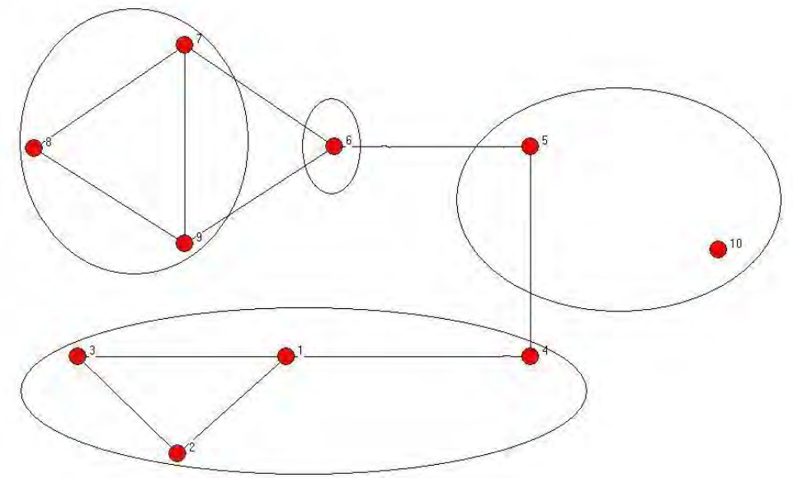
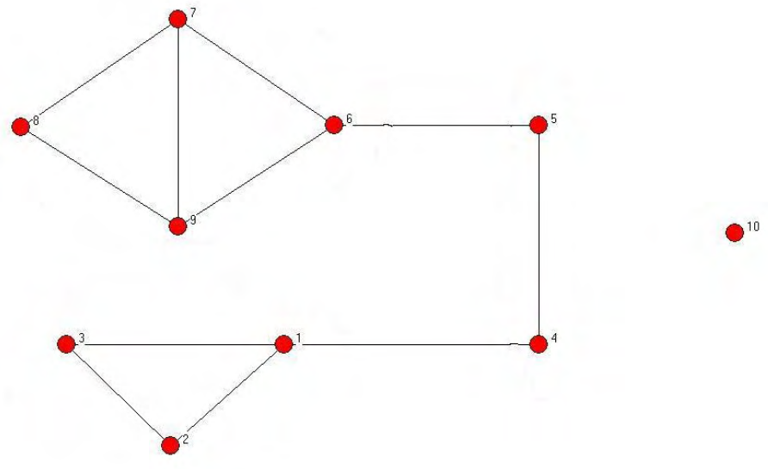
Community structure
1. SNA Introduction
2. Graphs
A. Basics
B. Beyond nodes
C. Beyond edges
3. Network Structure
A. Components, clusters,
B. Ties & Bridges
C. Centrality
4. Community Detection
A. Graph bisection
B. Edge removal
C. Hierarchical clust.
D. Stoch. block models
5. Random Graphs
A. Poisson model
B. Small worlds
C. Configuration
defined on nodes/vertices
Dfn: A community structure, ∏, is a collection of disjoint subsets of V (i.e., a partition) whose union is V.

Slide 27
Structural equivalence
1. SNA Introduction
2. Graphs
A. Basics
B. Beyond nodes
C. Beyond edges
3. Network Structure
A. Components, clusters,
B. Ties & Bridges
C. Centrality
4. Community Detection
A. Graph bisection
B. Edge removal
C. Hierarchical clust.
D. Stoch. block models
5. Random Graphs
A. Poisson model
B. Small worlds
C. Configuration
Dfn: Two nodes i and j are structurally equivalent for graph G if:
I.e., relationships to all other nodes are identical!
In practice: too rigid
Group into equivalence classes
edges are the same
all other nodes

Slide 28
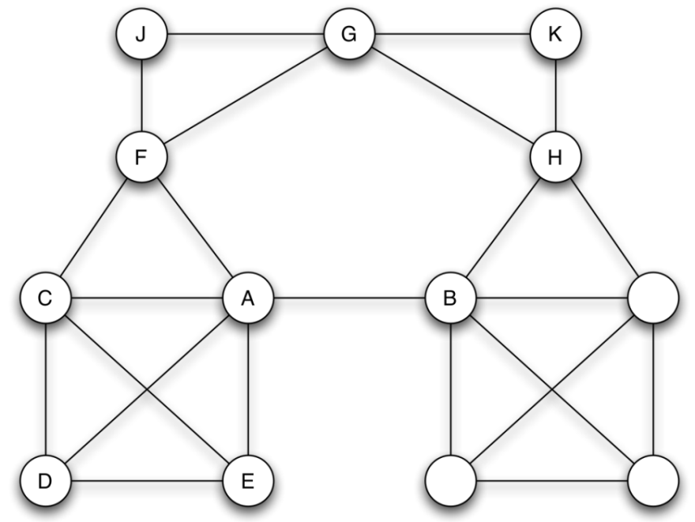
Practice:
1. SNA Introduction
2. Graphs
A. Basics
B. Beyond nodes
C. Beyond edges
3. Network Structure
A. Components, clusters,
B. Ties & Bridges
C. Centrality
4. Community Detection
A. Graph bisection
B. Edge removal
C. Hierarchical clust.
D. Stoch. block models
5. Random Graphs
A. Poisson model
B. Small worlds
C. Configuration
Find all cliques and structurally equivalent nodes.
What is the clustering coefficient of A? of E?
L
M
N

Slide 29
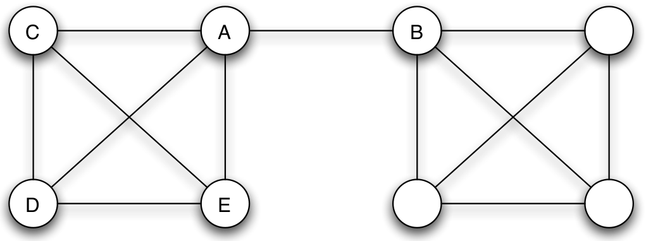
Bridges
1. SNA Introduction
2. Graphs
A. Basics
B. Beyond nodes
C. Beyond edges
3. Network Structure
A. Components, clusters,
B. Ties & Bridges
C. Centrality
4. Community Detection
A. Graph bisection
B. Edge removal
C. Hierarchical clust.
D. Stoch. block models
5. Random Graphs
A. Poisson model
B. Small worlds
C. Configuration
Dfn:
An edge e
is a bridge
in the graph G
if G―e
has more components than G
What about giant components?

Slide 30

Local Bridges
1. SNA Introduction
2. Graphs
A. Basics
B. Beyond nodes
C. Beyond edges
3. Network Structure
A. Components, clusters,
B. Ties & Bridges
C. Centrality
4. Community Detection
A. Graph bisection
B. Edge removal
C. Hierarchical clust.
D. Stoch. block models
5. Random Graphs
A. Poisson model
B. Small worlds
C. Configuration
Dfn:
An edge e = (v,u)
is a local bridge
in the graph G
if path_{G-e}(v, u) ― path_{G}(v, u) > 2
i.e., no friends in common
span of local bridge

Slide 31
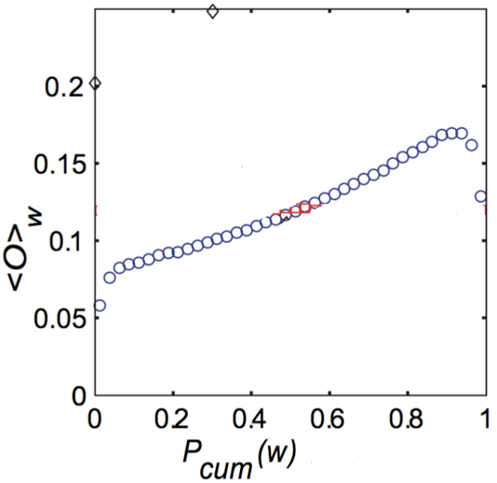
Neighborhood Overlap
1. SNA Introduction
2. Graphs
A. Basics
B. Beyond nodes
C. Beyond edges
3. Network Structure
A. Components, clusters,
B. Ties & Bridges
C. Centrality
4. Community Detection
A. Graph bisection
B. Edge removal
C. Hierarchical clust.
D. Stoch. block models
5. Random Graphs
A. Poisson model
B. Small worlds
C. Configuration
Dfn: The neighborhood overlap of an edge e = (v, u) is:
shared neighbors (i.e., triadic closure)
all neighbors of either node

Slide 32
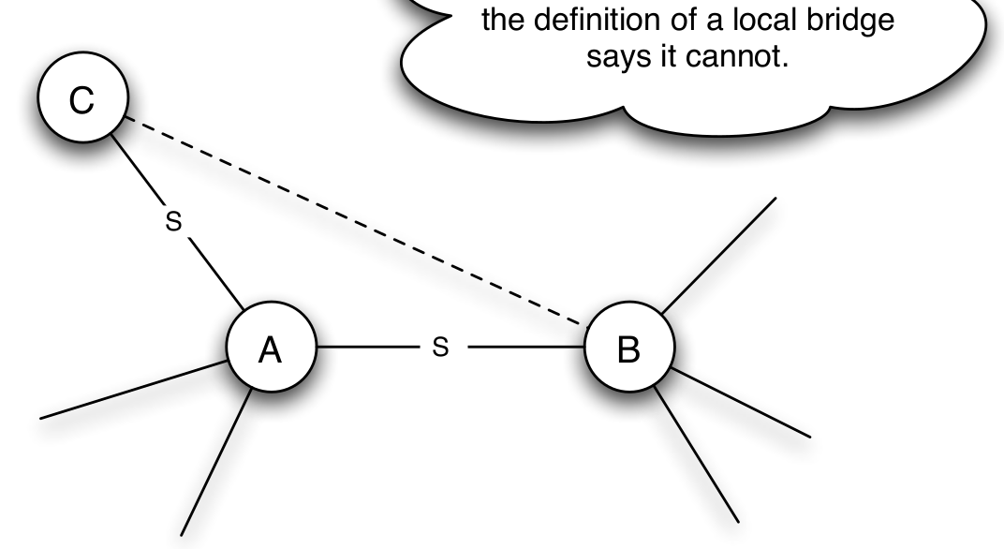
Local Bridges must be Weak Ties!
1. SNA Introduction
2. Graphs
A. Basics
B. Beyond nodes
C. Beyond edges
3. Network Structure
A. Components, clusters,
B. Ties & Bridges
C. Centrality
4. Community Detection
A. Graph bisection
B. Edge removal
C. Hierarchical clust.
D. Stoch. block models
5. Random Graphs
A. Poisson model
B. Small worlds
C. Configuration
What if:
A has strong ties
A = local bridge
Contradiction!
Strong Triadic Closure violated
A has strong ties to 2 other nodes B and C
and there is no edge at all (strong or weak) between B and C

Slide 33

Practice:
1. SNA Introduction
2. Graphs
A. Basics
B. Beyond nodes
C. Beyond edges
3. Network Structure
A. Components, clusters,
B. Ties & Bridges
C. Centrality
4. Community Detection
A. Graph bisection
B. Edge removal
C. Hierarchical clust.
D. Stoch. block models
5. Random Graphs
A. Poisson model
B. Small worlds
C. Configuration
What are the span and neighborhood overlap of :
1. BC edge? 2. AB edge?
G
B
C
F
A
E
D
Notes:
BC Neighborhood overlap = ¼
Neighbors: 4
B: G, F, A, (C)
C: (B), A, D
Shared: 1
A
AB Neighborhood overlap: 0
Neighbors: 8
Shared: 0

Slide 34
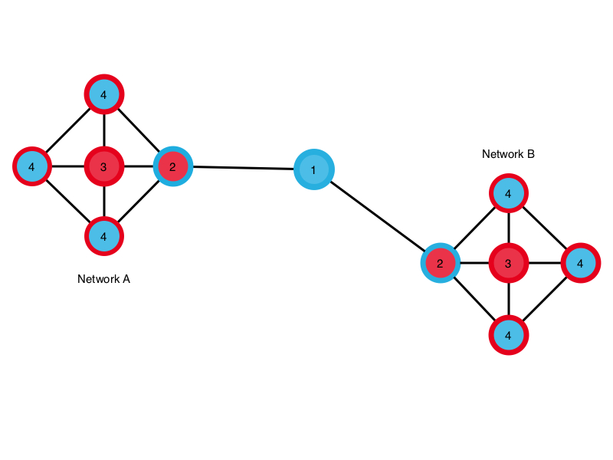
Degree Centrality
1. SNA Introduction
2. Graphs
A. Basics
B. Beyond nodes
C. Beyond edges
3. Network Structure
A. Components, clusters,
B. Ties & Bridges
C. Centrality
4. Community Detection
A. Graph bisection
B. Edge removal
C. Hierarchical clust.
D. Stoch. block models
5. Random Graphs
A. Poisson model
B. Small worlds
C. Configuration
How connected is the node?
Node degree, scaled to [0,1]
Missing: node location?
degree of node i
# of nodes in network (not i)

Slide 35
Betweenness Centrality
1. SNA Introduction
2. Graphs
A. Basics
B. Beyond nodes
C. Beyond edges
3. Network Structure
A. Components, clusters,
B. Ties & Bridges
C. Centrality
4. Community Detection
A. Graph bisection
B. Edge removal
C. Hierarchical clust.
D. Stoch. block models
5. Random Graphs
A. Poisson model
B. Small worlds
C. Configuration
How important is this node in connecting others?
# shortest paths between k and j that include i
# shortest paths between k and j

Slide 36
Closeness Centrality
1. SNA Introduction
2. Graphs
A. Basics
B. Beyond nodes
C. Beyond edges
3. Network Structure
A. Components, clusters,
B. Ties & Bridges
C. Centrality
4. Community Detection
A. Graph bisection
B. Edge removal
C. Hierarchical clust.
D. Stoch. block models
5. Random Graphs
A. Poisson model
B. Small worlds
C. Configuration
How easily can a node reach others?
Simple: Inverse average distance
Decay centrality:
# nodes (not i)
avg. distance from node i
If δ -> 0?
If δ -> 1?
Degree centrality
Component size
decay parameter in [0,1]

Slide 37
Information Centrality
1. SNA Introduction
2. Graphs
A. Basics
B. Beyond nodes
C. Beyond edges
3. Network Structure
A. Components, clusters,
B. Ties & Bridges
C. Centrality
4. Community Detection
A. Graph bisection
B. Edge removal
C. Hierarchical clust.
D. Stoch. block models
5. Random Graphs
A. Poisson model
B. Small worlds
C. Configuration
How well can the network respond if a node is deactivated?
Measure in graph efficiency:
Compare the change in efficiency
graph G without node i or corresponding edges

Slide 38
Practice:
1. SNA Introduction
2. Graphs
A. Basics
B. Beyond nodes
C. Beyond edges
3. Network Structure
A. Components, clusters,
B. Ties & Bridges
C. Centrality
4. Community Detection
A. Graph bisection
B. Edge removal
C. Hierarchical clust.
D. Stoch. block models
5. Random Graphs
A. Poisson model
B. Small worlds
C. Configuration
Calculate centrality values for Node A: degree centrality, betweenness centrality, closeness centrality, information centrality
G
B
C
F
A
E
D
Notes:
BC Neighborhood overlap = ¼
Neighbors: 4
B: G, F, A, (C)
C: (B), A, D
Shared: 1
A
AB Neighborhood overlap: 0
Neighbors: 8
Shared: 0

Slide 39
Group Exercise (E&K 2.4.1):
A node X is pivotal for a pair of distinct nodes Y and Z if X lies on every shortest path between Y and Z (and X is not equal to either Y or Z).
Give an example of a graph in which every node is pivotal for at least two different pairs of nodes.
Explain your answer.

Slide 40
Group Exercise (E&K 2.4.2):
A node X is a gatekeeper if for some other two nodes Y and Z, every path from Y to Z passes through X.
A node X is a local gatekeeper if there are two neighbors of X, say Y and Z, that are not connected by an edge.
Give an example (together with an explanation) of a graph in which more than half of all nodes are gatekeepers.

Slide 41
Community Detection
1. SNA Introduction
2. Graphs
A. Basics
B. Beyond nodes
C. Beyond edges
3. Network Structure
A. Components, clusters,
B. Ties & Bridges
C. Centrality
4. Community Detection
A. Graph bisection
B. Edge removal
C. Hierarchical clust.
D. Stoch. block models
5. Random Graphs
A. Poisson model
B. Small worlds
C. Configuration

Slide 42
Graph Bisection Intuition
1. SNA Introduction
2. Graphs
A. Basics
B. Beyond nodes
C. Beyond edges
3. Network Structure
A. Components, clusters,
B. Ties & Bridges
C. Centrality
4. Community Detection
A. Graph bisection
B. Edge removal
C. Hierarchical clust.
D. Stoch. block models
5. Random Graphs
A. Poisson model
B. Small worlds
C. Configuration
In a partition, nodes are similar (w.r.t. edges)
Find similar nodes e.g., via correlation
Pattern of edges: adjacency matrix
2D adjacency matrix -> 2D correlation matrix
Iterate!... Will become stable…

Slide 43
CONCOR Graph Bisection
1. SNA Introduction
2. Graphs
A. Basics
B. Beyond nodes
C. Beyond edges
3. Network Structure
A. Components, clusters,
B. Ties & Bridges
C. Centrality
4. Community Detection
A. Graph bisection
B. Edge removal
C. Hierarchical clust.
D. Stoch. block models
5. Random Graphs
A. Poisson model
B. Small worlds
C. Configuration
A
 | A | B | C | D | E | F | G | H | I | J | K | L | M
A | 0 | 1 | 0 | 0 | 0 | 0 | 0 | 0 | 0 | 0 | 0 | 0 | 0
B | 1 | 0 | 0 | 0 | 0 | 0 | 0 | 0 | 0 | 0 | 0 | 0 | 0
C | 0 | 0 | 0 | 0 | 1 | 0 | 0 | 0 | 0 | 0 | 0 | 0 | 0
D | 0 | 0 | 0 | 0 | 1 | 0 | 0 | 0 | 0 | 0 | 0 | 0 | 0
E | 0 | 0 | 1 | 1 | 0 | 0 | 0 | 0 | 0 | 0 | 0 | 0 | 0
F | 0 | 0 | 0 | 0 | 0 | 0 | 1 | 1 | 0 | 0 | 0 | 0 | 0
G | 0 | 0 | 0 | 0 | 0 | 1 | 0 | 0 | 1 | 1 | 0 | 0 | 0
H | 0 | 0 | 0 | 0 | 0 | 1 | 0 | 0 | 0 | 1 | 0 | 0 | 1
I | 0 | 0 | 0 | 0 | 0 | 0 | 1 | 0 | 0 | 0 | 1 | 0 | 0
J | 0 | 0 | 0 | 0 | 0 | 0 | 1 | 1 | 0 | 0 | 1 | 0 | 0
K | 0 | 0 | 0 | 0 | 0 | 0 | 0 | 0 | 1 | 1 | 0 | 1 | 0
L | 0 | 0 | 0 | 0 | 0 | 0 | 0 | 0 | 0 | 0 | 1 | 0 | 1
M | 0 | 0 | 0 | 0 | 0 | 0 | 0 | 1 | 0 | 0 | 0 | 1 | 0
C⁽⁰⁾
 | A | B | C | D | E | F | G | H | I | J | K | L | M
A | 1.00 | -0.08 | -0.08 | -0.08 | -0.12 | -0.12 | -0.16 | -0.16 | -0.12 | -0.16 | -0.16 | -0.12 | -0.12
B | -0.08 | 1.00 | -0.08 | -0.08 | -0.12 | -0.12 | -0.16 | -0.16 | -0.12 | -0.16 | -0.16 | -0.12 | -0.12
C | -0.08 | -0.08 | 1.00 | 1.00 | -0.12 | -0.12 | -0.16 | -0.16 | -0.12 | -0.16 | -0.16 | -0.12 | -0.12
D | -0.08 | -0.08 | 1.00 | 1.00 | -0.12 | -0.12 | -0.16 | -0.16 | -0.12 | -0.16 | -0.16 | -0.12 | -0.12
E | -0.12 | -0.12 | -0.12 | -0.12 | 1.00 | -0.18 | -0.23 | -0.23 | -0.18 | -0.23 | -0.23 | -0.18 | -0.18
F | -0.12 | -0.12 | -0.12 | -0.12 | -0.18 | 1.00 | -0.23 | -0.23 | 0.41 | 0.78 | -0.23 | -0.18 | 0.41
G | -0.16 | -0.16 | -0.16 | -0.16 | -0.23 | -0.23 | 1.00 | 0.57 | -0.23 | -0.30 | 0.57 | -0.23 | -0.23
H | -0.16 | -0.16 | -0.16 | -0.16 | -0.23 | -0.23 | 0.57 | 1.00 | -0.23 | -0.30 | 0.13 | 0.27 | -0.23
I | -0.12 | -0.12 | -0.12 | -0.12 | -0.18 | 0.41 | -0.23 | -0.23 | 1.00 | 0.78 | -0.23 | 0.41 | -0.18
J | -0.16 | -0.16 | -0.16 | -0.16 | -0.23 | 0.78 | -0.30 | -0.30 | 0.78 | 1.00 | -0.30 | 0.27 | 0.27
K | -0.16 | -0.16 | -0.16 | -0.16 | -0.23 | -0.23 | 0.57 | 0.13 | -0.23 | -0.30 | 1.00 | -0.23 | 0.27
L | -0.12 | -0.12 | -0.12 | -0.12 | -0.18 | -0.18 | -0.23 | 0.27 | 0.41 | 0.27 | -0.23 | 1.00 | -0.18
M | -0.12 | -0.12 | -0.12 | -0.12 | -0.18 | 0.41 | -0.23 | -0.23 | -0.18 | 0.27 | 0.27 | -0.18 | 1.00
C^{(t)}
C⁽¹⁾
 | A | B | C | D | E | F | G | H | I | J | K | L | M
A | 1 | 1 | 1 | 1 | 1 | -1 | 1 | 1 | -1 | -1 | 1 | -1 | -1
B | 1 | 1 | 1 | 1 | 1 | -1 | 1 | 1 | -1 | -1 | 1 | -1 | -1
C | 1 | 1 | 1 | 1 | 1 | -1 | 1 | 1 | -1 | -1 | 1 | -1 | -1
D | 1 | 1 | 1 | 1 | 1 | -1 | 1 | 1 | -1 | -1 | 1 | -1 | -1
E | 1 | 1 | 1 | 1 | 1 | -1 | 1 | 1 | -1 | -1 | 1 | -1 | -1
F | -1 | -1 | -1 | -1 | -1 | 1 | -1 | -1 | 1 | 1 | -1 | 1 | 1
G | 1 | 1 | 1 | 1 | 1 | -1 | 1 | 1 | -1 | -1 | 1 | -1 | -1
H | 1 | 1 | 1 | 1 | 1 | -1 | 1 | 1 | -1 | -1 | 1 | -1 | -1
I | -1 | -1 | -1 | -1 | -1 | 1 | -1 | -1 | 1 | 1 | -1 | 1 | 1
J | -1 | -1 | -1 | -1 | -1 | 1 | -1 | -1 | 1 | 1 | -1 | 1 | 1
K | 1 | 1 | 1 | 1 | 1 | -1 | 1 | 1 | -1 | -1 | 1 | -1 | -1
L | -1 | -1 | -1 | -1 | -1 | 1 | -1 | -1 | 1 | 1 | -1 | 1 | 1
M | -1 | -1 | -1 | -1 | -1 | 1 | -1 | -1 | 1 | 1 | -1 | 1 | 1
 | A | B | C | D | E | F | G | H | I | J | K | L | M
A | 1.00 | -0.08 | -0.08 | -0.08 | -0.12 | -0.12 | -0.16 | -0.16 | -0.12 | -0.16 | -0.16 | -0.12 | -0.12
B | -0.08 | 1.00 | -0.08 | -0.08 | -0.12 | -0.12 | -0.16 | -0.16 | -0.12 | -0.16 | -0.16 | -0.12 | -0.12
C | -0.08 | -0.08 | 1.00 | 1.00 | -0.12 | -0.12 | -0.16 | -0.16 | -0.12 | -0.16 | -0.16 | -0.12 | -0.12
D | -0.08 | -0.08 | 1.00 | 1.00 | -0.12 | -0.12 | -0.16 | -0.16 | -0.12 | -0.16 | -0.16 | -0.12 | -0.12
E | -0.12 | -0.12 | -0.12 | -0.12 | 1.00 | -0.18 | -0.23 | -0.23 | -0.18 | -0.23 | -0.23 | -0.18 | -0.18
F | -0.12 | -0.12 | -0.12 | -0.12 | -0.18 | 1.00 | -0.23 | -0.23 | 0.41 | 0.78 | -0.23 | -0.18 | 0.41
G | -0.16 | -0.16 | -0.16 | -0.16 | -0.23 | -0.23 | 1.00 | 0.57 | -0.23 | -0.30 | 0.57 | -0.23 | -0.23
H | -0.16 | -0.16 | -0.16 | -0.16 | -0.23 | -0.23 | 0.57 | 1.00 | -0.23 | -0.30 | 0.13 | 0.27 | -0.23
I | -0.12 | -0.12 | -0.12 | -0.12 | -0.18 | 0.41 | -0.23 | -0.23 | 1.00 | 0.78 | -0.23 | 0.41 | -0.18
J | -0.16 | -0.16 | -0.16 | -0.16 | -0.23 | 0.78 | -0.30 | -0.30 | 0.78 | 1.00 | -0.30 | 0.27 | 0.27
K | -0.16 | -0.16 | -0.16 | -0.16 | -0.23 | -0.23 | 0.57 | 0.13 | -0.23 | -0.30 | 1.00 | -0.23 | 0.27
L | -0.12 | -0.12 | -0.12 | -0.12 | -0.18 | -0.18 | -0.23 | 0.27 | 0.41 | 0.27 | -0.23 | 1.00 | -0.18
M | -0.12 | -0.12 | -0.12 | -0.12 | -0.18 | 0.41 | -0.23 | -0.23 | -0.18 | 0.27 | 0.27 | -0.18 | 1.00
+1, -1: Two communities!

Slide 44
Practice:
1. SNA Introduction
2. Graphs
A. Basics
B. Beyond nodes
C. Beyond edges
3. Network Structure
A. Components, clusters,
B. Ties & Bridges
C. Centrality
4. Community Detection
A. Graph bisection
B. Edge removal
C. Hierarchical clust.
D. Stoch. block models
5. Random Graphs
A. Poisson model
B. Small worlds
C. Configuration
Make the first graph bisection in CONCOR on the graph below.
(use, e.g., CORREL in Excel)
G
B
C
F
A
E
D
Notes:
BC Neighborhood overlap = ¼
Neighbors: 4
B: G, F, A, (C)
C: (B), A, D
Shared: 1
A
AB Neighborhood overlap: 0
Neighbors: 8
Shared: 0

Slide 45
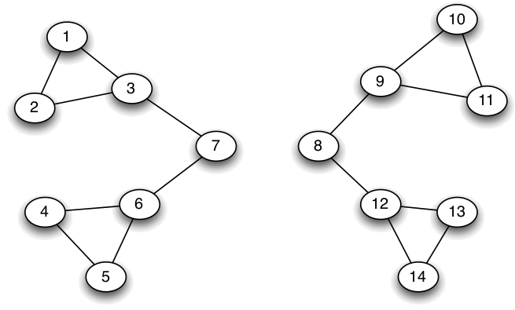
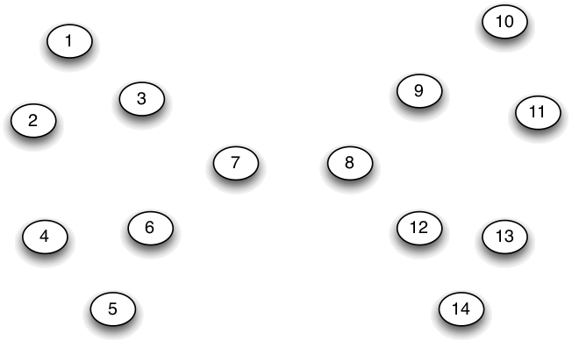
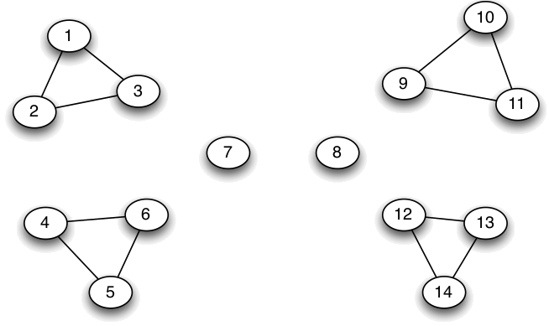
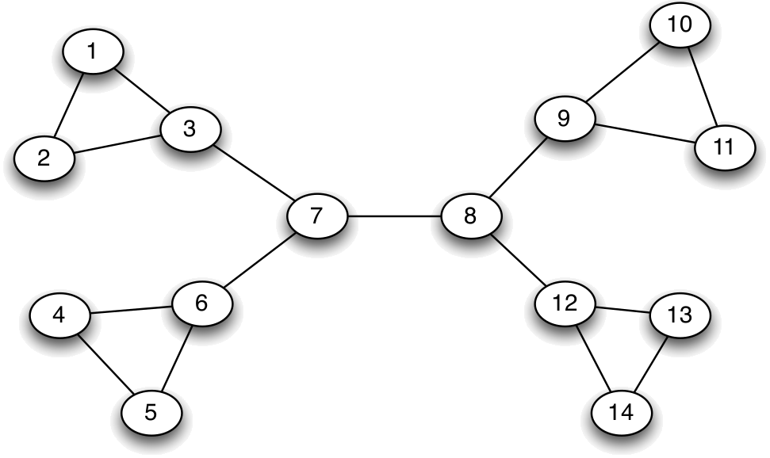
Girvan-Newman Edge Removal
1. SNA Introduction
2. Graphs
A. Basics
B. Beyond nodes
C. Beyond edges
3. Network Structure
A. Components, clusters,
B. Ties & Bridges
C. Centrality
4. Community Detection
A. Graph bisection
B. Edge removal
C. Hierarchical clust.
D. Stoch. block models
5. Random Graphs
A. Poisson model
B. Small worlds
C. Configuration
Calculate betweenness of all edges
Cut (remove max betweenness)
Repeat! Until…

Slide 46
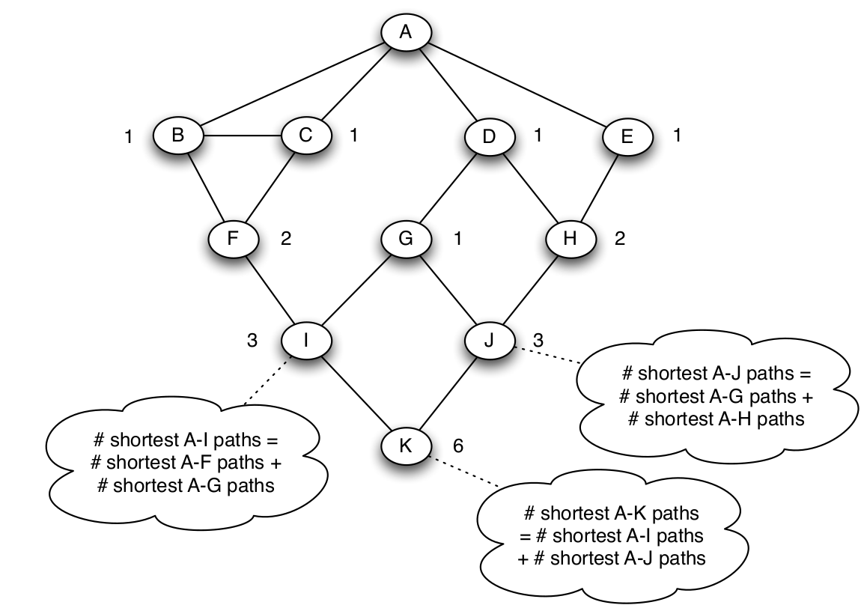
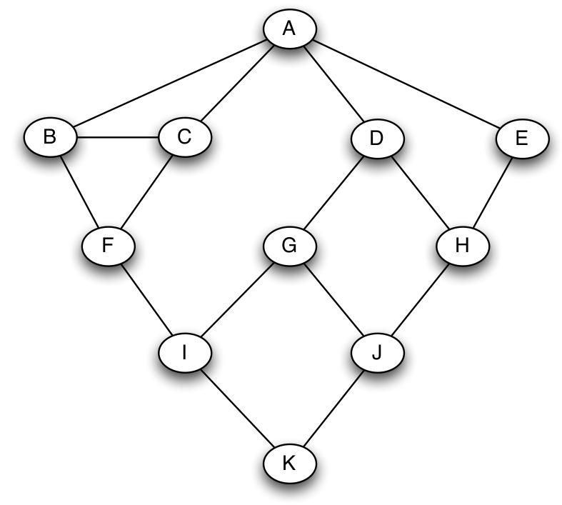
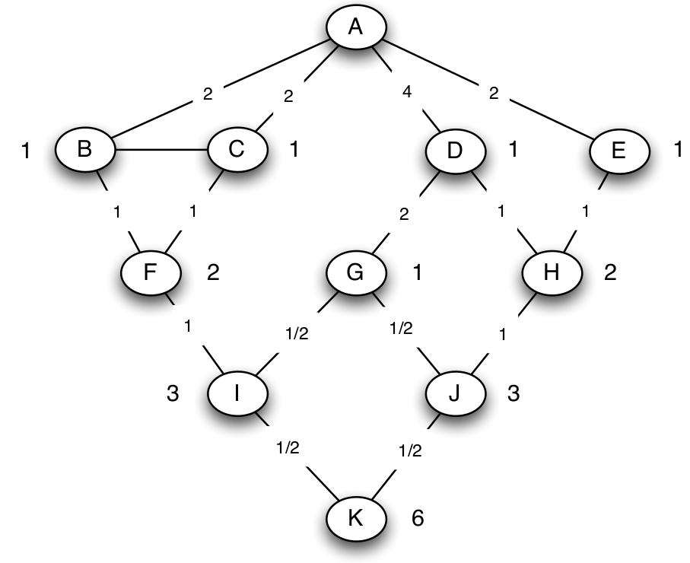
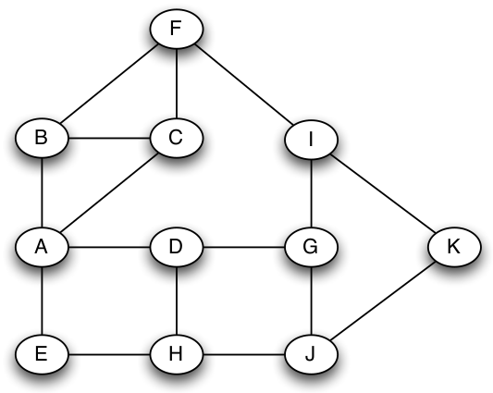
Computing Betweenness
1. SNA Introduction
2. Graphs
A. Basics
B. Beyond nodes
C. Beyond edges
3. Network Structure
A. Components, clusters,
B. Ties & Bridges
C. Centrality
4. Community Detection
A. Graph bisection
B. Edge removal
C. Hierarchical clust.
D. Stoch. block models
5. Random Graphs
A. Poisson model
B. Small worlds
C. Configuration
BFS from v
# shortest paths from v to each node
Propagate flow

Slide 47
Modularity thresholding
1. SNA Introduction
2. Graphs
A. Basics
B. Beyond nodes
C. Beyond edges
3. Network Structure
A. Components, clusters,
B. Ties & Bridges
C. Centrality
4. Community Detection
A. Graph bisection
B. Edge removal
C. Hierarchical clust.
D. Stoch. block models
5. Random Graphs
A. Poisson model
B. Small worlds
C. Configuration
Stopping criterion for partitioning
Expected random edges (Configuration model) within a community
the communities that v and u are assigned to
1_{v,u} = 1 if there is an edge v, u
1 if equal
count edges within a community
divide over all edges m

Slide 48
Practice:
1. SNA Introduction
2. Graphs
A. Basics
B. Beyond nodes
C. Beyond edges
3. Network Structure
A. Components, clusters,
B. Ties & Bridges
C. Centrality
4. Community Detection
A. Graph bisection
B. Edge removal
C. Hierarchical clust.
D. Stoch. block models
5. Random Graphs
A. Poisson model
B. Small worlds
C. Configuration
Compute betweenness and make the first cut on the graph below.
How does this change the Modularity?
G
B
C
F
A
E
D
Notes:
BC Neighborhood overlap = ¼
Neighbors: 4
B: G, F, A, (C)
C: (B), A, D
Shared: 1
A
AB Neighborhood overlap: 0
Neighbors: 8
Shared: 0

Slide 49
Intuition: Hierarchical Clustering
1. SNA Introduction
2. Graphs
A. Basics
B. Beyond nodes
C. Beyond edges
3. Network Structure
A. Components, clusters,
B. Ties & Bridges
C. Centrality
4. Community Detection
A. Graph bisection
B. Edge removal
C. Hierarchical clust.
D. Stoch. block models
5. Random Graphs
A. Poisson model
B. Small worlds
C. Configuration
Node similarity (distance) metric
Find communities on blank nodes
Apply threshold t₀ and add edges
Draw graph of communities G^{(t0)}
Community = Component of G^{(t0)}
Decrease (increase) threshold & repeat, yielding G^{(tn+1)}

Slide 50
Hier. Clustering Example (1)
1. SNA Introduction
2. Graphs
A. Basics
B. Beyond nodes
C. Beyond edges
3. Network Structure
A. Components, clusters,
B. Ties & Bridges
C. Centrality
4. Community Detection
A. Graph bisection
B. Edge removal
C. Hierarchical clust.
D. Stoch. block models
5. Random Graphs
A. Poisson model
B. Small worlds
C. Configuration
exclude
2 nodes
Node distance: Manhattan distance
 | 1 | 2 | 3 | 4 | 5 | 6 | 7 | 8 | 9 | 10
1 | 1 | 1 | 1 | 1 | 0 | 0 | 0 | 0 | 0 | 0
2 | 1 | 1 | 1 | 0 | 0 | 0 | 0 | 0 | 0 | 0
3 | 1 | 1 | 1 | 0 | 0 | 0 | 0 | 0 | 0 | 0
4 | 1 | 0 | 0 | 1 | 1 | 0 | 0 | 0 | 0 | 0
5 | 0 | 0 | 0 | 1 | 1 | 1 | 0 | 0 | 0 | 0
6 | 0 | 0 | 0 | 0 | 1 | 1 | 1 | 0 | 1 | 0
7 | 0 | 0 | 0 | 0 | 0 | 1 | 1 | 1 | 1 | 0
8 | 0 | 0 | 0 | 0 | 0 | 0 | 1 | 1 | 1 | 0
9 | 0 | 0 | 0 | 0 | 0 | 1 | 1 | 1 | 1 | 0
10 | 0 | 0 | 0 | 0 | 0 | 0 | 0 | 0 | 0 | 1
7
8
6
5
9
10
3
1
4
2
G
G⁽⁰⁾
Π⁽⁰⁾
A
Distance = 0

Slide 51
Hier. Clustering Example (2)
1. SNA Introduction
2. Graphs
A. Basics
B. Beyond nodes
C. Beyond edges
3. Network Structure
A. Components, clusters,
B. Ties & Bridges
C. Centrality
4. Community Detection
A. Graph bisection
B. Edge removal
C. Hierarchical clust.
D. Stoch. block models
5. Random Graphs
A. Poisson model
B. Small worlds
C. Configuration
exclude
2 nodes
Node distance: Manhattan distance
 | 1 | 2 | 3 | 4 | 5 | 6 | 7 | 8 | 9 | 10
1 | 1 | 1 | 1 | 1 | 0 | 0 | 0 | 0 | 0 | 0
2 | 1 | 1 | 1 | 0 | 0 | 0 | 0 | 0 | 0 | 0
3 | 1 | 1 | 1 | 0 | 0 | 0 | 0 | 0 | 0 | 0
4 | 1 | 0 | 0 | 1 | 1 | 0 | 0 | 0 | 0 | 0
5 | 0 | 0 | 0 | 1 | 1 | 1 | 0 | 0 | 0 | 0
6 | 0 | 0 | 0 | 0 | 1 | 1 | 1 | 0 | 1 | 0
7 | 0 | 0 | 0 | 0 | 0 | 1 | 1 | 1 | 1 | 0
8 | 0 | 0 | 0 | 0 | 0 | 0 | 1 | 1 | 1 | 0
9 | 0 | 0 | 0 | 0 | 0 | 1 | 1 | 1 | 1 | 0
10 | 0 | 0 | 0 | 0 | 0 | 0 | 0 | 0 | 0 | 1
7
8
6
5
9
10
3
1
4
2
G⁽⁰⁾
G⁽¹⁾
Π⁽¹⁾
A
Distance = 1

Slide 52
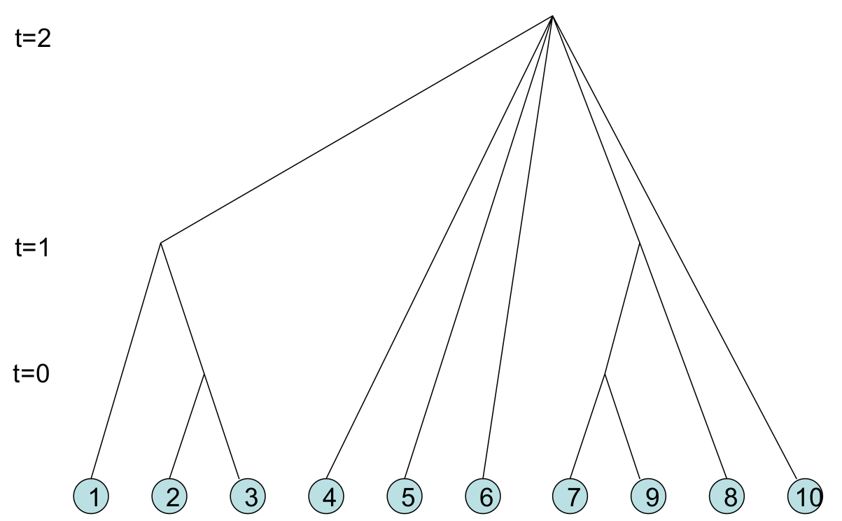
Result: Cluster Dendrogram
1. SNA Introduction
2. Graphs
A. Basics
B. Beyond nodes
C. Beyond edges
3. Network Structure
A. Components, clusters,
B. Ties & Bridges
C. Centrality
4. Community Detection
A. Graph bisection
B. Edge removal
C. Hierarchical clust.
D. Stoch. block models
5. Random Graphs
A. Poisson model
B. Small worlds
C. Configuration
Clusters merge over time
Issues:
When do you stop?
(Just report the tree? Stopping criteria?)
Ignoring structure of G^{(t)}

Slide 53
Practice:
1. SNA Introduction
2. Graphs
A. Basics
B. Beyond nodes
C. Beyond edges
3. Network Structure
A. Components, clusters,
B. Ties & Bridges
C. Centrality
4. Community Detection
A. Graph bisection
B. Edge removal
C. Hierarchical clust.
D. Stoch. block models
5. Random Graphs
A. Poisson model
B. Small worlds
C. Configuration
Find the hierarchical clusters Π⁽⁰⁾ on this graph, using Euclidean Distance and a t⁰ threshold of 2.0.
G
B
C
F
A
E
D
Notes:
BC Neighborhood overlap = ¼
Neighbors: 4
B: G, F, A, (C)
C: (B), A, D
Shared: 1
A
AB Neighborhood overlap: 0
Neighbors: 8
Shared: 0

Slide 54
Stochastic Block Models
1. SNA Introduction
2. Graphs
A. Basics
B. Beyond nodes
C. Beyond edges
3. Network Structure
A. Components, clusters,
B. Ties & Bridges
C. Centrality
4. Community Detection
A. Graph bisection
B. Edge removal
C. Hierarchical clust.
D. Stoch. block models
5. Random Graphs
A. Poisson model
B. Small worlds
C. Configuration
prob. of edges observed in G
possible partition
likelihood function;
i.e., prob. assuming params η
parameters: probabilities of edges
prob. of not producing edges (that weren’t observed in G)
1 prob. per i,j pair!
TOO ABSTRACT!

Slide 55
Simplify: In- or Out-block
1. SNA Introduction
2. Graphs
A. Basics
B. Beyond nodes
C. Beyond edges
3. Network Structure
A. Components, clusters,
B. Ties & Bridges
C. Centrality
4. Community Detection
A. Graph bisection
B. Edge removal
C. Hierarchical clust.
D. Stoch. block models
5. Random Graphs
A. Poisson model
B. Small worlds
C. Configuration
General: η → 1 prob per i,j pair
Copic/Jackson/Kirman: η → p_{in}, p_{out}
P_{in}: prob. of link within community
P_{out}: prob. of link outside community
pairs in same community
# links in communities under Π

Slide 56
Maximum Likelihood Algorithm
1. SNA Introduction
2. Graphs
A. Basics
B. Beyond nodes
C. Beyond edges
3. Network Structure
A. Components, clusters,
B. Ties & Bridges
C. Centrality
4. Community Detection
A. Graph bisection
B. Edge removal
C. Hierarchical clust.
D. Stoch. block models
5. Random Graphs
A. Poisson model
B. Small worlds
C. Configuration
i and j within community
i and j not in community
Take log of both sides… rearrange…
Simple calculation: # pairs in communities
# links in communities

Slide 57
Practice:
1. SNA Introduction
2. Graphs
A. Basics
B. Beyond nodes
C. Beyond edges
3. Network Structure
A. Components, clusters,
B. Ties & Bridges
C. Centrality
4. Community Detection
A. Graph bisection
B. Edge removal
C. Hierarchical clust.
D. Stoch. block models
5. Random Graphs
A. Poisson model
B. Small worlds
C. Configuration
Write the likelihood (or log-likelihood) for the pictured partition if p_{in}=0.5 and p_{out}=0.1
G
B
C
F
A
E
D
Notes:
BC Neighborhood overlap = ¼
Neighbors: 4
B: G, F, A, (C)
C: (B), A, D
Shared: 1
A
AB Neighborhood overlap: 0
Neighbors: 8
Shared: 0

Slide 58
Random Graphs
1. SNA Introduction
2. Graphs
A. Basics
B. Beyond nodes
C. Beyond edges
3. Network Structure
A. Components, clusters,
B. Ties & Bridges
C. Centrality
4. Community Detection
A. Graph bisection
B. Edge removal
C. Hierarchical clust.
D. Stoch. block models
5. Random Graphs
A. Poisson model
B. Small worlds
C. Configuration

Slide 59
Binomial Link Formation Erdös and Rényi, 1959-1961
1. SNA Introduction
2. Graphs
A. Basics
B. Beyond nodes
C. Beyond edges
3. Network Structure
A. Components, clusters,
B. Ties & Bridges
C. Centrality
4. Community Detection
A. Graph bisection
B. Edge removal
C. Hierarchical clust.
D. Stoch. block models
5. Random Graphs
A. Poisson model
B. Small worlds
C. Configuration
Nodes n = {1,…, n}
i, j links form with probability p
No link: (1-p)
Independent probabilities
6
1
5
2
4
3

Slide 60
Probability of Node degree d
1. SNA Introduction
2. Graphs
A. Basics
B. Beyond nodes
C. Beyond edges
3. Network Structure
A. Components, clusters,
B. Ties & Bridges
C. Centrality
4. Community Detection
A. Graph bisection
B. Edge removal
C. Hierarchical clust.
D. Stoch. block models
5. Random Graphs
A. Poisson model
B. Small worlds
C. Configuration
Links form independently
Binomial 1 node i (out of n nodes):
Poisson approximation

Slide 61
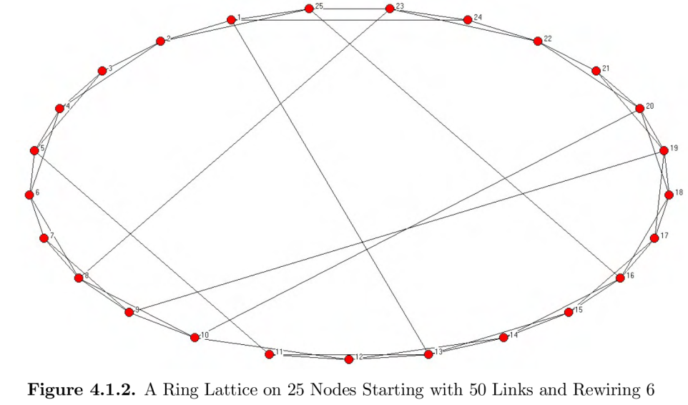
Watts-Strogatz Small World
1. SNA Introduction
2. Graphs
A. Basics
B. Beyond nodes
C. Beyond edges
3. Network Structure
A. Components, clusters,
B. Ties & Bridges
C. Centrality
4. Community Detection
A. Graph bisection
B. Edge removal
C. Hierarchical clust.
D. Stoch. block models
5. Random Graphs
A. Poisson model
B. Small worlds
C. Configuration
Model “small world phenomenon”
high clustering
low distance
Start w/ highly clustered network
Rewire some links

Slide 62
Configuration Model
1. SNA Introduction
2. Graphs
A. Basics
B. Beyond nodes
C. Beyond edges
3. Network Structure
A. Components, clusters,
B. Ties & Bridges
C. Centrality
4. Community Detection
A. Graph bisection
B. Edge removal
C. Hierarchical clust.
D. Stoch. block models
5. Random Graphs
A. Poisson model
B. Small worlds
C. Configuration
Degree sequence: Node i with degree d_{i}, list d_{i} times
Ex: 1112233445566677788999
7
8
6
5
9
10
3
1
4
2

Slide 63
Add links
1. SNA Introduction
2. Graphs
A. Basics
B. Beyond nodes
C. Beyond edges
3. Network Structure
A. Components, clusters,
B. Ties & Bridges
C. Centrality
4. Community Detection
A. Graph bisection
B. Edge removal
C. Hierarchical clust.
D. Stoch. block models
5. Random Graphs
A. Poisson model
B. Small worlds
C. Configuration
Randomly select pairs; link & remove
1112233445566677788999
Links:
3,7
6,6
8,9
3,7
duplicate link: multi-graph!
1,4 1,5 2,4 6,8
5,7 1,9 2,9
7
self-link
8
6
5
Despite self-links and duplicate links, new graph with similar degree distribution!
9
10
3
1
4
2

Slide 64
Ready for your midterm!!!

