Slide 1
Final Exam Review
Social Network Analysis
AAIT ITSC Spring 2018
Instructor: Stephen Wu

Slide 2
Outline
1. Social networks
2. New edges
A. Poisson rand. model
B. Configuration model
3. Nodes unite!
A. Measuring homophily
B. Selectionn v. socialization
C. Affiliation
4. New nodes
A. Preferential attachment
B. Assortativity
C. Small world effects
5. New behaviors
A. Simple model
B. Cascades
C. Stopping cascades
D. Collective Action
6. Ethics
Social networks
New edges (Lec. 6)
Poisson random model
Configuration model
Nodes unite! (Lec. 7)
Measuring homophily
Selection vs. socialization
Affiliation
New nodes (Lec. 8)
Preferential attachment
Assortativity
Small world effects
New behaviors (Lec. 9)
Simple model
Cascades
Stopping cascades
Collective Action
Ethics (Lec. 10)

Slide 3
New Edges: Random Graphs
1. Social networks
2. New edges
A. Poisson rand. model
B. Configuration model
3. Nodes unite!
A. Measuring homophily
B. Selectionn v. socialization
C. Affiliation
4. New nodes
A. Preferential attachment
B. Assortativity
C. Small world effects
5. New behaviors
A. Simple model
B. Cascades
C. Stopping cascades
D. Collective Action
6. Ethics
MOJ 1.2.3, 4; E&K 20.1-20.2

Slide 4
Background: Binomial Distr.
1. Social networks
2. New edges
A. Poisson rand. model
B. Configuration model
3. Nodes unite!
A. Measuring homophily
B. Selectionn v. socialization
C. Affiliation
4. New nodes
A. Preferential attachment
B. Assortativity
C. Small world effects
5. New behaviors
A. Simple model
B. Cascades
C. Stopping cascades
D. Collective Action
6. Ethics
Out of n coin flips, how many H?
Prob n heads:
sampled 100 times
Written:
X is distr. according to a binomial distr.

Slide 5
Background: Binomial Coeff.
1. Social networks
2. New edges
A. Poisson rand. model
B. Configuration model
3. Nodes unite!
A. Measuring homophily
B. Selectionn v. socialization
C. Affiliation
4. New nodes
A. Preferential attachment
B. Assortativity
C. Small world effects
5. New behaviors
A. Simple model
B. Cascades
C. Stopping cascades
D. Collective Action
6. Ethics
How many ways are there to get n out of 3 heads?
Calculate:
8 possible results
HHH
HHT
HTH
HTT
THH
THT
TTH
TTT
3 Heads:
= 1 way
Pascal’s triangle
1
1 1
1 2 1
1 3 3 1
1 4 6 4 1
1 5 10 10 5 1
1 6 15 20 15 6 1
…
2 Heads:
= 3 ways
1 Heads:
= 3 ways
0 Heads:
= 1 way

Slide 6
Binomial Link Formation Erdös and Rényi, 1959-1961
1. Social networks
2. New edges
A. Poisson rand. model
B. Configuration model
3. Nodes unite!
A. Measuring homophily
B. Selectionn v. socialization
C. Affiliation
4. New nodes
A. Preferential attachment
B. Assortativity
C. Small world effects
5. New behaviors
A. Simple model
B. Cascades
C. Stopping cascades
D. Collective Action
6. Ethics
Nodes n = {1,…, n}
i, j links form with probability p
No link: (1-p)
Independent probabilities
6
1
5
2
4
3

Slide 7
Probability of Node degree d
1. Social networks
2. New edges
A. Poisson rand. model
B. Configuration model
3. Nodes unite!
A. Measuring homophily
B. Selectionn v. socialization
C. Affiliation
4. New nodes
A. Preferential attachment
B. Assortativity
C. Small world effects
5. New behaviors
A. Simple model
B. Cascades
C. Stopping cascades
D. Collective Action
6. Ethics
Links form independently
For 1 node i (out of n nodes):
→ binomial!
Note: Not exactly independent, since 1 link affects 2 nodes. But as n increases, this effect is minimal

Slide 8
Poisson Approximation see MOJ 1.2.3
1. Social networks
2. New edges
A. Poisson rand. model
B. Configuration model
3. Nodes unite!
A. Measuring homophily
B. Selectionn v. socialization
C. Affiliation
4. New nodes
A. Preferential attachment
B. Assortativity
C. Small world effects
5. New behaviors
A. Simple model
B. Cascades
C. Stopping cascades
D. Collective Action
6. Ethics
Usually: large n, small p
Poisson: normally, # events in fixed interval, with events independent

Slide 9
Exercise:
1. Social networks
2. New edges
A. Poisson rand. model
B. Configuration model
3. Nodes unite!
A. Measuring homophily
B. Selectionn v. socialization
C. Affiliation
4. New nodes
A. Preferential attachment
B. Assortativity
C. Small world effects
5. New behaviors
A. Simple model
B. Cascades
C. Stopping cascades
D. Collective Action
6. Ethics
6
1
Given p = 0.1, what is the probability that this graph is produced?
Same as a), but given p = 0.4?
For the better result above, what is the Poisson approx. of P(deg(i)=3)?
Does the Poisson approximation fit for this graph?
5
2
4
3
Notes:
(0.1)^7 * (0.9)^(6*5/2 – 7) = 4.30 x 10^-8
(0.4)^7 * (0.6)^(6*5/2 – 7) = 2.75 x 10^-5

Slide 10
Config. model: Keep degree
1. Social networks
2. New edges
A. Poisson rand. model
B. Configuration model
3. Nodes unite!
A. Measuring homophily
B. Selectionn v. socialization
C. Affiliation
4. New nodes
A. Preferential attachment
B. Assortativity
C. Small world effects
5. New behaviors
A. Simple model
B. Cascades
C. Stopping cascades
D. Collective Action
6. Ethics
Degr. Distributions → Sequences
Node i with degree d_{i}, list d_{i} times
Ex: 1112233445566677788999
7
8
6
5
9
10
3
1
4
2

Slide 11
Add links
1. Social networks
2. New edges
A. Poisson rand. model
B. Configuration model
3. Nodes unite!
A. Measuring homophily
B. Selectionn v. socialization
C. Affiliation
4. New nodes
A. Preferential attachment
B. Assortativity
C. Small world effects
5. New behaviors
A. Simple model
B. Cascades
C. Stopping cascades
D. Collective Action
6. Ethics
Randomly select pairs; link & remove
1112233445566677788999
Links:
3,7
6,6
8,9
3,7
duplicate link: multi-graph!
1,4 1,5 2,4 6,8
5,7 1,9 2,9
7
self-link
8
6
5
Despite self-links and duplicate links, new graph with similar degree distribution!
9
10
3
1
4
2

Slide 12
Exercise:
1. Social networks
2. New edges
A. Poisson rand. model
B. Configuration model
3. Nodes unite!
A. Measuring homophily
B. Selectionn v. socialization
C. Affiliation
4. New nodes
A. Preferential attachment
B. Assortativity
C. Small world effects
5. New behaviors
A. Simple model
B. Cascades
C. Stopping cascades
D. Collective Action
6. Ethics
6
1
You want to use this graph as a basis for a configuration model.
Write the degree sequence.
Say that the configuration model produces 1 self-link, on a node of degree 3, which you remove. If the original graph was a Poisson random network of p = 0.4, how does that change the likelihood of the graph?
5
2
4
3
Notes:
11122344445666

Slide 13
Nodes Unite! Homophily
1. Social networks
2. New edges
A. Poisson rand. model
B. Configuration model
3. Nodes unite!
A. Measuring homophily
B. Selectionn v. socialization
C. Affiliation
4. New nodes
A. Preferential attachment
B. Assortativity
C. Small world effects
5. New behaviors
A. Simple model
B. Cascades
C. Stopping cascades
D. Collective Action
6. Ethics
E&K 4

Slide 14
Grouping by similarity…
1. Social networks
2. New edges
A. Poisson rand. model
B. Configuration model
3. Nodes unite!
A. Measuring homophily
B. Selectionn v. socialization
C. Affiliation
4. New nodes
A. Preferential attachment
B. Assortativity
C. Small world effects
5. New behaviors
A. Simple model
B. Cascades
C. Stopping cascades
D. Collective Action
6. Ethics
Homophily: we tend to be similar to our friends
Plato: “similarity begets friendship”
Aristotle: people “love those who are like themselves”
Intrinsic causes, e.g., triadic closure
Extrinsic causes, e.g., affiliation

Slide 15
Measuring homophily
1. Social networks
2. New edges
A. Poisson rand. model
B. Configuration model
3. Nodes unite!
A. Measuring homophily
B. Selectionn v. socialization
C. Affiliation
4. New nodes
A. Preferential attachment
B. Assortativity
C. Small world effects
5. New behaviors
A. Simple model
B. Cascades
C. Stopping cascades
D. Collective Action
6. Ethics
Pick a characteristic, e.g., ethnicity
Does that kind of similarity matter?
… links more likely than random?
Possible results:
Not significant
Homophily (signif. more likely links)
Inverse homophily (signif. less likely)

Slide 16
Example: Childhood friendships
1. Social networks
2. New edges
A. Poisson rand. model
B. Configuration model
3. Nodes unite!
A. Measuring homophily
B. Selectionn v. socialization
C. Affiliation
4. New nodes
A. Preferential attachment
B. Assortativity
C. Small world effects
5. New behaviors
A. Simple model
B. Cascades
C. Stopping cascades
D. Collective Action
6. Ethics
Edges:
P(M:M edge) = p²
P(F:F edge) = q²
P(M:F edge) = 2pq
Test: if heterogeneous edges are significantly less than 2pq, we have homophily!
= male, proportion p
= female, proportion q
Notes:
Given the P(M:M) and P(F:F), the heterogeneous edge probability must sum to 1. Thus,
P(M:F edge) = 1 – p^2 – q^2
= 1 – p^2 – (1-p)^2
= 1 – p^2 – 1 + 2p – p^2
= -2*p^2 + 2p
= 2 * (-p^2 + p)
= 2 * p(-p+1)
= 2pq

Slide 17
Example: Schelling Model (1972, 1978)
1. Social networks
2. New edges
A. Poisson rand. model
B. Configuration model
3. Nodes unite!
A. Measuring homophily
B. Selectionn v. socialization
C. Affiliation
4. New nodes
A. Preferential attachment
B. Assortativity
C. Small world effects
5. New behaviors
A. Simple model
B. Cascades
C. Stopping cascades
D. Collective Action
6. Ethics
Simpl. 1: people=agents in 2 groups
Simpl. 2: space=grid (8 neighbors)
Simpl. 3: time in rounds
Homophily constraint
Agents need threshold in-group neighbors
Else “discontent” – will move in next round
1 | 2 | 3
4 |  | 5
6 | 7 | 8
* “models are always wrong, but sometimes they can be useful”

Slide 18
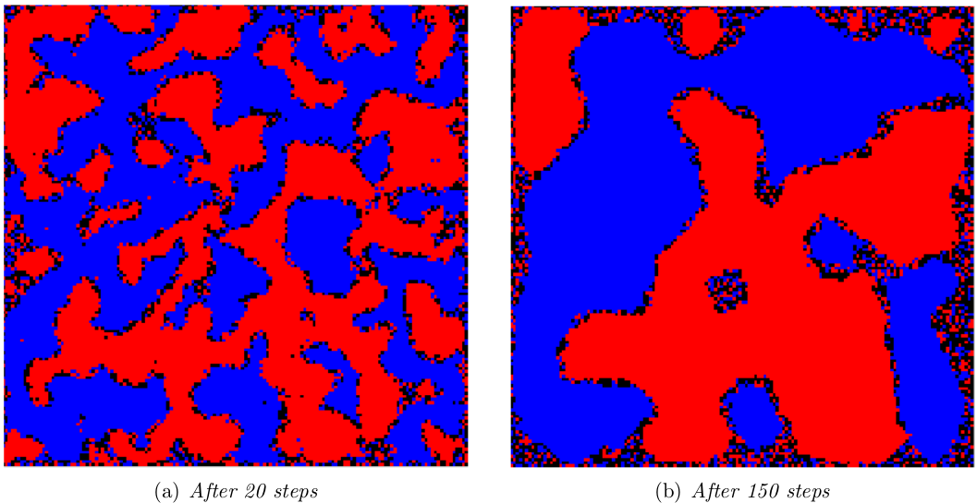
Local homophily → Global effect
1. Social networks
2. New edges
A. Poisson rand. model
B. Configuration model
3. Nodes unite!
A. Measuring homophily
B. Selectionn v. socialization
C. Affiliation
4. New nodes
A. Preferential attachment
B. Assortativity
C. Small world effects
5. New behaviors
A. Simple model
B. Cascades
C. Stopping cascades
D. Collective Action
6. Ethics
150x150 grid, 100k blue, 100k red,
Threshold = 4
Individual desires for homophily have global effect!

Slide 19
Exercise:
1. Social networks
2. New edges
A. Poisson rand. model
B. Configuration model
3. Nodes unite!
A. Measuring homophily
B. Selectionn v. socialization
C. Affiliation
4. New nodes
A. Preferential attachment
B. Assortativity
C. Small world effects
5. New behaviors
A. Simple model
B. Cascades
C. Stopping cascades
D. Collective Action
6. Ethics
Does this graph show homophily by gender?
Say a new female is added to the graph. How many F:M or F:F edges would she need to have to change your answer in part a)?
In words, describe what you would need to do for measuring homophily between 3 options.
= male, proportion p
= female, proportion q
Notes:
p = 6/9 = 2/3
q = 3/9 = 1/3
2pq = 2/9 = .222
5/18 = .277 edges are heterogeneous => YES

Slide 20
Selection v. Social Influence
1. Social networks
2. New edges
A. Poisson rand. model
B. Configuration model
3. Nodes unite!
A. Measuring homophily
B. Selectionn v. socialization
C. Affiliation
4. New nodes
A. Preferential attachment
B. Assortativity
C. Small world effects
5. New behaviors
A. Simple model
B. Cascades
C. Stopping cascades
D. Collective Action
6. Ethics
Selecting similar friends
Characteristics shape network
Intentional: e.g., at a social gathering
Systemic: e.g., physical neighborhood
Socialization/social influence
Network shapes characteristics
Nodes are mutable (changeable)

Slide 21
What’s at play in Homophily?
1. Social networks
2. New edges
A. Poisson rand. model
B. Configuration model
3. Nodes unite!
A. Measuring homophily
B. Selectionn v. socialization
C. Affiliation
4. New nodes
A. Preferential attachment
B. Assortativity
C. Small world effects
5. New behaviors
A. Simple model
B. Cascades
C. Stopping cascades
D. Collective Action
6. Ethics
Nuanced… unfolding over time, which characteristic, etc.
How to study this?
Longitudinal studies! How did behavior change…
before/after joining a “group”
as neighbors’ behavior changed

Slide 22
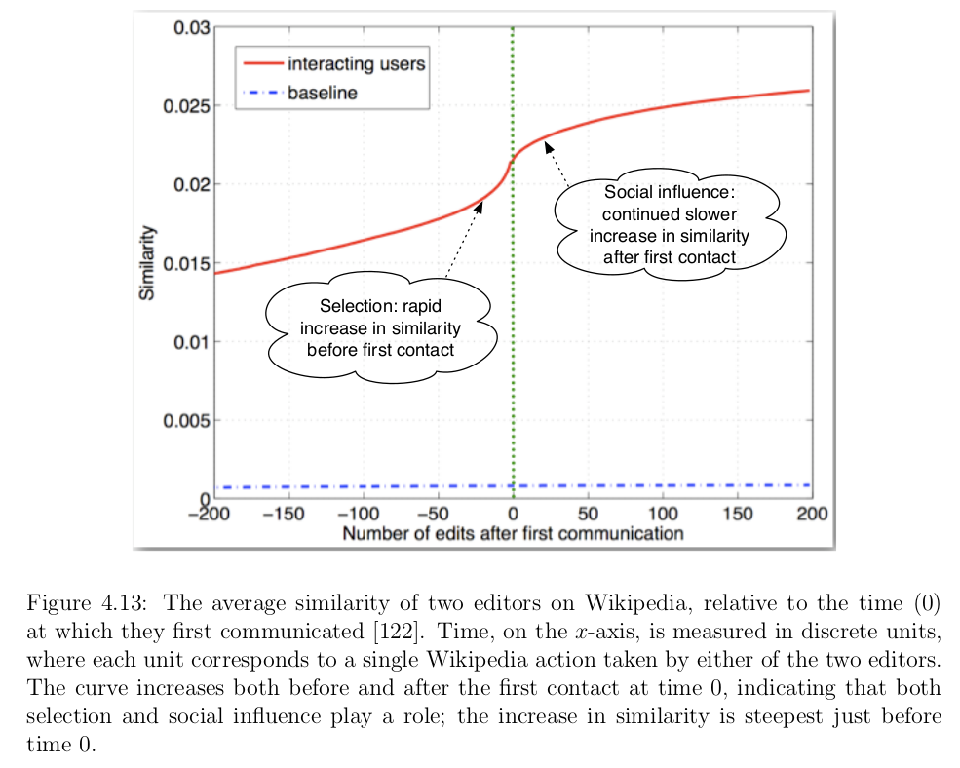
Example: Wikipedia editors
1. Social networks
2. New edges
A. Poisson rand. model
B. Configuration model
3. Nodes unite!
A. Measuring homophily
B. Selectionn v. socialization
C. Affiliation
4. New nodes
A. Preferential attachment
B. Assortativity
C. Small world effects
5. New behaviors
A. Simple model
B. Cascades
C. Stopping cascades
D. Collective Action
6. Ethics
Similarity: overlap in editing topics (y-axis)
Time 0: editors message each other

Slide 23
Exercise:
1. Social networks
2. New edges
A. Poisson rand. model
B. Configuration model
3. Nodes unite!
A. Measuring homophily
B. Selectionn v. socialization
C. Affiliation
4. New nodes
A. Preferential attachment
B. Assortativity
C. Small world effects
5. New behaviors
A. Simple model
B. Cascades
C. Stopping cascades
D. Collective Action
6. Ethics
You are researching the spread of political ideologies in Twitter. How would you quantify selection and socialization effects? I.e.,
State one way you could measure selection, and justify why.
State one way you could measure socialization, and justify why.

Slide 24
Extrinsic node properties – Foci
1. Social networks
2. New edges
A. Poisson rand. model
B. Configuration model
3. Nodes unite!
A. Measuring homophily
B. Selectionn v. socialization
C. Affiliation
4. New nodes
A. Preferential attachment
B. Assortativity
C. Small world effects
5. New behaviors
A. Simple model
B. Cascades
C. Stopping cascades
D. Collective Action
6. Ethics
Intrinsic (to graph) only – incomplete picture!
Foci (focal points of activity) are
“social, psychological, legal, or physical entit[ies] around which joint activities are organized”
Not on typical Social Network graph
Subsets of V
Many/overlapping possible!

Slide 25
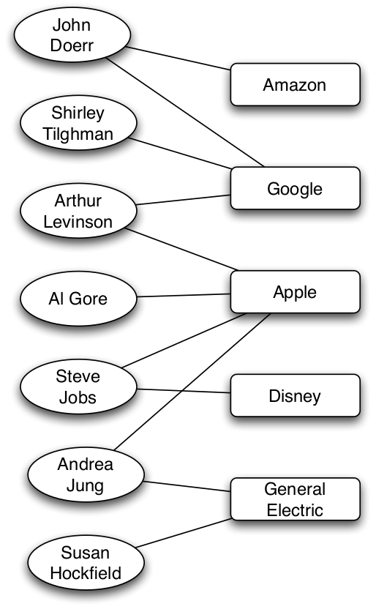
Affiliation networks
1. Social networks
2. New edges
A. Poisson rand. model
B. Configuration model
3. Nodes unite!
A. Measuring homophily
B. Selectionn v. socialization
C. Affiliation
4. New nodes
A. Preferential attachment
B. Assortativity
C. Small world effects
5. New behaviors
A. Simple model
B. Cascades
C. Stopping cascades
D. Collective Action
6. Ethics
G=(V₁, V₂, E), where E=(v₁, v₂)
Bipartite graphs: only connections across 2 types of nodes
nodes
(here: people)
foci
(here: company board of directors)
What about node-node links?
member-of

Slide 26
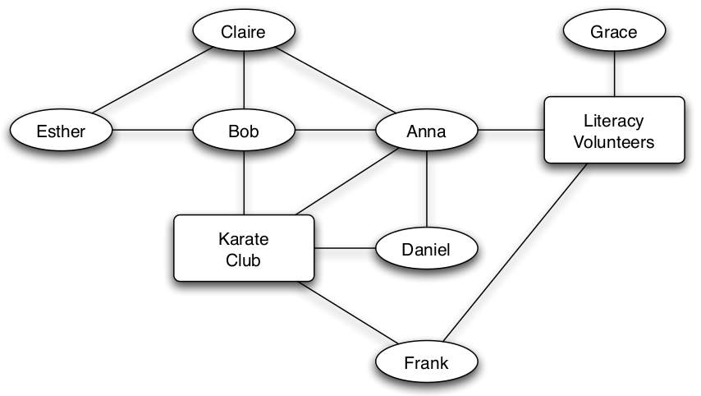
Social-Affiliation Networks
1. Social networks
2. New edges
A. Poisson rand. model
B. Configuration model
3. Nodes unite!
A. Measuring homophily
B. Selectionn v. socialization
C. Affiliation
4. New nodes
A. Preferential attachment
B. Assortativity
C. Small world effects
5. New behaviors
A. Simple model
B. Cascades
C. Stopping cascades
D. Collective Action
6. Ethics
Affiliation networks: had 2 types of nodes
Social-Affiliation networks: also 2 types of edges

Slide 27
3 types of Closure
1. Social networks
2. New edges
A. Poisson rand. model
B. Configuration model
3. Nodes unite!
A. Measuring homophily
B. Selectionn v. socialization
C. Affiliation
4. New nodes
A. Preferential attachment
B. Assortativity
C. Small world effects
5. New behaviors
A. Simple model
B. Cascades
C. Stopping cascades
D. Collective Action
6. Ethics
Triadic closure:
person => person:person
Focal closure:
focus => person:person
Membership closure:
person => focus:person

Slide 28
Exercise:
1. Social networks
2. New edges
A. Poisson rand. model
B. Configuration model
3. Nodes unite!
A. Measuring homophily
B. Selectionn v. socialization
C. Affiliation
4. New nodes
A. Preferential attachment
B. Assortativity
C. Small world effects
5. New behaviors
A. Simple model
B. Cascades
C. Stopping cascades
D. Collective Action
6. Ethics
Calculate the clustering coefficients for the foci in the social-affiliation network below.
Which type of closure does part a) affect? Explain.

Slide 29
New Nodes: Growing Networks
1. Social networks
2. New edges
A. Poisson rand. model
B. Configuration model
3. Nodes unite!
A. Measuring homophily
B. Selectionn v. socialization
C. Affiliation
4. New nodes
A. Preferential attachment
B. Assortativity
C. Small world effects
5. New behaviors
A. Simple model
B. Cascades
C. Stopping cascades
D. Collective Action
6. Ethics
MOJ 5

Slide 30
Grow network w/ new nodes
1. Social networks
2. New edges
A. Poisson rand. model
B. Configuration model
3. Nodes unite!
A. Measuring homophily
B. Selectionn v. socialization
C. Affiliation
4. New nodes
A. Preferential attachment
B. Assortativity
C. Small world effects
5. New behaviors
A. Simple model
B. Cascades
C. Stopping cascades
D. Collective Action
6. Ethics
Pre-existing network: m connected nodes
At “birth”:
Index node’s “birth order” = i
Node i gets d_{i}(i) links at random
Later, at time t:
# New links = d_{i}(t) - d_{i}(i)

Slide 31
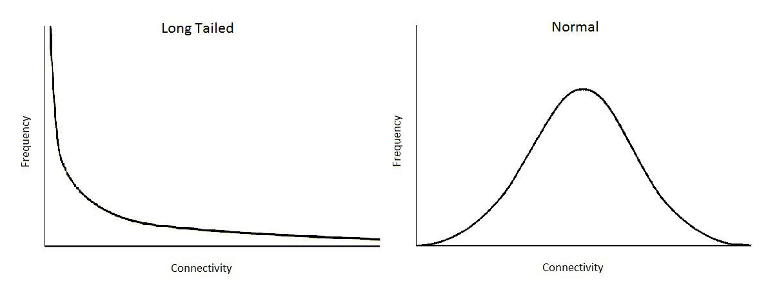
Preferential Attachment (Barabasi & Albert 1999)
1. Social networks
2. New edges
A. Poisson rand. model
B. Configuration model
3. Nodes unite!
A. Measuring homophily
B. Selectionn v. socialization
C. Affiliation
4. New nodes
A. Preferential attachment
B. Assortativity
C. Small world effects
5. New behaviors
A. Simple model
B. Cascades
C. Stopping cascades
D. Collective Action
6. Ethics
Idea: Nodes of high degree are more likely to form new links
Ex: Well-cited scientific papers more likely to be read & cited (Price 1976)
{long,fat,heavy}-tail/scale-free distr.
A few rich get richer
Long tail of “poor”
Image credit: Pender, Casey. The Long-tailed Network Structure of Trade. In Blog: PPE.life. 2017. Blog: http://ppe.life/long-tailed-trade/.

Slide 32
Pref. attachment on a Graph
1. Social networks
2. New edges
A. Poisson rand. model
B. Configuration model
3. Nodes unite!
A. Measuring homophily
B. Selectionn v. socialization
C. Affiliation
4. New nodes
A. Preferential attachment
B. Assortativity
C. Small world effects
5. New behaviors
A. Simple model
B. Cascades
C. Stopping cascades
D. Collective Action
6. Ethics
New node is “born”; link to node i?
Expected degree of i:
(Using the mean-field approximation)
Freq. distr. of degree:
probability is proportionate to node degree
new node will make m connections
total # links * 2
(At time t: = 2 tm)

Slide 33
Exercise:
1. Social networks
2. New edges
A. Poisson rand. model
B. Configuration model
3. Nodes unite!
A. Measuring homophily
B. Selectionn v. socialization
C. Affiliation
4. New nodes
A. Preferential attachment
B. Assortativity
C. Small world effects
5. New behaviors
A. Simple model
B. Cascades
C. Stopping cascades
D. Collective Action
6. Ethics
6
1
When a new node 7 is “born” on this network, what is the probability that it will link to node 4 under a Poisson random graph model with p = 0.4?
Same as a), but under a preferential attachment model?
5
2
4
3

Slide 34
Assortativity
1. Social networks
2. New edges
A. Poisson rand. model
B. Configuration model
3. Nodes unite!
A. Measuring homophily
B. Selectionn v. socialization
C. Affiliation
4. New nodes
A. Preferential attachment
B. Assortativity
C. Small world effects
5. New behaviors
A. Simple model
B. Cascades
C. Stopping cascades
D. Collective Action
6. Ethics
Prob that i has degree d is at least as high (and at least once higher) than j
Nodes’ degrees and their neighbors’ degrees are positively correlated
Proposition: On average…
Node i’s degree is larger than node j’s degree at time t after both are born …
if and only if i is older than j.
In that case, the estimated distribution of i’s neighbors’ degrees
strictly first order stochastically dominates
that of j’s at each time t > j, and in particular for all d < d_{i}(t).

Slide 35
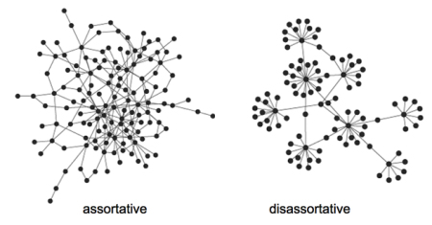
Ex: Assortativity
1. Social networks
2. New edges
A. Poisson rand. model
B. Configuration model
3. Nodes unite!
A. Measuring homophily
B. Selectionn v. socialization
C. Affiliation
4. New nodes
A. Preferential attachment
B. Assortativity
C. Small world effects
5. New behaviors
A. Simple model
B. Cascades
C. Stopping cascades
D. Collective Action
6. Ethics

Slide 36
Exercise:
1. Social networks
2. New edges
A. Poisson rand. model
B. Configuration model
3. Nodes unite!
A. Measuring homophily
B. Selectionn v. socialization
C. Affiliation
4. New nodes
A. Preferential attachment
B. Assortativity
C. Small world effects
5. New behaviors
A. Simple model
B. Cascades
C. Stopping cascades
D. Collective Action
6. Ethics
Describe a setting where there could arise, and justify:
an assortative graph
A disassortative graph

Slide 37
Diameter in pref. attachment
1. Social networks
2. New edges
A. Poisson rand. model
B. Configuration model
3. Nodes unite!
A. Measuring homophily
B. Selectionn v. socialization
C. Affiliation
4. New nodes
A. Preferential attachment
B. Assortativity
C. Small world effects
5. New behaviors
A. Simple model
B. Cascades
C. Stopping cascades
D. Collective Action
6. Ethics
Proposition: (Bollobas & Riordan 2002)
In a preferential attachment model where each newborn node forms m≥2 links,
as n grows the resulting network will consist of a single component with diameter proportional to
log(n)/(log log(n)),
almost surely.
Poisson: proportional to log(n).
→ Pref. attach: lower diameter

Slide 38
Simple process → clustering
1. Social networks
2. New edges
A. Poisson rand. model
B. Configuration model
3. Nodes unite!
A. Measuring homophily
B. Selectionn v. socialization
C. Affiliation
4. New nodes
A. Preferential attachment
B. Assortativity
C. Small world effects
5. New behaviors
A. Simple model
B. Cascades
C. Stopping cascades
D. Collective Action
6. Ethics
New node chooses to link to node j (prob p)
Next:
Follow from node j to another node with prob q
Or jump to new node with prob 1-q

Slide 39
Exercise:
1. Social networks
2. New edges
A. Poisson rand. model
B. Configuration model
3. Nodes unite!
A. Measuring homophily
B. Selectionn v. socialization
C. Affiliation
4. New nodes
A. Preferential attachment
B. Assortativity
C. Small world effects
5. New behaviors
A. Simple model
B. Cascades
C. Stopping cascades
D. Collective Action
6. Ethics
New node chooses to link to node j (prob p)
Next:
Follow from node j to another node with prob q
Or jump to new node with prob 1-q
What happens if q=0?
If q=1?
Notes:
q=0 => uniformly random attachment
q=1 => 1st node random, rest found via network

Slide 40
New Behaviors: Information Cascades
1. Social networks
2. New edges
A. Poisson rand. model
B. Configuration model
3. Nodes unite!
A. Measuring homophily
B. Selectionn v. socialization
C. Affiliation
4. New nodes
A. Preferential attachment
B. Assortativity
C. Small world effects
5. New behaviors
A. Simple model
B. Cascades
C. Stopping cascades
D. Collective Action
6. Ethics
E&K 19

Slide 41
“Diffusion of Innovations”
1. Social networks
2. New edges
A. Poisson rand. model
B. Configuration model
3. Nodes unite!
A. Measuring homophily
B. Selectionn v. socialization
C. Affiliation
4. New nodes
A. Preferential attachment
B. Assortativity
C. Small world effects
5. New behaviors
A. Simple model
B. Cascades
C. Stopping cascades
D. Collective Action
6. Ethics
What innovations? E.g., A vs. B
New behaviors, practices, opinions, conventions, technologies, etc.
Principles (Everett 1995)
Relative advantage: A better than B?
Complexity: Easy to understand?
Observability: See it?
Trialability: Try it out?
Compatibility: Fit with social context?

Slide 42
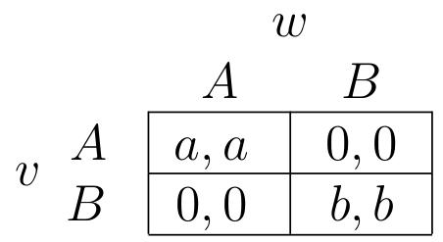
A-B coordination game
1. Social networks
2. New edges
A. Poisson rand. model
B. Configuration model
3. Nodes unite!
A. Measuring homophily
B. Selectionn v. socialization
C. Affiliation
4. New nodes
A. Preferential attachment
B. Assortativity
C. Small world effects
5. New behaviors
A. Simple model
B. Cascades
C. Stopping cascades
D. Collective Action
6. Ethics
Focus on 2 nodes, v and w
Each choose behavior A or B
Direct-benefit effects:
Benefits to you increase as more neighbors adopt
Payoff matrix:
v
w
Extend to multiple nodes

Slide 43
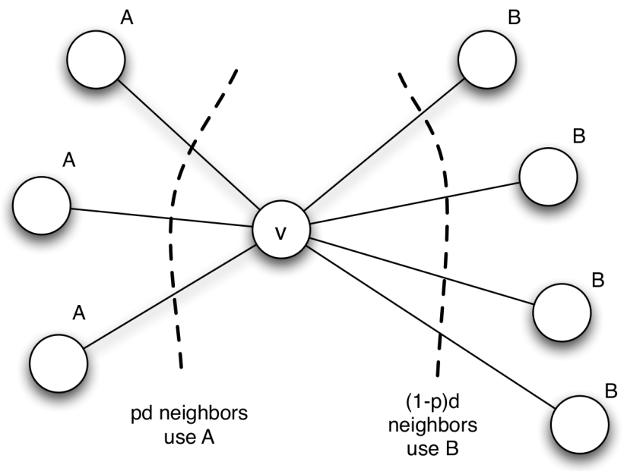
Strategy depends on neighbors!
1. Social networks
2. New edges
A. Poisson rand. model
B. Configuration model
3. Nodes unite!
A. Measuring homophily
B. Selectionn v. socialization
C. Affiliation
4. New nodes
A. Preferential attachment
B. Assortativity
C. Small world effects
5. New behaviors
A. Simple model
B. Cascades
C. Stopping cascades
D. Collective Action
6. Ethics
prob. of neighbor choosing A
prob. of neighbor choosing B
Of d neighbors:
pd choose A
(1-p)d choose B
v choose A or B given neighbors?
Which expected payoff is higher?
To prefer A:
Threshold q:
Proportion of neighbors choosing A
must outweigh the payoff of choosing B
= q
Notes:
The threshold can be interpreted as this:
“The proportion of neighbors choosing A
has to outweigh the payoff of choosing B”

Slide 44
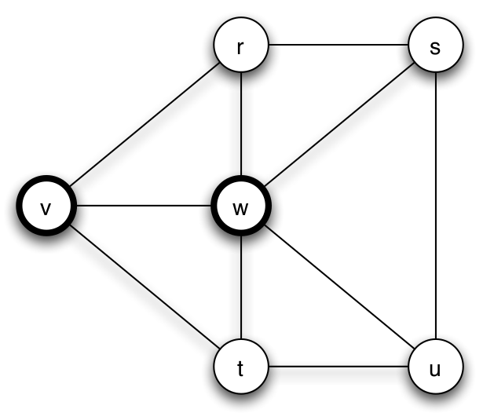
Exercise:
1. Social networks
2. New edges
A. Poisson rand. model
B. Configuration model
3. Nodes unite!
A. Measuring homophily
B. Selectionn v. socialization
C. Affiliation
4. New nodes
A. Preferential attachment
B. Assortativity
C. Small world effects
5. New behaviors
A. Simple model
B. Cascades
C. Stopping cascades
D. Collective Action
6. Ethics
Which behavior should node r prefer?
(bold) a=3
(normal) b=2
Threshold
to prefer A:

Slide 45
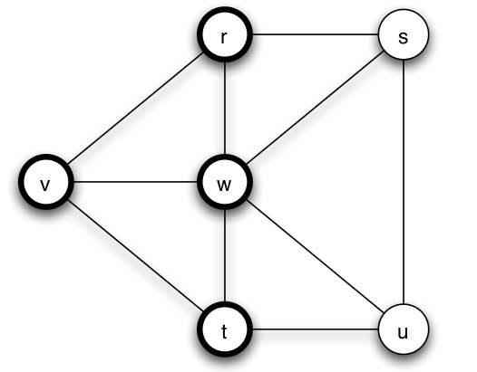
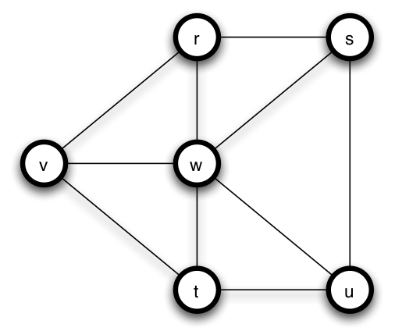
What happens over time?
1. Social networks
2. New edges
A. Poisson rand. model
B. Configuration model
3. Nodes unite!
A. Measuring homophily
B. Selectionn v. socialization
C. Affiliation
4. New nodes
A. Preferential attachment
B. Assortativity
C. Small world effects
5. New behaviors
A. Simple model
B. Cascades
C. Stopping cascades
D. Collective Action
6. Ethics
Early adopters of A
Cascade of adopting A
Complete cascade
Nodes v and w couldn’t influence s and u alone, but they did eventually via r and t

Slide 46
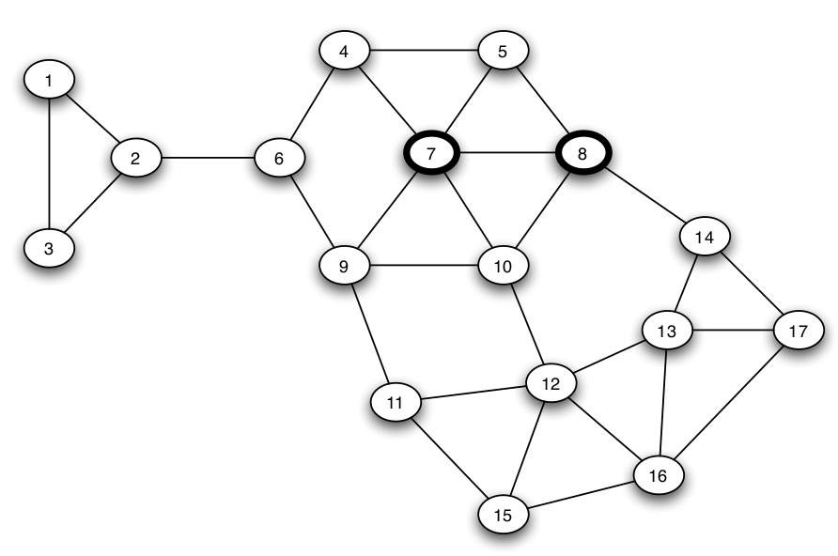
Cascades: A bigger example
1. Social networks
2. New edges
A. Poisson rand. model
B. Configuration model
3. Nodes unite!
A. Measuring homophily
B. Selectionn v. socialization
C. Affiliation
4. New nodes
A. Preferential attachment
B. Assortativity
C. Small world effects
5. New behaviors
A. Simple model
B. Cascades
C. Stopping cascades
D. Collective Action
6. Ethics
1/3 < 2/5
2/3 > 2/5
a=3
b=2
q_{a}=2/5
1/3 < 2/5
1/4 < 2/5
2/4 > 2/5

Slide 47
Cascades: A bigger example
1. Social networks
2. New edges
A. Poisson rand. model
B. Configuration model
3. Nodes unite!
A. Measuring homophily
B. Selectionn v. socialization
C. Affiliation
4. New nodes
A. Preferential attachment
B. Assortativity
C. Small world effects
5. New behaviors
A. Simple model
B. Cascades
C. Stopping cascades
D. Collective Action
6. Ethics
2/3 > 2/5
a=3
b=2
q_{a}=2/5
1/3 < 2/5
2/4 > 2/5
1/5 < 2/5

Slide 48
Cascades: A bigger example
1. Social networks
2. New edges
A. Poisson rand. model
B. Configuration model
3. Nodes unite!
A. Measuring homophily
B. Selectionn v. socialization
C. Affiliation
4. New nodes
A. Preferential attachment
B. Assortativity
C. Small world effects
5. New behaviors
A. Simple model
B. Cascades
C. Stopping cascades
D. Collective Action
6. Ethics
a=3
b=2
q_{a}=2/5
2/3 > 2/5
1/3 < 2/5
1/3 < 2/5
1/5 < 2/5
1/3 < 2/5
Not a complete cascade! Why?

Slide 49
Exercise:
1. Social networks
2. New edges
A. Poisson rand. model
B. Configuration model
3. Nodes unite!
A. Measuring homophily
B. Selectionn v. socialization
C. Affiliation
4. New nodes
A. Preferential attachment
B. Assortativity
C. Small world effects
5. New behaviors
A. Simple model
B. Cascades
C. Stopping cascades
D. Collective Action
6. Ethics
6
1
5
2
4
3
Given a_{red}=2 and b_{blue}=2, in what order (by turns) will the red cascade in this network?

Slide 50

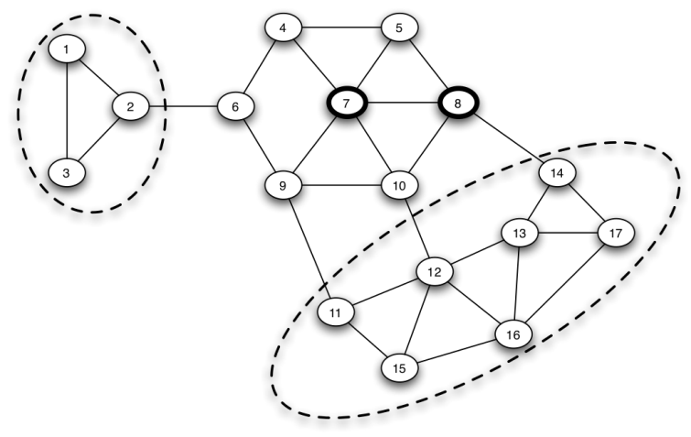
Clusters kill cascades!
1. Social networks
2. New edges
A. Poisson rand. model
B. Configuration model
3. Nodes unite!
A. Measuring homophily
B. Selectionn v. socialization
C. Affiliation
4. New nodes
A. Preferential attachment
B. Assortativity
C. Small world effects
5. New behaviors
A. Simple model
B. Cascades
C. Stopping cascades
D. Collective Action
6. Ethics
Hard for innovations to break in…
Cluster of density p (1 definition):
Set of nodes, each node has at least p fraction of neighbors in the set
Clusters of density 2/3

Slide 51
Clusters kill cascades! Formally…
1. Social networks
2. New edges
A. Poisson rand. model
B. Configuration model
3. Nodes unite!
A. Measuring homophily
B. Selectionn v. socialization
C. Affiliation
4. New nodes
A. Preferential attachment
B. Assortativity
C. Small world effects
5. New behaviors
A. Simple model
B. Cascades
C. Stopping cascades
D. Collective Action
6. Ethics
With initial adopters, threshold q for adopting behavior A…
If there is a cluster of density >(1-q), ⇒ no complete cascade!
If no complete cascade, ⇒ remaining network has cluster of density >(1-q)

Slide 52
Will everyone adopt A?
1. Social networks
2. New edges
A. Poisson rand. model
B. Configuration model
3. Nodes unite!
A. Measuring homophily
B. Selectionn v. socialization
C. Affiliation
4. New nodes
A. Preferential attachment
B. Assortativity
C. Small world effects
5. New behaviors
A. Simple model
B. Cascades
C. Stopping cascades
D. Collective Action
6. Ethics
Dfn: The cascade capacity is the maximum threshold at which a complete cascade is possible
Complete cascade is “easy” if payoffs strongly favor A (=low threshold)
Cascade capacity = worst payoffs (for A) that could cause complete cascade

Slide 53
Cascade capacity, by example
1. Social networks
2. New edges
A. Poisson rand. model
B. Configuration model
3. Nodes unite!
A. Measuring homophily
B. Selectionn v. socialization
C. Affiliation
4. New nodes
A. Preferential attachment
B. Assortativity
C. Small world effects
5. New behaviors
A. Simple model
B. Cascades
C. Stopping cascades
D. Collective Action
6. Ethics
Infinite path
Early adopters of A
If q = b/(a+b) = ½
u & v will adopt,
then x & w,
then…
Cascade capacity: network-specific
But NEVER > ½ (inferior A beats B)

Slide 54
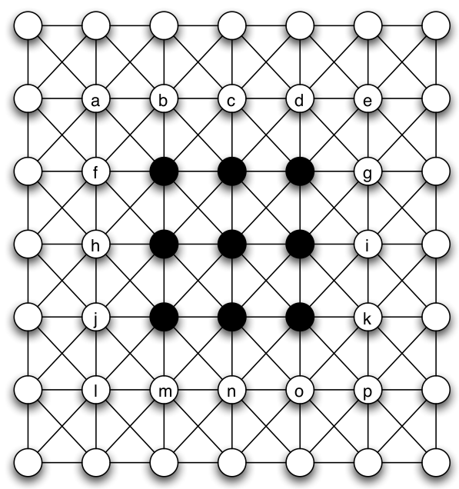
Exercise:
1. Social networks
2. New edges
A. Poisson rand. model
B. Configuration model
3. Nodes unite!
A. Measuring homophily
B. Selectionn v. socialization
C. Affiliation
4. New nodes
A. Preferential attachment
B. Assortativity
C. Small world effects
5. New behaviors
A. Simple model
B. Cascades
C. Stopping cascades
D. Collective Action
6. Ethics
Infinite grid
What is the cascade capacity of the infinite grid?
(Try thresholds of 1/8, 2/8, 3/8, 4/8.)

Slide 55
Payoffs of Collective Action
1. Social networks
2. New edges
A. Poisson rand. model
B. Configuration model
3. Nodes unite!
A. Measuring homophily
B. Selectionn v. socialization
C. Affiliation
4. New nodes
A. Preferential attachment
B. Assortativity
C. Small world effects
5. New behaviors
A. Simple model
B. Cascades
C. Stopping cascades
D. Collective Action
6. Ethics
Ex: Revolt against a repressive regime (or a bad boss). Will others join?
If no: negative payoff to participants!
If yes: positive payoff (possibly)!
So should you join or not?...

Slide 56
Problem of common knowledge
1. Social networks
2. New edges
A. Poisson rand. model
B. Configuration model
3. Nodes unite!
A. Measuring homophily
B. Selectionn v. socialization
C. Affiliation
4. New nodes
A. Preferential attachment
B. Assortativity
C. Small world effects
5. New behaviors
A. Simple model
B. Cascades
C. Stopping cascades
D. Collective Action
6. Ethics
Don’t know what others would do?
Only have local knowledge
Pluralistic ignorance: wildly inaccurate guesses of others’ stance
Model: each person has threshold on others’ involvement
Guess involvement based on local network

Slide 57
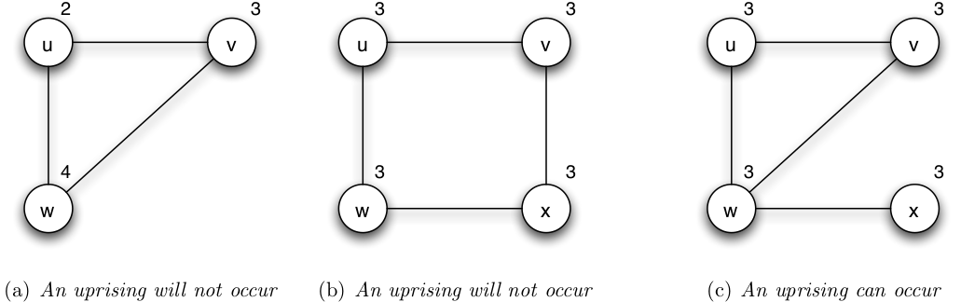
Structure affects knowledge
1. Social networks
2. New edges
A. Poisson rand. model
B. Configuration model
3. Nodes unite!
A. Measuring homophily
B. Selectionn v. socialization
C. Affiliation
4. New nodes
A. Preferential attachment
B. Assortativity
C. Small world effects
5. New behaviors
A. Simple model
B. Cascades
C. Stopping cascades
D. Collective Action
6. Ethics
Promote change: Low thresholds AND common knowledge!
Prevent change: Less communication means less risk!

Slide 58
Exercise:
1. Social networks
2. New edges
A. Poisson rand. model
B. Configuration model
3. Nodes unite!
A. Measuring homophily
B. Selectionn v. socialization
C. Affiliation
4. New nodes
A. Preferential attachment
B. Assortativity
C. Small world effects
5. New behaviors
A. Simple model
B. Cascades
C. Stopping cascades
D. Collective Action
6. Ethics
3
6
1
2
2
5
2
2
3
4
2
3
Will collective action be taken, given the individual thresholds?

Slide 59
Ethics in Social Network Analysis
1. Social networks
2. New edges
A. Poisson rand. model
B. Configuration model
3. Nodes unite!
A. Measuring homophily
B. Selectionn v. socialization
C. Affiliation
4. New nodes
A. Preferential attachment
B. Assortativity
C. Small world effects
5. New behaviors
A. Simple model
B. Cascades
C. Stopping cascades
D. Collective Action
6. Ethics
Respect for autonomy, Non-maleficience, Beneficience, Justice

Slide 60
Announcements
Final exam. The Final Exam is scheduled for Monday, 4th June @ 8:30am.
Late assignments due.
Please turn in all assignments by 11th June @ 1:30pm for 75% credit.
Submissions by 14th June @ 8:30am will get 25% credit.
After 8:30am, students with any number of missing assignments will receive an Fx for the course.

