Slide 1
Random Graphs
Social Network Analysis, Lecture 6
MOJ 1.2.3, 4; E&K 20.1-20.2
AAIT ITSC Spring 2018
Instructor: Stephen Wu

Slide 2
Today… Random graphs!
Last: Community Detection
Background: Probability Theory
Static random models
Poisson random networks
“Small World” model
The configuration model
Calculating metrics

Slide 3
Background: Probability Theory

Slide 4
Background: Random Variables
RVs: Represent probabilistic events
E.g., coin flip X
X: {H, T}→{p, (1-p)}
Options should add to 1
Instances of coin flips = samples
How flips play out = distribution
heads w/ prob p
tails w/ prob (1-p)

Slide 5
Background: Prob. Mass Function
Coin toss: Uniform
Coin toss: Weighted
Single dice: Uniform
Single dice: Weighted
How to know if it’s fair? Sample many times!

Slide 6
Background: Binomial Distr.
Out of n coin flips, how many H?
Prob n heads:
sampled 100 times
Written:
X is distr. according to a binomial distr.

Slide 7
Background: Binomial Coeff.
How many ways are there to get n out of 3 heads?
Calculate:
8 possible results
HHH
HHT
HTH
HTT
THH
THT
TTH
TTT
3 Heads:
= 1 way
Pascal’s triangle
1
1 1
1 2 1
1 3 3 1
1 4 6 4 1
1 5 10 10 5 1
1 6 15 20 15 6 1
…
2 Heads:
= 3 ways
1 Heads:
= 3 ways
0 Heads:
= 1 way

Slide 8
Group Discussion:
A 6-sided dice is a multinomial distribution.
How will this differ from binomial?
Notes:
There are more possible outcomes. You also need to estimate more parameters – a probability for each outcome (or one less that number).

Slide 9
Poisson Random Networks
Erdös and Rényi, 1959-1961; MOJ 1.2.3, 4.1.1

Slide 10
Binomial Link Formation Erdös and Rényi, 1959-1961
Nodes n = {1,…, n}
i, j links form with probability p
No link: (1-p)
Independent probabilities
6
1
5
2
4
3

Slide 11
Individual Exercise (with calculator):
Given p, what is the probability that each graph is produced?
a) p = 0.1 b) p = 0.4
c) p = 0.1 d) p = 0.4
6
1
6
1
5
2
5
2
4
3
4
3
Notes:
(0.1)^2 * (0.9)^13 = 2.54 x 10^-3
(0.4)^2 * (0.6)^13 = 2.09 x 10^-4
(0.1)^7 * (0.9)^8 = 4.30 x 10^-8
(0.4)^7 * (0.6)^8 = 2.75 x 10^-5

Slide 12
Group Discussion:
Derive a general equation for the probability of a network with n nodes, m edges, and link formation probability p.
Notes:
(0.1)^2 * (0.9)^13 = 2.54 x 10^-3
(0.4)^2 * (0.6)^13 = 2.09 x 10^-4
(0.1)^7 * (0.9)^8 = 4.30 x 10^-8
(0.4)^7 * (0.6)^8 = 2.75 x 10^-5

Slide 13
Probability of Node degree d
Links form independently
For 1 node i (out of n nodes):
→ binomial!
Note: Not exactly independent, since 1 link affects 2 nodes. But as n increases, this effect is minimal

Slide 14
Poisson Approximation see MOJ 1.2.3
Usually: large n, small p
Poisson: normally, # events in fixed interval, with events independent

Slide 15
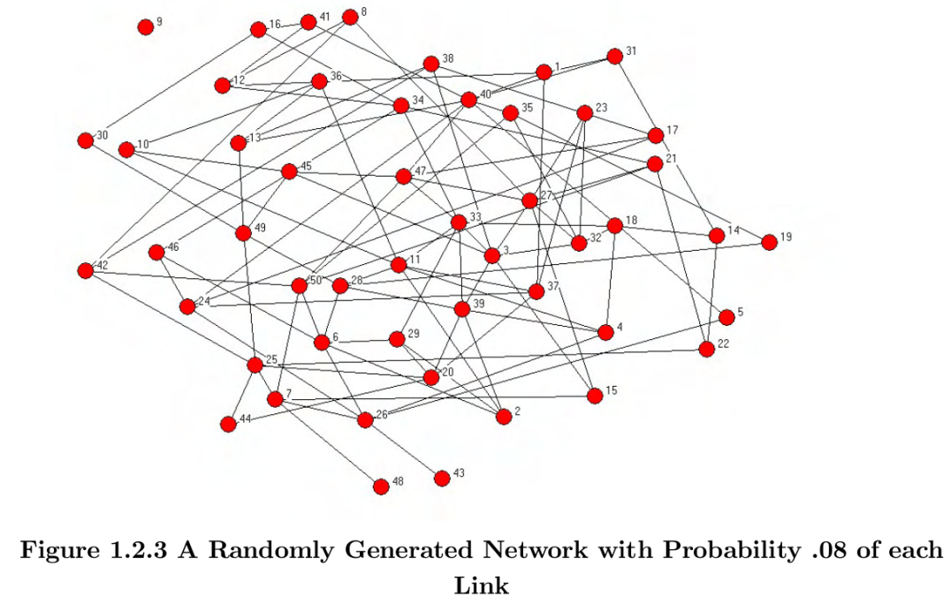
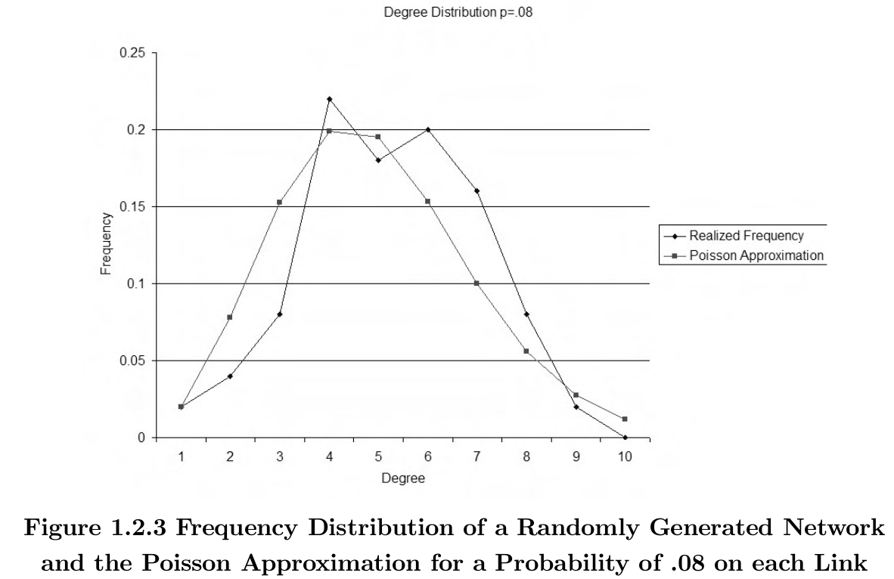
Examples: Poisson model
Images MOJ 1.2

Slide 16
Small World Model
Watts & Strogatz, 1998ff; MOJ 4.1.2, E&K 20.1-20.2

Slide 17
Why an alternate model?
Real life: high clustering, low avg. path length/diameter
E.g., me: CC=0.556, APL=2.93, d=10
Poisson: lacks high clustering
Any link formation prob: p
Triadic closure? Etc?
Low avg. path length/diameter

Slide 18
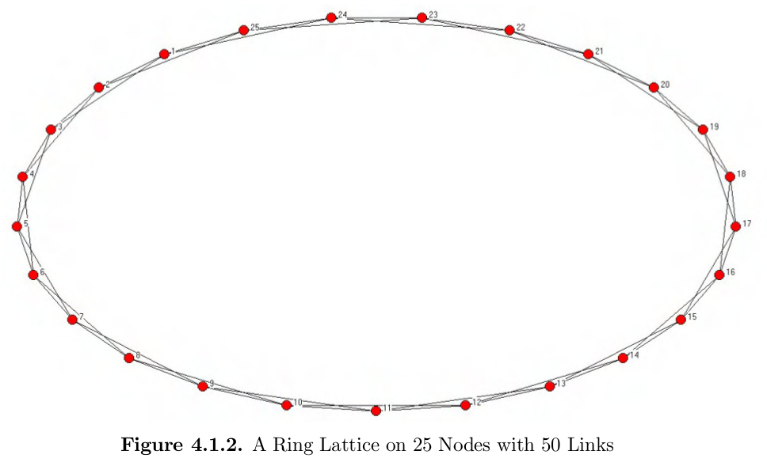
Watts-Strogatz: Starting out
each connected to 2 neighbors each side
High clustering, high diameter/APL
High clustering, high diameter/APL

Slide 19
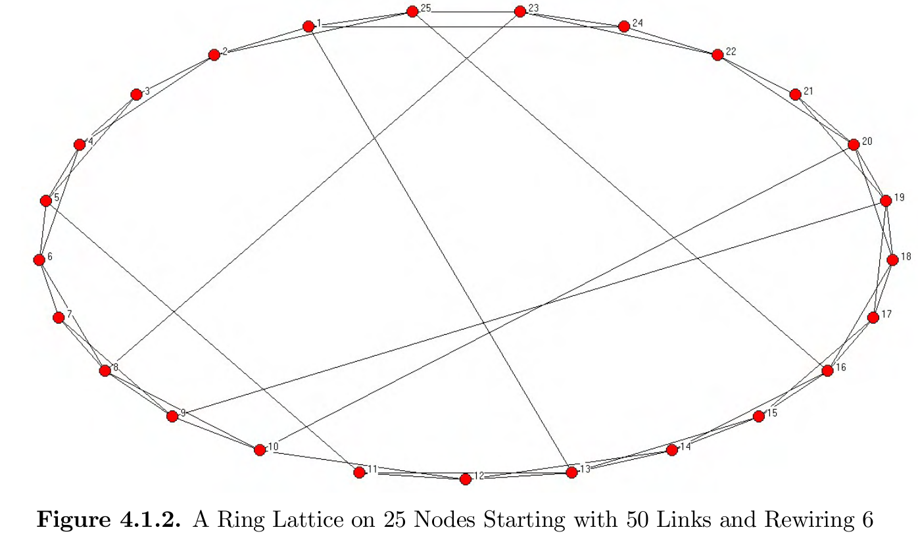
Watts-Strogatz: Rewiring
High clustering, lower diameter/APL
High clustering, high diameter/APL

Slide 20
Think-Pair-Share:
Why is the Watts-Strogatz model often called the “small world” model?

Slide 21
Watts-Strogatz: Summary
Model “small world phenomenon”
high clustering
low distance
Start w/ highly clustered network
Rewire some links
Explore in Assignment 3!

Slide 22
The Configuration Model
Bender & Canfield 1978; MOJ 4.1.4

Slide 23
Degr. Distributions → Sequences
Node i with degree d_{i}, list d_{i} times
Ex: 1112233445566677788999
7
8
6
5
9
10
3
1
4
2

Slide 24
Add links
Randomly select pairs; link & remove
1112233445566677788999
Links:
3,7
6,6
8,9
3,7
duplicate link: multi-graph!
1,4 1,5 2,4 6,8
5,7 1,9 2,9
7
self-link
8
6
5
Despite self-links and duplicate links, new graph with similar degree distribution!
9
10
3
1
4
2

Slide 25
Calculating Metrics on Random Networks

Slide 26
Metrics will vary!
Which graph for calculations?
E.g., Poisson, 6 nodes, p=0.4
6
1
6
1
6
1
5
2
5
2
5
2
4
3
4
3
4
3
Avg node degree: 2.33
Avg node degree: 2
Avg node degree: 3
Simulate!
Consider the Limit
Notes:
Avg node degree
3+2+1+4+1+3 -> 2.33
-> 2
-> 3

Slide 27
Announcements
Assignment 2 being graded: Grades for Assignment 2 are not ready. Please see me if you haven’t gotten Assignment 0 or 1 grades.
Midterm: Remember there will be a midterm Mon 23rd April @ 8:00am.
Assignment 3: Remember Assignment 3 is due Thu 26th April @ 8:30am.
New Lecture Schedule: Mon @ 8:00am, starting today.

