Slide 1
Graph Theory Essentials
Social Network Analysis, Lecture 02
E&K Ch 2.1-2.4
AAIT ITSC Spring 2018
Instructor: Stephen Wu
Credits: h/t Venkateswarlu Sunkari

Slide 2
Outline
(Review) Syllabus
Graph Theory & Metrics
Basics
Node degree
Paths & distance
Components
Lab 0: github, Slack, setup

Slide 3
On github: https://github.com/dragonstw/socialnets18
Syllabus

Slide 4
Graph Theory Basics
Graph, Node, Edge, Adjacency Matrix, Directed, Undirected, Weighted

Slide 5
Review: Network=Graph
A set of objects/ individuals
Dfn: A graph G is a tuple (V, E)
Edges in E connect vertices in V
Dfn: A neighbor set N(v) is the set of vertices adjacent to v.
Set of links between objects
Set of vertices u
Neighbors of v
not v itself
There’s an edge

Slide 6
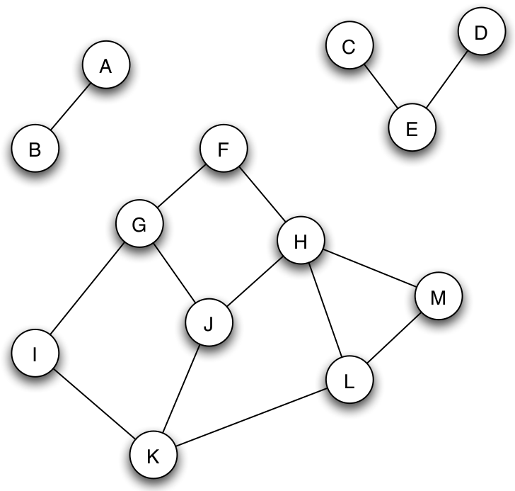
Review: Adjacency Matrix
N(v) pre-calc
 | A | B | C | D | E | F | G | H | I | J | K | L | M
A | 0 | 1 | 0 | …
B | 1 | 0 | 0 | …
C | 0 | 0 | ... |  | 1
D | … | … |  |  | 1
E |  |  | 1 | 1
F |  |  |  |  |  |  | 1 | 1
G |  |  |  |  |  | 1 |  |  | 1 | 1
H |  |  |  |  |  | 1 |  |  |  | 1 |  |  | 1
I |  |  |  |  |  |  | 1 |  |  |  | 1
J |  |  |  |  |  |  | 1 | 1 |  |  | 1
K |  |  |  |  |  |  |  |  | 1 | 1 |  | 1
L |  |  |  |  |  |  |  |  |  |  | 1 |  | 1
M |  |  |  |  |  |  |  | 1 |  |  |  | 1

Slide 7
Review: Undirected/Directed
A
A
E
B
E
B
D
C
D
C
Edges: defined by 2 vertices v and u
Undirected: unordered (v, u)
Directed: ordered (v, u)

Slide 8
Weighted Graphs
A
F
0.1
0.3
0.1
0.3
E
B
I
G
0.2
0.2
0.4
0.2
0.4
0.2
D
C
J
H
Weight for each edge e = (v,u)
w(A,B) =
w(E,D) =
w(I,J) =
w(G,F) =
0.3
0.4
0.4
0

Slide 9
Node Degree
Node degree, In- and Out-degree, Degree distribution, average degree, connectance, sparse, dense

Slide 10
Review: Node Degree
Dfn: The node degree is the number of neighbors a node has.
|N(v)|
w.r.t. adjacency matrix:
A
deg=3
E
B
adjacency matrix value
D
C
 | A | B | C | D | E
A | 0 | 1 | 0 | 0 | 1
B | 1 | 0 | 1 | 0 | 0
C | 0 | 1 | 0 | 0 | 1
D | 0 | 0 | 0 | 0 | 1
E | 1 | 0 | 1 | 1 | 0
pick row v

Slide 11
Directed: In- & Out-Degree
A
Out-degree:
In-degree:
E
B
D
C
column v, not row
 | A | B | C | D | E
A | 0 | 1 | 0 | 0 | 1
B | 0 | 0 | 0 | 0 | 0
C | 0 | 1 | 0 | 0 | 1
D | 0 | 0 | 0 | 0 | 0
E | 0 | 0 | 0 | 1 | 0

Slide 12
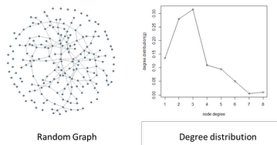
Degree Distribution
Plot node degrees of every node
Statistics: max, min, mean, variance, skewness, kurtosis
Useful: classifying graphs

Slide 13
Individual Exercise:
Find the average node degree of these two graphs.
A
E
B
D
C

Slide 14
More Degree Metrics
# edges
Average node degree:
Connectance:
Intuition: How connected is it?
Sparse graphs:
Dense graphs:
# vertices
scale by network size
positive constant

Slide 15
Paths and Distance
Paths, cycles, distance, breadth-first search, small world phenomenon, characteristic path length, graph efficiency

Slide 16
Review: Paths & Cycles
Dfn: A path is a sequence of nodes where pairs of consecutive nodes are connected by an edge.
Directed graph: direction matters!
Dfn: A cycle is a path where the start node is also the end node
A
E
B
Paths? Cycles?
D
C

Slide 17
Review: Distance
Dfn: The distance d_{v,u} between 2 nodes in a graph = length of the shortest path linking the 2 nodes
Note: Need to find shortest path!
A
E
B
D
C

Slide 18
Think-Pair-Share:
How would you calculate the average distance from a node?

Slide 19
Breadth-First Search (BFS)
Explore first-neighbors
Explore neighbors’ neighbors
Keep track of:
nodes to explore (queue)
visited nodes (set)
A
A
A
E
E
E
B
B
B
D
D
D
C
C
C

Slide 20
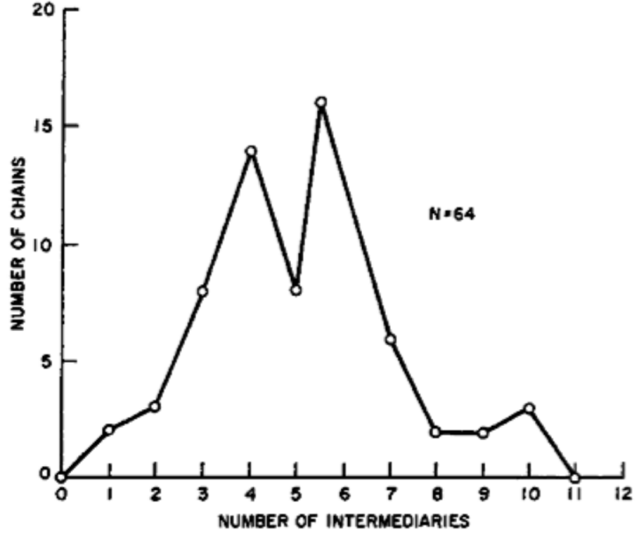
Small-world Phenomenon
For 2 random people: path distance?
Millgram 1967 & following:
296 “starters” forward a letter to a person through friends
64 completed chains
“six degrees”
Reasonable, unproven

Slide 21
Distance-based Metrics
The characteristic path length is the average shortest path length (average distance).
Graph efficiency measures how easily information is transferred.
distance from v to u
# possible node pairs

Slide 22
Group Exercise (E&K 2.4.3):
Describe an example of a graph where the diameter is more than three times as large as the average distance.

Slide 23
Components
Connectedness, component, giant component

Slide 24
Review: Connectedness
Not edge!
Dfn: A graph (or subgraph) is connected if there is a path between each pair of nodes.
If no path, this is disconnected.

Slide 25
Components
Dfn: a connected component is a subset S of nodes where:
Every node in S has a path to every other
S is not part of a larger subset S’ where property #1 holds

Slide 26
Giant Components
A giant component: “connected component that contains a significant fraction of all the nodes”
Ex: Real-world
Ex: Random graphs (Erdos-Renyi model – more later)

Slide 27
Individual Exercise:
Find the characteristic path length and efficiency of this graph.
A
E
B
D
C

Slide 28
Group Exercise (E&K 2.4.1):
A node X is pivotal for a pair of distinct nodes Y and Z if X lies on every shortest path between Y and Z (and X is not equal to either Y or Z).
Give an example of a graph in which every node is pivotal for at least two different pairs of nodes.
Explain your answer.

Slide 29
Group Exercise (E&K 2.4.2):
A node X is a gatekeeper if for some other two nodes Y and Z, every path from Y to Z passes through X.
A node X is a local gatekeeper if there are two neighbors of X, say Y and Z, that are not connected by an edge.
Give an example (together with an explanation) of a graph in which more than half of all nodes are gatekeepers.

Slide 30
On github: https://github.com/dragonstw/socialnets18/assignments/assignment0.md
Assignment 0: Setup
Push your branch named
develop-firstnamefathersname
by 12AM (Midnight) tonight!

