Slide 1
Network Structure
Social Network Analysis, Lecture 03
E&K Ch 3.1-3.7
AAIT ITSC Spring 2018
Instructor: Stephen Wu

Slide 2
Outline
(Review) Syllabus
Network Structure Basic definitions
Ties & Bridges in Large-scale data
Node-level metrics

Slide 3
Network Structure
Basic definitions: components, giant component, triadic closure, clustering coefficient, cliques, bridges, local bridges

Slide 4
Review: Network=Graph
A set of objects/ individuals
Dfn: A graph G is a tuple (V, E)
Edges in E connect vertices in V
Dfn: A neighbor set N(v) is the set of vertices adjacent to v.
Set of links between objects
Set of vertices u
Neighbors of v
not v itself
There’s an edge

Slide 5
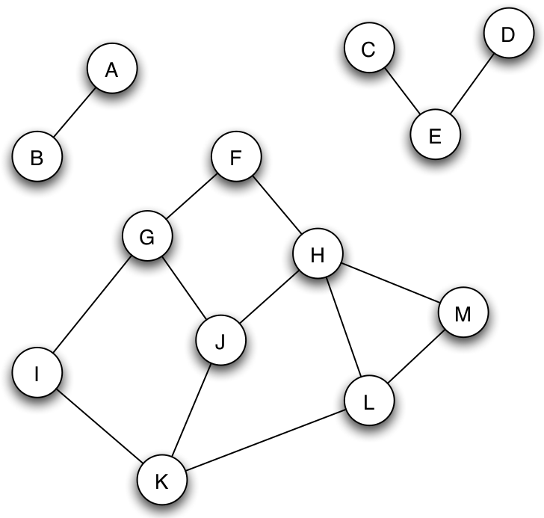
Review: Connectedness
Not edge!
Dfn: A graph (or subgraph) is connected if there is a path between each pair of nodes.
If no path, this is disconnected.

Slide 6
Components
Dfn: a connected component is a subset S of nodes where:
Every node in S has a path to every other
S is not part of a larger subset S’ where property #1 holds

Slide 7
Giant Component
A giant component: “connected component that contains a significant fraction of all the nodes”
Ex: Real-world social network
Ex: Random graphs (Erdos-Renyi model – more later)

Slide 8
Think-Pair-Share:
Do you expect that you are part of a giant component in the global social network?
Why or why not?
Notes:
Most people are part of the giant component

Slide 9
Triadic closure
“If two people in a social network have a friend in common,
then there is an increased likelihood that they will become friends themselves ...”
Rapoport 1953
Why?
Opportunity
Trust
Incentive
G
B
C
F
A
How prevalent is triadic closure in a graph?
E
D

Slide 10
Clustering Coefficient
Dfn: The (overall) clustering coefficient of a node v is
the probability that u₁, u₂ (two randomly selected neighbors of v) are themselves neighbors.
neighbors of v that are linked
Any 2 neighbors of v

Slide 11
Cliques
Dfn: A clique is a maximal, completely connected subgraph of a given graph.
B
B
B
C
A
C
A
C
A
D
D
D

Slide 12
Individual Exercise:
What is the clustering coefficient of this graph?
What are the cliques?
G
B
C
F
A
E
D
Notes:
Clustering coeff: 6/18
Linked
A: CD, BC
B: AC
C: AD, AB
D: AC
E:
F:
G:
Any
A: 6, B: 6, C: 3, D: 1, E: 1, F: 1, G: 0
Cliques
ABC, ACD

Slide 13
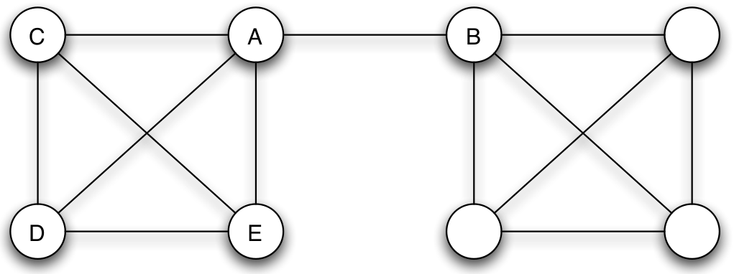
Bridges
Dfn:
An edge e
is a bridge
in the graph G
if G―e
has more components than G
What about giant components?

Slide 14
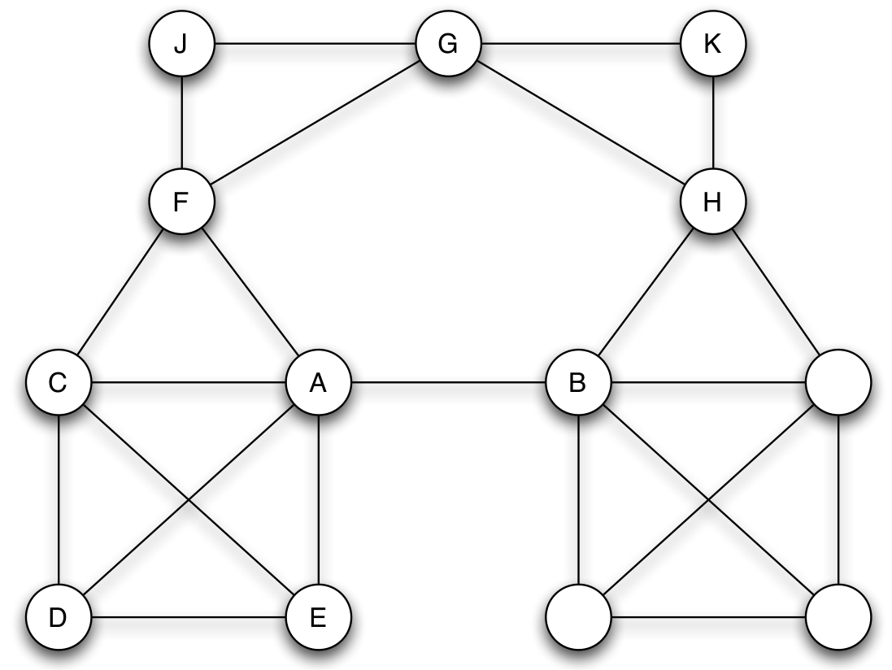
Local Bridges
Dfn:
An edge e = (v,u)
is a local bridge
in the graph G
if path_{G-e}(v, u) ― path_{G}(v, u) > 2
i.e., no friends in common
span of local bridge

Slide 15
Tie Strength and Bridges

Slide 16
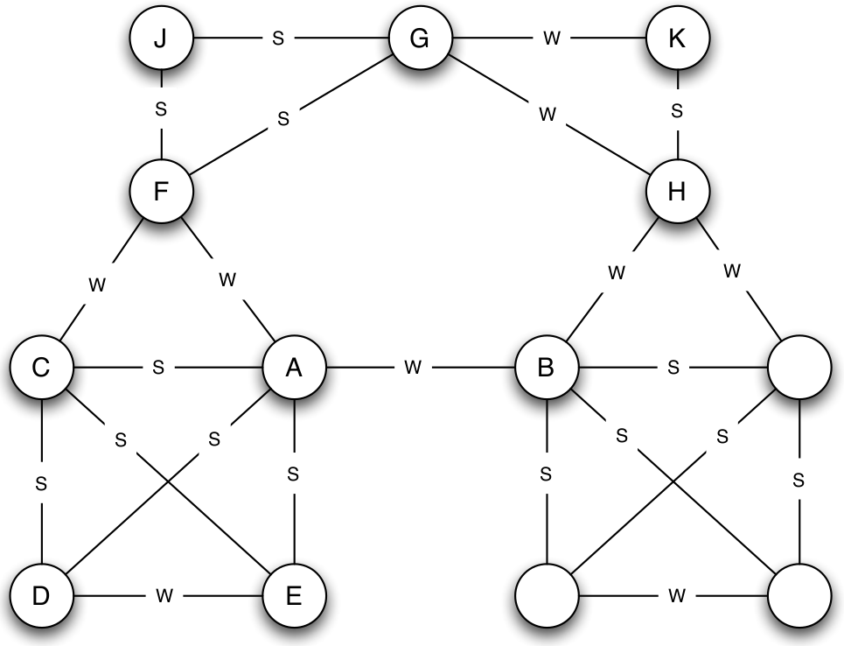
Group Discussion:
Not all edges (“ties”) are created equal.
To find a job, which would be more useful:
A good friend?
Or an acquaintance?
“strong” tie
“weak” tie
Notes:
Granovetter’s work in the 1960s found that acquaintances are more often the immediate cause of finding jobs.
This doesn’t negate the fact that good friends can help you improve yourself for a job, or may be more trustworthy in jobs.

Slide 17
Strong Triadic Closure Property
Node v violates the Strong Triadic Closure Property if:
it has strong ties to 2 other nodes u₁ and u₂
and there is no edge at all (strong or weak) between u₁ and u₂
Node v satisfies the Strong Triadic Closure Property if it does not violate it.

Slide 18
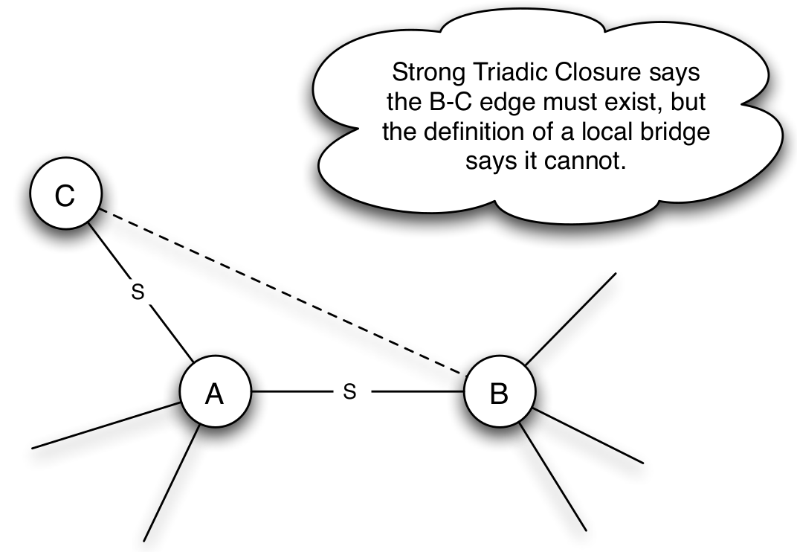
Local Bridges must be Weak Ties!
What if:
A has strong ties
A = local bridge
Contradiction!
… of Strong Triadic Closure
“Strong” and “weak” are imprecise!
How does this look in the real world?

Slide 19
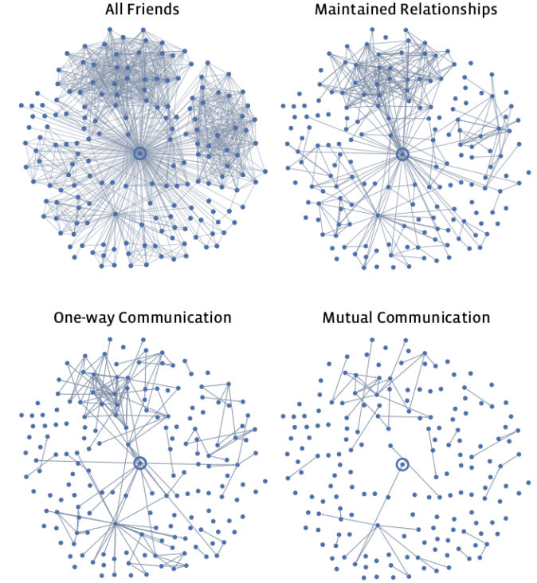
Tie Strength
Define “strong” and “weak” ties?
“Weak”: e.g., follow on Facebook (FB)
“Strong”: e.g., reciprocal FB messages
Quantify “strong” and “weak” ties?
E.g., # likes, messages, etc

Slide 20
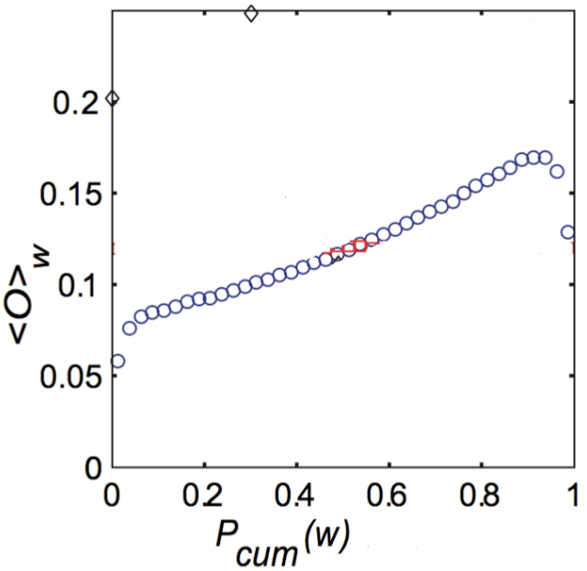
Neighborhood Overlap
Dfn: The neighborhood overlap of an edge e = (v, u) is:
shared neighbors (i.e., triadic closure)
all neighbors of either node

Slide 21

Individual Exercise:
What is the neighborhood overlap of :
1. BC edge? 2. AB edge?
G
B
C
F
A
E
D
Notes:
BC Neighborhood overlap = ¼
Neighbors: 4
B: G, F, A, (C)
C: (B), A, D
Shared: 1
A
AB Neighborhood overlap: 0
Neighbors: 8
Shared: 0

Slide 22
Announcements
Next class: Lab Thursday, 22nd March 2018 8:30am
Slack: Sign up for AAIT ITSC slack – get invited by email. Contact Naty.
Assignment 0: To push to the repository, you need access. Email Dr. Stephen with your github username if you haven’t gotten this yet.
Syllabus: Please check the course syllabus for updates. The allowance for missed classes has increased to 3. However, this means there will be very few special exceptions.

