Slide 1
Node-level Metrics
Social Network Analysis, Lecture 03b
E&K Ch 3.1-3.7
AAIT ITSC Spring 2018
Instructor: Stephen Wu

Slide 2
Node-level Metrics
Centrality: degree, betweenness, closeness, information; Eccentricity

Slide 3
Review: Network=Graph
A set of objects/ individuals
Dfn: A graph G is a tuple (V, E)
Edges in E connect vertices in V
Dfn: A neighbor set N(v) is the set of vertices adjacent to v.
Set of links between objects
Set of vertices u
Neighbors of v
not v itself
There’s an edge

Slide 4
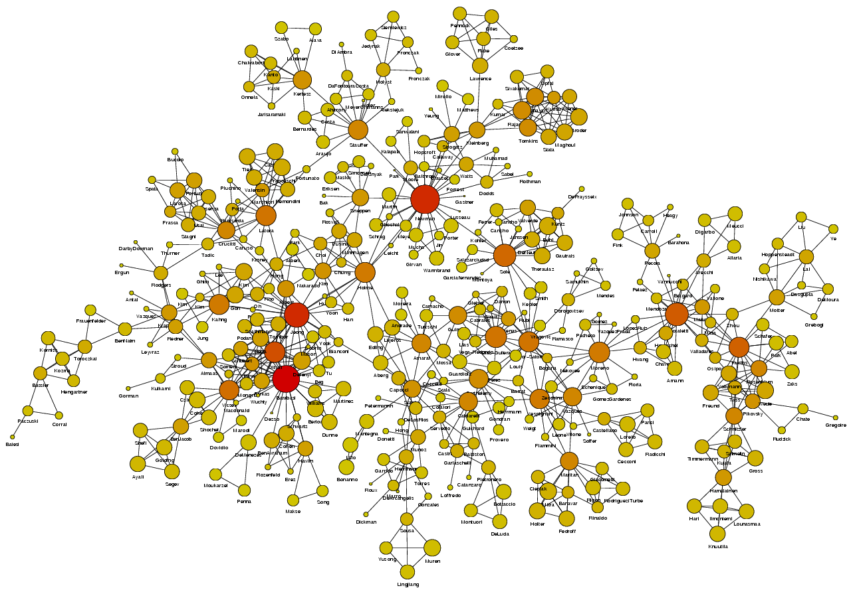
Centrality
How does a node relate to the overall network?
In real-life…
Information flow
Bargaining power
Influence

Slide 5
Review: Node Degree
Dfn: The node degree is the number of neighbors a node has.
d_{i}(G) = |N(i)|
w.r.t. adjacency matrix:
A
deg=3
E
B
adjacency matrix value
D
C
 | A | B | C | D | E
A | 0 | 1 | 0 | 0 | 1
B | 1 | 0 | 1 | 0 | 0
C | 0 | 1 | 0 | 0 | 1
D | 0 | 0 | 0 | 0 | 1
E | 1 | 0 | 1 | 1 | 0
pick row i

Slide 6
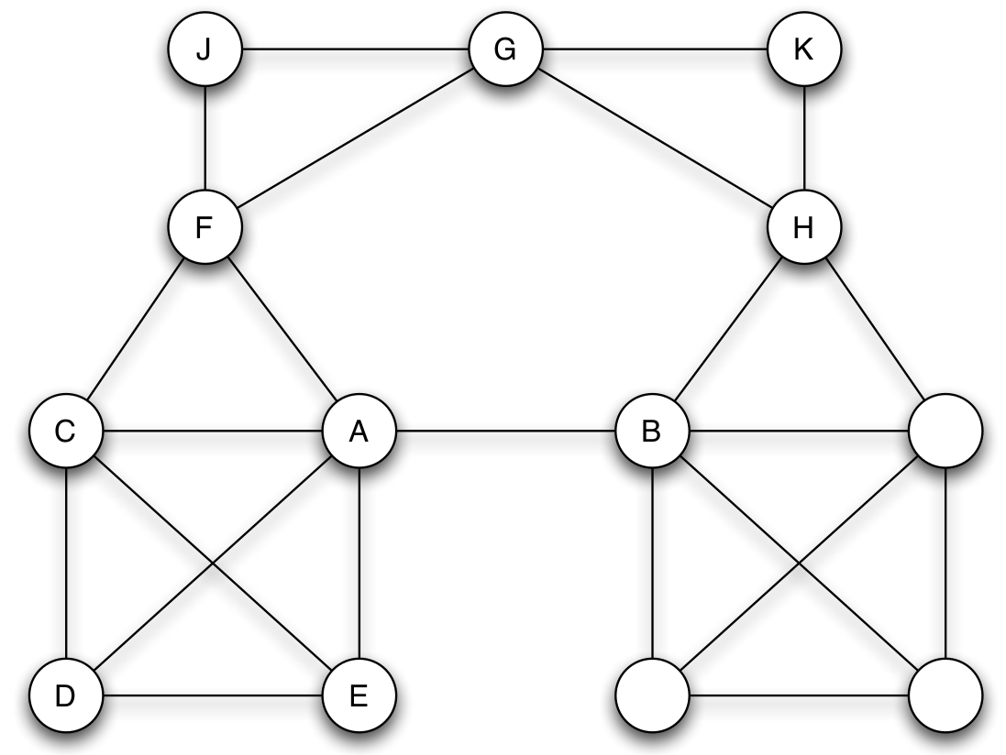
Review: Local Bridges
Dfn:
An edge e = (i,j)
is a local bridge
in the graph G
if path_{G-e}(i, j) ― path_{G}(i, j) > 2
i.e., no friends in common
span of local bridge

Slide 7
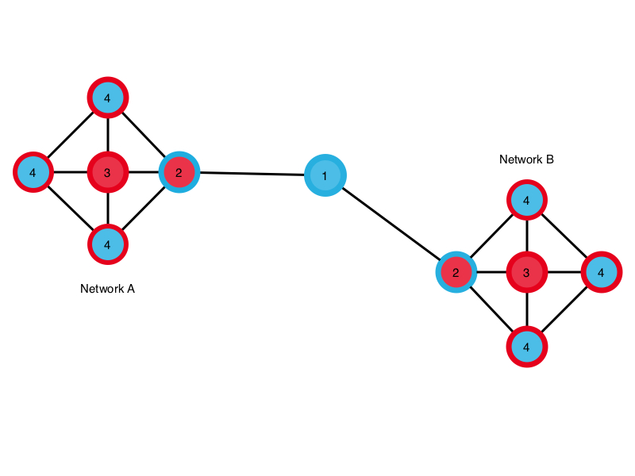
Degree Centrality
How connected is the node?
Node degree, scaled to [0,1]
Missing: node location?
degree of node i
# of nodes in network (not i)

Slide 8
Betweenness Centrality
How important is this node in connecting others?
# shortest paths between k and j that include i
# shortest paths between k and j

Slide 9
Closeness Centrality
How easily can a node reach others?
Simple: Inverse average distance
Decay centrality:
# nodes (not i)
avg. distance from node i
If δ -> 0?
If δ -> 1?
Degree centrality
Component size
decay parameter in [0,1]

Slide 10
Information Centrality
How well can the network respond if a node is deactivated?
Measure in graph efficiency:
Compare the change in efficiency
graph G without node i or corresponding edges

Slide 11
Announcements
Next class: Lecture Tuesday, 27th March 2018 @ 8:00am
Slack: Sign up for AAIT ITSC slack. Get on #general and #socialnets18. Contact Naty.
Github: To push to the repository, you need access. Email Dr. Stephen with your github username if you haven’t gotten this yet.
Assignment1: This is due on Thursday 29th March at 8:30am.

