Slide 1
Web Programming
Term Project
Shin Dong Wha

Slide 2
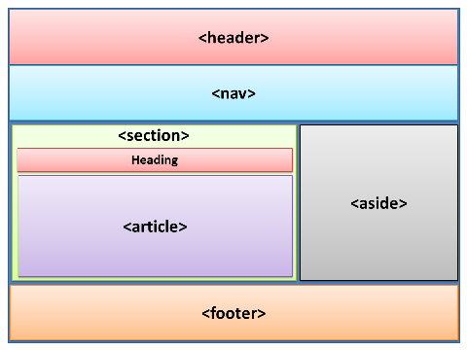
HTML5
Header : <h1>Title
Nav : <ul>Menu link
Article : <iframe>
Aside : <a>weather, dust
Footer : copyright

Slide 3



CONTENT
Profile
Tour
Brag
Education
Hobby
Experience
SNS
2013USA&CANADA
2015USA
2017JAPAN
2017AUS
LOL
Exercise

Slide 4


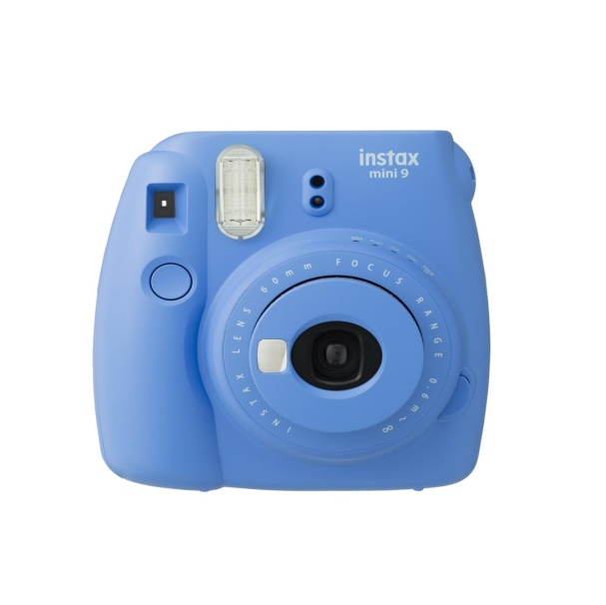
Features
Music
Changeable
Pictures
Playing background music
Using JavaScript
Age, Greeting, Slideshow
Many pictures and gifs

Slide 5
Music
Main
<embed src="iu.mp3" autostart="true" hidden="true" loop="true">

Slide 6
Changeable
Greeting
day = new Date()
hr = day.getHours()
hr1 = hr - 12
if (hr < "6") {document.write("<p class=\"greet\">It is "+hr+" AM. Why don't you go to bed?</p>")}
else if (hr < "12") {document.write("<p class=\"greet\">Have a nice day!! It is "+hr+" AM.</p>")}
else if (hr < "13") {document.write("<p class=\"greet\">It is "+hr+" PM!! Let's do lunch!!</p>")}
else if (hr < "17") {document.write("<p class=\"greet\">It is already "+hr1+" PM..Cheer Up</p>")}
else if (hr < "22") {document.write("<p class=\"greet\">It is "+hr1+" PM</p>")}
else if (hr > "22") {document.write(”<p class=\"greet\">” hr1+" PM. It's time to go sleep.</p>")}

Slide 7
Changeable
Old
var birthday = new Date("11/1/1993");
var today = new Date();
var years = today.getFullYear() - birthday.getFullYear();
birthday.setFullYear(today.getFullYear());
document.write("<p>Old : " + years + "</p>");

Slide 8
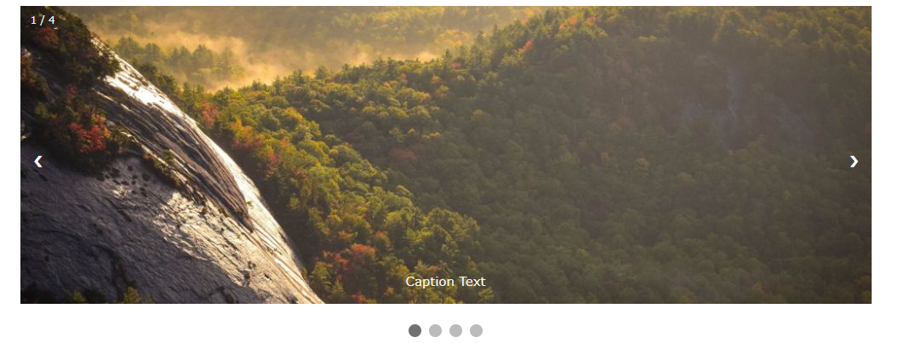
Changeable-slideshow

Slide 9


Reference
http://www.w3school.com/
http://unikys.tistory.com/

Slide 10
The End

