Slide 1


Interns Team:
Aayush Sharma
Abhinav Ennazhiyil
Naman Joshi
Subham Agarwal
Srinjayee Paul
Vaishnavi Gupta

Slide 2
OUR GOALS ARE:
To find how the different variables affect attrition.
To predict how future values can be classified
To make suitable recommendations

Slide 3
WHAT WE UNDERSTOOD FROM THE DATA?
The dataset consisted of 1470 rows consisting data of all employees corresponding to 35 variables such as Age, daily rate, department, education field etc.
The data consist of 14 quantitative variables and 21 categorical variables.
The dataset did not consist of any null or missing values.
Variables such as employee count and standard hours can be removed from the data as they have zero variance and cannot contribute to the model.
16 % of the employees left the company while 84% did not leave the company.

Slide 4
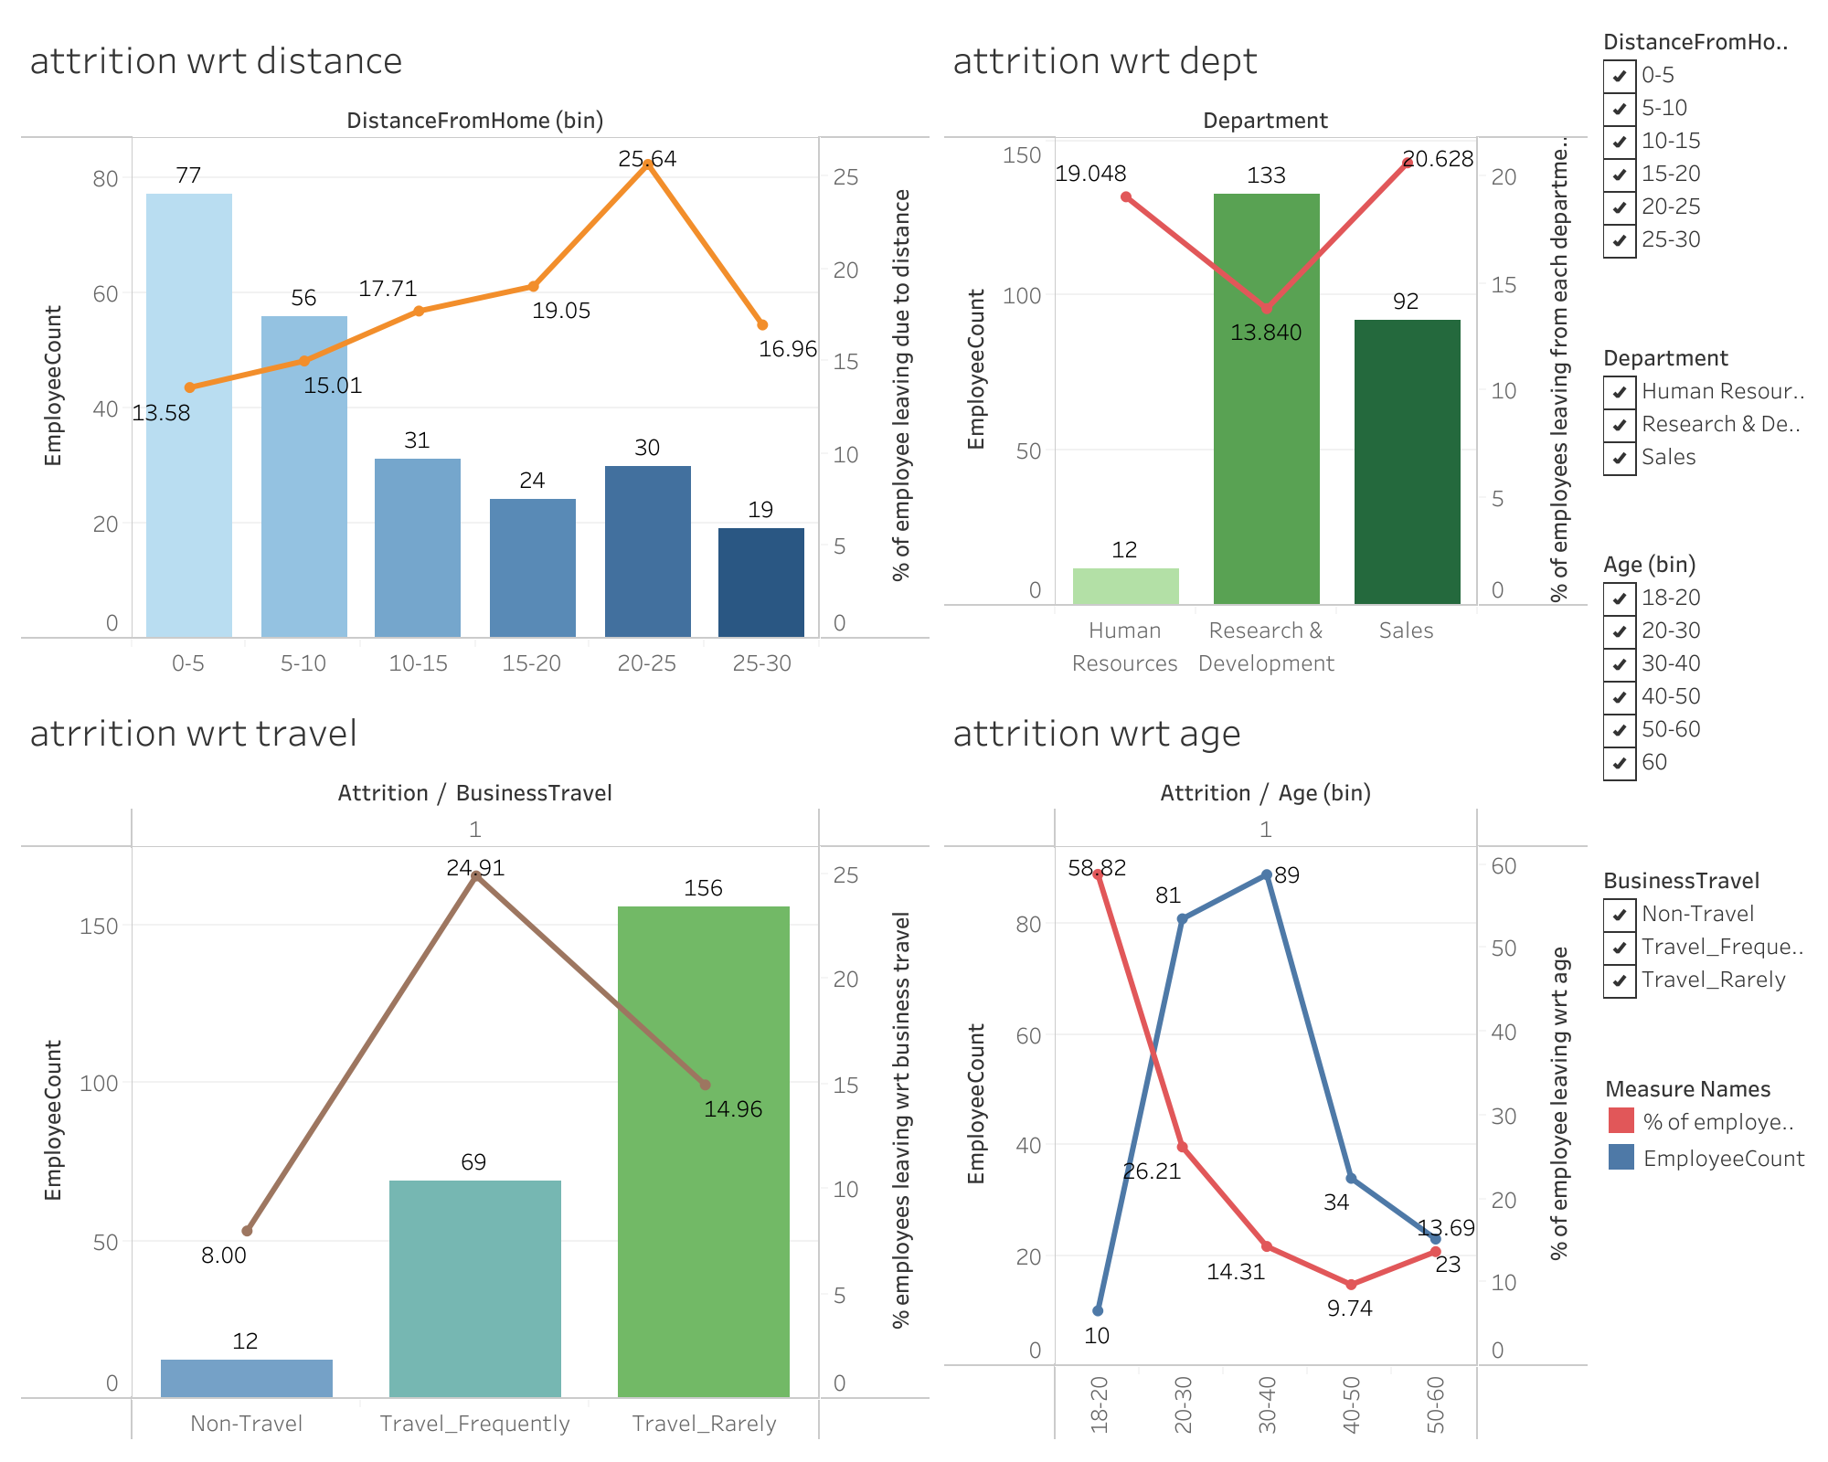

Slide 5
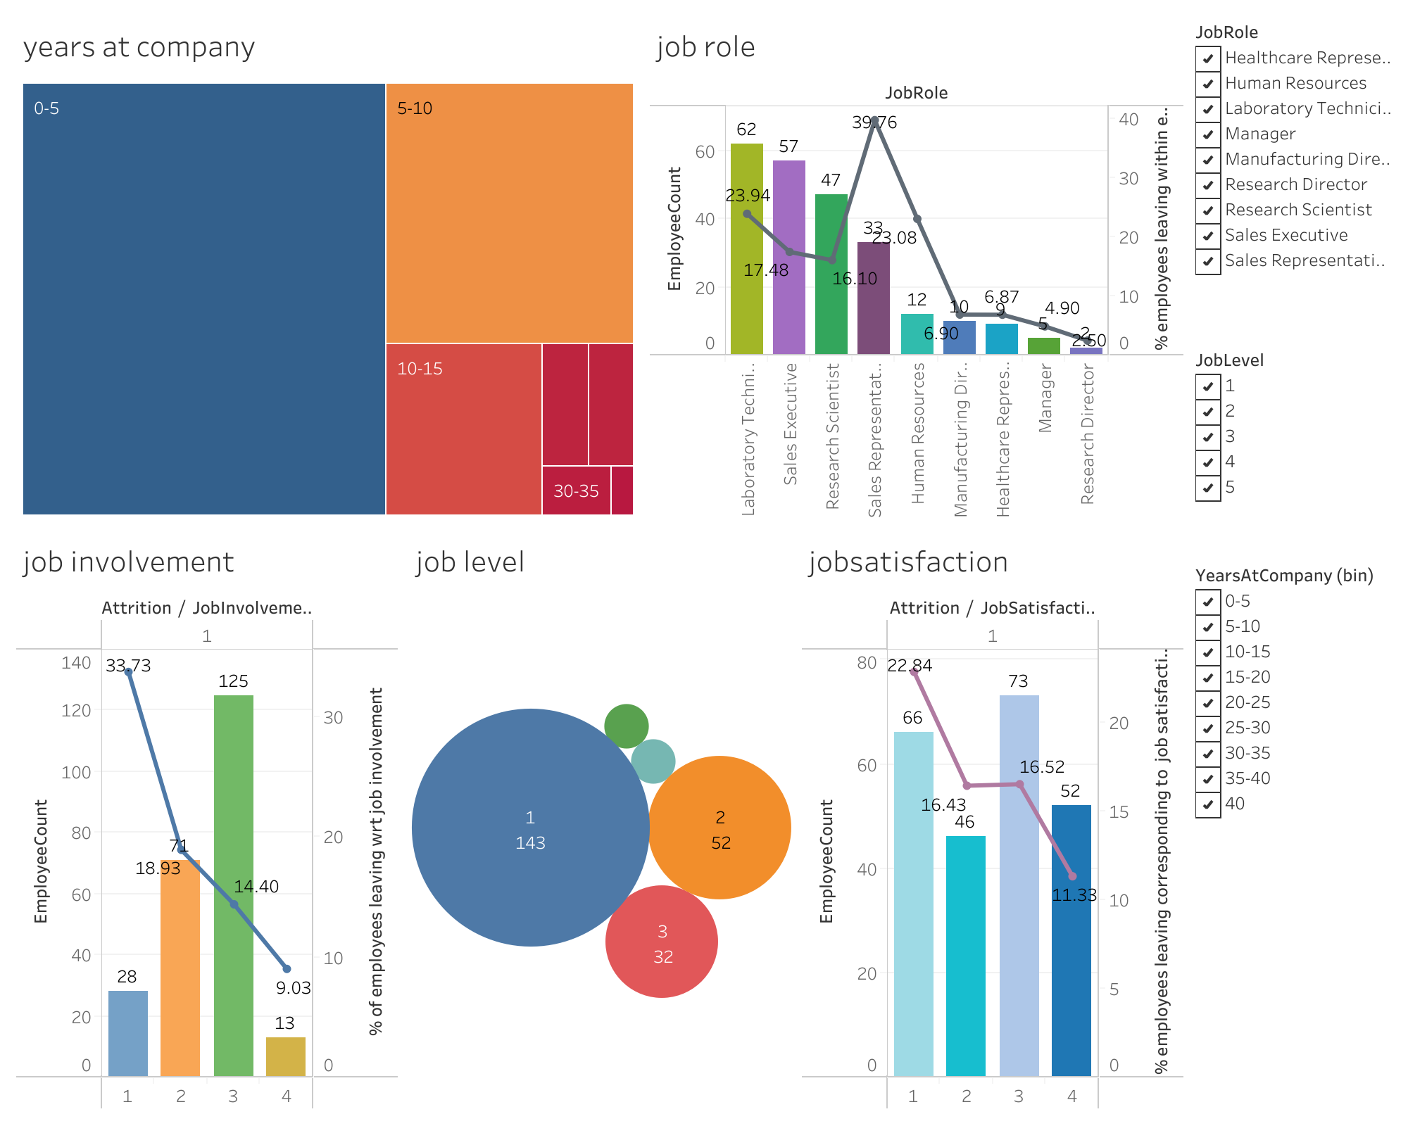

Slide 6
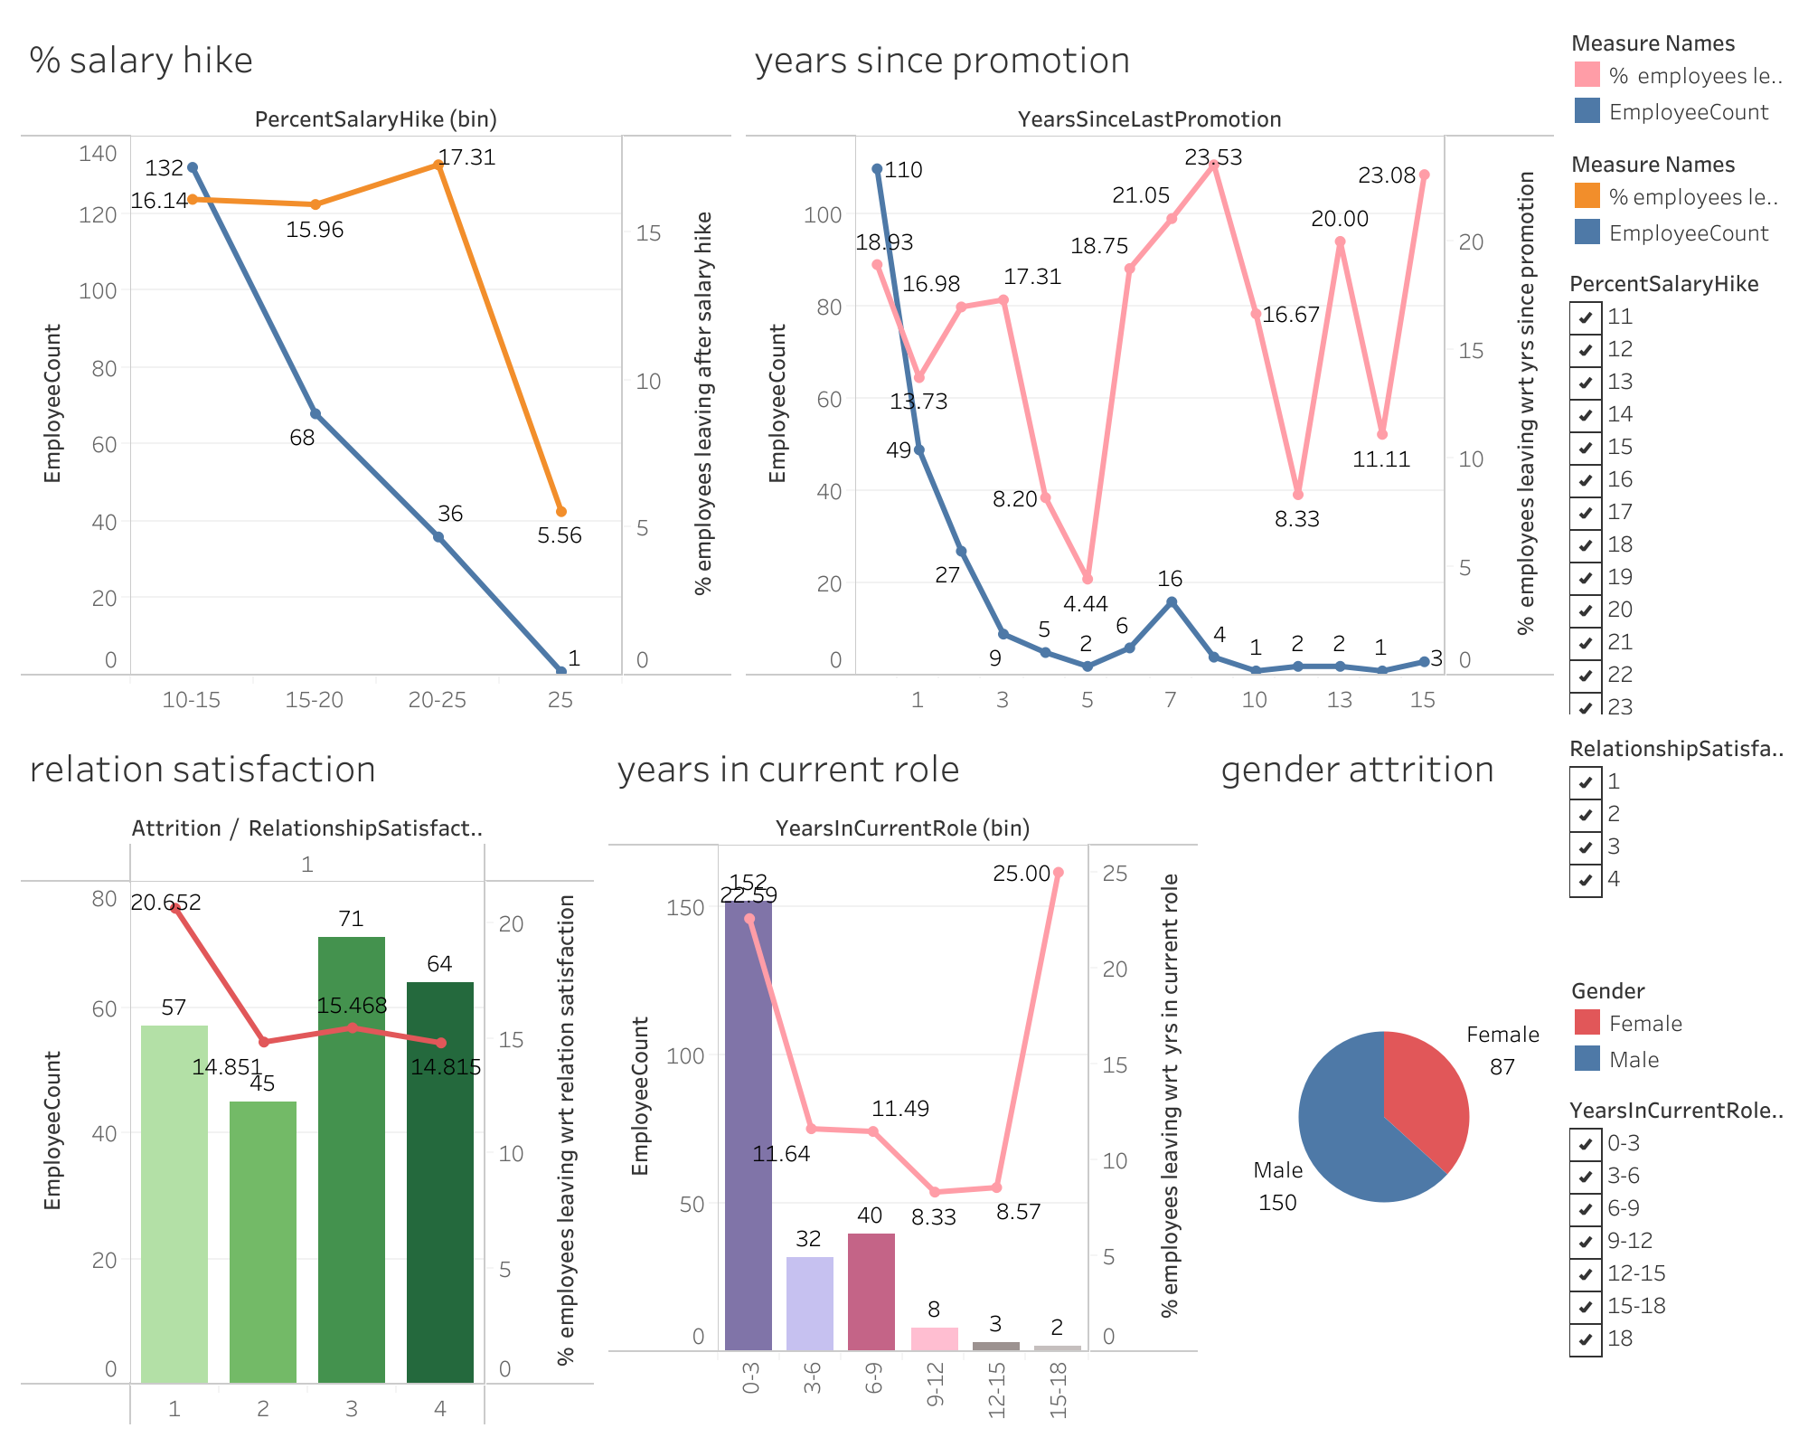

Slide 7
INSIGHTS FROM THE VISUALISATIONS
1) Attrition is more common in males and younger employees.
2) The tendency to leave the company increase with increase in the distance from home
3) Maximum attrition is seen from the research and development department and people working as Lab technicians
4) People travelling rarely are likely to leave as compared to frequent or non travelers.
5) Attrition also increases with lower job involvement, job satisfaction and relationship satisfaction.
6) A new joiner with lower job level is more likely to leave.
7) Attrition decreases with increase in percentage increase in salary hike

Slide 8
Logistic regression
Analysis and insights

Slide 9
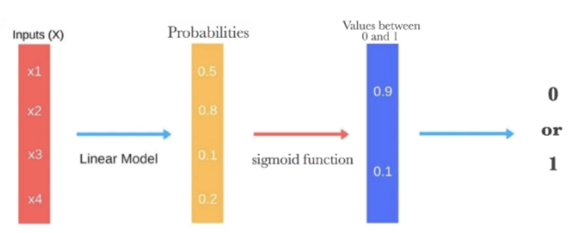

Logistic regression
A simple yet effective tool for classification tasks is the logit model. This model is often used as a baseline/benchmark approach before using more sophisticated machine learning models to evaluate the performance improvements.
The logistic regression takes the output of a linear function of k independent variables and uses the logistic link function to output this value within the range of [0,1]. The logistic function has an "S" shape and takes a set of real values and maps it to a range of 0 to 1, but never exactly at the 0 or 1 values. Thus, the outputs of a logistic regression are probability values and we assign a value of 1 if the probability value is above a threshold value.

Slide 10


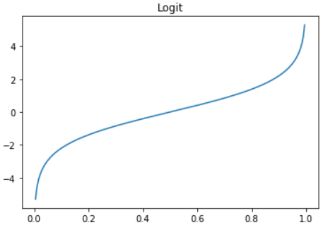
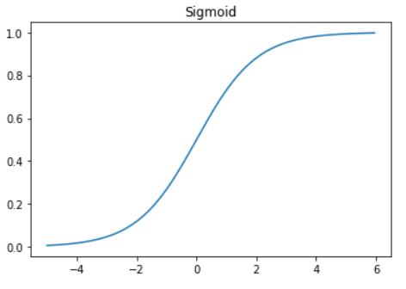
Logit and sigmoid functions
The inverse of the logit function is the sigmoid function. If you have a probability p, Sigmoid(Logit(p))=p. Thus, the sigmoid function maps the real values back to the range of [0,1].
The logit link function is particularly intuitive as it is log of the odds ratio. For example, given a probability p, the odds are calculated as {p}/{1-p} where p=0.8, the odds are 4 to 1 (i.e., 0.8/0.2=4).

Slide 11
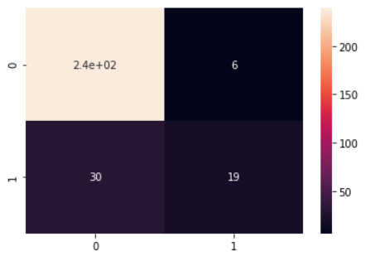

Confusion matrix and accuracy score
We obtain an accuracy of 87.75% using the Logistic Regression model.
From the confusion matrix, we see that:
Type | Count
True Negative | 239
False Positive | 6
False Negative | 30
True Positive | 19

Slide 12
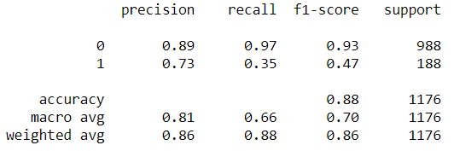
Training set metrics – precision, recall, f1 score
Metric | Attrition = 0 | Attrition = 1
Precision | 0.89 | 0.73
Recall | 0.97 | 0.35
F1-Score | 0.93 | 0.47
Support | 988 | 188

Slide 13
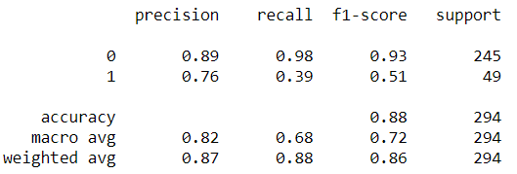
Test set metrics – precision, recall, f1 score
Metric | Attrition = 0 | Attrition = 1
Precision | 0.89 | 0.76
Recall | 0.98 | 0.39
F1-Score | 0.93 | 0.51
Support | 245 | 49

Slide 14
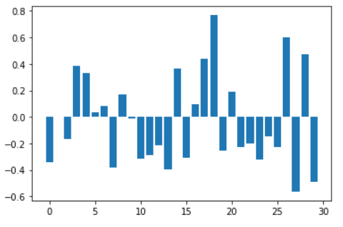
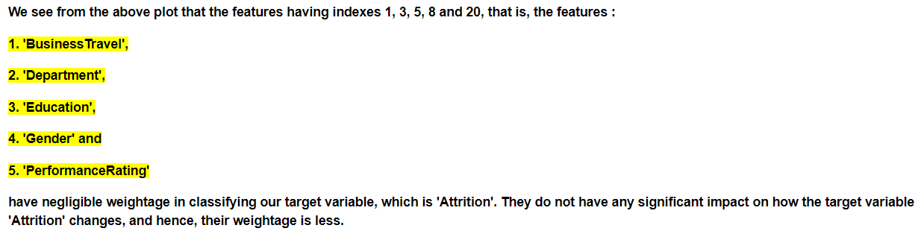
Feature importance analysis

Slide 15
Logistic regression
USING SMOTE()

Slide 16
smote
Classification using class-imbalanced data is biased in favor of the majority class. The bias is even larger for high-dimensional data, where the number of variables greatly exceeds the number of samples.
The problem can be attenuated by undersampling or oversampling, which produce class-balanced data. Generally undersampling is helpful, while random oversampling is not.
Synthetic Minority Oversampling Technique (SMOTE) is a very popular oversampling method that was proposed to improve random oversampling but its behavior on high-dimensional data has not been thoroughly investigated

Slide 17
Confusion matrix and accuracy score
We obtain an accuracy of 87.75% using the Logistic Regression model.
From the confusion matrix, we see that:
Type | Count
True Negative | 220
False Positive | 22
False Negative | 27
True Positive | 225
Confusion Matrix [[220 22] [ 27 225]]
Accuracy:0.9008097165991903

Slide 18
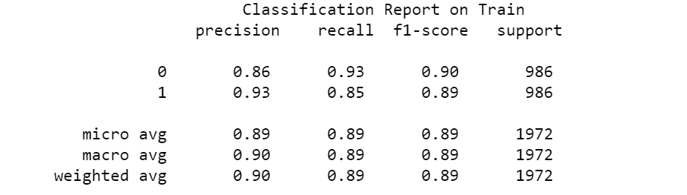
Training set metrics – precision, recall, f1 score
Metric | Attrition = 0 | Attrition = 1
Precision | 0.86 | 0.93
Recall | 0.93 | 0.85
F1-Score | 0.90 | 0.89
Support | 986 | 986

Slide 19
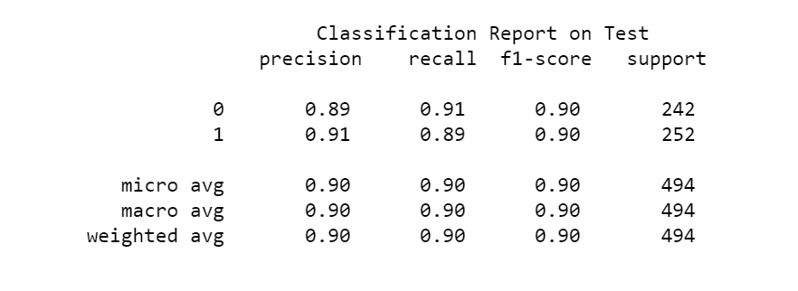
Test set metrics – precision, recall, f1 score
Metric | Attrition = 0 | Attrition = 1
Precision | 0.89 | 0.91
Recall | 0.91 | 0.89
F1-Score | 0.90 | 0.90
Support | 242 | 252

Slide 20
DECISION TREE

Slide 21
Decision Trees
Decision Trees (DTs) are a non-parametric supervised learning method used for classification and regression. Decision trees learn from data to approximate a sine curve with a set of if-then-else decision rules. The deeper the tree, the more complex the decision rules and the fitter the model.
How Do Decision Trees Work?
Splitting
Pruning
Tree Selection
Key Factors :
Entropy
Information Gain

Slide 22
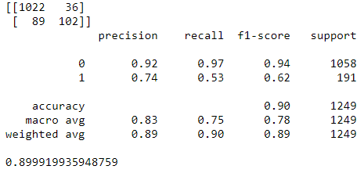
Training set metrics – precision, recall, f1 score
Confusion Matrix
Metric | Attrition = 0 | Attrition = 1
Precision | 0.92 | 0.74
Recall | 0.97 | 0.53
F1-Score | 0.94 | 0.62
Support | 1058 | 191

Slide 23
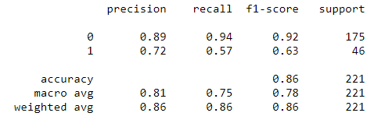

Test set metrics – precision, recall, f1 score
Confusion Matrix
Metric | Attrition = 0 | Attrition = 1
Precision | 0.89 | 0.72
Recall | 0.94 | 0.57
F1-Score | 0.92 | 0.63
Support | 175 | 46

Slide 24
RANDOM FOREST

Slide 25

Random Forest
Random forests or random decision forests are an ensemble learning method for classification, regression and other tasks that operate by constructing a multitude of decision trees at training time and outputting the class that is the mode of the classes (classification) or mean prediction (regression) of the individual trees.
It consists of a large number of individual decision trees that operate as an ensemble.
Each individual tree in the random forest spits out a class prediction and the class with the most votes becomes our model’s prediction.

Slide 26
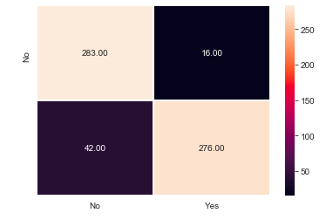

Confusion matrix and accuracy score
We obtain an accuracy of 90.59% (testing data) using the Random Forest model.
From the confusion matrix, we see that:
Type | Count
True Negative | 283
False Positive | 16
False Negative | 42
True Positive | 276

Slide 27
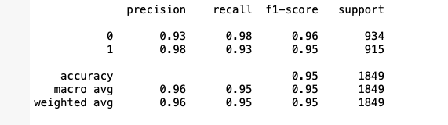
Training set metrics – precision, recall, f1 score, Support
Metric | Attrition = 0 | Attrition = 1
Precision | 0.93 | 0.98
Recall | 0.98 | 0.93
F1-Score | 0.96 | 0.95
Support | 934 | 915

Slide 28
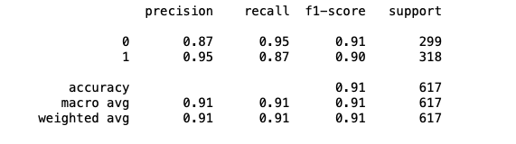
Test set metrics – precision, recall, f1 score, Support
Metric | Attrition = 0 | Attrition = 1
Precision | 0.87 | 0.95
Recall | 0.95 | 0.87
F1-Score | 0.91 | 0.90
Support | 299 | 318

Slide 29
XGBOOST

Slide 30
XGBoost
XGBoost is an optimized distributed gradient boosting library designed to be highly efficient, flexible and portable.
It implements machine learning algorithms under the Gradient Boosting framework.
XGBoost provides a parallel tree boosting (also known as GBDT, GBM) that solve many data science problems in a fast and accurate way.

Slide 31
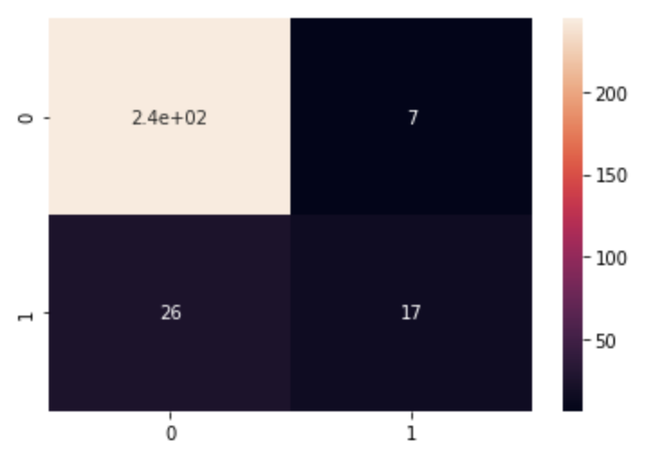

Confusion matrix and accuracy score
We obtain an accuracy of 90.59% (testing data) using the Random Forest model.
From the confusion matrix, we see that:
Type | Count
True Negative | 244
False Positive | 7
False Negative | 26
True Positive | 17

Slide 32
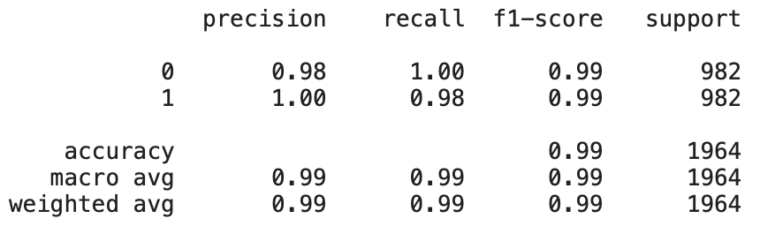
Training set metrics – precision, recall, f1 score, Support
Metric | Attrition = 0 | Attrition = 1
Precision | 0.98 | 1.00
Recall | 1.00 | 0.98
F1-Score | 0.99 | 0.99
Support | 982 | 982

Slide 33
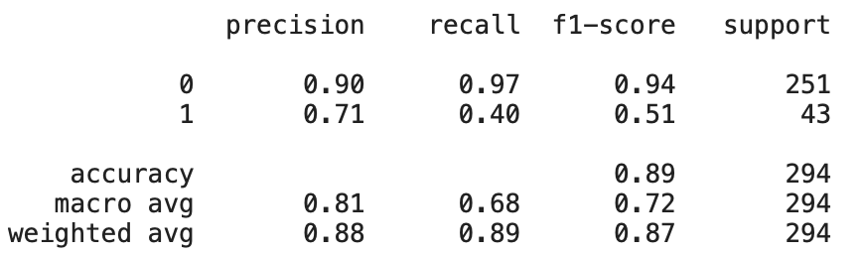
Test set metrics – precision, recall, f1 score, Support
Metric | Attrition = 0 | Attrition = 1
Precision | 0.90 | 0.71
Recall | 0.97 | 0.40
F1-Score | 0.94 | 0.51
Support | 251 | 43

Slide 34
COMPARISON OF TRAINING SET METRICS FROM DIFFERENT ALGORITHMS
Algorithm | Precision (Attrition=0) | Recall (Attrition=0) | Precision (Attrition=1) | Recall (Attrition=1) | F1 Score (Attrition=0) | F1 Score (Attrition=1)
Logistic Regression | 0.89 | 0.97 | 0.73 | 0.35 | 0.93 | 0.47
Logistic Regression (with SMOTE) | 0.86 | 0.93 | 0.93 | 0.85 | 0.90 | 0.89
Decision Tree | 0.92 | 0.97 | 0.74 | 0.53 | 0.94 | 0.62
Random Forest | 0.93 | 0.98 | 0.98 | 0.93 | 0.96 | 0.95
XGBoost | 0.98 | 1.00 | 1.00 | 0.98 | 0.99 | 0.99
The XGBoost algorithm gives the best precision, recall and F1 Score for the training data.
It is followed by Random Forest and Logistic Regression with SMOTE.

Slide 35
COMPARISON OF testing SET METRICS FROM DIFFERENT ALGORITHMS
Algorithm | Precision (Attrition=0) | Recall (Attrition=0) | Precision (Attrition=1) | Recall (Attrition=1) | F1 Score (Attrition=0) | F1 Score (Attrition=1)
Logistic Regression | 0.89 | 0.98 | 0.76 | 0.39 | 0.93 | 0.51
Logistic Regression (with SMOTE) | 0.89 | 0.91 | 0.91 | 0.89 | 0.90 | 0.90
Decision Tree | 0.89 | 0.94 | 0.72 | 0.57 | 0.92 | 0.63
Random Forest | 0.87 | 0.95 | 0.95 | 0.87 | 0.91 | 0.90
XGBoost | 0.90 | 0.97 | 0.71 | 0.40 | 0.94 | 0.51
The precision, recall and F1 score for test set is the best for both Logistic Regression as well as Random Forest.
The precision and F1 score of XGBoost is however not good.

Slide 36
CONCLUSION
From the comparison of metrics on train and test data, we can conclude that we can use Logistic regression for predicting the attrition of employees as it gives the best result on combining both test and train data metrics.
The XGBoost algorithm performs well in case of the training data but fails to perform well in case of the testing set.
We can calculate the attrition probability of each employee, given all the variables, and can recognize potential job leavers with respect to the chosen algorithm.

Slide 37
WHAT WE MAY SUGGEST:
We can develop different retention strategy for each group. The company can address the concerns of the employees of Research and Development department.
The employees who live far away from the office can be giving travel allowances.
Laboratory technicians can be given certain incentives.
The job satisfaction among employees can be improved by rewarding outside financial renumeration or by engaging more with them.

Slide 38

Thank You

