Slide 1
Entity Recommendation and Search in Heterogeneous Information Networks
Xiao Yu
Department of Computer Science
University of Illinois, at Urbana Champaign
4/1/2014

Slide 2


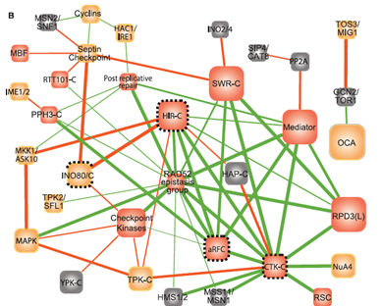
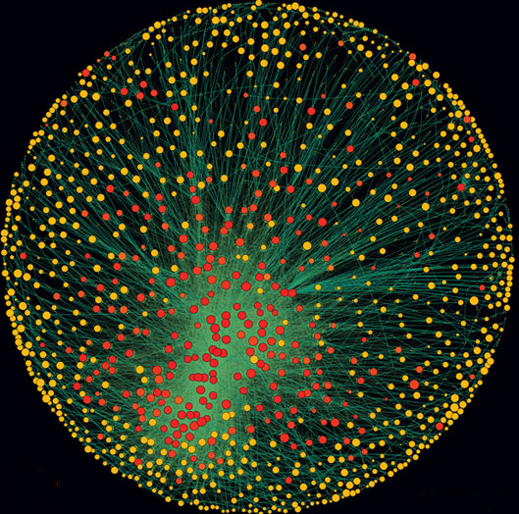
Booming Age of Heterogeneous Information Networks
Information network with multi-typed entities and relationships
Social Media
E-Commerce
Medical
Medical
Medical
Database
Images
Records
Treatment Plan
Biology
Healthcare
Pharmacy Service
Global Economy

Slide 3






Heterogeneous Information Networks Can Be Large-Scale
Information Network | Number | Source / Date
 | 1.11 billion users, 208,300 photos every minute | Yahoo! News (05/01/2013)
 | 190 million users, 58 million tweets per day | statisticbrain.com (05/07/2013)
 | 235 million users, “+1” button used 5 billion times per day | wikipedia.org (05/2013)
 | 2.54 billion titles, 5.25 billion personalities | wikipedia.org (06/013)
 | 2.16 million papers | http://www.informatik.uni-trier.de/~ley/db/
 | 100 million users (01/2013), 20 million reviews (07/2011) | wikipedia.org, yelp.com
Notes:
Social media services have millions and billions of users

Slide 4
Previous Works on Mining Heterogeneous Information Networks
Knowledge hidden in DBLP Network | Mining Functions | Papers
How are CS research areas structured? | Clustering | Sun KDD12
Which authors work on data mining? | Classification | Ji PKDD10, Ji KDD11
Who are the leading researchers on web search? | Ranking | Sun EDBT09, Sun KDD09
Who are similar researchers of C. Faloutsos? | Entity Similarity | Sun VLDB11
Who is the advisor of J. Leskovec? | Relationship Prediction | Wang KDD10
......

Slide 5

How to help users explore heterogeneous information networks, find desired information and discover interesting knowledge?

Slide 6

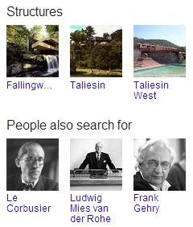

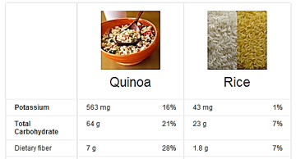
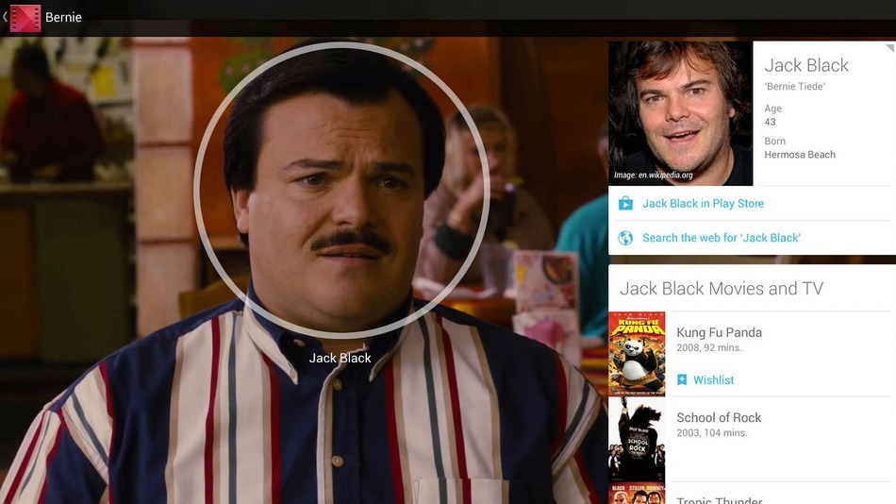
Enrich Search Experience with Information Networks
Entity Attributes and Related Entities
Lists and Collections of Entities
Entity Comparison
Face Recognition in Google Play Movies

Slide 7
Search and Recommendation
SDM 12; CIKM 12
RecSys 13; WSDM 14a; WSDM 14b
Technique | Search Engine | Recommender System
Use Case | Users actively issue queries. | Users passively view recommendation results.
System Paradigm | Understand queries and answer questions. | Recommend information to users based on history.
Example in HIN | Which paper should I cite if I am working on NMF? | Which books should be recommended to this user given his/her past behavior?
Help users find information
interactive
Help users discover knowledge
nonreciprocal
Notes:
Two techniques are commonly used for such goals with other data models.
System has to be aggressive when recommending information.

Slide 8
Roadmap
Entity Recommendation in Heterogeneous Information Networks with Implicit User Feedback
RecSys’13, WSDM’14a
Building Recommender System for Search Engine Users with User Log and Freebase Knowledge
WSDM’14b
Quick Review: Entity Search in Heterogeneous Networks
SDM’12, CIKM’12
Summary

Slide 9





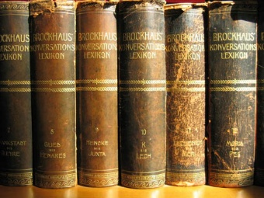
Recommendation Paradigm
feedback
user
community user-item feedback
recommender system
recommendation
product features
Collaborative Filtering
E.g., K-Nearest Neighbor (Sarwar WWW’01), Matrix Factorization (Hu ICDM’08, Koren IEEE-CS’09), Probabilistic Model (Hofmann SIGIR’03)
Content-Based Methods
E.g., (Balabanovic Comm. ACM’ 97, Zhang SIGIR’02)
Hybrid Methods
E.g., Content-Based CF (Antonopoulus, IS’06), External Knowledge CF (Ma WSDM’11)
external knowledge

Slide 10
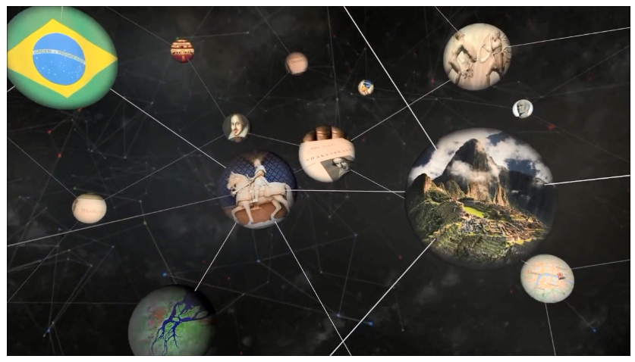
Problem Definition
feedback
user
implicit user feedback
Explicit: 1, 2, 3, 4, 5
Implicit: 0 or 1
recommender system
recommendation
hybrid collaborative filtering with information networks
information network

Slide 11

Hybrid Collaborative Filtering with Networks
Utilizing network relationship information can enhance the recommendation quality
However, most of the previous studies only use single type of relationship between users or items (e.g., social network Ma,WSDM’11, trust relationship Ester, KDD’10, service membership Yuan, RecSys’11)

Slide 12





The Heterogeneous Information Network View of Recommender System
Avatar
Aliens
Titanic
Revolution-ary Road
James Cameron
Romance
Zoe Saldana
Adventure
Leonardo Dicaprio
Kate Winslet

Slide 13
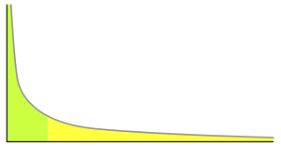
Relationship heterogeneity alleviate data sparisty
Collaborative filtering methods suffer from data sparsity issue
A small number of users and items have a large number of ratings
Most users and items have a small number of ratings
# of ratings
# of users or items
Heterogeneous relationships complement each other
Users and items with limited feedback can be connected to the network by different types of paths
Connect new users or items (cold start) in the information network

Slide 14

Relationship heterogeneity refines personalization
Different users may have different behaviors or preferences
Two levels of personalization
Data level
Most recommendation methods use one model for all users and rely on personal feedback to achieve personalization
Model level
With different entity relationships, we can learn personalized models for different users to further distinguish their differences
James Cameron fan
Aliens
80s Sci-fi fan
Sigourney Weaver fan
Different users may be interested in the same movie for different reasons

Slide 15








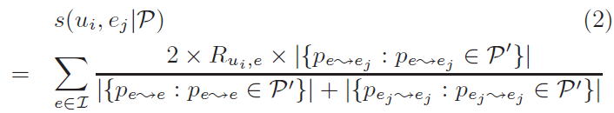
User Preference Propagation along Meta-Paths
genre: drama
King Kong
Bob
Naomi Watts
Charlie
tag: Oscar Nomination
Ralph Fiennes
Alice
Titanic
skyfall
Kate Winslet
revolutionary road
Sam Mendes
Preference score between u_{i} and e_{j}
feedback
paths between entities following meta-path P’
(1)

Slide 16


Propagation based Latent Features
For each meta-path, calculate $s(⋅)$ between all users and items, denoting as $\tilde{R}$
We then derive the low-rank features for users and items from the diffused matrix $\tilde{R}$ as follows
(2)
Generate L different meta-path (path types) connecting users and items
Propagate user implicit feedback along each meta-path
Calculate latent-features for users and items for each meta-path with NMF related method

Slide 17

Global Recommendation Model
Observation 1: Different meta-paths may have different importance
Global Recommendation Model
ranking score
features for user i and item j
(3)
the q-th meta-path

Slide 18

Personalized Model
Observation 2: Different users may require different models
Soft cluster users with NMF + k-means
For each user cluster, learn one model with Eq. (5)
Generate personalized model for each user on the fly with Eq. (4)
Personalized Recommendation Model
user-cluster similarity
L
(4)
c total soft user clusters

Slide 19


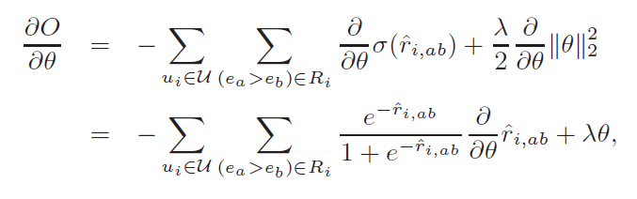

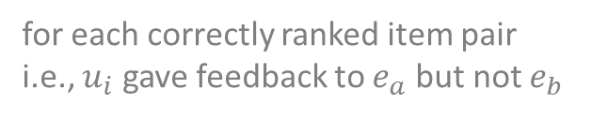
Parameter Estimation
Bayesian personalized ranking (Rendle UAI’09)
Objective function
Gradient
sigmoid function
$$\min_{Θ}{ }$$
(5)
for each correctly ranked item pair
i.e., $u_{i}$ gave feedback to $e_{a}$ but not $e_{b}$
(6)

Slide 20



Recommendation Framework
information network
Preference Propagation Latent Features
implicit user feedback
Off-line
g1
g2
gn
On-line
user subgroup models
personalized
recommendation
target user

Slide 21

Experiment Setup
Datasets
Comparison methods:
Popularity: recommend the most popular items to users
Co-click: conditional probabilities between items
NMF: non-negative matrix factorization on user feedback
Hybrid-SVM: use Rank-SVM with plain features (utilize both user feedback and information network)

Slide 22
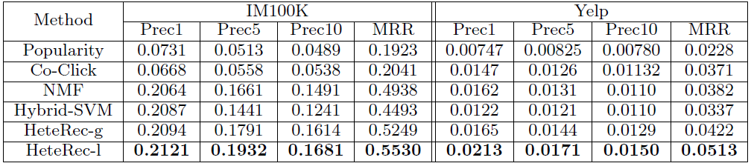
Performance Comparison
p
HeteRec personalized recommendation (HeteRec-p) provides the best recommendation results

Slide 23
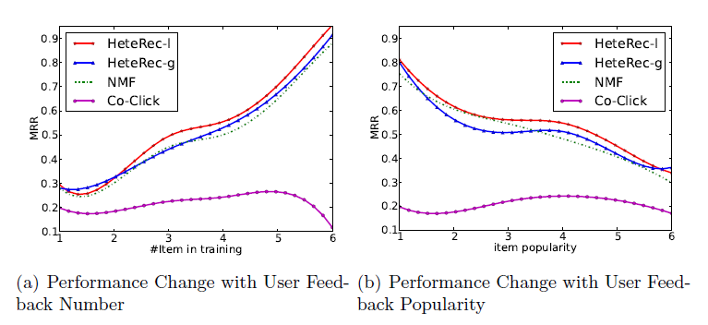
Performance under Different Scenarios
p
p
user
HeteRec–p consistently outperform other methods in different scenarios
better recommendation results if users provide more feedback
better recommendation for users who like less popular items

Slide 24
Contributions
Entity Recommendation in Information Networks with Implicit User Feedback
(RecSys’13, WSDM’14a)
Propose latent representations for users and items by propagating user preferences along different meta-paths
Employ Bayesian ranking optimization technique to correctly evaluate recommendation models
Further improve recommendation quality by considering user differences at model level and define personalized recommendation models
Two levels of personalization

Slide 25
Roadmap
Entity Recommendation in Heterogeneous Information Networks with Implicit User Feedback
RecSys’13, WSDM’14a
Building Recommender System for Search Engine Users with User Log and Freebase Knowledge
WSDM’14b
Quick Review: Entity Search in Heterogeneous Networks
SDM’12, CIKM’12
Summary

Slide 26








Personalized Lists of Entities
Google “restaurants near Maui”
“restaurants near Maui” for Xiao

Slide 27

















Recommendation in Search
Google “things to do in Chicago”
movie recommendation
restaurant recommendation
point of interest recommendation
event recommendation
dec 5th
dec 13th
dec 6th
dec 5th

Slide 28









Problem Definition
feedback
user
search engine user logs
Freebase
entity graph
recommender system
recommendation
User log sequence, sorted by timestamp
Entity related webpages
$$e_{1}$$
$$e_{2}$$
$$e_{3}$$
…
$$e_{T−1}$$
$$e_{T}$$
denote as $L_{T}$

Slide 29
Handling User Logs and Entity Graph
Rich-Content
Large-Scale
Besides implicit feedback, user log also has
e.g., timestamp, dwell time, user country or region, time of day …
Cross domain user log events
Which movies will foxnews.com readers like?
Besides entity relationship, entity graph also has
e.g., movie release date, tagline, running time, gross revenue, budget, MPAA rating, text description, number of ratings, …
User logs
A large number of URL clicks
Entity graph (freebase)
Hundreds of millions of triples (entity, attributes and relationships)
Is our method scalable enough?

Slide 30
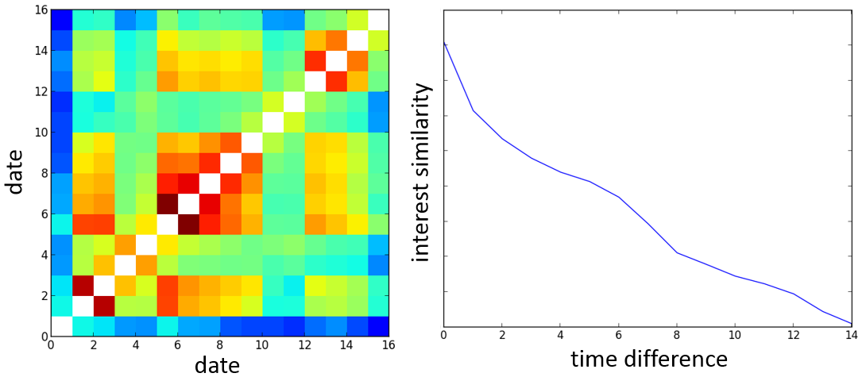
Consistency and Drift of User Interests
Observation 3: User interests are consistent within a short time period but drift over time
The longer the time interval is, the less similar users’ interests are
Left: accumulated user interest similarity for two weeks in 2012
Right: averaged user interest similarity with relative time difference (number of day)

Slide 31
Cross Domain Correlation
comicbookresources.com
(comic books)
The Avengers
Spider-Man
The Dark Knight Rises
Prometheus
Men In Black 1, 2, 3
Iron Man 2
Superman: The Man Of Steel
Thor
Snow White & Huntsman
Dark Shadows
Ted
Battleship
ruelala.com
(women shopping)
Magic Mike
The avengers
Prometheus
Moonrise Kingdom
Ted
Snow White & Huntsman
Savages
Everything Hunger Games
Rock of Ages
Dark Shadows
The Best Exotic Marigold Hotel
The Twilight Saga: Breaking Dawn
Top 10 most viewed movies estimated using cross domain correlation (summer 2012)

Slide 32

Entity Pairwise Features
Meta-path based entity similarity from Freebase
$$S(e_{i}, e_{j})$$
Other pairwise or non-pairwise feature (e.g., popularity)
Entity attribute similarity (e.g., movie description,, revenue)
Entity relations derived from user log (e.g., conditional probability)
Latent features (as in previous work) are expensive to calculate and hard to scale. Pairwise features can be calculated under a map-reduce framework

Slide 33
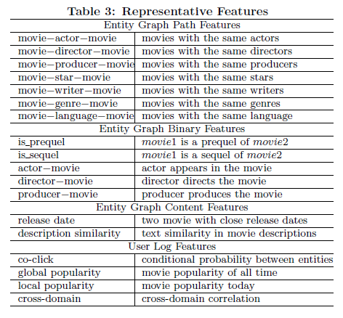
Feature Examples

Slide 34


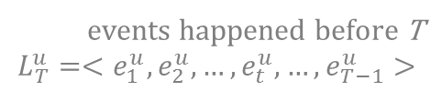
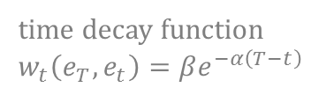
Recommendation Models
Global recommendation model
entity at timestamp T
(7)
time decay function
$$w_{t}\left(e_{T}, e_{t}\right)=βe^{−α\left(T−t\right)}$$
pairwise features
events happened before T
${L_{T}^{u}=<e}_{1}^{u}, e_{2}^{u},…, e_{t}^{u}, …, e_{T−1}^{u}>$
Personalized recommendation model (PRM)
(8)
for each user at target timestamp T

Slide 35

Parameter Estimation for Global Model
Define margin between the target entity and the second best entity with the current model
Objective function
Optimization is performed with BFGS-B method
Time decay parameters were cross-validated in this project, although it can be learned accordingly
$$g\left(e_{T}^{u};L_{T}^{u}, θ\right)=h(r\left(e_{T}^{u};L_{T}^{u},θ\right)−r(e_{m}^{u};L_{T}^{u},θ))$$
(9)

Slide 36
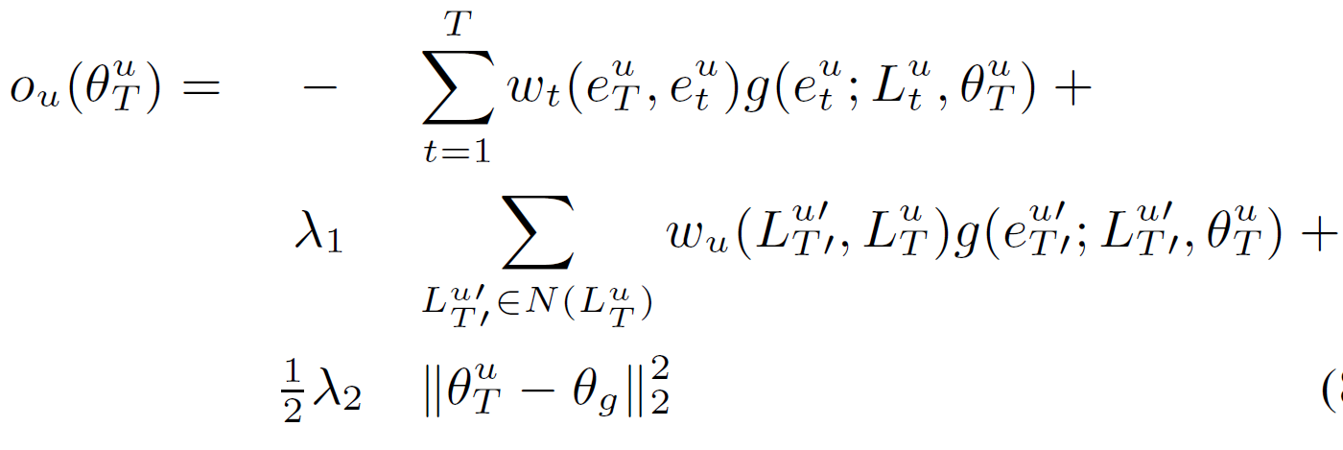
Parameter Estimation for Personalized Model
Utilize user log subsequences similar to the u (neighbors) when learning personalized model for u
Same as g() in global model
T -1
–
neighbor subsequences
neighbor similarity
(10)
global model

Slide 37
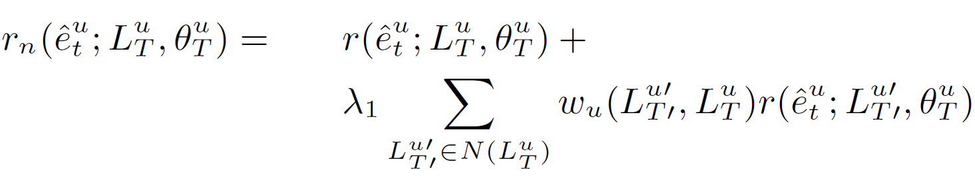
Locality Sensitive Hashing Based K-Nearest Neighbor Method
Locality sensitive hashing (LSH) estimates K-NN in O(N) with preprocessing
More efficient and scalable than previously adopted soft clustering method
LSH based KNN method decouples data dependency between users during personalized model learning
Personalized model learning parallelization
Personalized Recommendation with K-NN (PRM+KNN)
(11)
Collaborative filtering

Slide 38
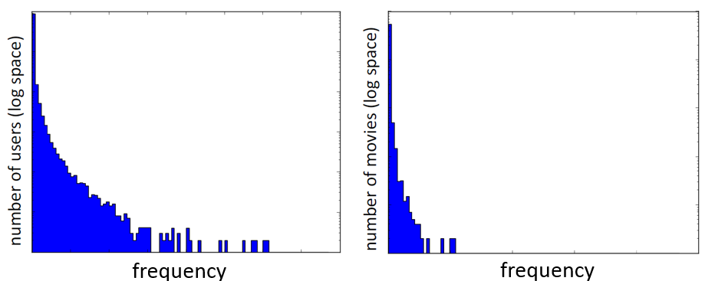
Experiment Setup
Movie recommendation with commercial search engine user log and movie related freebase knowledge graph
Sampled 1+ million users with at least one movie entity in their log
2+ million movie related entities with attributes and relationships

Slide 39
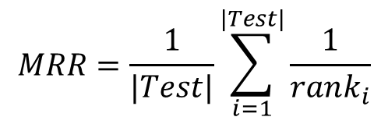
Evaluation and Comparison
Top 10 Mean Reciprocal Rank (MRR) as evaluation metric
Only rates a pool of most promising candidates for each method
$$MRR=\frac{1}{|Test|}\sum_{i=1}^{|Test|}{\frac{1}{rank_{i}}}$$
Comparison Method | Description
Global Popularity | Frequently visited movies in 3 months
Local Popularity | Frequently visited movies in short time period
Domain Co-Click | Recommend based on non-movie related events
NMF | Hu ICDM’08
Co-Click with Time Decay | Conditional probability of events

Slide 40
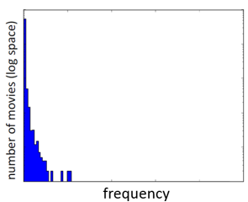
Performance
Method | MRR
Global Popularity | 0.024
Local Popularity | 0.043
Domain Co-click | 0.039
NMF | 0.160
Co-Click Time Decay | 0.340
Global Model | 0.354
PRM | 0.361
PRM+KNN | 0.451
comparison
methods
With sufficient data, co-click with time decay is the strongest baseline
proposed methods
Both PRM and PRM+KNN capture all three observations
PRM+KNN utilizes neighbor information when recommending (CF)

Slide 41
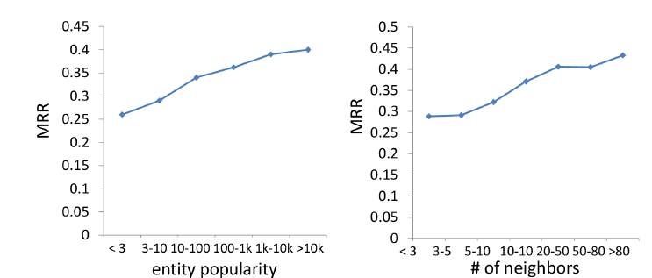
Personalized Recommendation Result Analysis

Slide 42
Personalized Result Analysis – Length of User Log Sequence
1, Personalized time decay may help
2, Movie-holics have more diverse interests
MRR
Not enough data
Length of Sequence
Performance varies with sequence length

Slide 43
Contributions
Building Recommender System for Search Engine Users with User Log and Freebase Knowledge (WSDM’14b)
We re-examine entity recommendation in information network problem against a real-world application
We propose recommendation models with different granularities (global and personalized)
The proposed methods take advantage of the rich-content of search engine user log and knowledge graph
Experiments with commercial search engine data demonstrate the scalability and effectiveness of our methods

Slide 44
Roadmap
Entity Recommendation in Heterogeneous Information Networks with Implicit User Feedback
RecSys’13, WSDM’14a
Building Recommender System for Search Engine Users with User Log and Freebase Knowledge
WSDM’14b
Quick Review: Entity Search in Heterogeneous Networks
SDM’12, CIKM’12
Summary

Slide 45
The Citation Prediction Problem [SDM’12]
Input: authors, target publication venue, text and time information of a query paper
Output: list of papers ranked by the probability of being cited by the query paper
Search Space: heterogeneous bibliographical information network
Query Paper
DBLP
input
Term
Bins
off-line
on-line
Prediction Results
Prediction
Model
Meta-Path Based Feature Space
output

Slide 46


Discriminative Term Bins
Term / topic similarity + reduce search space without breaking citation relations
Method
1, identify seed terms with a link space discriminative-ness measure
2, expand each bin with similar terms
3, assign papers to bins
1
2
……
K
Seed: GPS
Terms: Moving, Trajectory, …
Papers: 12, 25, 233, …
Citation probability is higher within the same bins.

Slide 47
User Guided Similarity Search [CIKM’12]
Input
Output
Hidden
Query Target | Similarity Examples | Top Answers | Semantic Meanings
The Dark Knight | Batman Begins, Batman | Batman Returns, Batman Forever | Similar keyword
 | Hancock, Bejamin Button | Iron Man, Cloverfield | Similar release time, genre, ratings
Christos Faloutsos | Hanghang Tong, Jimeng Sun | S. Papadimitriou, J. Leskovec | Collaboration
 | Philip Yu, H. V. Jagadish | H. Garcia-Molina, Jiawei Han | Similar area, similar reputation

Slide 48
Ambiguity from the Network Perspective
Paths exist between similar entities
Paths can be of different types
Path types are represented by meta-paths
Entities which are linked by the same meta-paths share the same similarity semantic
Example (APVPA):
Christos Faloutsos and Jiawei Han
Michael Stonebraker and David DeWitt
Yoshua Bengio and Michael I. Jordan
Bill Gropp and Katherine Yelick
Notes:
If mix different types of paths together, its like comparing apple to an orange, does not make much sense.
We can also observe that entities which are linked by the same meta-paths share the same similarity semantics.

Slide 49
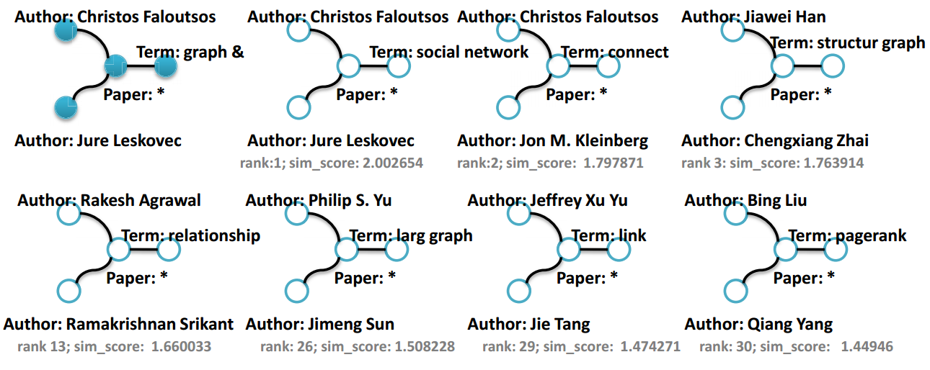
Query-Driven Discovery of Semantically Similar Substructures [KDD demo 2012]
Search for semantically similar subgraphs in information networks
http://s4.cs.illinois.edu

Slide 50

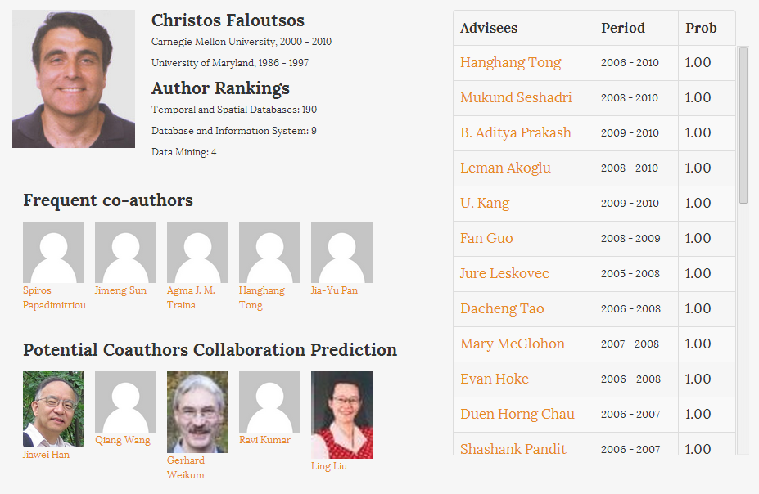
[SIGMOD demo 2013]
Improve search experience with mining results from a bibliographical information

Slide 51
Roadmap
Entity Recommendation in Heterogeneous Information Networks with Implicit User Feedback
RecSys’13, WSDM’14a
Building Recommender System for Search Engine Users with User Log and Freebase Knowledge
WSDM’14b
Quick Review: Entity Search in Heterogeneous Networks
SDM’12, CIKM’12
Summary

Slide 52
Referred Publications
SIGMOD’13
CIKM’12
KDD’12
SDM’12
SIGMOD'11
KDD'11
Search
Recommender
System
WSDM14a
WSDM14b
IJCAI-HINA’13
RecSys’13
Demo systems
Works mentioned in this talk
Relationship Prediction
ASONAM'11
WSDM’14c
TKDD’13
KDD’12
(best student paper)
SSTD’11
IJDSN’11
Clustering
KDD’13
SDM’12
JCSS’11
ICDE’12
ICDM’10
ICDM’12
ICDM’09
Intruder/
Outlier
Information Network
Cyber-Physical System
Other Dataset
See http://ews.illinois.edu/~xiaoyu1/pub.html for a full list of publications

Slide 53
Applied Research with Real-World Large-Scale Data
Data Mining Applications
Entity Recommendation in Search Engine
Social Media
Health Care
…
Real-World Large-Scale Applications
Mining Heterogeneous Information Networks
Recommender Methods
Prediction
Clustering
…
Mathematical Solutions
Network Principles
Meta-Path Similarity
Network Property
Link Analysis
…
Data Science Fundamental

Slide 54

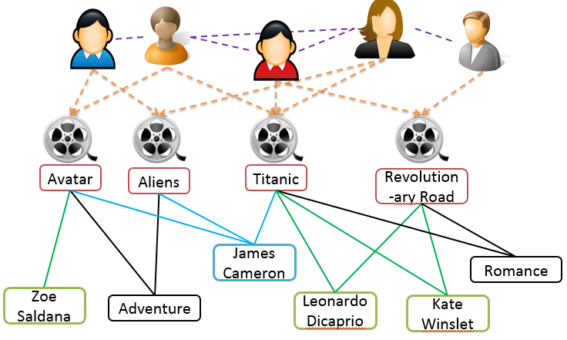

What’s Next?
Will join Dr. Alon Halevy’s team at Google Research as a Research Scientist
web documents
network
applications
network construction (Future work)
network mining (PhD study)

Slide 55
Acknowledgements
Great Thanks to
Professor Jiawei Han
Professor ChengXiang Zhai
Professor Thomas S. Huang
Dr. Hao Ma, Microsoft Research
My Frequent Collaborators
Professor Yizhou Sun, Northeastern University
Dr. Lu-An Tang, NEC Lab
Xiang Ren
Quanquan Gu
Chi Wang
Dr. Hao Ma, Microsoft Research
Dr. Paul Hsu, Microsoft Research
Fangbo Tao
Mianwei Zhou
Brandon Norick
Professor Jing Gao, University at Buffalo
Professor Peixiang Zhao, Florida State University
Professor Zhenhui Li, Penn State University
And everyone else in DAIS and computer science dept. who listened to my ideas along with some bad jokes and helped me make my works better.

Slide 56
Thanks!
Selected Publications (2012 – 2014)
Xiao Yu, Hao Ma, Paul Hsu and Jiawei Han, "On Building Entity Recommender Systems Using User Click Log and Freebase Knowledge", WSDM'14
Xiao Yu, Xiang Ren, Yizhou Sun and Jiawei Han, "Personalized Entity Recommendation in Heterogeneous Information Networks with Implicit User Feedback", WSDM'14
Xiang Ren, Yujing Wang, Xiao Yu, Jun Yan and Jiawei Han, "Heterogeneous Graph-Based Intent Learning With Queries,", WSDM'14
Chi Wang, Xiao Yu, Yanen Li, Chengxiang Zhai, and Jiawei Han, "Content Coverage Maximization on Word Networks for Hierarchical Topic Summarization", CIKM'13
Xiao Yu, Xiang Ren, Yizhou Sun and Jiawei Han, "HeteRec: Entity Recommendation in Heterogeneous Information Networks with Implicit User Feedback", RecSys'13
Lu-An Tang, Xiao Yu, Quanquan Gu, Jiawei Han, Alice Leung, and Thomas La Porta, “Mining Lines in the Sand: On Trajectory Discovery From Untrustworthy Data in Cyber-Physical System”, KDD’13
Fangbo Tao, Xiao Yu, Kin Hou Lei, George Brova, Xiao Cheng Jiawei Han, Rucha Kanade, Yizhou Sun, Chi Wang, Lidan Wang, Tim Weninger, "Research-Insight: Providing Insight on Research by Publication Network Analysis", (system demo), SIGMOD'13
Xiao Yu, Yizhou Sun, Brandon Norick and Jiawei Han, "User Guided Entity Similarity Search Using Meta-Path Selection in Heterogeneous Information Networks", CIKM'12
Yizhou Sun, Brandon Norick, Jiawei Han, Xifeng Yan, Philip S. Yu, and Xiao Yu, "Integrating Meta-Path Selection with User Guided Object Clustering in Heterogeneous Information Networks", KDD'12 (Best Student Paper Award)
Xiao Yu, Yizhou Sun, Peixiang Zhao, Jiawei Han, "Query-Driven Discovery of Semantically Similar Substructures in Heterogeneous Networks" (System Demo),KDD'12
Xiao Yu, Quanquan Gu, Mianwei Zhou, and Jiawei Han, "Citation Prediction in Heterogeneous Bibliographic Networks", SDM'12

