Slide 1

Going declarative
From low level to high level code

Slide 2
Summary
What is declarative programming
Statements vs Expressions
Domain language
Types
Extending types to support Linq and/or Async
Rant on code comments

Slide 3
What is declarative programming?
In computer science, declarative programming is a programming paradigm—a style of building the structure and elements of computer programs—that expresses the logic of a computation without describing its control flow.
- Lloyd, J.W., Practical Advantages of Declarative Programming
Control flow represents the order in which statements are executed or evaluated.
Declarative programming - Wikipedia

Slide 4
The main goal of this presentation is to show some patterns we can use to create more expressive and declarative programs. Control flows are the building blocks of programs but should be encapsulated through abstractions at different levels. Application logic should be visible at a high level without any care about control flows.

Slide 5
Rant on comments
Comments are technical debt.
A comment tries to clarify something that is not obvious in code.
Comments make room for bad names.
Neither the programmer nor the compiler read them.

Slide 6
A comment is not necessary when
The operation obvious
It explains what a variable does → use the comment as the name of the variable (keep it short);
It explains what a function returns → change the name of the variable to reflect that.
It explains why a function is used → change the function name to the explanation
It explains business logic → Your code and unit tests explain business logic.
A comment does not account for or mentions bugs
The comment will probably be wrong in 3 months; Funnily enough, most of the time comments do not get updated when the code gets updated

Slide 7
Conclusion
Don't comment your code – Unit test your code
Business logic must be defined as the name of a test case.
Running the unit tests would at least verify the validity of the test case.
Comments can be replaced with better named variables and functions.

Slide 8
Examples

Slide 9
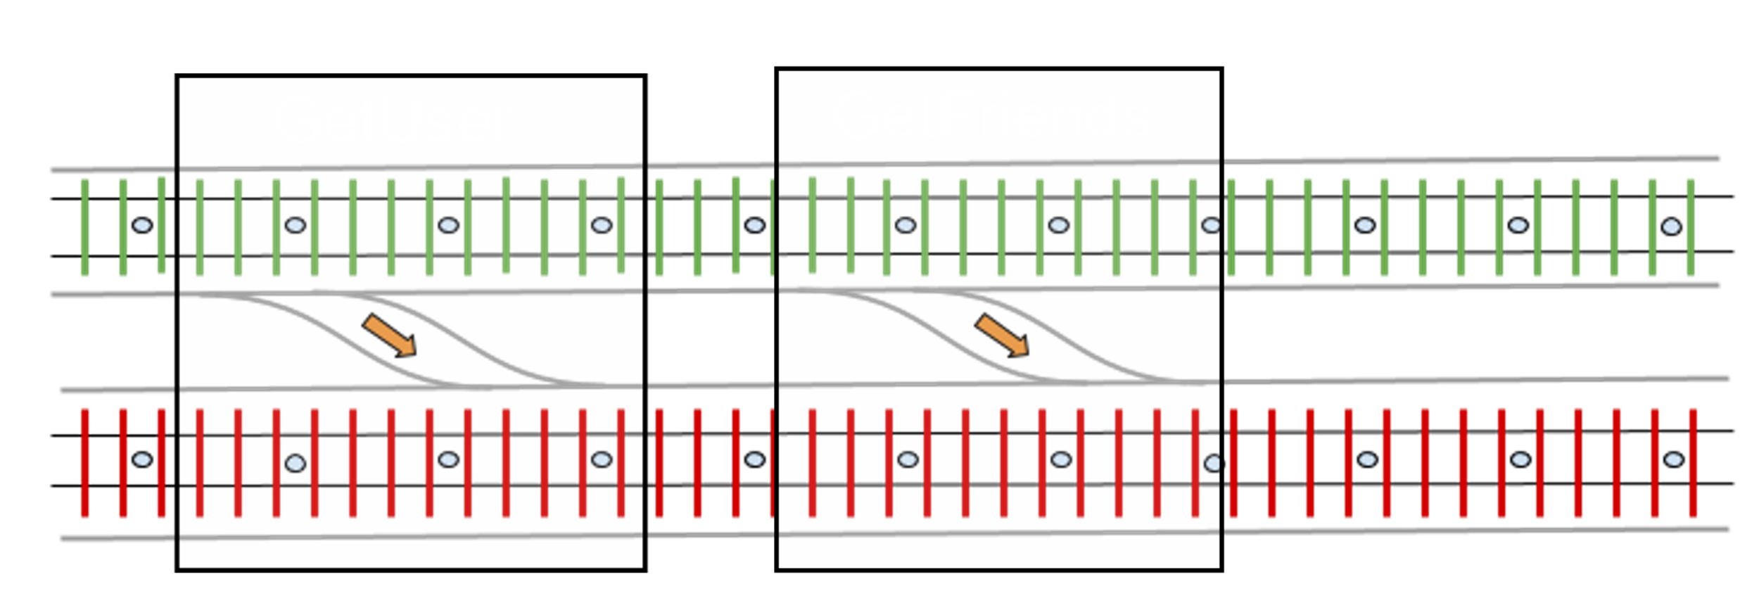

Slide 10
Callouts
Join #hub-dotnet
Source code: https://github.com/dragos-ismana/GoingDeclarative

