Slide 1
PCAP-Based Intrusion Detection Using a Local LLM
  Bratfalean Dragos
  Techincal University of Cluj-Napoca
  26.12.2025

Slide 2
Project Overview
Analyze network traffic captured in PCAP files
Detect specific attacks: SYN Flood, Port Scan, DNS Exfiltration
Hybrid approach: traditional packet analysis + local LLM

Slide 3
Project Objectives
Parse and analyze PCAP files
Aggregate traffic by IPs, ports, DNS queries, and time
Detect suspicious activity and classify using LLM
Provide human-readable explanations for flagged traffic

Slide 4
Attack Types
🌊 SYN Flood: excessive TCP SYN packets, few ACKs
🔍 Port Scan: many ports contacted from single IP
🗄️DNS Exfiltration: long/frequent DNS queries

Slide 5
Know-how
Used semester practical laboratories to:
- Understand attack patterns
- Select features and validate detection logic
- Design LLM prompt

Slide 6
Role of the Local LLM
Classifies aggregated traffic as:
SYN Flood
Port Scan
DNS Exfiltration
Benign
Generates explanations for reasoning
Runs entirely locally for data privacy

Slide 7
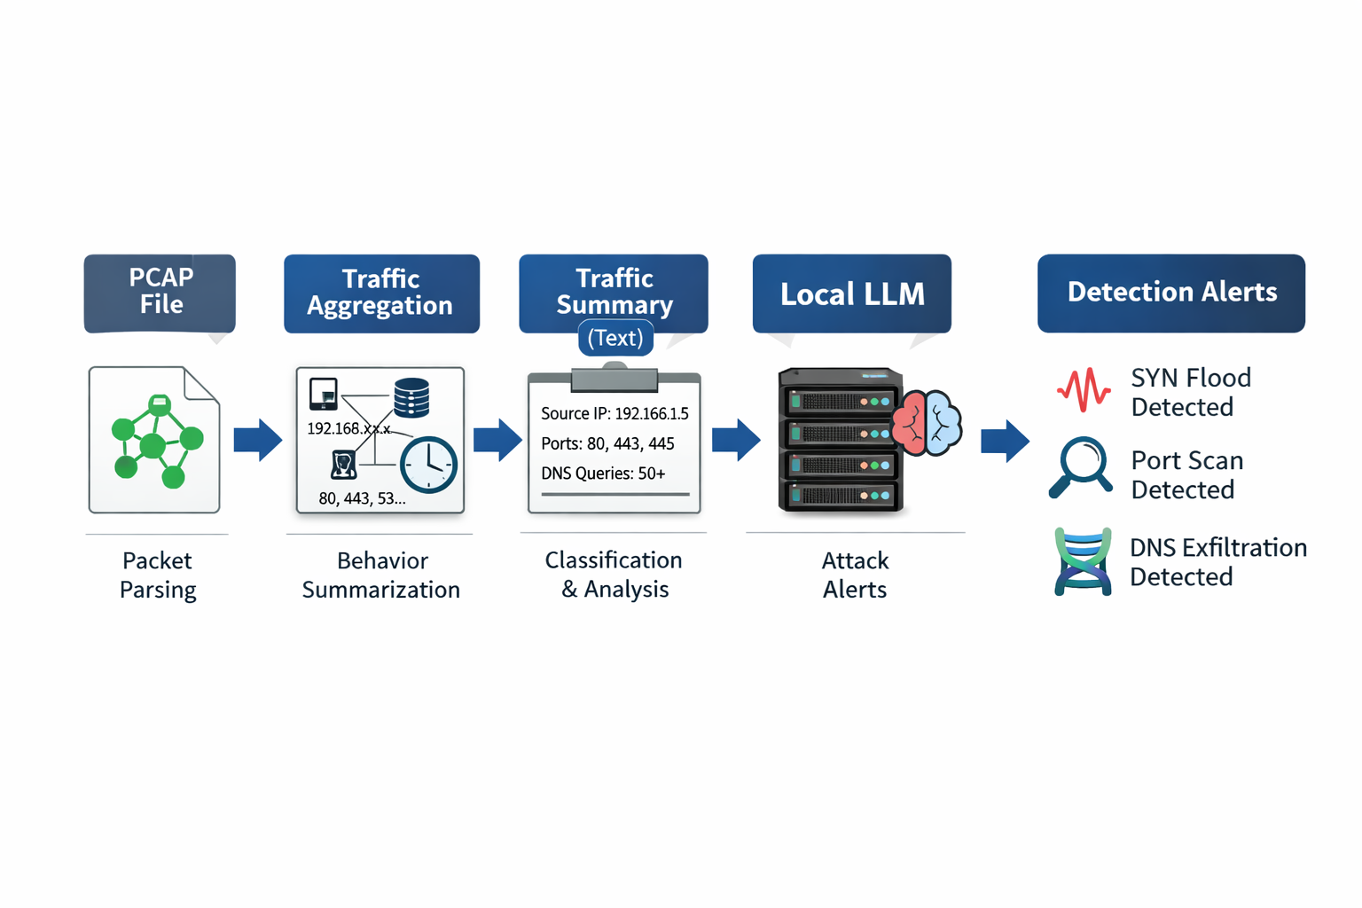
System Architecture
PCAP File → Packet Parsing → Traffic Aggregation → Traffic Summarization → Local LLM → Alerts & Explanations

Slide 8
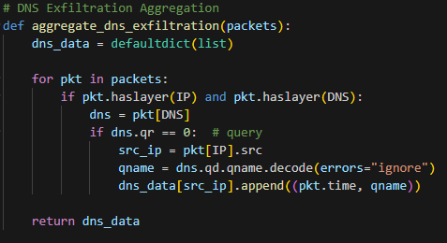
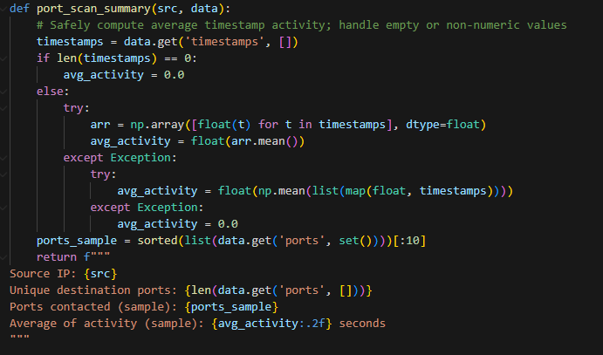
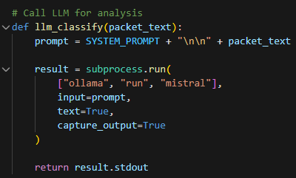
Detection Pipeline
              Aggregate SYN/ACK counts, destination ports, DNS queries
Summarize traffic behavior per source IP
              Feed summaries to LLM for classification and explanation

Slide 9
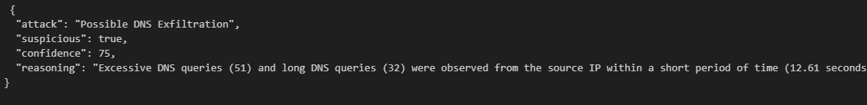
Output
List of detected traffic patterns
Attack type / benign
Confidence score
Explanation from LLM

Slide 10
Design Rationale
Rules + aggregation: efficient and reliable
LLM: interpretable reasoning and classification
Local execution ensures privacy and flexibility

Slide 11
Limitations
Static thresholds and windows
Dependent on quality of PCAP captures
LLM outputs may vary slightly
Not real-time ready

Slide 12
Conclusion
Hybrid approach combines traditional analysis + LLM
Detects SYN Flood, Port Scan, DNS Exfiltration
Provides interpretable, privacy-preserving network attack detection

Slide 13
References / Acknowledgements
Scapy (Python packet manipulation library)
Ollama (Local LLM inference framework)
AI in Cybersecurity “C2.Network Security Devices: Firewalls. IDS/IPS” – Conf dr.ing. Daniel Zinca AI in Cybersecurity “C5.2.DNS” – Conf dr.ing. Daniel Zinca AI in Cybersecurity “C6.1LLM_Cybersecurity” – Conf dr.ing. Daniel Zinca AI in Cybersecurity “L10_1_DNS_readPCAP.ipynb” – Conf dr.ing. Daniel Zinca AI in Cybersecurity “LaboratorSnortEng.pdf” – Conf dr.ing. Daniel Zinca AI in Cybersecurity “PortScanRule.pdf” – Conf dr.ing. Daniel Zinca AI in Cybersecurity “IDSclassification.pdf” – Conf dr.ing. Daniel Zinca

