Slide 1
Stu-Talk Data Exchange and Publish & Subscribe
Foundation Course

Slide 2
Course Pre-Requisites
SITS development skills
XML knowledge

Slide 3
Goals of this Training
This training will cover the basics of Stu-Talk Exchange Templates and Stu-Talk Publish & Subscribe. The goal of the day is to leave with a firm understanding of the following:
What an Exchange Template is
What Publish and Subscribe is
How to setup simple Publish and Subscribe workflows
Exchange Templates are used within Publish and Subscribe

Slide 4
Stu-Talk Responsibilities

Slide 5
Stu-Talk Exchange Templates

Slide 6
What are Exchange Templates?
Create and maintain templates for transferring data
Used for exporting (generation) and importing (consumption)
Can be XML or JSON format
Entity- based but the ‘driving entity’ can have sub-entities
Data can be formatted during export or import
Multiple versions of XET - All new build should be done using XET 2.0

Slide 7
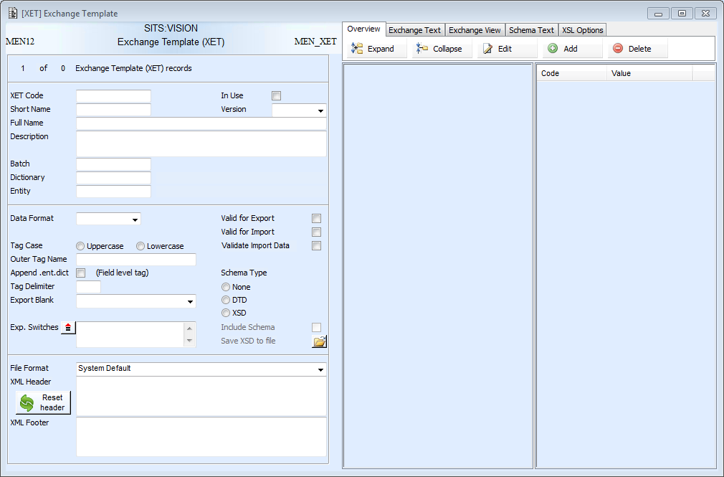

Slide 8
XML Data Format
Mappings | XML File
XML Header | <?xml version=”1.0” encoding=”UTF-8” ?>
Outer tag name | <EXCHANGE>
Entity tag | <STU>
Occurrence tag | <STU.SRS>
Field | <STU_CODE.STU.SRS>1600588</STU_CODE.STU.SRS>
Field | <STU_STA2.STU.SRS>C</STU_STA2.STU.SRS>
Field | <STU_TITL.STU.SRS>MR</STU_TITL.STU.SRS>
Field | <STU_SURN.STU.SRS>SMITH</STU_SURN.STU.SRS>
Field | <STU_FNM1.STU.SRS>KEIRAN</STU_FNM1.STU.SRS>
Field | <STU_DOB.STU.SRS>1998-06-18</STU_DOB.STU.SRS>
Field | <STU_GEND.STU.SRS>M</STU_GEND.STU.SRS>
Field | <STU_BTCH.STU.SRS>TRAINING</STU_BTCH.STU.SRS>
Close Occurrence tag | </STU.SRS>
Close Entity tag | </STU>
Close Outer tag name | </EXCHANGE>

Slide 9
JSON Data Format
Mappings | JSON File
Opening tag | {
Outer tag name | "EXCHANGE" : {
Entity tag | "STU" : {
Occurrence tag (start of array) | "STU.SRS" : [
Object tag | {
Field | "STU_CODE.STU.SRS" : “1600588",
Field | "STU_STA2.STU.SRS" : "C",
Field | "STU_TITL.STU.SRS" : "MR",
Field | "STU_SURN.STU.SRS" : "SMITH",
Field | "STU_FNM1.STU.SRS" : "KEIRAN",
Field | "STU_DOB.STU.SRS" : "1998-06-18",
Field | "STU_GEND.STU.SRS" : "MALE",
Field | "STU_BTCH.STU.SRS" : “TRAINING"
Close Object tag | }
Close Occurrence tag (end of array) | ]
Close Entity tag | }
Close Outer tag name | }
Closing tag | }
JSON exported and imported using XET must always use an array list format.

Slide 10
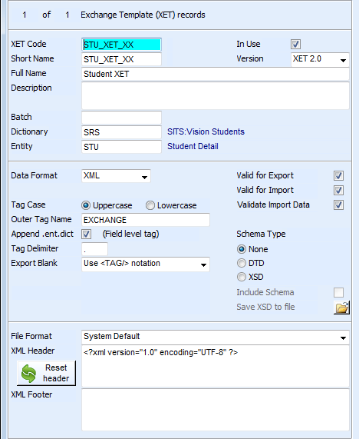
XET Global Properties - XML
Dictionary and Entity of ‘driving Entity’
Version needs specifying to XET 2.0 on all new XET records
Can the XET be used for export, import or both?
Controls whether tags appear like STU_CODE or STU_CODE.STU.SRS
Turns on entity/field validation for import
Whether blanks fields are included
Headers and footers can be set if required

Slide 11
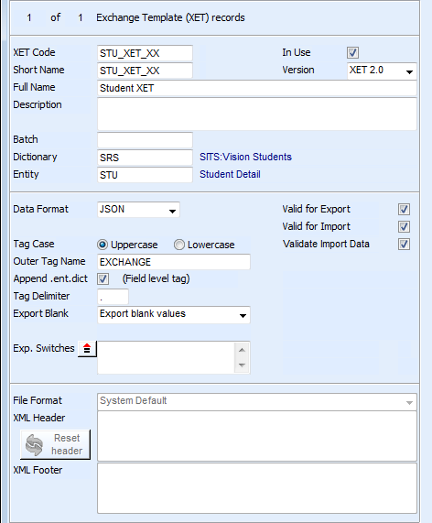
XET Global Properties - JSON
Switches can be applied to the data, such as WHITESPACE=N
Headers and footers are disabled

Slide 12
Exercise 1
Creating an XET and setting Global Properties

Slide 13
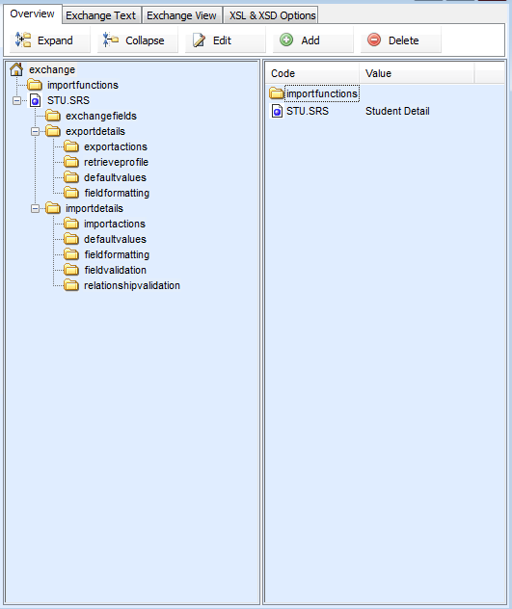
The Overview Tab
Driving Entity
Export details will appear in the tree if the XET is ‘valid for export’
Import details will appear in the tree if the XET is ‘valid for import’
Relationship validation will appear if the XET is set to ‘validate import data’

Slide 14
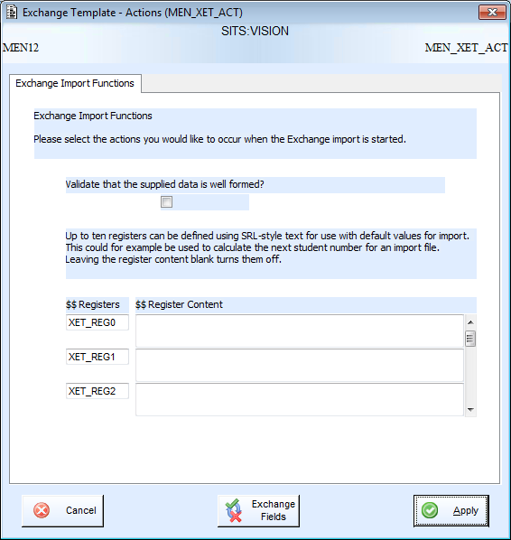
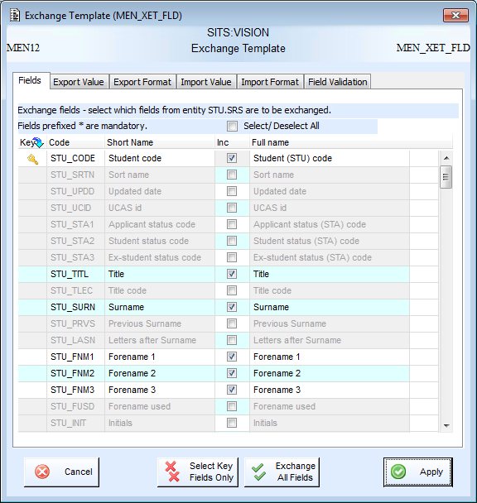
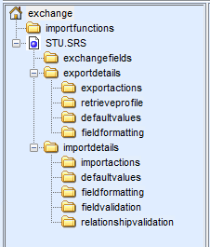
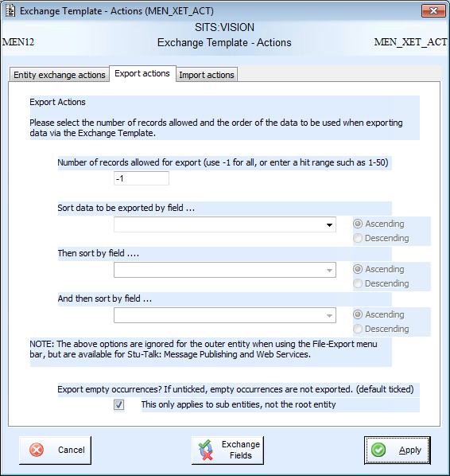
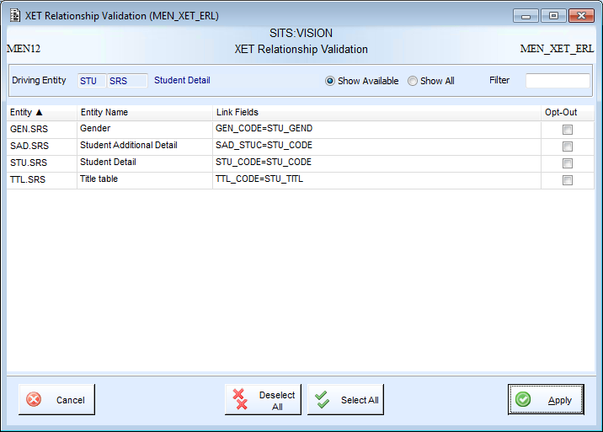
Also accessible through:
Retrieve profile
Default values
Field formatting
Field validation
Different folders open different
pop-ups.
Each with their own set of tabs.

Slide 15
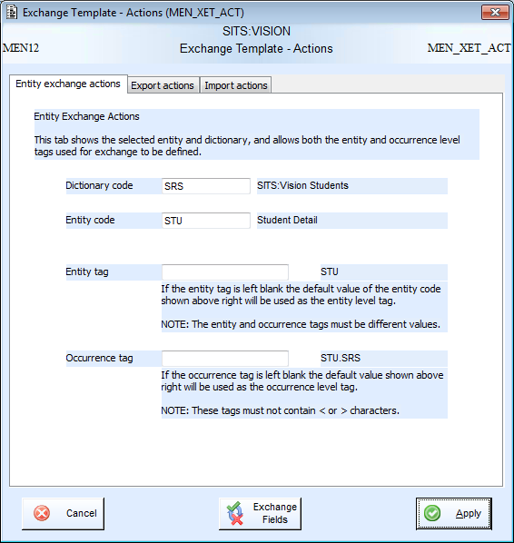
Entity Exchange Actions
The entity tag appears once per entity within the XML. The occurrence tag appears for each record of that entity. For example:
<STU>
<STU.SRS>
Data for first STU
</STU.SRS>
<STU.SRS>
Data for second STU
</STU.SRS>
</STU>

Slide 16

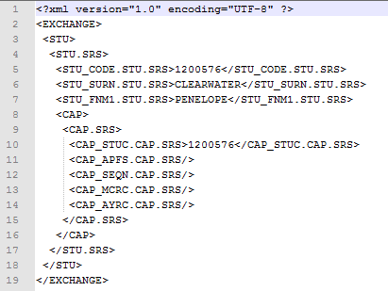
Export Actions
The order the records will be exported in
How many records will be included in the export
Empty occurrences are where the retrieve profile is passed through from the parent entity, but no record exists in the system.

Slide 17
Exchange Fields
Sortable by columns from 9.3.0
Select the fields which will be included in the export and import.
Note: not all fields selected have to be included in import

Slide 18
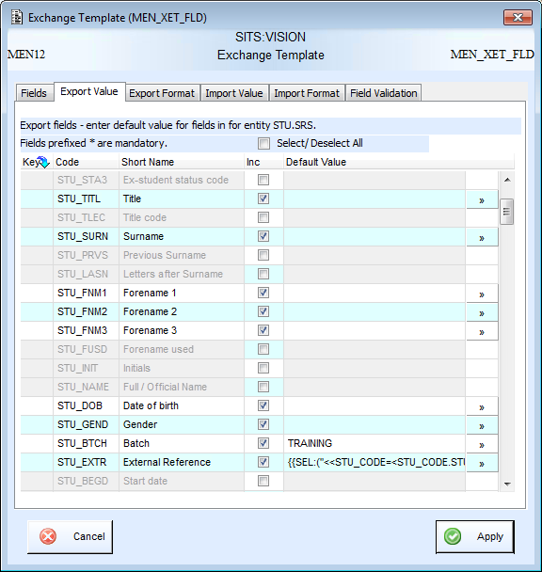
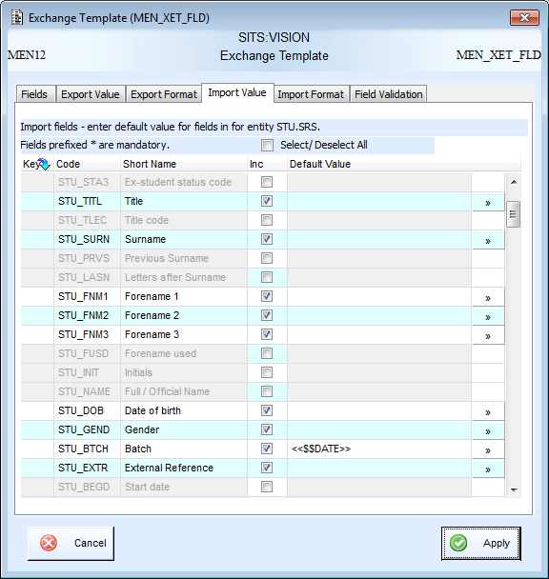
Default Values
Default values will overwrite the value stored on the record
On import you cannot reference fields within the data you are importing.
Literal values or SRL syntax can be used.
On export the system has access to the record primary key.

Slide 19
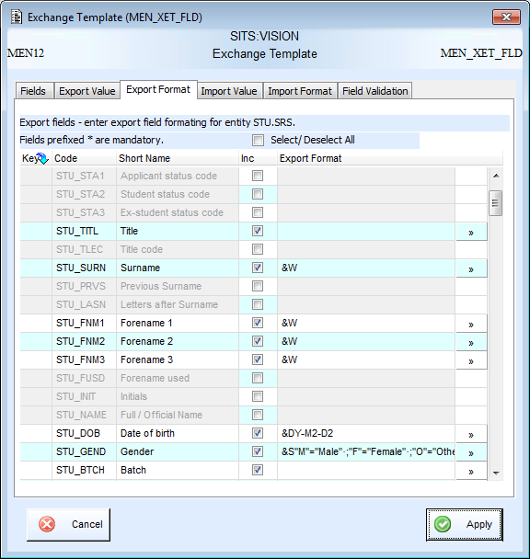
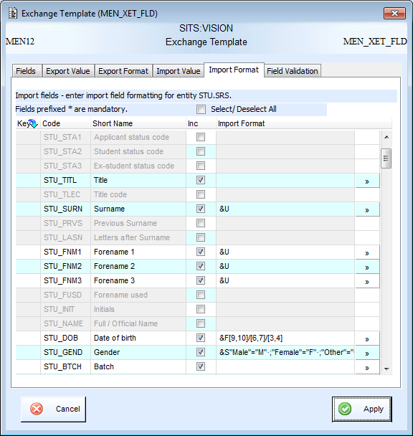
Field Formatting
Field formatting can be applied to the values within fields on both export and import

Slide 20
Exercise 2
Creating and using your XET for export

Slide 21
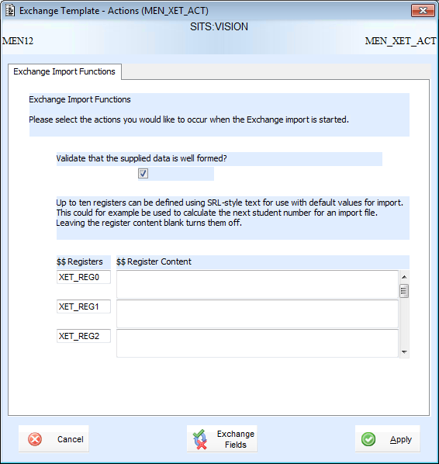
Exchange Import Functions
Checks that data being imported is well formed XML
XET registers will be covered in the practitioner course

Slide 22
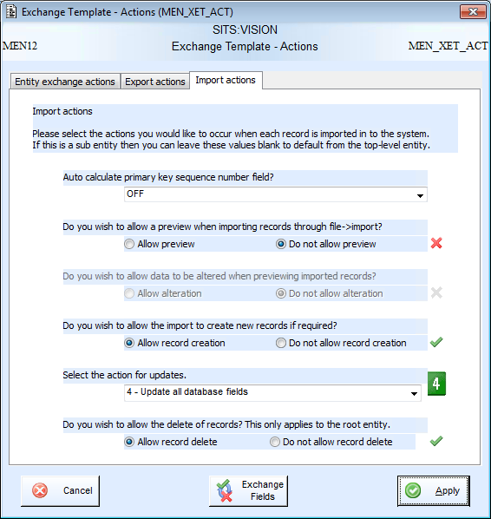
Import Actions
If the entity has a sequence number it will appear in the dropdown. Can be used to auto-calculate a sequence on record creation.
Set which actions are allowed on import
Update has 4 options:
Ignore all duplicate records
Update fields which are currently blank
Update field if imported value is not blank
Update all database fields
Delete will only appear for a root entity

Slide 23
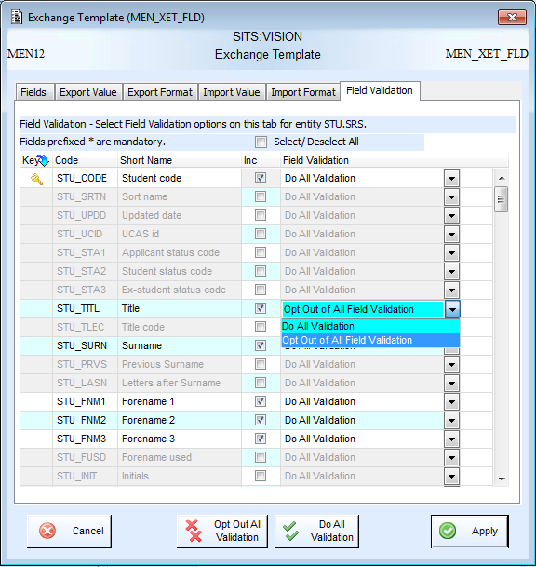
Field Validation
Validation can be set on a field-by-field basis.
If validation is switched on the values imported will be compared against FLD and IFD records.

Slide 24
Relationship Validation
Turns off validation for a whole entity relationship

Slide 25
Exercise 3
Creating and using your XET for import

Slide 26
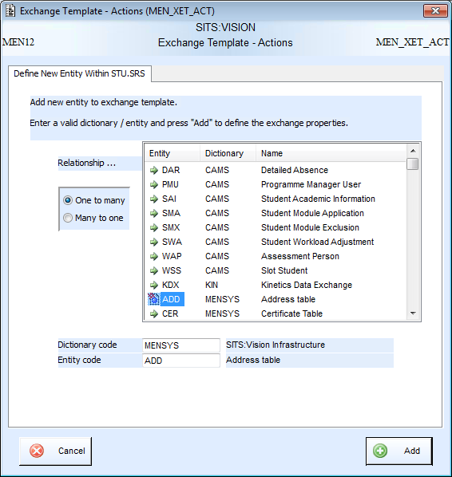
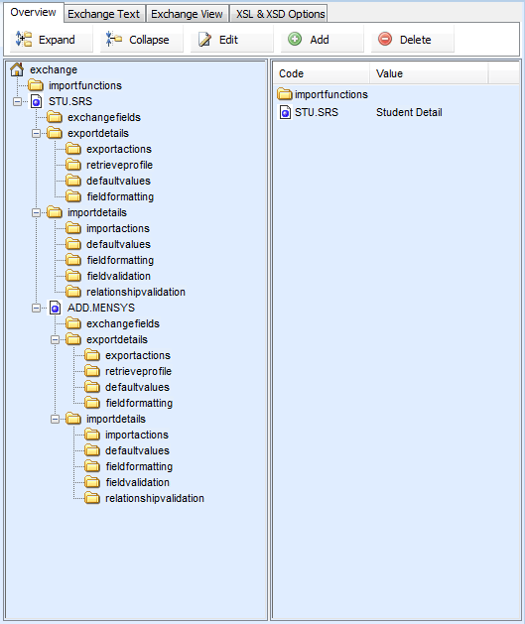
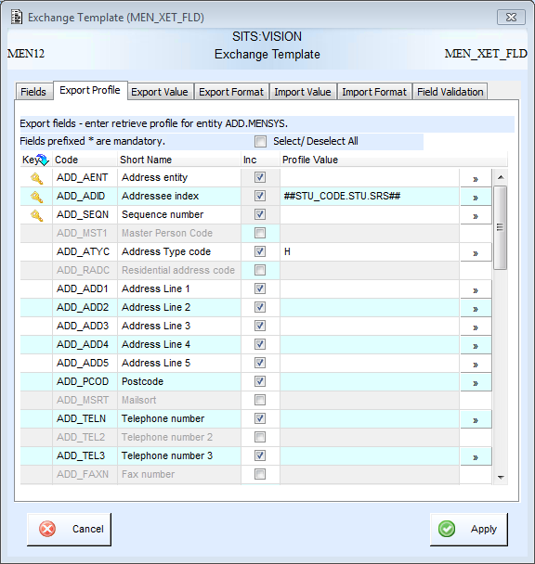
Sub-Entities and Retrieve Profiles
Sub-entities can be added by selecting the root entity and using the add option at the top of the overview tab or in the right-click menu
A retrieve profile must be defined. This can use literal values or values from the parents entity – written using ## instead of << and >>.
Once added the sub-entity will appear in the tree
Entities can be selected from the box (populated with Tribal-defined ERLs) or manually typed into dictionary and entity.

Slide 27
Exercise 4
Using Sub-Entities in XET

Slide 28
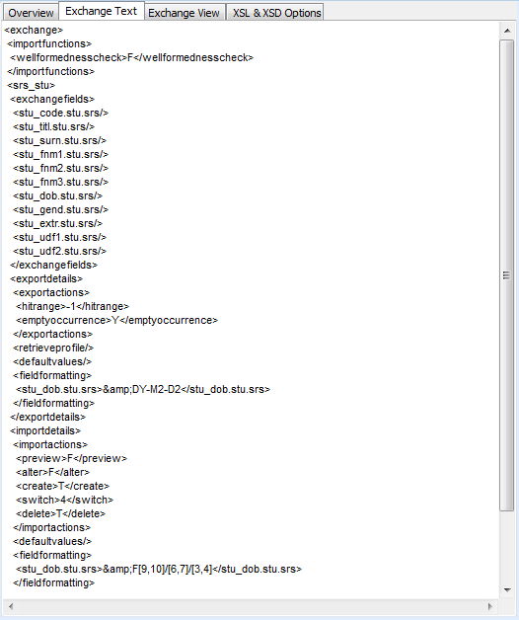
Exchange Text
The exchange text shows how the template is stored in the database and will always be displayed in XML format.

Slide 29
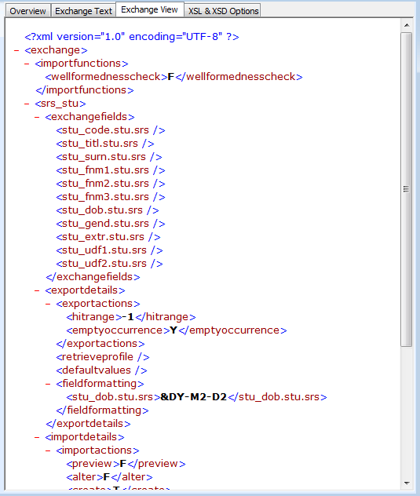
Exchange View
The exchange view is the same as the exchange text, however it is displayed using the Internet Explorer XML Viewer.

Slide 30
Stu-Talk Publish and Subscribe

Slide 31
What is Publish and Subscribe?
Automated tool for exporting (publish) and importing (subscribe) data
The publish and subscribe processes are split into stages – evaluation, generation, transfer out, transfer in and consumption
Each stage is run by a ‘monitor’. These are SITS processes that run outside the SITS application and have to be scheduled.
Publish is triggered by data events taking place in SITS:Vision
Data can be generated or consumed using XET
There are multiple transfer types available
Multiple versions of Publish and Subscribe - All new build should be done using Stu-Talk Publish & Subscribe 2.0

Slide 32
Stu-Talk Publish can export data from the SITS as data changes happen.
Data Change (TUP)
Data Rule Evaluation
Event Rule
Evaluation
Data
Generation
Data
Transfer
HTTP
SOAP
File
Email
SQL Operation
Data
Generation
Data
Transfer
Data Change (TUP)
Data Rule Evaluation
Data
Transfer
Data Change (TUP)
Data Generation
Stu-Talk Subscribe can import data into SITS. SITS initiates these imports.
SITS Record
Data Consumption
Data Transfer In
HTTP
SOAP
File
SQL Operation

Slide 33
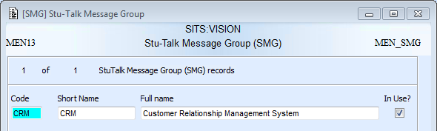
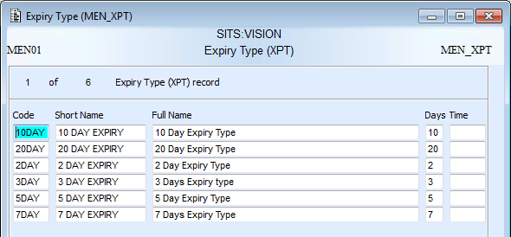
Message Group and Expiry Type
The SMG record groups the configuration records, event records and monitor processes together
XPT is held on most configuration records and is used to calculate the expiry date and time
Current
date &
time
Expiry
date &
time
+
=
XPT

Slide 34
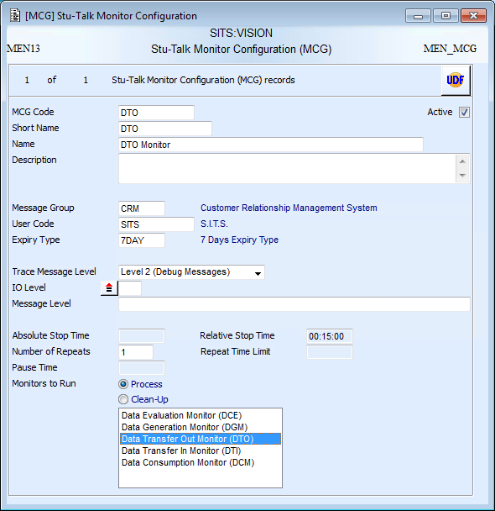
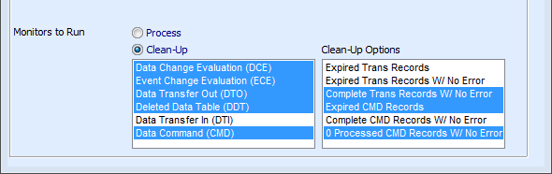
Stu-Talk Monitors
MCG record MUST be active
The MCG record controls the duration of a monitor process and which Stu-Talk processes take place
SMG code needs setting to connect the monitor to the configuration and event records
Message levels can be set for the message text and message buffer
XPT code needs setting to calculate expiry date and time
The duration of the monitor process needs to be set
One or more of the process monitors can be selected, or the clean-up process can be selected

Slide 35
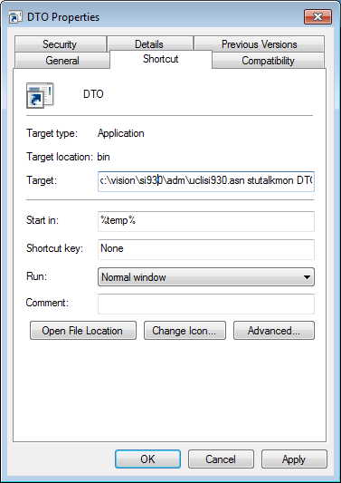
Stu-Talk Monitors
The command line of the monitor then needs to reference the MCG record code.
This is an example where the icon is being run from the desktop.
Path to the uniface executable
K:\vision\si930\uniface\bin\uniface.exe /asn=k:\vision\si930\adm\uclisi930.asn stutalkmon DTO
Path to the assignment file
Application name
MCG Code

Slide 36
Stu-Talk Monitors
Windows example using a .bat file to trigger the monitor from a scheduled task
Scheduled task should point to a .bat file containing:
Task must be run as the urouter user
Unix example using a .sh file to trigger the monitor from the crontab
Cron job should point to the .sh file and log as follows:
The contents of the .sh file should contain:
Task must be run under the urouter crontab
The insunis file must contain a line as follows
stutalk="$USYSBIN/uniface /asn=${asndir}/svrsipr_stutalk.asn stutalk";export stutalk
E:
cd e:\siapp\vision\live\logs\stutalk
e:\siapp\vision\live\uniface\bin\uniface.exe /asn=e:\siapp\vision\live\adm\svrsipr_stutalk.asn stutalkmon dto
#0,10,20,30,40,50 * * * * /u01/siapp/vision/live/scripts/stutalk/dto.sh >/u01/siapp/vision/live/logs/stutalk/dto.log 2>>/u01/siapp/vision/live/logs/stutalk/dto.err
#!/bin/sh
. /u01/siapp/vision/live/uniface/adm/insunis
cd /u01/siapp/vision/live/logs/menbcp
$stutalk dto
Points to consider for both methods:
Need stutalk folder in the logs directory
May not have a specific svrsipr_stutalk.asn file in which case use svrsipr.asn should be used.
Frequency usually every 5-10min but can be at the choice of the customer

Slide 37
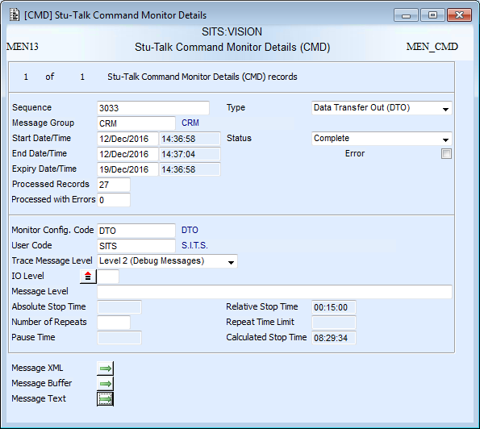
Messaging
The CMD record holds the messaging for each monitor run
Information about the monitor run
Information about the MCG record
Message XML contains both the message text and the message buffer in XML format. Can be extracted using the MEN_CMD_SVC.
Message buffer contains the SITS message buffer and any IO messaging
Message text contains all the messaging from the monitor process. Detail depends on the Trace Messaging Level.

Slide 38
Exercise 5
Stu-Talk Monitors

Slide 39
Publish Process
Trigger
Event Records
Configuration
Records
Monitors
TUP
DCE
DDT
*
DDT
DOR
DRE
*
*
*
ECE
DDT
ECR
ECC
DCE Monitor
*
DTO
DDT
EOR
XET or PRA
* At each stage a DTC is used to decide the direction
DGM Monitor
HTM, ETM, STM, SOAP, OPE, FOP
DTO with XML
DDT
EOR
DTS
DTO Monitor
3rd Party System or Middleware

Slide 40
Publish – No Conditions
Trigger
Event Records
Configuration
Records
Monitors
TUP
DCE
DDT
*
DDT
DOR
DRE
*
*
*
ECE
DDT
ECR
ECC
DCE Monitor
*
DTO
DDT
EOR
XET or PRA
* At each stage a DTC is used to decide the direction
DGM Monitor
HTM, ETM, STM, SOAP, OPE, FOP
DTO with XML
DDT
EOR
DTS
DTO Monitor
3rd Party System or Middleware

Slide 41
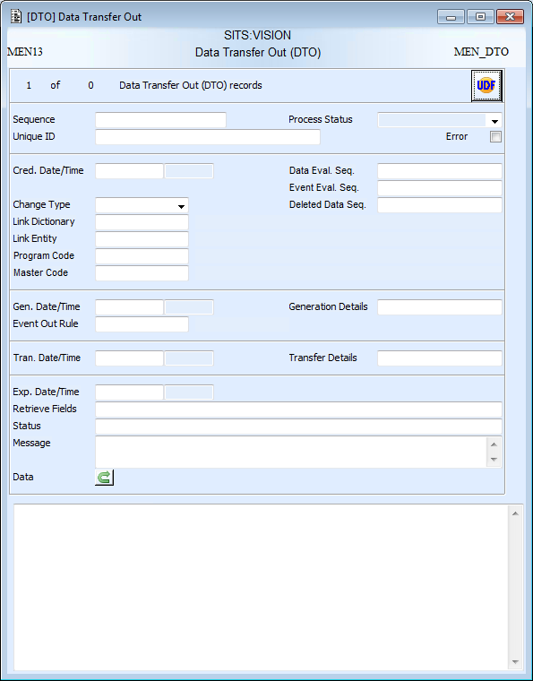
Data Transfer Out (DTO)
Values are new, update or delete
Status reflects where the record is in the process
Sequences of any connected DCE, ECE or DDT records
Driving dictionary and entity
Sequences of connected CMD records
Event-Out-Tray (EOR) code holds configuration for data generation and data transfer
Primary key of the record – used to generate data
Generated data packet

Slide 42
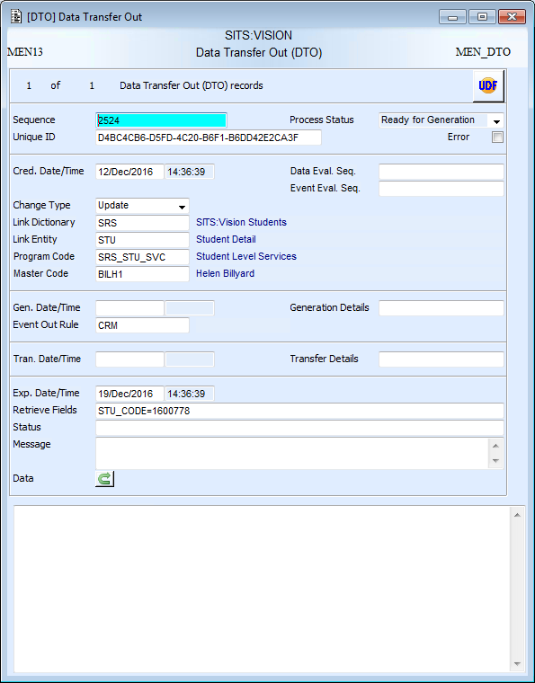
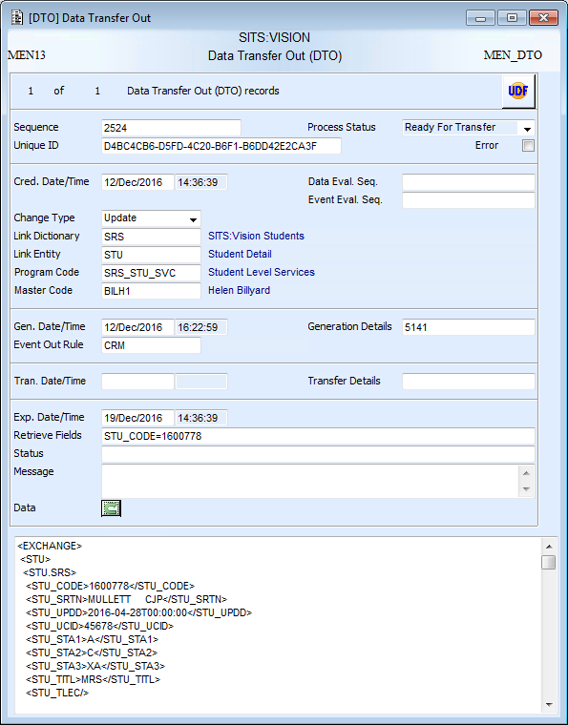
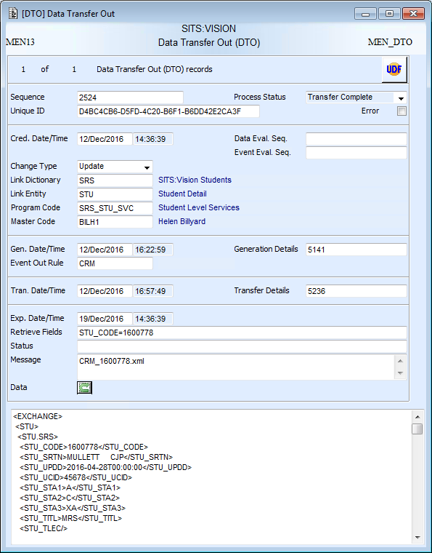
DTO Stages
After Creation
After Data Generation
After Data Transfer
‘Ready for Generation’
No Data
‘Ready for Transfer’
Data generated
Generated details completed
‘Transfer Complete’
Transfer details completed
Transfer outputs mapped

Slide 43
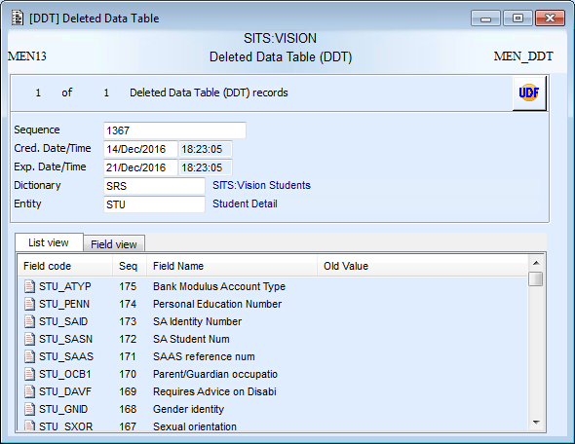
Deleted Data Table (DDT)
Only created when a delete takes place and will be attached to DCE, ECE and DTO
List and field views contain all the data as it was on the record at the time of the delete

Slide 44
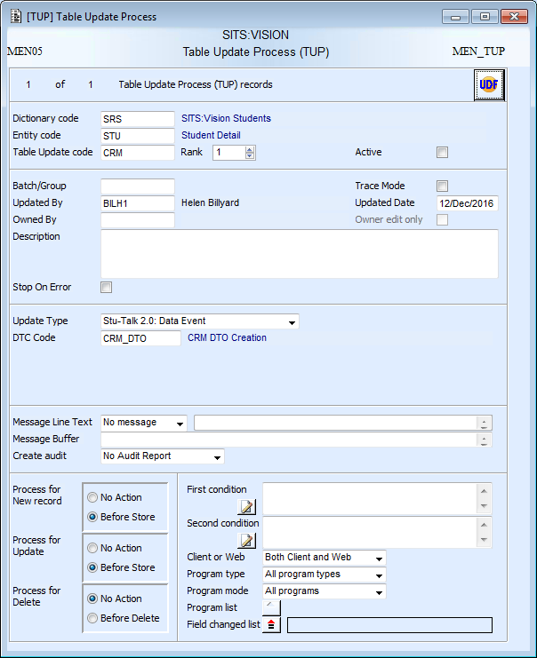
Table Update Process (TUP)
TUP is the trigger for Stu-Talk Publish workflows
Dictionary and entity of record being ‘watched’
Must have an update type of ‘Stu-Talk 2.0 Data Event’
A Data Transfer Configuration (DTC) must be attached to tell the TUP what to create when it is triggered
When will it be triggered, on new, update or delete?

Slide 45
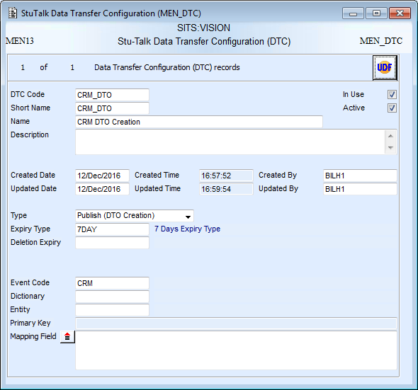
Data Transfer Configuration (DTC)
The type directs the Publish workflow and tells it what to create. This can be set to DCE or DTO when attached to TUP.
When set to DTO an Event (EOR) code must be specified. This tells the process what configuration to stamp on the newly created DTO.
Dictionary, Entity, Primary Key and Mapping fields will be covered in the practitioner course

Slide 46
Exercise 6
Create the publish trigger configuration

Slide 47
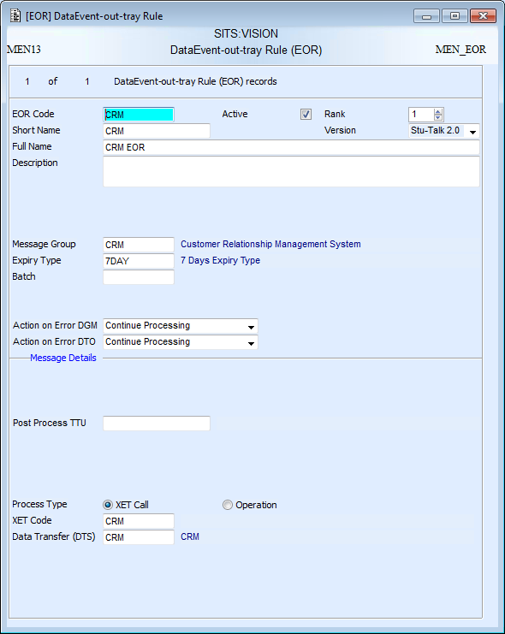
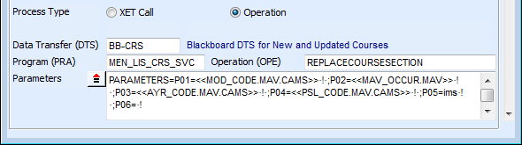
Event-Out-Tray Rule (EOR)
EOR contains the configuration for data generation (DGM) and data transfer out (DTO)
Must be set to version ‘Stu-Talk 2.0’
Controls what happens when errors occur:
Continue
Move onto next rule
Stop
Message group to connect the configuration to the monitors
Data generation can use XET or a Tribal defined exposed operation
Configuration for data transfer is held in an attached DTS

Slide 48
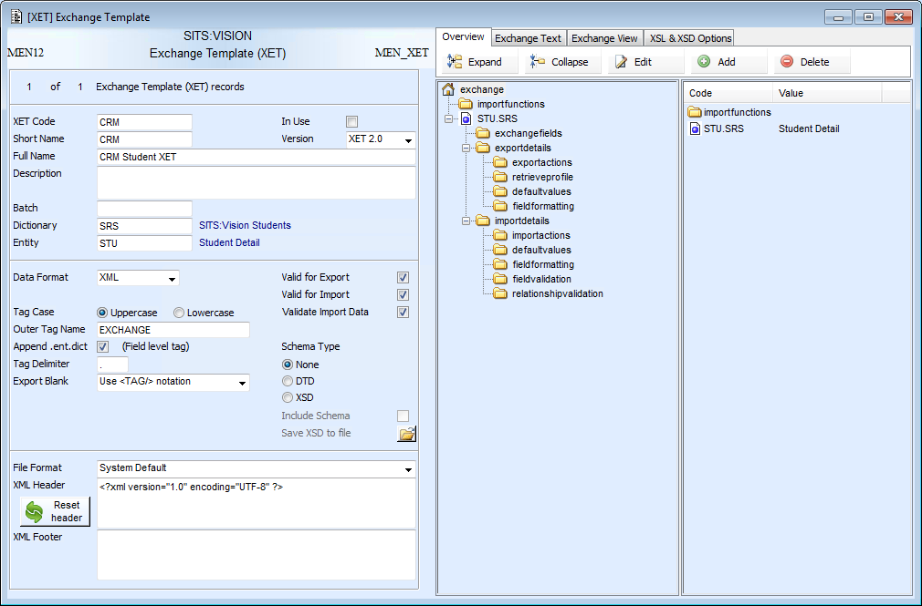
Exchange Template (XET)
If generating data via XET, an XET will need attaching to the EOR

Slide 49
Exercise 7
Create the publish data generation configuration

Slide 50
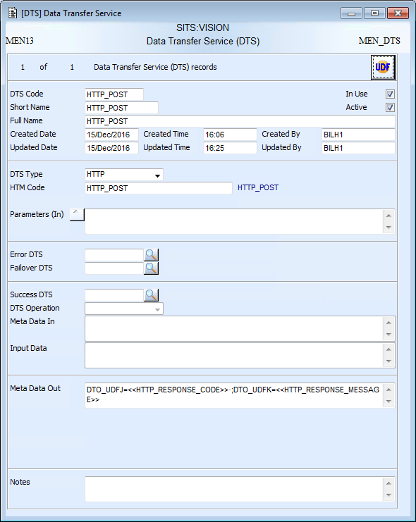
Data Transfer Service (DTS)
DTS holds the configuration for data transfer
DTS type defines how the transfer will run:
HTTP
SOAP
File
Email
Operation
SQL DB Connector
Data/tokens can be passed into the transfer configuration
The code needing to specified will change depending on the DTS type selected
Error, failover and success DTS will be covered in the practitioner training
Data can be mapped from the transfer back onto the DTO record

Slide 51
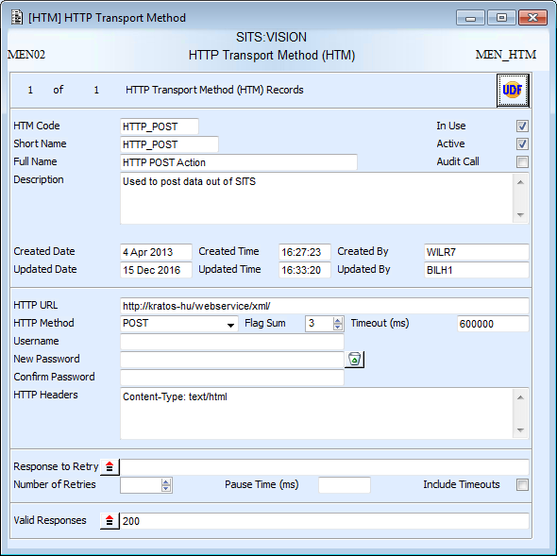
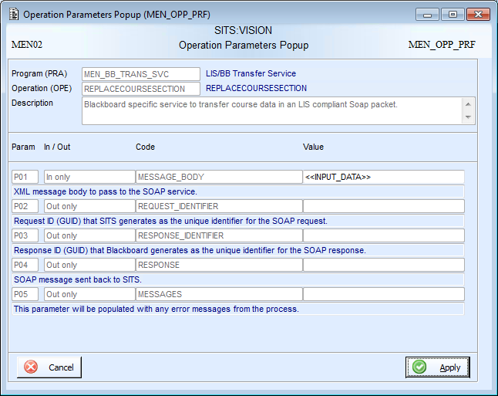
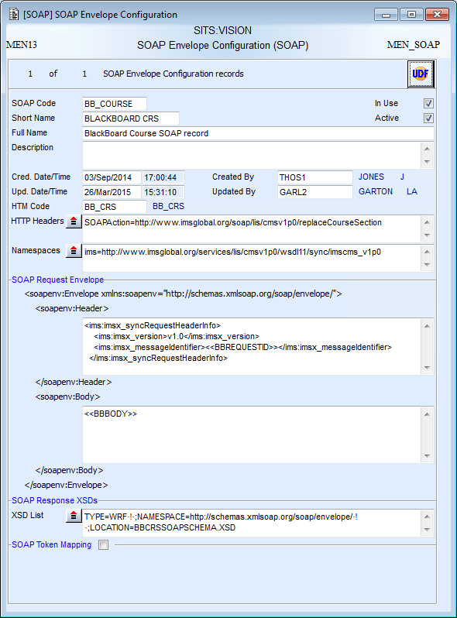
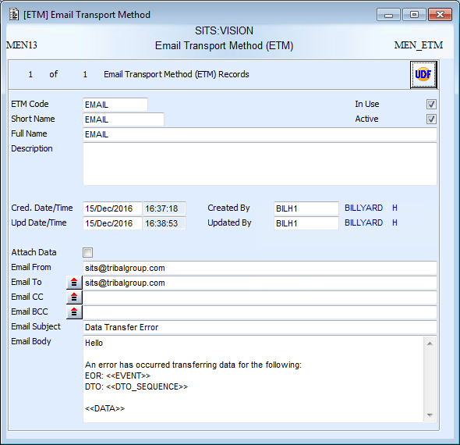
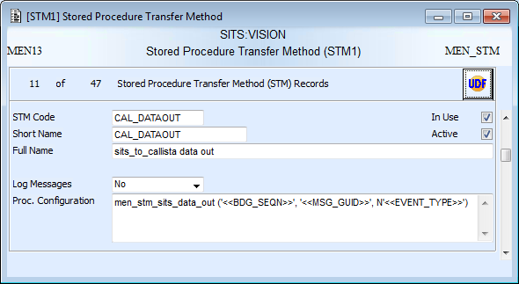
Data Transfer Service
HTTP
Operation
SOAP
Email
SQL DB Connector

Slide 52
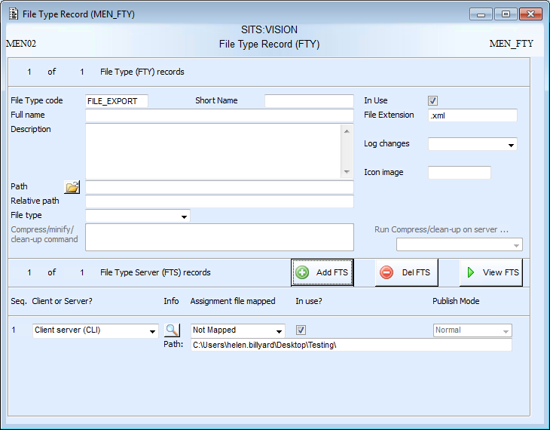
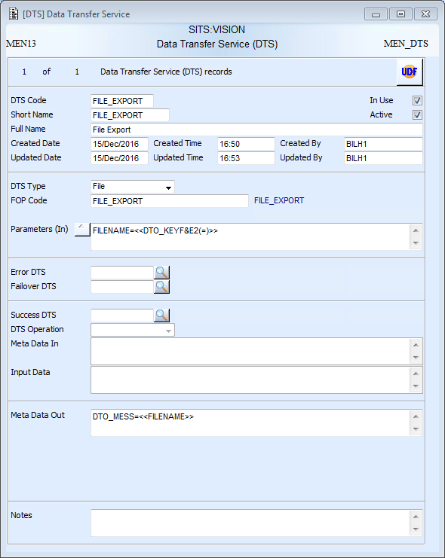
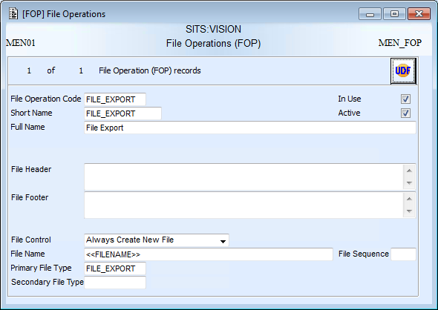
File Transfer
File extension for the file that will be created
DTS type set to file and FOP code specified
FILENAME token set
Path for the file transfer
FILENAME token passed in – tokens don’t have to be used but allow the file name to be more dynamic
File control set to create a new file. Appending is covered in the practitioner course
Filename created mapped back to DTO
FTY code specified – only a primary FTY is needed for export

Slide 53
Exercise 8
Create the publish data transfer out configuration

Slide 54
Exercise 9
Run the simple publish process

Slide 55
Publish – Data Level Conditions
Trigger
Event Records
Configuration
Records
Monitors
TUP
DCE
DDT
*
DDT
DOR
DRE
*
*
*
ECE
DDT
ECR
ECC
DCE Monitor
*
DTO
DDT
EOR
XET or PRA
* At each stage a DTC is used to decide the direction
DGM Monitor
HTM, ETM, STM, SOAP, OPE, FOP
DTO with XML
DDT
EOR
DTS
DTO Monitor
3rd Party System or Middleware

Slide 56
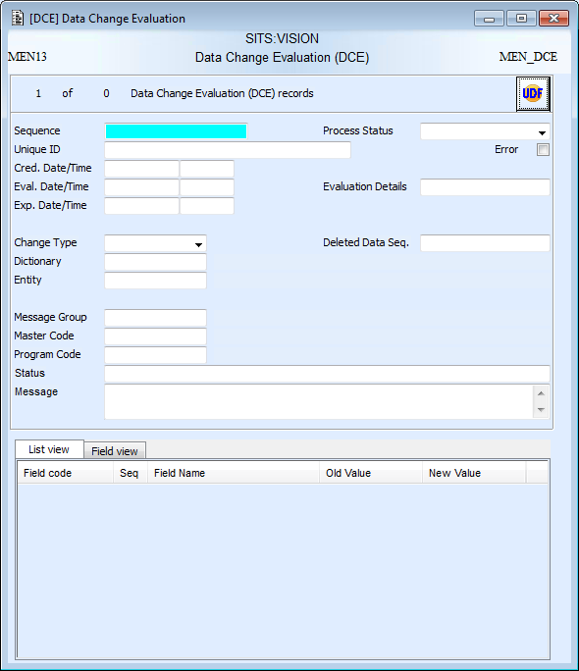
Data Change Evaluation (DCE)
Values are new, update or delete
Status reflects where the record is in the process
Sequence of connected CMD records
Driving dictionary and entity
Sequence of any connected DDT records
Message group stamped on from the DTC
Detail of who and what program made the change
Details of the changed fields, plus the primary key

Slide 57
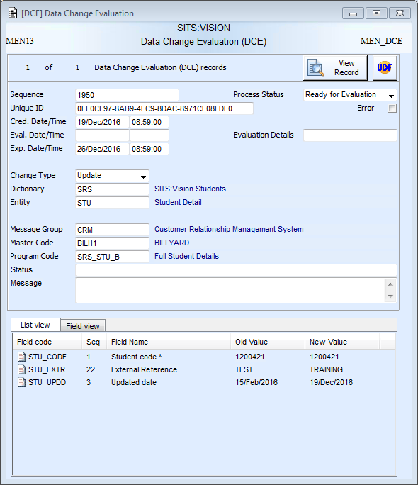

DCE Stages
After Creation
After Data Evaluation
‘Ready for Evaluation’
Evaluation details blank
‘Evaluation Complete’
Evaluation details completed

Slide 58


TUP & DTC
TUP has a different DTC attached. The DTC is set to ‘DCE Creation’ instead of ‘DTO Creation’.
Message group and expiry type need setting

Slide 59

Data-Out-Tray Rule (DOR)
DOR controls which data changes get published out
Change types can be:
All
Update
New
Delete
A DTC is needed to tell the process what to create when the DOR is passed. Can be ECE or DTO creation.
Open rules and link values will be covered in the practitioner course
Dictionary and entity must be set to match the changed record i.e. the same as TUP
Care must be taken with old and new values!!
This rule states that the value of STU_EXTR must have changed OR the old value of STU_STA1 must be A and the new value of STU_STA2 must be C*
Note: Use of double and single quotes

Slide 60
Exercise 10
Create publish data evaluation configuration

Slide 61
Exercise 11
Run through publish process with data-level conditions

Slide 62
Subscribe
Event Records
Configuration
Records
Monitors
3rd Party System or Middleware
DTI Monitor
‘Ready for Consumption’ DTI
HTM, STM, SOAP, OPE, FOP
TIC
DTS
DCM Monitor
‘Consumption Complete’ DTI
TIC
XET or PRA
Changes to SITS records

Slide 63

Data Transfer In (DTI)
Status reflects where the record is in the process
Transfer-In-Class (TIC) code holds configuration for data transfer in and data consumption
Sequences of connected CMD records
Imported data packet

Slide 64


Transfer-In-Tray Class (TIC)
TIC contains the configuration for data transfer in (DTI) and data consumption (DCM)
Must be set to version ‘Stu-Talk 2.0’
Message group to connect the configuration to the monitors
Controls what happens when errors occur:
Continue
Move onto next rule
Stop
Note: ‘Continue’ is not available for transfer
Data consumption can use XET or a Tribal defined exposed operation. Consumption using an OPE will be covered in the practitioners course.
Control whether an XET import is a create/update or delete
Configuration for data transfer is held in an attached DTS

Slide 65

Data Transfer Service
DTS holds the configuration for data transfer
DTS type defines how the transfer will run:
HTTP
SOAP
File
Operation
SQL DB Connector
The code needing to specified will change depending on the DTS type selected
Error, failover and success DTS will be covered in the practitioner training
Data can be mapped from the transfer back onto the DTI record

Slide 66



Data Transfer Service
HTTP
Operation
SOAP
Email
SQL DB Connector
Email is not available for transfer in

Slide 67




File Transfer
File extension for the files to be picked up
DTS type set to file and FOP code specified
File extension for the files to be picked up
Primary file type
Secondary file type
FTY codes specified – files are picked up from the primary FTY and moved to the secondary FTY when processed. If no secondary FTY is specified the file is deleted.
Path for the file transfer
File control is not needed
Path to move process file to
Filename used as a retrieve profile to pick files up
Overwrite controls what happened if there is already a file with the same name in the secondary FTY.
Name of the imported file mapped back to DTI

Slide 68
Exercise 12
Create subscribe transfer configuration

Slide 69
Exchange Template(XET)
If consuming data via XET, an XET will need attaching to the TIC

Slide 70
Exercise 14
Create subscribe consumption configuration

Slide 71
Exercise 14
Run the subscribe process

Slide 72

Clean-Up Monitor
The clean-up monitor runs in the same way to the other monitors and is used to delete Stu-Talk event and messaging records
Monitors to Run is set to Clean-Up
Specify which records from the chosen entities will be deleted:
Expired
Completed
No error
Choose which records will be deleted by the monitor

Slide 73

Monitor Summary (XCMD)
Provides monitor performance information
MEN_XCMD* system parameters can be used to control the look and feel of some of the tabs

Slide 74
Monitor Summary (XCMD)
Monitor Details
Shows the monitor run details, split into monitor types, for the retrieved monitors
Monitor Comparison
Shows details for each monitor run for a specified monitor type within a message group
Group Comparison
Compares monitor runs for a specified type from different message groups
Transaction Comparison
Shows the progress of the DTO or DTI records for a specified message group, EOR code or TIC code

Slide 75
Exercise 15
Use XCMD for monitoring

Slide 76
Exercise 16
Create and run the clean-up monitor

