Slide 1
Stu-Talk Data Exchange and Publish & Subscribe
Practitioner Course

Slide 2
Course Pre-Requisites
Stu-Talk Foundation: Data Exchange and Publish & Subscribe

Slide 3
Goals of this Training
This training will cover the more complex functions of Stu-Talk Exchange Templates and Stu-Talk Publish & Subscribe. The goal of the day is to leave with a firm understanding of the following:
Using XSL and XSD with Exchange Templates
How to setup more complex Publish and Subscribe workflows
Using multiple levels of conditions
Chaining processes together

Slide 4
Stu-Talk Responsibilities

Slide 5
Stu-Talk Exchange Templates

Slide 6
Exchange Templates Recap
Create and maintain templates for transferring data
Used for exporting (generation) and importing (consumption)
Can be XML or JSON format
Entity- based but the ‘driving entity’ can have sub-entities
Data can be formatted during export or import
Multiple versions of XET - All new build should be done using XET 2.0

Slide 7
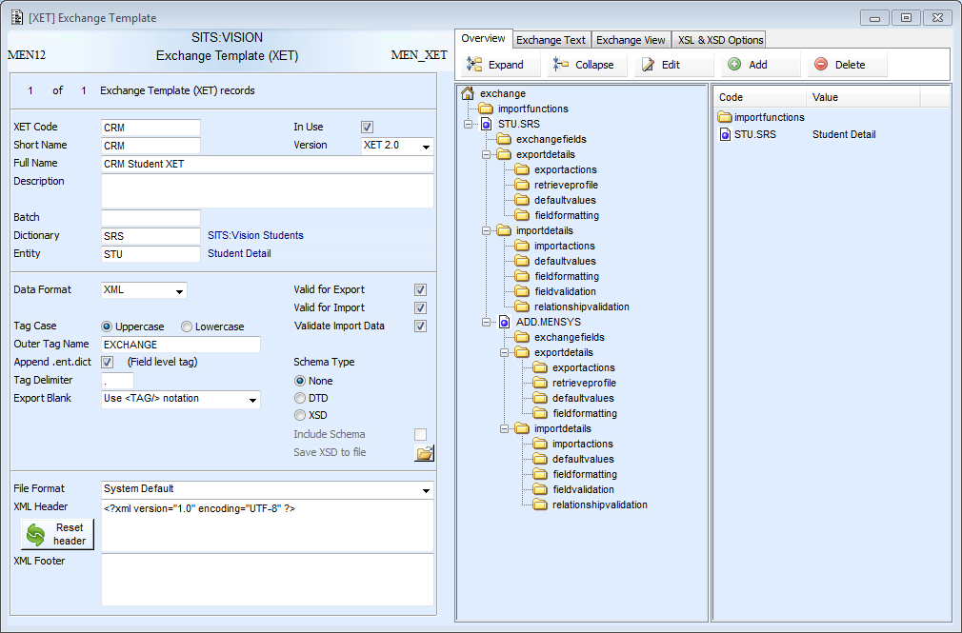
The XET is setup using the global properties on the right and by accessing various pop-ups in the folder tree.
This course covers more complex XET functions which were not covered in the foundation course.

Slide 8
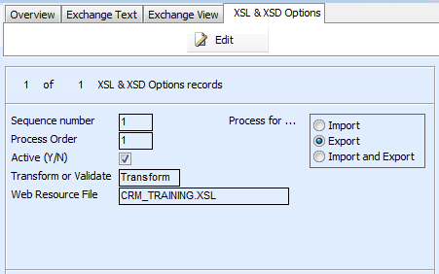
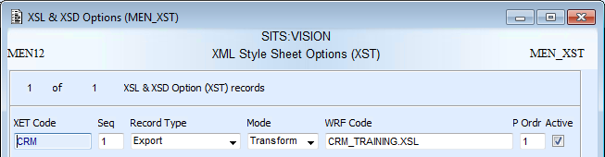
XML Stylesheets (XSL)
Clicking ‘Edit’ allows an XST record to be created
If the XET is set to XML, XSL files can be added to the XET to transform data on either export or import, using the ‘XSL & XSD Options’ tab.
If multiple records are added set the process order accordingly
Select if the transform is for export or import
The XSL file needs creating outside of SITS, uploading to a WRF record using FMU and them published using FMU.
Once created specify the WRF code to attach the XSL file.
Mode MUST be set to transform for an XSL

Slide 9
TRAINER DEMO
Run an XET export using XSL

Slide 10
Exercise 1
XML Transformation

Slide 11
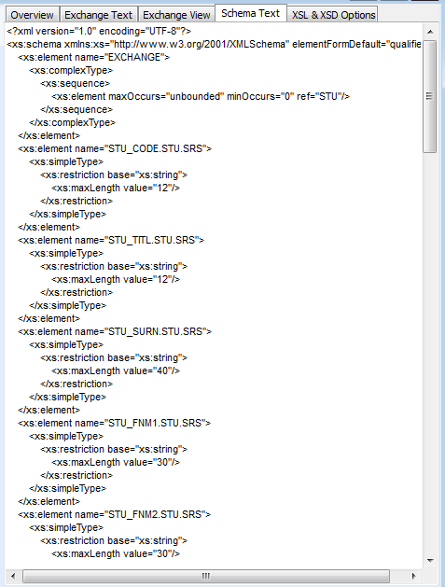
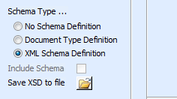
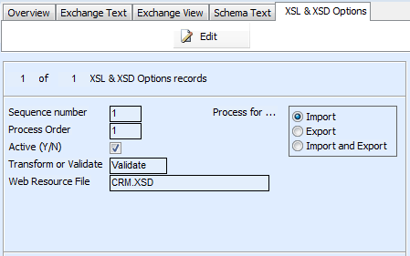
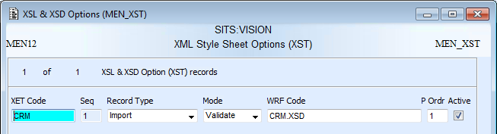
XML Schema Definitions (XSD)
If the XET is set to XML, XSD files can be added to the XET to validate the XML structure on import.
Clicking ‘Edit’ allows an XST record to be created
If multiple records are added set the process order accordingly
Selecting ‘XML Schema Definition’ produces a SITS schema in the ‘Schema Text’ tab. The schema can be downloaded using ‘save to file’ and edited it needed. The XSD file then uploading to a WRF record and published using FMU.
Record type MUST be import
Mode MUST be set to validate for an XSD
Once created specify the WRF code to attach the XSD file

Slide 12
TRAINER DEMO
Run an XET import using XSD

Slide 13
Exercise 2
XML Validation

Slide 14
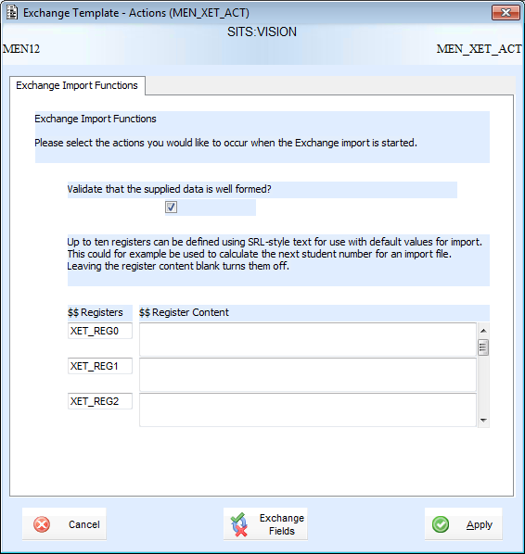
XET Registers
XET registers can be used to define SRL syntax or to set a register value.
The register can then be called in the import values using <<$$XET_REG0>> - useful when the same syntax is needed repeatedly.
It is also useful to reference the register on conditions of Stu-Talk TUPs to prevent loops.

Slide 15
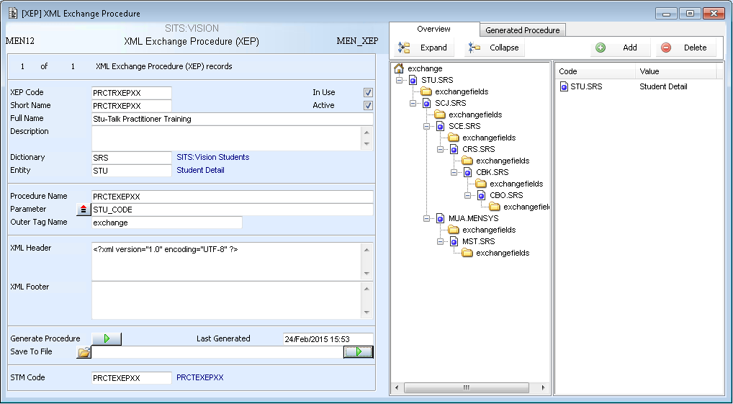
XML Exchange Procedure (XEP)
Exchange fields and sub-entities are added like in XET
XML is less complex than XET due to the lack of retrieve profiles, however the stored procedure can be edited after been saved.
Name of stored procedure and parameters to be passed in
Options to generate and save stored procedure
XEP is used to create stored procedures which generate XML.
STM record attached. Needed to run stored procedure.

Slide 16
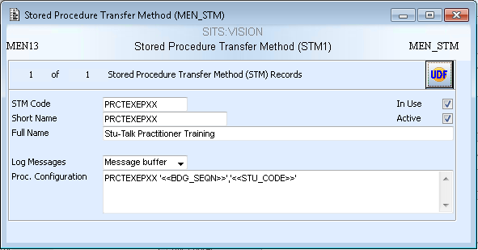
Running XEP
1. Create an STM record to attach to the XEP record. This is used to run the procedure and specifies the procedure name and parameters.
‘<<BDG_SEQN>>’ must always be the first parameter in addition to those on XEP. This is because the exported data is passed through the SQL Bridging (BDG) record.
2. Generate and save the procedure.
3. Amend the ‘select’ statement within the procedure if necessary and store the procedure on the database.
4. Run the procedure through &P or Stu-Talk using:
PRA: RUN_STORED_PROCEDURE_CTS
OPE: MEN_XEP_SVC
As the ‘select’ statement can be amended, using XEP can help to build table joins which would not have been possible in XET.

Slide 17
Stu-Talk Publish and Subscribe

Slide 18
Publish and Subscribe Recap
Automated tool for exporting (publish) and importing (subscribe) data
The publish and subscribe processes are split into stages – evaluation, generation, transfer out, transfer in and consumption
Each stage is run by a ‘monitor’. These are SITS processes that run outside the SITS application and have to be scheduled.
Publish is triggered by data events taking place in SITS:Vision
Data can be generated or consumed using XET
There are multiple transfer types available
Multiple versions of Publish and Subscribe - All new build should be done using Stu-Talk Publish & Subscribe 2.0

Slide 19
Stu-Talk Publish can export data from the SITS as data changes happen.
Data Change (TUP)
Data Rule Evaluation
Event Rule
Evaluation
Data
Generation
Data
Transfer
HTTP
SOAP
File
Email
SQL Operation
Data
Generation
Data
Transfer
Data Change (TUP)
Data Rule Evaluation
Data
Transfer
Data Change (TUP)
Data Generation
Stu-Talk Subscribe can import data into SITS. SITS initiates these imports.
SITS Record
Data Consumption
Data Transfer In
HTTP
SOAP
File
SQL Operation

Slide 20
Background Records Recap
SMG
(Message Group)
Groups the configuration records, event records and monitor processes together
MCG
(Monitor Configuration)
Controls the duration of a monitor process and which Stu-Talk processes take place
CMD
(Command Monitor Details)
Holds the messaging for each monitor run
XPT
(Expiry Type)
Held on most configuration records and is used to calculate the expiry date and time

Slide 21
Exercise 3
Stu-Talk Monitors

Slide 22
Publish Process
Trigger
Event Records
Configuration
Records
Monitors
TUP
DCE
DDT
*
DDT
DOR
DRE
*
*
*
ECE
DDT
ECR
ECC
DCE Monitor
*
DTO
DDT
EOR
XET or PRA
* At each stage a DTC is used to decide the direction
DGM Monitor
HTM, ETM, STM, SOAP, OPE, FOP
DTO with XML
DDT
EOR
DTS
DTO Monitor
3rd Party System or Middleware

Slide 23
Publish – No Conditions
Trigger
Event Records
Configuration
Records
Monitors
TUP
DCE
DDT
*
DDT
DOR
DRE
*
*
*
ECE
DDT
ECR
ECC
DCE Monitor
*
DTO
DDT
EOR
XET or PRA
* At each stage a DTC is used to decide the direction
DGM Monitor
HTM, ETM, STM, SOAP, OPE, FOP
DTO with XML
DDT
EOR
DTS
DTO Monitor
3rd Party System or Middleware
Notes:
Covered in foundation training

Slide 24
Publish – Data Level Conditions
Trigger
Event Records
Configuration
Records
Monitors
TUP
DCE
DDT
*
DDT
DOR
DRE
*
*
*
ECE
DDT
ECR
ECC
DCE Monitor
*
DTO
DDT
EOR
XET or PRA
* At each stage a DTC is used to decide the direction
DGM Monitor
HTM, ETM, STM, SOAP, OPE, FOP
DTO with XML
DDT
EOR
DTS
DTO Monitor
3rd Party System or Middleware
Notes:
Covered in foundation training

Slide 25
Publish – Event Level Conditions
Trigger
Event Records
Configuration
Records
Monitors
TUP
DCE
DDT
*
DDT
DOR
DRE
*
*
*
ECE
DDT
ECR
ECC
DCE Monitor
*
DTO
DDT
EOR
XET or PRA
* At each stage a DTC is used to decide the direction
DGM Monitor
HTM, ETM, STM, SOAP, OPE, FOP
DTO with XML
DDT
EOR
DTS
DTO Monitor
3rd Party System or Middleware
Notes:
Will be covered in this practitioner training

Slide 26
Event Change Evaluation Explained!
There may be scenarios where you do not want to publish data out until multiple events have happened
DCE Monitor
Evaluates against DOR and ECR rules
TUP
DCE
DOR
ECE
DGM and DTO monitor processes as usual
ECR
DTO
TUP
DCE
DOR
ECE
First event gets held at the ECE level until the next event takes place. The DTO is not created until all events required have taken place

Slide 27
Event Change Evaluation Example
STU
TUP
New
STU
DCE
STU DOR
STU DTO
Create record
ID sent back
Updates whilst no ID
STU
DCE
STU DOR
STU ECE
STU & MAI ECR
STU DTO
MAI TUP
MAI DCE
MAI DOR
MAI ECE
Move
ID into DTI
DCM Monitor consumes ID into MAI and triggers TUP
MAI DTI
Ensures no student updates get sent or missed until the third party ID has been received

Slide 28
TRAINER DEMO
Run a publish process using event-level conditions

Slide 29
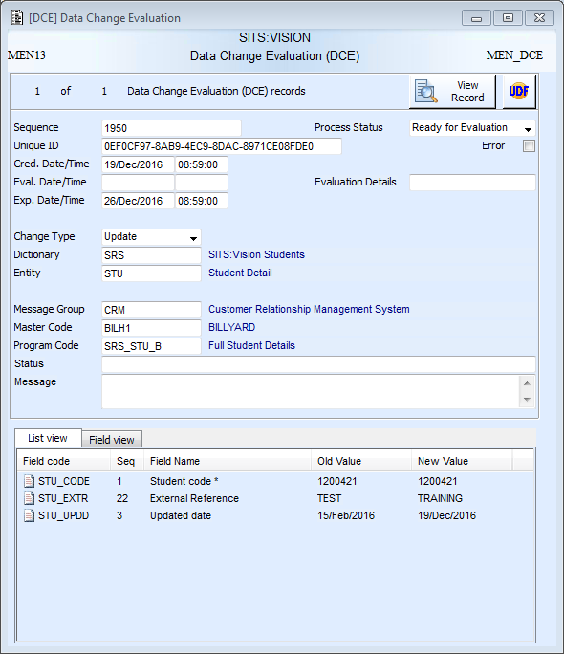
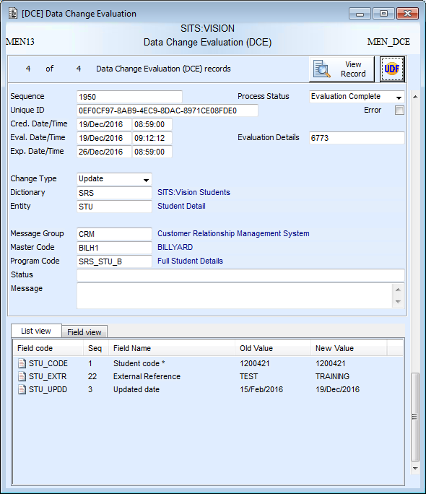
Data Change Evaluation (DCE)
After Creation
After Data Evaluation
Records details of the data change.
Evaluated against DOR rules.
‘Ready for Evaluation’
Evaluation details blank
‘Evaluation Complete’
Evaluation details completed

Slide 30
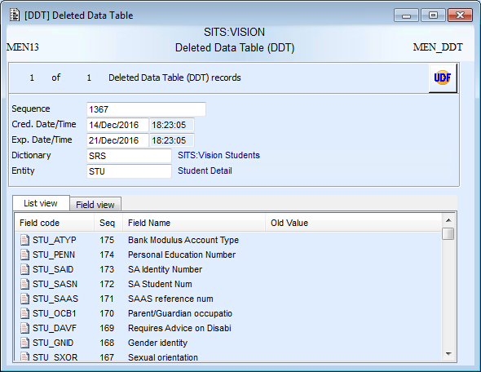
Deleted Data Table (DDT)
Only created when a delete takes place and will be attached to DCE, ECE and DTO
List and field views contain all the data as it was on the record at the time of the delete

Slide 31
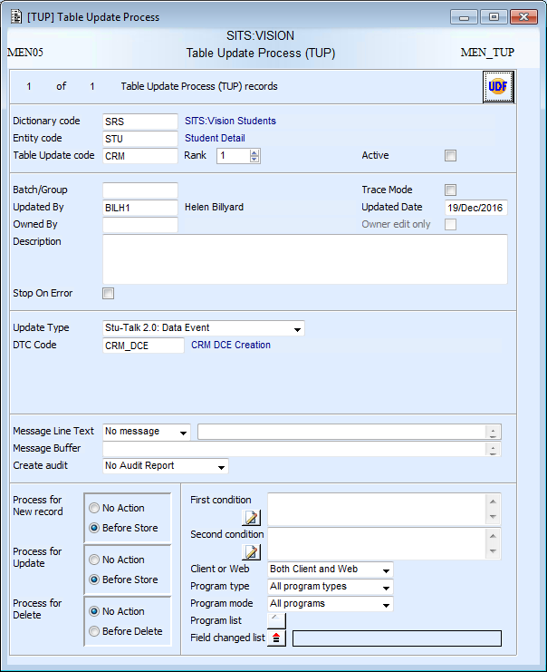
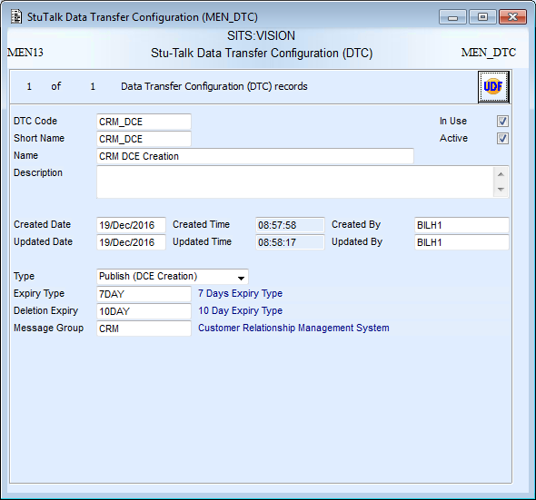
Table Update Process (TUP)
TUP is the trigger for Stu-Talk Publish workflows
Type of ‘Stu-Talk 2.0 Data Event’
A Data Transfer Configuration (DTC) must be attached to tell the TUP what to create when it is triggered

Slide 32
Exercise 4
Create triggers and trigger the events

Slide 33
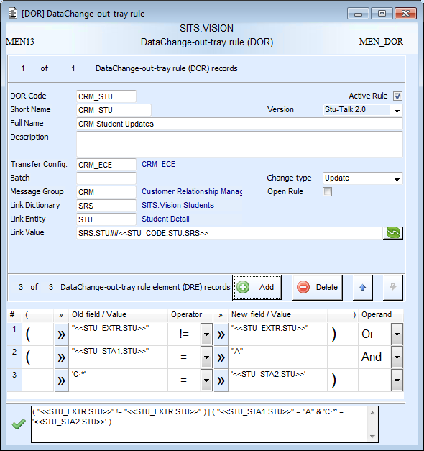
Data-Out-Tray Rule (DOR)
DOR controls which data changes get published out
If the ‘Open Rule’ box is ticked the ECE created will have an ‘Open’ status
A DTC is needed to tell the process what to create when the DOR is passed. Can be ECE or DTO creation.
This now uses an ‘ECE’ DTC, instead of a ‘DTO’ one.
The link values sets the link value on the ECE record.
Link values must be set correctly when using event level rules (ECR) as this is what links the events together.
Care must be taken with old and new values!!
This rule states that the value of STU_EXTR must have changed OR the old value of STU_STA1 must be A and the new value of STU_STA2 must be C*
Note: Use of double and single quotes

Slide 34
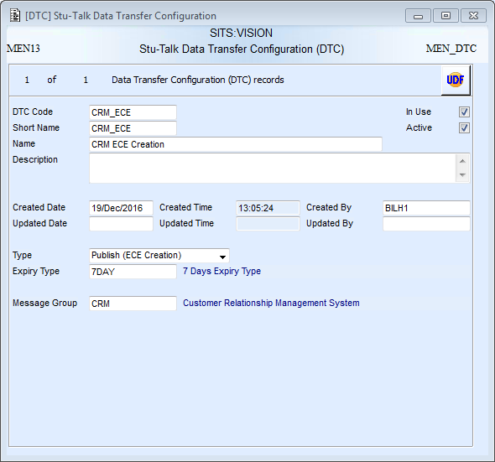
Data Transfer Configuration (DTC)
The type directs the Publish workflow and tells it what to create. This can be set to ECE or DTO when attached to DOR.
Expiry type and message group need setting

Slide 35
Exercise 5
Create publish data evaluation configuration

Slide 36
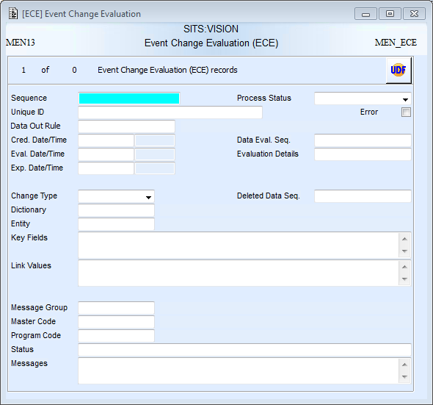
Event Change Evaluation (ECE)
Status reflects where the record is in the process
Values are new, update or delete
Sequence of any connected DCE, CMD and DDT records
Driving dictionary and entity
Primary key of the changed record
Link value stamped on from the DOR rule
Message group stamped on from the DTC
Detail of who and what program made the change

Slide 37
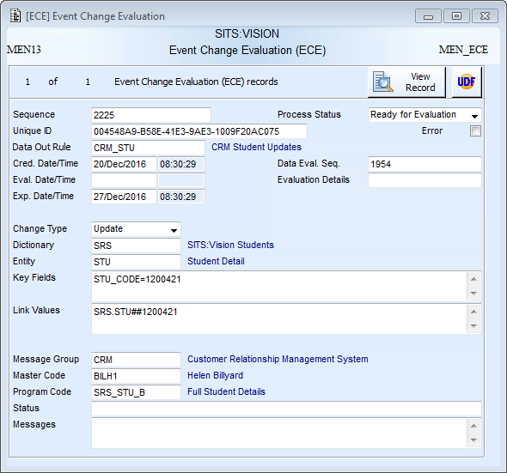
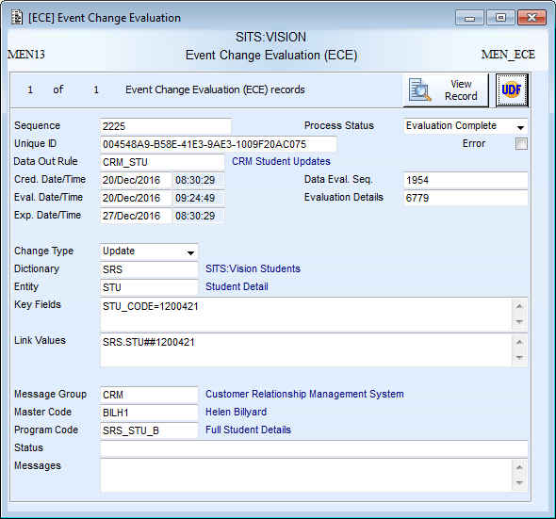
ECE Stages
After Creation
After Data Evaluation
‘Ready for Evaluation’
Evaluation details blank
‘Evaluation Complete’
Evaluation details completed

Slide 38
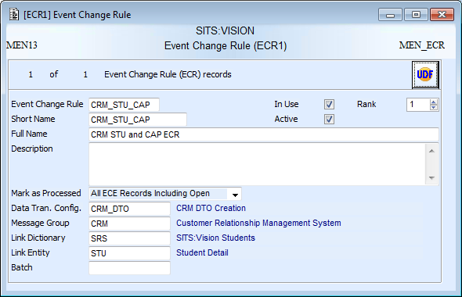
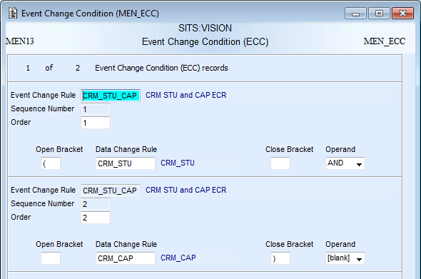
Event Change Rules (ECR) and Event Change Conditions (ECC)
‘Mark as processed’ controls the status ECEs are given after they have been processed. Records that have a ‘ready’ status can be treated differently to those with an ‘open’ status.
A DTC is needed to tell the process what to create when the ECR is passed. Can only be DTO creation.
Driving dictionary and entity
Only use ECR to create ‘AND’ rules
Rule states there must be linking DCEs from DORs CRM_STU and CRM_CAP before a DTO will be created

Slide 39
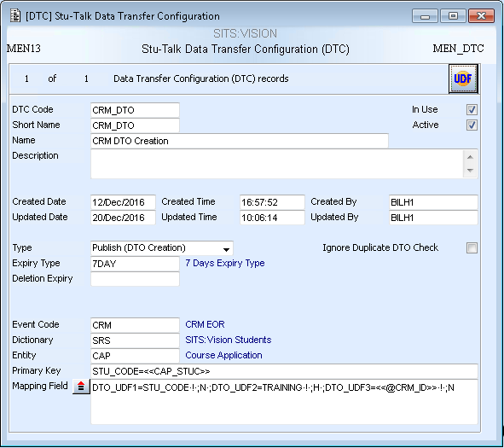
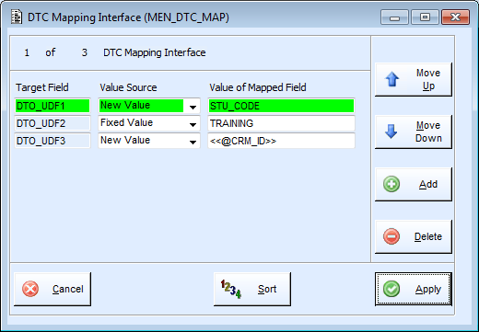
Data Transfer Configuration (DTC)
When set to DTO an Event (EOR) code must be specified. This tells the process what configuration to stamp on the newly created DTO.
The type directs the Publish workflow and tells it what to create. This can only be set to DTO when attached to ECR.
Dictionary, Entity and Primary Key fields can be used to overwrite the values on the event records between DCE/ECE stage and DTO stage. This useful where the trigger is on a different entity to the XET.
Mapping fields can be used to stamp old or new values from the DCE, or literal values into the DTO UDFs. Build text can also be used – this will have access to the primary key of the changed record.

Slide 40
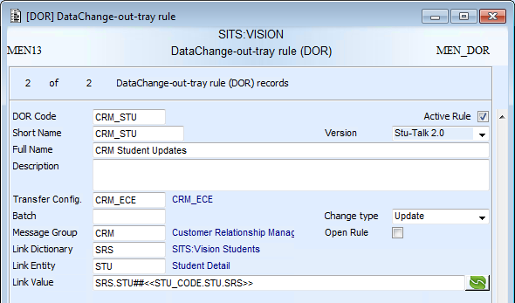
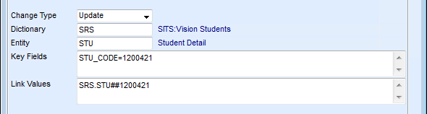
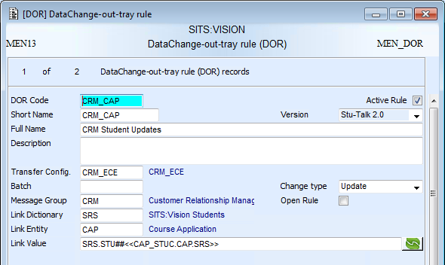
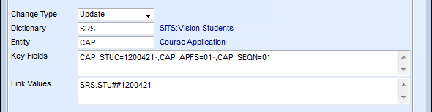
Link Values
First DOR
ECE created from first DOR
Link values are set on the DOR rules and stamped onto ECE.
When using ECR rules these must be set so that the translated values on the ECEs which need linking together match exactly.
Second DOR
ECE created from second DOR

Slide 41
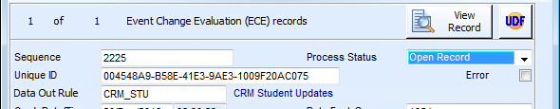
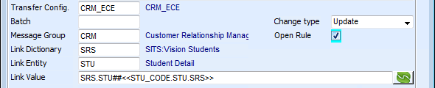

Open Rules
When an ECE is created from an DOR with ‘Open Rule’ ticked it will have an ‘Open’ status
How ‘open’ ECEs are processed is controlled by ‘Mark as processed’ on ECR
First ECR
Ending ECE process status: Open
Second ECR
Mark as processed: All ECE records excluding open
Third ECR
Mark as processed: All ECE records including open
Starting ECE process status: Open
Starting ECE process status: Open
Ending ECE process status: Open
Starting ECE process status: Open
Ending ECE process status: Evaluation Complete
Mark as processed: All ECE records excluding open
‘Mark as processed’ Example
This is useful when a single data change may be required by multiple publishes in the same message group

Slide 42
Exercise 6
Create publish event evaluation configuration

Slide 43
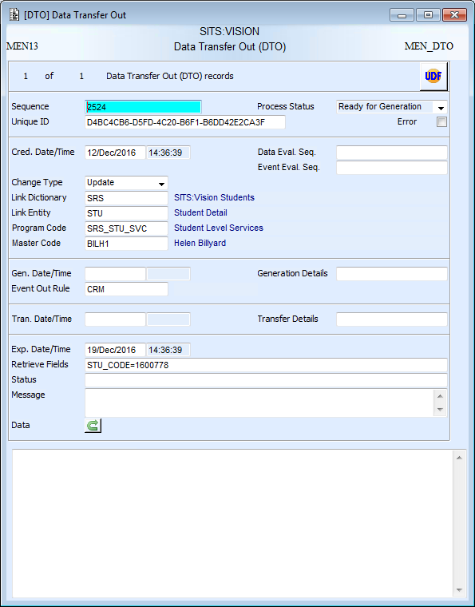
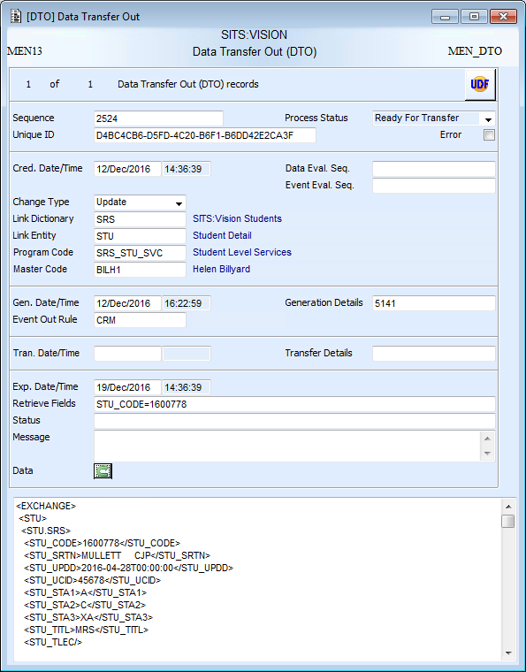
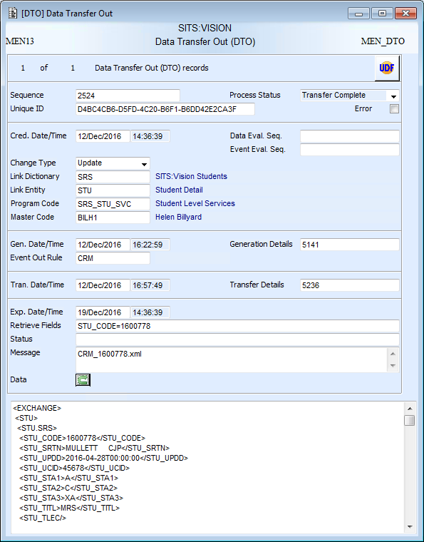
Data Transfer Out (DTO)
After Creation
After Data Generation
After Data Transfer
‘Ready for Generation’
No Data
‘Ready for Transfer’
Data generated
Generated details completed
‘Transfer Complete’
Transfer details completed
Transfer outputs mapped

Slide 44
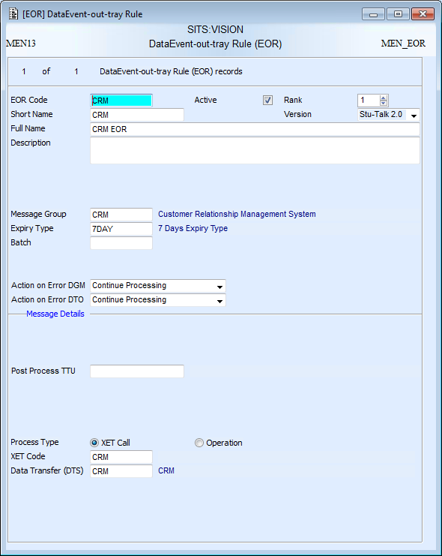
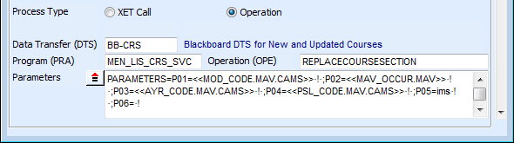
Event-Out-Tray Rule (EOR)
EOR contains the configuration for data generation (DGM) and data transfer out (DTO)
Must be set to version ‘Stu-Talk 2.0’
Controls what happens when errors occur:
Continue
Move onto next rule
Stop
Message group to connect the configuration to the monitors
Data generation can use XET or a Tribal defined exposed operation
Configuration for data transfer is held in an attached DTS

Slide 45
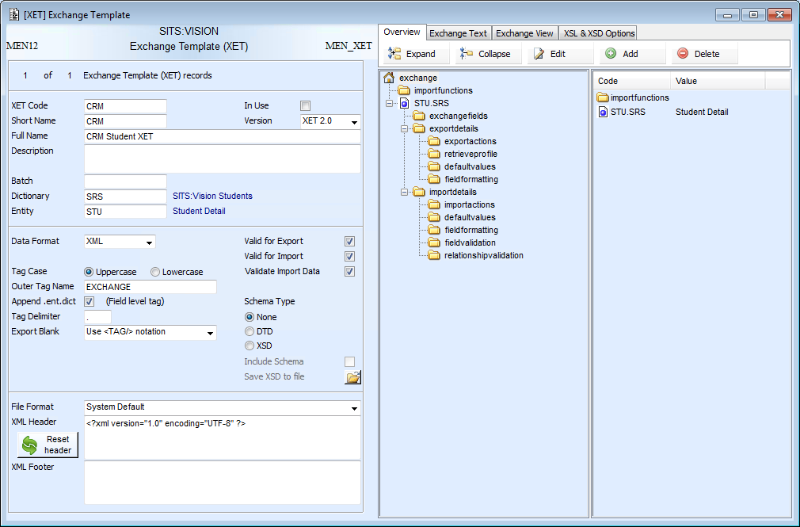
Exchange Template (XET)
If generating data via XET, an XET will need attaching to the EOR

Slide 46
Exercise 7
Create publish data generation configuration

Slide 47
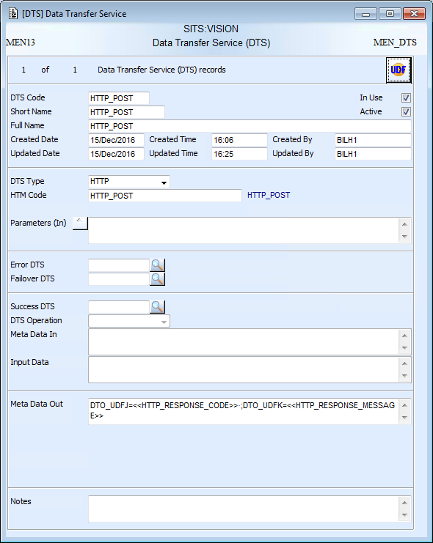
Data Transfer Service
DTS holds the configuration for data transfer
DTS type defines how the transfer will run:
HTTP
SOAP
File
Email
Operation
SQL DB Connector
Data/tokens can be passed into the transfer configuration
The code needing to specified will change depending on the DTS type selected
Error, failover and success DTS can be used to link DTS processes together
Data can be mapped from the transfer back onto the DTO record

Slide 48
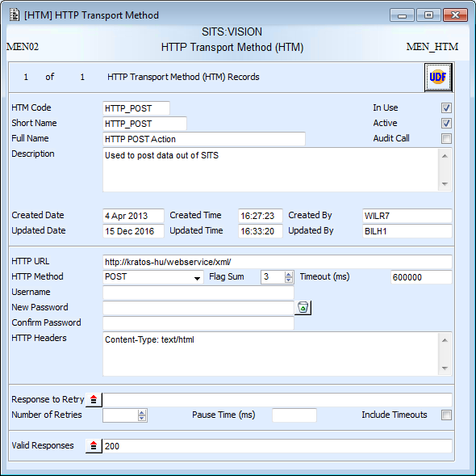
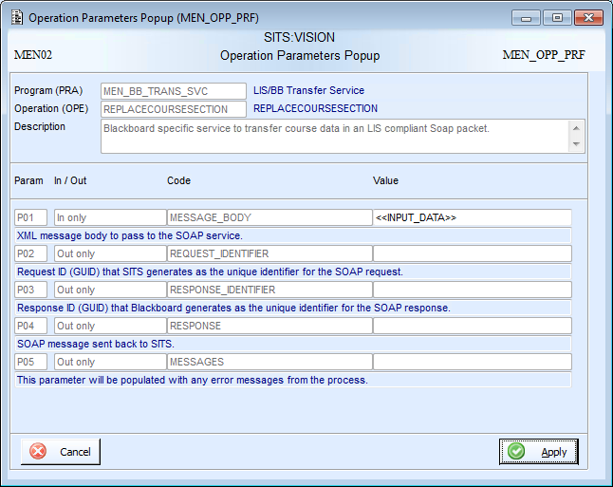
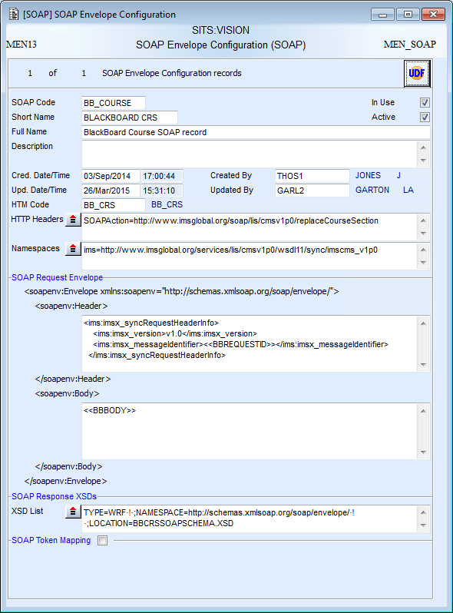
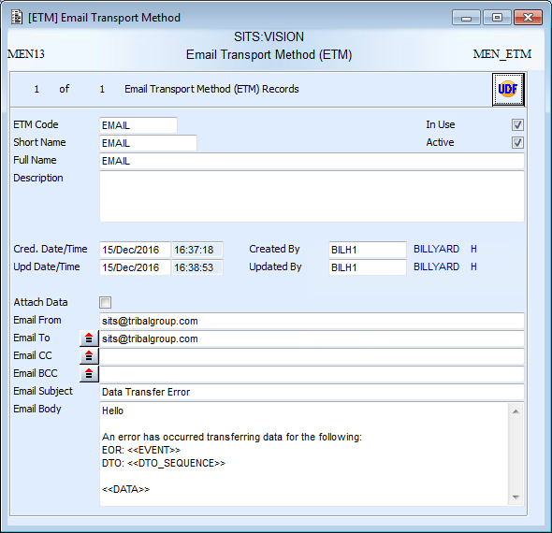
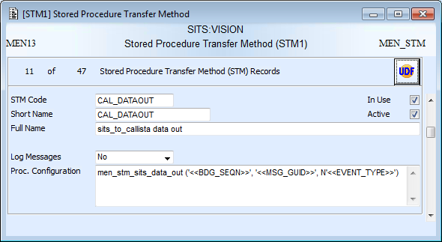
Data Transfer Service
HTTP
Operation
HTM auditing creates HAT records. These can be cleaned up using the ‘HTM Audit’ tab on XACU
SOAP
Email
SQL DB Connector

Slide 49
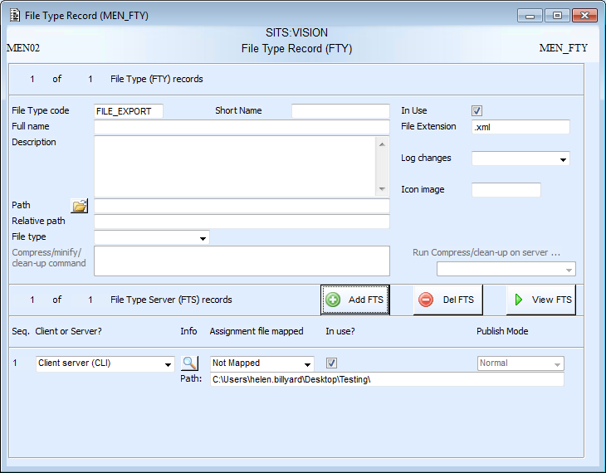
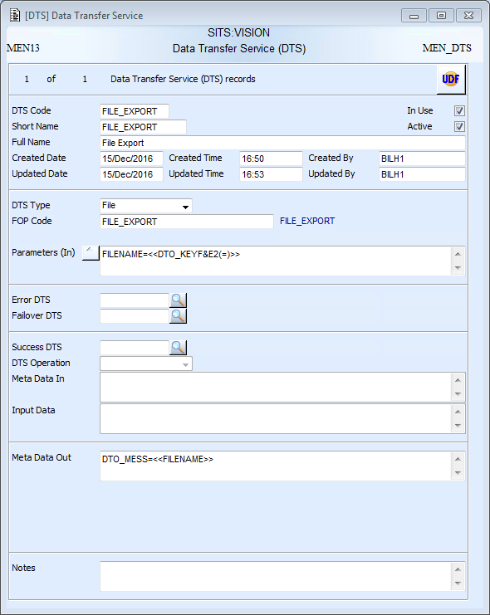
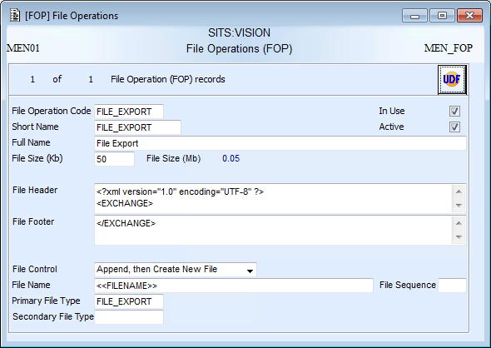
File Transfer
File extension for the file that will be created
DTS type set to file and FOP code specified
FILENAME token set
When using append, set the file size, file headers and file footers. The XML declaration and outer tags must be removed from XET to prevent them appearing repeatedly.
Path for the file transfer
FILENAME token passed in – tokens don’t have to be used but allow the file name to be more dynamic
File control set to append. Create new file is covered in the foundation course
Filename created mapped back to DTO
FTY code specified – only a primary FTY is needed for export

Slide 50
Success, Error and Failover DTS
Success, Error and Failover DTS can be used to chain DTS processes together, i.e. when something needs to take place of the back of the successful or failed transfer.
Success DTS
Runs another DTS off the back of a successful transfer
Error DTS
Runs another DTS when the original DTS is not successful
Recommended to be an email
Failover DTS
Runs another DTS to transfer data when the original fails
Can be used as a back up transfer, i.e. to another server

Slide 51
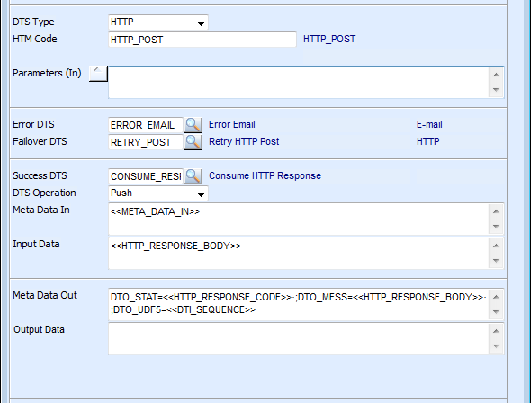
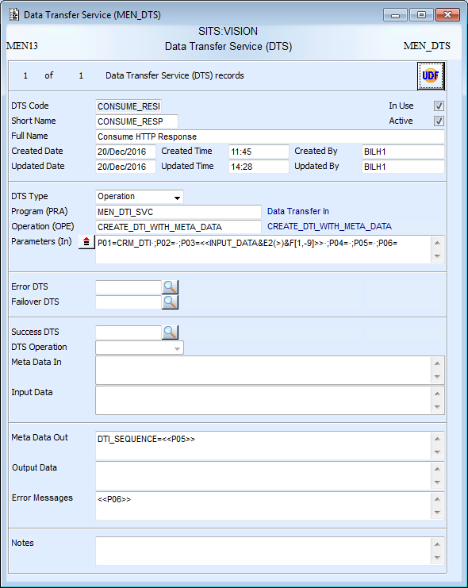
Success DTS
Input data is set on the original DTS to the HTTP Response Body and referenced on the Success DTS
P05 is mapped to the DTI_SEQUENCE token on the Success DTS, which is mapped in DTO_UDF5 on the original DTS.
Success DTS is being used to create a DTI record containing information from the HTTP Response Body.

Slide 52
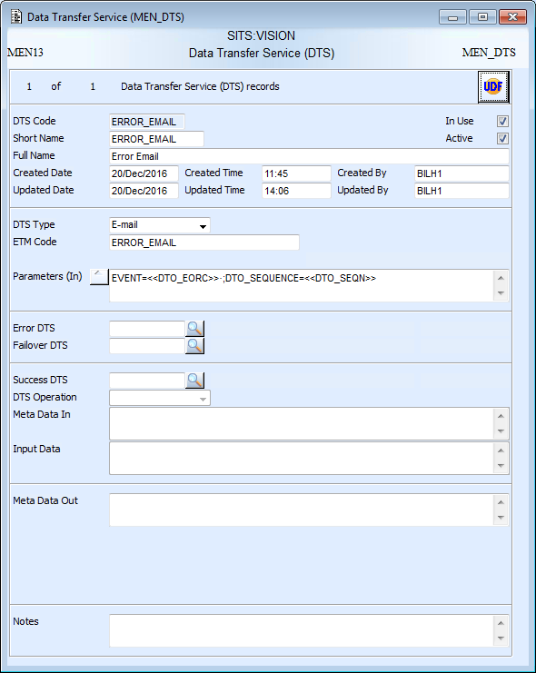
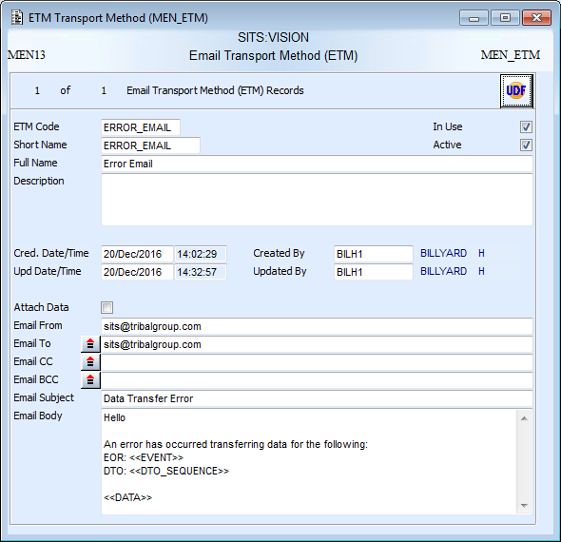
Error DTS
Tokens are created to map to data on the DTO. These are referenced on the ETM record
Error DTS is being used to send error alert emails when a transfer fails.

Slide 53
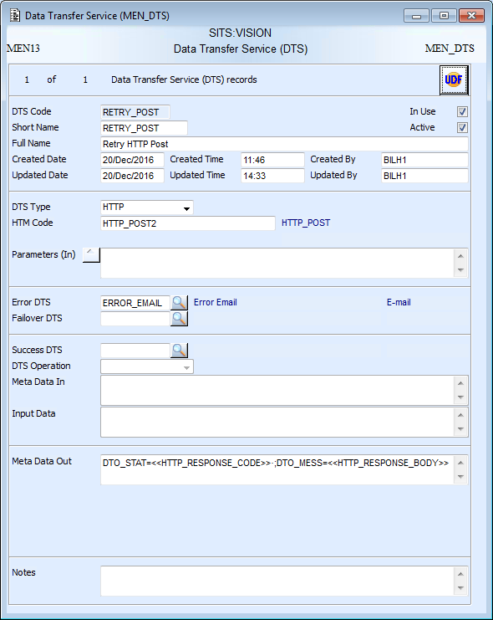
Failover DTS
Outputs from the HTTP Transfer Method are mapped back to the DTO record
Failover DTS is being used as a back up HTTP transfer if the first one fails.

Slide 54
Exercise 8
Create publish transfer out configuration and run Stu-Talk monitors

Slide 55
Subscribe
Event Records
Configuration
Records
Monitors
3rd Party System or Middleware
DTI Monitor
‘Ready for Consumption’ DTI
HTM, STM, SOAP, OPE, FOP
TIC
DTS
DCM Monitor
‘Consumption Complete’ DTI
TIC
XET or PRA
Changes to SITS records

Slide 56

Data Transfer In (DTI)
Status reflects where the record is in the process
Transfer-In-Class (TIC) code holds configuration for data transfer in and data consumption
Sequences of connected CMD records
Imported data packet

Slide 57


Transfer-In-Tray Class (TIC)
TIC contains the configuration for data transfer in (DTI) and data consumption (DCM)
Must be set to version ‘Stu-Talk 2.0’
Message group to connect the configuration to the monitors
Controls what happens when errors occur:
Continue
Move onto next rule
Stop
Note: ‘Continue’ is not available for transfer
Data consumption can use XET or a Tribal defined exposed operation.
Control whether an XET import is a create/update or delete
Configuration for data transfer is held in an attached DTS

Slide 58

Data Transfer Service
DTS holds the configuration for data transfer
DTS type defines how the transfer will run:
HTTP
SOAP
File
Operation
SQL DB Connector
The code needing to specified will change depending on the DTS type selected
Error, failover and success DTS can be used to link DTS processes together
Data can be mapped from the transfer back onto the DTI record

Slide 59



Data Transfer Service
HTTP
Operation
SOAP
Email
SQL DB Connector
Email is not available for transfer in

Slide 60




File Transfer
File extension for the files to be picked up
DTS type set to file and FOP code specified
File extension for the files to be picked up
Primary file type
Secondary file type
FTY codes specified – files are picked up from the primary FTY and moved to the secondary FTY when processed. If no secondary FTY is specified the file is deleted.
Path for the file transfer
File control is not needed
Path to move process file to
Filename used as a retrieve profile to pick files up
Overwrite controls what happened if there is already a file with the same name in the secondary FTY.
Name of the imported file mapped back to DTI

Slide 61
Exercise 9
Create subscribe transfer in configuration

Slide 62



Consuming using an Operation: Simple
Data can be consumed into SITS using a Tribal provided OPE.
This example consumes data using the Document Manager service.
Operation and parameters are specified on TIC
Pop-ups are available to setup the parameters and specify which contain the success/failure messages and meta data.

Slide 63



Consuming using an Operation: Complex
Operation and parameters are specified on TIC
Data can be consumed into SITS using a Tribal provided OPE.
This example consumes data using an OPE and also utilises success DTS.
The OPE called is MEN_DTS_SVC, PUSH_DATA. This triggers the first DTS below, which then calls the second DTS.
It is being used to chain operations together.
1. Transforms data into SITS format
2. Consumes data into SITS records

Slide 64


Step 1: Transform Data
The first DTS calls the MEN_TVT_SVC, PERFORM_TVT operation. This is used to transform the data stored on DTI into the required SITS format.
The transformed data which is held in P03 is then passed as in data into the success DTS.
The MESSAGE token is set on the second DTS, and it is then mapped in the DTI_MESS field.
TVT can be used to transform, validate and translate data

Slide 65

Step 2: Consume Data
The second DTS calls the API_PERSON, IMPORT_STUDENT_IDENTITY operation. The transformed data is passes into the operation and creates an MAI record.
The INPUT_DATA token passes in the transformed data. Any error messages in P04 are output into the MESSAGES token.
MAI record created using the IMPORT_STUDENT_IDENTITY operation.

Slide 66
TRAINER DEMO
Run subscribe using an operation for consumption

Slide 67
Exercise 10
Create subscribe consumption configuration

Slide 68
Exercise 11
Run the subscribe process

Slide 69
Stu-Talk Exposed Operations
MEN_DTO_SVC
MEN_DTI_SVC
MEN_DCE_SVC
CREATE_DCE_CTS
APPEND_DATA_BY_SEQUENCE
CREATE_DTI
CREATE_DTI_WITH_META_DATA
CREATE_DTO
CREATE_DTO_MULTIPLE
CREATE_TRANSFER_DTO
CREATE_UNDER_CONSTRUCTION_DTO
GET_DATA_BY_SEQUENCE
GET_DATA_BY_UNIQUE_ID
GET_NEXT_BY_UNIQUE_ID
GET_NEXT_READY_SET_TO_AC
GET_NEXT_READY_SET_TO_COMPLETE
REPLACE_DATA_BY_SEQUENCE
RESET_ERRORED_TO_TRANSFER
RESET_NEXT_READY_FOR_TRANSFER
RESET_TRANSFER_TO_UC_BY_SEQN
SET_TO_COMPLETE_BY_UNIQUE_ID
SET_TO_TRANSFER
Stu-Talk exposed operations can be triggered through SRL or web services and give flexibility.
For example a call to a Stu-Talk web service could drop off a DTI record ready to be consumed into the SITS database.

Slide 70
Stu-Talk Exposed Operations
MEN_CMD_SVC
GET_ERRORED_SUMMARIES
MEN_DTS_SVC
FETCH_DATA
MEN_TVT_SVC
PERFORM_TVT
PUSH_DATA
PUSH_AND_FETCH_DATA
GET_SUMMARIES
GET_MESSAGES_BY_SEQUENCE
MEN_XCMD_SVC
GET_EVENT_OUT_RULE_SUMMARY
GET_MESSAGE_GROUP_COMPARISON
GET_MONITOR_COMPARISON
GET_MONITOR_DETAILS
GET_TRANSFER_IN_CLASS_SUMMARY

Slide 71
Stu-Talk Exposed Operations
MEN_HTM_SVC
SEND_HTTP_REQUEST
API_DATAEXCHANGE
EXPORT
MEN_TVT_SVC
PERFORM_TVT
IMPORT
API_PUBLISH
CREATE_TRANSFER_DTO

Slide 72

MEN_CMD_SVC
GET_ERRORED_
SUMMARIES
Extracts information from retrieved errored CMD records and outputs XML. An XSL can be applied.
GET_SUMMARIES
Extracts information from retrieved CMD records and outputs XML. An XSL can be applied.
Operations can be called through &P to extract data from the CMD records
GET_MESSAGES_
BY_SEQUENCE
Extracts message XML from a single retrieved CMD record. An XSL can be applied.

Slide 73


MEN_CMD_SVC e:Vision Example
The GET_SUMMARIES operation plugged into an SRL and tasking. An XSL is used to convert the XML into HTML.

Slide 74
Exercise 12
Create and run the clean-up monitor

