Slide 1
Stu-Talk Web Services

Slide 2
Course Pre-Requisites
Stu-Talk Foundation: Data Exchange and Publish & Subscribe
Knowledge of HTTP, SOAP and REST

Slide 3
Goals of this Training
This training will cover Stu-Talk Web Services including Web Service Functions, REST Web Services and Web Service Manager. The goal of the day is to leave with a firm understanding of the following:
Setting up web services and the different functions available
Testing web services within SITS
Testing web services externally
The different types of web service that can be set up in SITS

Slide 4
Stu-Talk Responsibilities

Slide 5
What are Stu-Talk Web Services?
Allow SITS functionality to be exposed
The specified functionality can be called by 3rd party systems
Web services can be setup to use HTTP, SOAP or REST
Access to web services is controlled through role groups
Multiple versions of web services - All new build should be done using WSF

Slide 6
Web Services
A web service is a service offered by an electronic device to another electronic device, communicating with each other via the World Wide Web.
Standardised way of integrating web-based applications
Technology such as HTTP, is utilised for machine-to-machine communication, e.g. server to server.
SOAP (Simple Object Access Protocol) over HTTP may also be used
Or Representational State Transfer (REST) or RESTful
SITS Data
External System
Stu-Talk Web Services
Request
External System
Response

Slide 7
Access to Web Services

Slide 8
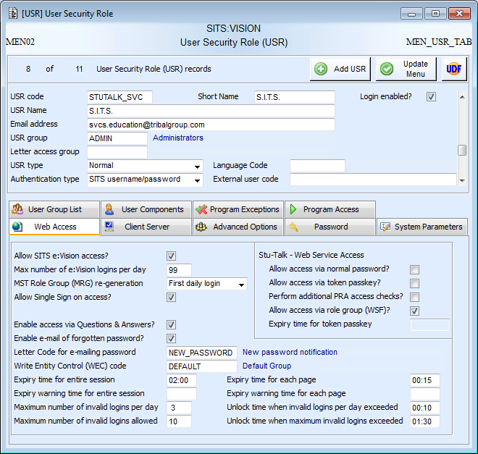
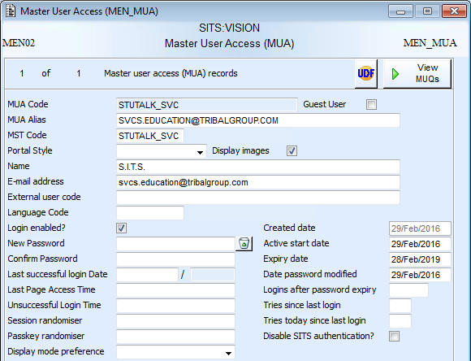
User Security Role (USR)
To call the web services users must have a USR and an active MUA record.
A Stu-Talk or integration user is normally setup with appropriate access.
Supported authentication types are:
SITS (uses MUA password)
LDAP Type 1
LDAP Type 2
The combination types cannot be used.
‘Allow access via role group (WSF)’ MUST be set on USR. The other options are for WSO which will be de-supported from 9.4.0.

Slide 9
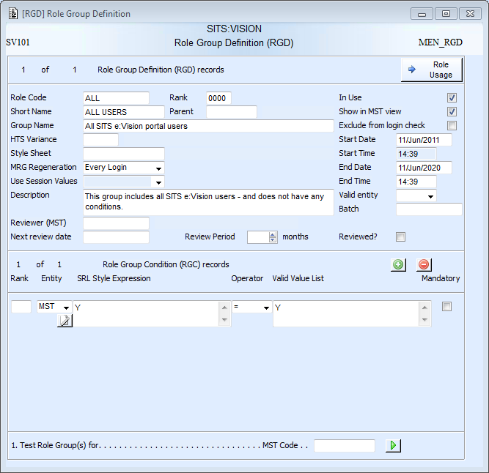
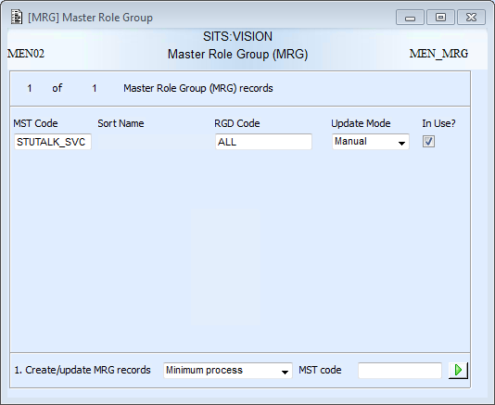
Role Groups
Once a user has been given access to run the web services, they get access to specific web service functions through role groups

Slide 10
Exercise 1
User and Role Groups

Slide 11
Logicals
WSF_SOAP_
SHA512_HASHKEY
Used as a security check – the hash key passed by the 3rd Party must match the one generated in SITS
Default value: <<USER>><<PASSWORD>>|SITS| <<FUNCTION>>|VISION|<<PARAMETERS>><<INDATA>>
WSF_HTTP_
SHA512_HASHKEY
Used as a security check – the hash key passed by the 3rd Party must match the one generated in SITS
WSF_
TRACEMODE
Enables additional messaging
Can contain tokens or literal values
‘SITS’ and ‘VISION’ should be changed to something unique to your institution
Client and web server logicals must be identical
Default value: <<AUTH_HEADER>>|SITS|<<QUERY_STRING>>|VISION|<<MESSAGE>>
Can contain tokens or literal values
‘SITS’ and ‘VISION’ should be changed to something unique to your institution
Client and web server logicals must be identical
<<AUTH_HEADER>> contains a base 64 encoded value of Basic <username>:<password>
<<QUERY_STRING>> contains function=<WSF_CODE>
<<MESSAGE>> contains the input data
Can be useful to identify problems
Should not be turned on in a Live system
There is pre-requisite technical setup that must be completed before using the Stu-Talk web services, this includes the logicals below.

Slide 12
Web Service Functions

Slide 13
HTTP Example - Request
The Hypertext Transfer Protocol (HTTP) is the foundation of data communication for the World Wide Web and uses a request-response protocol.
HTTP Request
HTTP Header | POST http://<<BASE_URL>>/urd/sits.urd/run/siw_wsf.http_action? function=STU_COUNT&hash=4A7DFD3523F7FF4AF4918FE0B8D15000CE88E26C0A0BF4D232D87C3573E2E5D5E5D1B0E39C7D761B56F48AD825C121AE5B882DD50C67CF1B5F293E7E49BD8403 HTTP/1.1 Authorization: Basic Qk9ZUDI6MTIzNDU Content-Type: text/xml Content-Length: 18 Host: si930.at.sitsnet.co.uk
HTTP Body | STU_CODE=1600001
Basic authorisation is used where credentials are passed in in the format Basic ‘<<username>>:<<password>>’ and Base64 encoded.

Slide 14
HTTP Example - Response
HTTP Response
HTTP Header | HTTP/1.1 200 OK Cache-Control: no-cache Content-Length: 601 Content-Type: text/html;charset=UTF-8 Expires: Thu, 01 Jan 1970 00:00:00 GMT Server: Microsoft-IIS/7.0 X-Powered-By: ASP.NET Date: Mon, 16 Jan 2017 15:15:00 GMT
HTTP Body | <?xml version="1.0" encoding="UTF-8"?> <response> <status>1</status> <messagebuffer/> <outdata>1</outdata> </response>

Slide 15
SOAP Example
SOAP (Simple Object Access Protocol) is a protocol for exchanging information in the implementation of web services.
HTTP is used as a transport method for SOAP messages.
The SOAP message is an XML document made up of the following:
Envelope
Identifies the XML document as a SOAP message
Mandatory
Header
Contains header information
Optional
Body
Contains call, and response information
Mandatory
Fault
Provides information about errors that occurred while processing the message
Optional
SOAP-ENV: Envelope
SOAP-ENV: Header
SOAP-ENV: Body

Slide 16
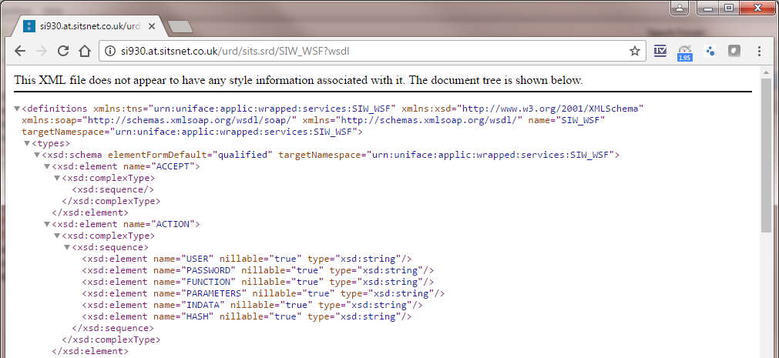
SOAP Example - WSDL
The Web Services Description Language (WSDL) describes the functionality offered by a web service.
Always :
https://<<BASE_URL>>/urd/sits.srd/siw_wsf?wsdl

Slide 17
SOAP Example - Request
SOAP Request
SOAP Envelope Element declaring namespaces | <soapenv:Envelope xmlns:soapenv="http://schemas.xmlsoap.org/soap/envelope/" xmlns:urn="urn:uniface:applic:wrapped:services:SIW_WSF">
SOAP Envelope Header Element | <soapenv:Header/>
SOAP Envelope Body Element | <soapenv:Body>
Start of SOAP Message with application specific namespace | <urn:ACTION>
Username – USR or LDAP | <urn:USER>SITS</urn:USER>
Password – MUA or LDAP | <urn:PASSWORD>12345</urn:PASSWORD>
Web Service Function (WSF) | <urn:FUNCTION>STU_COUNT</urn:FUNCTION>
Parameters specified on WSF – delimited list | <urn:PARAMETERS/>
In data specified on WSF – delimited list | <urn:INDATA>STU_CODE=1600001</urn:INDATA>
SOAP SHA512 Hash Key | <urn:HASH>8E6D0BE54E4A58A1FF313EED7279F9094A28D8E763F661818CB271C3B130F2DFF18CC77A13A90D5B198A3CC0AA590349F50D162E504F8B 89B161268CB0F490C</urn:HASH>
End of SOAP Message | </urn:ACTION>
End of SOAP Body Element | </soapenv:Body>
End of SOAP Element | </soapenv:Envelope>

Slide 18
SOAP Example - Response
SOAP Response
SOAP Envelope Element declaring namespaces | <soapenv:Envelope xmlns:soapenv="http://schemas.xmlsoap.org/soap/envelope/" xmlns:xsd="http://www.w3.org/2001/XMLSchema" xmlns:xsi="http://www.w3.org/2001/XMLSchema-instance">
SOAP Envelope Body Element | <soapenv:Body>
Start of SOAP Message with application specific namespace | <ACTIONResponse xmlns="urn:uniface:applic:wrapped:services:SIW_WSF">
Result | <return>1</return>
Out data from function | <OUTDATA>1</OUTDATA>
Any extra messages, including errors | <MESSAGETEXT/>
End of SOAP Message | </ACTIONResponse>
End of SOAP Body Element | </soapenv:Body>
End of SOAP Element | </soapenv:Envelope>

Slide 19
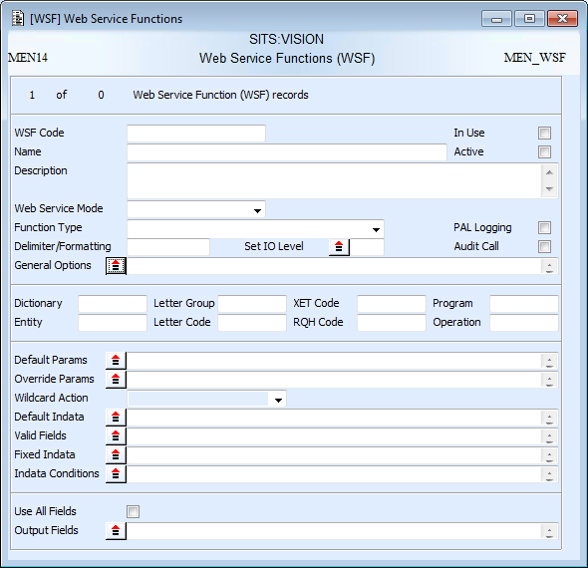
Web Service Functions (WSF)
Function type defines what the web service is doing behind the scenes
Web service mode can be SOAP/HTTP or REST
WSF controls which functions are exposed through web services.
Defines in data to be supplied and the output.
Delimiter is used to separate in data when calling the web service
Additional messaging and auditing can be switched on
In data and parameters are specified differently depending on the chosen function
Options defined here will depend on the function type chosen
Some function require an output to be defined

Slide 20
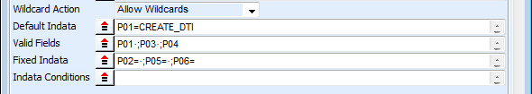
How the In Data Fields work
The in data options work in conjunction
Wildcard Action
Allow wildcards
Default Indata
Values used if a ‘valid field’ is not provided when the web service is called
Valid Fields
The in data which must be provided when the web service is called
Fixed Indata
These are used when an item of in data will always have the same value
Do not allow wildcards
Ignore wildcard conversion - treats a gold character as a literal value and is not available for all function types.
Defines how gold values in the in data is treated
These are not provided in when the web service is called

Slide 21
In Data Example
WSF Setup:
1
2
Indata provided when calling the web service:
P03=<xml>testing data</xml>##P04=DTO_UDF1=Web Service Drop-off
Combined indata passed into the function:
3
P01=CREATE_DTI·;P02=·;P03=<xml>testing data</xml>·;P04=DTO_UDF1=Web Service Drop-off·;P05=·;P06=

Slide 22
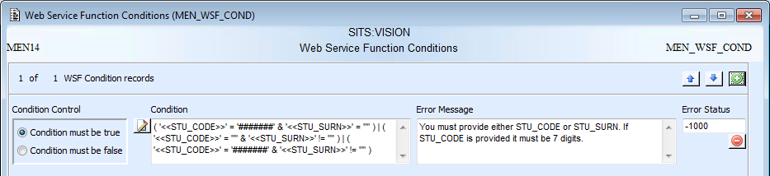
In Data Conditions
Specify whether the condition must be true or false to pass
Conditions can be defined to control the values entered into the in data and to output custom error messages and statuses when these are not met
Specify the condition.
This condition ensures that either the student code or surname must be provided and states that:
The student code must be 7 digits and the surname must be blank OR
The student code must be blank and the surname must be any value OR
The student code must be 7 digits and the surname must be any value
Specify custom error messages and statuses

Slide 23
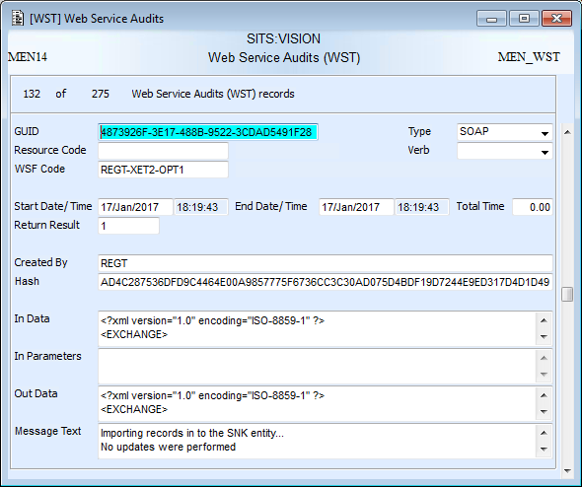
Web Service Audits (WST)
WST records can be cleaned up using the ‘Web Service Audits’ tab on XACU
If WSF auditing is on, a WST record will be created to record the details of the web service call

Slide 24
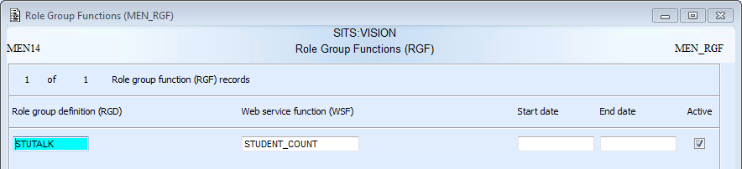
Role Group Functions (RGF)
RGF attaches the role groups to the web service functions (WSF) and defines who can access the web service.

Slide 25
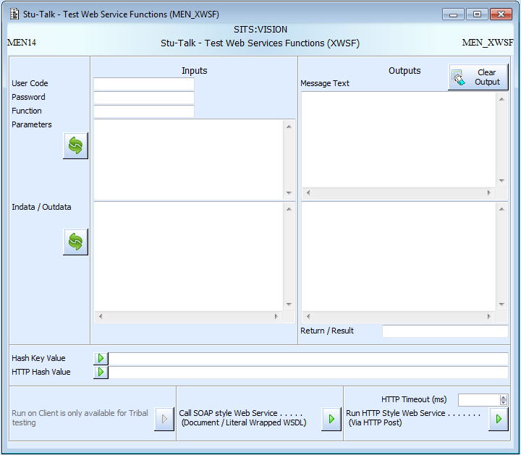
Testing through XWSF
Enter e:Vision or LDAP credentials
Any outputted message text
Specify WSF code
XWSF can be used to test web service configuration and generate SHA512 hash keys
Enter any parameters or in data that is required by the WSF. The convert buttons will convert uniface format to JSON format.
Output data or HTTP response body
Returned status code. Will be the number of records affected or HTTP code. Negative statuses represent errors.
Hash keys will be calculated automatically
Runs SOAP and HTTP style calls.

Slide 26
Using Wildcards
Wildcards within SITS are ‘gold’ characters
‘Gold’ characters are not known outside SITS, therefore they must be substituted with the following in a web service call
Gold Character | Web Services Wildcard
·* | +*
·? | +?
·| | +|
·= | +=
·& | +&
·> | +>
·< | +<
·! | +!

Slide 27
Using JSON
To use JSON format the delimiter on the WSF must be set to JSON or JSON2
In data and parameters must be in JSON format
Will not get JSON output if using an XML formatted XET
JSON2 Delimiter
Newer version of a SITS Uniface list to JSON conversion format, this will format non associate lists as a single array of values ( [NAME1,NAME2] )
[
{
"000001": {
"TITLE": "MR",
"FORNAME": "STERLING",
"SURNAME": "ARCHER"
}
}
]
JSON Delimiter
Old version of SITS Uniface list to JSON conversion, this format outputs non associate lists as { value : value }
[
{
"SURNAME": "SMITH",
"FORNAME": "JOHN",
"TITLE": "MR"
}
]

Slide 28
Function Types
COUNT
Counts the number of records matching a retrieve criteria
DELETE
Deletes a single record
GET_FLD
Gets a single field for single or multiple records
GET_REC
Gets all the fields for a record
GET_VREP
Gets a value=representation list for single or multiple records
INFO
Returns the server information
INSERT
Inserts a single record
GET_LIST
Gets a list of fields for single or multiple records

Slide 29
Function Types
OPE
Runs a Tribal defined operation (OPE) – from 9.2.0
PWD
Change an MUA password
RQH
Runs an Report Query Header (RQH) – SQL
RUN
Run a process (older version of OPE)
SRL
Generate a Standard Letter (SRL)
UPDATE
Update a single record
XET_DEL
Delete using Exchange Templates (XET)
XET_EXP
Export using Exchange Templates (XET)
XET_IMP
Import using Exchange Templates (XET)

Slide 30
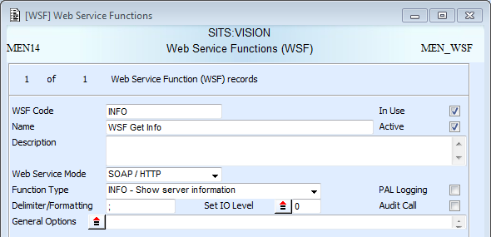
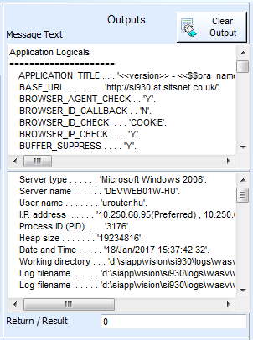
INFO
INFO is used to return server information and is useful for testing the technical setup is correct
Web service mode needs to be ‘SOAP/HTTP’ to be called through WSF
Function type needs setting to INFO

Slide 31
Exercise 2
Setup an INFO web service

Slide 32
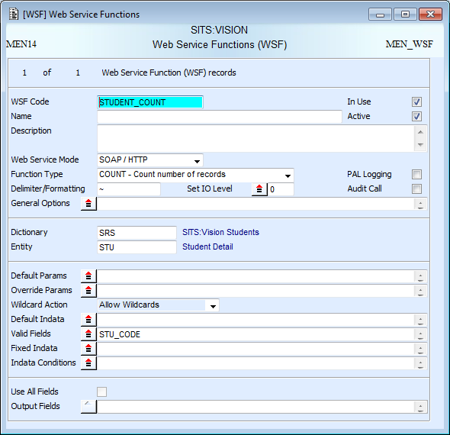
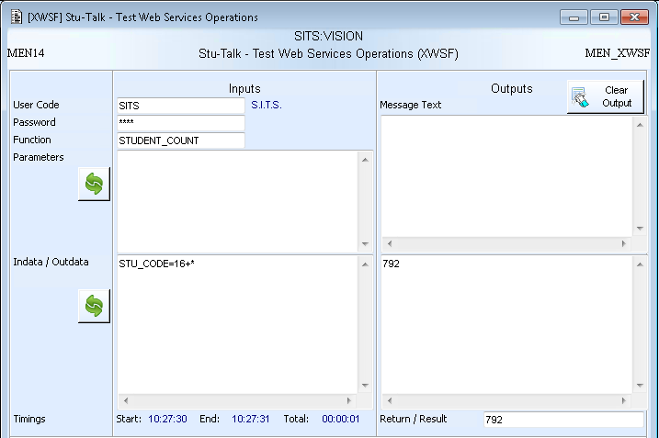
COUNT
Entity being counted needs specifying
COUNT returns the number of records that match a defined criteria
In data needs to be set and can use any of the in data options

Slide 33
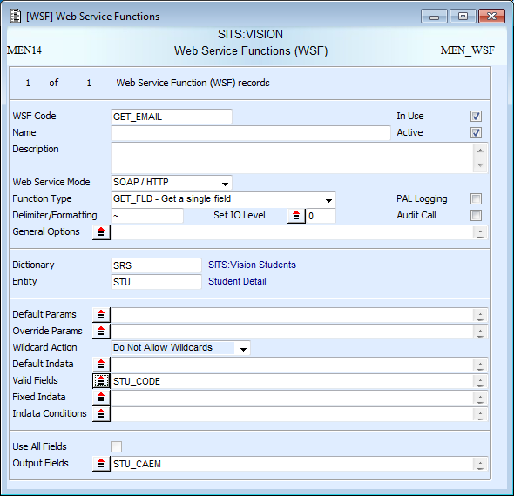
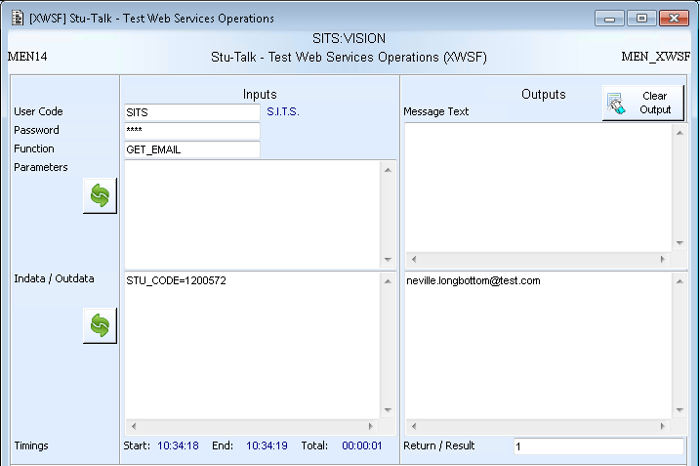
GET_FLD
Entity being queried needs specifying
GET_FLD returns the specified field for the retrieved records. If multiple records are retrieved, results will be separated using the WSF delimiter.
Output field needs specifying
In data needs to be set and can use any of the in data options

Slide 34
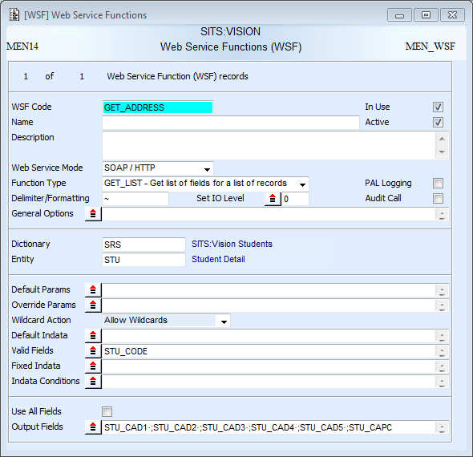
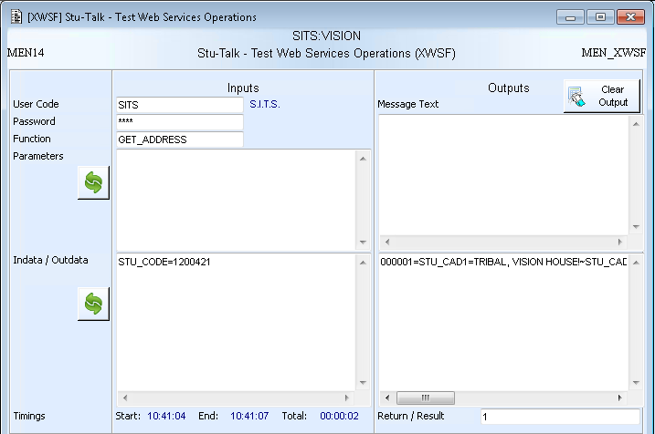
GET_LIST
Entity being queried needs specifying
GET_LIST returns the specified list of fields for the retrieved records. If multiple records are retrieved, results will be separated using the WSF delimiter.
Output fields need specifying
In data needs to be set and can use any of the in data options

Slide 35
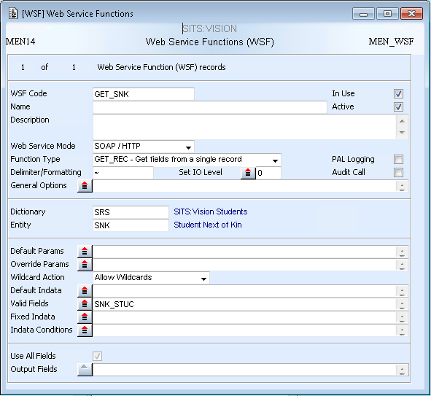
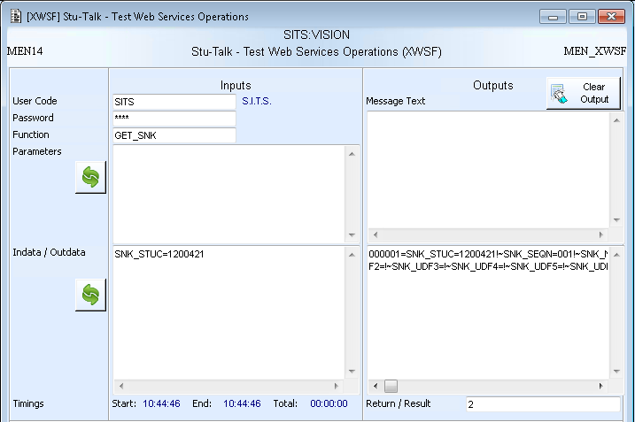
GET_REC
Entity being queried needs specifying
GET_REC returns all the fields for the retrieved records. If multiple records are retrieved, results will be separated using the WSF delimiter.
Output is set to all fields
In data needs to be set and can use any of the in data options

Slide 36
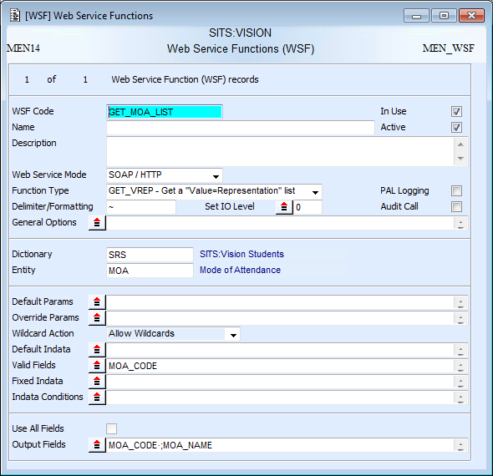

GET_VREP
Entity being queried needs specifying
GET_VREP returns the specified fields in a “field 1=field 2” format. If multiple records are retrieved, results will be separated using the WSF delimiter.
Output is set to the 2 fields to be returned
In data needs to be set and can use any of the in data options

Slide 37
Exercise 3
Setup a GET_LIST web service using wildcards

Slide 38
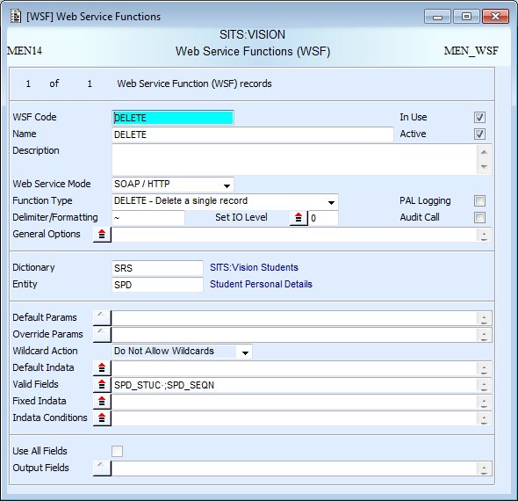
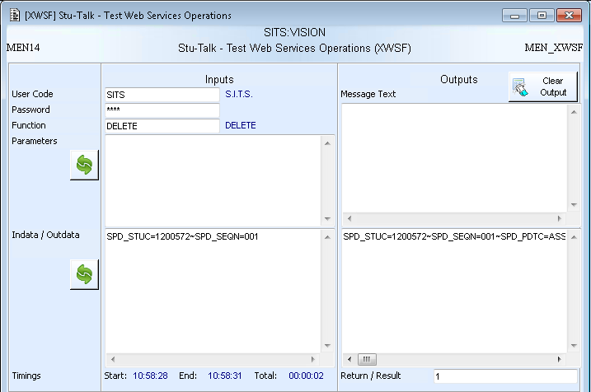
DELETE
Entity being deleted needs specifying
DELETE is used to delete a single record and returns all the fields of the deleted record
In data needs to be set and can use any of the in data options. This must only retrieve one record for a delete.

Slide 39
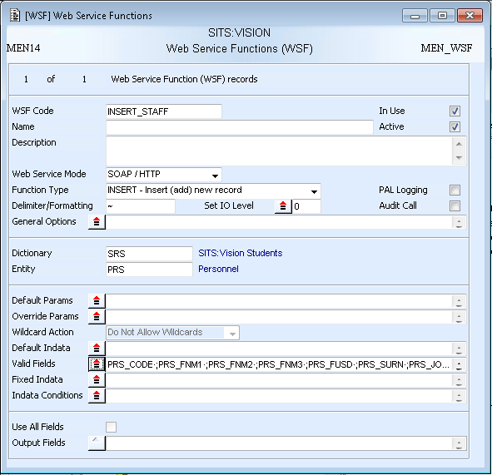
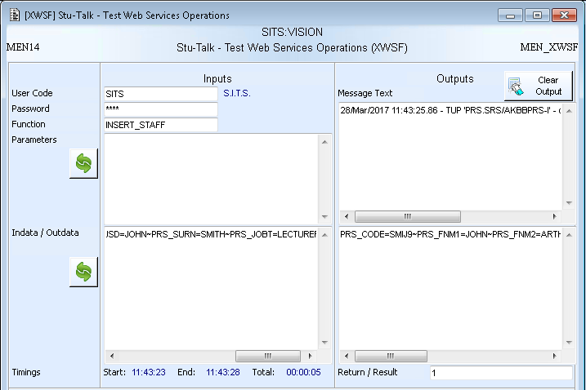
INSERT
Entity being inserted needs specifying
INSERT is used to insert a single record and returns all the fields set on the inserted record
Switches can be defined in the parameters:
VALIDATE: (Y/N) Turns on the validation.
FIELD_IGNORE_LIST: (FLD_CODE) excludes individual fields from the validation.
LOOKUP_IGNORE_LIST (FLD_CODE) excludes lookups from the validation.
ENTITY_IGNORE_LIST (ENT.DCT) excludes entire entities from the validation.
In data needs to include all the fields that need to be set on the newly inserted record

Slide 40
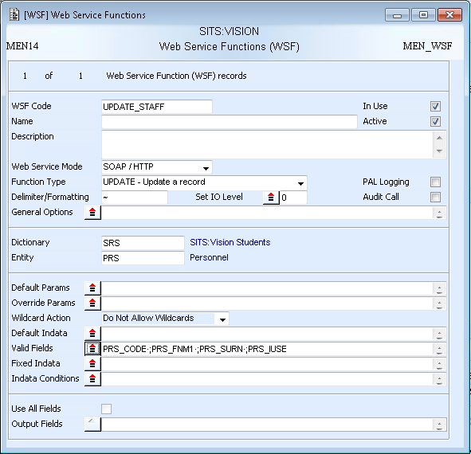
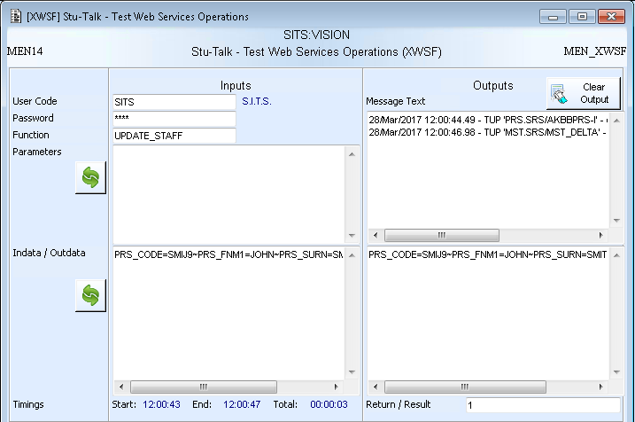
UPDATE
Entity being updated needs specifying
UPDATE is used to update a single record and returns all the fields set on the updated record
Switches can be defined in the parameters:
VALIDATE: (Y/N) Turns on the validation.
FIELD_IGNORE_LIST: (FLD_CODE) excludes individual fields from the validation.
LOOKUP_IGNORE_LIST (FLD_CODE) excludes lookups from the validation.
ENTITY_IGNORE_LIST (ENT.DCT) excludes entire entities from the validation.
In data needs to include the primary key to retrieve the record and any fields to update

Slide 41
Exercise 4
Setup an UPDATE web service using JSON

Slide 42
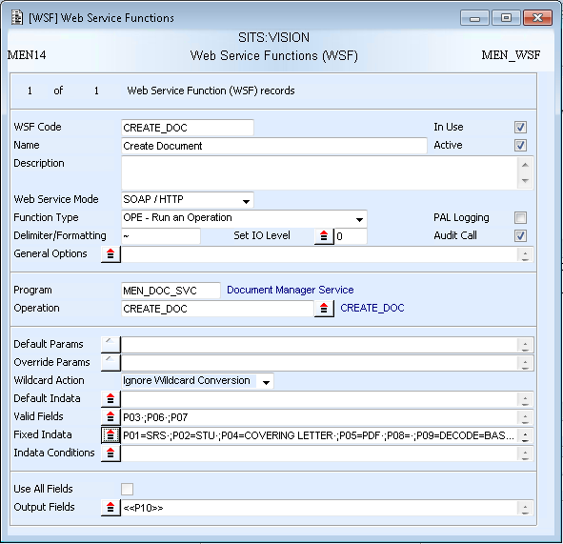
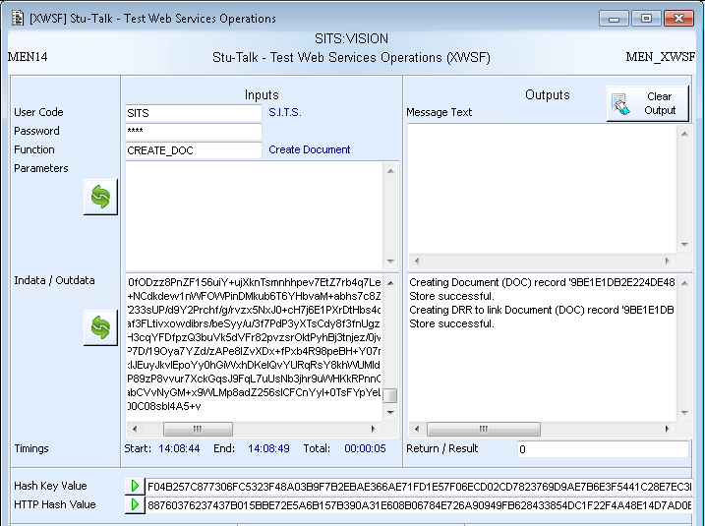
OPE
Program and operation need specifying
OPE allows any ‘in-use’ operations in the OPE table to be called through a web service.
Parameters for the operation need to be set and can use any of the in data options
Output parameter needs specifying

Slide 43
Exercise 5
Setup an OPE web service

Slide 44
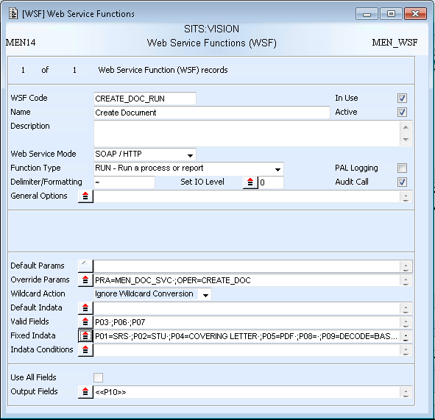
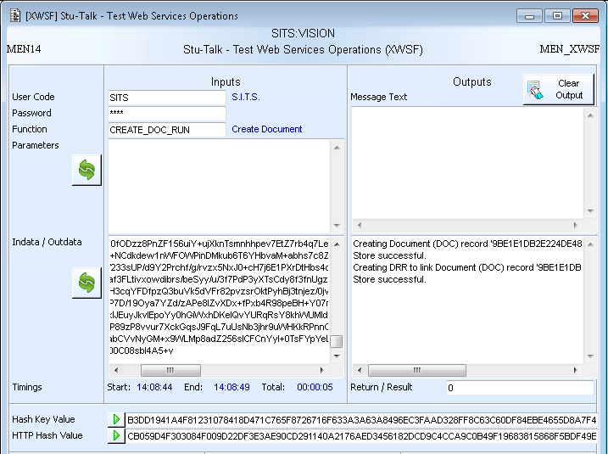
RUN
Program and operation need specifying
RUN is an older version of OPE. It allows operations to be run but is not validated against the OPE table.
Parameters for the operation need to be set and can use any of the in data options
Output parameter needs specifying

Slide 45
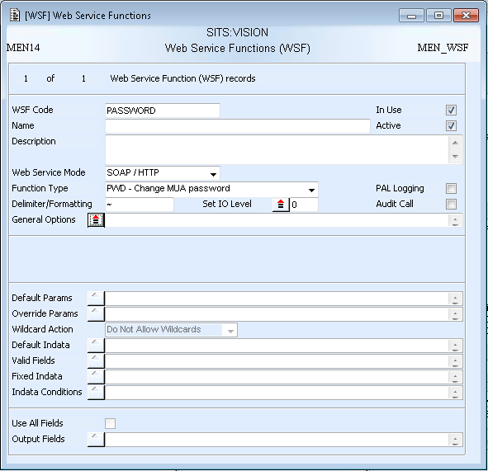
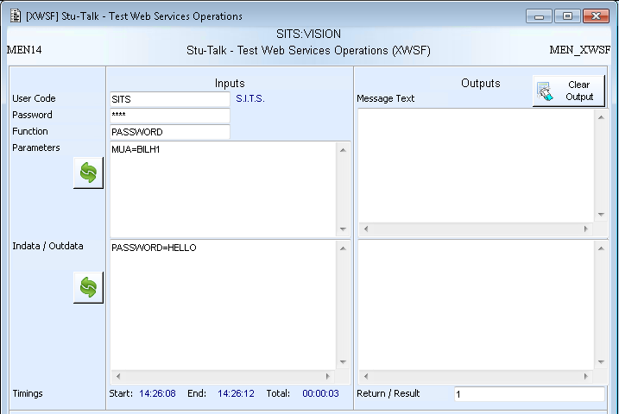
PWD
PWD allows the MUA password for a specified MUA to be changed.
Function type needs setting to PWD

Slide 46
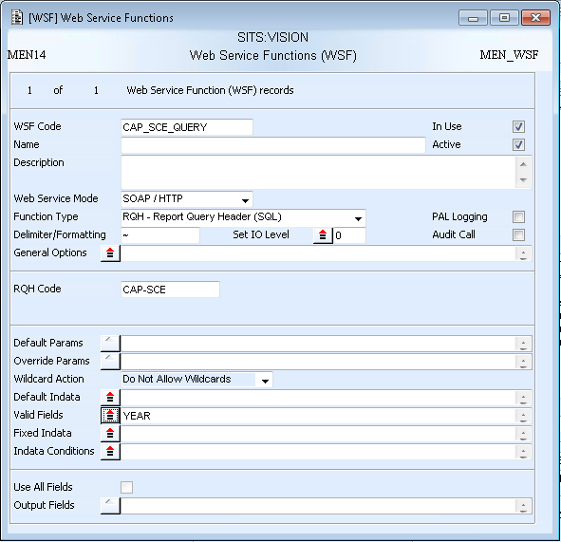
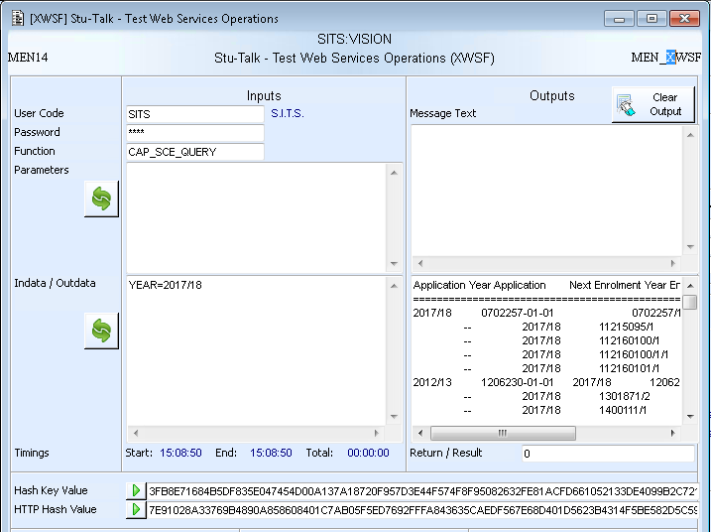
RQH
RQH code needs specifying
RQH allows SQL queries stored within SITS to be run. RQH is recommended for select statements only.
Any RQH tokens get passed in through the in data

Slide 47
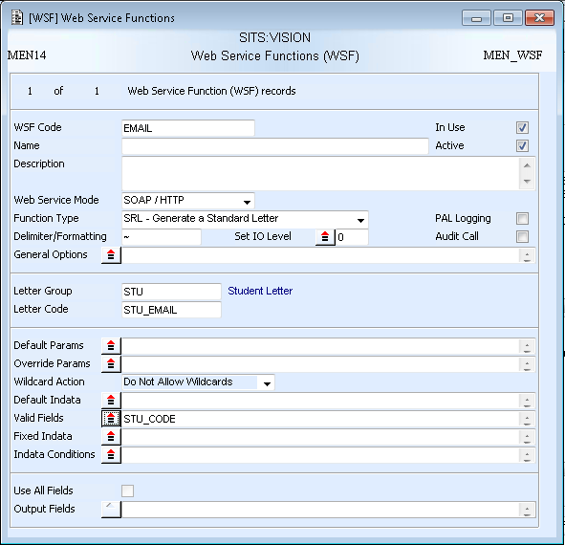
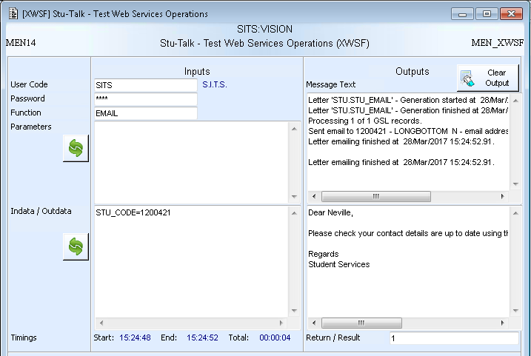
SRL
SLG and SRL code need specifying
SRL allows standard letters to be run.
Criteria to run the SRL is passed through in data. This cold retrieve single or multiple records.

Slide 48
Exercise 6
Setup an SRL web service using indata conditions

Slide 49
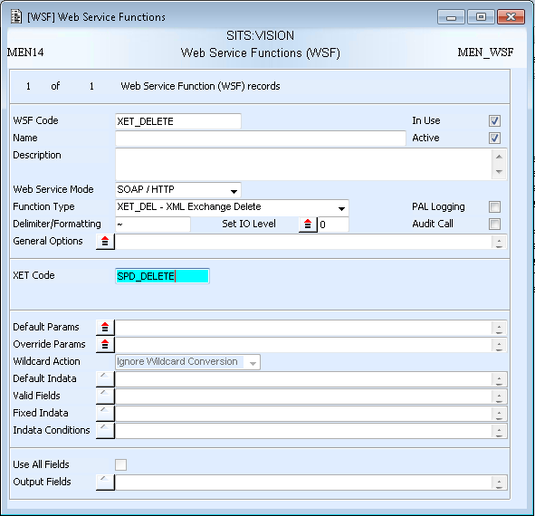
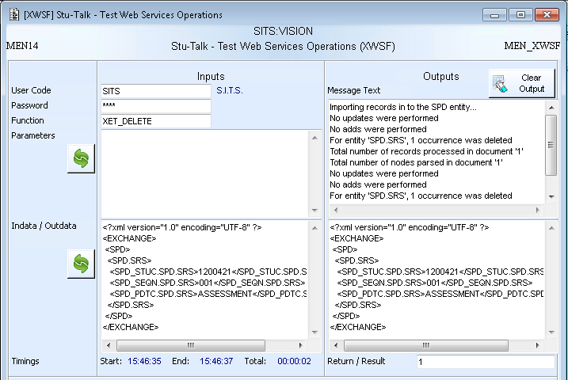
XET_DEL
XET_DEL allows data to be deleted from SITS using an XET template. Primary key must be passed in.
XET code needs specifying

Slide 50
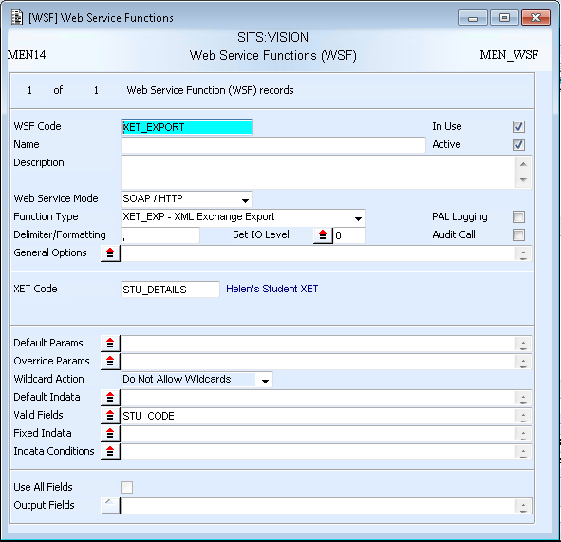
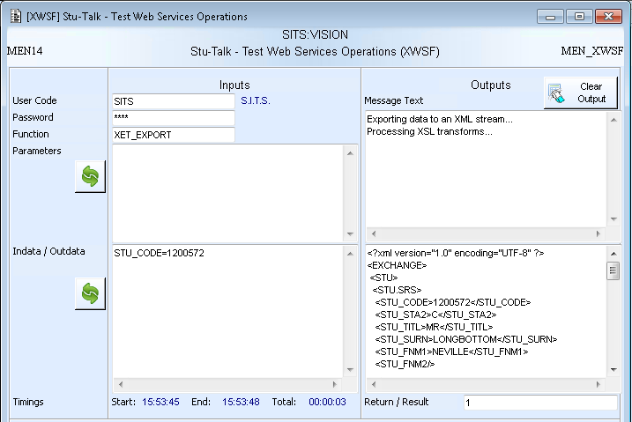
XET_EXP
XET_EXP allows data to be exported from SITS using an XET template.
XET code needs specifying
Retrieve criteria is passed in using in data

Slide 51
Exercise 7
Setup an XET Export web service

Slide 52
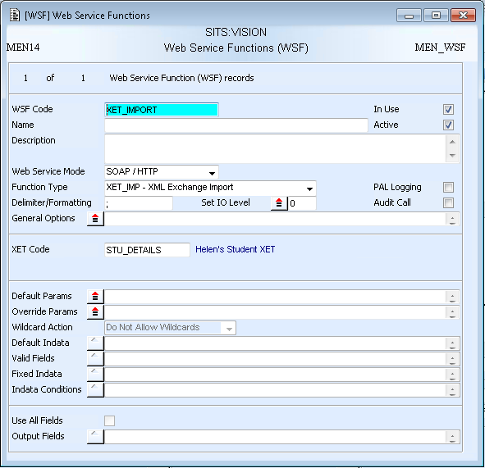
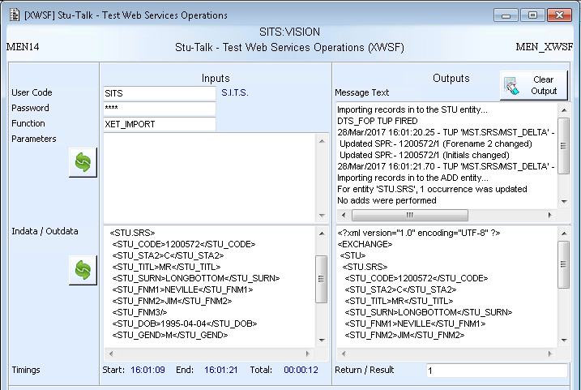
XET_IMP
XET_IMP allows data to be imported into SITS using an XET template. Primary key must be passed in, apart from when the XET calculates a sequence number on create.
XET code needs specifying

Slide 53
Exercise 8
Setup an XET Import web service

Slide 54
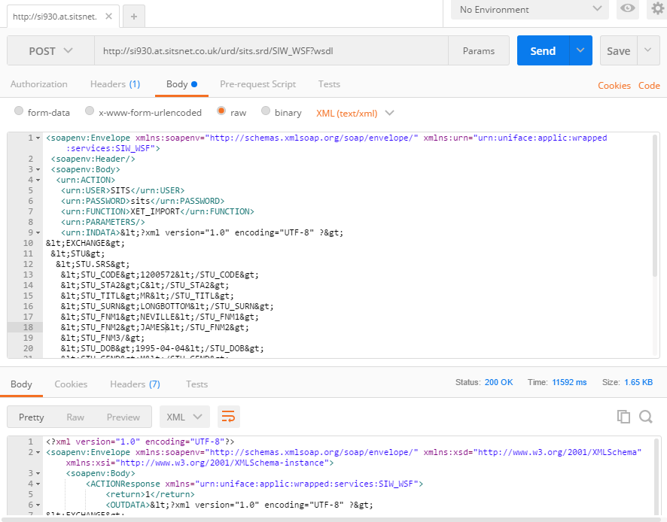
Testing WSF Externally
3rd party applications such as Postman or SOAP:UI can be used to test WSF functionality.
SOAP example where the URL is the WSDL and the SOAP envelope is sent in the body as text/xml.

Slide 55
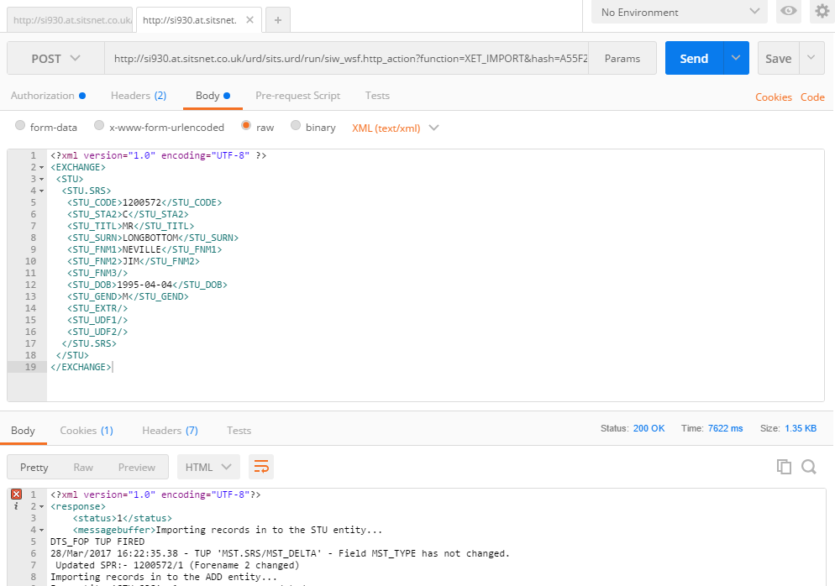
Testing WSF Externally
3rd party applications such as Postman or SOAP:UI can be used to test WSF functionality.
HTTP example where the URL is made up of the WSF endpoint, WSF code and hash value. Headers specify the content type and pass in the username and password using basic authorisation. Any in data is passed in in the body.

Slide 56
OAuth 2.0 Authentication in WSF
Access to WSF web services can be through OAuth 2.0, instead of SITS or LDAP credentials. This uses a tokens for access.
OAuth 2.0 is accessed by calling the WSDL:
http://<<BASE_URL>>/urd/sits.srd/siw_oauth?wsdl
There are 2 operations with SIW_OAUTH
Operation | Description
GRANT_ACCESS_TOKEN | Used to create a token that will grant access to WSF web services
REFRESH_ACCESS_TOKEN | Used to generate another token when the original has expired. Also deactivates the old token.

Slide 57
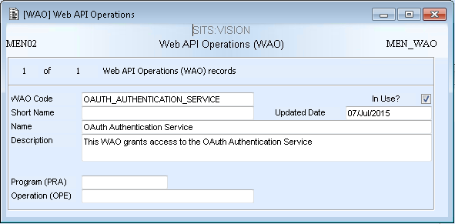
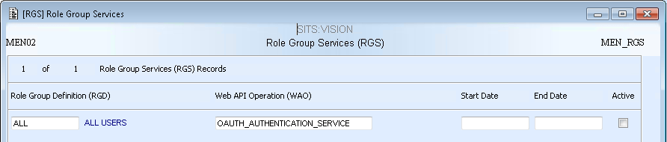
OAuth 2.0 Authentication in WSF
SIW_OAUTH has a Web API Operation (WAO) record is SITS
Access to SIW_OAUTH is controlled via role groups in SITS
Role groups are attached to the WAO through the RGS record.
Users will also be able to use the SIW_OAUTH service if they are part of an assigned role group.

Slide 58
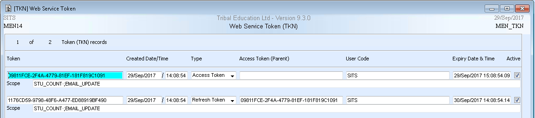
OAuth 2.0 – Grant Access
<soapenv:Envelope xmlns:soapenv="http://schemas.xmlsoap.org/soap/envelope/" xmlns:urn="urn:uniface:applic:wrapped:services:SIW_OAUTH">
<soapenv:Header/>
<soapenv:Body>
<urn:GRANT_ACCESS_TOKEN>
<urn:GRANT_TYPE>password</urn:GRANT_TYPE>
<urn:USERNAME>SITS</urn:USERNAME>
<urn:PASSWORD>sits</urn:PASSWORD>
<urn:TOKEN_SCOPE>STU_COUNT#EMAIL_UPDATE</urn:TOKEN_SCOPE>
</urn:GRANT_ACCESS_TOKEN>
</soapenv:Body>
</soapenv:Envelope>
REQUEST
Grant type is always password. Username and password are MUA credentials. Scope holds the WSF codes of the web services to be accessed.
System parameters control the expiry and list separator – MEN_OAUTH*
<soapenv:Envelope xmlns:soapenv="http://schemas.xmlsoap.org/soap/envelope/" xmlns:xsd="http://www.w3.org/2001/XMLSchema" xmlns:xsi="http://www.w3.org/2001/XMLSchema-instance">
<soapenv:Body>
<GRANT_ACCESS_TOKENResponse xmlns="urn:uniface:applic:wrapped:services:SIW_OAUTH">
<return>0</return>
<ACCESS_TOKEN>nZgwGnokLPWqDWJ/NEsOZHdP4Dy4iXkJU68B+IIh0LzK9nCO0wc561UTYt1O2ofc</ACCESS_TOKEN>
<TOKEN_TYPE>Bearer</TOKEN_TYPE>
<EXPIRES_IN>3600</EXPIRES_IN>
<REFRESH_TOKEN>OunqhU6hfkHPWssfT7/+QN0NJKEUafI7ZflTQNpQAPyjZMr3Q4gwjxSd8pvJYGOS</REFRESH_TOKEN>
</GRANT_ACCESS_TOKENResponse>
</soapenv:Body>
</soapenv:Envelope>
RESPONSE
Token (TKN) records are created in SITS

Slide 59
OAuth 2.0 – Refresh Access
<soapenv:Envelope xmlns:soapenv="http://schemas.xmlsoap.org/soap/envelope/" xmlns:urn="urn:uniface:applic:wrapped:services:SIW_OAUTH">
<soapenv:Header/>
<soapenv:Body>
<urn:REFRESH_ACCESS_TOKEN>
<urn:GRANT_TYPE>refresh_token</urn:GRANT_TYPE>
<urn:REFRESH_TOKEN>OunqhU6hfkHPWssfT7/+QN0NJKEUafI7ZflTQNpQAPyjZMr3Q4gwjxSd8pvJYGOS</urn:REFRESH_TOKEN>
<urn:TOKEN_SCOPE>INFO</urn:TOKEN_SCOPE>
</urn:REFRESH_ACCESS_TOKEN>
</soapenv:Body>
</soapenv:Envelope>
REQUEST
Grant type is always refresh_token. Username and password are MUA credentials. Scope holds the WSF codes of the web services to be accessed – can be reduced from the original token.
RESPONSE
<soapenv:Envelope xmlns:soapenv="http://schemas.xmlsoap.org/soap/envelope/" xmlns:xsd="http://www.w3.org/2001/XMLSchema" xmlns:xsi="http://www.w3.org/2001/XMLSchema-instance">
<soapenv:Body>
<REFRESH_ACCESS_TOKENResponse xmlns="urn:uniface:applic:wrapped:services:SIW_OAUTH">
<return>0</return>
<REFRESH_TOKEN>OunqhU6hfkHPWssfT7/+QN0NJKEUafI7ZflTQNpQAPyjZMr3Q4gwjxSd8pvJYGOS</REFRESH_TOKEN>
<ACCESS_TOKEN>hdodgF3xekMLdBNZI2O9NjHC5fEMRQ325+VtnURdc3f0XxGvRQ+N6lngk0BK1a6F</ACCESS_TOKEN>
<TOKEN_TYPE>Bearer</TOKEN_TYPE>
<EXPIRES_IN>3600</EXPIRES_IN>
</REFRESH_ACCESS_TOKENResponse>
</soapenv:Body>
</soapenv:Envelope>
A new Token (TKN) record of type ‘ Access Token’ is created in SITS.
The old access TKN is deactivated.

Slide 60
OAuth 2.0 – Calling a WSF
When OAuth 2.0 is used to call WSF the normal SIW_WSF WSDL is used, but the SOAP envelope differs:
http://<<BASE_URL>>/urd/sits.srd/siw_wsf?wsdl
<soapenv:Envelope xmlns:soapenv="http://schemas.xmlsoap.org/soap/envelope/" xmlns:urn="urn:uniface:applic:wrapped:services:SIW_WSF">
<soapenv:Header/>
<soapenv:Body>
<urn:OAUTH_ACTION>
<urn:TOKEN>ZZPy6OME5I+YsOGnU6oxLw0UUvU7nqu9V/TfXBIzvZ8DubjMjrN7o5+BywlyHfQB</urn:TOKEN>
<urn:FUNCTION>INFO</urn:FUNCTION>
<urn:PARAMETERS></urn:PARAMETERS>
<urn:INDATA></urn:INDATA>
</urn:OAUTH_ACTION>
</soapenv:Body>
</soapenv:Envelope>
Provide token and then function, parameters and indata as normal.

Slide 61
REST Web Services

Slide 62
REST
REST provides a lighter weight alternative to SOAP.
Instead of using XML to make a request, REST relies on a simple URL in many cases.
REST can use four different HTTP 1.1 verbs (GET, POST, PUT, and DELETE) to perform tasks

Slide 63
Example REST Format
Calls to a Stu-Talk REST Web Service are made to a URL similar to:
If there are multiple indata items on WSF, these can be appended to the URL:
http://www.evision.middleton.ac.uk/urd/sits.urd/run/SIW_RWS/STUDENT/STU_CODE/01230456
SYP SIW_RWS_001 specifies the location URL for REST web services
Resource – represented by a RRS record in SITS
Query string – in data specified on WSF
SYP SIW_RWS_002 can be used to specify any characters substitutions, e.g. where a / would be used in an in data value
…/SNK_STUC/01230456/SNK_SEQN/001
Indata 1
Indata 2

Slide 64
REST Entities
An RRS can have up to 4 RWS records. One for each verb.
Rest Web Service
(RWS)
Web Service Function
(WSF)
GET
Rest Web Service
(RWS)
Web Service Function
(WSF)
POST
Rest Resource
(RRS)
Rest Web Service
(RWS)
Web Service Function
(WSF)
PUT
Rest Web Service
(RWS)
Web Service Function
(WSF)
DELETE

Slide 65
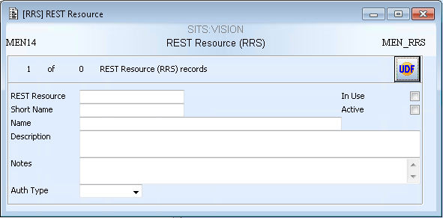
Rest Resource (RRS)
The Resource code forms part of the URL. Do not use characters that cannot be used in URLs, such as /.
MUST be active to be called
RRS defines a Resource that can be called through Stu-Talk Rest Web Services.

Slide 66

REST Web Service (RWS)
Defines the verb uses to call the web service.
Can be:
GET, POST, PUT, DELETE
MUST be active to be called
Custom response messages can be output based on conditions
Defines the WSF attached to the REST web service
RWS defines the actual REST web service.

Slide 67

RWS Response Conditions
3 tokens are available to use in the Response Conditions
Token
<<STATUS>> | Status returned from WSF
<<MESSAGES>> | Any error messages returned from the WSF process
<<RESULTS>> | Result of the WSF call

Slide 68

Testing through XRWS
Specify RRS code and verb
Returned HTTP response code and message
Enter e:Vision or LDAP credentials
XRWS can be used to test REST web service configuration
Query string for GET, PUT and DELETE
Returned HTTP response body containing output data/messages
Request indata for POST and PUT
Runs REST style web service call

Slide 69



REST Example – GET
Web service mode must be REST
RWS is attached to the RRS
Auth type is set to Basic
WSF is attached to the RWS
WSF also has role groups attached via RGF as normal

Slide 70

REST Example – GET
Resource and verb identify the RWS being called
Successful HTTP response returned
e:Vision or LDAP credentials
Fields returned as setup on WSF. Delimiter is the one specified on WSF.
Indata provided in the form of a query string. Indata matches the indata setup on WSF.

Slide 71

REST Example – GET
REST endpoint with query string
Credentials provided using basic authentication in HTTP header
Basic <<username>>:<<password>>
Verb
The REST web services can also be tested externally, using an application such as Postman.
Out data returned in the HTTP body

Slide 72
Exercise 9
Setup a GET REST web service

Slide 73



REST Example – POST
Web service mode must be REST
RWS is attached to the RRS
Auth type is set to Basic
WSF is attached to the RWS
WSF also has role groups attached via RGF as normal

Slide 74

REST Example – POST
Resource and verb identify the RWS being called
Successful HTTP response returned
e:Vision or LDAP credentials
Indata provided in the form of a query string. Indata matches the indata setup on WSF.

Slide 75


REST Example – POST
Verb
REST endpoint
Credentials provided using basic authentication in HTTP header
Basic <<username>>:<<password>>
The REST web services can also be tested externally, using an application such as Postman.
Request Data
HTTP Response

Slide 76
Exercise 10
Setup a POST REST web service

Slide 77

OAuth 2.0 Authentication in REST
Using OAuth 2.0 authentication in REST is very similar to WSF.
The same WAO and RGS records are used.
Auth Type is set to ‘OAuth’

Slide 78
OAuth 2.0 – Grant Access
POST http://<<BASE_URL>>/urd/sits.urd/run/SIW_OAUTH/GRANT_ACCESS_TOKEN/ HTTP/1.1
Content-Type: application/x-www-form-urlencoded
Authorization: Basic Qk9ZUDI6MTIzNDU2
grant_type=password&
scope=STU_COUNT#EMAIL_UPDATE&
username=SITS&
password=sits
REQUEST
The authorization header contains the MUA credentials of the client user who will use the password.
Grant type is always password. Username and password are MUA credentials for the resource owner, who is granting the token. Scope holds the WSF codes of the web services to be accessed.
System parameters control the expiry and list separator – MEN_OAUTH*
{
"access_token": "AW5dxkVmoV5roTMCuskZQyz/0tdbV+Hn8XI4/p5p10TgRAN5Xp+Ed3Qe2y13op95",
"token_type": "Bearer",
"expires_in": "7200",
"refresh_token": "T6ppDFlstyHbbGc16E23T3NAGvVmpOT0RVeM8pM9qF0lJV+3WiN8fpYupyclWi+a"
}
RESPONSE
Token (TKN) records are created in SITS

Slide 79
OAuth 2.0 – Refresh Access
POST http://<<BASE_URL>>/urd/sits.urd/run/SIW_OAUTH/REFRESH_ACCESS_TOKEN/ HTTP/1.1
Content-Type: application/x-www-form-urlencoded
Authorization: Basic Qk9ZUDI6MTIzNDU2
grant_type=refreshtoken&
refresh_token= T6ppDFlstyHbbGc16E23T3NAGvVmpOT0RVeM8pM9qF0lJV+3WiN8fpYupyclWi+a &
scope=STU_COUNT#EMAIL_UPDATE&
REQUEST
Grant type is always refresh_token. Scope holds the WSF codes of the web services to be accessed – can be reduced from the original token.
{
"access_token": "AW5dxkVmoV5roTMCuskZQyz/0tdbV+Hn8XI4/p5p10TgRAN5Xp+Ed3Qe2y13op95",
"token_type": "Bearer",
"expires_in": "7200",
"refresh_token": "T6ppDFlstyHbbGc16E23T3NAGvVmpOT0RVeM8pM9qF0lJV+3WiN8fpYupyclWi+a"
}
RESPONSE
A new Token (TKN) record of type ‘ Access Token’ is created in SITS.
The old access TKN is deactivated.

Slide 80
OAuth 2.0 – Calling a REST web service
When OAuth 2.0 is used to call a REST web service the normal REST endpoint is used
http://<<BASE_URL>>/urd/sits.srd/siw_rws/<<RRS_CODE>>
The verb will be as defined on the Rest Web Service (RWS)
Either a query string or indata will be required depending on the function of the web service.
The token is provided within the HTTP Authorization header, where <<access_token>> is replaced with the token
Authorization: Basic <<access_token>>

Slide 81
Web Service Manager
Specific technical setup is required for web service manager. This is detailed in FAQ 8640.

Slide 82
Web Service Manager versus WSF
WSDL: http://si930.at.sitsnet.co.uk/urd/sits.srd/SIW_WSF?wsdl
SOAP Request:
<soapenv:Envelope xmlns:soapenv="http://schemas.xmlsoap.org/soap/envelope/" xmlns:urn="urn:uniface:applic:wrapped:services:SIW_WSF">
<soapenv:Header/>
<soapenv:Body>
<urn:ACTION>
<urn:USER>SITS</urn:USER>
<urn:PASSWORD>sits</urn:PASSWORD>
<urn:FUNCTION>STUDENT_COUNT</urn:FUNCTION>
<urn:PARAMETERS/>
<urn:INDATA>STU_CODE=12345</urn:INDATA>
<urn:HASH>15D3AA7FDADDFC8C9E9D501DCB117753B6
729DE7ED3B82CD31431BA4A793D7E16EB27EAC800EF577F46CDDD557E8B96E596ABF3924B5399E581E97C251E53DD8</urn:HASH>
</urn:ACTION>
</soapenv:Body>
</soapenv:Envelope>
WSDL:
http://kratos-hu:8080/sitsws930/StudentLookup?wsdl
SOAP Request:
<soapenv:Envelope xmlns:soapenv="http://schemas.xmlsoap.org/soap/envelope/" xmlns:web="http://WebServiceManager.SITS/">
<soapenv:Header>
<web:Password>sits</web:Password>
<web:Username>SITS</web:Username>
</soapenv:Header>
<soapenv:Body>
<web:StudentCount>
<StudentNumber>12345</StudentNumber>
</web:StudentCount>
</soapenv:Body>
</soapenv:Envelope>
Web Service Manager is a layer over WSF functionality.
Web services have individual WSDLs and knowledge on the inner workings of SITS is not needed.
Notes:
Web service manager has:
Specific WSDL for each web service
Do not specify the WSF code
Can semantically name parameters
No knowledge of SITS needed

Slide 83
Web Service Manager versus WSF
SOAP Response:
<soapenv:Envelope xmlns:soapenv="http://schemas.xmlsoap.org/soap/envelope/" xmlns:xsd="http://www.w3.org/2001/XMLSchema" xmlns:xsi="http://www.w3.org/2001/XMLSchema-instance">
<soapenv:Body>
<ACTIONResponse xmlns="urn:uniface:applic:wrapped:services:SIW_WSF">
<return>1</return>
<OUTDATA>1</OUTDATA>
<MESSAGETEXT/>
</ACTIONResponse>
</soapenv:Body>
</soapenv:Envelope>
SOAP Response:
<soapenv:Envelope xmlns:soapenv="http://schemas.xmlsoap.org/soap/envelope/">
<soapenv:Body>
<ns2:StudentCountResponse xmlns:ns2="http://WebServiceManager.SITS/">
<StudentExists>1</StudentExists>
</ns2:StudentCountResponse>
</soapenv:Body>
</soapenv:Envelope>
The out data from Web Service Manager can also be customised.
Notes:
Web service manager has:
Specific WSDL for each web service
Do not specify the WSF code
Can semantically name parameters
No knowledge of SITS needed

Slide 84
Web Service Manager Entities
Web Service Parameter
(WPA)
Complex Data Type
(CDT)
Complex Data Type Element
(CDE)
Web Service
(WSV)
Web Service Operation
(WOP)
Web Service Function
(WSF)

Slide 85







XWSV
Icon | Status
 | Under Construction
 | Ready for Deployment
 | Deployed
 | Under Modification
 | Remove from Deployment
 | Imported
XWSV is an overview screen where all the web services can be managed from

Slide 86

Web Service (WSV)
The title of the web service must be alpha numeric
The WSV records defines a web service which can be made up of multiple operations

Slide 87



Web Service Operation (WOP) and Web Service Parameter (WPA)
The title of the operation and the WSF it is linked to
There will be an input parameter for each piece of WSF in data
WSF in data is mapped to the input parameters
Messages, status or out data can be mapped to the output parameter through WPA
An output parameter must be defined

Slide 88

Example Output: One Simple Output Parameter
Name of parameter controlled by ‘Output parameter title’ on WPA
Content of the parameter controlled by ‘Output mapping’ on WPA

Slide 89


Cloning Parameters
The ‘copy web services parameters’ screen allows common parameters to be copied from one web service to another
1. Select web service to copy parameters from
4. Parameters on current web service, i.e. where they are copied to
3. Copy selected or copy all
2. Parameters will appear
5. Remove selected or all

Slide 90



Deployment
Once a web service has been fully setup it can be set to ‘Ready for deployment’
Web services are deployed using the ‘Sync web services’ option and can be called externally once deployed.
Message buffer from the deployment
Phase 1: Preparing Java source code for deployment.
Phase 2: Preparing Servlet Files for deployment.
Phase 3: Deploying web service.
Phase 4: Updating Web Service Status’ to deployed.
**Local deployment can be useful for debugging**

Slide 91



Test web services and documentation
‘Test web services’ displays the wsdl URLs for all deployed web services
‘Generate documentation’ allows WSV SRLs to be generated/printed

Slide 92


Simple Web Service Manager Example
2. WSV created
3. WOP created
4. WSF attached
1. WSF setup as normal.
- Mode set to ‘SOAP/HTTP’
- Including RGFs
5. Input parameter setup to match number of WSF in data items
6. WSF indata mapped to web service parameter
8. Finally ‘Sync the web services’…
7. Output parameter setup – contains the outdata

Slide 93

Simple Web Service Manager Example
Once deployed the wsdl can be called externally, through an application such as Postman
Request containing:
Username
Password
In data value
Response containing:
Out data

Slide 94
Exercise 11
Setup a simple web service using Web Service Manager

Slide 95




Complex Output Parameters
If more than one output parameter is required, complex parameters need to be used. Using complex output parameters also mean the output gets describes within the WSDL definition. Can only be used when the output is a uniface list, e.g. DMU functions and SRL.
CDT titles need to be unique. CDE titles need to be unique within the CDT.
CDTs should be built in a re-usable way.
Once CDTs and CDEs have been created. Mappings need to be created to control which data item appears in which CDE.
This CDT is made up of 3 CDEs – StudentExists, Message and Status

Slide 96


CDT Mappings
Once CDTs and CDEs are attached, the outdata must be mapped to CDT/CDEs using the mapping tree
Data is mapped by selecting a node in the tree and then right-clicking in the mapping input box to bring up the options. The following can be selected:
- A standard outData, returnStatus or messageBuffer token
The outData token followed by an ordinal delimiter reference (0 will always be entered and must be edited)
The outData token followed by an field delimiter reference (FLD_CODE will always be entered and must be edited)
Examples of ordinal and field delimiters are shown in the next slides

Slide 97

Example Output: One Complex Output Parameter
Output WPA
‘Outputs’
Outer parameter tag controlled by the ‘Output parameter title’ on WPA
Each element is a CDE attached to the WPA. The element name is controlled by the CDE ‘Title’
Content of each element is controlled by the ‘Generate mapping’ on the output WPA
CDT
‘OutParameters’
CDE
‘StudentExists’
CDE
‘MessageBuffer’
CDE
‘Status’

Slide 98
Exercise 12
Setup a web service using Web Service Manager with a complex output parameter

Slide 99


Complex Output Parameters cont.
Uses an ordinal delimiter reference to map fields - refers to the order the fields are output from your WSF.
Ordinal delimiter reference rely on the output being in a simple list.
Uses an field reference to map fields - refers to default target on CDE.
Field references rely on the output being an indexed list.
More complex output parameters can be created by chaining CDT together, i.e. a CDE is set to complex with a CDT attached.
Utilises the ‘object list’ type on CDT to output a list within a list
Notes:
Simple and indexed lists are demonstrated in the different SRL formats in the examples.

Slide 100

Complex Output Parameter using ordinal delimiter references
Output WPA
‘Output’
CDT
‘Outputs’
CDE
‘OutData’
CDE
‘Message’
CDE
‘Status’
CDT
‘StudentData’
Complex parameters can also be used to split up the outdata.
This example uses further CDTs and CDEs to create nested XML containing the student details.
XML names are taken from WPA and CDE.
CDE
‘StudentCode’
CDE
‘Title’
CDE
‘Forename1’
CDE
‘Surname’
CDE
‘DateOfBirth’

Slide 101

Ordinal delimiter references cont.
SRL attached to WSF and forming the outdata:
<<STU_CODE.STU.SRS>>~<<STU_TITL.STU.SRS>>~<<STU_FNM1.STU.SRS>>~<<STU_SURN.STU.SRS>>~<<STU_DOB.STU.SRS>>
Use WSF delimiter
‘Generate mappings’ on WPA is used to map the elements of the SRL to the CDEs shown in the tree.
This example is mapped using ordinal delimiters:
StudentCode is mapped to outData[0] as STU_CODE.STU.SRS is the first field output in the SRL
Title is then mapped to [1] as STU_TITL.STU.SRS is the second field
And so on….

Slide 102

Complex Output Parameter using field references
SRL attached to WSF and forming the outdata:
STU_CODE=<<STU_CODE.STU.SRS>>~STU_TITL=<<STU_TITL.STU.SRS>>~STU_FNM1=<<STU_FNM1.STU.SRS>>~STU_SURN=<<STU_SURN.STU.SRS>>~STU_DOB=<<STU_DOB.STU.SRS>>
Use WSF delimiter
Another way to generate the mappings is to use field references. This setup creates the same output as the previous example but is setup differently.
The SRL contains field references e.g. ‘STU_CODE=‘
Each CDE is then mapped to the corresponding field reference:
StudentCode is mapped to outData[“STU_CODE”]
Note: Default Targets can be setup on CDE so that field references already appear in the right-click menu

Slide 103

Complex Output Parameter using object lists
Output WPA
‘Output’
CDT
‘WebServiceOutput’
CDE
‘StudentData’
CDE
‘Message’
CDE
‘Status’
CDT
‘StudentInfo’
CDE
‘StudentCode’
CDE
‘Title’
CDE
‘DateOfBirth’
CDE
‘AddressList’
CDE
‘Forename1’
CDE
‘Surname’
CDT
‘AddressList’
Type: Object List
Object list CDTs point to a SINGLE object version of the CDT.
CDE
‘AddressData’
CDT
‘AddressData’
CDE
‘AddressLine1’
CDE
‘Postcode’
This example shows the object list type on CDT being used to deal with a list of records and also uses another level of complex parameters.
CDE
‘AddressLine2’
CDE
‘AddressLine5’
DRAFT - March 2017
CDE
‘AddressLine3’
CDE
‘AddressLine4’

Slide 104

Object lists cont.
SRL attached to WSF and forming the outdata:
STU_CODE=<<STU_CODE.STU.SRS>>~STU_TITL=<<STU_TITL.STU.SRS>>~STU_FNM1=<<STU_FNM1.STU.SRS>>~STU_SURN=<<STU_SURN.STU.SRS>>~STU_DOB=<<STU_DOB.STU.SRS>>~[[ADD.MENSYS:SEL:(ADD_ACTV.ADD = "C"):{{SEL:"<<curocc>>"!="1":!~}}ADD_ADD1=<<ADD_ADD1.ADD.MENSYS>>!!~ADD_ADD2=<<ADD_ADD2.ADD.MENSYS>>!!~ADD_ADD3=<<ADD_ADD3.ADD.MENSYS>>!!~ADD_ADD4=<<ADD_ADD4.ADD.MENSYS>>!!~ADD_ADD5= <<ADD_ADD5.ADD.MENSYS>>!!~ADD_PCOD=<<ADD_PCOD.ADD.MENSYS>>]]
Delimiter must match the WSF delimiter and be encoded correctly for lists.
The following are used within this letter:
~ !~ !!~
When using object lists mapping for the individual elements must be done using field references. Therefore the SRL contains field references.
The object list must be mapped using an ordinal delimiter to represent where the lists starts in the SRL. The example is mapped to [5]. [5] represents the 6th item and the first address field in 6th in the SRL.
DRAFT - March 2017

