Slide 1

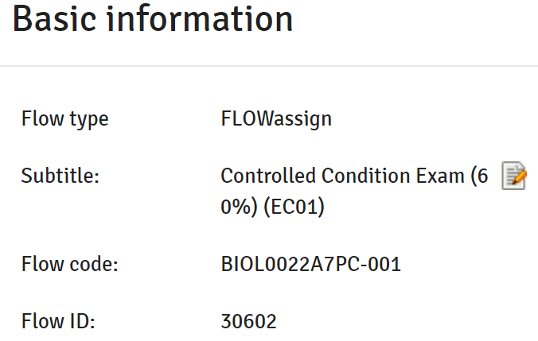
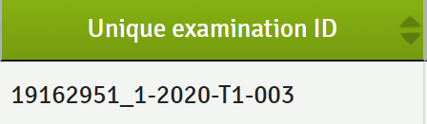
UCL on-premises
Cloud Wiseflow
API tokens store
SAS/RAS records
Component (Flow code):
BIOL0022A7PC-001
Examination Id:
20139931_1-2020-T1-003
SAL/SRR records
Marks and Grades
STUTALK
API-DEV
Wiseflow
Submission Dates
Present: https://stutalk-dev.ucl.ac.uk/urd/sits.urd/run/SIW_RWS/MARKSIMPORT/
New: https://stutalk-dev.ucl.ac.uk/urd/sits.urd/run/SIW_RWS/MARKSIMPORT2/assessment-component/{component}/student/{examination_id}
https://stutalk-dev.ucl.ac.uk/urd/sits.urd/run/SIW_RWS/MARKSLOGIMPORT/assessment-component/{component}/student/{examination_id}
EASIkit API draft: https://miro.com/app/board/uXjVOKlfEyk=/ (Publish/Subscribe model)
Marks and Grades
Run once after marks and grades are populated.
Submission Dates
Can be run multiple times, usually after participation ends to record or update status in SIS (nightly or trigger or manually).

Slide 2
Search all flows with SIS code and not archived: https://europe-stage-api.wiseflow.net/v1/license/flows/search
{
"isSis": true,
"isArchived": false
}
Filter Type and State: 2,8,16 and Started, Finished, Marked
type | integer | FLOWDEFAULT = 0 FLOWDEMO = 1 FLOWASSIGN = 2 FLOWLOCK = 4 FLOWMULTI = 8 FLOWHANDIN = 16 FLOWORAL = 32 FLOWATTEND = 64
state | integer | NOT_ACTIVATED = 0 PARTICIPATION_NOT_STARTED = 1 PARTICIPATION_STARTED = 2 PARTICIPATION_ENDED = 3 CONCLUDED = 4 ARCHIVED = 5

Slide 3
Get participant ids for all flows concerned: https://europe-stage-api.wiseflow.net/v1/flow/34537/participants
[
{
"id": 1813202,
"user": {
"id": 3248237,
"firstName": "Danni",
"lastName": "Harnett",
"phone": null,
"externalIds": [
{
"name": "UCLondon id",
"value": "ucesarn@ucl.ac.uk"
},
{
"name": "UCL London UPI",
"value": "DHARN55"
},
{
"name": "Department",
"value": "Civil, Environmental and Geomatic Engineering"
},
{
"name": "UCL candidate no",
"value": "QJLF8"
},
{
"name": "UCL Student Id",
"value": "20174920"
},
{
"name": "Department",
"value": "University College London"
}
]
},
"groupId": null,
"submissionId": 999932,
"assessorIds": [],
"assessorGroupIds": []
},

Slide 4
Get submission ids for all flows concerned: https://europe-stage-api.wiseflow.net/v1/flow/34537/submissions
Extract submission ids:
[
{
"id": 999883,
"handedIn": false,
"handedInBlank": false,
"handedInDate": null,
"handedInIP": null,
"files": [],
"plagiarism": null
},
{
"id": 999884,
"handedIn": false,
"handedInBlank": false,
"handedInDate": null,
"handedInIP": null,
"files": [],
"plagiarism": null
},

Slide 5
Get submissions details using submission ids https://europe-stage-api.wiseflow.net/v1/flow/34537/submission/999883
and extract participantId and all other fields in “participants” section.
{ "id": 999883, "handedIn": false, "handedInBlank": false, "handedInDate": null, "handedInIP": null, "files": [], "coverSheet": [], "assessors": [], "participants": [ { "participantId": 1813104, "userId": 3248933, "grade": null, "gradingDate": null, "adminGrade": null, "adminGradingDate": null } ], "plagiarism": null, "assessorGroupIds": [] } | }

Slide 6
Get exam-id ids for all participants concerned: https://europe-stage-api.wiseflow.net/v1/flow/34537/participants/1813104/unique-exam-id
{
"success": true,
"data": {
"uniqueExamId": "20174920_1-2021-T3-0"
},
"error": null
}
Returns the general dates on the flow and the calculated value of the earliest and latest individual adjustments
https://europe-stage-api.wiseflow.net/v1/flow/34537/dates
{
"success": true,
"data": {
"participation": {
"start": 1660723200,
"end": 1660737600,
"earliestIndividualStart": 1660723200,
"latestIndividualEnd": 1660737600
},
"marking": {
"start": 1660798800,
"end": 1663477200,
"earliestIndividualEnd": 1663477200,
"latestIndividualEnd": 1663477200
}
},
"error": null
}

Slide 7
Open questions:
How to get individual participation end dates for each participant? Flow/{flowid}/dates only shows earliest/latest
of all participants, not individual ones. /user/{user id}/flows only returns active flows. /user/{user id}/flows/archived – only archived. May be in October release 1.92? https://uniwise-sycamore.web.app/public/integrations
How to get late submission permitted period on the flow? Not in API yet?
No events/webhooks/logs for “Individual student participation ended” “Individual student permitted late
submission period ended” via API, so that “submission dates and status” API call can be triggered for the student.
In “Pull” option I need to cross-check all participants and dates which is more time consuming and complex.
Potentially can also use daily event (overnight) with a list of students with ended participation on a flow
for bulk API calls.
Wisecon2022: Gunhild Raunsgard, Høgskulen på Vestlandet (HVL)

