Slide 1


Paper Wireframes of Mark Transfer Wizard

Slide 2
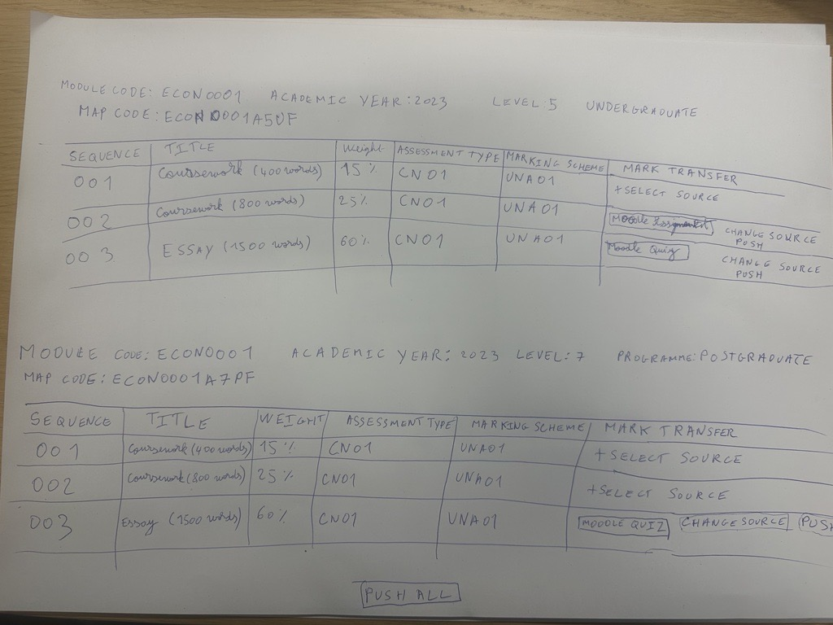

Slide 3
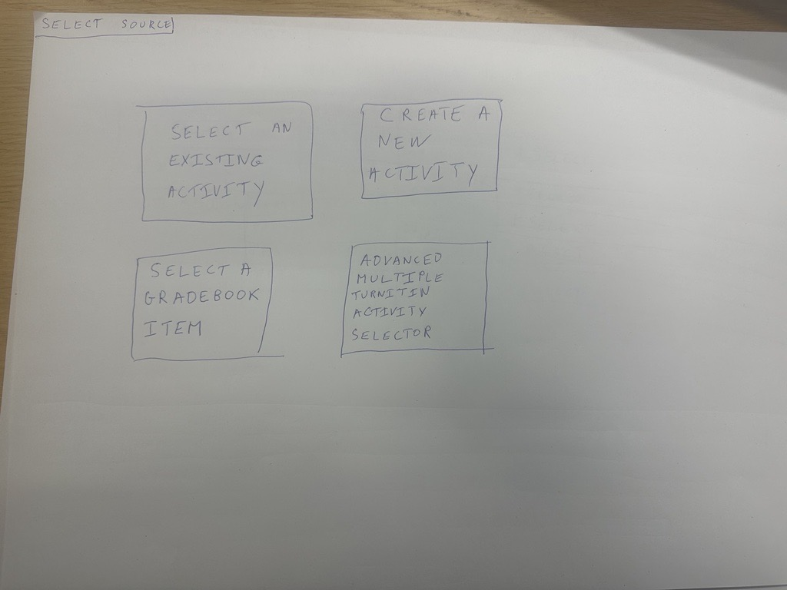

Slide 4
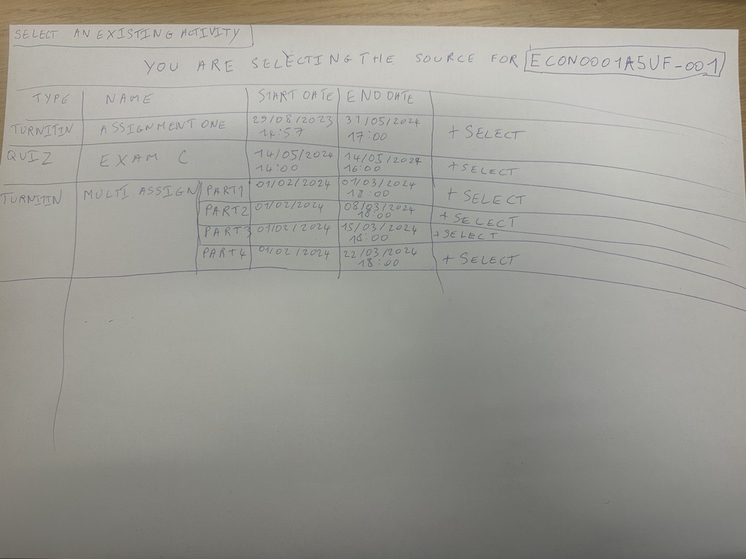

Slide 5
