Slide 1
One-click ebook
3rd Year Project, Dragos Alexandru Radu, UOM
Notes:
lots of places to find books online, such as Gutenberg
The point of a book should be to fully immerse in the experience, not having to search for words you don’t know

Slide 2
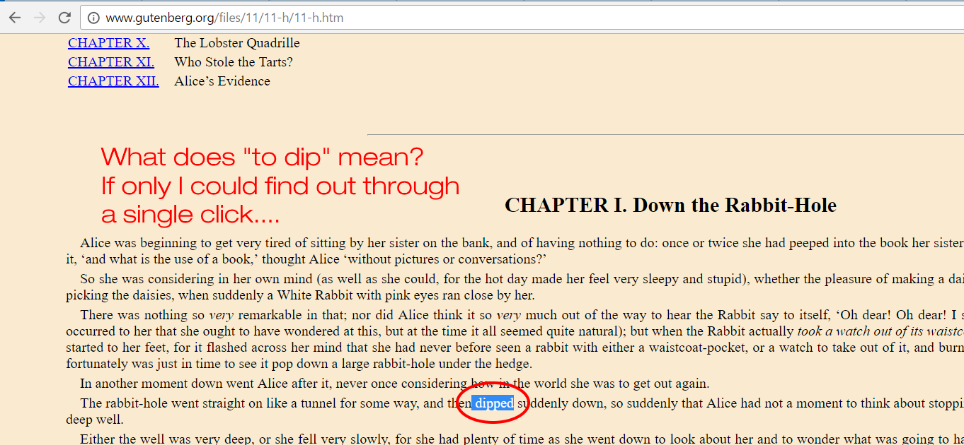
Notes:
Those books can contain lesser known words or phrases, how can I find out more about them?
Ideally, I shouldn’t have to leave the book in order to understand it.

Slide 3
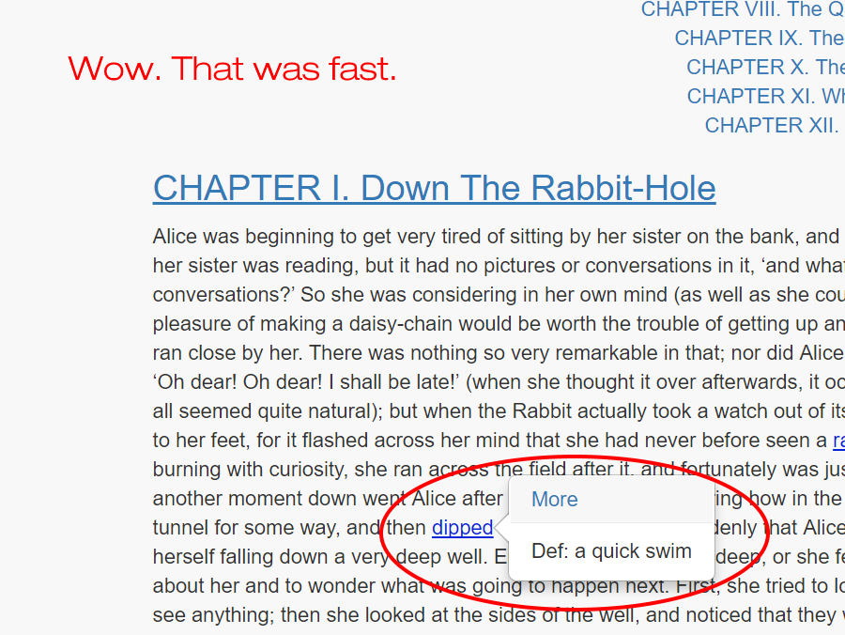
Notes:
One-click ebook !
By a single click on the uncommon word, you gain a whole new understanding of the subject.

Slide 4
Problem:
Many devices to cover
Solution:
Use a cross-platform approach
Notes:
Of course, there are many devices and environments people read ebooks in
Kindle, ipads, Android smartphones, web (like Gutenberg)
All have something in common: they can access websites
A website is the simplest application any person can interact with

Slide 5
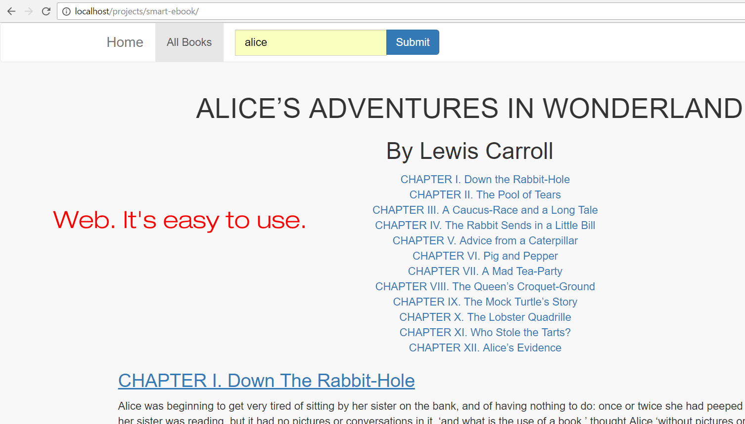
Notes:
Intuitive to use
Search for a book
Get the first result, do the processing and annotation, then show it.
We could show multiple results and let user choose (more on that later)

Slide 6
Problem:
You may need offline access
(on multiple different devices)
Solution:
Use a (somewhat) cross-platform
file format
Notes:
Sometimes, you really need access to offline books
Waiting for a new internet provider activation?
Preparing for a long flight?
Even preparing for a long train journey (UK network speed on train tends to 0 KB/s)

Slide 7




Notes:
- Hard to do proper pdf styling in python, so use latex
- Create latex source file from the parsed book in python, then use pdflatex to generate pdf
- Again, use caching

Slide 8
But how do we generate annotations?

Slide 9
Current pipeline
Original text
Dictionary lookup
Annotated text
Common words filter
Notes:
- have a large file with ~50k most used English words
- check each word in text, if not there, it is uncommon => get meaning
- not really efficient, lots of common words are not there

Slide 10
Smart Ebook Generator?
Not very smart right now
Notes:
- need to manually check every word, not too "smart"
- currently ignores the part of speech, so words that can be both verbs and nouns
may be defined wrong.

Slide 11
Is there any hope?
Users can always help you
Notes:
(just for the web version)
- every word would have a "annotation likelihood"
- the initial likelihood would be set depending whether said word is in the common words list
- then, every time a user clicks it in any book, they have the option to increase or decrease the likelihood.
- if user thinks words is too common, they can decrease. if they think the definition helped them, they can increase.
- also, users can click on any word and increase the likelihood.
- if a lot of users marked a word as "uncommon" (it means there are a lot of people not knowing the definition for it),
it will have a bigger and bigger likelihood
- we have a threshold after which any word displays an annotation

Slide 12
Any other problems?
Plenty
Notes:
-> Problems ? a lot !
Impossible to build a system that knows exactly what the user wants
Very hard to parse the html generated from different sources
Sad when awesome websites don’t provide good API

Slide 13
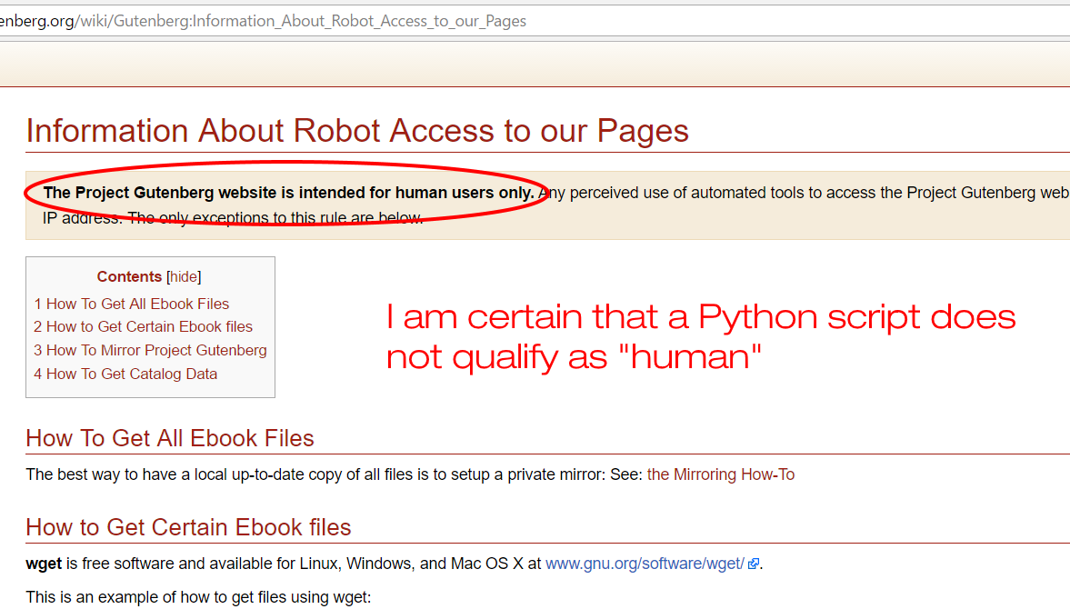
Notes:
Gutenberg already banned several proxies I tried to use
Other mirrors do not provide a search feature
Google / bing / yahoo do not work reliably
Had to download the full rdf catalog and parse it
Created a local sqlite3 DB, it’s easier to search for titles there, than parsing the rdf every time
Will implement cronjob to update the rdf catalog once every month or so

Slide 14
Hardest problem of them all?
As with codebases: inconsistency
Notes:
- inconsistent structure of the book
html structure of the title, author, table of contents and chapters is inconsistent between different books
Probably different books were generated by different parsing alogs, so different rules were used

Slide 15
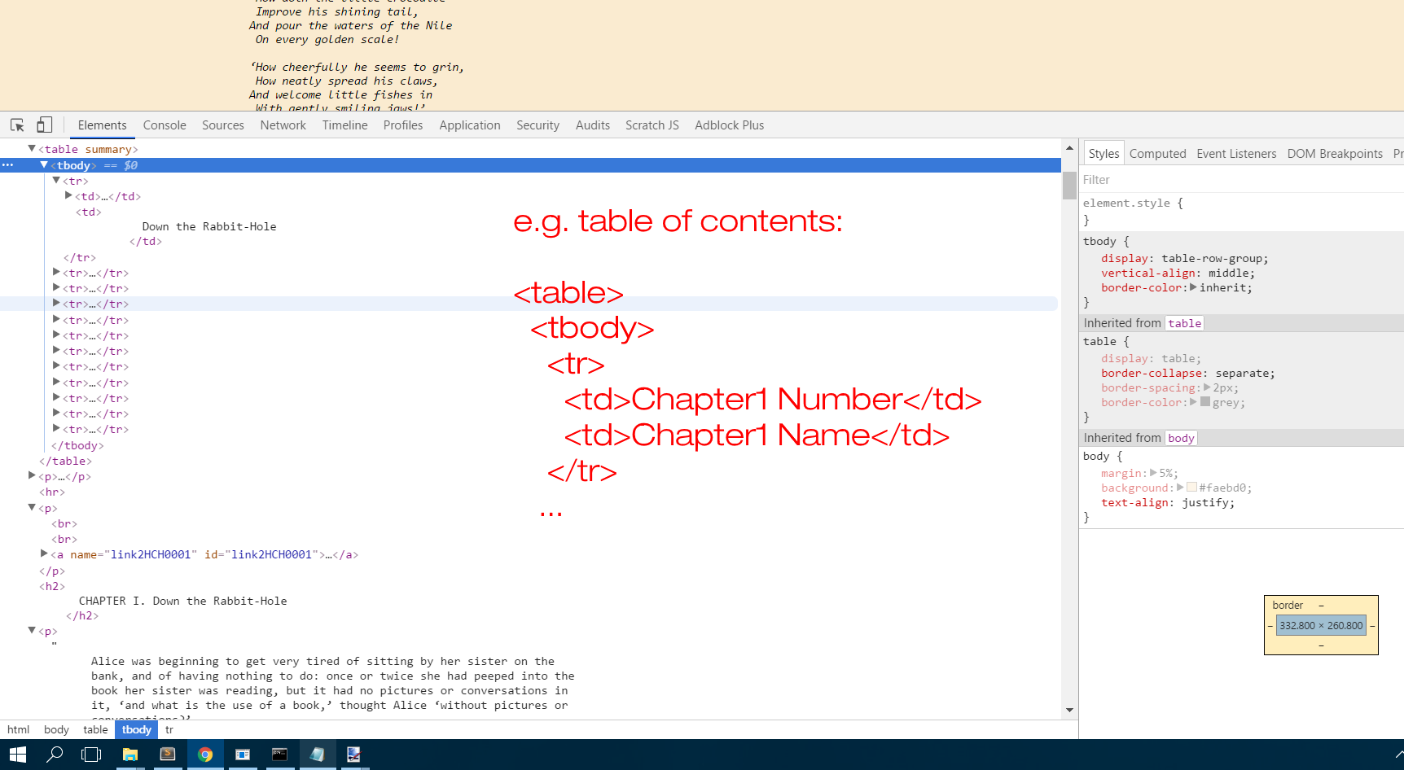

Slide 16
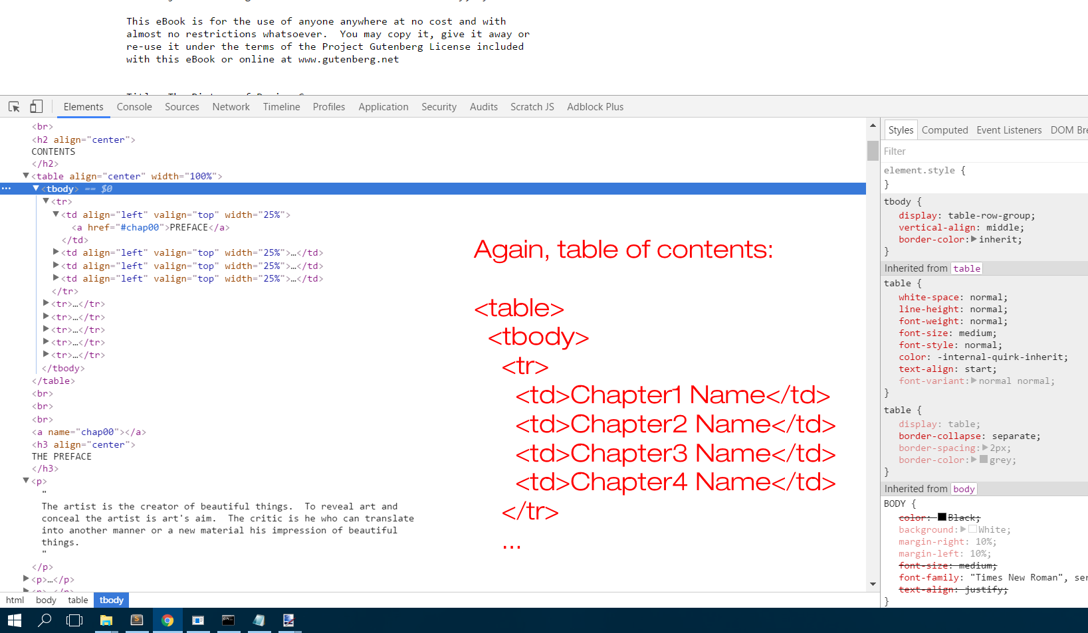

Slide 17
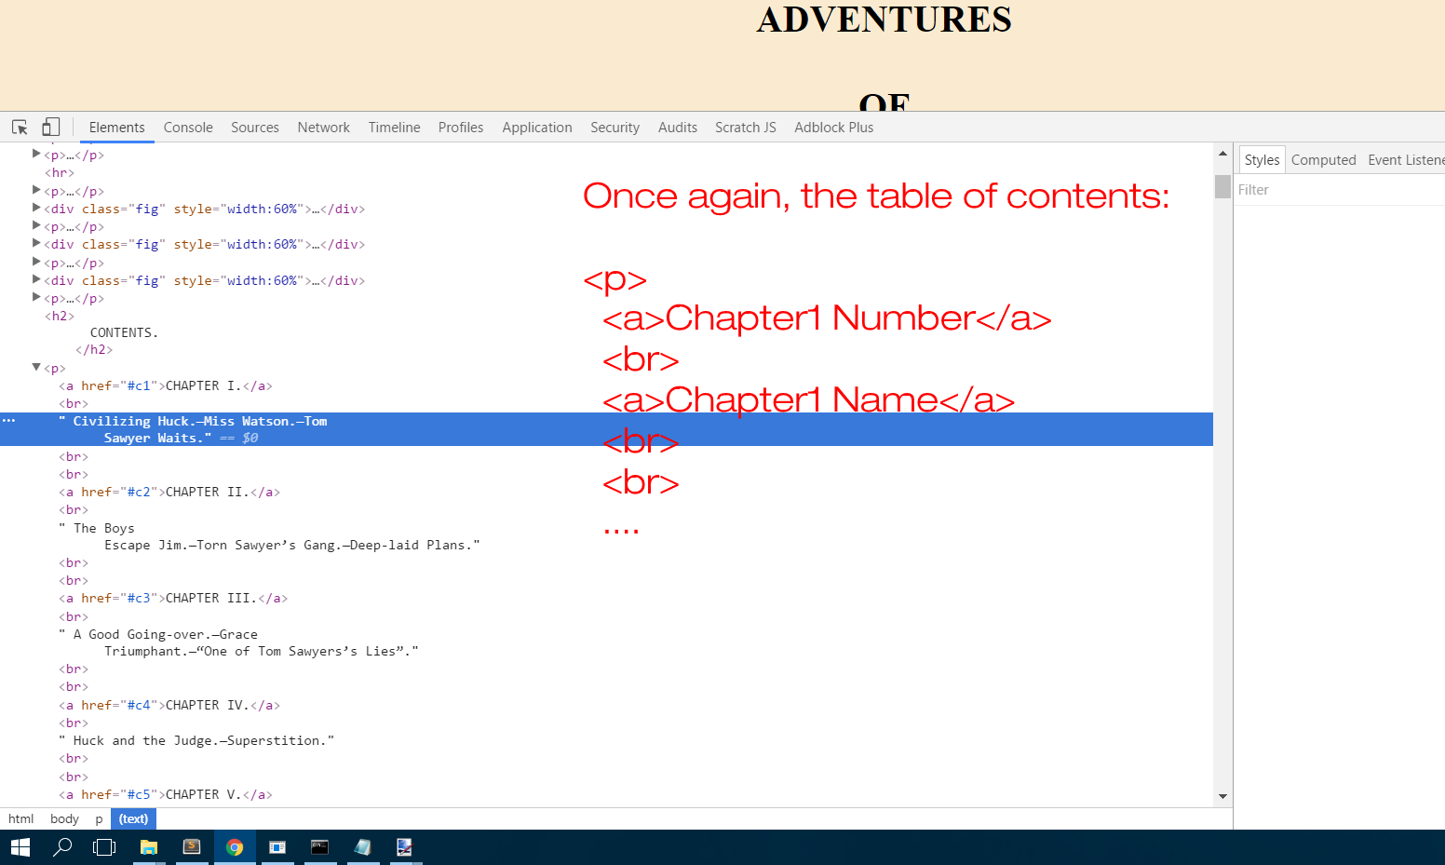

Slide 18
Possible solution?
Machine Learning, of course.
Notes:
- one way to solve it is by implementing a classifier
- classify html tags into "title" "author" "chapter title" "chapter text" "other"
- as features use things like text length, nesting depth, parent tag name, sibling tag names, distance from the top
- as it seems they are not liniarly classifiable, use a 1 hidden layered perceptron
- we need 4 classes, so 4 different classifiers.

Slide 19

Is it going to be ready on time?
With a good plan, sure.
Notes:
Most important thing in big projects is planning
I spent the first weeks doing research in order to find out how much time it would take me to complete specific features
I stuck with that plan, catching up with any unforeseen delay that appeared.

Slide 20
22 Nov
Improve web interface
6 Dec
Implement ML classifiers
12 Dec
Implement
PDF generation

Slide 21
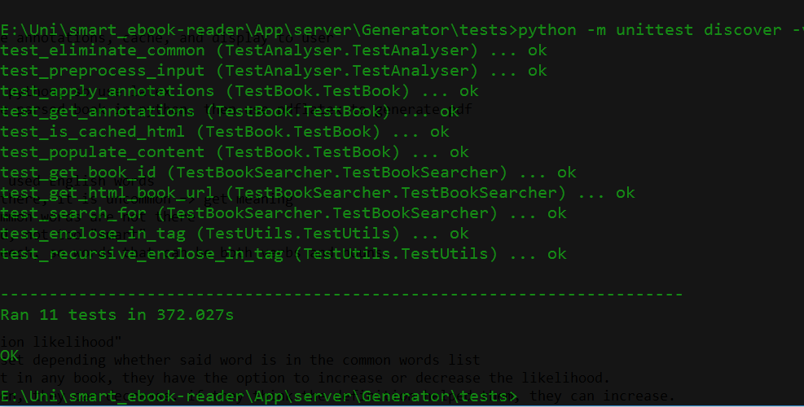
By 16th of Dec. finish implementing all tests
Notes:
Testing the app is very important
It makes the debugging way easier and prevents inserting new bugs
Also improve the common words accuracy (without the user feedback approach)
Use features like part-of-speech tagging from nltk

Slide 22
What more could be done?
Lots more.
Notes:
After having a tested working mvp, I need to think of extra features that would be nice to be implemented
What could help users even more?

Slide 23
24 Jan
Extra annotations for places, historical events, etc.
29 Jan
Find and insert images for the extra annotations
7 Feb
Implement user-sourced word commonness tagging

Slide 24
Managed to follow the plan, and still
have some time left?
Sentence complexity reduction.
Notes:
Analyse the sentences’ meaning, using lambda functions
Strip the unnecessary attributes and objects
Replace the more complicated words with easier to understand synonims
Keep the same meaning

Slide 25
Questions?
Ready to answer.

