Slide 1
EbookAnnotations
A reader that enriches your e-books

Slide 2
The purpose
Create a seamless e-book experience for users
Remove the extra steps required to find out more information
Build a polished, production-grade application

Slide 3
Now let’s see a live demo

Slide 4
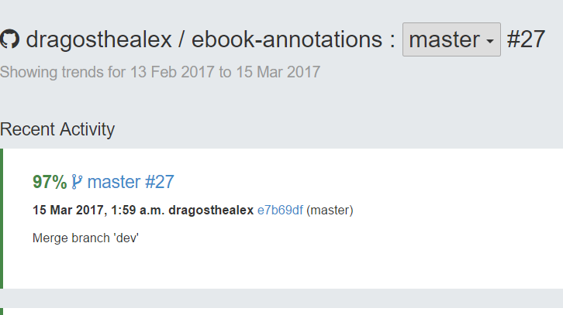
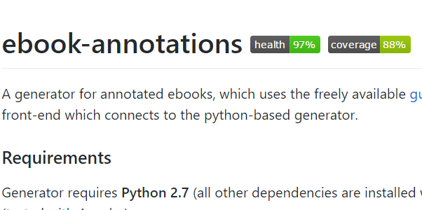
Keeping the code production-grade
Using Git version control system (dev, master, refactor branches)
Running full unittest suite after every push to master
Checking test coverage with coverage.py
Checking code quality with Landscape.io

Slide 5
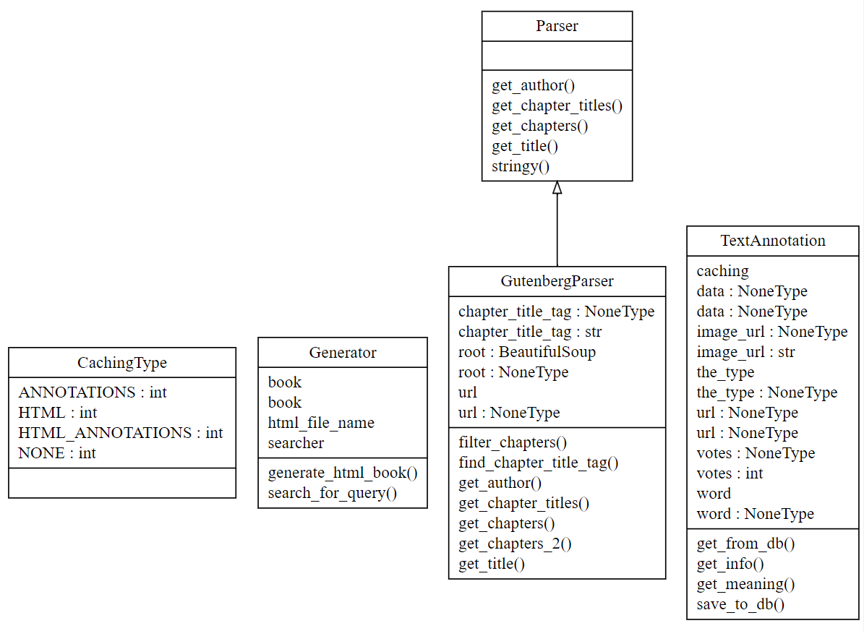
Making use of Object Oriented Design

Slide 6
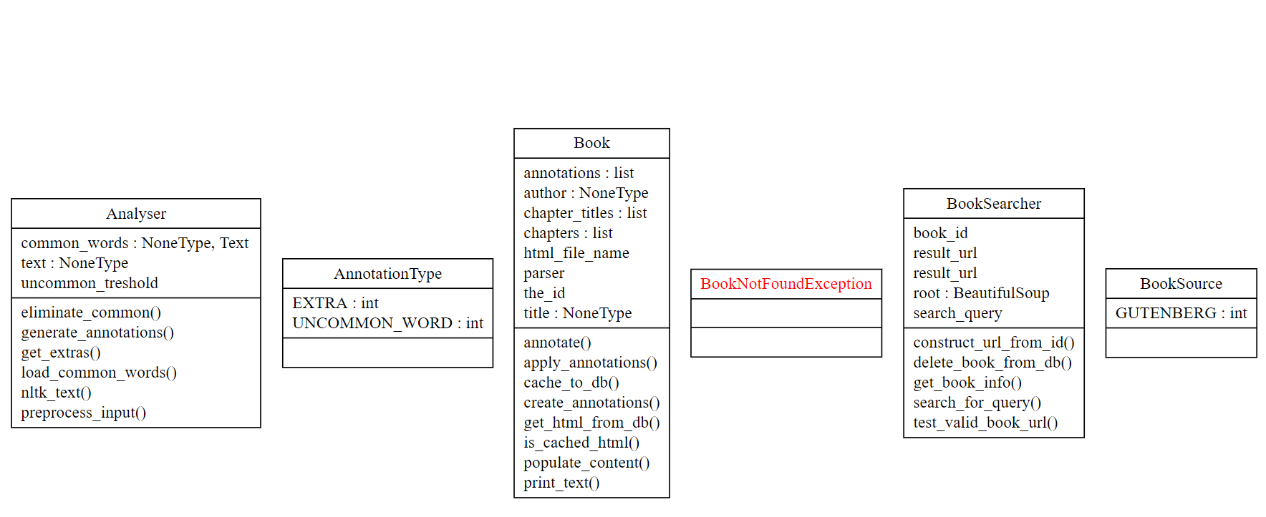

Slide 7
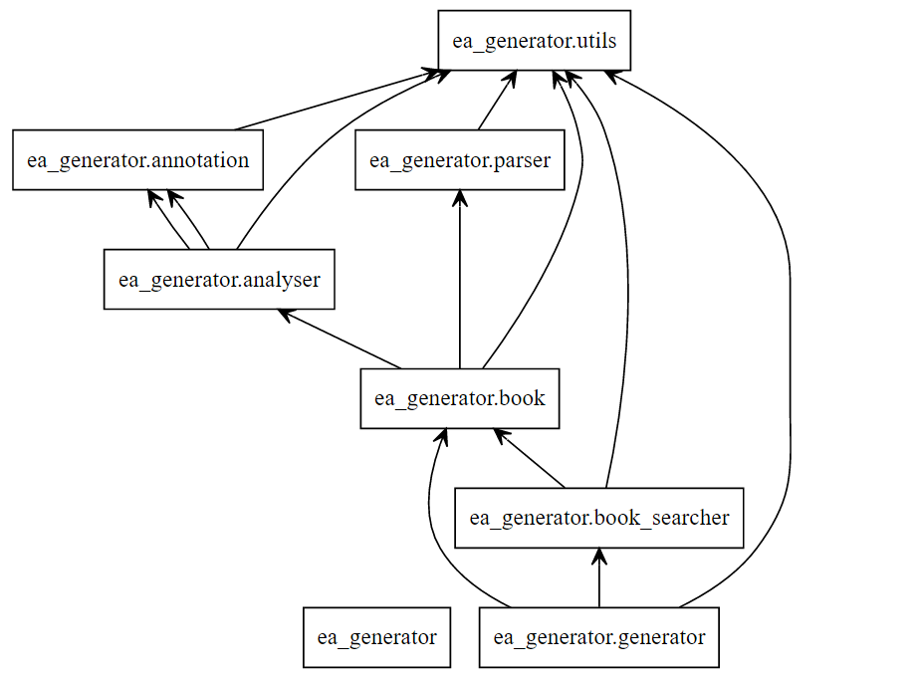
The pipeline

Slide 8
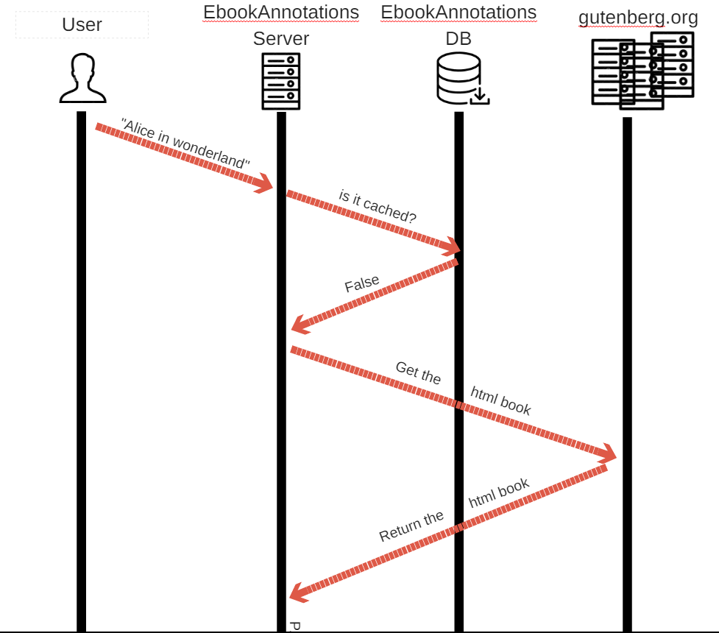
Complex distributed architecture

Slide 9
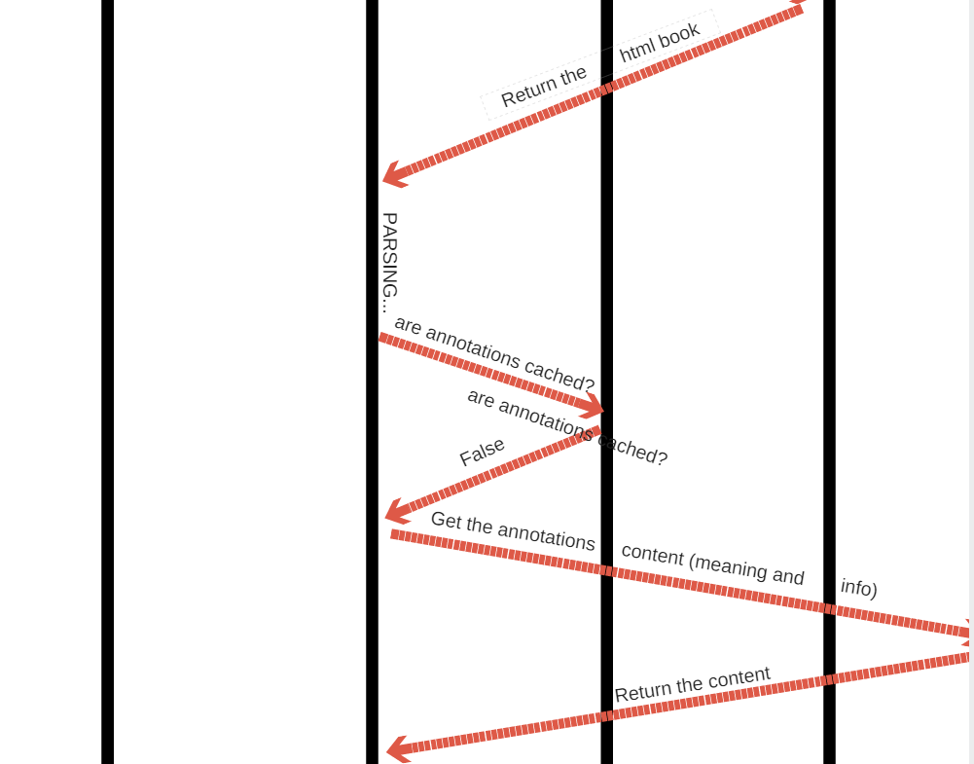

Slide 10
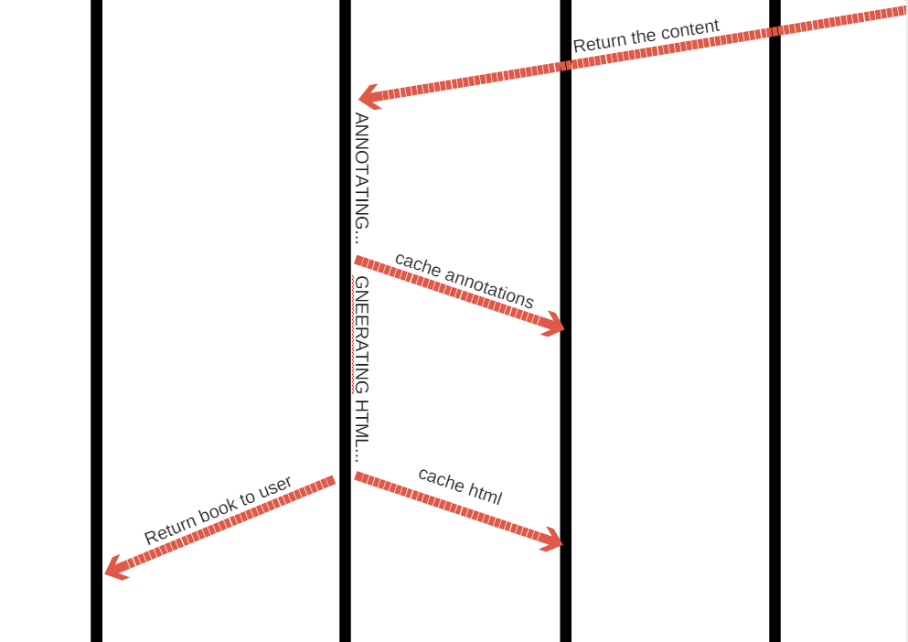

Slide 11
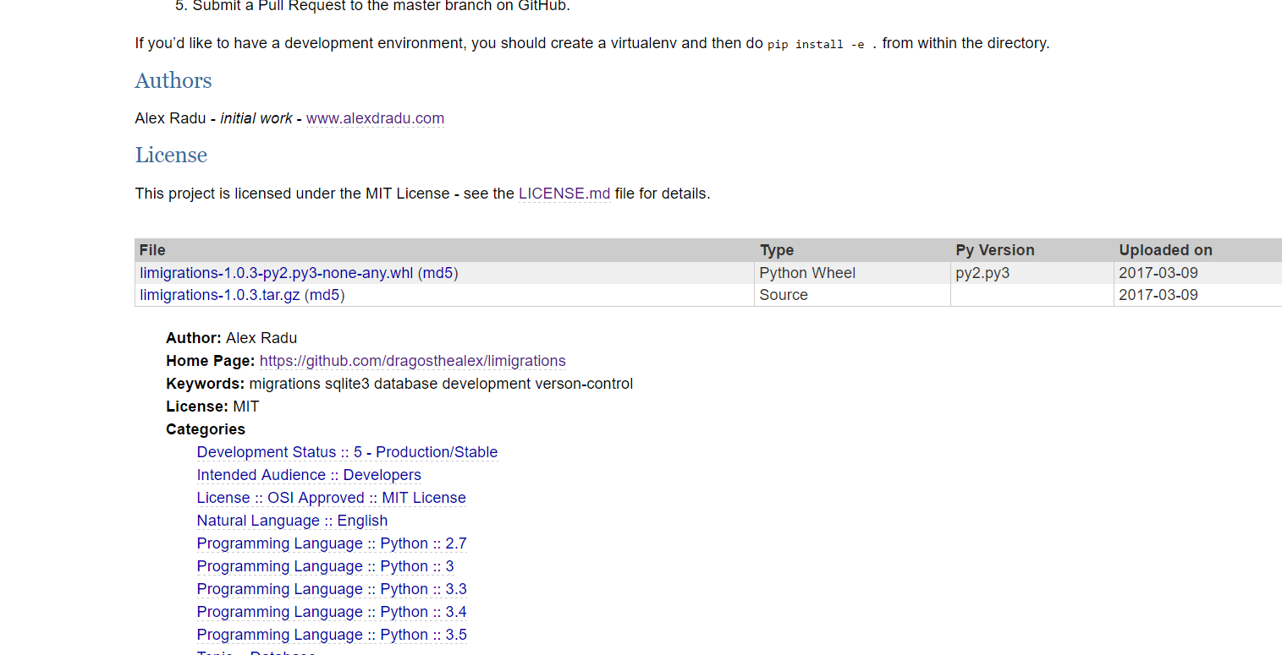
A lot of new concepts learned
SPARQL for DBPEDIA
RDF parsing
Caching techniques
Published my own PyPi package

