Slide 1


Slide 2
Why you need our website
LIAM
Larry
Likes computers.
Likes sports.
Likes Nicki Minaj.
Plays the trombone.
Dislikes spiders.
Likes computers.
Likes sports.
Likes Nicki Minaj.
Loves trombones.
Owns a pet spider called Barry.

Slide 3
Room-mate Matching Service
People need to find room-mates.
Finding suitable room-mates can be hard.
We aim to help them do that.
4. Profit. Just kidding. Maybe.
Ideally aimed at university students.

Slide 4
What does it do?
Checks compatibility of users
…based on their preferences.
Suggests them to each other.
They add each other.
They become friends.
They become room-mates.
And they all live happily ever after.

Slide 5
Matching and Compatibility
Users can fill up a questionnaire which covers everything from religion to allergies to music preference.
Because nobody should have to deal with Nicki Minaj.
The matching depends on their answer and what they would want their potential room-mate to answer.

Slide 6
Matching

Slide 7
Techniques: PHP
Making use of inheritance to avoid redundant code
Designing classes for every table in the database
Using exceptions for handling all possible errors

Slide 8
Techniques: MySQL
Designed tables for every entity
Normalising the database by adding intersection tables (many to many relations)
e.g. Table for storing percentages and friendships for each user

Slide 9
Accommodation and Reviews
Includes reviews of current university housing as well as a complete accommodation index.
Possibility for owner’s of private accommodation to add their listings.
Need pictures of accommodation index

Slide 10
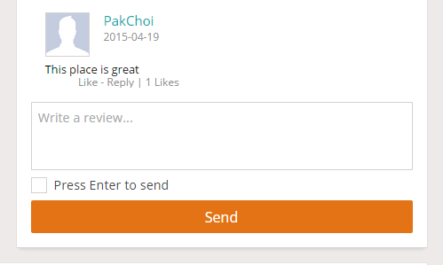
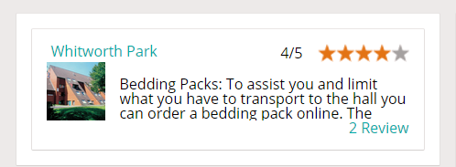
Accommodation and Reviews
Avoiding spam by not letting non-registered or logged out users to rate/review.
Reviews would be checked and filtered, to assure the maximum quality.

Slide 11
Messaging: Instant Chat
Added features to send messages and instant chat system.
Remove the need to use alternate websites such as Facebook to communicate
Allow users to communicate better with the students they are matched with.

Slide 12
Messaging: Implementation
Uses long-polling to check for new messages.
Implemented using JavaScript and PHP.
In the future, we hope to have group messaging as well.

Slide 14



Social Network: Integration
The ability to link your Roomies account to other popular
social networks, such as:
Facebook
Twitter
Google +

Slide 15
Social Network: Implementation
Adding Friends:
Options to add other users as friends as well as unfriend or block them.
‘Make me invisible’ feature
Ask alex about the many to many feature
Platform similar to a social networking site for users to interact with each other.

Slide 16
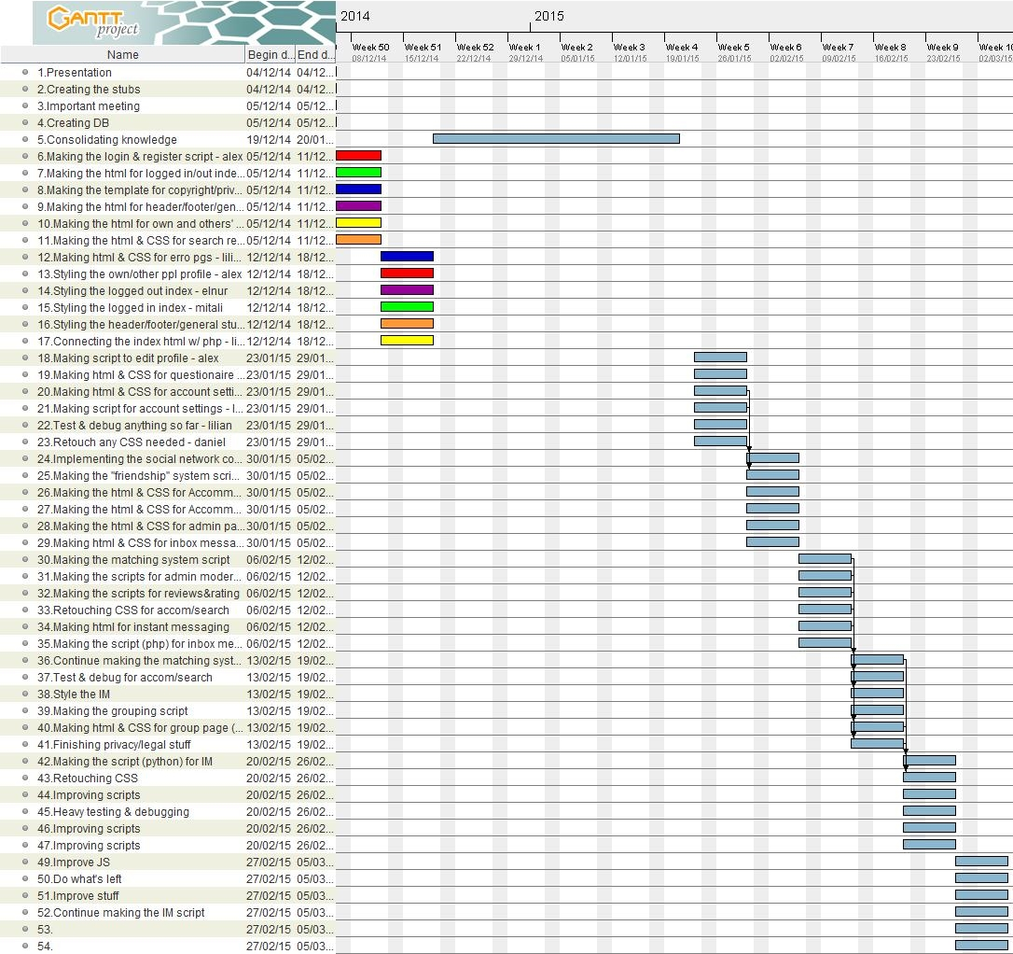
Will put gantt chart

Slide 17
Planning & Implementation
Weekly meetings on Friday and Tuesday
Discuss how the previous tasks went
Discuss and (re)assign the next tasks for each other
Allocate tasks considering everyone’s strengths and weaknesses
Made sure to help each other out with tasks

Slide 18
Planning & Implementation (II)
Used GitLab for proper version control
MySQL for mapping to compact data and limit user options
Kept common output in the back-end fragmented
Included template files for consistent layout
PHP for classes to prevent accidental damage to database by
restricting functionality

Slide 19
Overview of legal and ethical aspects
Some potential issues regarding privacy, ethical and legal matters are :
Instant messaging
Religious beliefs compatibility
Personal information confidentiality
User reviews

Slide 20
Overview of legal and ethical aspects
We have covered all details of how we use personal details and website information in our:
Privacy Policy and Cookie Use
Terms and Conditions
Disclaimer
About

Slide 21
Personal details and privacy
All personal information and user details are public within the website (for registered users only).
The matching engine uses all the filters and details provided by the user.
User profile is public but user details are visible only to friends.

Slide 22
Reflections
What would we have done differently?
What did we learn from this course unit?
What we felt was the best and worst part of this course unit?

Slide 23
Thank you!
Any questions?

