Slide 1


Slide 2
Why you need our website

Slide 3
LIAM
LARRY
Likes computers.
Likes sports.
Likes Nicki Minaj.
Plays the trombone.
Dislikes spiders.
Likes computers.
Likes sports.
Likes Nicki Minaj.
Loves trombones.
Owns a pet spider called Barry.

Slide 4
Room-mate Matching Service
People need to find room-mates.
Finding suitable room-mates can be hard.
We aim to help them do that.
4. Profit. Just kidding. Maybe.
Ideally aimed at university students.

Slide 5
What does our site do?

Slide 6
And they live happily ever after (yay)
Users can add them as friends
Provides list of possible matches
Checks user compatibility

Slide 7
Matching and Compatibility
Users can fill up a questionnaire which covers everything from religion to allergies to music preference.
Because nobody should have to deal with Nicki Minaj.
The matching depends on their answer and what they would want their potential room-mate to answer.

Slide 8
Techniques: PHP
PHP
Inheritance to avoid redundancy
Classes for all tables
Exception handling for errors

Slide 9
Techniques: MySQL
MySQL
Tables for each entity
Many to many relation
Mapping to save memory
idgaf

Slide 10
Accommodation & Reviews

Slide 11
Accommodation: Listings
Includes reviews of current university housing as well as a complete accommodation index.
Possibility for owner’s of private accommodation to add their listings.
Need pictures of accommodation index

Slide 12
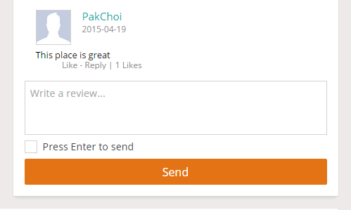
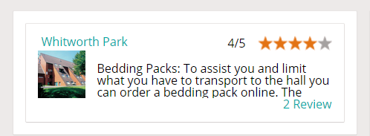
Accommodation: Reviews
Avoiding spam by not letting non-registered or logged out users to rate/review.
Reviews would be checked and filtered, to assure the maximum quality.

Slide 13
Messaging: Instant Chat
Added features to send messages and instant chat system.
Remove the need to use alternate websites such as Facebook to communicate
Allow users to communicate better with people they are matched with.

Slide 14
Messaging: Implementation
Uses long-polling to check for new messages.
Implemented using JavaScript and PHP.
In the future, we hope to have group messaging as well.

Slide 16
Social Networking

Slide 17



Social Network: Integration
Ability to link accounts with :

Slide 18
Social Network: Implementation
Adding Friends:
Options to friend, unfriend or block other users
‘Make me invisible’ feature
Ask alex about the many to many feature

Slide 19
Implementation and Structure

Slide 20
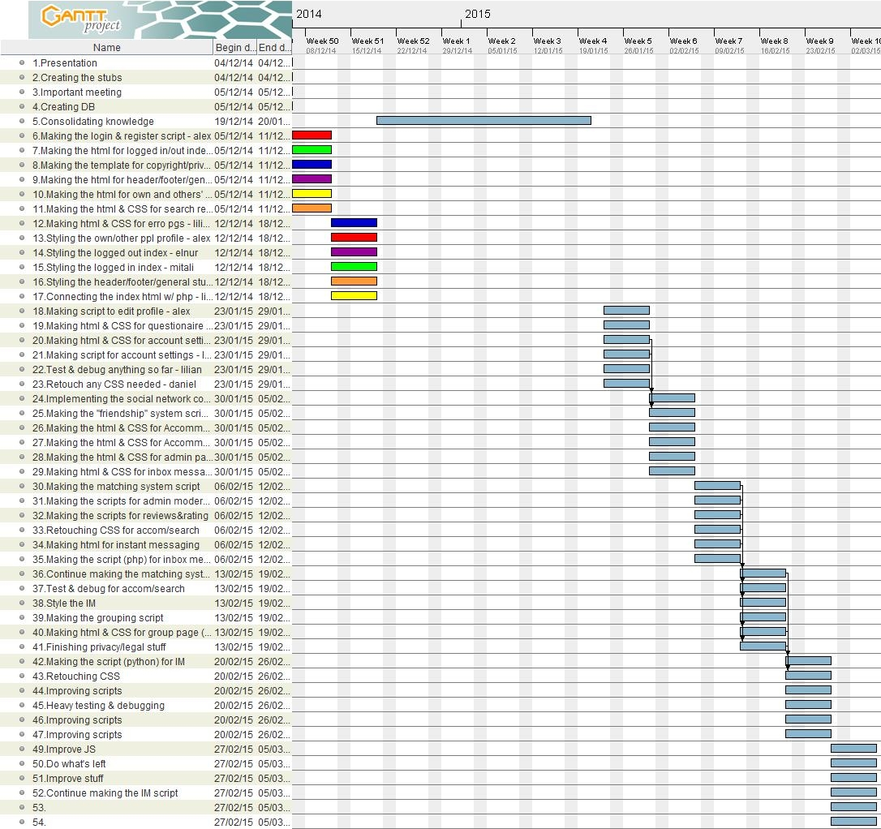
Will put gantt chart

Slide 21
Implementation: Planning
Weekly meetings on Friday and Tuesday
Discuss how the previous tasks went
Discuss and dynamically (re)assign the next tasks for each other
Allocate tasks considering everyone’s strengths and weaknesses
Made sure to help each other out with tasks

Slide 22
Implementation: Structure
Used GitLab for proper version control
MySQL for mapping to compact data and limit user options
Kept common output in the back-end fragmented
Included template files for consistent layout
PHP for classes to prevent accidental damage to database by
restricting functionality

Slide 23
Overview of Legal and Ethical Aspects

Slide 24
Overview: Ethical Issues
Instant messaging
Religious beliefs compatibility
Personal information confidentiality
User reviews

Slide 25
Overview of legal and ethical aspects
We have covered all details of how we use personal details and website information in our:
Privacy Policy and Cookie Use
Terms and Conditions
Disclaimer
About

Slide 26
Personal details and privacy
All personal information and user details are public within the website (for registered users only).
The matching engine uses all the filters and details provided by the user.
User profile is public but user details are visible only to friends.

Slide 27
Reflections
What would we have done differently?
What did we learn from this course unit?
What we felt was the best and worst part of this course unit?

Slide 28
Thank you!
Any questions?

