Slide 1


Slide 2
Why you need our website

Slide 3
LIAM
LARRY
Likes computers.
Likes sports.
Likes Nicki Minaj.
Plays the trombone.
Dislikes spiders.
Likes computers.
Likes sports.
Likes Nicki Minaj.
Loves trombones.
Owns a pet spider called Barry.

Slide 4
Room-mate Matching Service
People need to find room-mates.
Finding suitable room-mates can be hard.
We aim to help them do that.
4. Profit. Just kidding. Maybe.
Ideally aimed at university students.

Slide 5
What does our site do?

Slide 6
And they live happily ever after (yay)
Users can add them as friends
Provides list of possible matches
Checks user compatibility

Slide 7
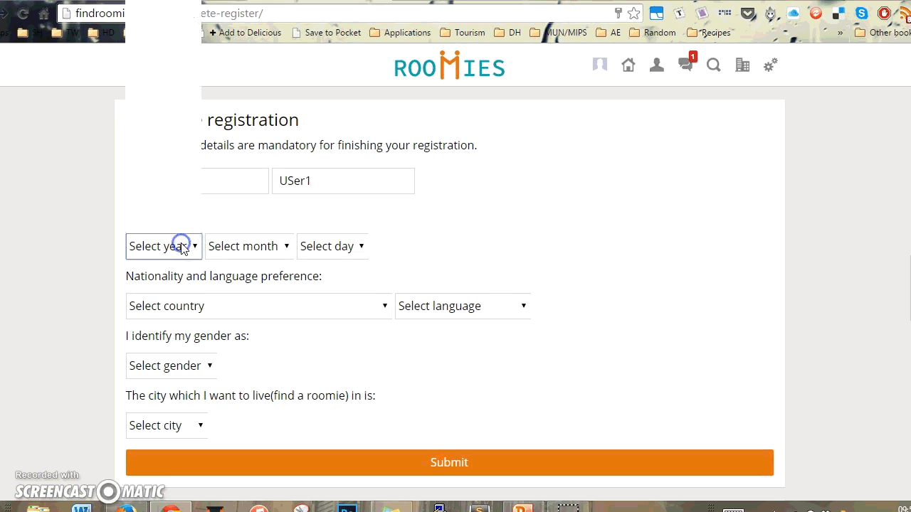

Slide 8
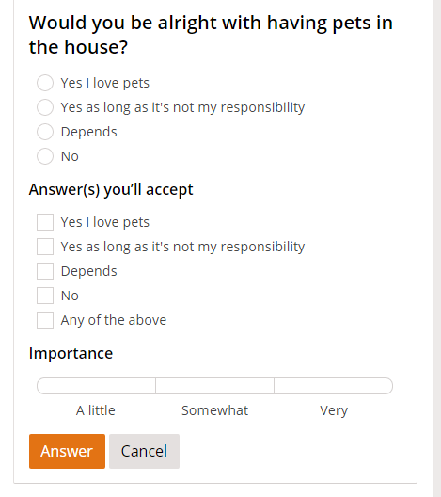
Matching and Compatibility
Users can fill up a questionnaire which covers everything from religion to allergies to music preference.
Because nobody should have to deal with Nicki Minaj.
The matching depends on their answer and what they would want their potential room-mate to answer.

Slide 9
Techniques: PHP
PHP
Exception handling for errors
Inheritance to avoid redundancy
Classes for all tables

Slide 10
Techniques: MySQL
MySQL
PDO
Tables for each entity
Mapping to save memory
Many to many relations

Slide 11
Accommodation & Reviews

Slide 12
Accommodation: Listings
User-reviews of university housing as well as other information.
Possibility for owner’s of private accommodation to add their listings.

Slide 13
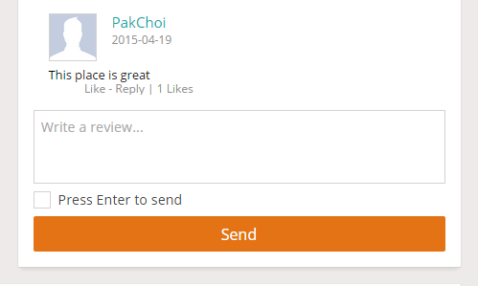
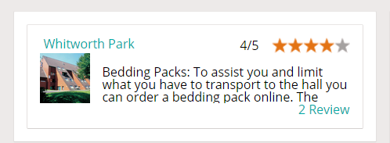
Accommodation: Reviews
Avoiding spam by not letting non-registered or logged out users to rate/review.
Reviews would be checked and filtered, to assure the maximum quality.

Slide 14
Social Networking

Slide 15
Social Networking: Messaging
Added features to send messages and instant chat system.
Remove the need to use alternate websites such as Facebook to communicate
Allow users to communicate better with people they are matched with.

Slide 16
Messaging: Implementation
Uses long-polling to check for new messages.
Implemented using JavaScript and PHP.
Also have an option for group-messaging.

Slide 18



Social Network: Integration
Ability to link accounts with :

Slide 19
Social Network: Implementation
Adding Friends:
Options to friend, unfriend or block other users
‘Make me invisible’ feature

Slide 20
Implementation & Structure

Slide 21
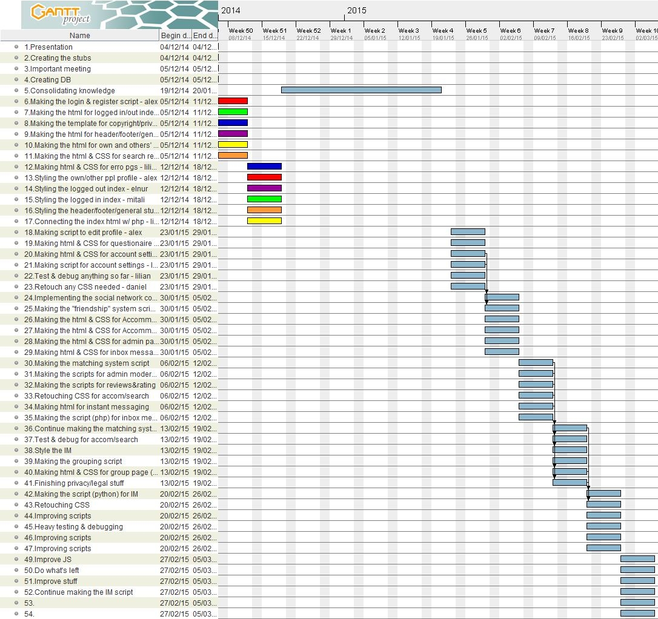
Will put gantt chart

Slide 22
Implementation: Planning
Weekly Meetings
Discussion of tasks
Dynamic
re-allocation
GREAT
TEAM WORK!

Slide 23
Implementation: Structure
Used GitLab for proper version control
PHP for classes to prevent accidental damage to database by restricting functionality
Included template files for consistent layout

Slide 24
Overview of Legal and Ethical Aspects

Slide 25
Where do we need to consider ethical issues?

Slide 26
Overview: Ethical Issues
Instant messaging
Personal information confidentiality
User reviews

Slide 27
How have we taken care of them?

Slide 28
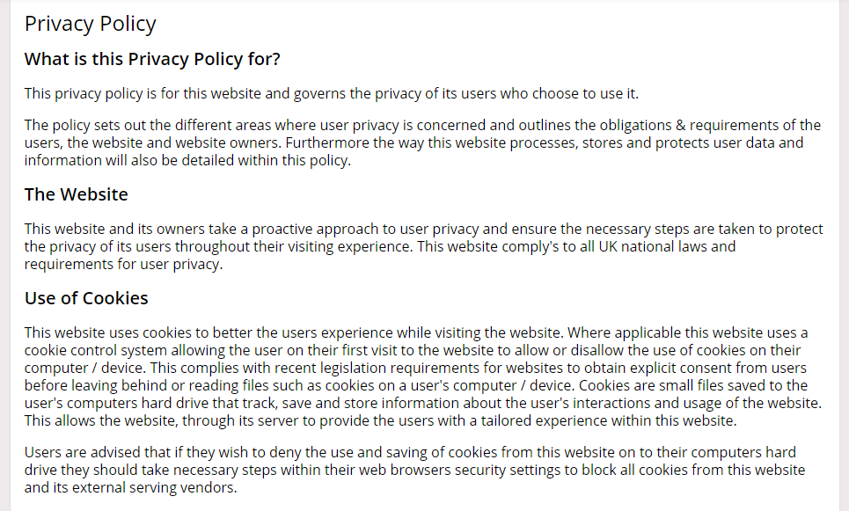
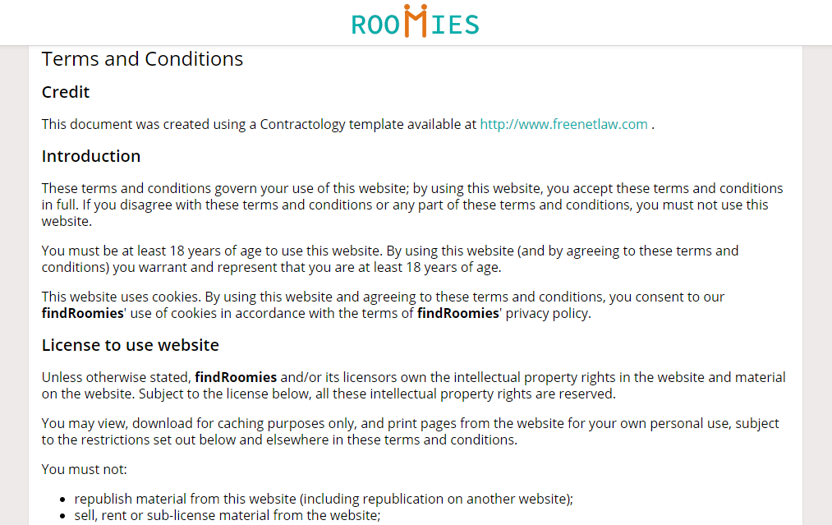
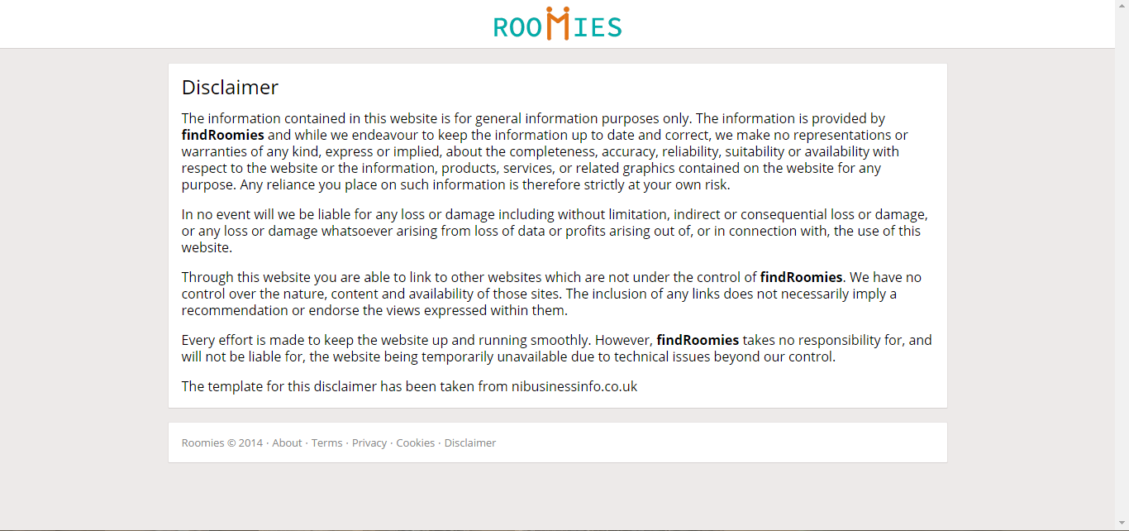
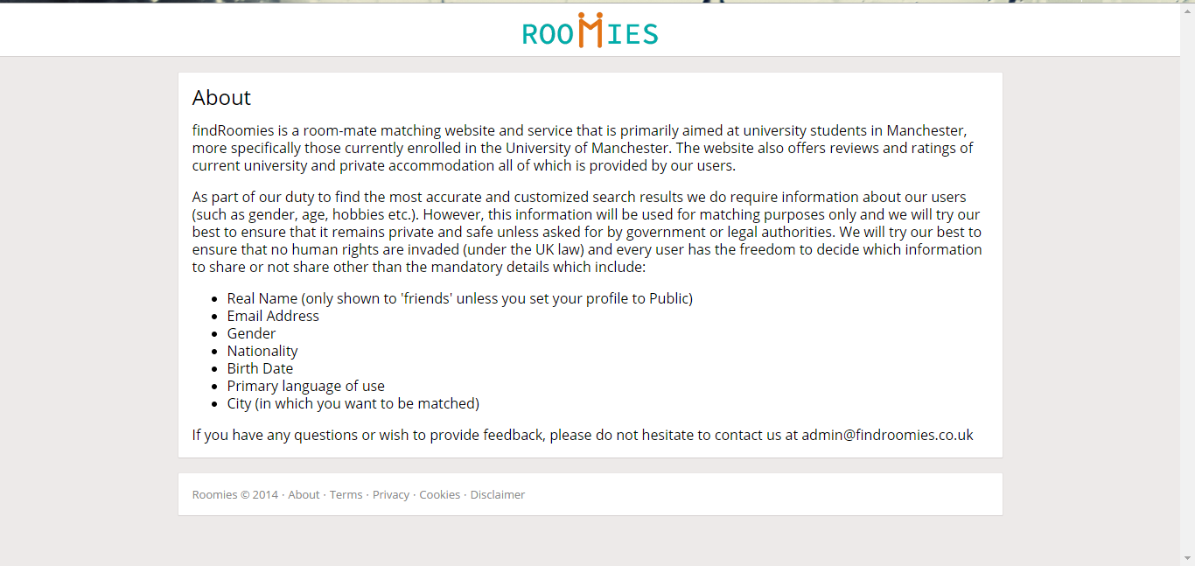
Overview: Provisions
Privacy Policy and Cookie Use
Terms and Conditions
Disclaimer
About

Slide 29
Reflections
What would we have done differently?
What did we learn from this course unit?
What we felt was the best and worst part of this course unit?

Slide 30
Thank you!
Any questions?

