Slide 1

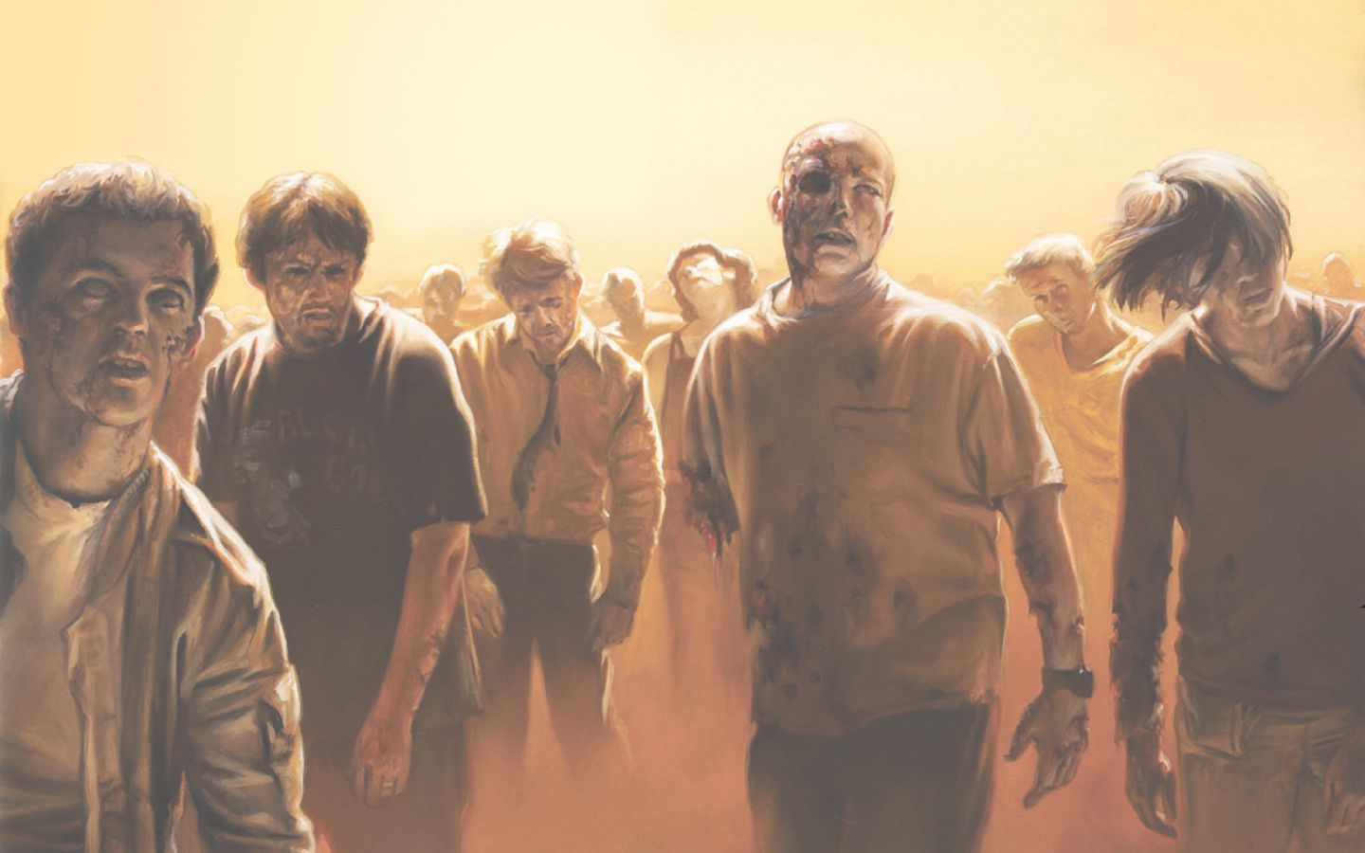
ZOMBIE PLAGUE!!

Slide 2
Group - !AFK
Our group consists of 5 members:
Daniel Hodgson
Harshdeep
Veselin Kirev
Dragos Alex Radu
Tudor Oltean
We all are studying Computer Science at the University of Manchester. (1st year)

Slide 3
Functionality
Our game is based on the concept of having an emergency centre, which is the means of reacting to various reports of zombie activity.
We have devised a new way of dealing with reports, that the player has to solve set of mathematics questions, in order to respond back.
We can set the difficulty of the game in 3 levels – Easy, Medium and Difficulty.
The player has 3 lives, and after he has lost all lives the game ends and the score increments by 1 with every answer.

Slide 4
Design
We have made a website, which has been exclusively been built for the game.
Photo Editing tools like Corel Draw have also been used.
The game has been built in such a way, that it can be used by all age groups. Hence, game is extremely user friendly.
We have used open source images( hence no copyright issues), and we have made images of our own too!
We centred our design around a red, black and blue theme. But we use yellow, red and green to report urgency of event.

Slide 5
Implementation
We have used the following tools for the implementation of our project:
We have used Pygame, a framework of Python for the construction of the game.
We have used Sublime Text and gedit as the text editors.
For the design of the website, Micrsoft Visual Studio IDE has been used.
As, we were making a program with Python for the first time, various resources like Stack Overflow, Python/Pygame online documentation were referenced.
For the website, HTML5, CSS5 and Javascript has been used.

Slide 6
Conclusion
It was an all new experience for all of us, as it was our first time at a hackathon.
We made our project using a language, which we did’nt knew 24 hours before. Now, we know Python.
Finally, we have built an game, which not only reacts to reports of zombies, but also increases your mathematics skills.
Particularly, we enjoyed here and learnt a lot of things, not only related to computing, but related to life.

