Slide 1
Predicting Vaccination rates
Dhruv Ragunathan

Slide 2
Business Objectives
The Covid– 19 pandemic exposed the ineffectiveness of vaccination policies.
Vaccinations are effective in preventing deaths or adverse effects of viruses.
Reviewed data on the seasonal flu to predict whether a patient should get a vaccination.
Created a model aimed to identify as many people who require vaccination.

Slide 3
Data
The data set contains data on the H1N1 pandemic of 2009 and the seasonal flu.
In this study, we will only be focused on the features and predicting vaccination for the seasonal flu.
The training data for the model contains around 26 thousands records and 35 data features.
Key features include: age, race, educational level, doctors recommendation.

Slide 4
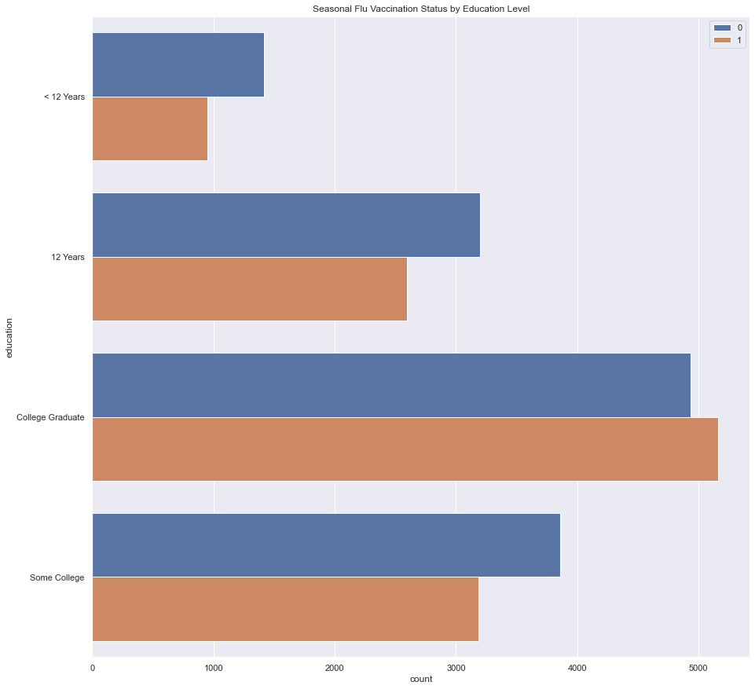
Data Exploration - Education
Higher education generally correlates with higher vaccination rates.
Seasonal Vaccination Status by Education Level
< 12 years
12 years
College Graduate
Some Graduate

Slide 5
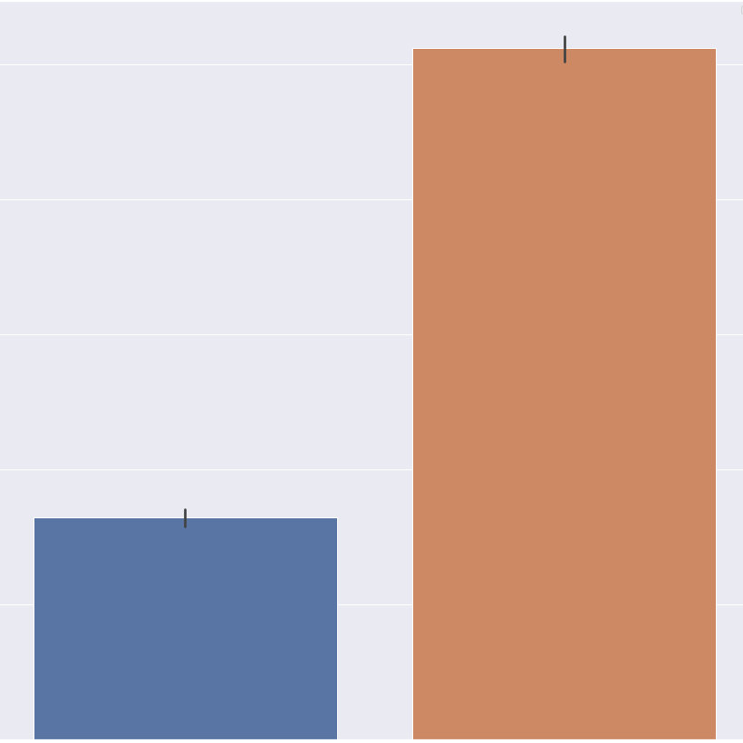
Data Exploration – Doctors Recommendation
People who got a doctor’s recommendation are almost 3 times as likely to take a vaccine.
0.5
0.4
0.3
0.2
0.1
0
Did not take Vaccine
Took Vaccine

Slide 6
Model Results
The final model was selected on reducing False negatives
It had an accuracy of 76%.
Recall of 76%
False
1926
529
Actual Value
True
612
1648
False
True
Model Prediction

Slide 7
Recommendations
Focus on ensuring that doctor’s give vaccine recommendations.
Target groups with less education for vaccine outreach.
Optimize on identifying patients who need the vaccine.

Slide 8
Future Projects
Apply different models to different populations. Reduce false negatives in vurnerable populations, but reduce false positives in healthier ones.

Slide 9
Contact Information
Email: Dhruvragunathan@gmail.com
LinkedIn: https://www.linkedin.com/in/dhruv-ragunathan-908993b1/
Github: https://github.com/dragunat2016/CDCH1N1

