Slide 1
PREDICTING PNEUMONIA IN LUNGS
Dhruv Ragunathan

Slide 2
Business Objectives
Pneumonia is caused from an infection within the lungs either from bacteria, virus, or other pathogens.
This condition could lead too hospitalizations and potentially death.
In the US alone,1 million people are hospitalized and 50,000 die every year.
The goal of this project is too create a model that can identify pneumonia lung X-rays.

Slide 3
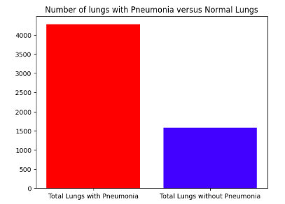
Data
Data sets off lungs with Pneumonia and healthy lungs were provided by Guangzhou Women and Children’s Medical Center, Guangzhou.
The data contains 3 data sets, train, test, and validation. In each file, there are two folders: Pneumonia and normal.
The records in each set were re-combined before they were split into training/validation set for modeling.

Slide 4
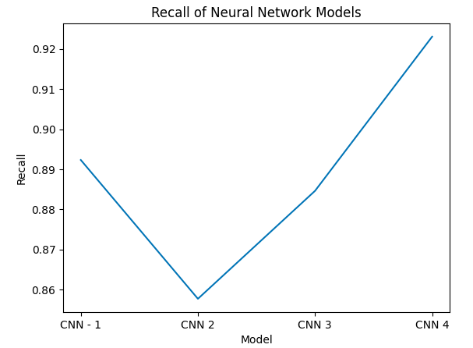
Model Results
The final model was selected on the following:
How accurate it’s predictions were
How well it identified lungs that have pneumonia.
The final model, while lower in accuracy identified the most number of lungs with pneumonia.
This model would have saved the most amount off lives.

Slide 5
Recommendations
These results on the small subset off data are promising since a validation accuracy off 94% was achieved.
Further research is needed before this model is implemented in hospitals.
Training on larger and more diverse data sets are needed. This dataset only contained lung x-rays off children under 5.

Slide 6
Future Projects
Aggregate significantly more lung data across groups off different ages.
Enhance the model by allowing it too identify bacterial and viral pneumonia.
Implement model in a small hospital then scale it up.

Slide 7
Contact Information
Email: Dhruvragunathan@gmail.com
LinkedIn: https://www.linkedin.com/in/dhruv-ragunathan-908993b1/
Github: https://github.com/dragunat2016/Pneumonia_Image_Detection

